Slide 1
You Never Mentioned Him To Me
Words: | James Rowe
Music: | J. W. Gaines
3/4
A^{b}/C - MI
Verses: 3/Chorus
Lead - | MI
Alto - | DO
Tenor - | SOL
Bass - | DO
PDHymns.com

Slide 2
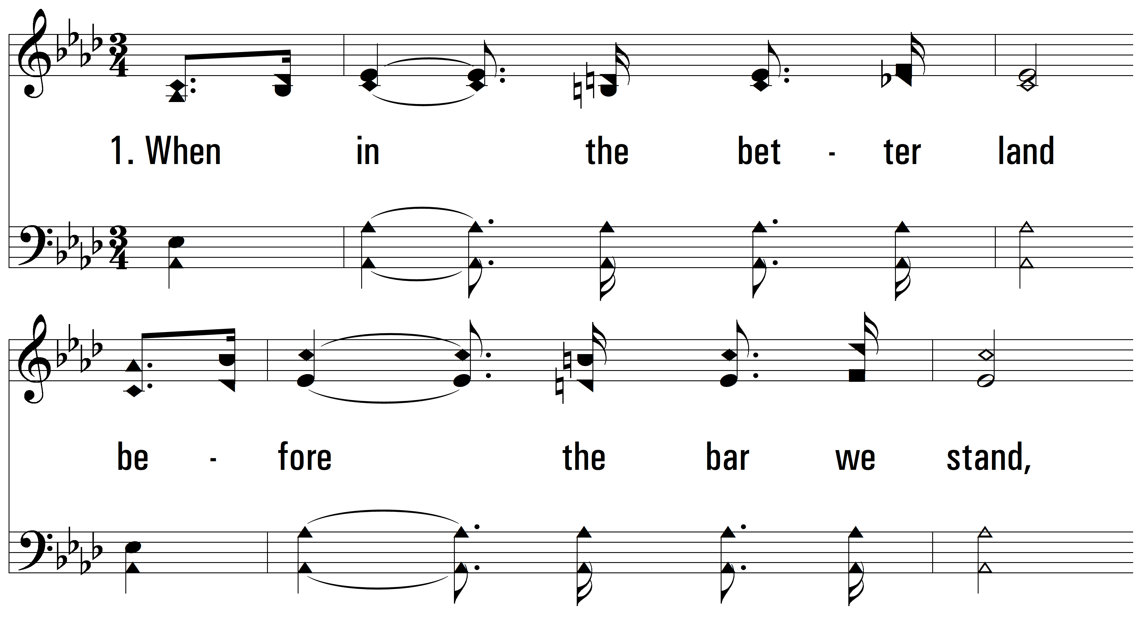
vs. 1 ~ You Never Mentioned Him To Me

Slide 3
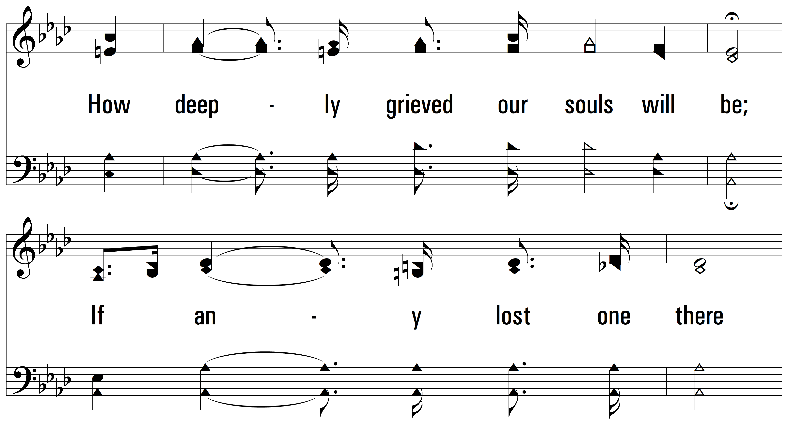
vs. 1

Slide 4
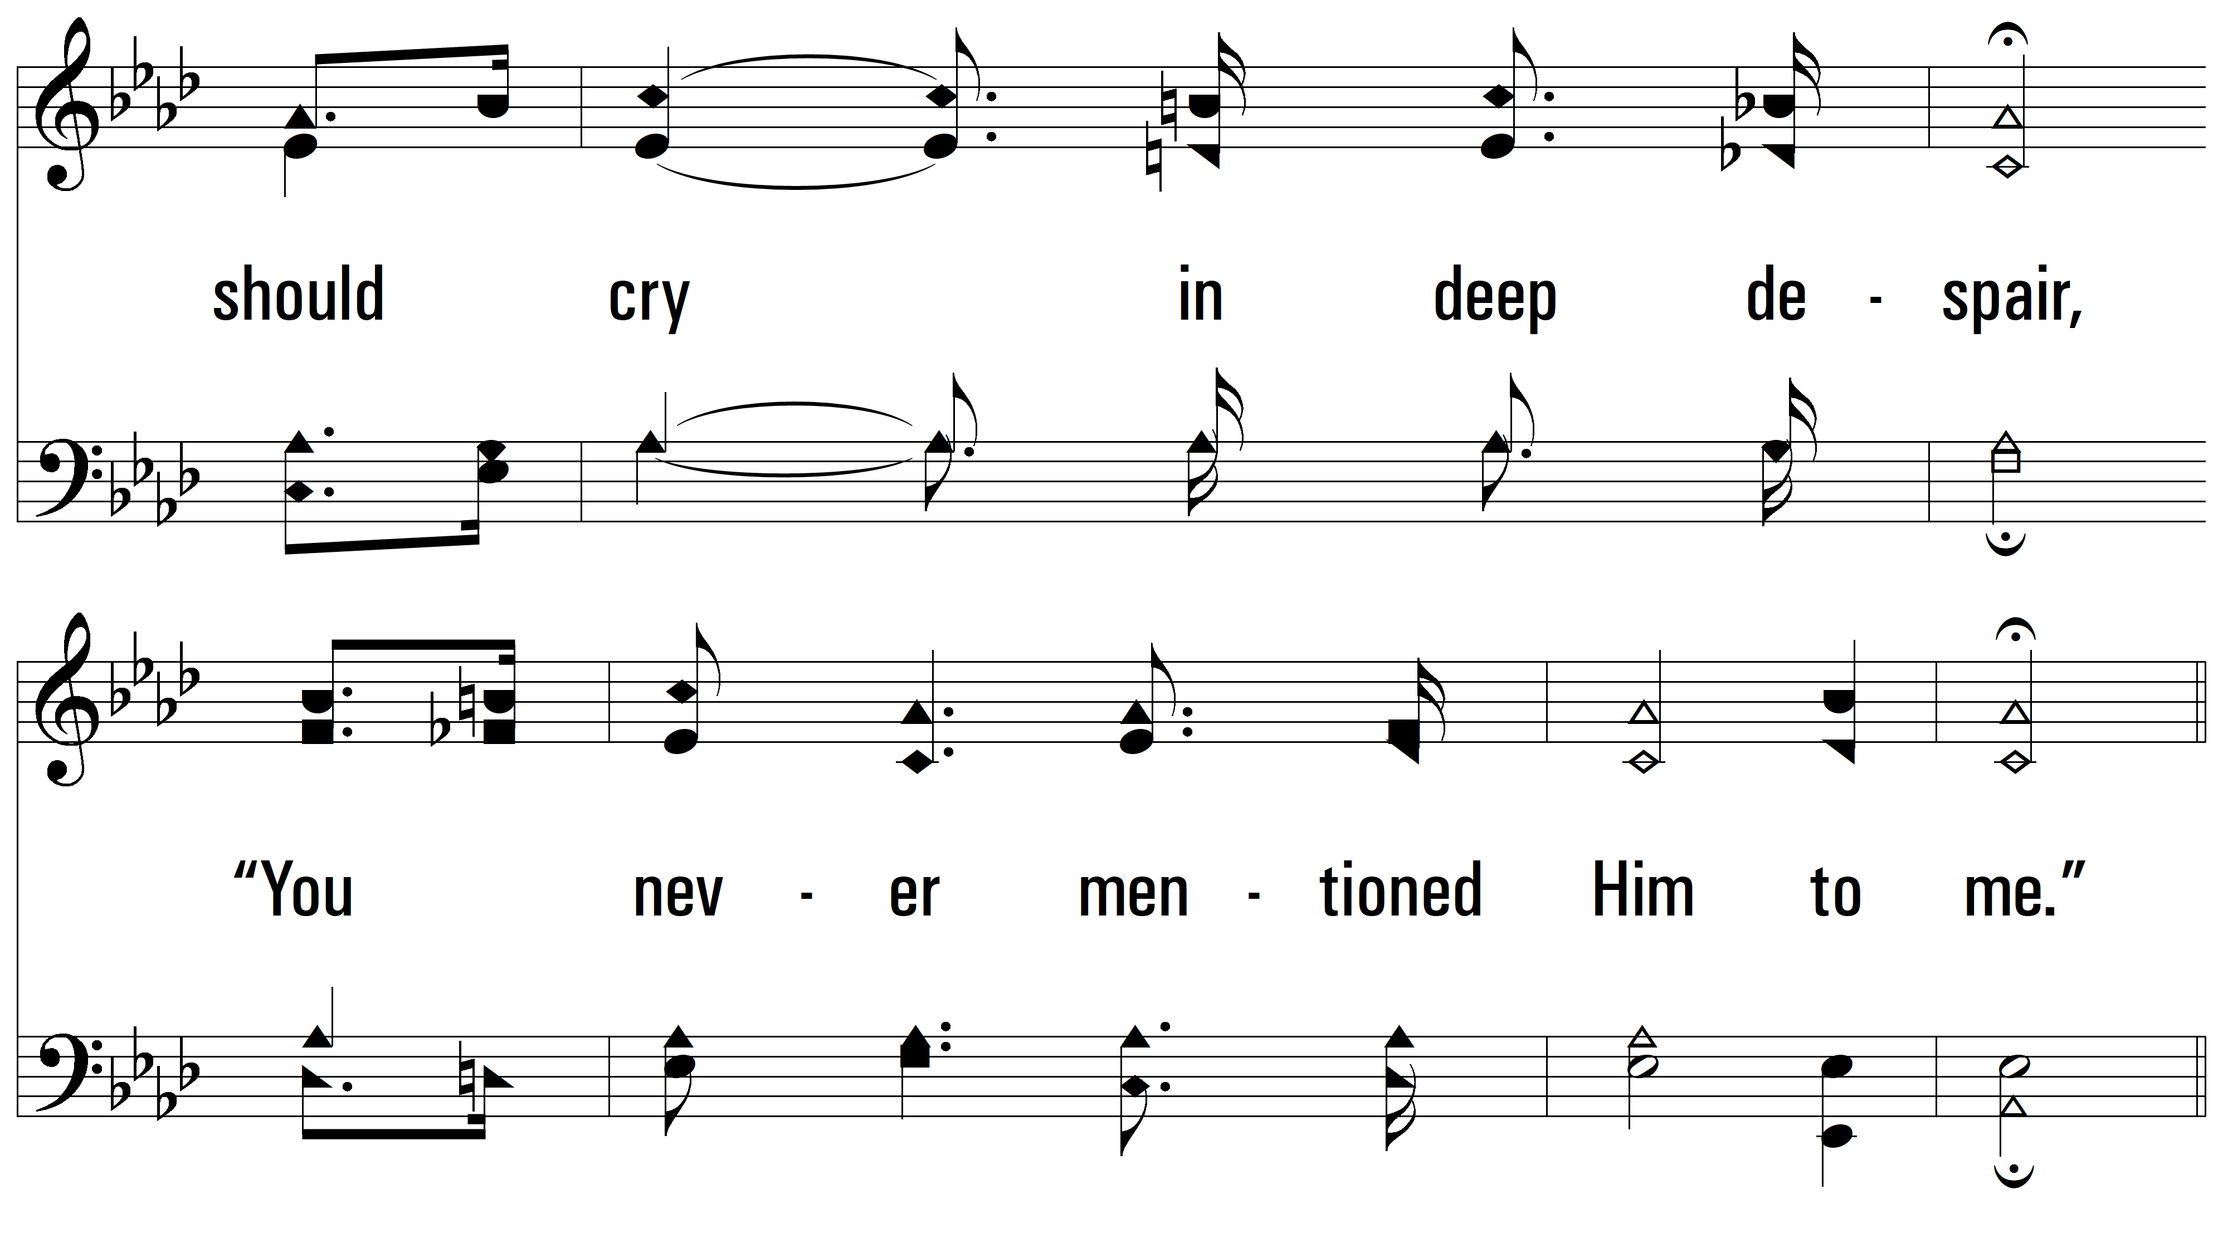
vs. 1

Slide 5
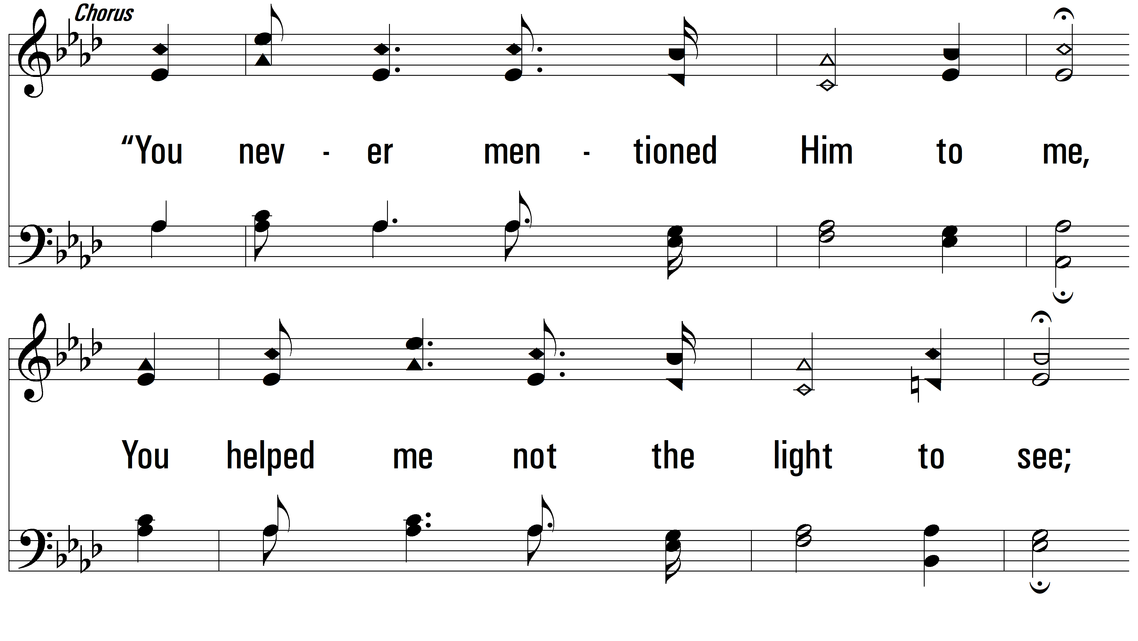
vs. 1

Slide 6
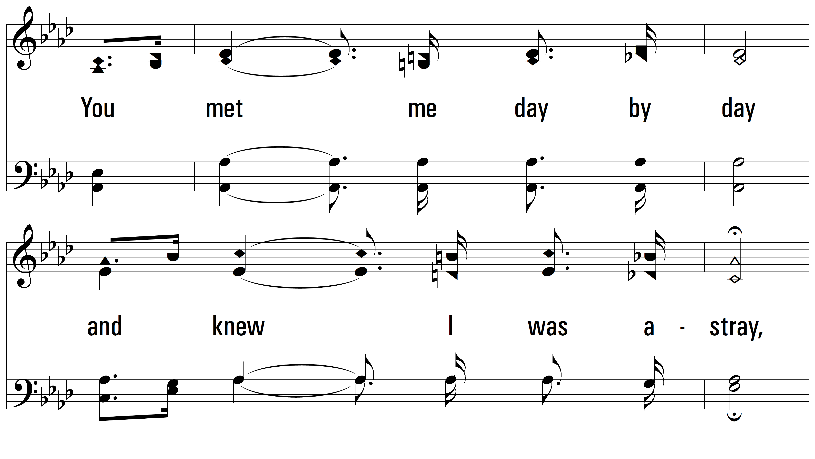
vs. 1

Slide 7
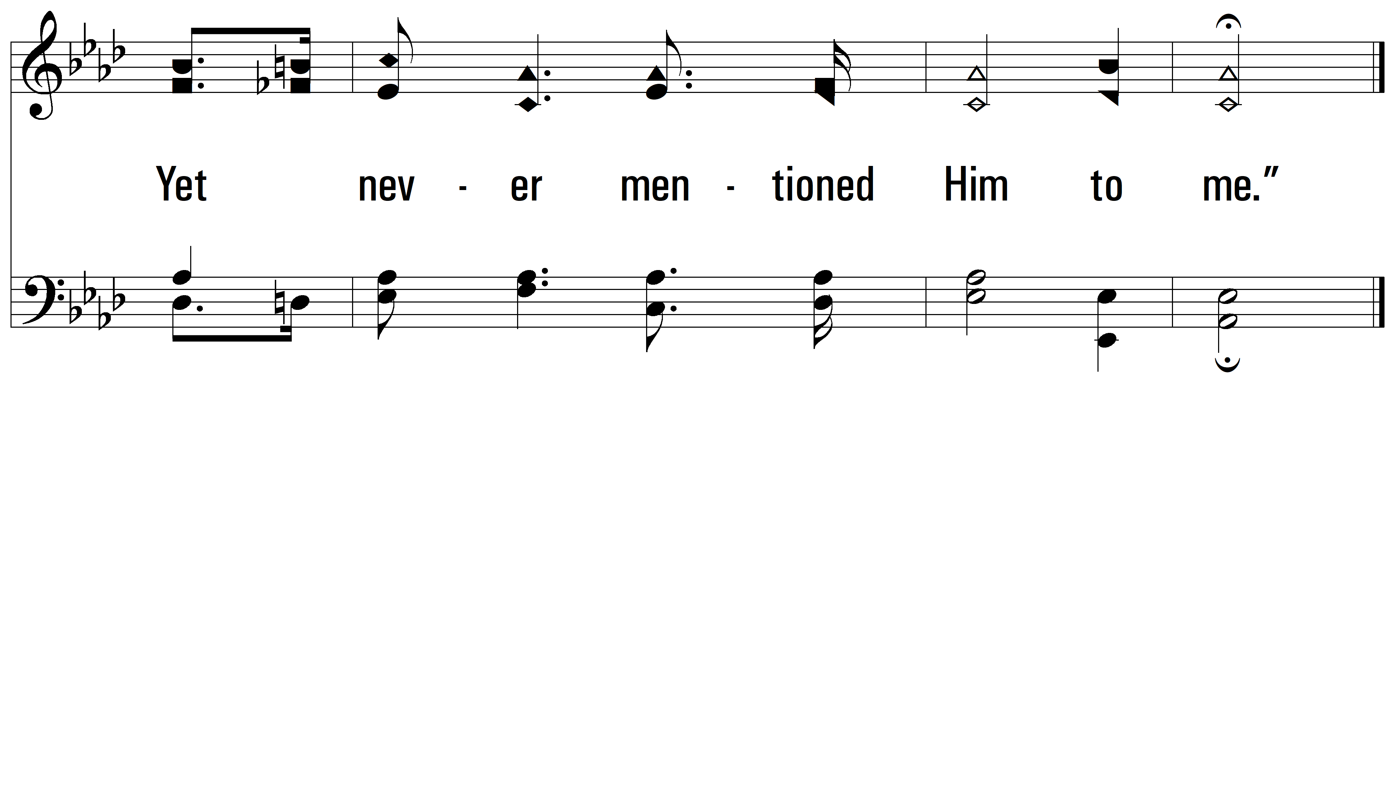
vs. 1

Slide 8
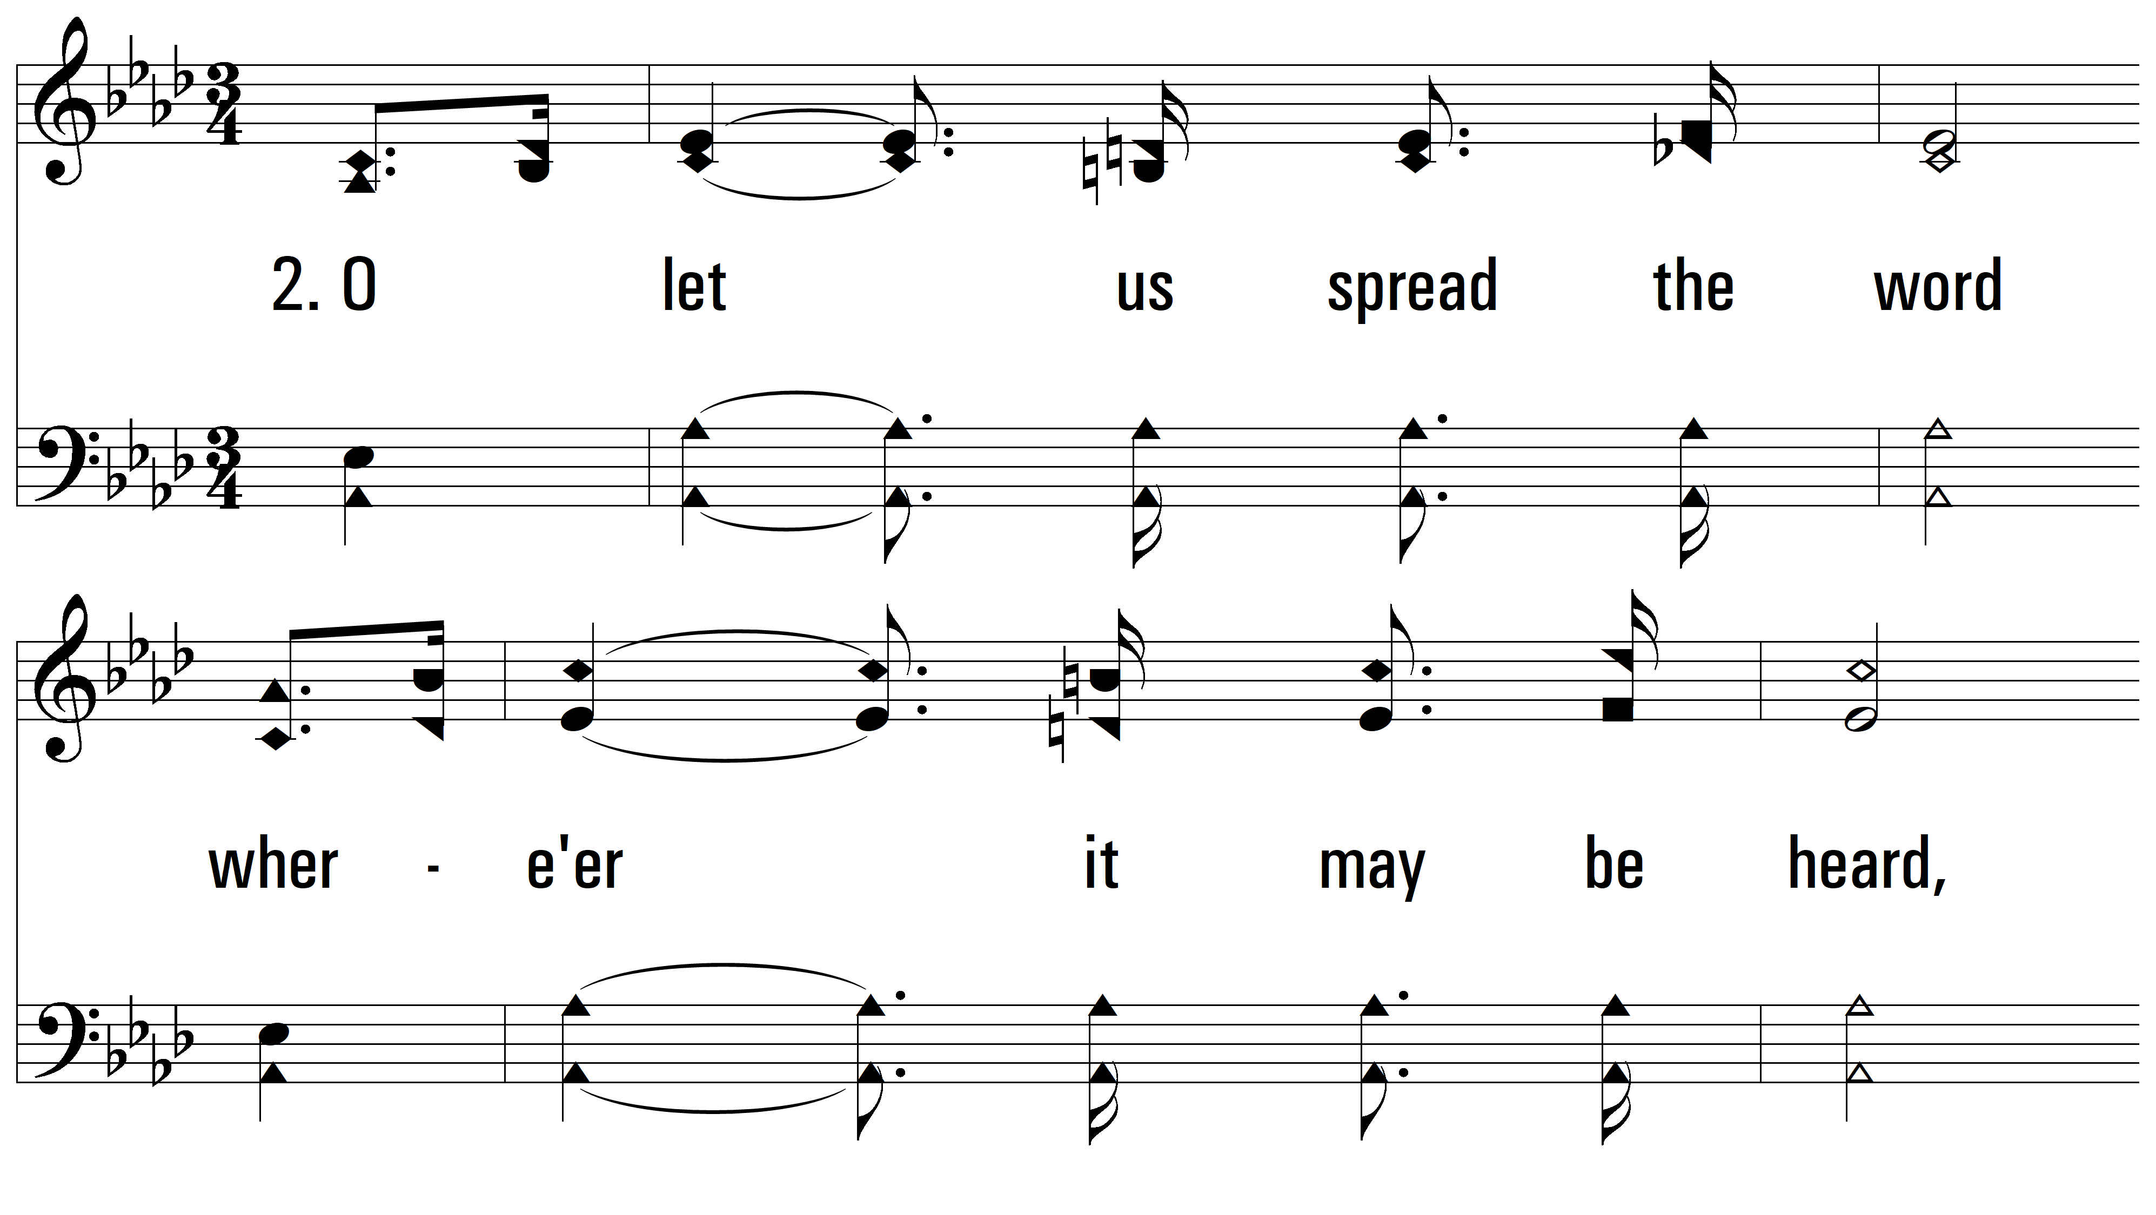
vs. 2 ~ You Never Mentioned Him To Me

Slide 9
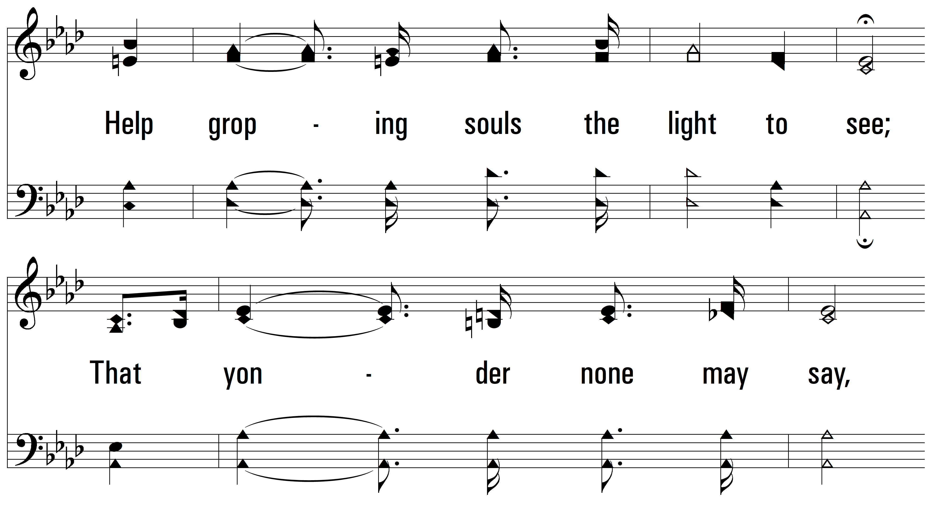
vs. 2

Slide 10
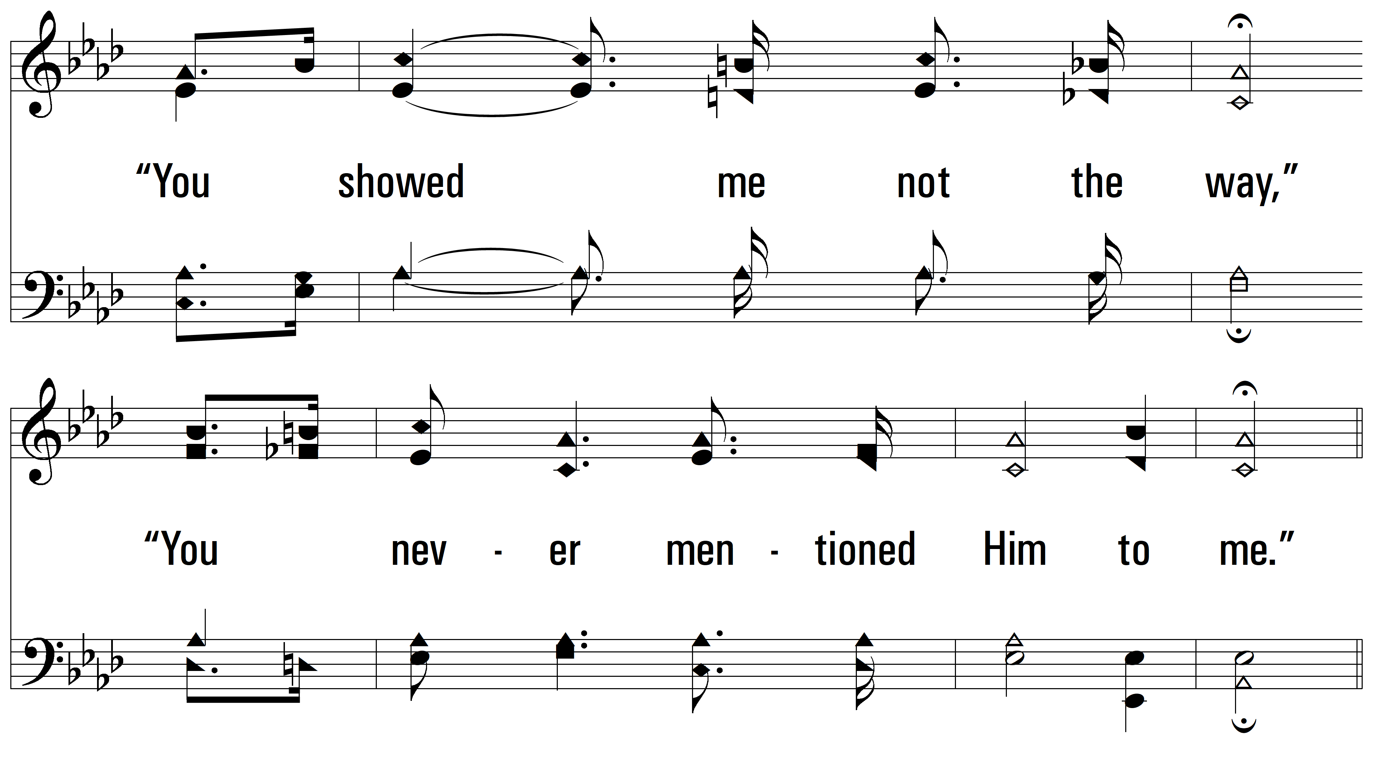
vs. 2

Slide 11
vs. 2

Slide 12
vs. 2

Slide 13
vs. 2

Slide 14
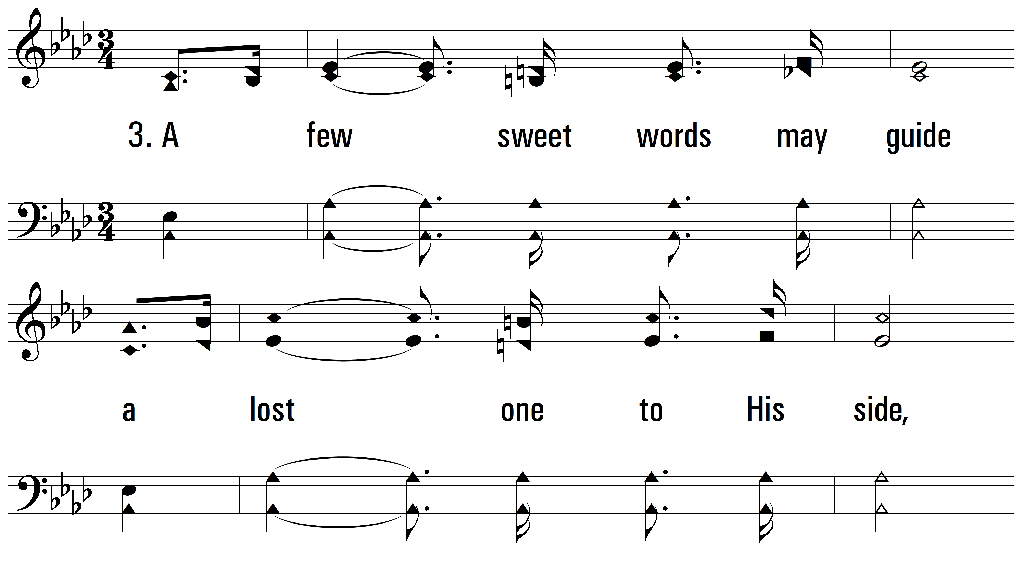
vs. 3 ~ You Never Mentioned Him To Me

Slide 15
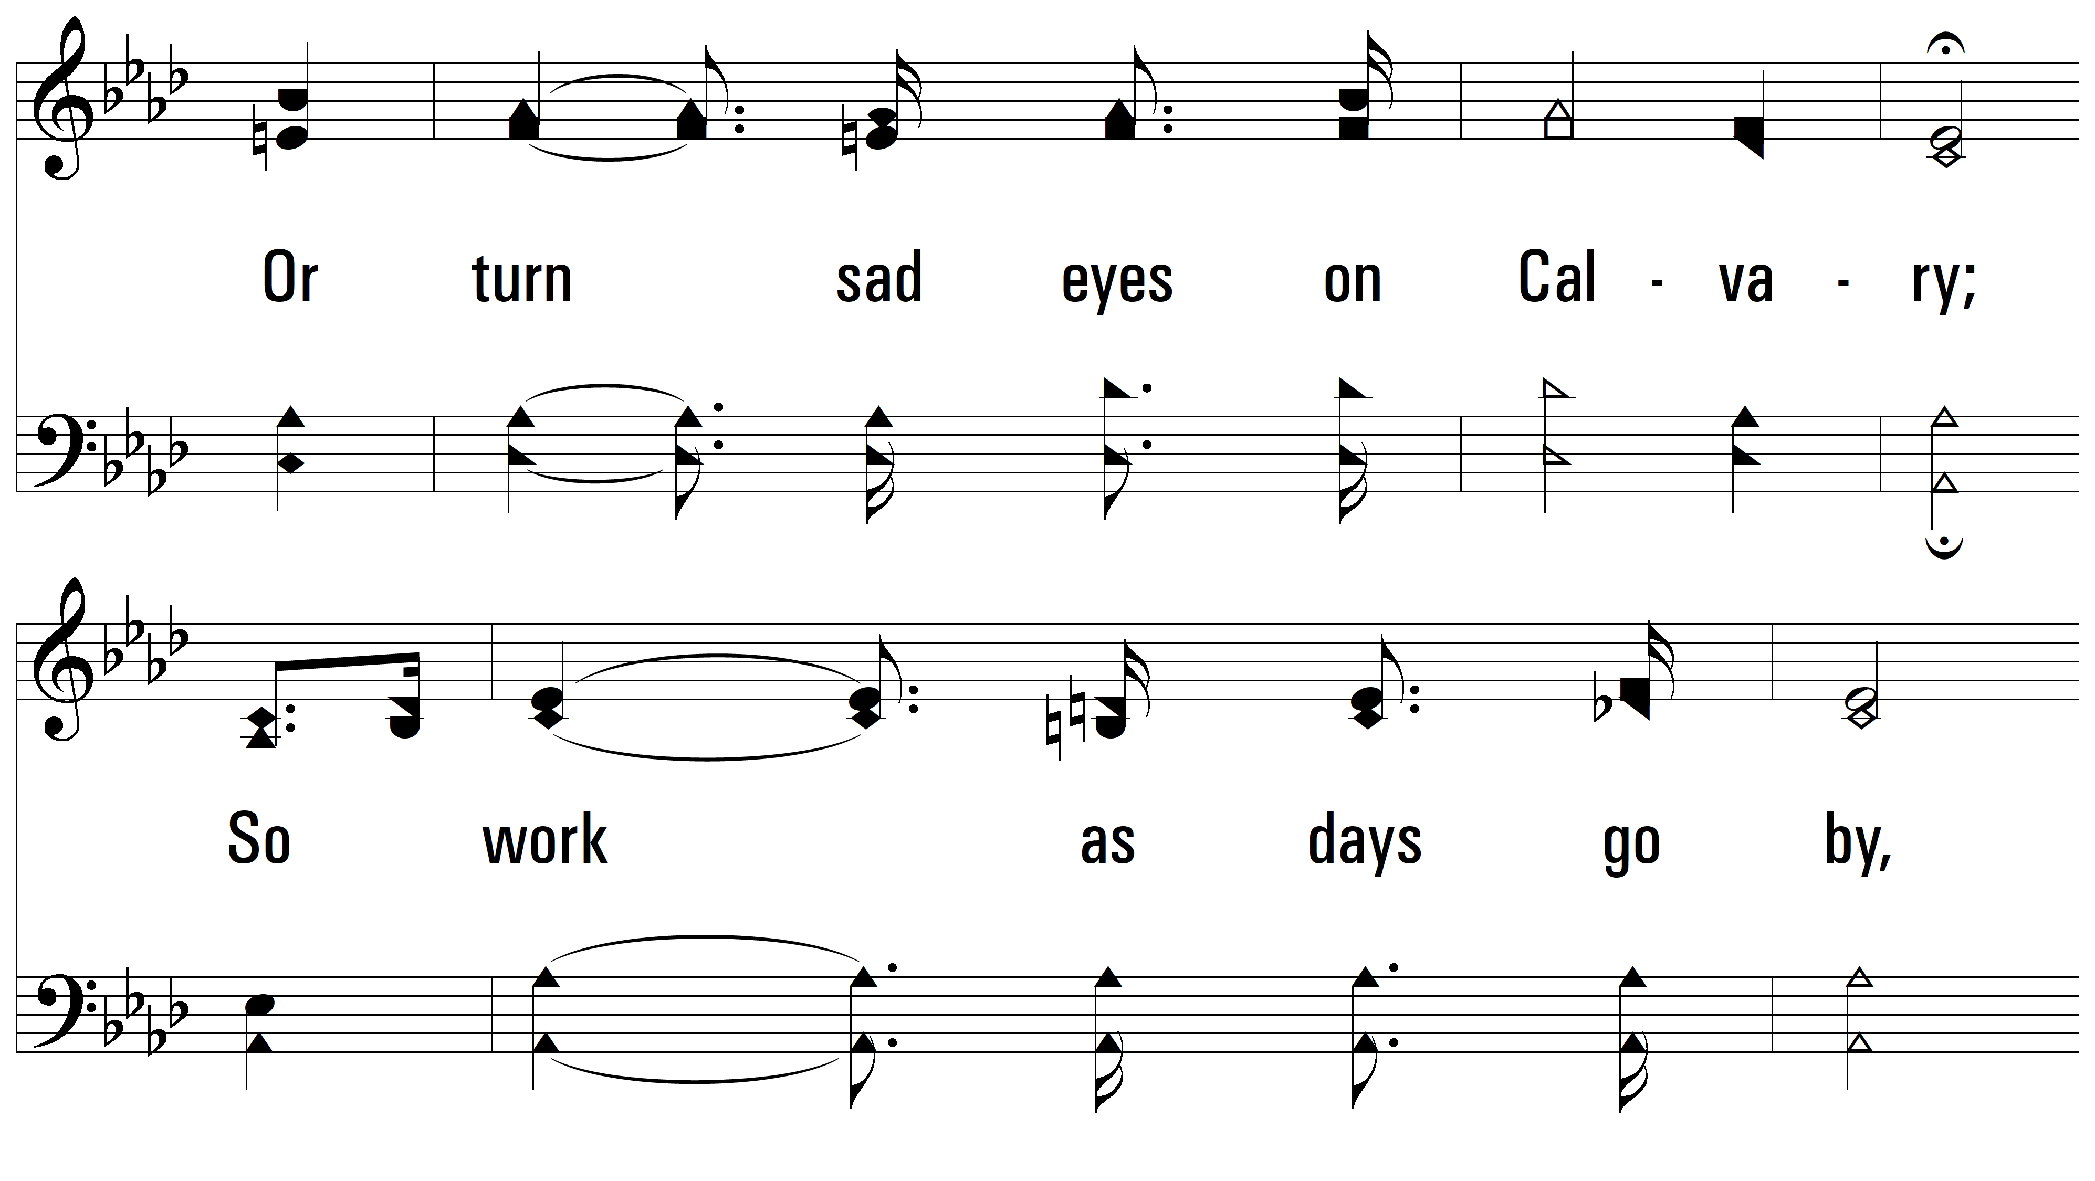
vs. 3

Slide 16
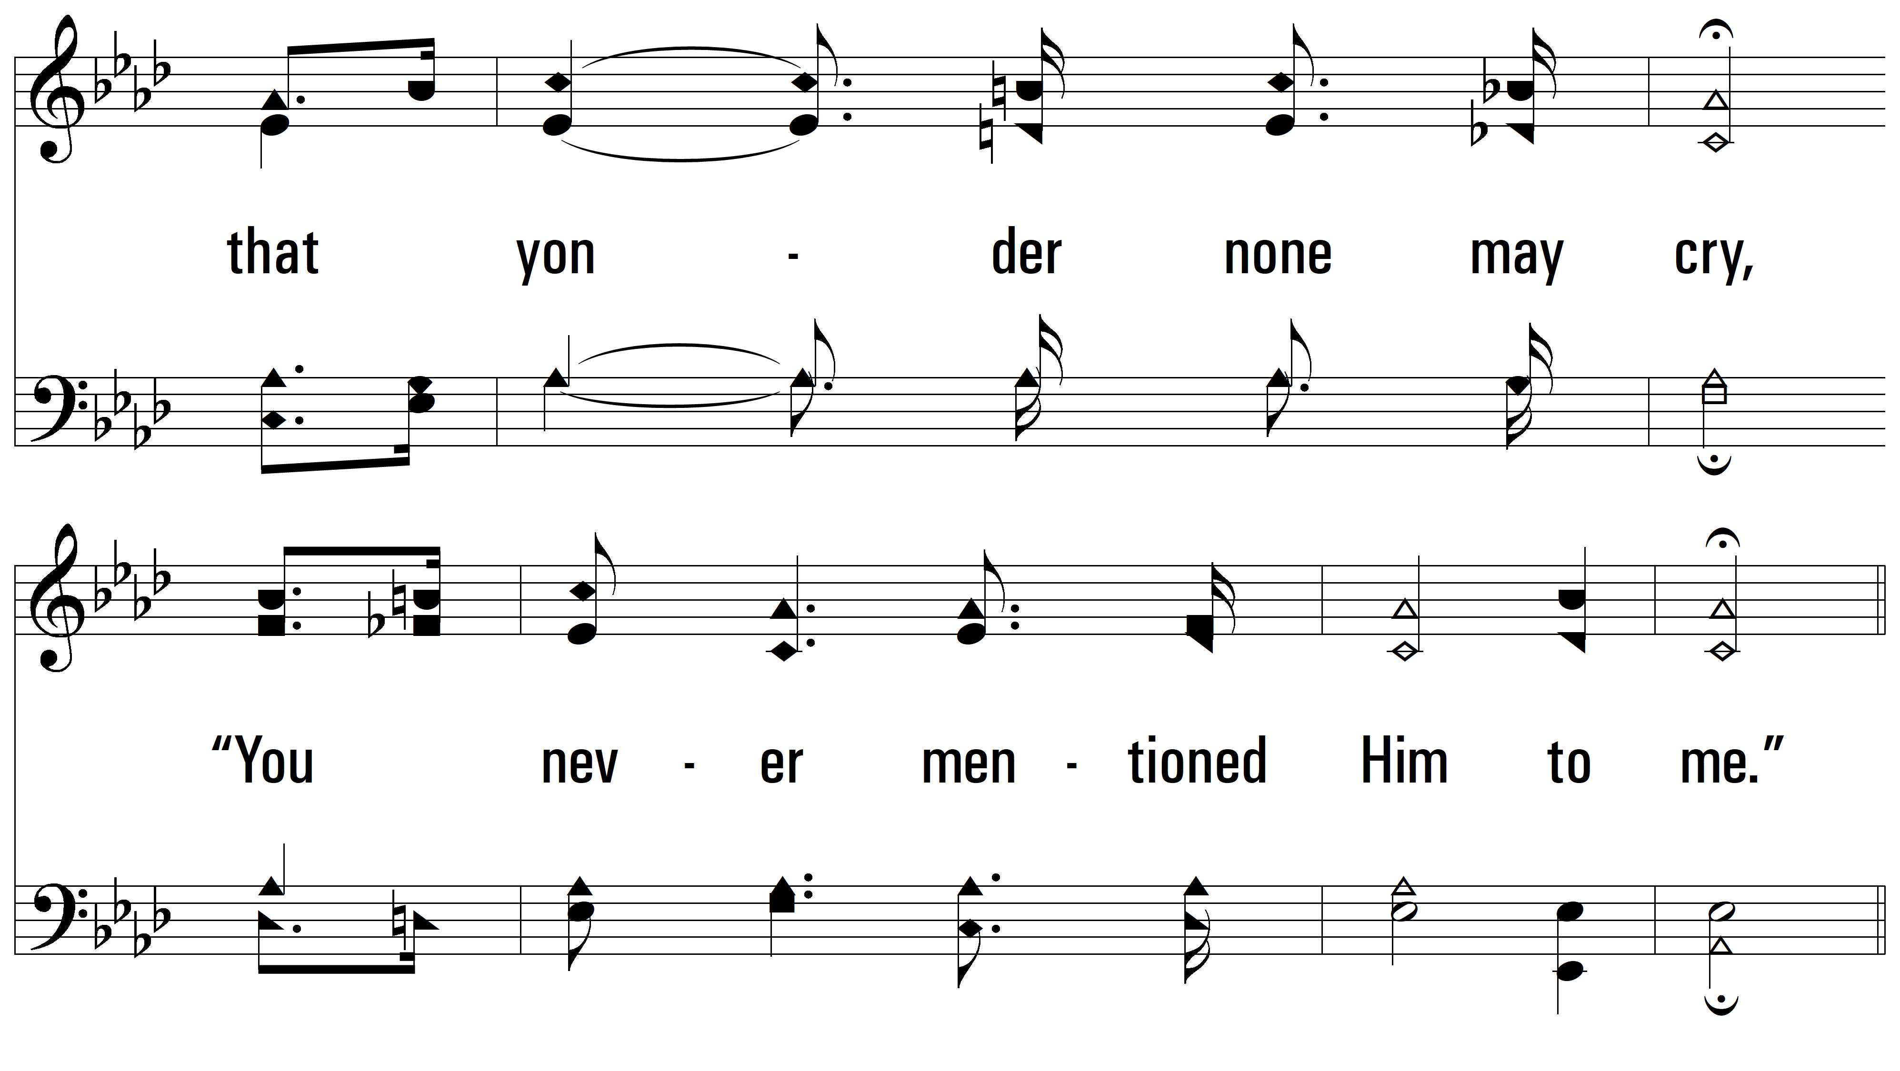
vs. 3

Slide 17
vs. 3

Slide 18
vs. 3

Slide 19
vs. 3
PDHymns.com
END

