Slide 1
Yield Not To Temptation
Words: | Hotatior R. Palmer (1868)
Music: | Hotatior R. Palmer (1868)
6/8
B^{b}/D - MI
Verses: 3/Chorus
Lead - | MI
Alto - | SOL
Tenor - | DO
Bass - | DO
PDHymns.com

Slide 2
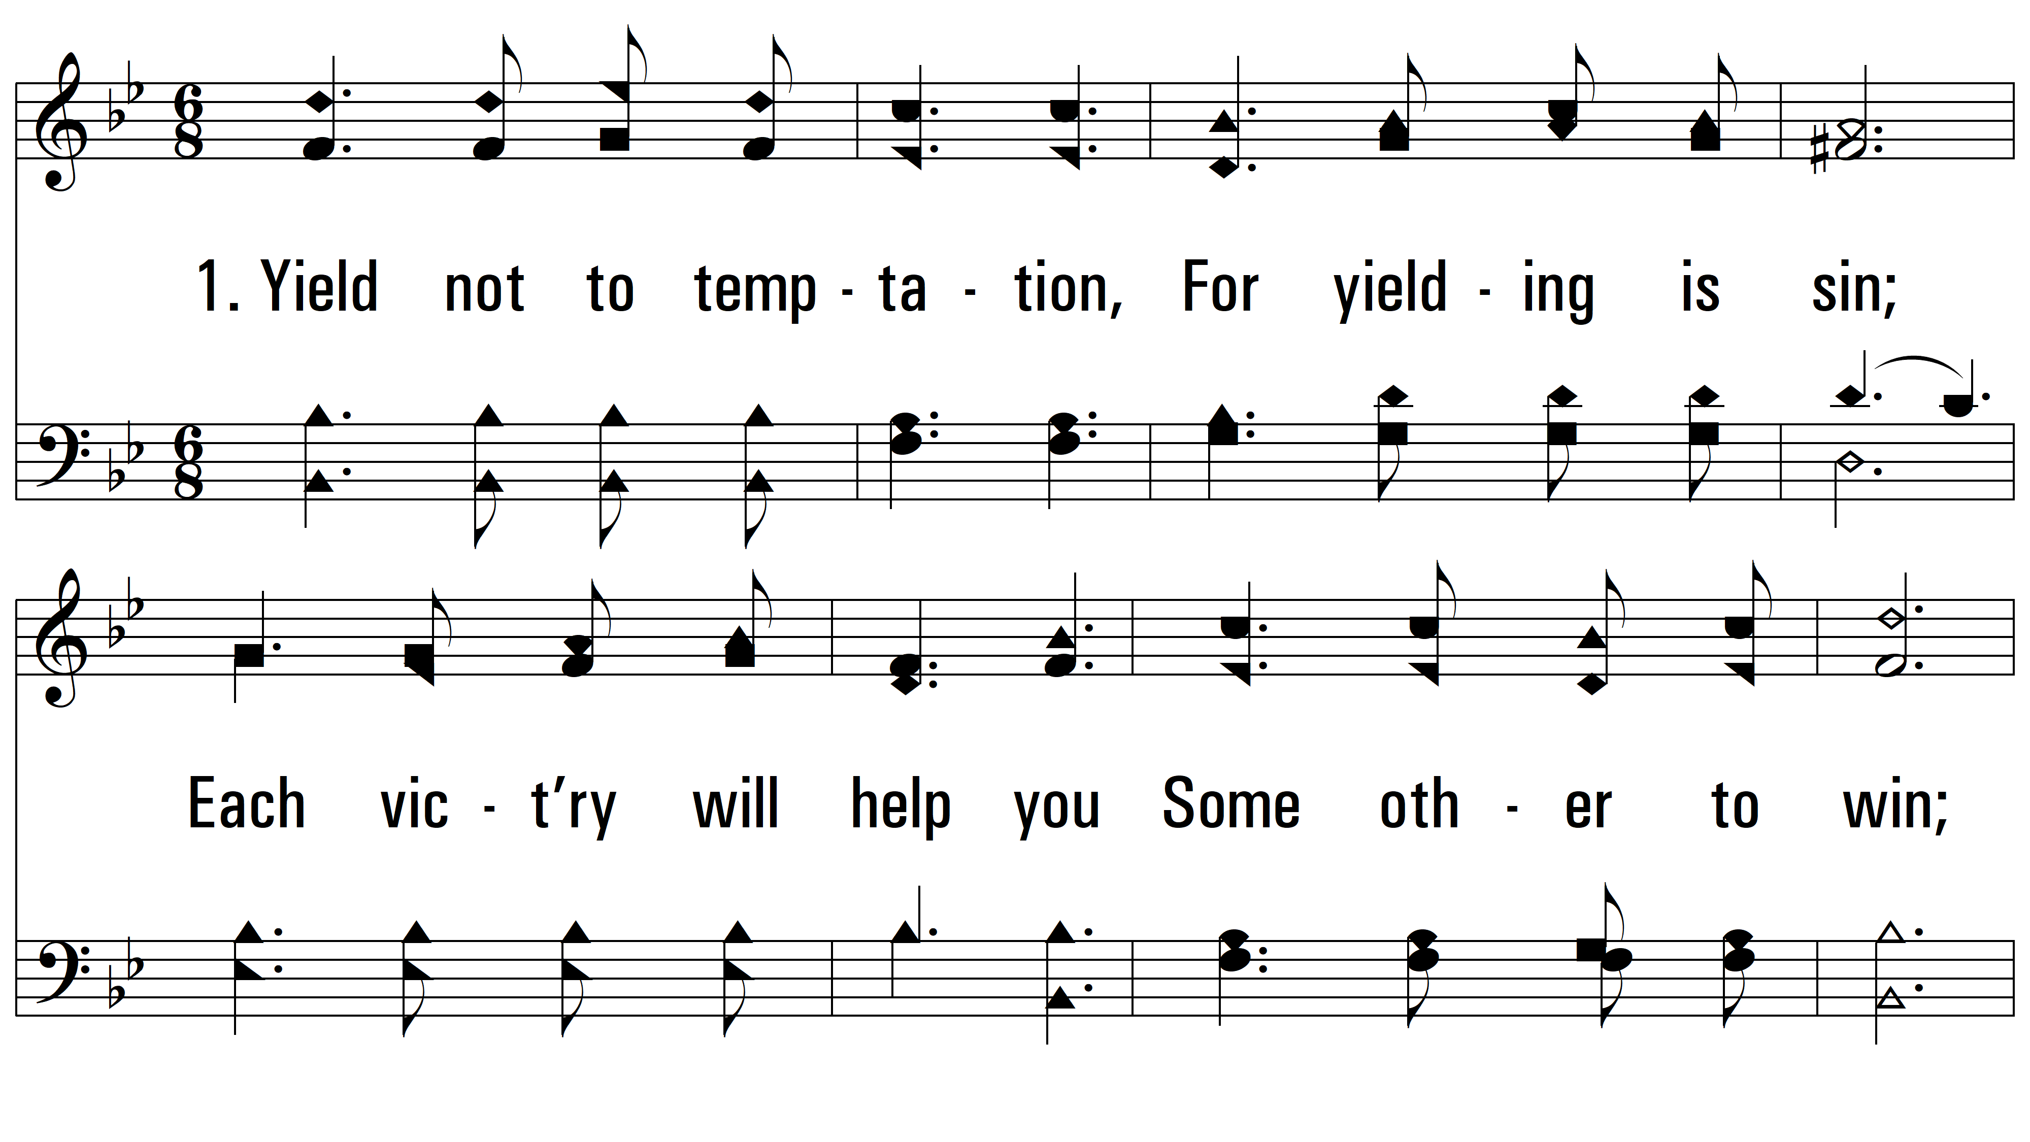
vs. 1 ~ Yield Not To Temptation

Slide 3
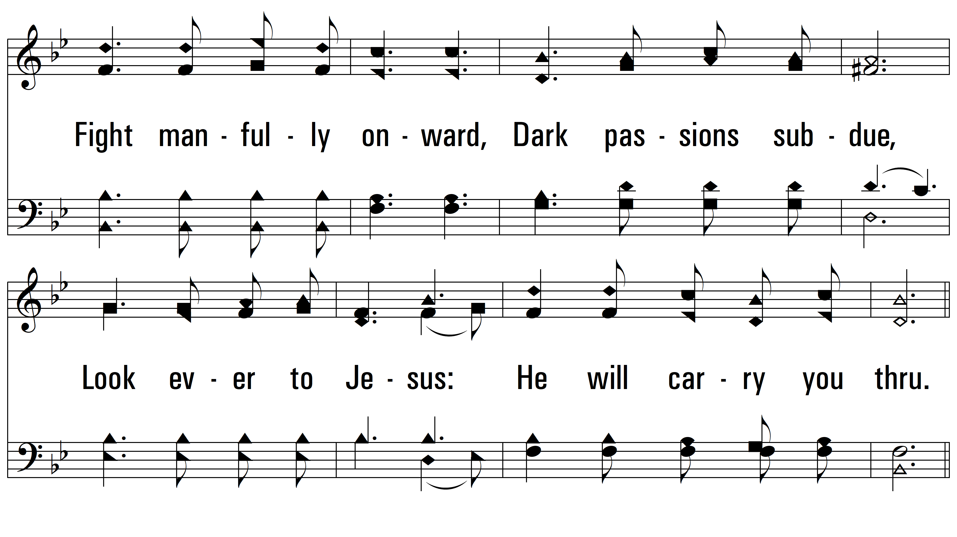
vs. 1

Slide 4
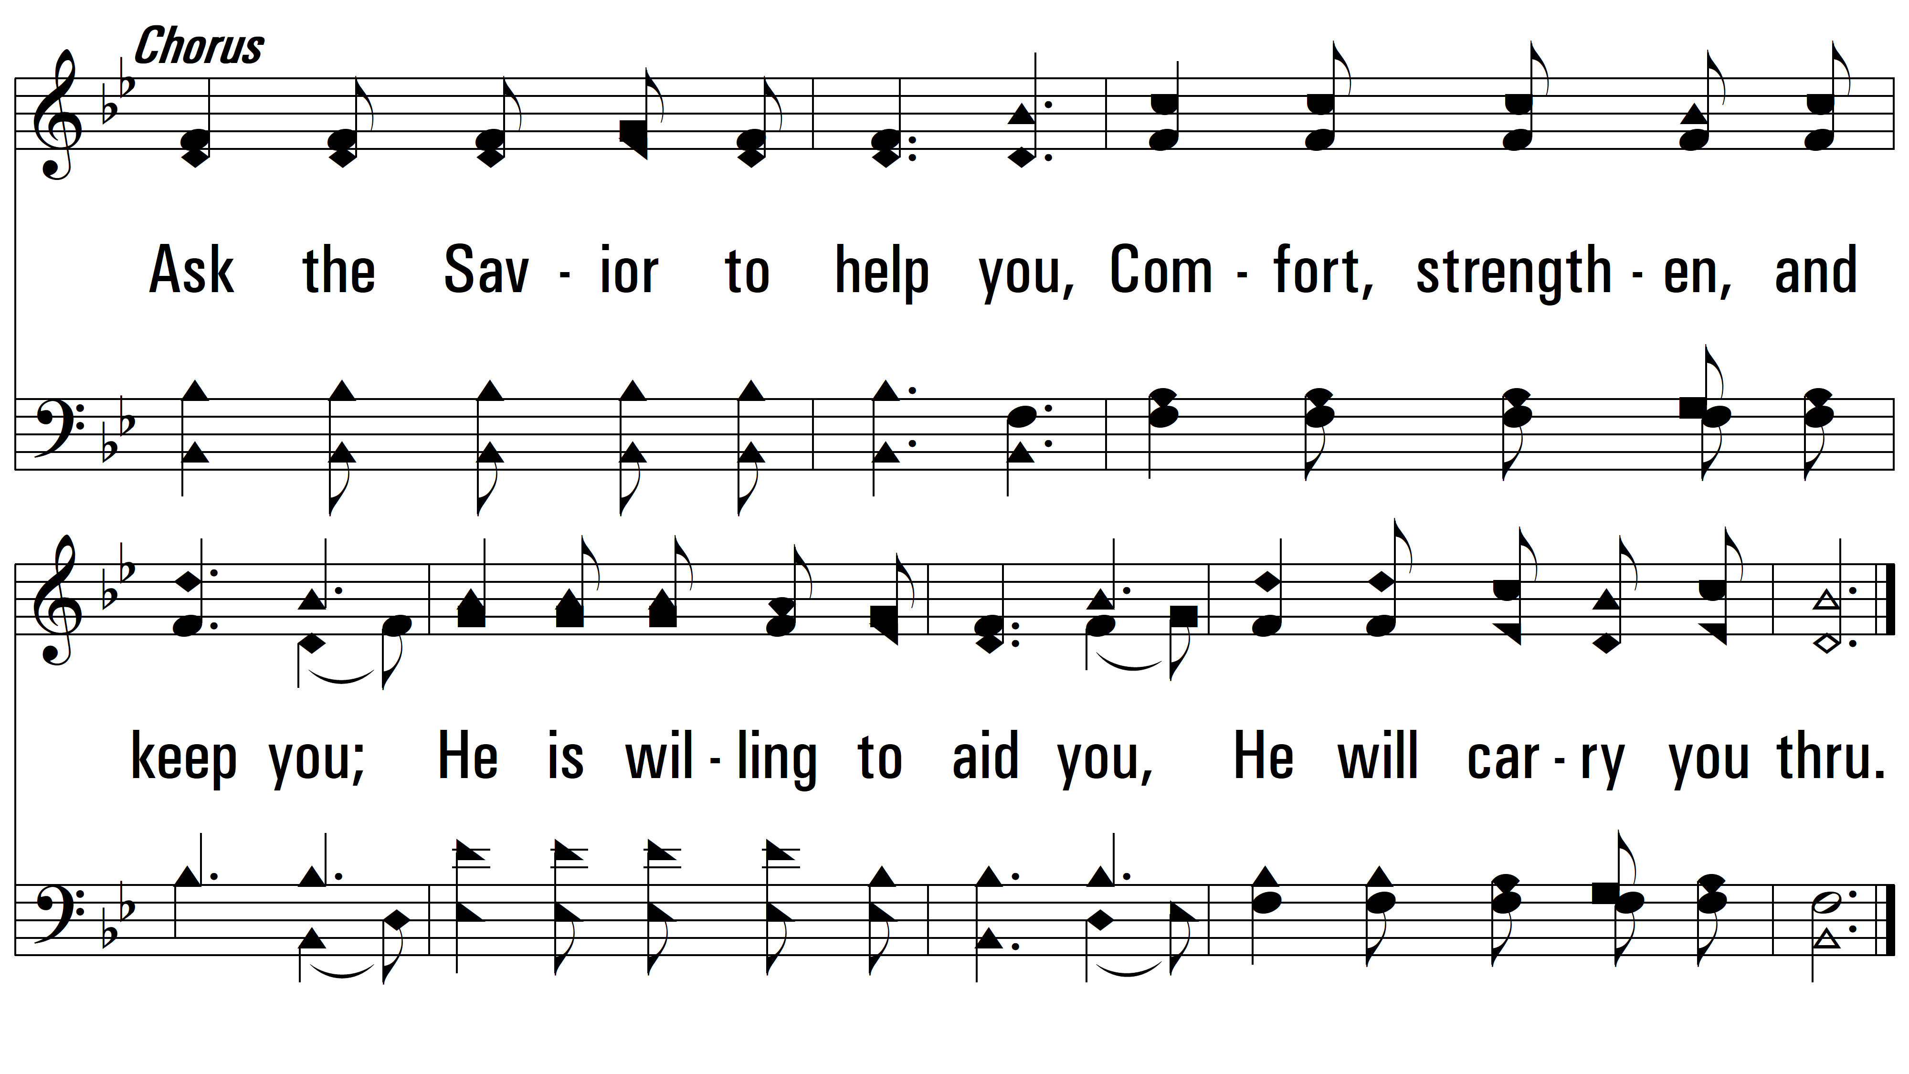
vs. 1

Slide 5
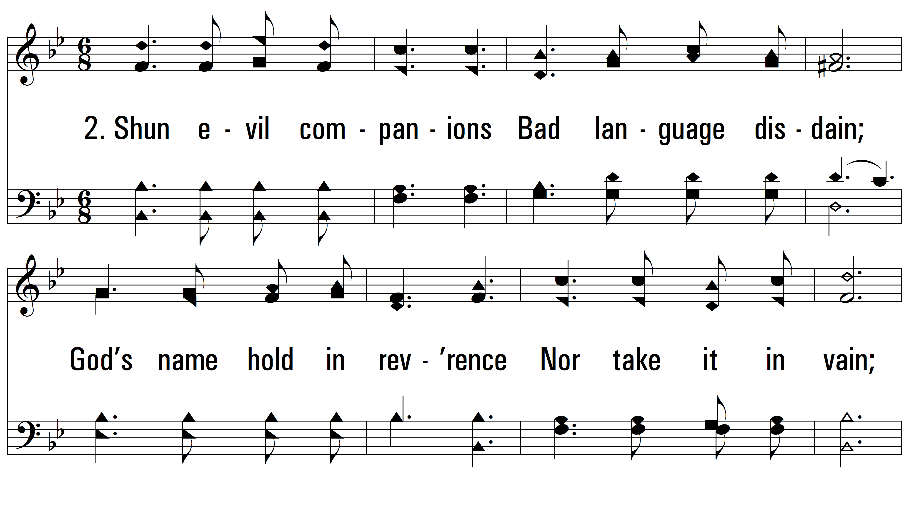
vs. 2 ~ Yield Not To Temptation

Slide 6
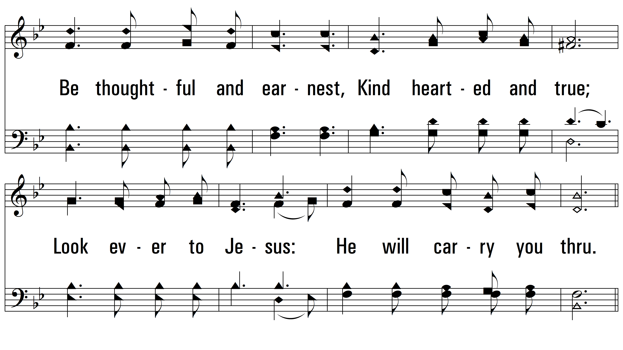
vs. 2

Slide 7
vs. 2

Slide 8
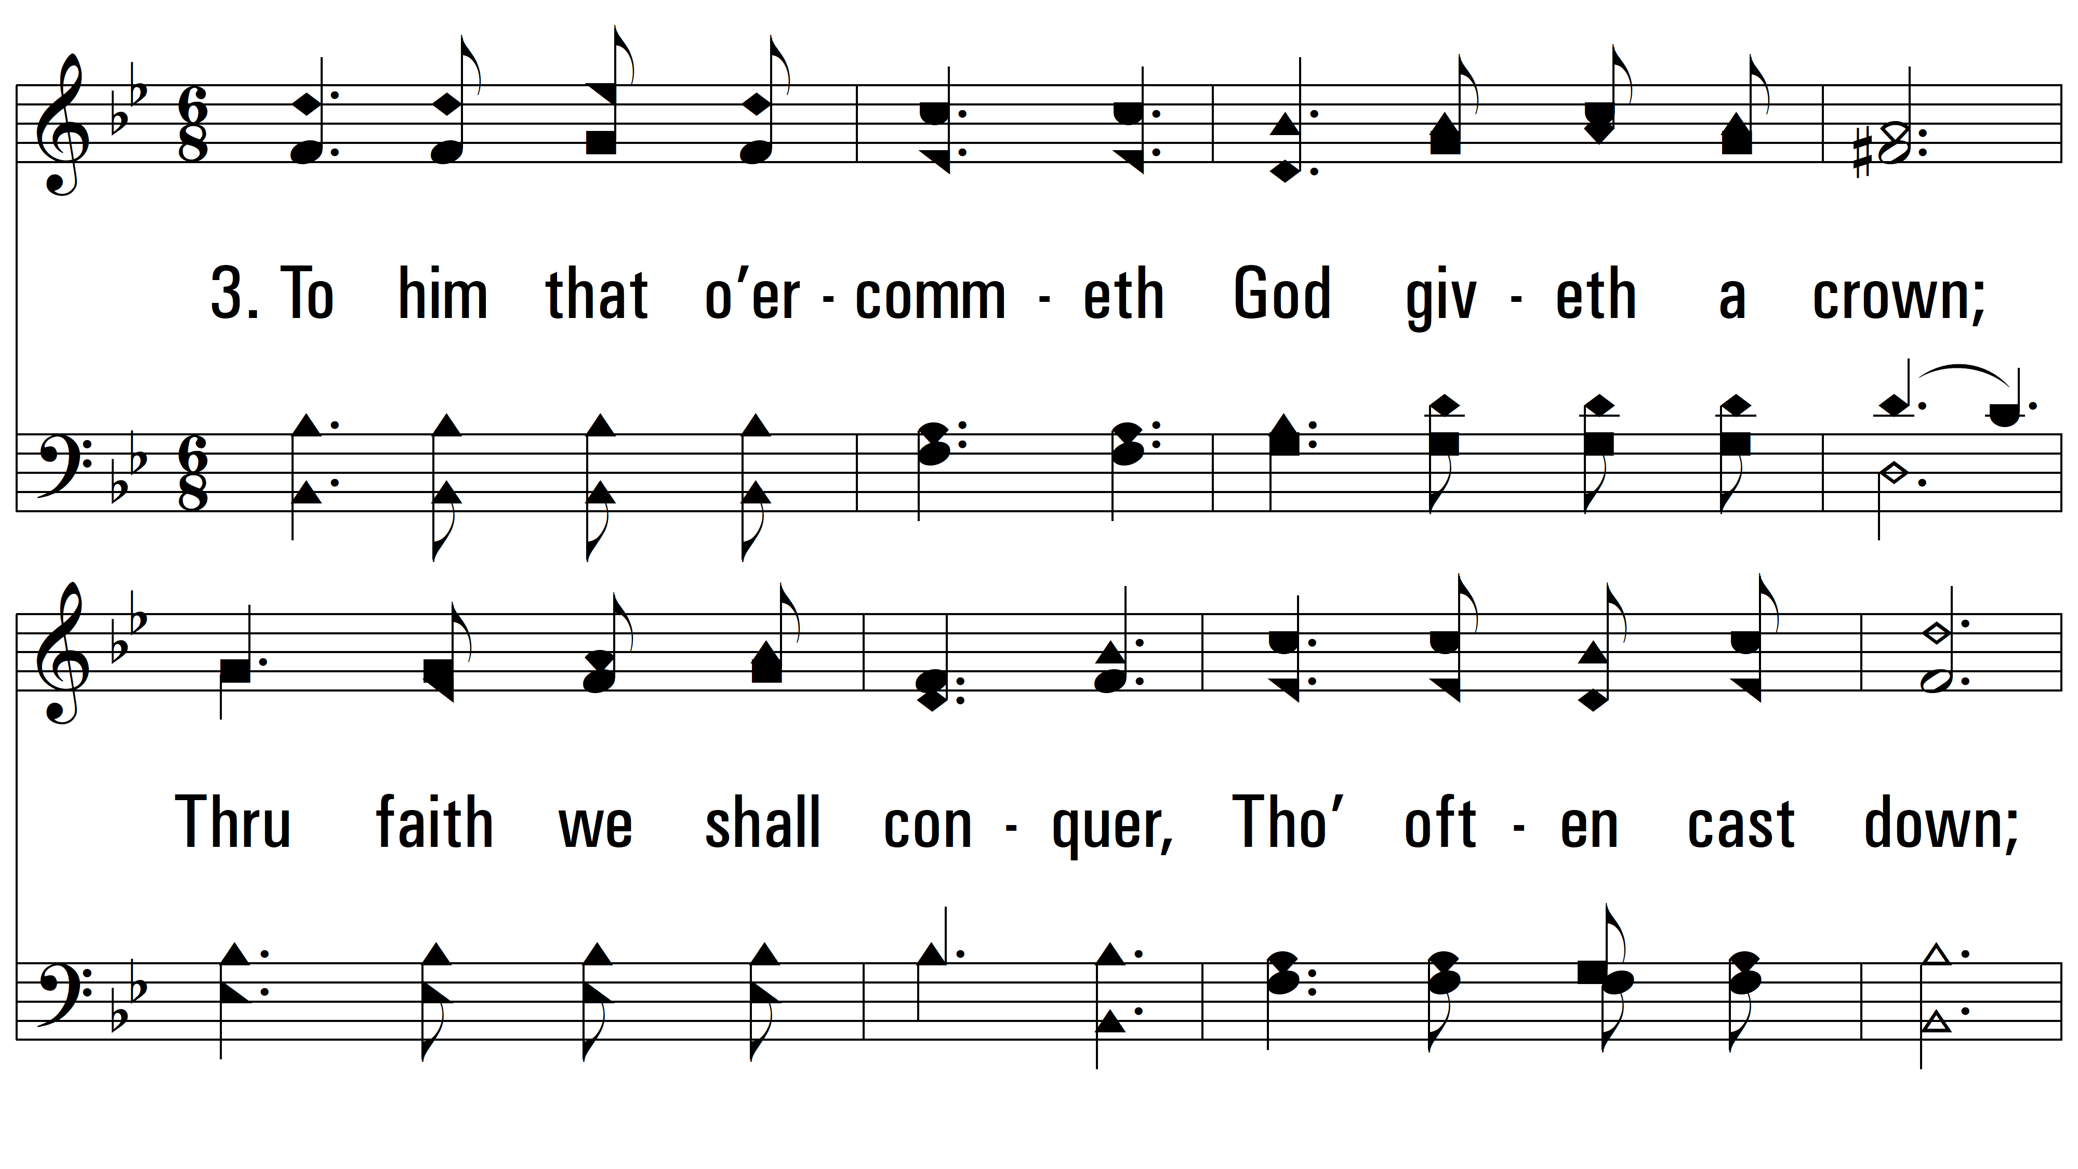
vs. 3 ~ Yield Not To Temptation

Slide 9
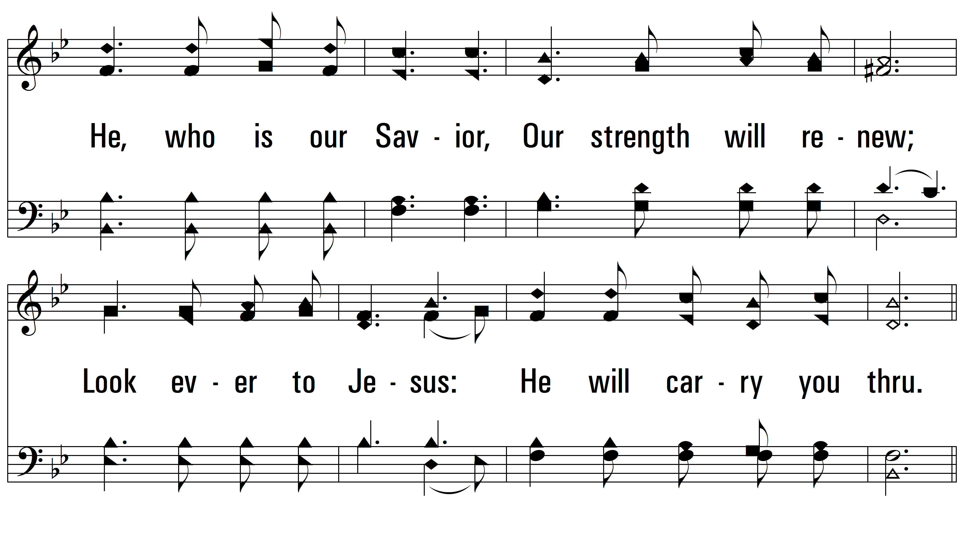
vs. 3

Slide 10
vs. 3
PDHymns.com
END

