Slide 1
Wonderful Grace Of Jesus
Words: | Haldor Lillenas (1918)
Music: | Haldor Lillenas (1918)
4/4
C/G - SOL
Verses: 3/Chorus
Lead - | SOL
Alto - | MI
Tenor - | DO
Bass - | DO
PDHymns.com

Slide 2
vs. 1 ~ Wonderful Grace Of Jesus

Slide 3
vs. 1

Slide 4
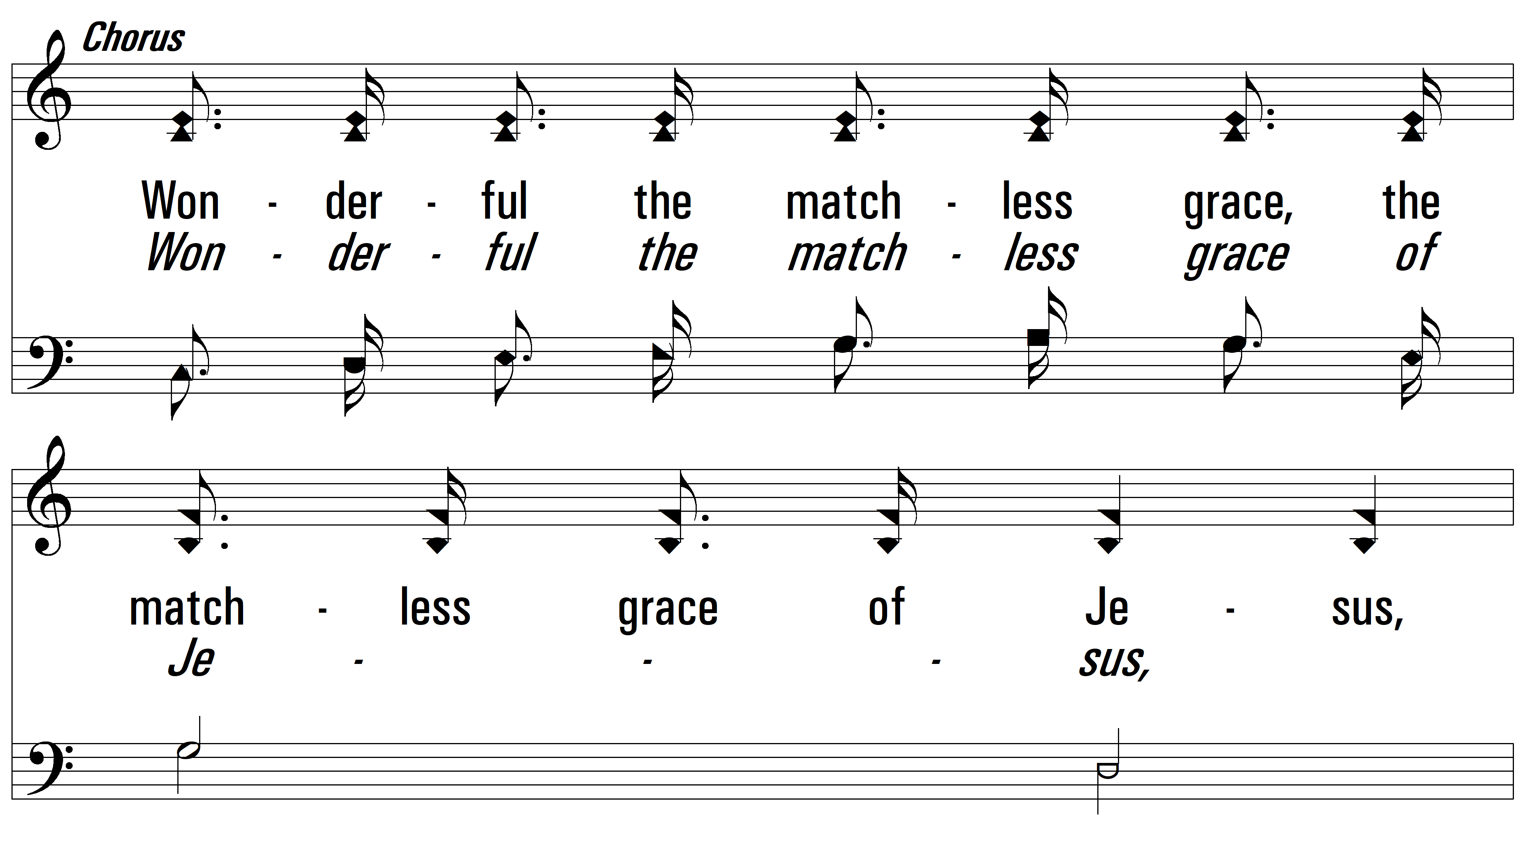
vs. 1

Slide 5
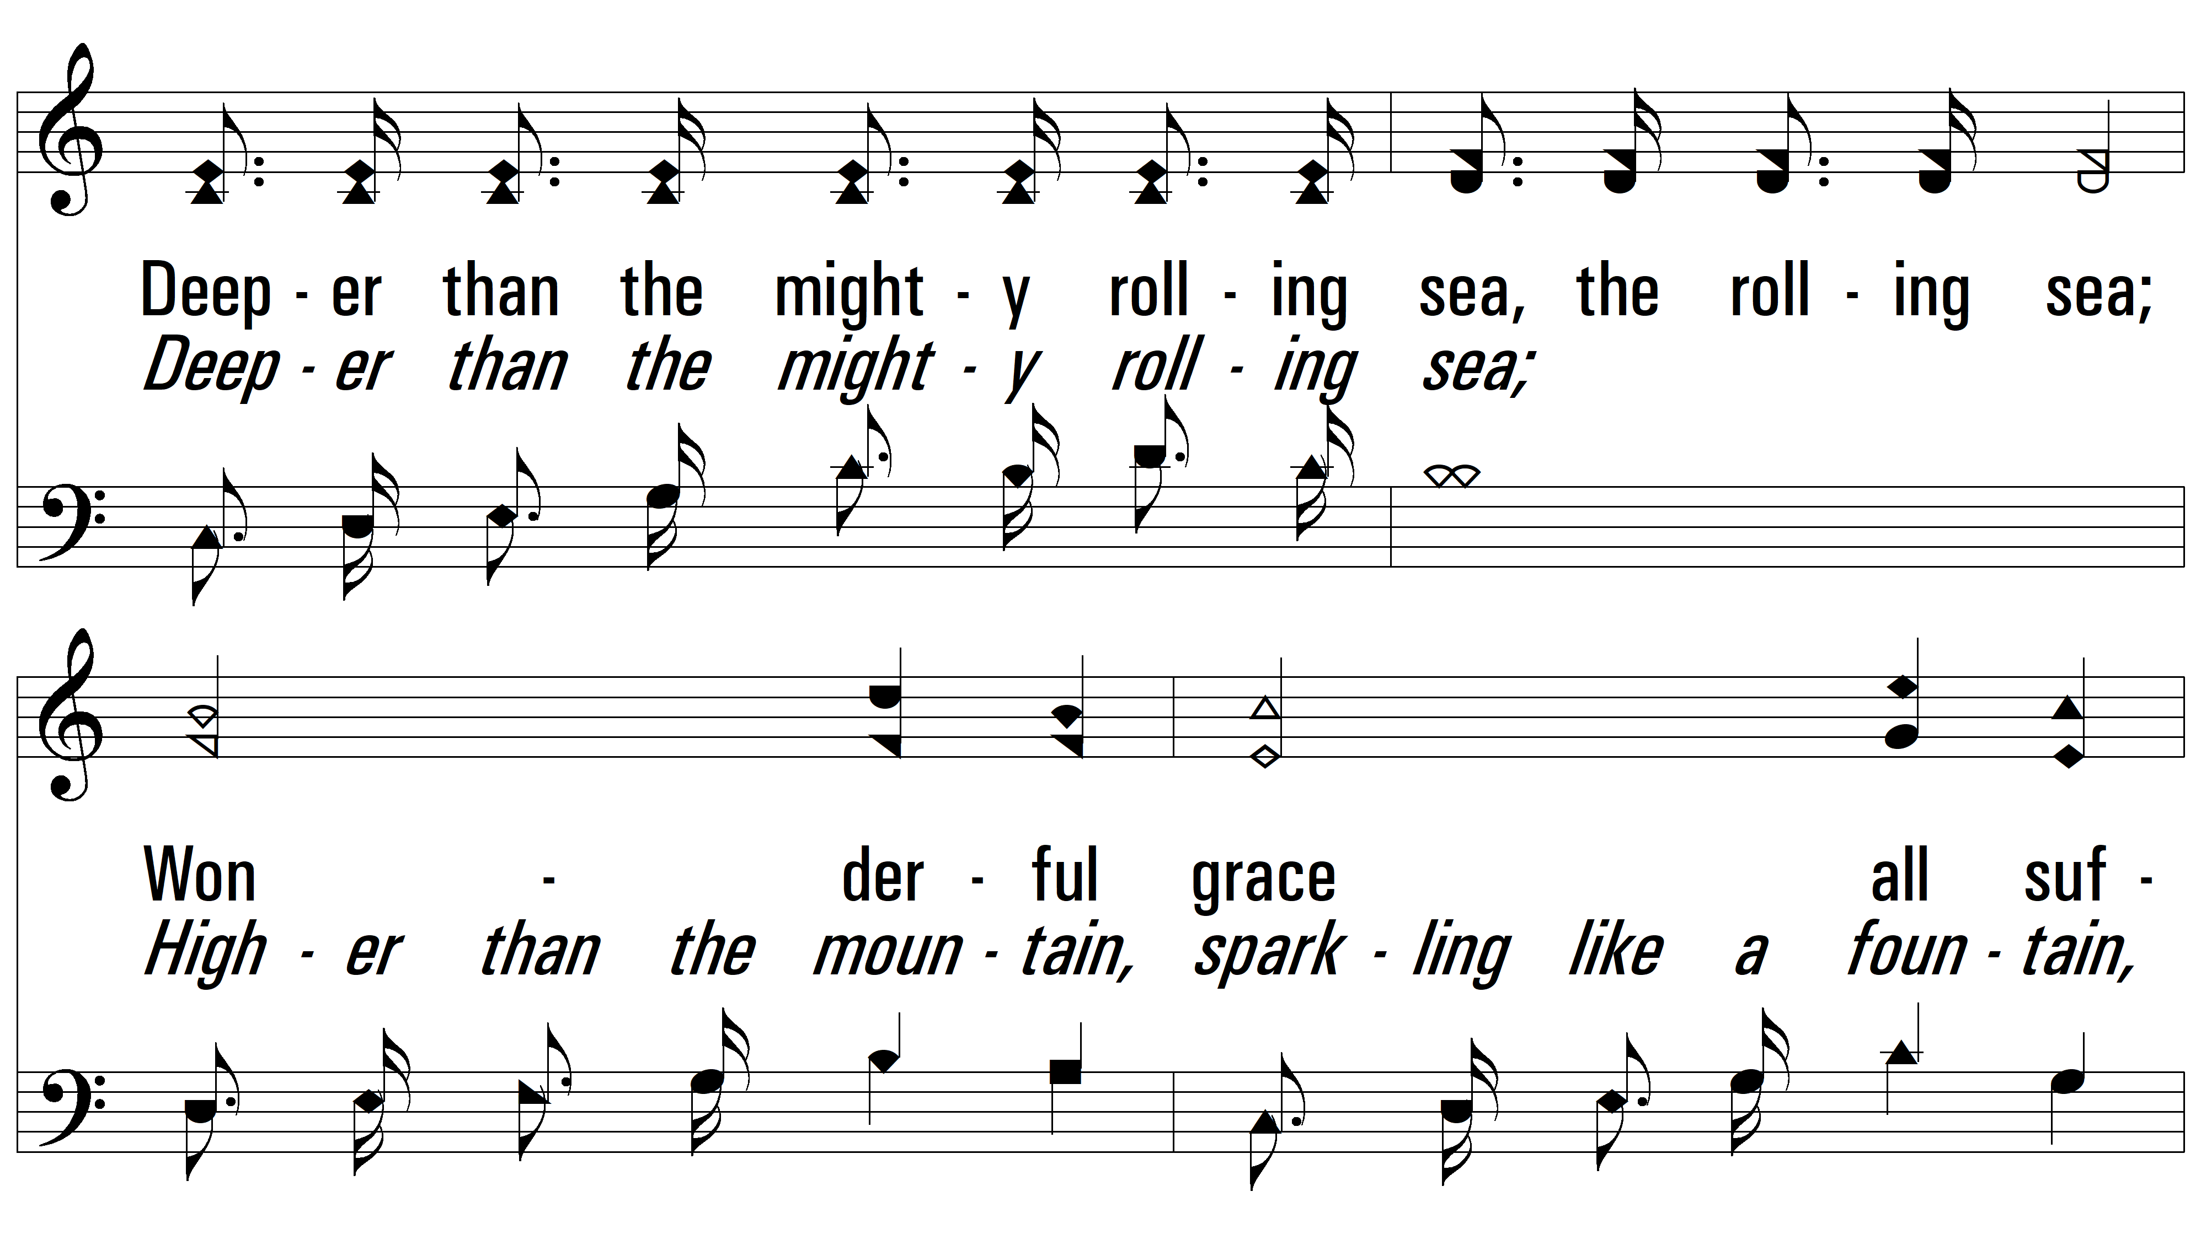
vs. 1

Slide 6
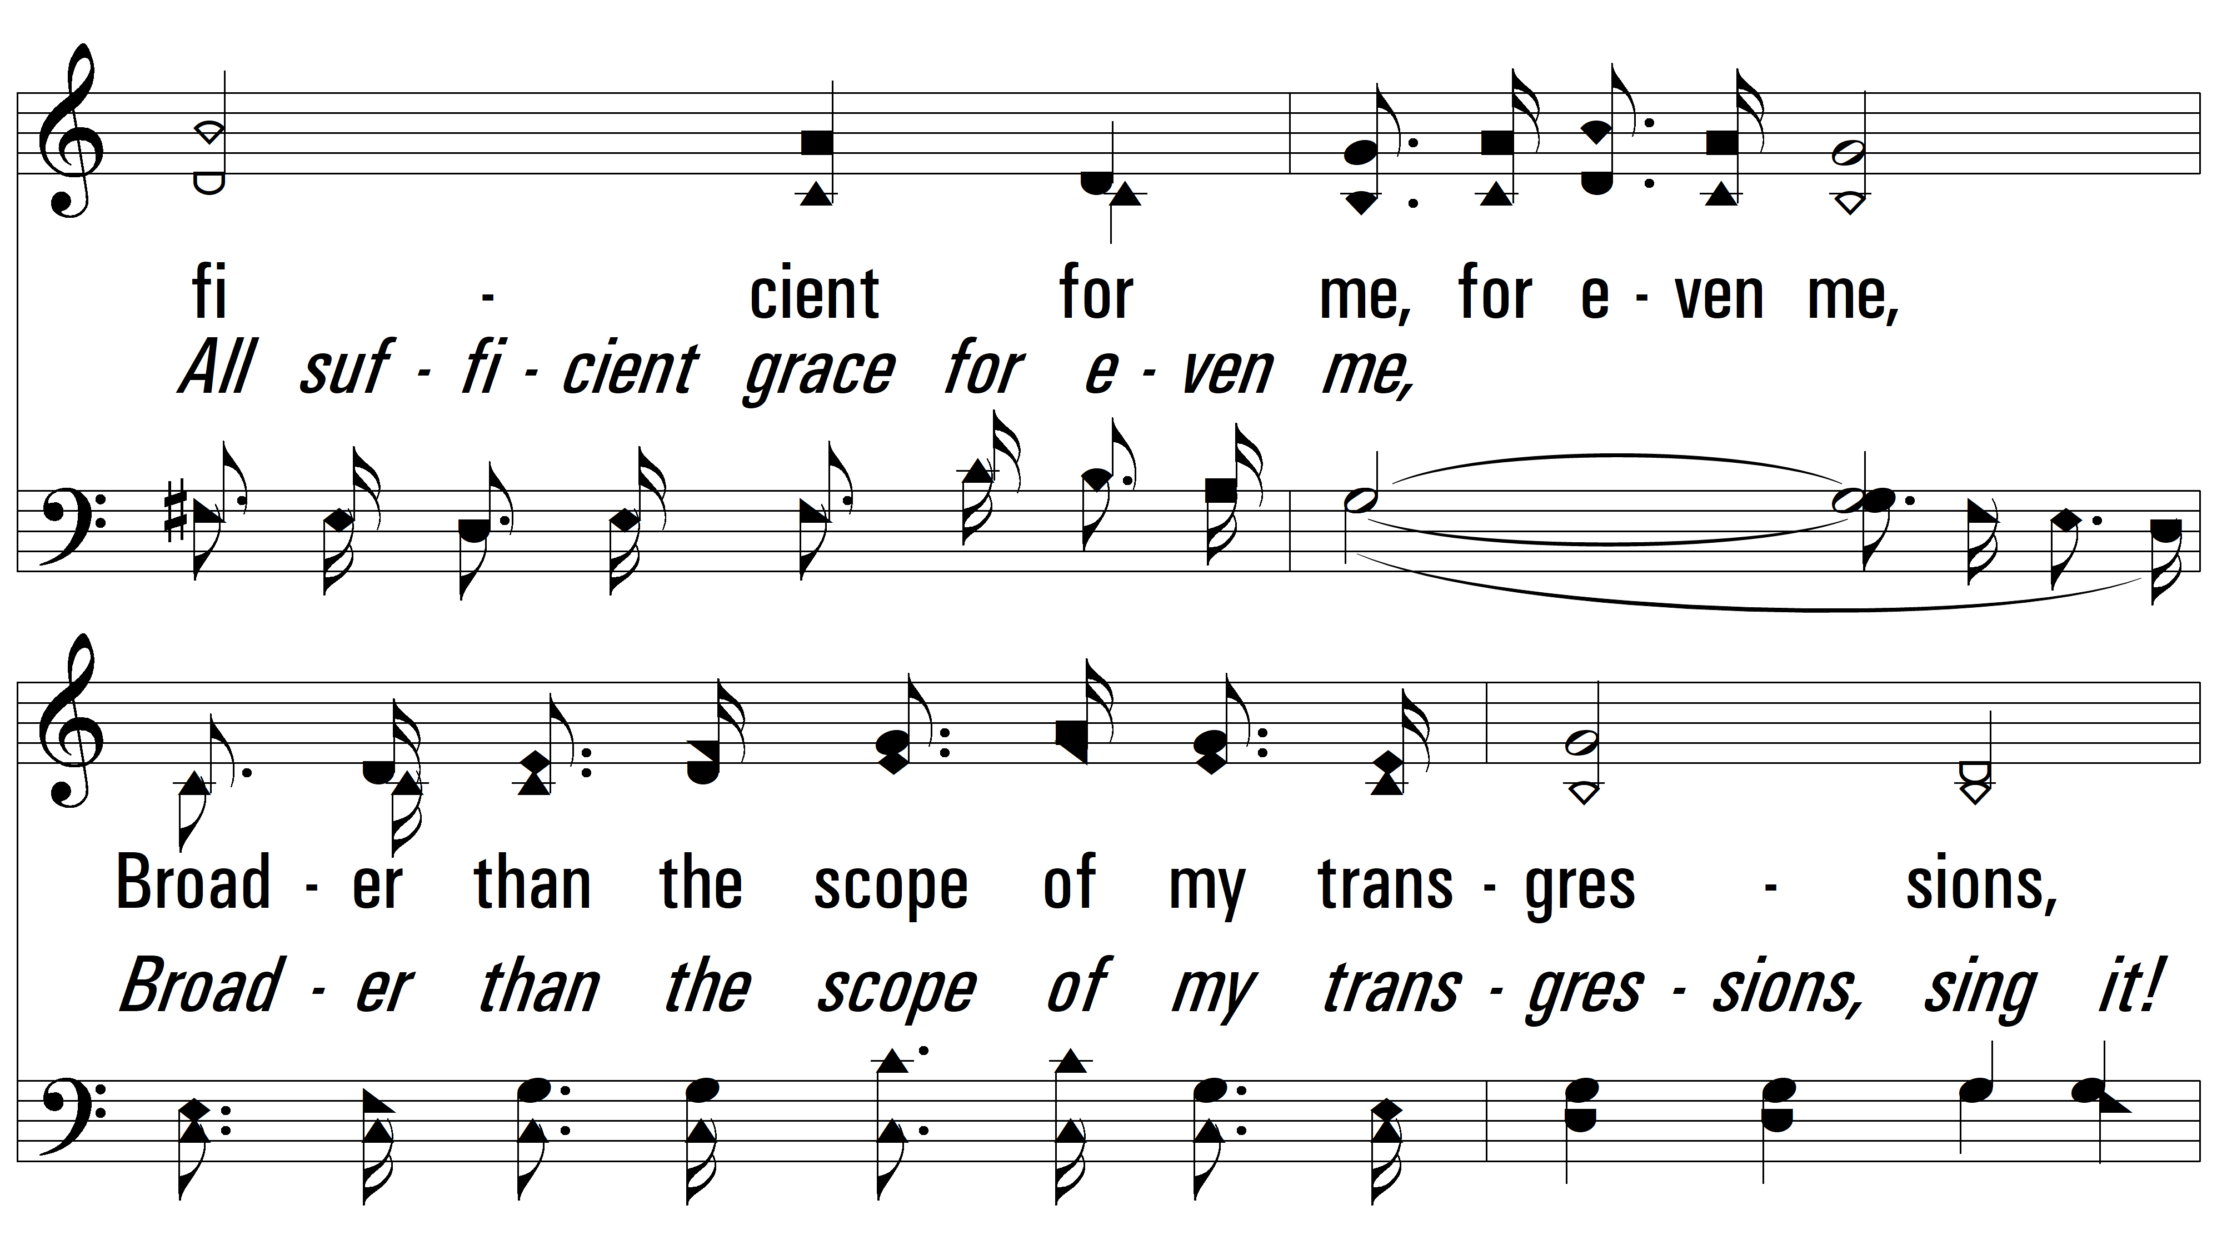
vs. 1

Slide 7
vs. 1

Slide 8
vs. 2 ~ Wonderful Grace Of Jesus

Slide 9
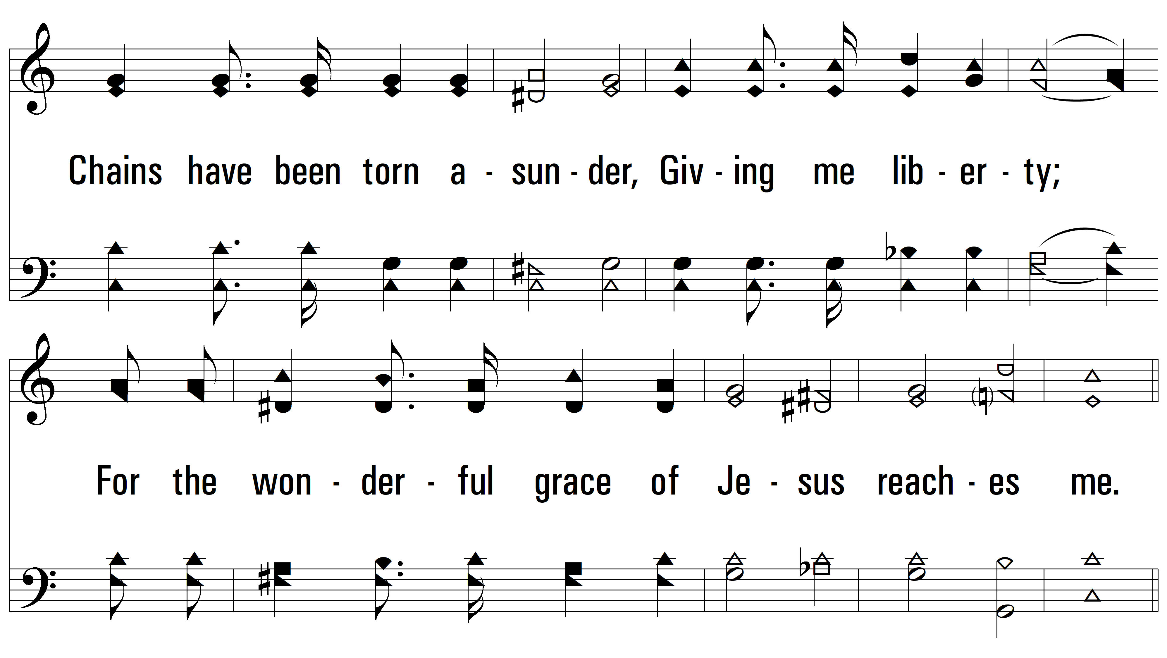
vs. 2

Slide 10
vs. 2

Slide 11
vs. 2

Slide 12
vs. 2

Slide 13
vs. 2

Slide 14
vs. 3 ~ Wonderful Grace Of Jesus

Slide 15
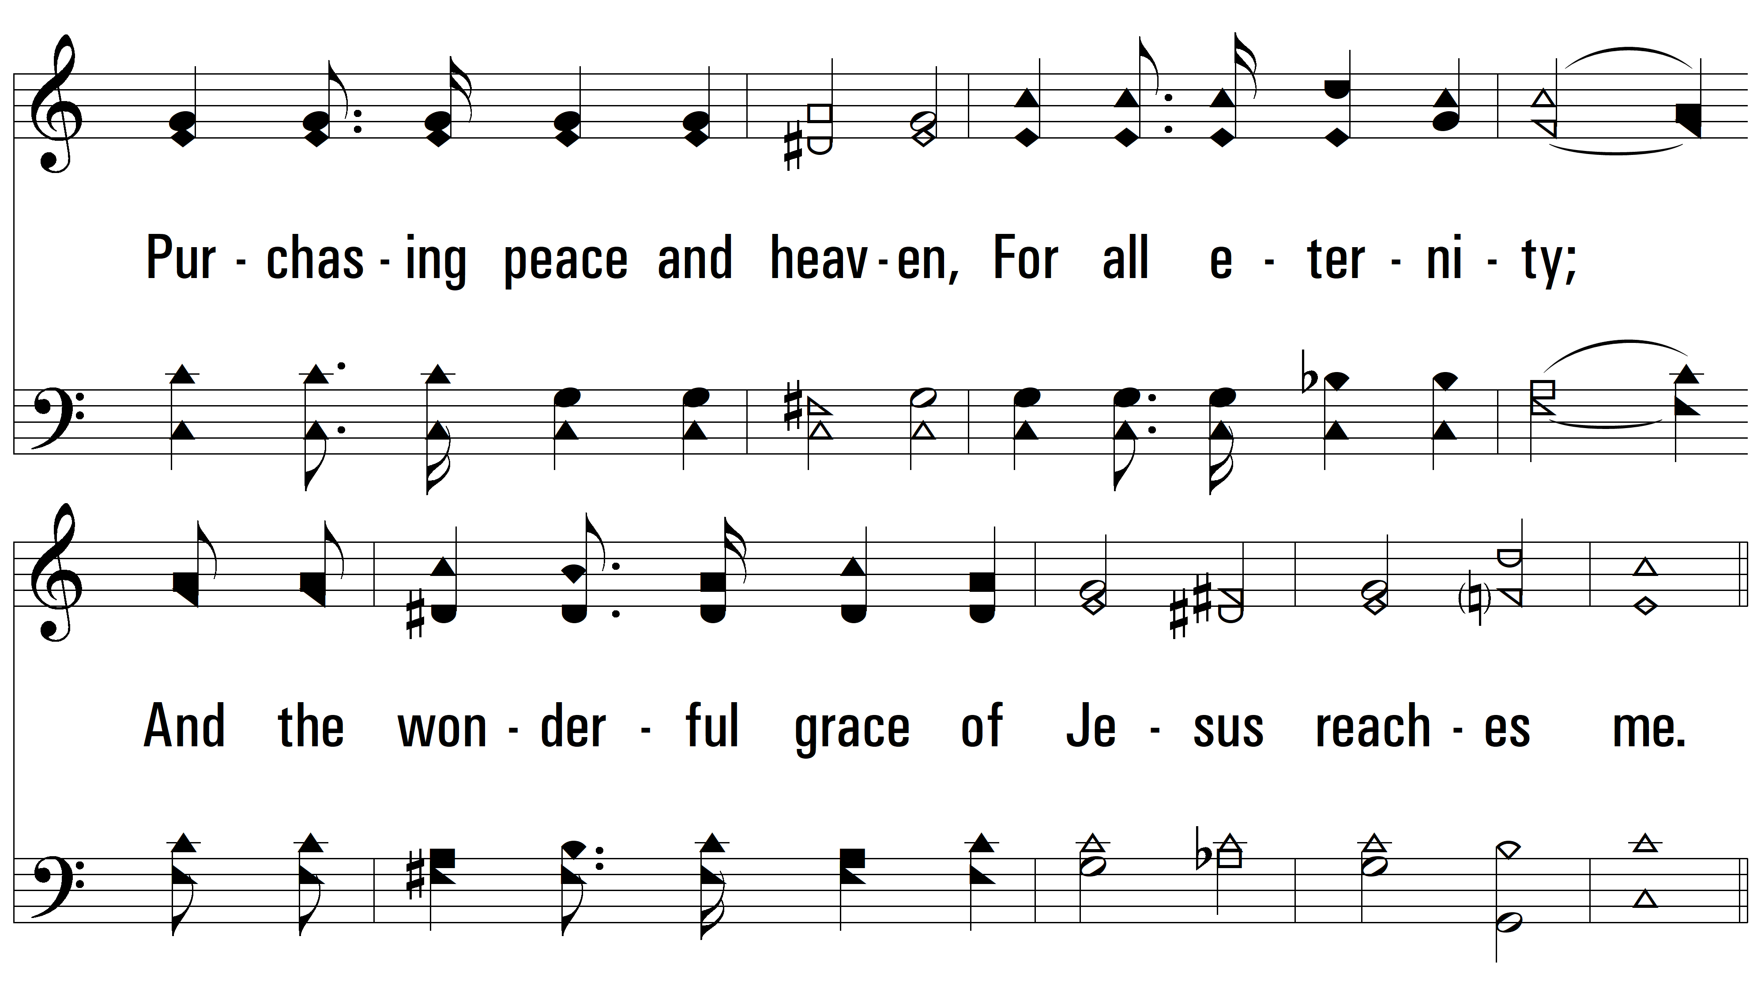
vs. 3

Slide 16
vs. 3

Slide 17
vs. 3

Slide 18
vs. 3

Slide 19
vs. 3
PDHymns.com
END

