Slide 1
Turn Your Eyes Upon Jesus
Words: | Helen Howarth Lemmel
Music: | Helen Howarth Lemmel
6/4
F/A - MI
Verses: 3/Chorus
Lead - | MI
Alto - | DO
Tenor - | SOL
Bass - | DO
PDHymns.com

Slide 2
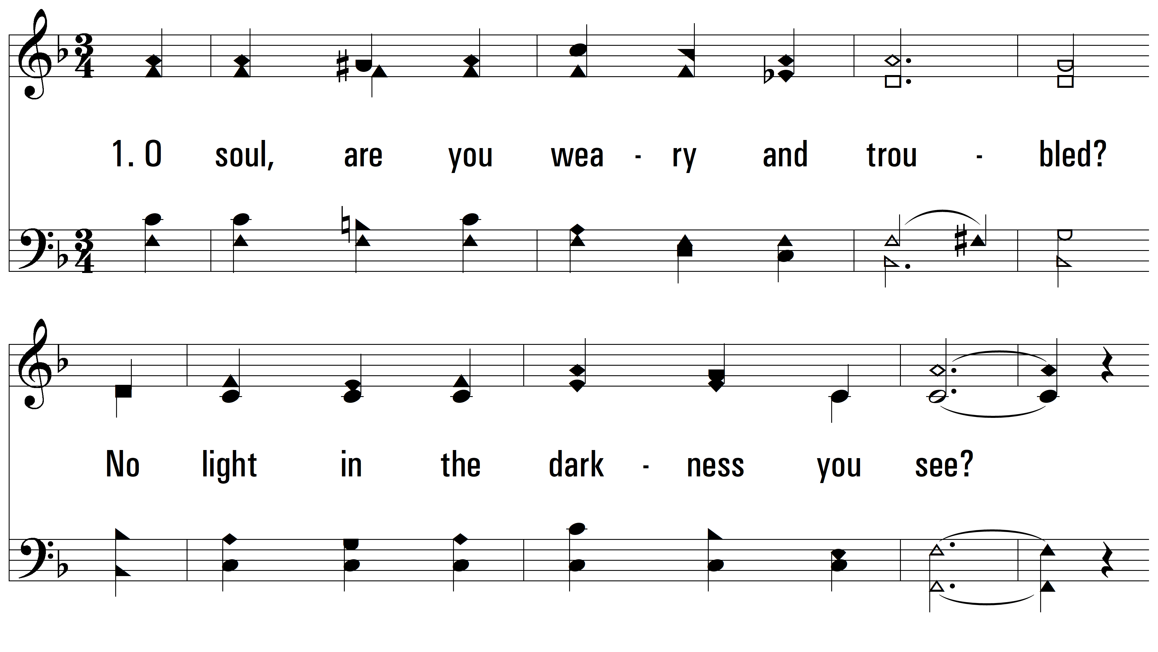
vs. 1 ~ Turn Your Eyes Upon Jesus

Slide 3
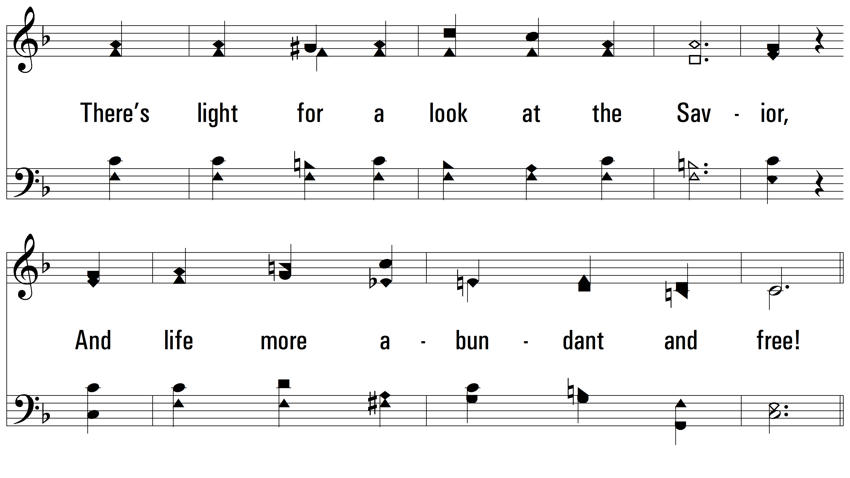
vs. 1

Slide 4
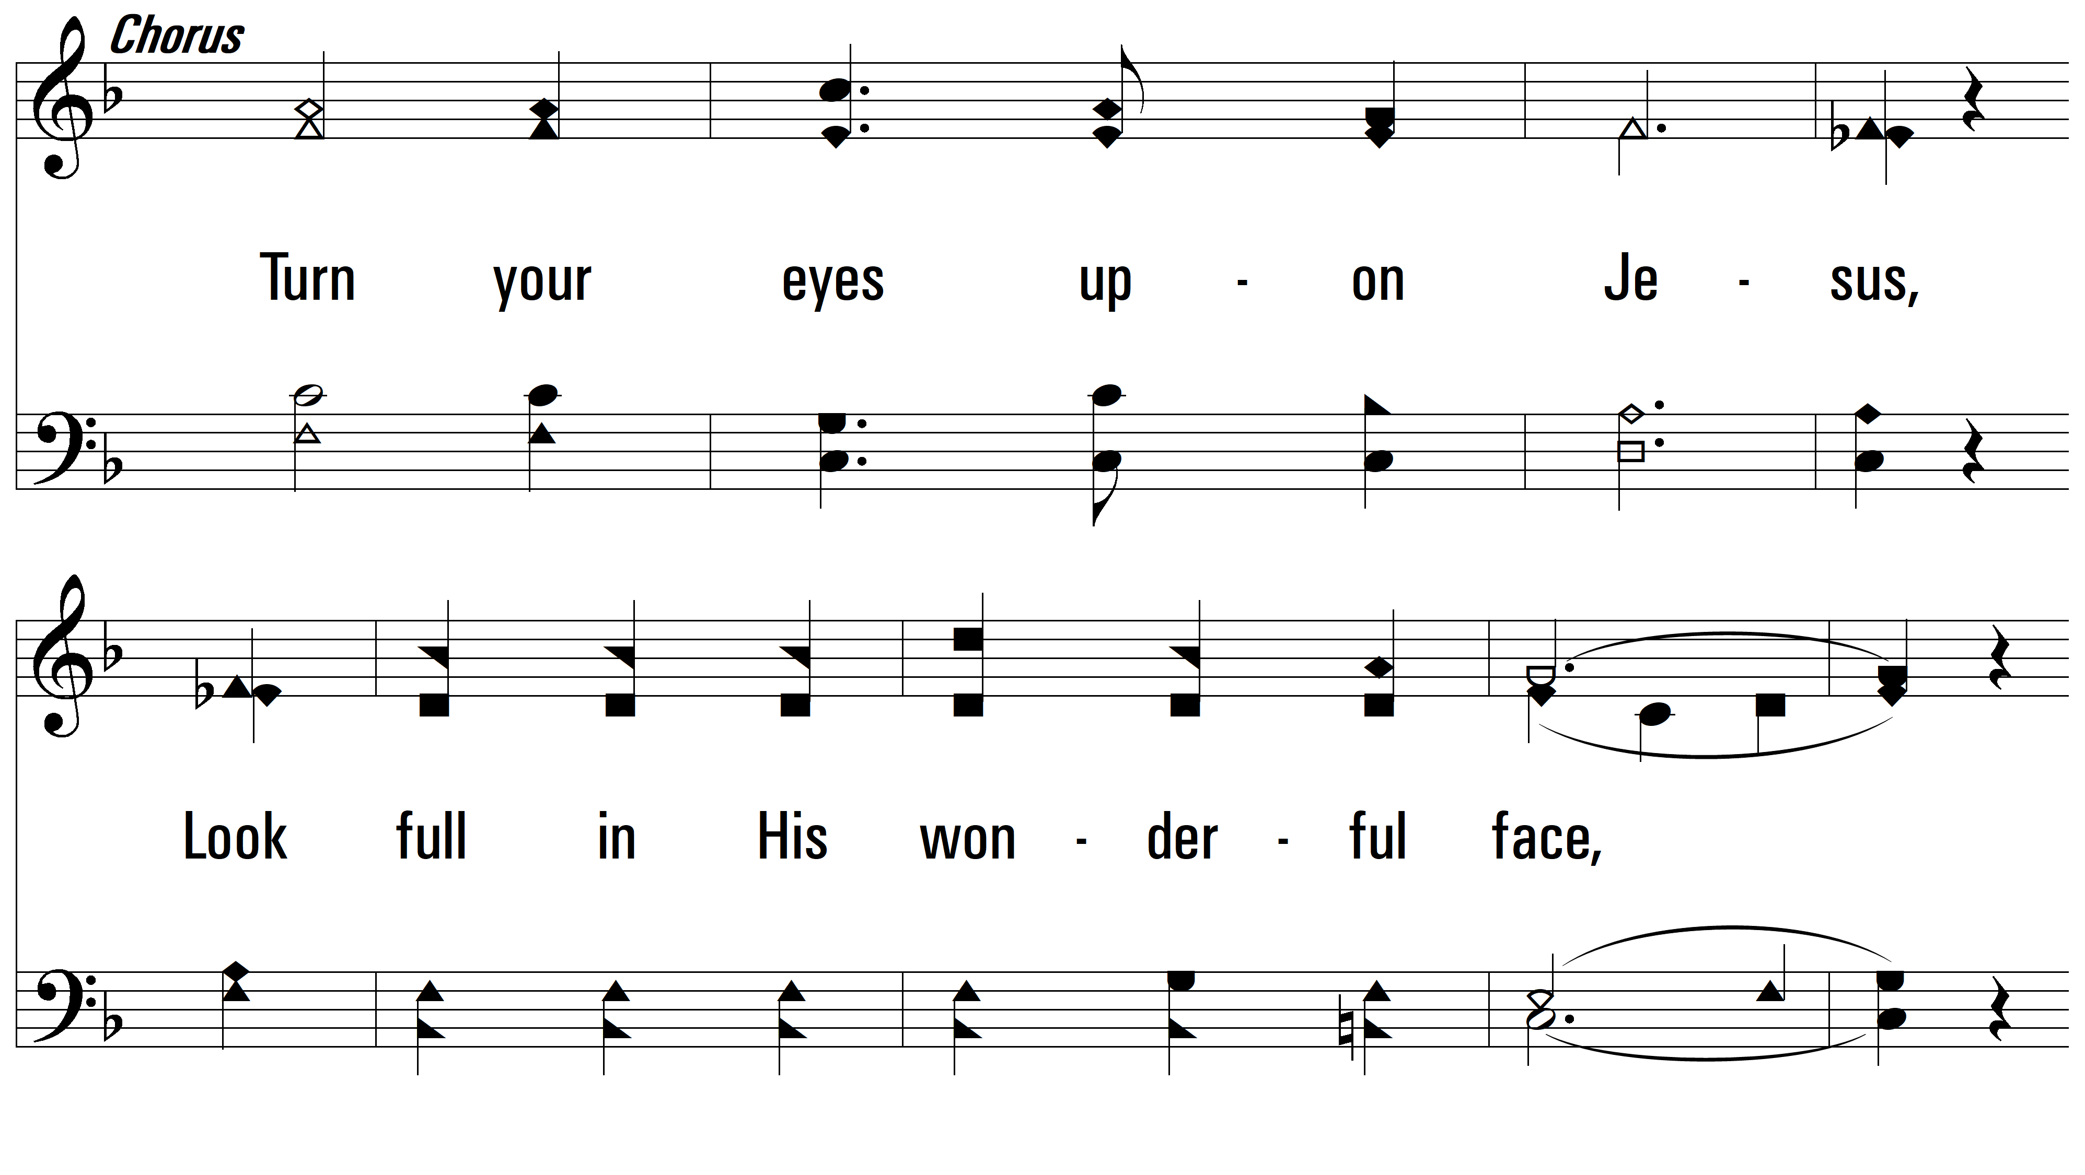
vs. 1

Slide 5
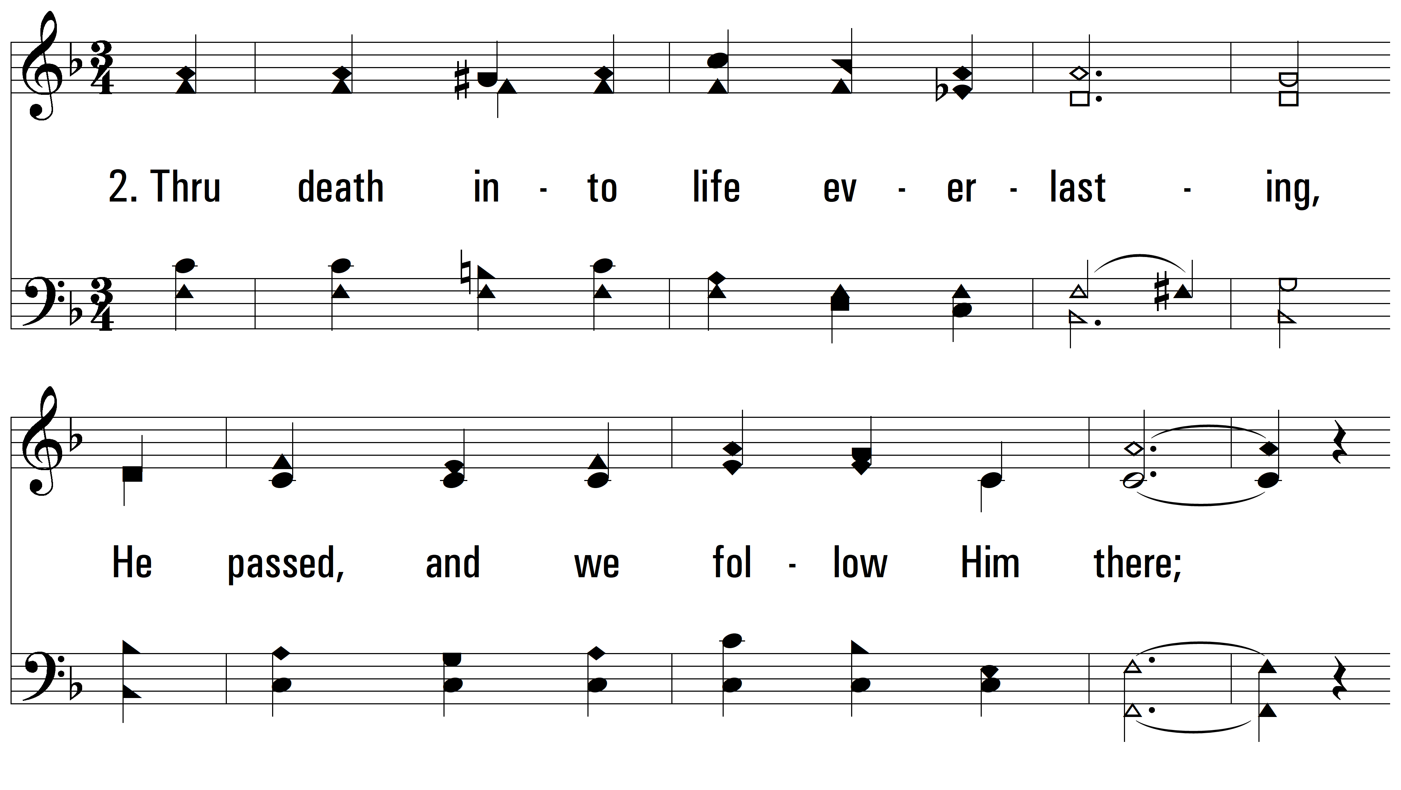
vs. 2 ~ Turn Your Eyes Upon Jesus

Slide 6
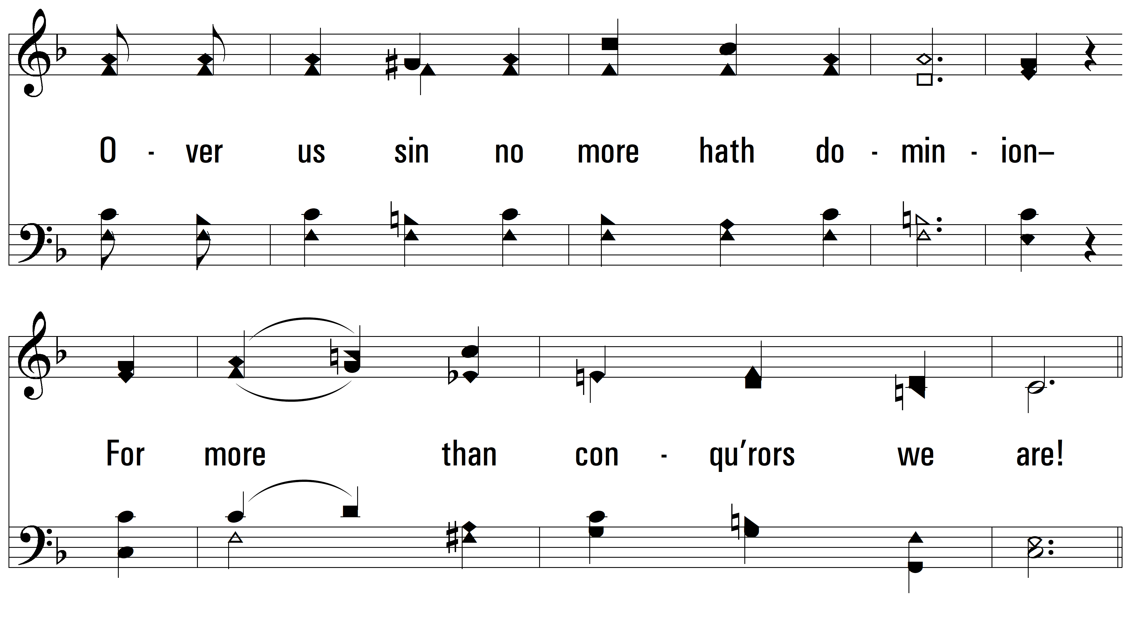
vs. 2

Slide 7
vs. 2

Slide 8
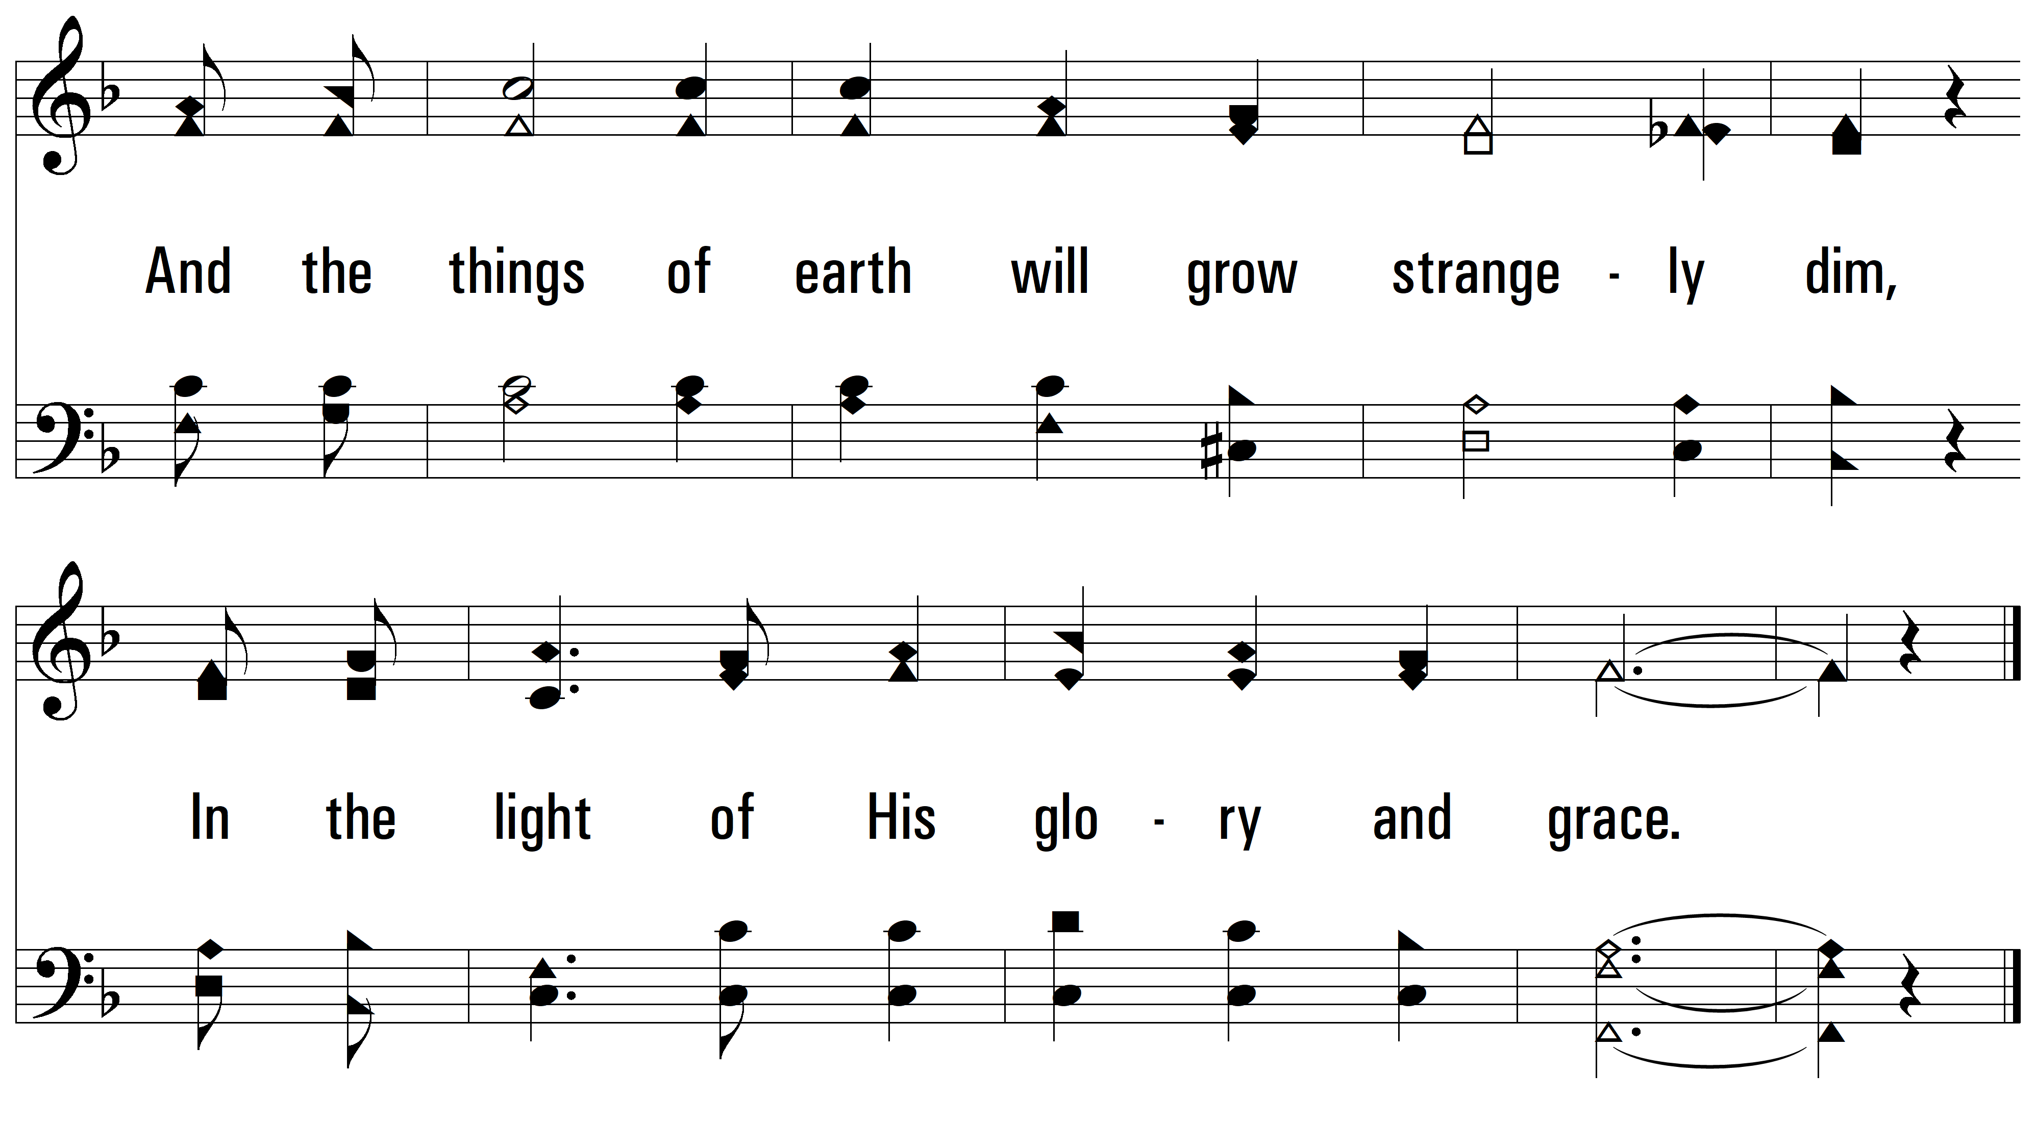
vs. 2

Slide 9
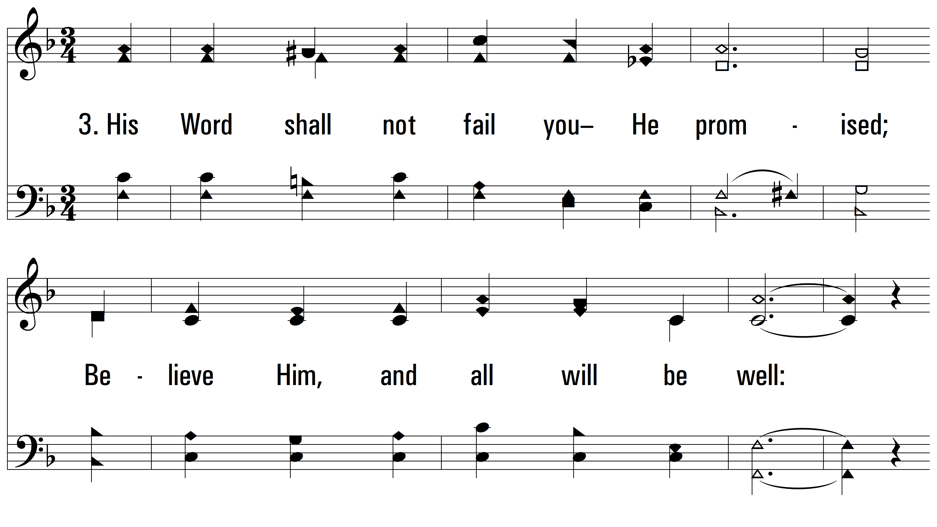
vs. 3 ~ Turn Your Eyes Upon Jesus

Slide 10
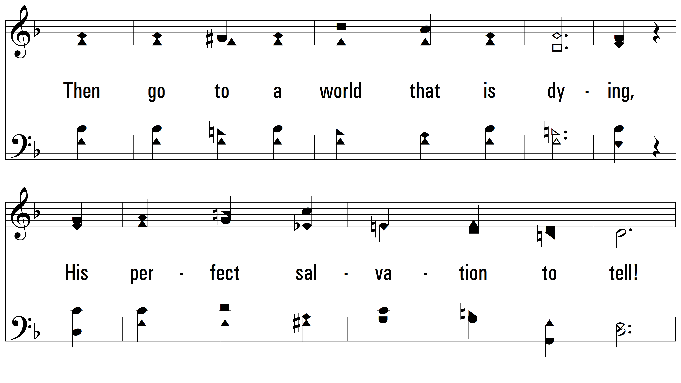
vs. 3

Slide 11
vs. 3

Slide 12
vs. 3
PDHymns.com
END

