Slide 1
The Love Of God
Words: | Laurene Highfield (1916)
Music: | Samuel W. Beazley (1916)
4/4
D/F# - MI
Verses: 3/Chorus
Lead - | MI
Alto - | DO
Tenor - | SOL
Bass - | DO
PDHymns.com

Slide 2
vs. 1 ~ The Love Of God

Slide 3
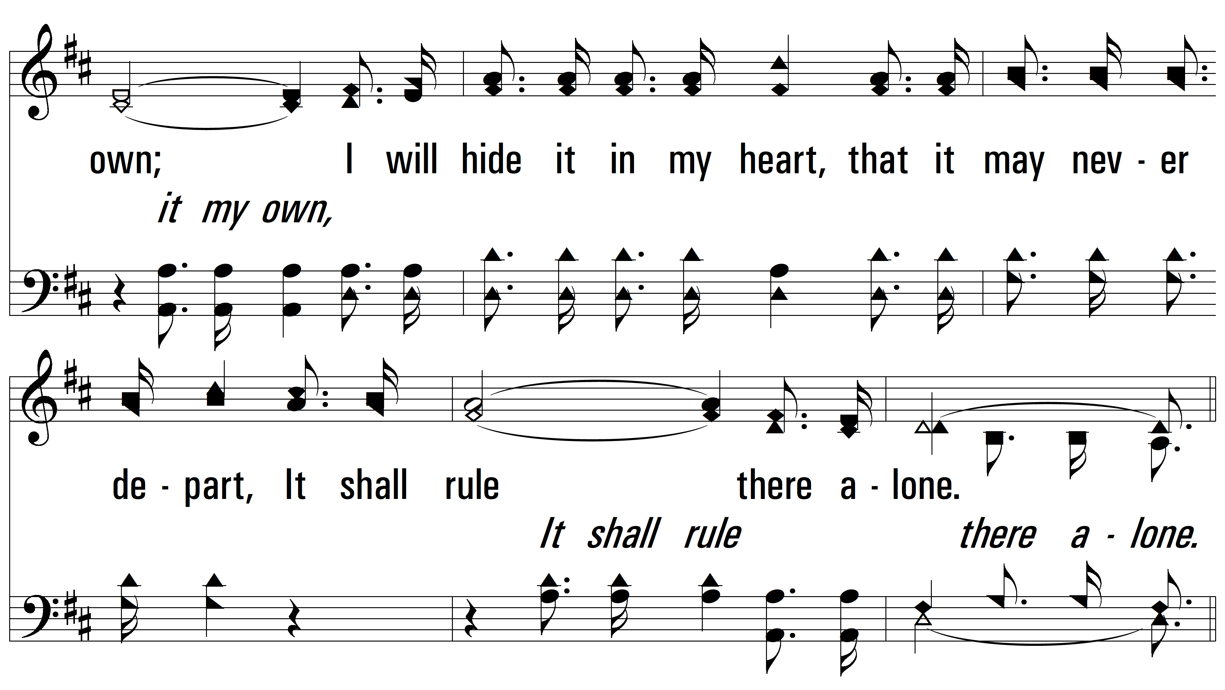
vs. 1

Slide 4
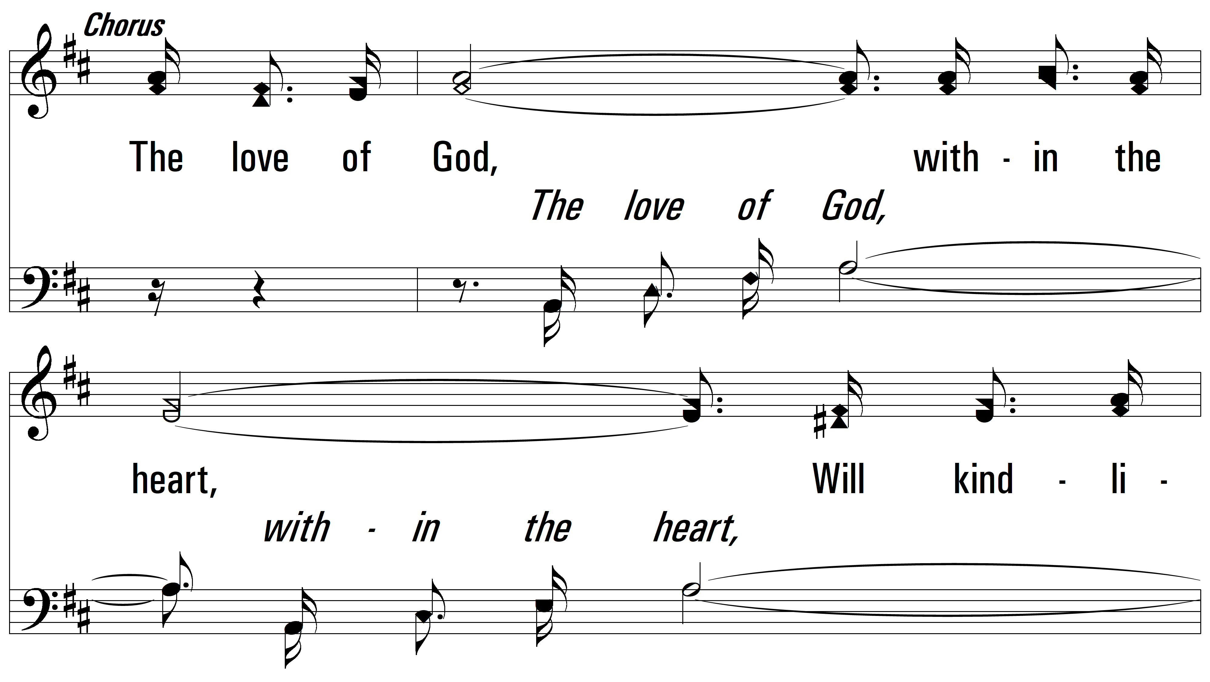
vs. 1

Slide 5
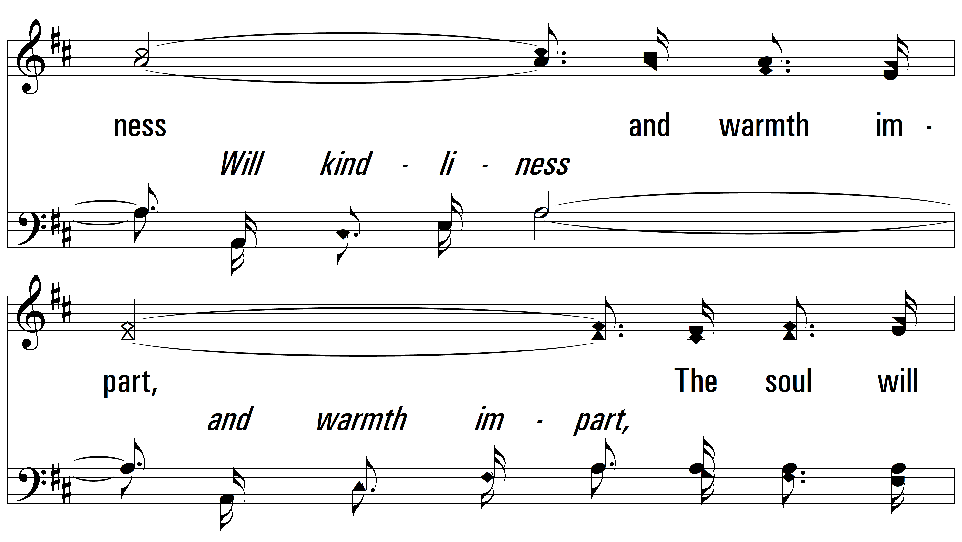
vs. 1

Slide 6
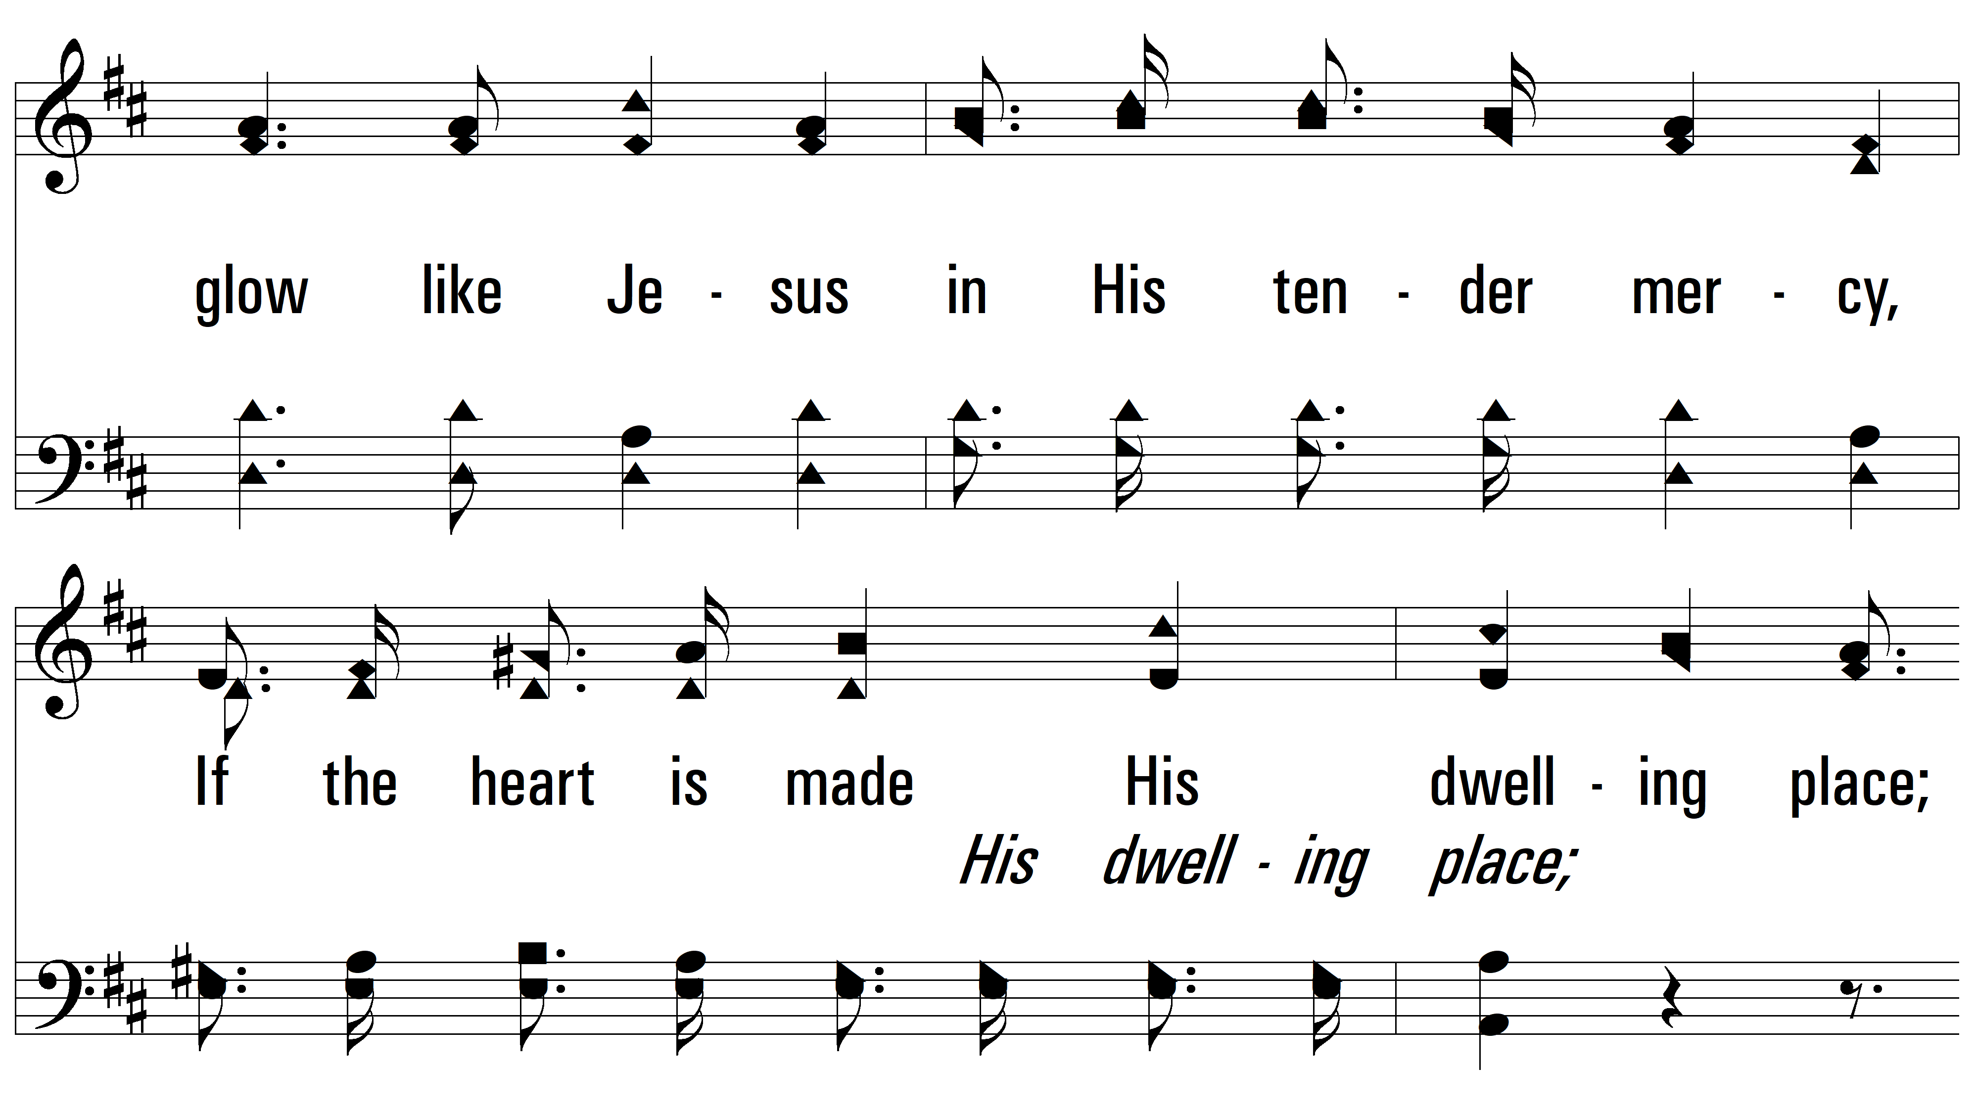
vs. 1

Slide 7
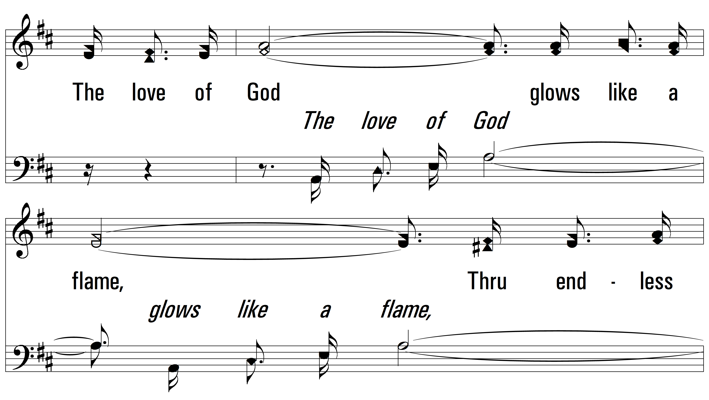
vs. 1

Slide 8
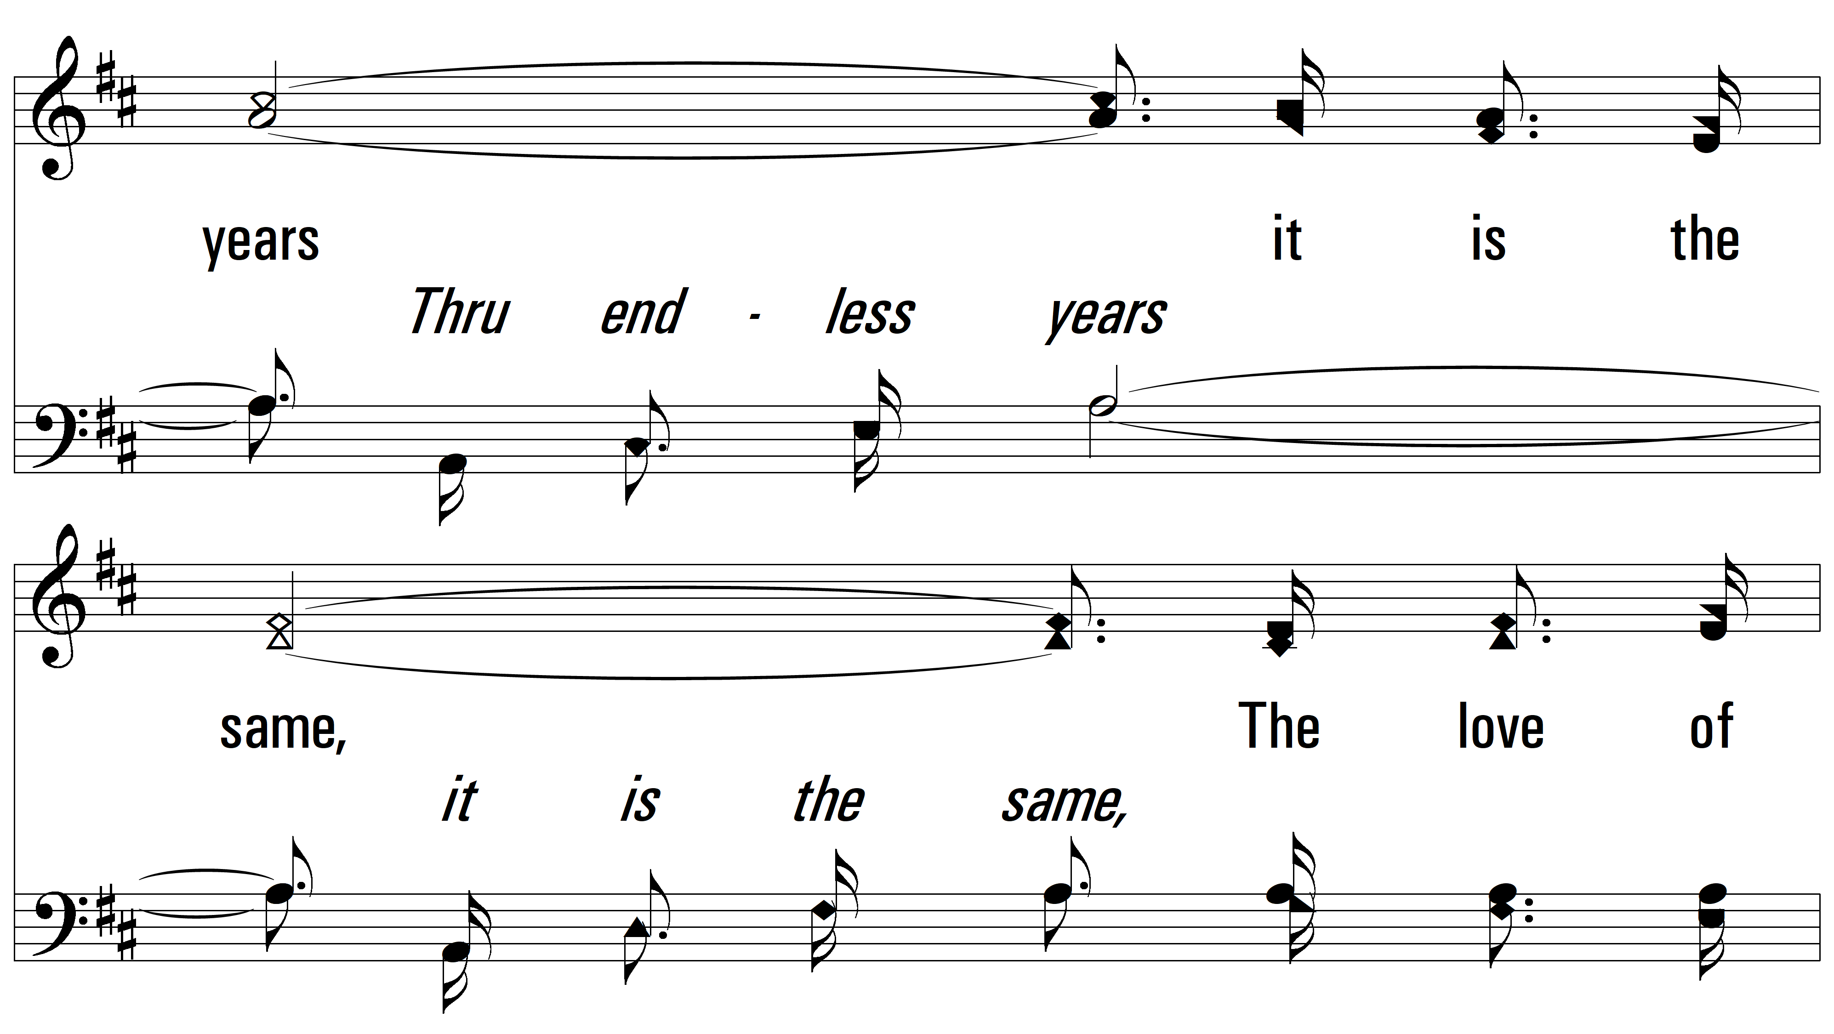
vs. 1

Slide 9
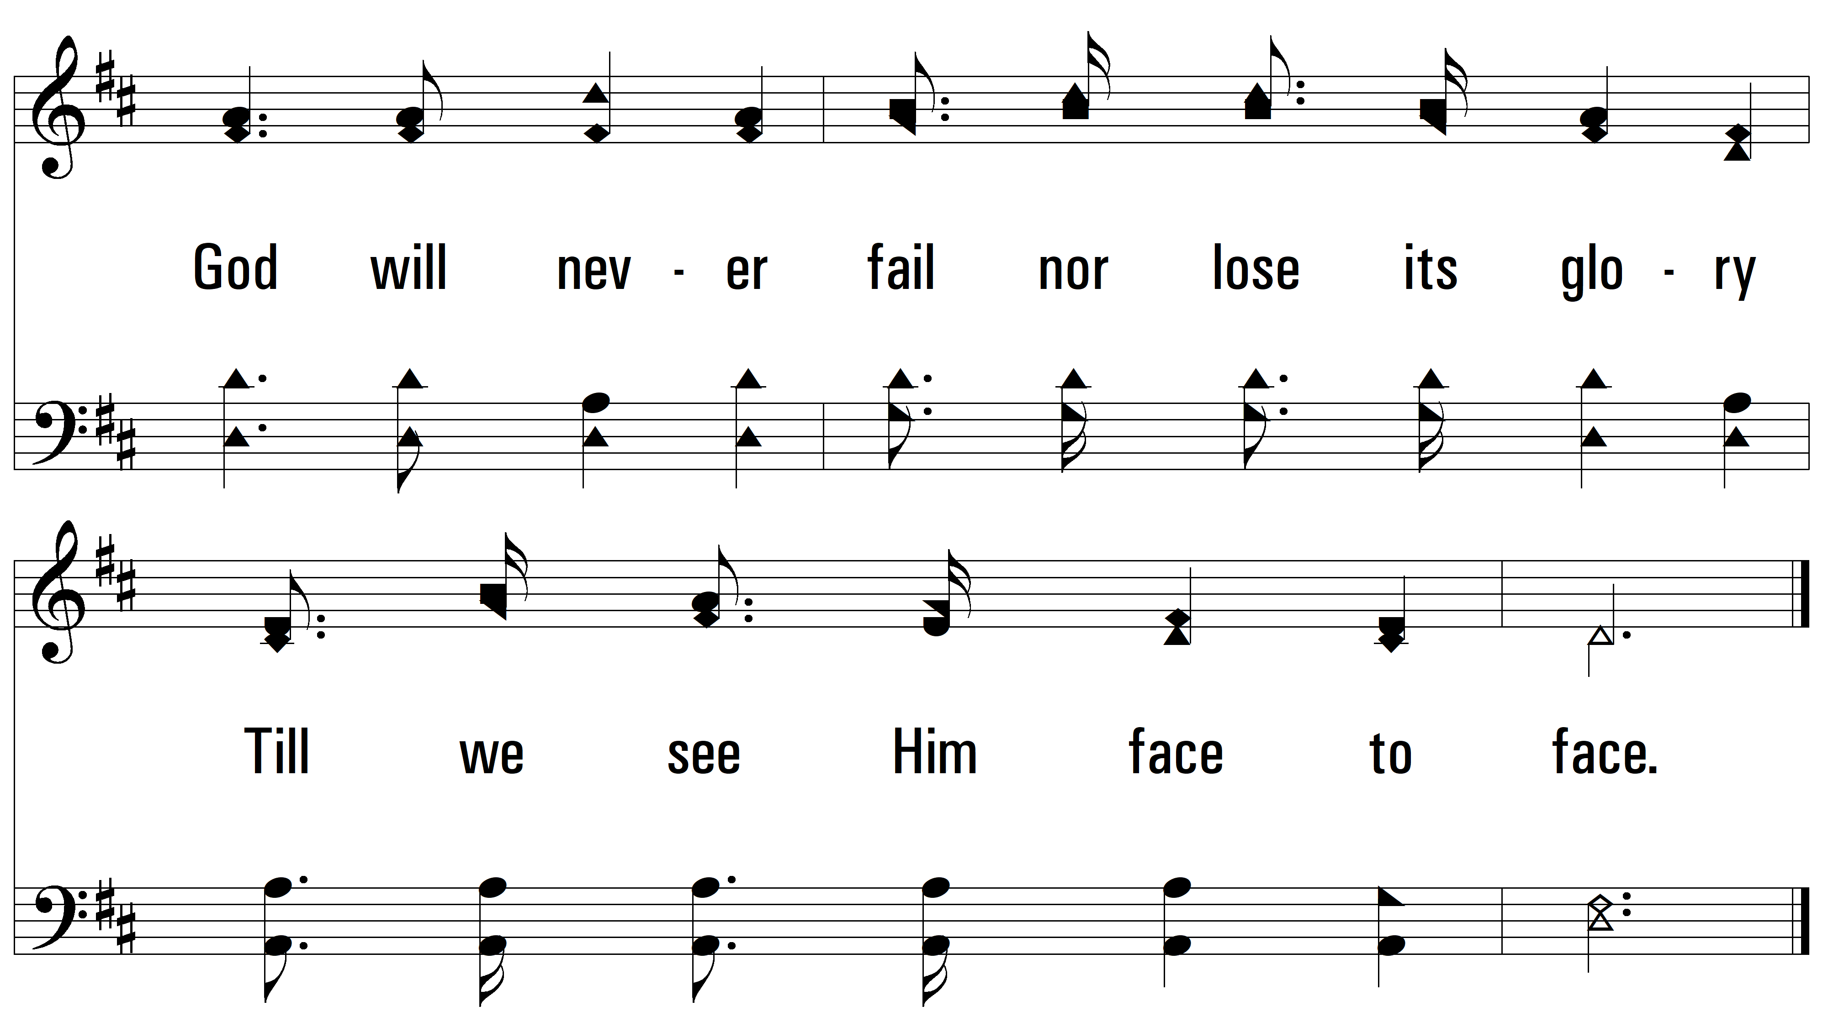
vs. 1

Slide 10
vs. 2 ~ The Love Of God

Slide 11
vs. 2

Slide 12
vs. 2

Slide 13
vs. 2

Slide 14
vs. 2

Slide 15
vs. 2

Slide 16
vs. 2

Slide 17
vs. 2

Slide 18
vs. 3 ~ The Love Of God

Slide 19
vs. 3

Slide 20
vs. 3

Slide 21
vs. 3

Slide 22
vs. 3

Slide 23
vs. 3

Slide 24
vs. 3

Slide 25
vs. 3
PDHymns.com
END

