Slide 1
The Great Redeemer
Words: | Francis Foster (1915)
Music: | Samuel W. Beazley (1915)
4/4
D/A - SOL
Verses: 3/Chorus
Lead - | SOL
Alto - | MI
Tenor - | DO
Bass - | DO
PDHymns.com

Slide 2
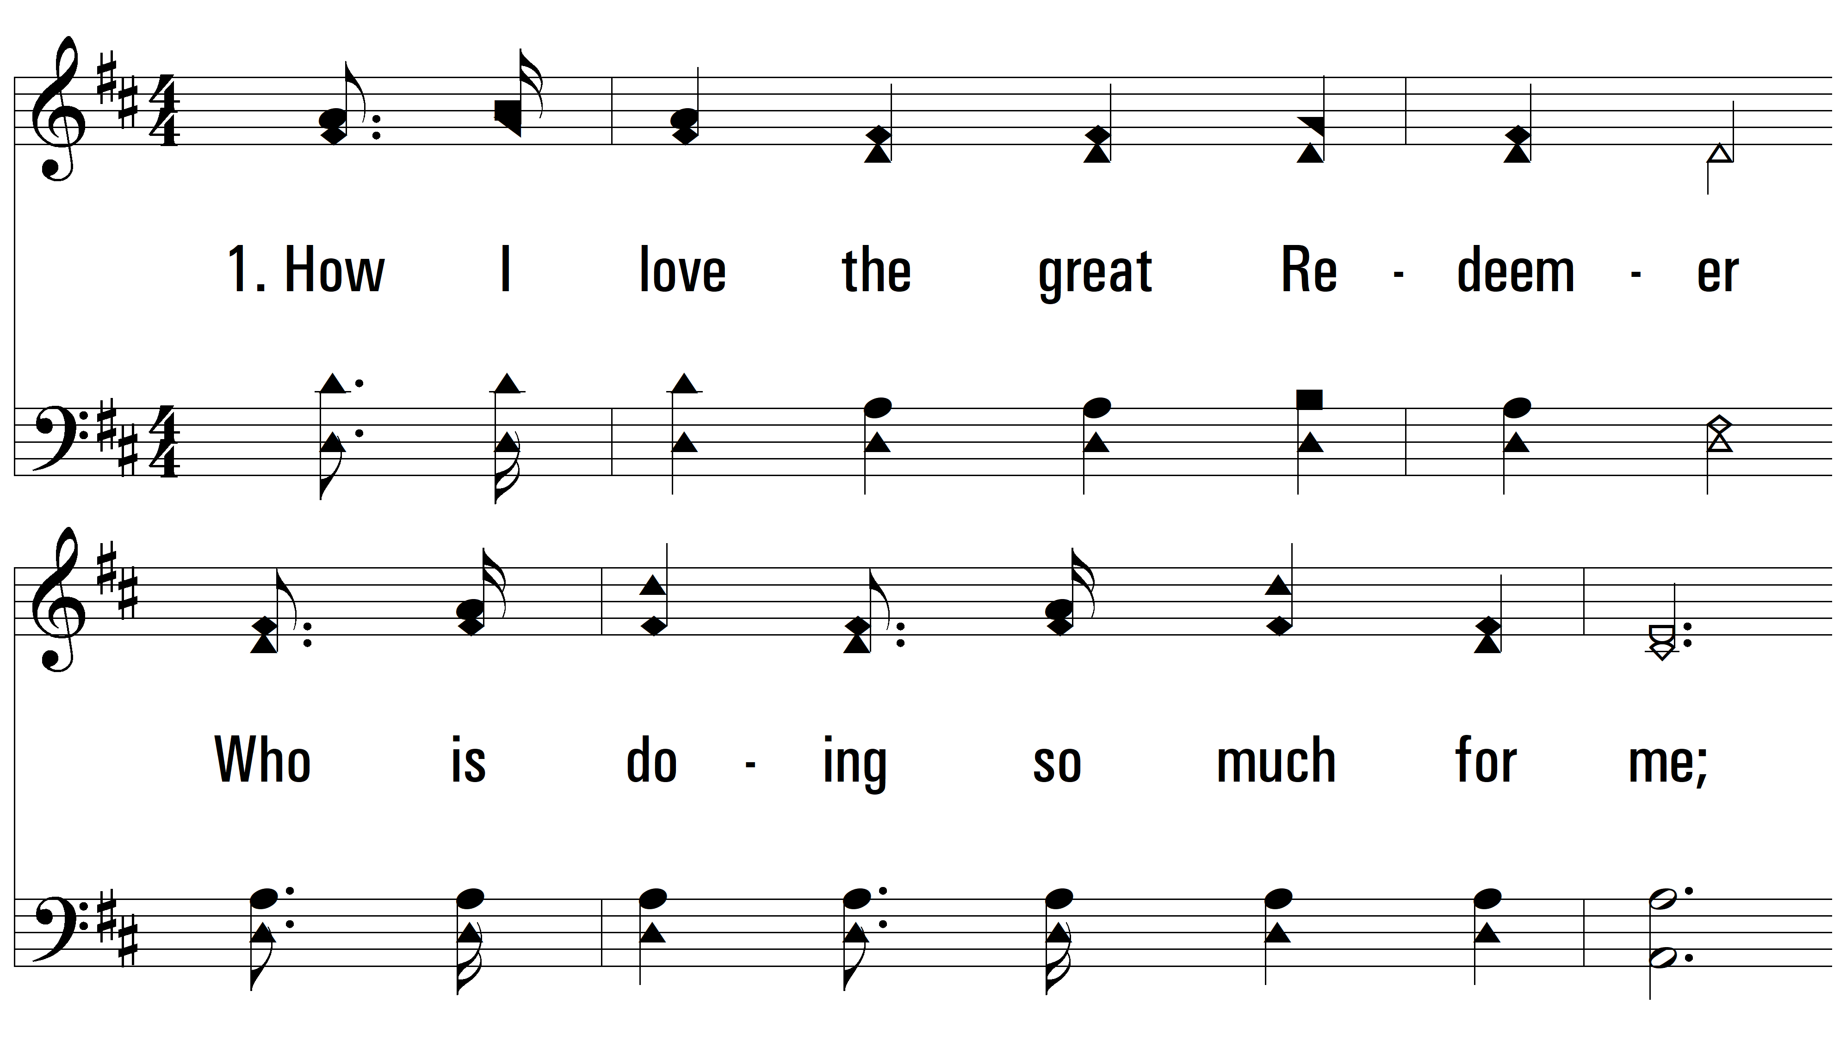
vs. 1 ~ The Great Redeemer

Slide 3
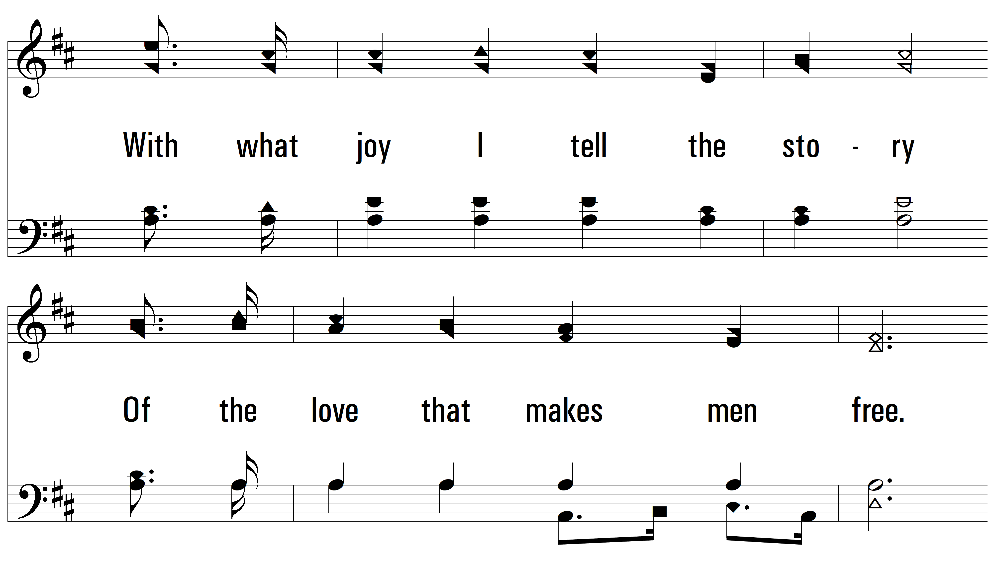
vs. 1

Slide 4
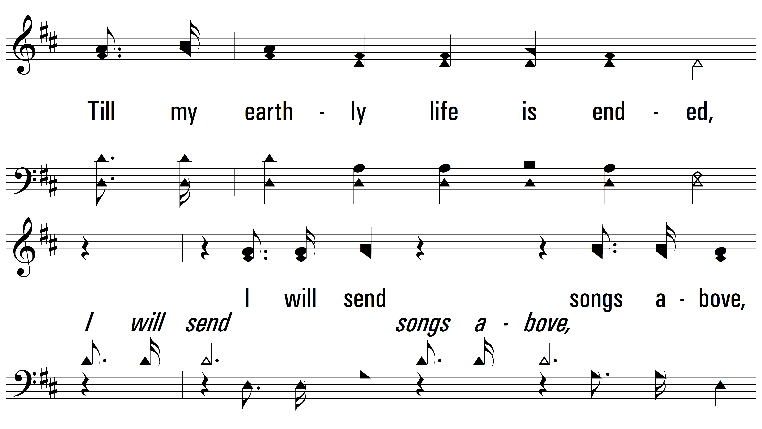
vs. 1

Slide 5
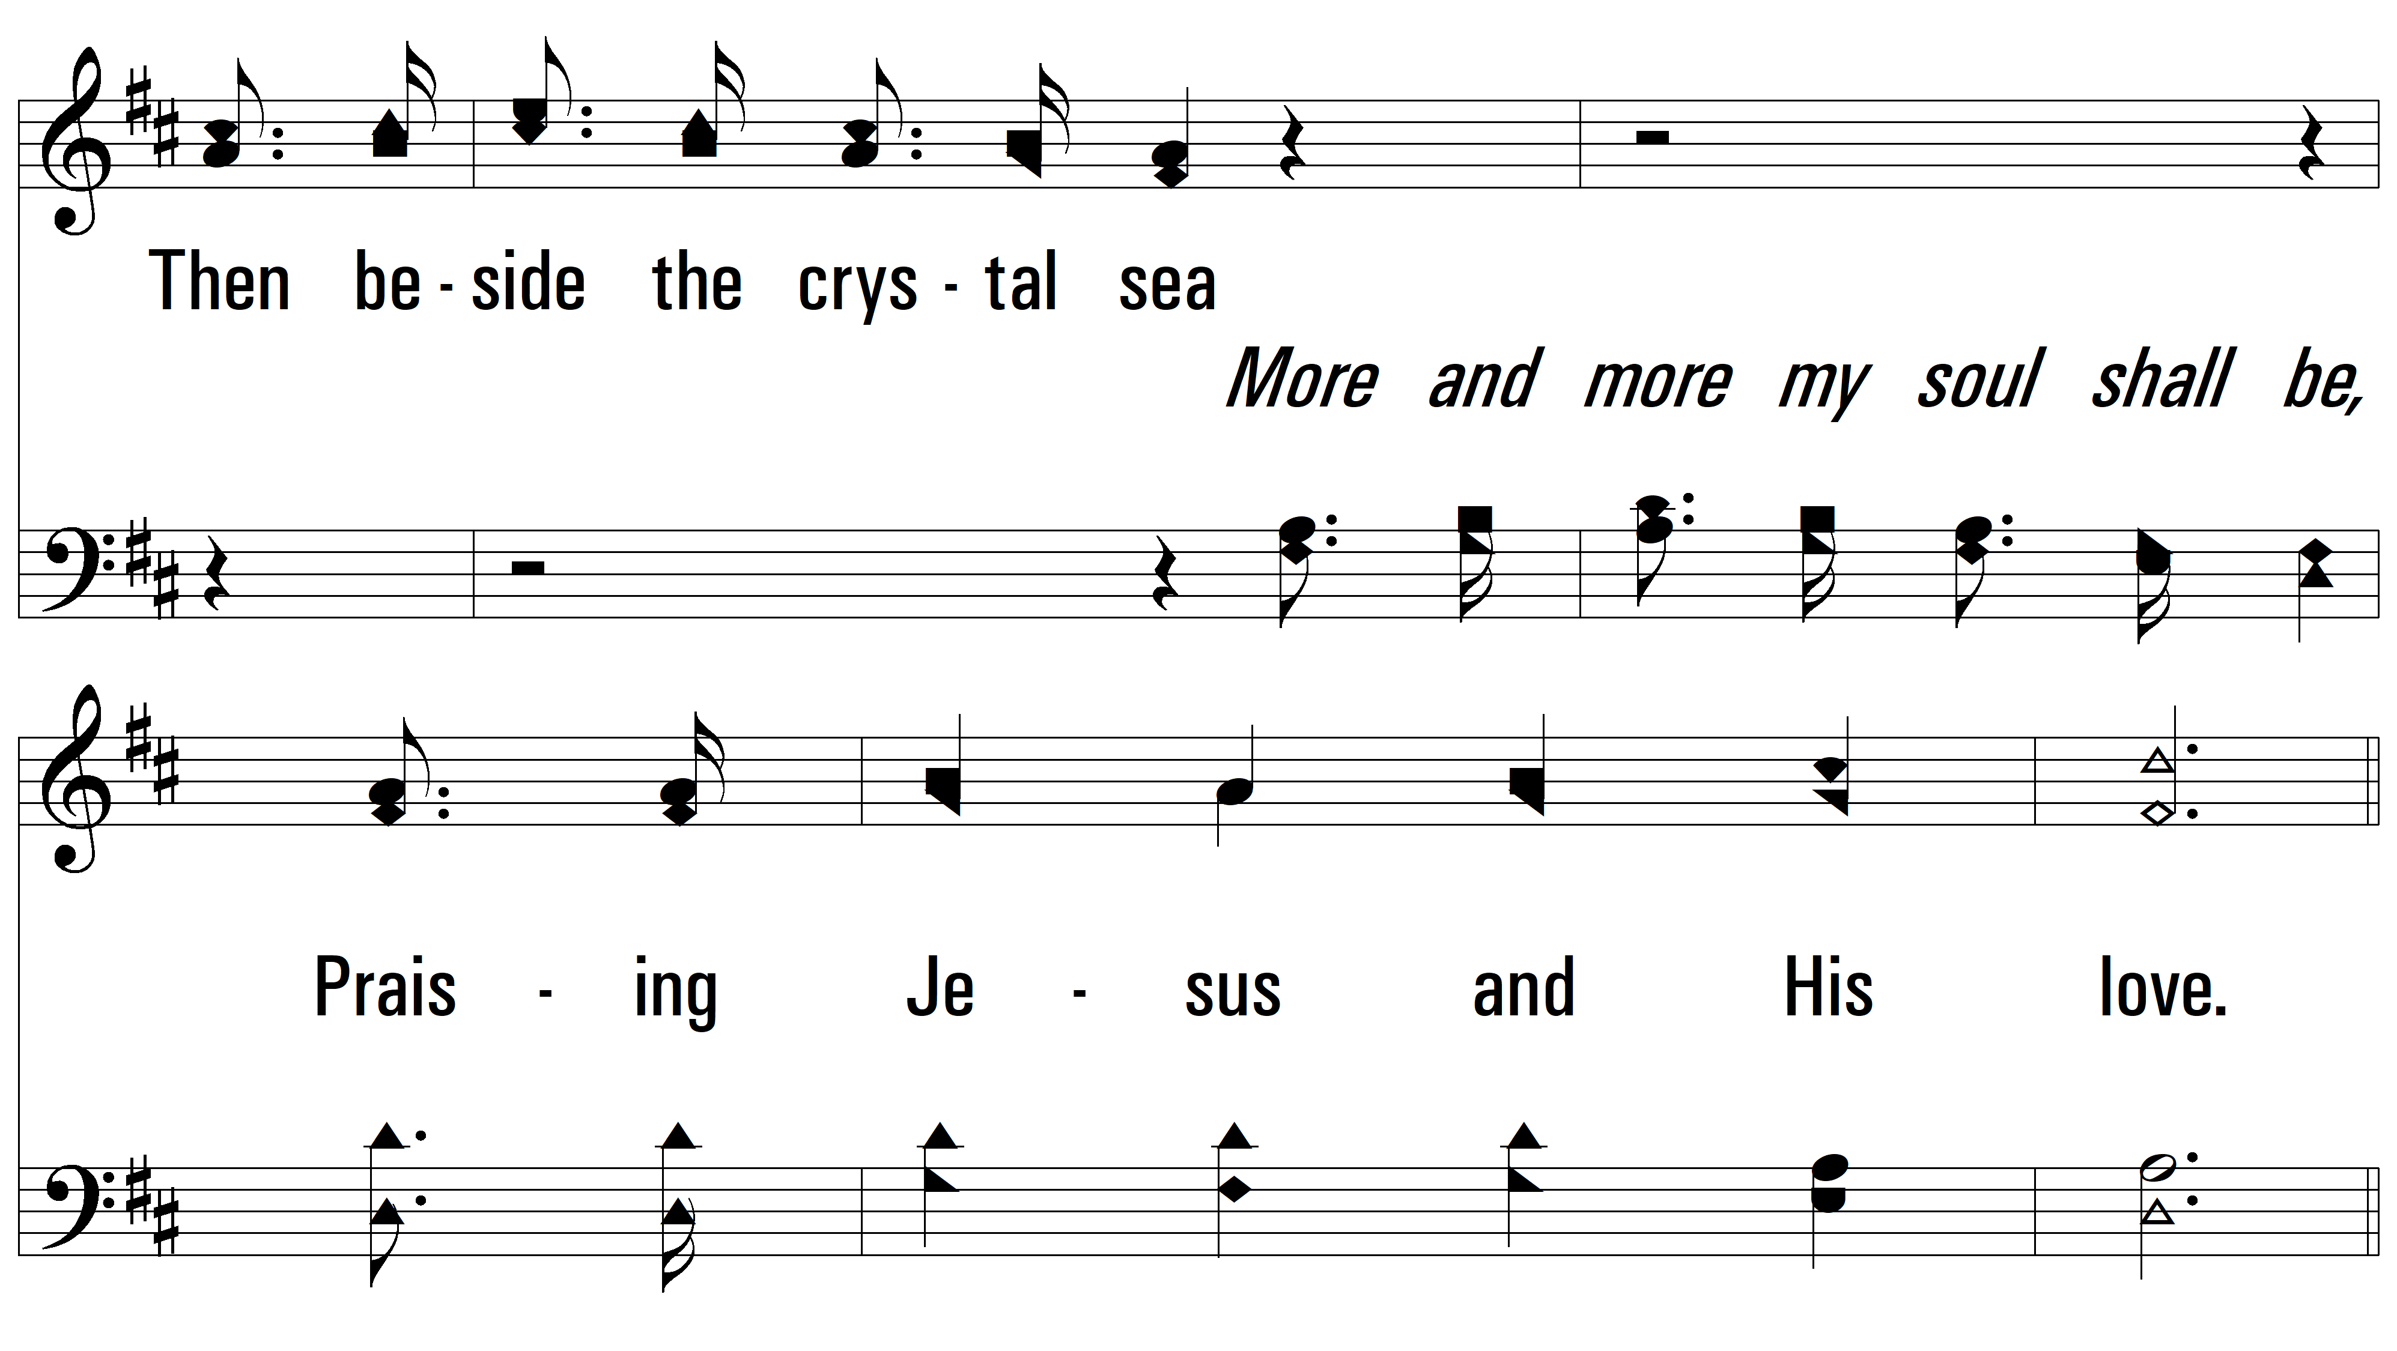
vs. 1

Slide 6
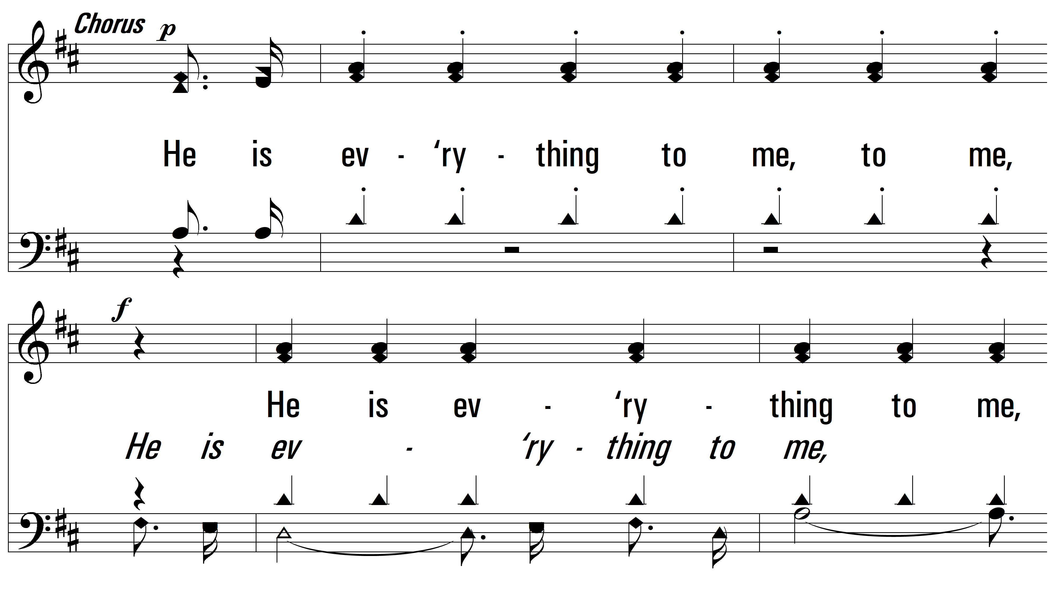
vs. 1

Slide 7
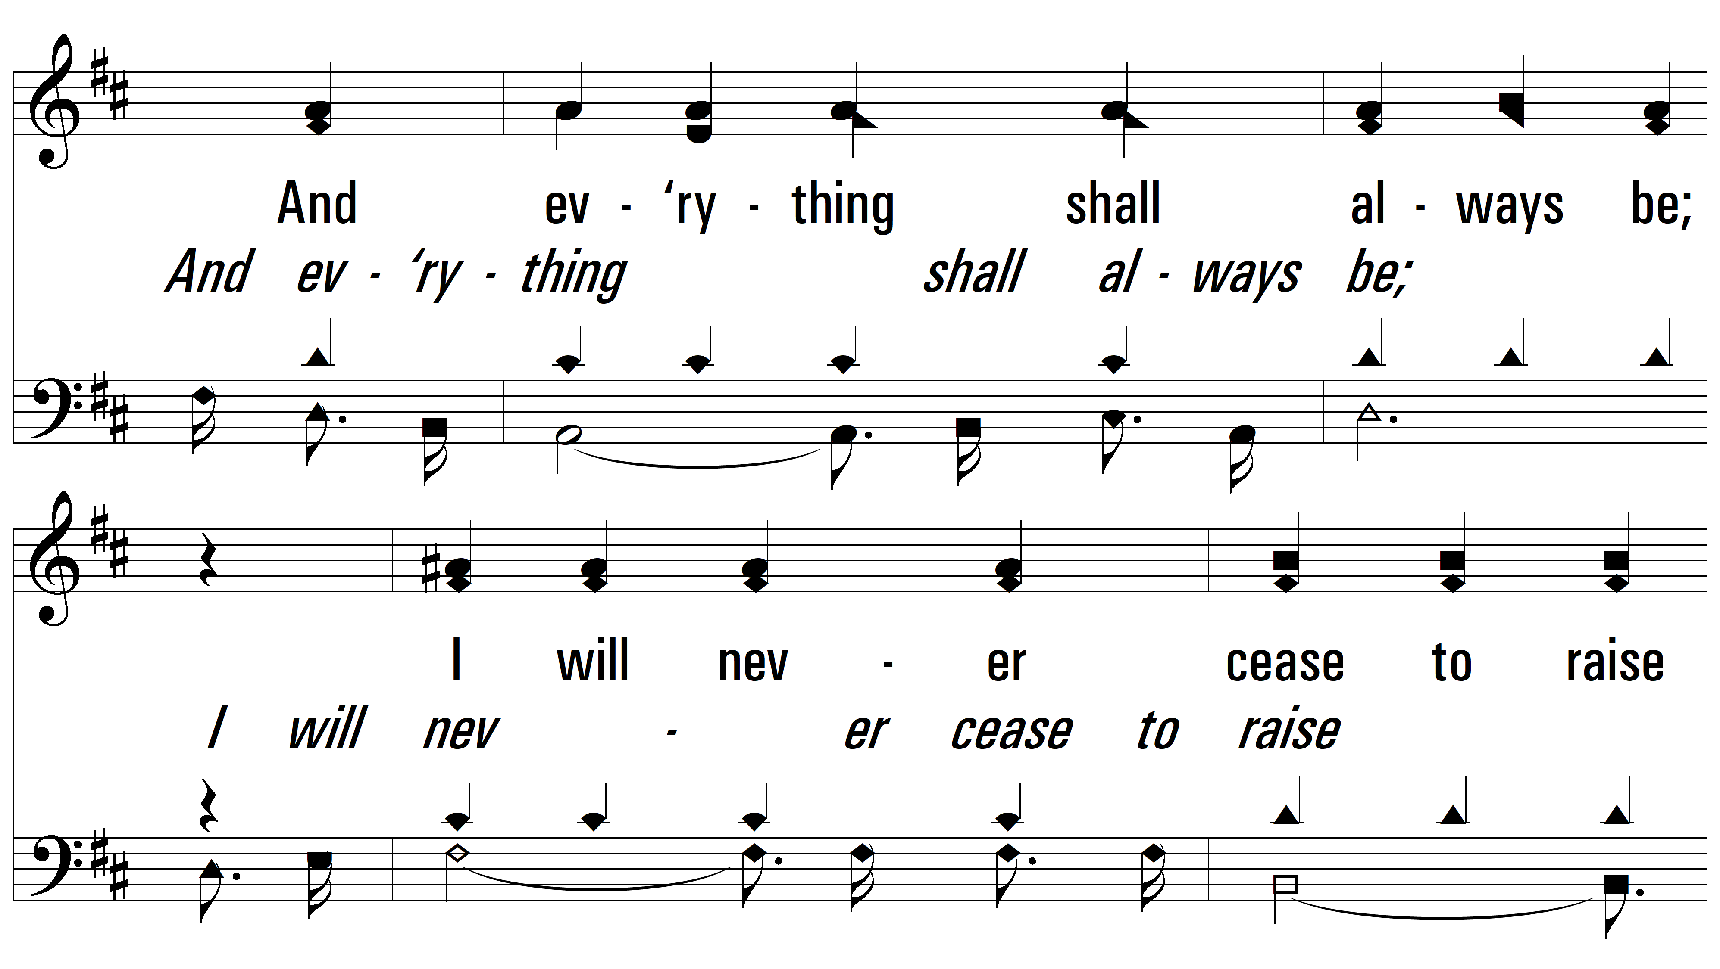
vs. 1

Slide 8
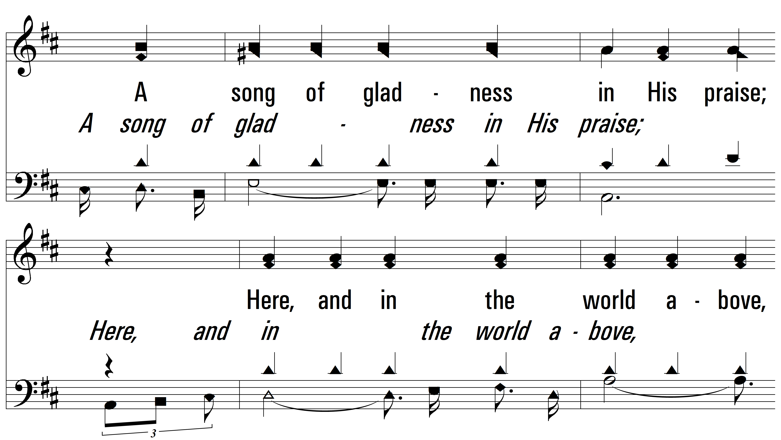
vs. 1

Slide 9
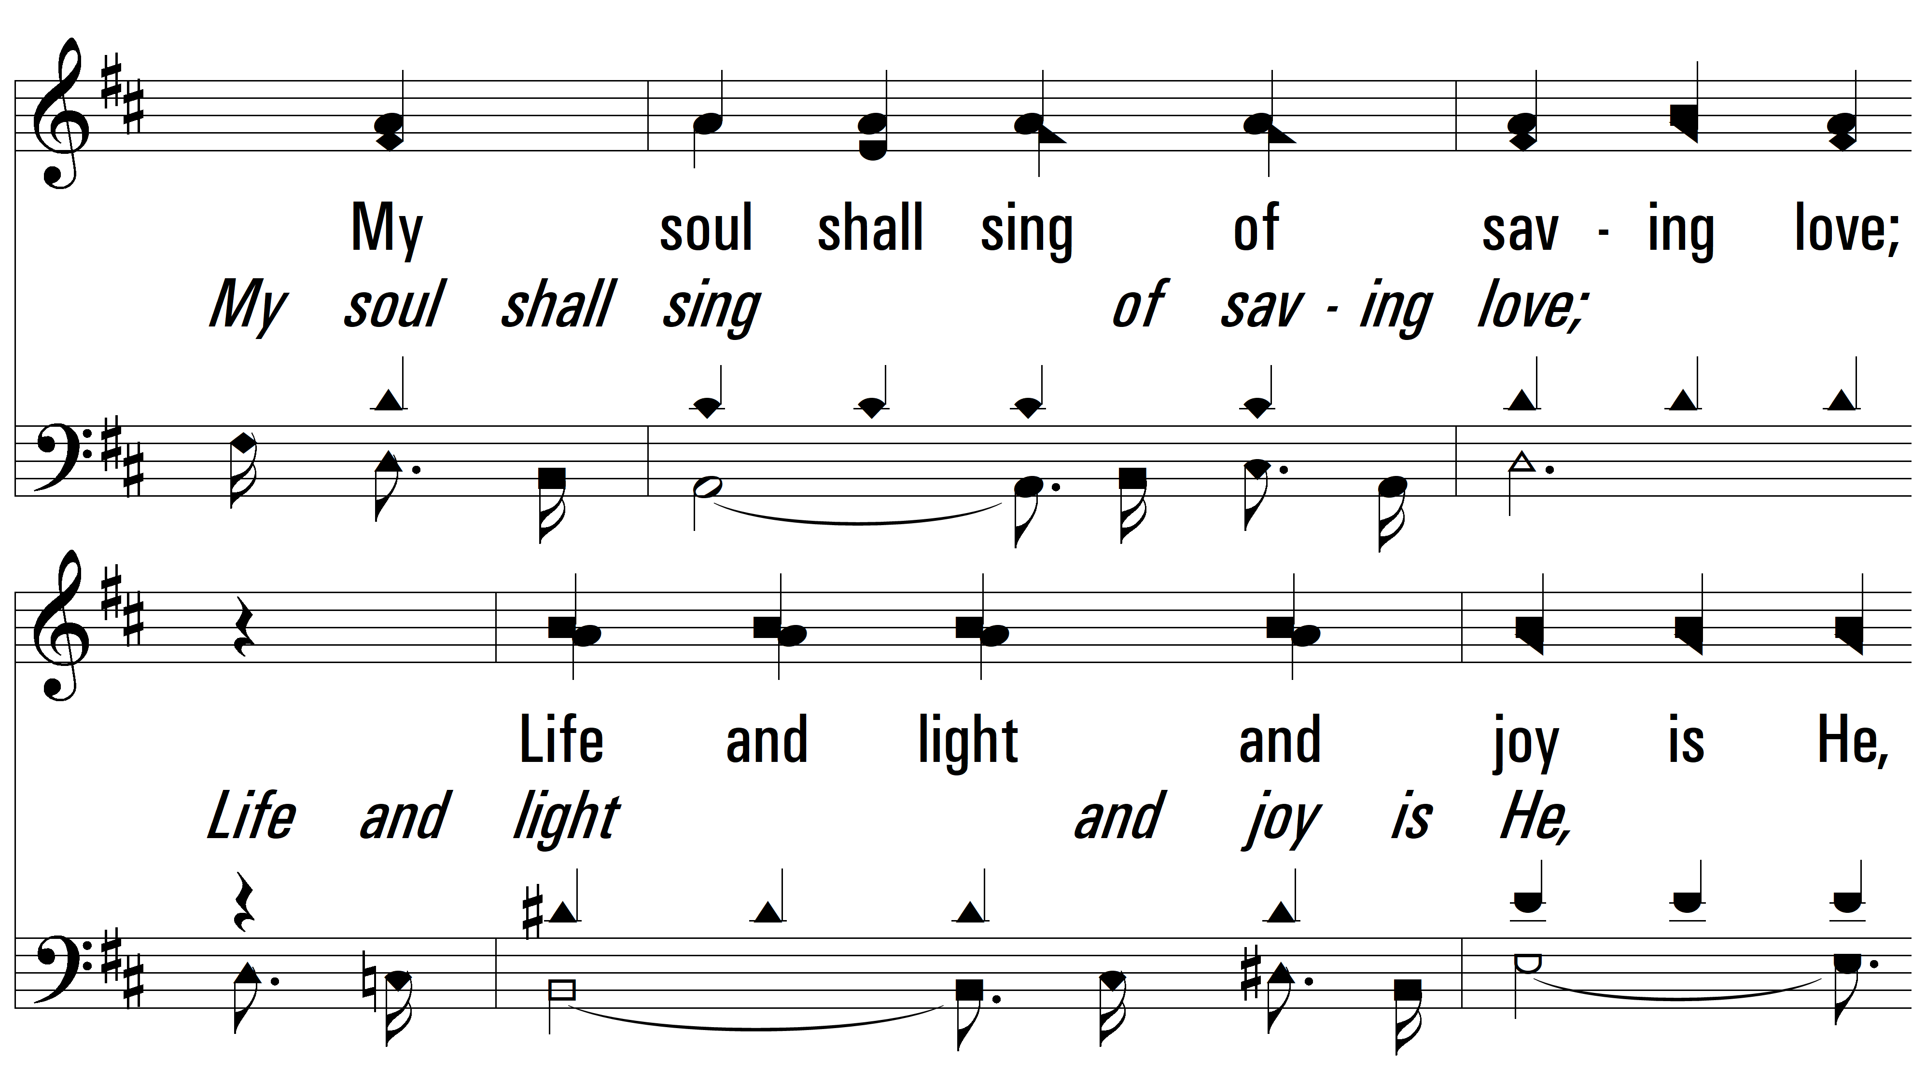
vs. 1

Slide 10
vs. 1

Slide 11
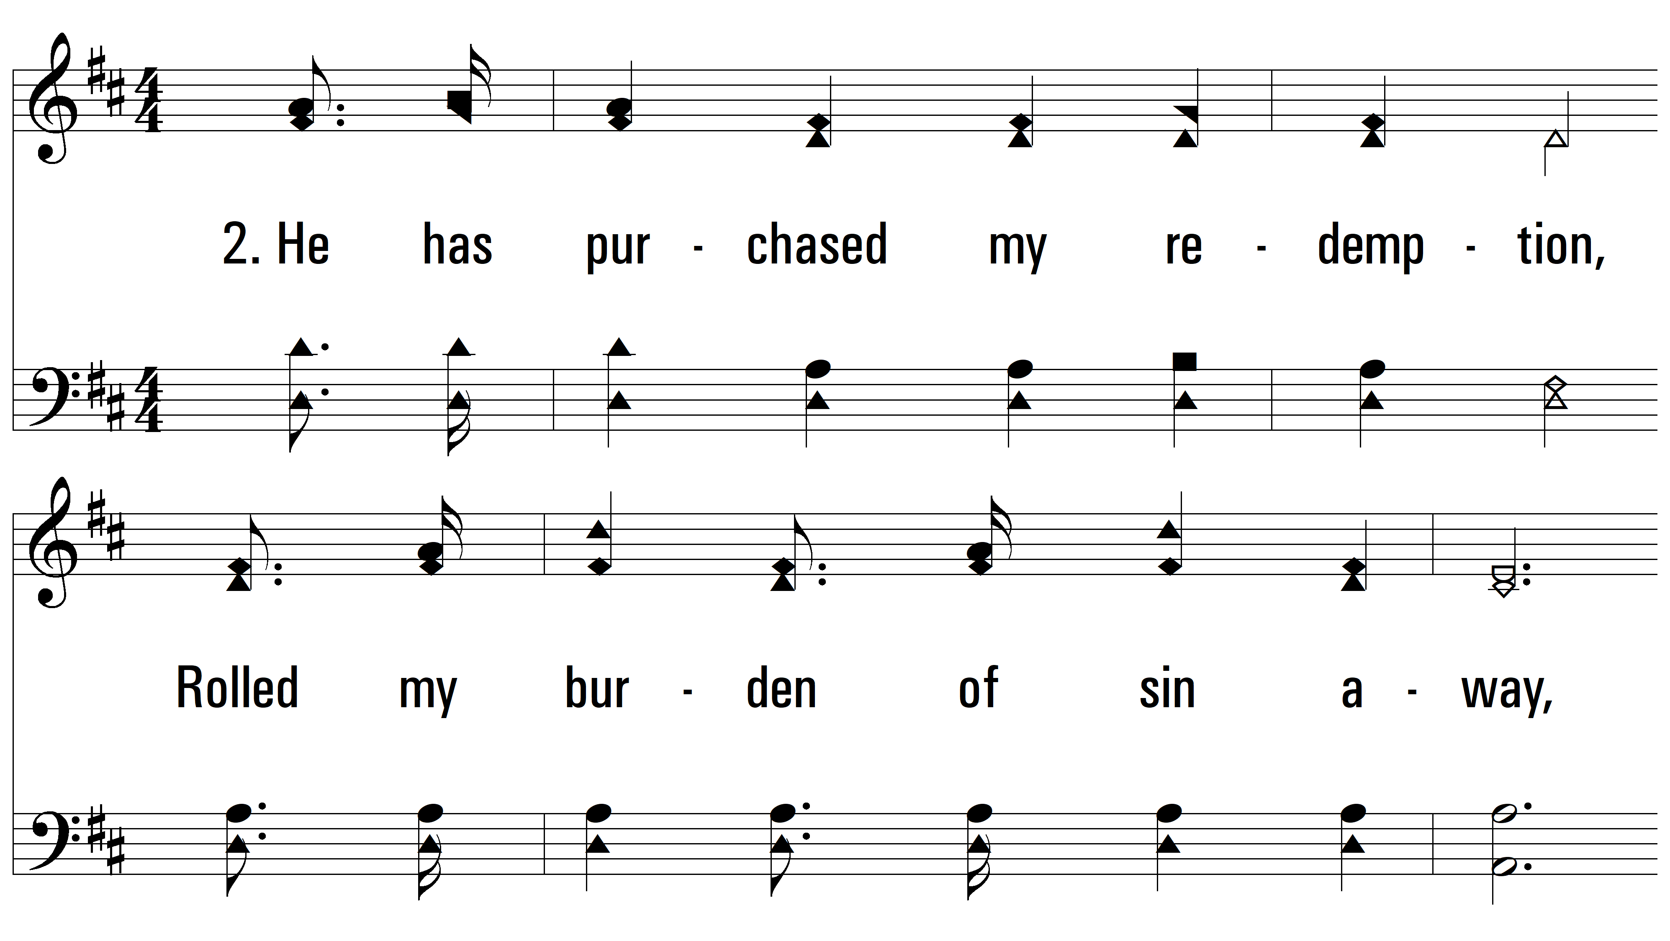
vs. 2 ~ The Great Redeemer

Slide 12
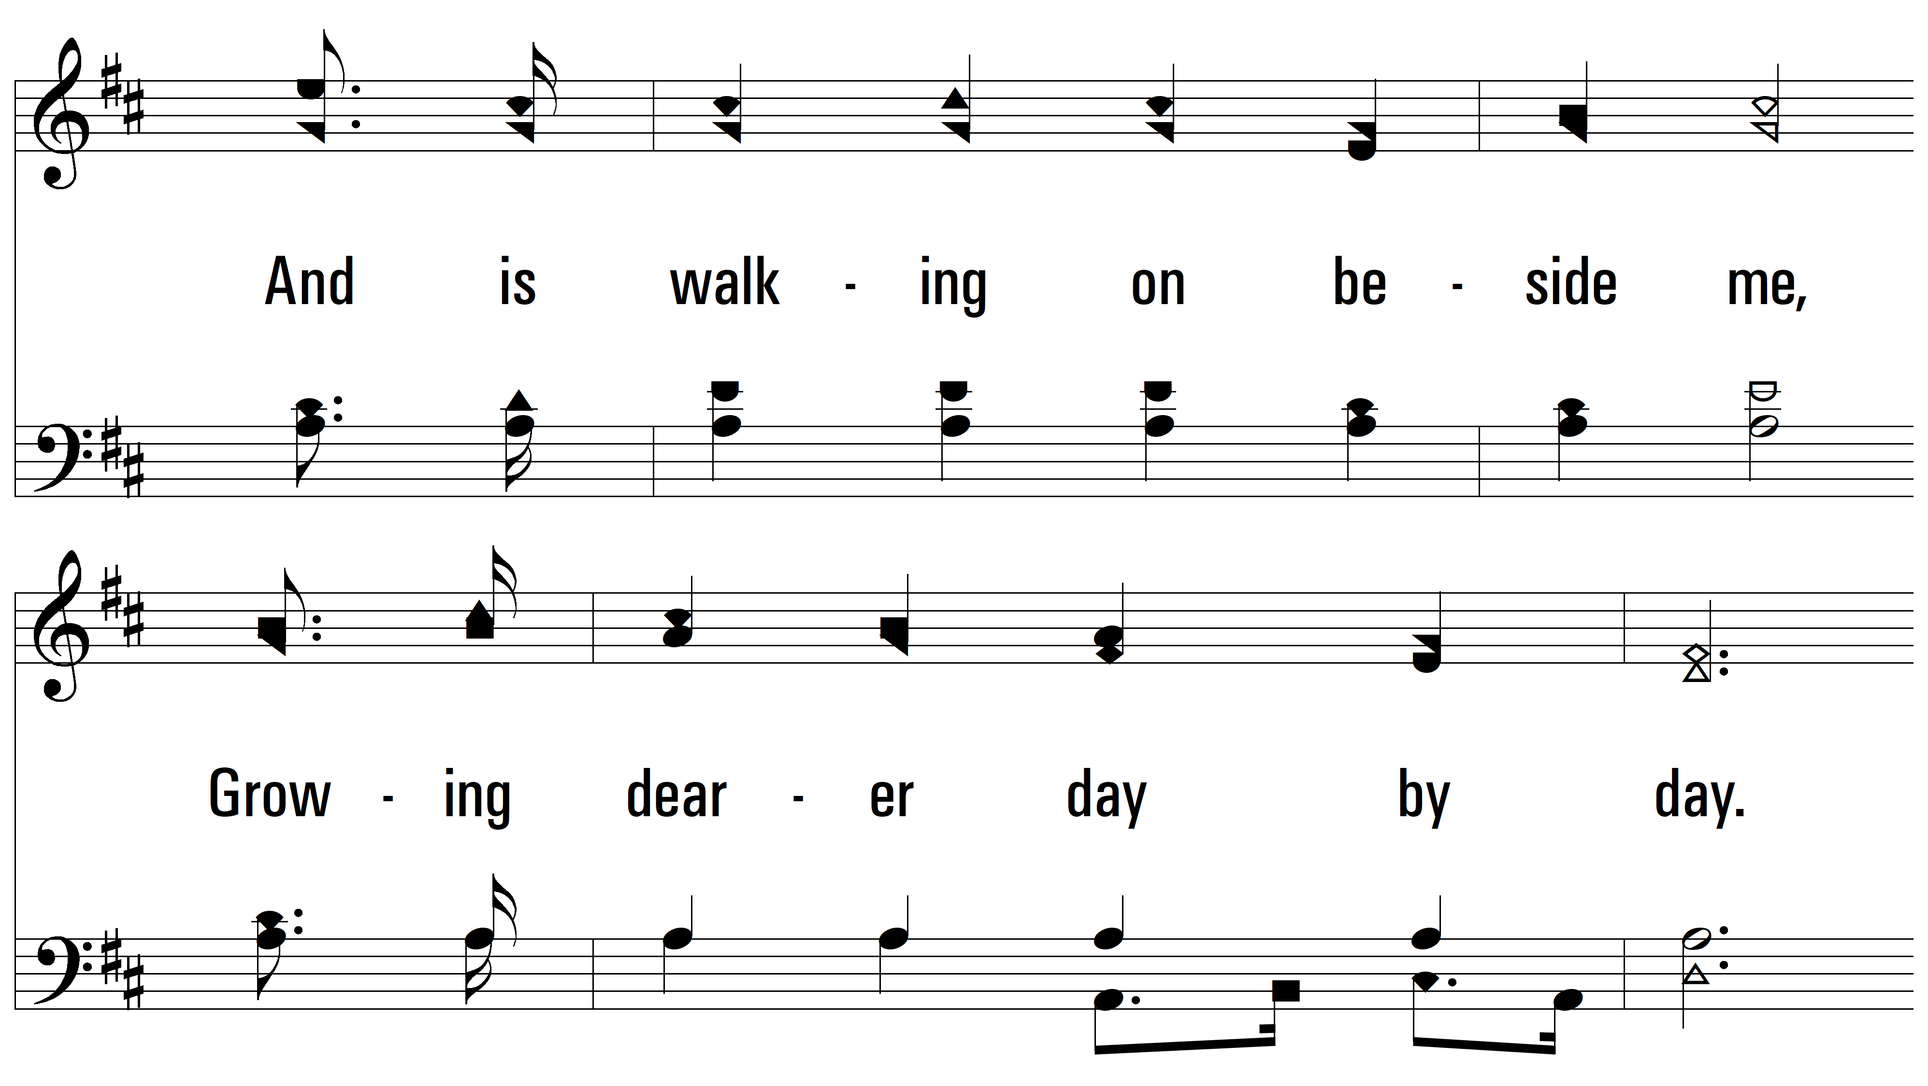
vs. 2

Slide 13
vs. 2

Slide 14
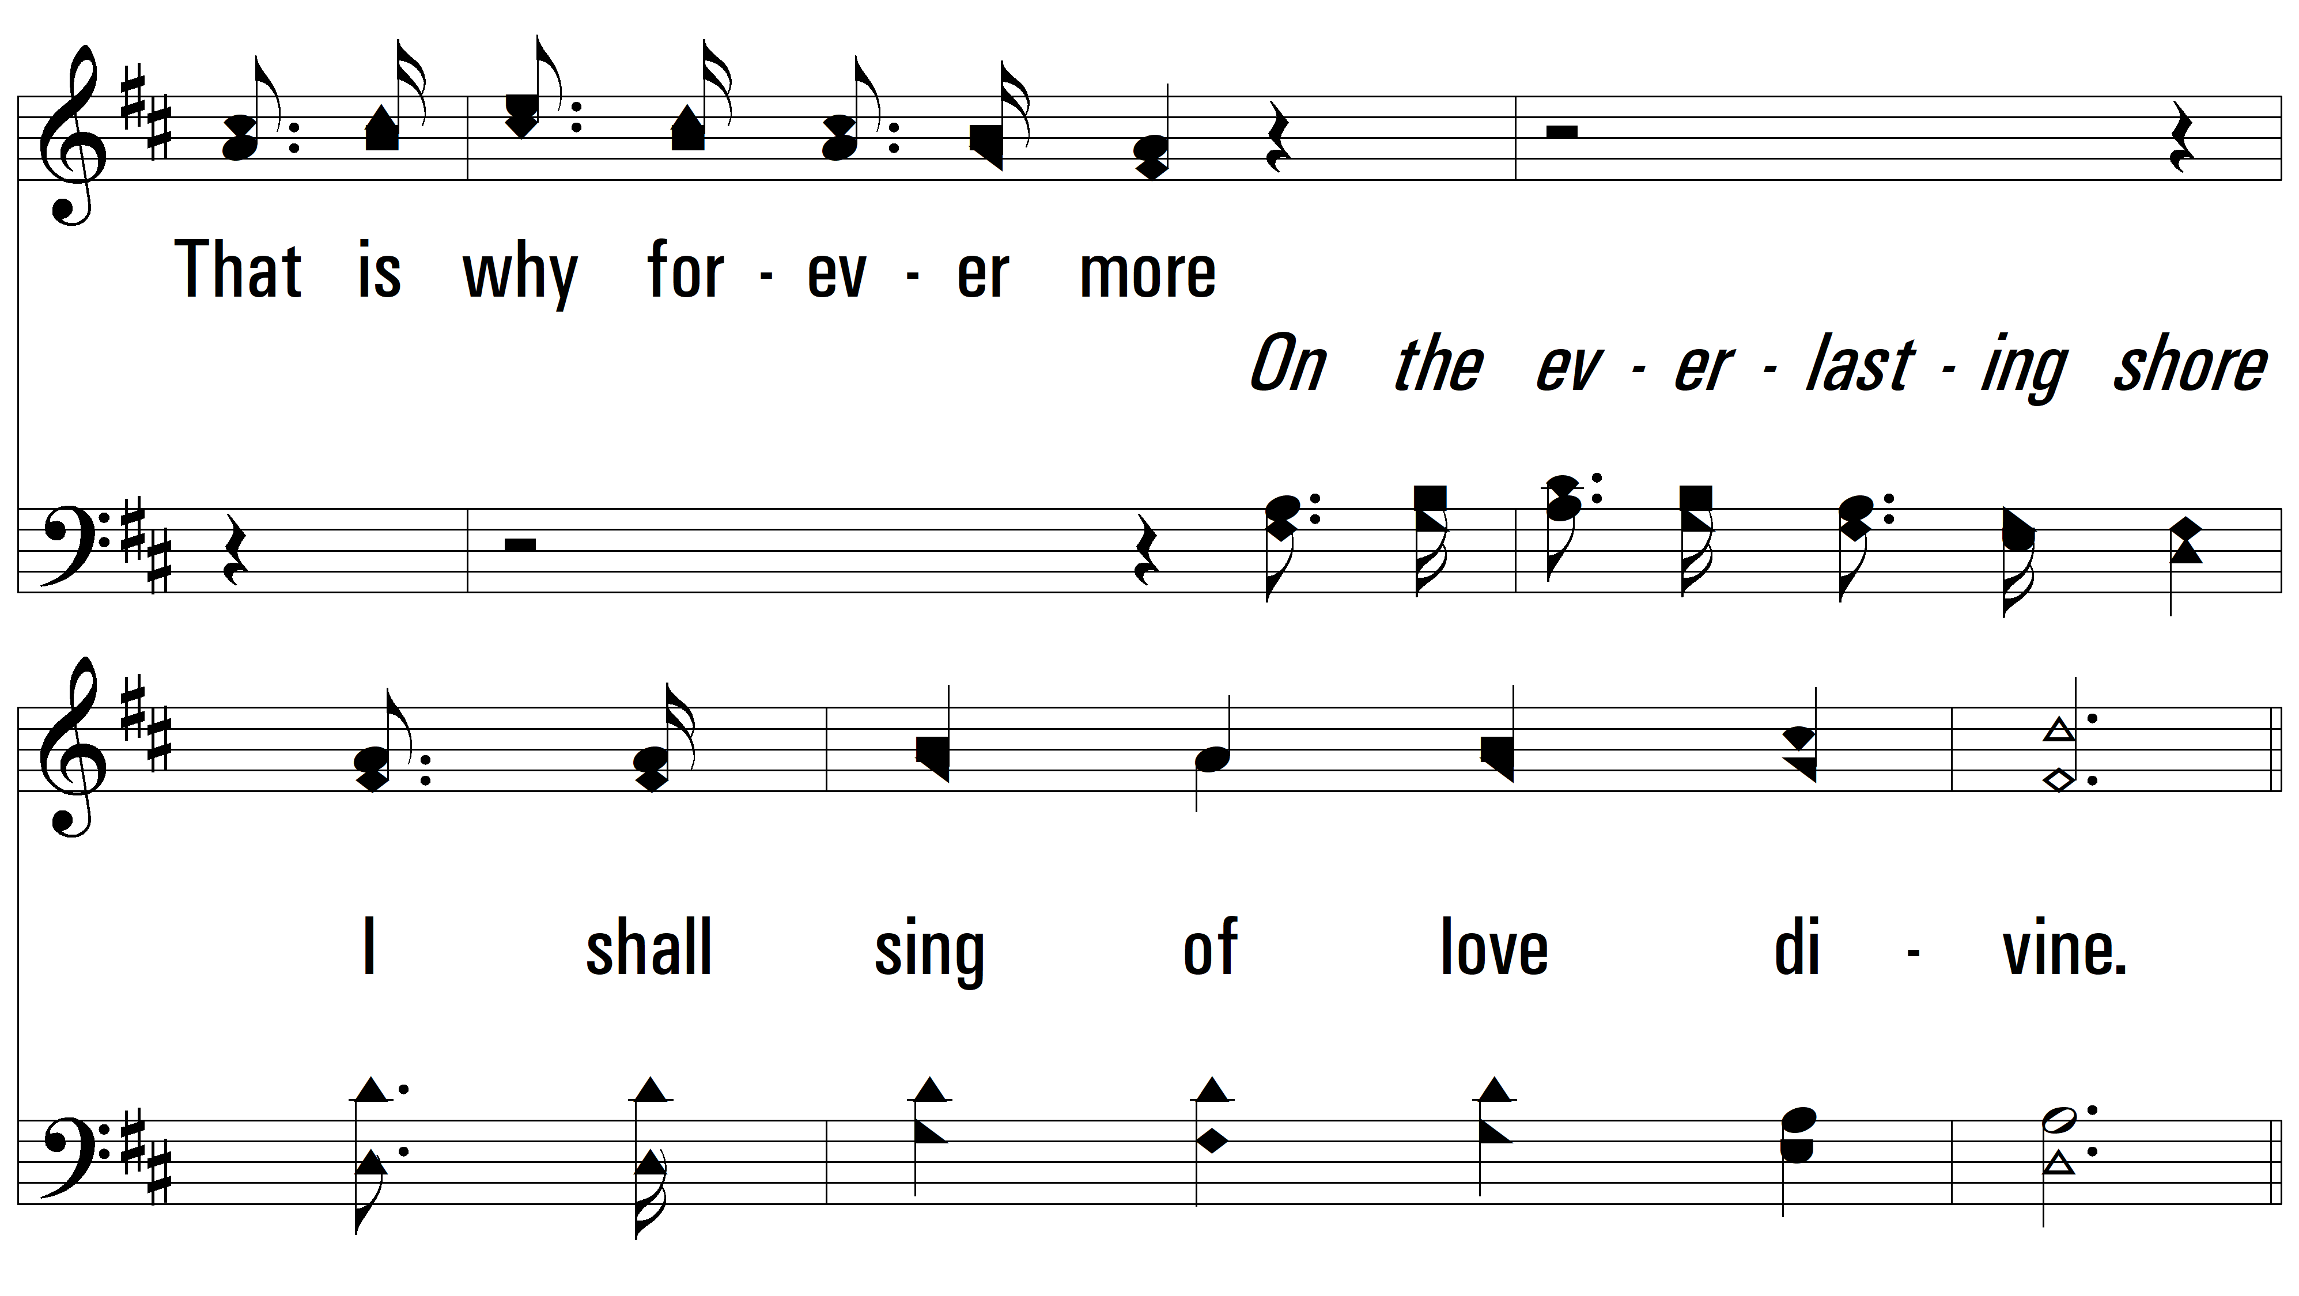
vs. 2

Slide 15
vs. 2

Slide 16
vs. 2

Slide 17
vs. 2

Slide 18
vs. 2

Slide 19
vs. 2

Slide 20
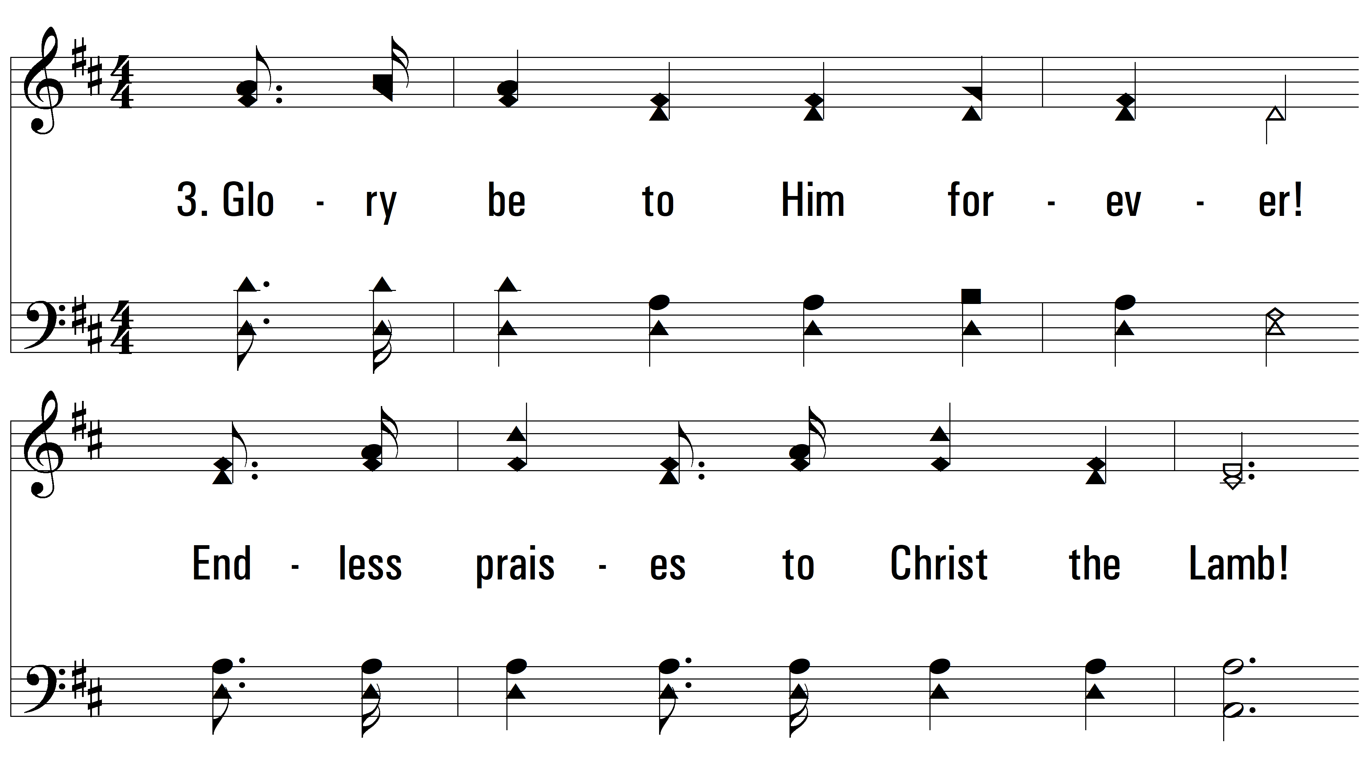
vs. 3 ~ The Great Redeemer

Slide 21
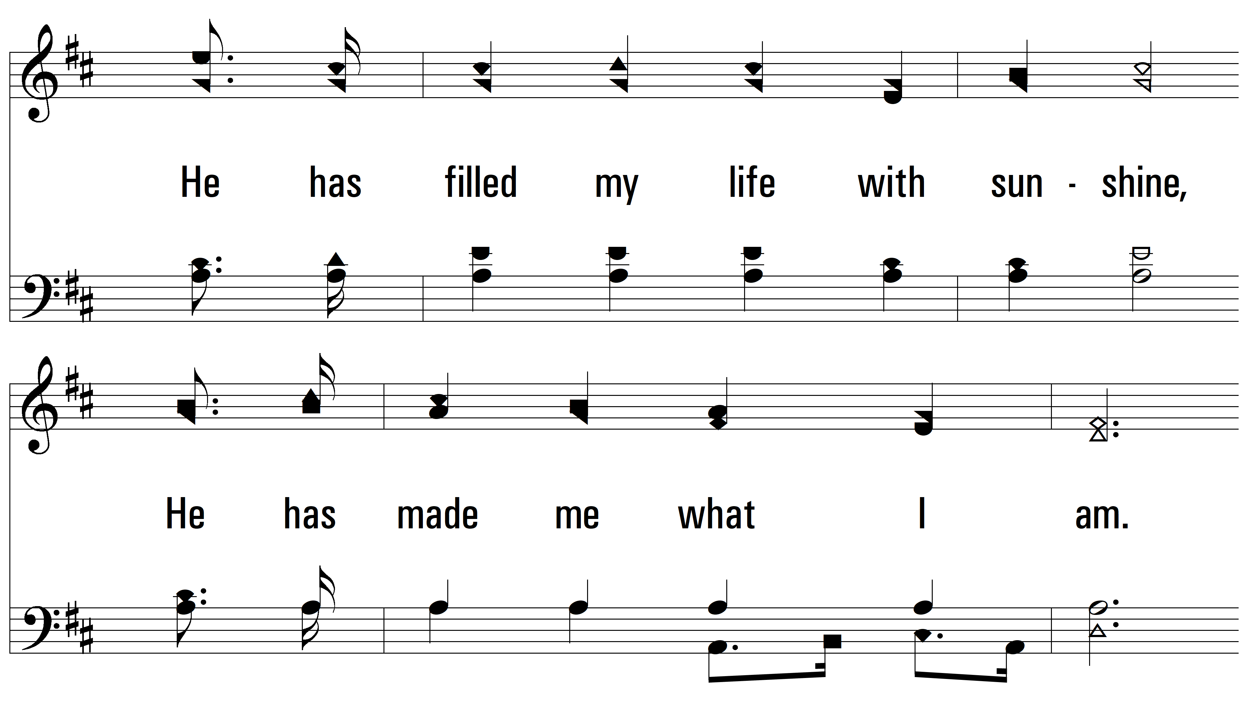
vs. 3

Slide 22
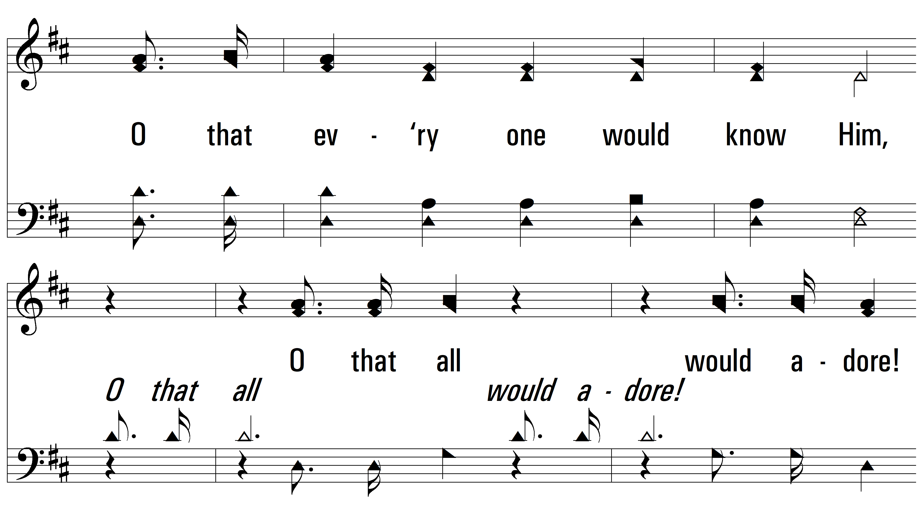
vs. 3

Slide 23
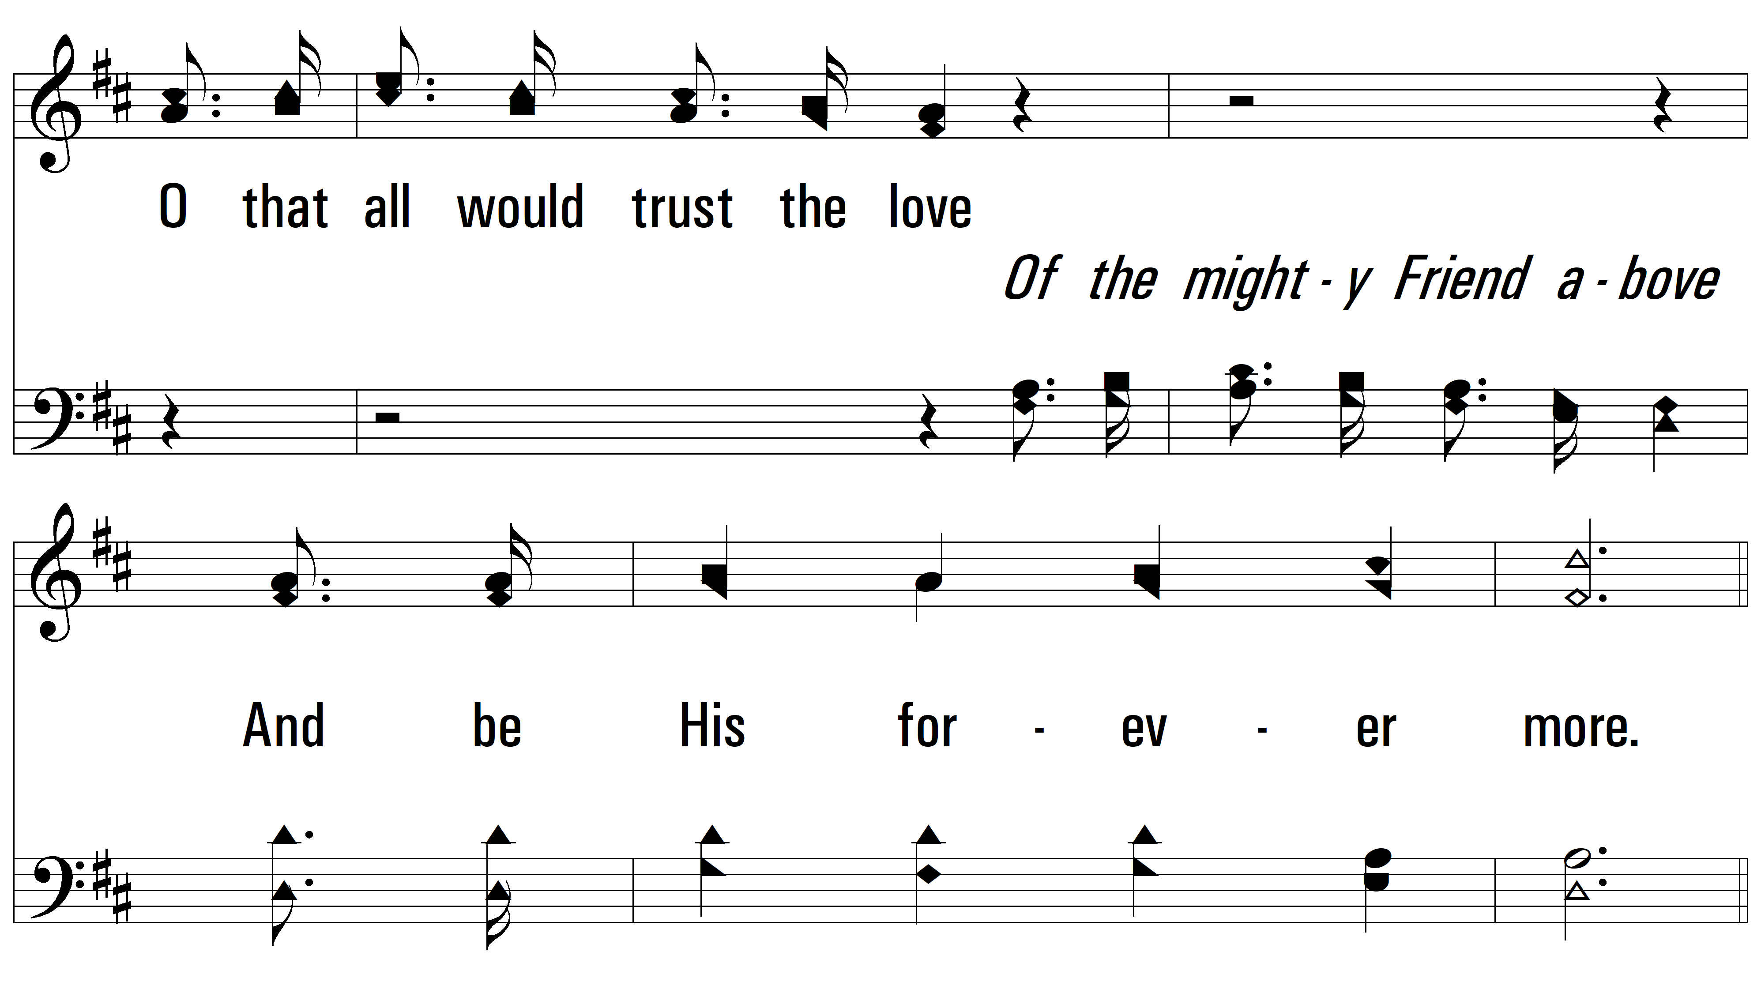
vs. 3

Slide 24
vs. 3

Slide 25
vs. 3

Slide 26
vs. 3

Slide 27
vs. 3

Slide 28
vs. 3
PDHymns.com
END

