Slide 1
Sweeter As The Years Go By
Words: | Mrs. C. H. Morris (1912)
Music: | Mrs. C. H. Morris (1912)
3/4 + 4/4
B^{b}/F - SOL
Verses: 3/Chorus
Lead - | SOL
Alto - | MI
Tenor - | DO
Bass - | DO
PDHymns.com

Slide 2
vs. 1 ~ Sweeter As The Years Go By

Slide 3
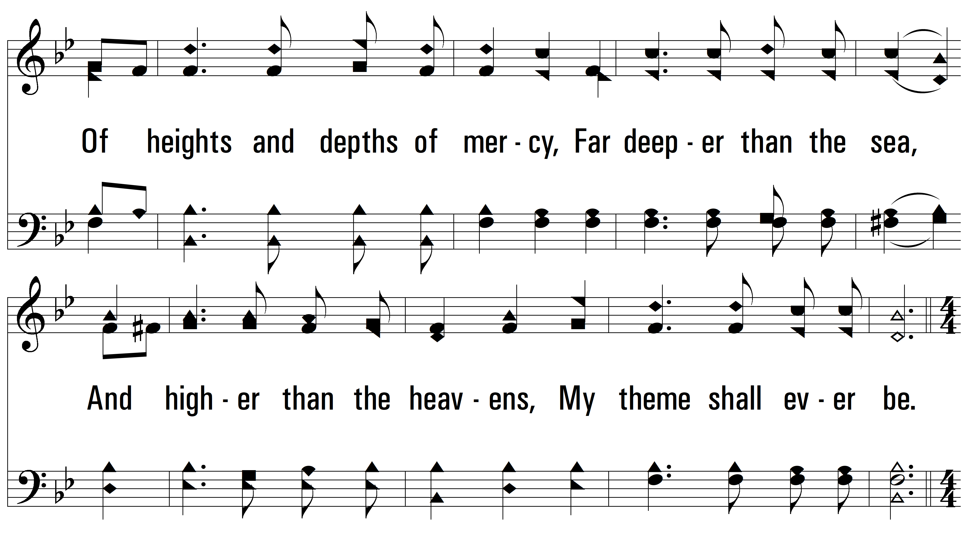
vs. 1

Slide 4
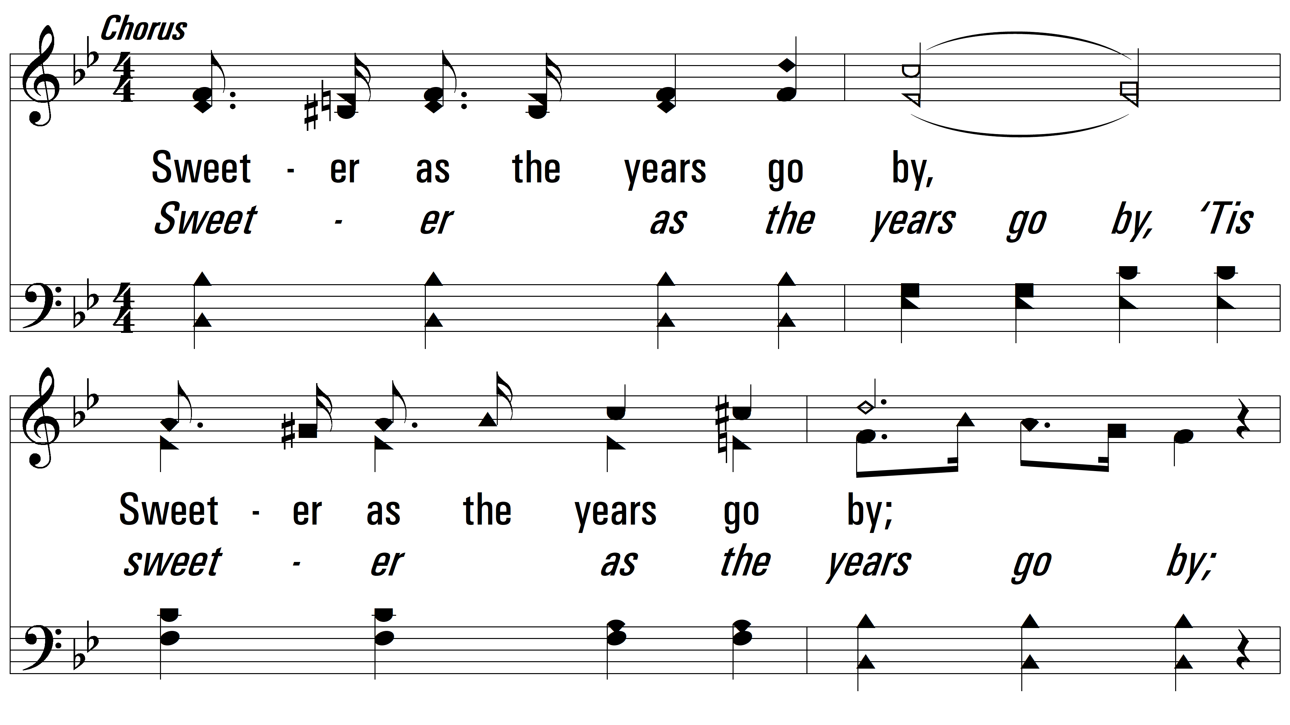
vs. 1

Slide 5
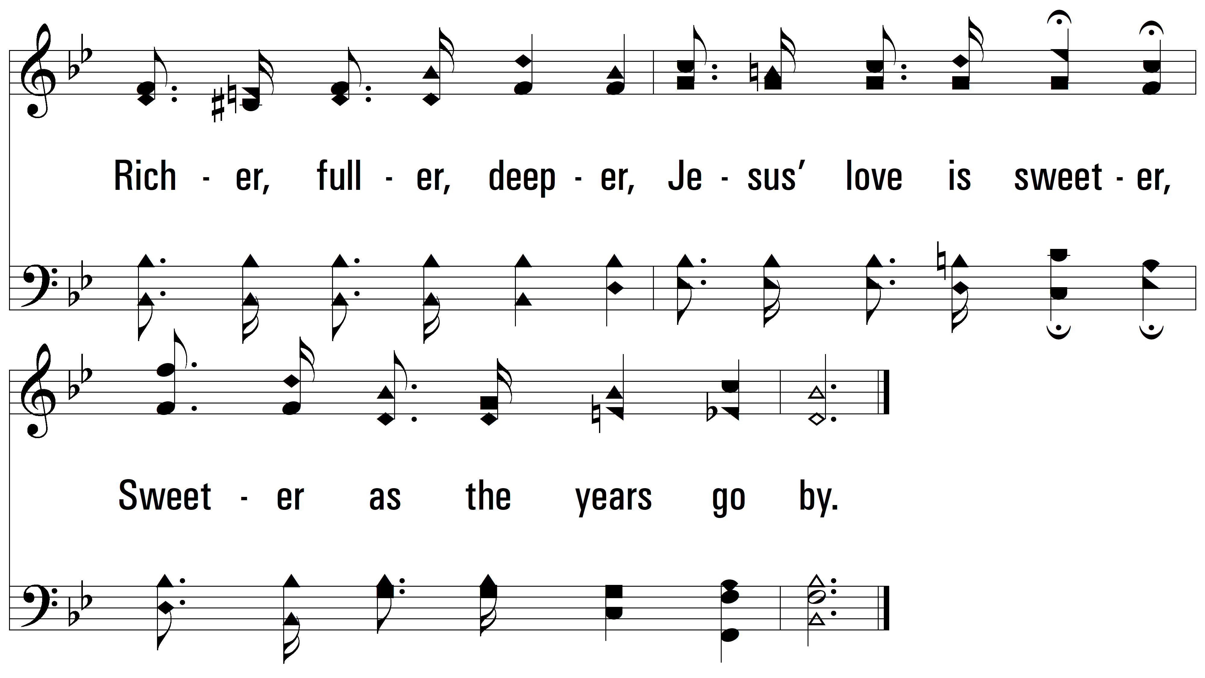
vs. 1

Slide 6
vs. 2 ~ Sweeter As The Years Go By

Slide 7
vs. 2

Slide 8
vs. 2

Slide 9
vs. 2

Slide 10
vs. 3 ~ Sweeter As The Years Go By

Slide 11
vs. 3

Slide 12
vs. 3

Slide 13
vs. 3
PDHymns.com
END

