Slide 1
Sweet Peace, The Gift Of Gods Love
Words: | Peter P. Bilhorn (1887)
Music: | Peter P. Bilhorn (1887)
6/8
A/E - SOL
Verses: 3/Chorus
Lead - | SOL
Alto - | MI
Tenor - | DO
Bass - | DO
PDHymns.com

Slide 2
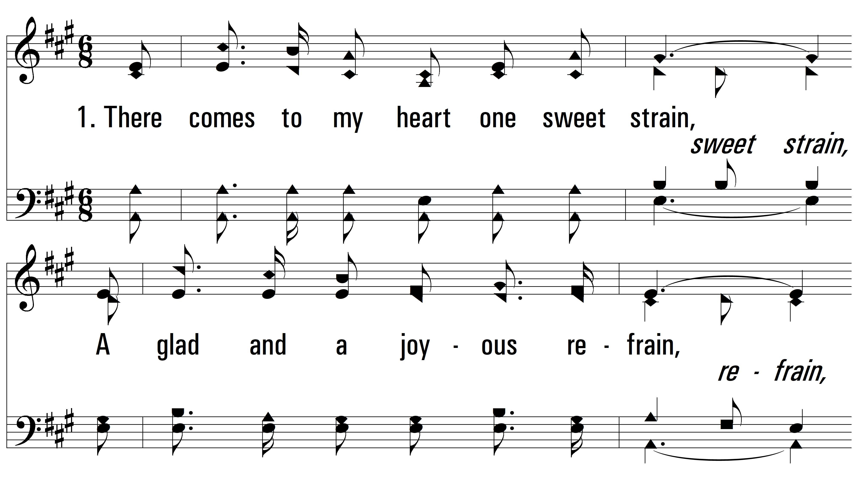
vs. 1 ~ Sweet Peace, The Gift Of Gods Love

Slide 3
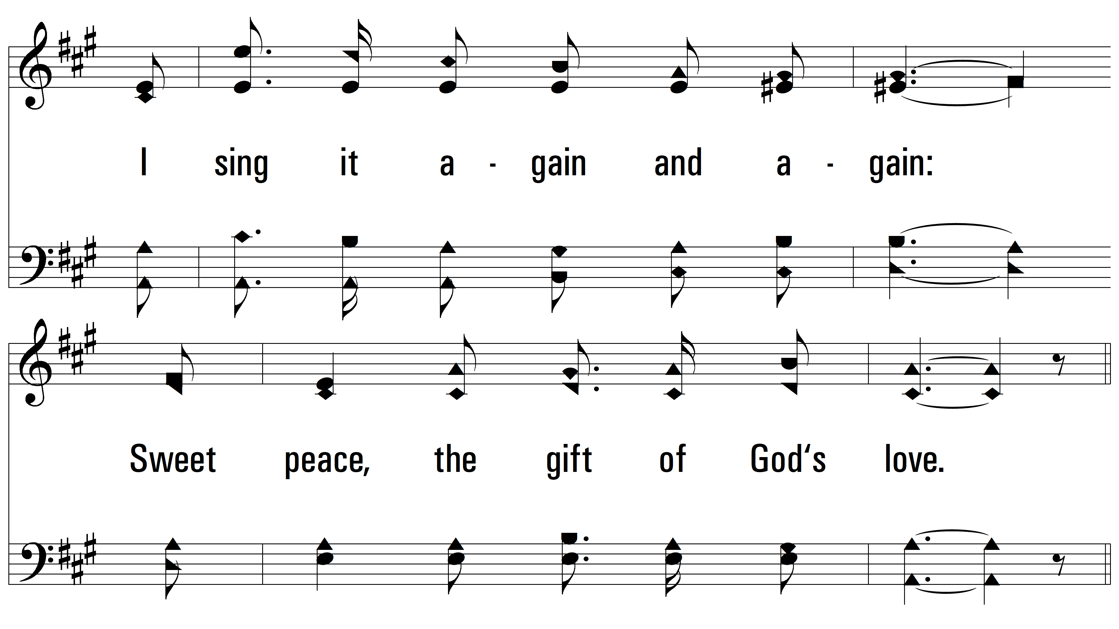
vs. 1

Slide 4
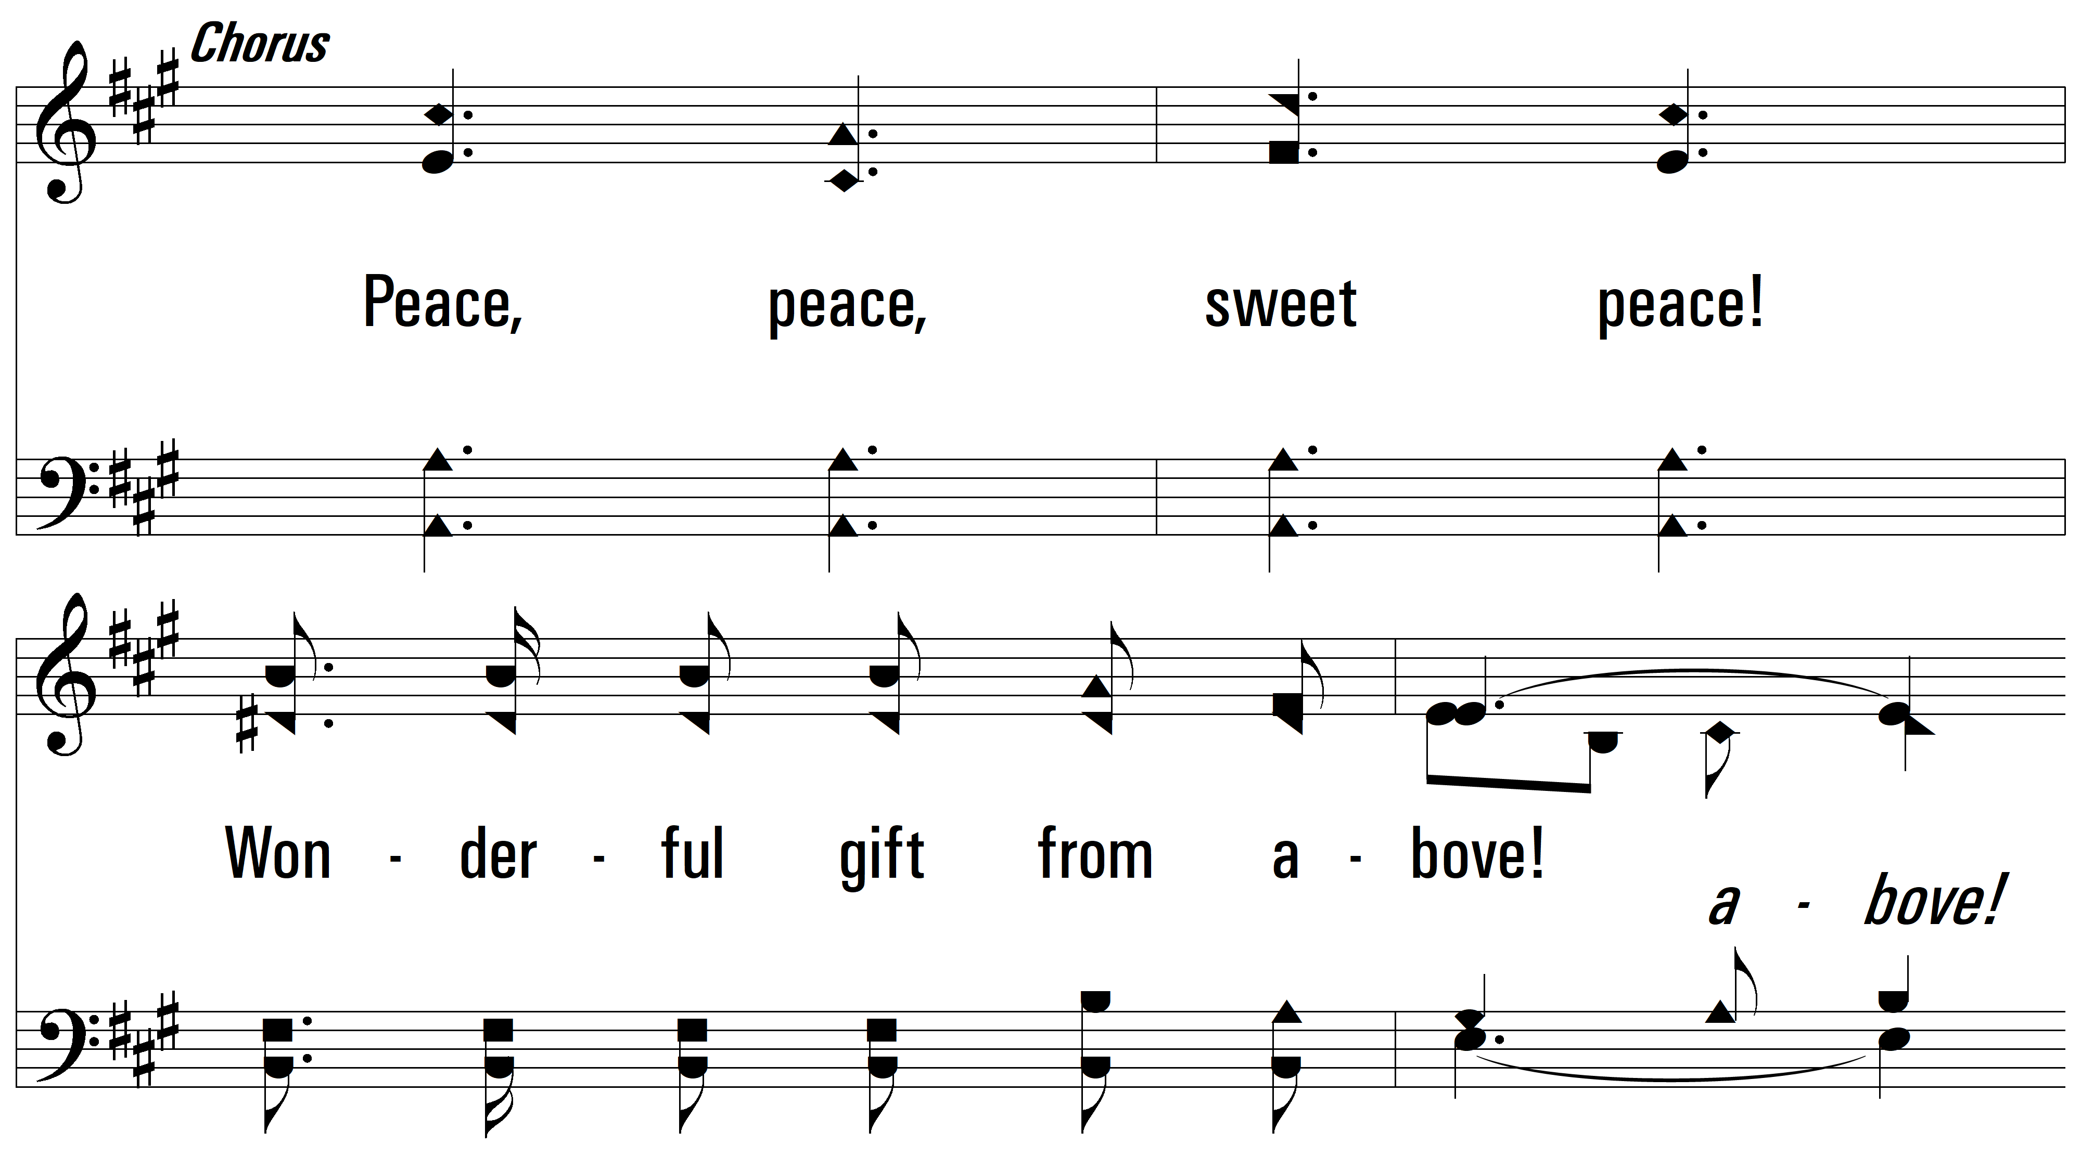
vs. 1

Slide 5
vs. 1

Slide 6
vs. 2 ~ Sweet Peace, The Gift Of Gods Love

Slide 7
vs. 2

Slide 8
vs. 2

Slide 9
vs. 2

Slide 10
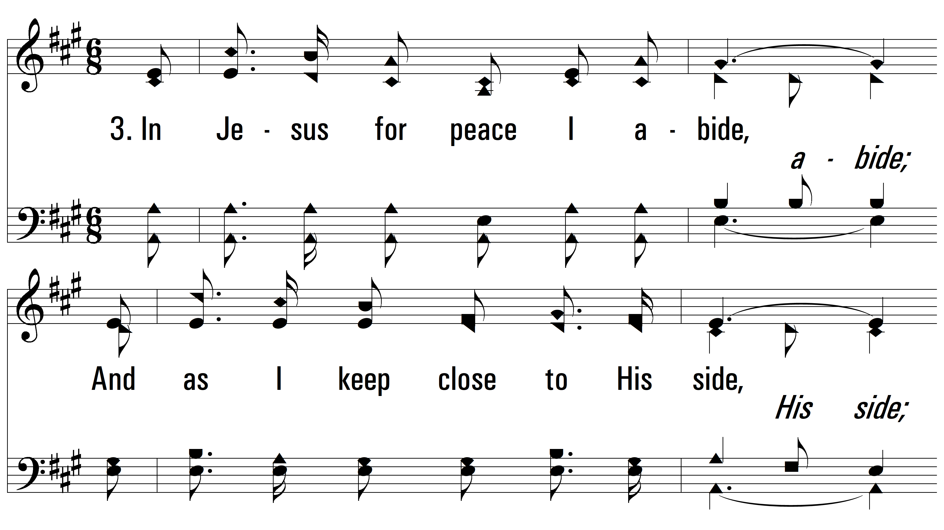
vs. 3 ~ Sweet Peace, The Gift Of Gods Love

Slide 11
vs. 3

Slide 12
vs. 3

Slide 13
vs. 3
PDHymns.com
END

