Slide 1
Sunlight, Sunlight
Words: | J. W. Van De Venter (1897)
Music: | W. S. Weeden (1897)
4/4
E/B - SOL
Verses: 5/Chorus
Lead - | SOL
Alto - | SOL
Tenor - | MI
Bass - | DO
PDHymns.com

Slide 2
vs. 1 ~ Sunlight, Sunlight

Slide 3
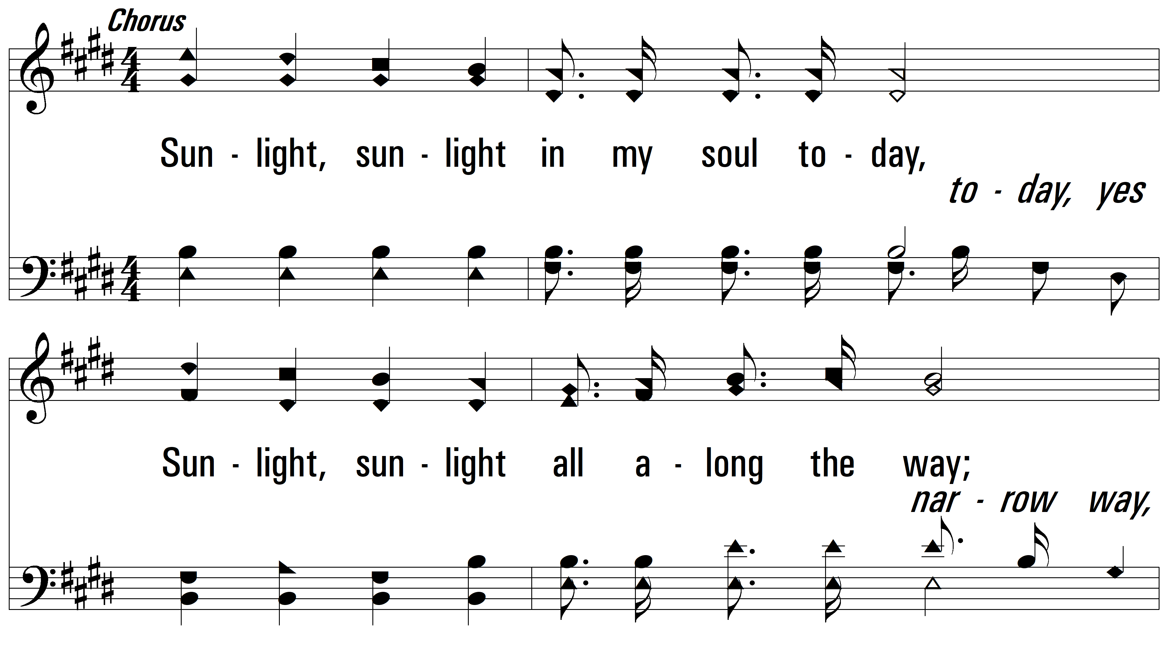
vs. 1

Slide 4
vs. 1

Slide 5
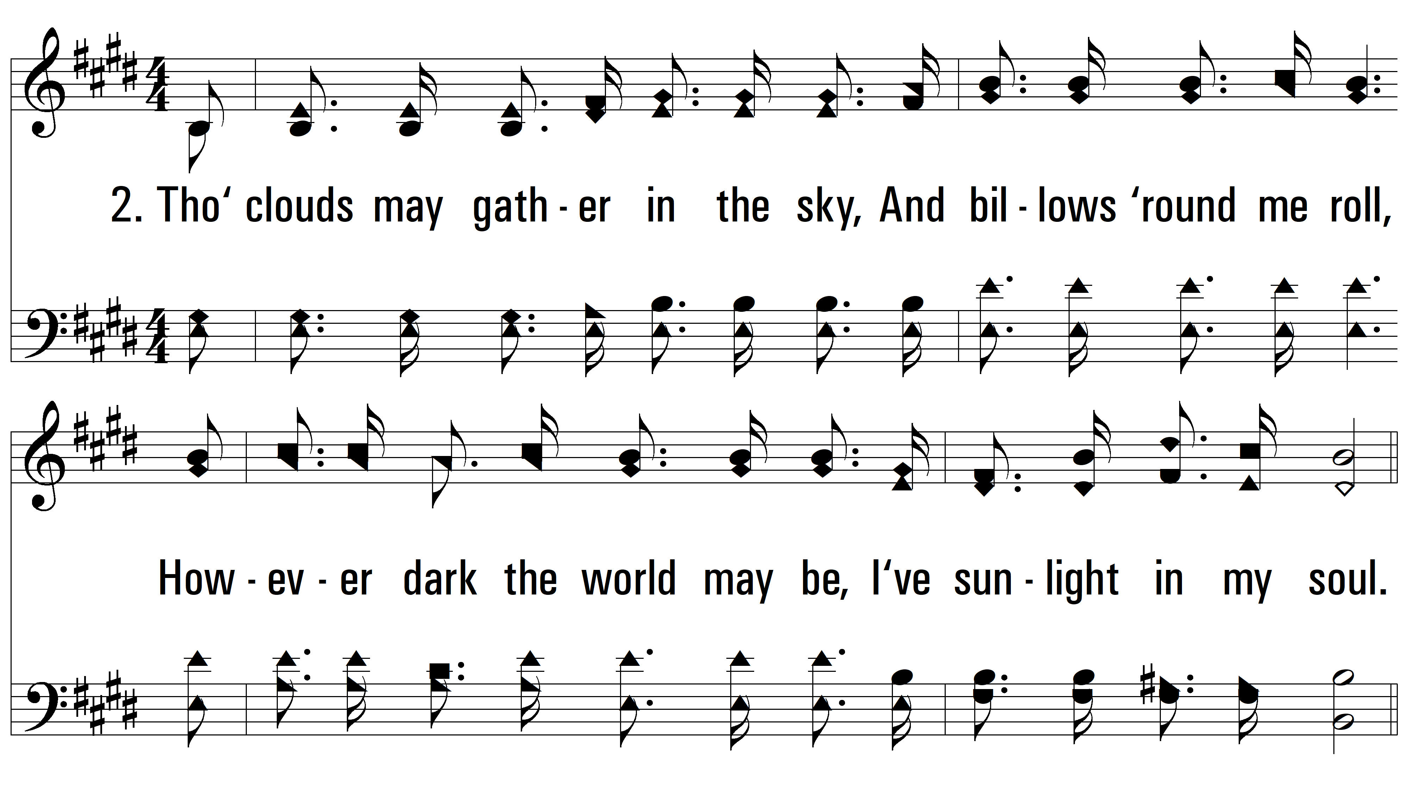
vs. 2 ~ Sunlight, Sunlight

Slide 6
vs. 2

Slide 7
vs. 2

Slide 8
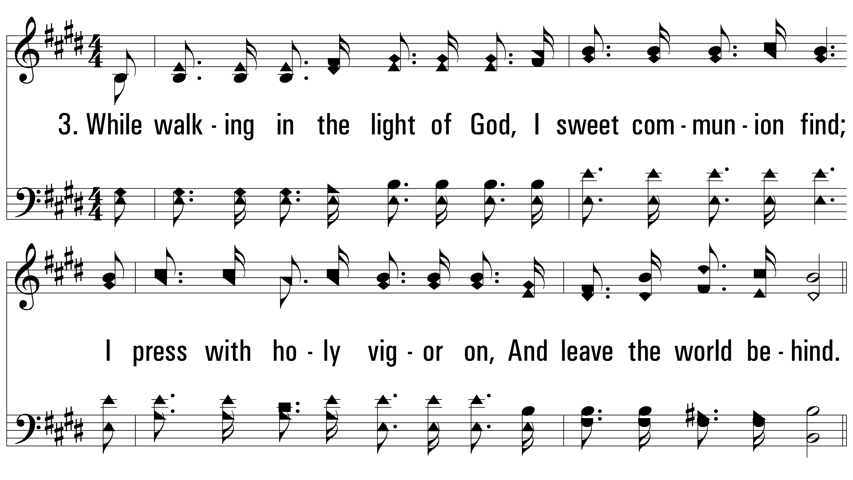
vs. 3 ~ Sunlight, Sunlight

Slide 9
vs. 3

Slide 10
vs. 3

Slide 11
vs. 4 ~ Sunlight, Sunlight

Slide 12
vs. 4

Slide 13
vs. 4

Slide 14
vs. 5 ~ Sunlight, Sunlight

Slide 15
vs. 5

Slide 16
vs. 5
PDHymns.com
END

