Slide 1
Stand By Me
Words: | C. A. Tindley (1923)
Music: | F. A. Clark (1923)
4/4
E^{b}/E^{b} - DO
Verses: 5
Lead - | DO
Alto - | SOL
Tenor - | MI
Bass - | DO
PDHymns.com

Slide 2
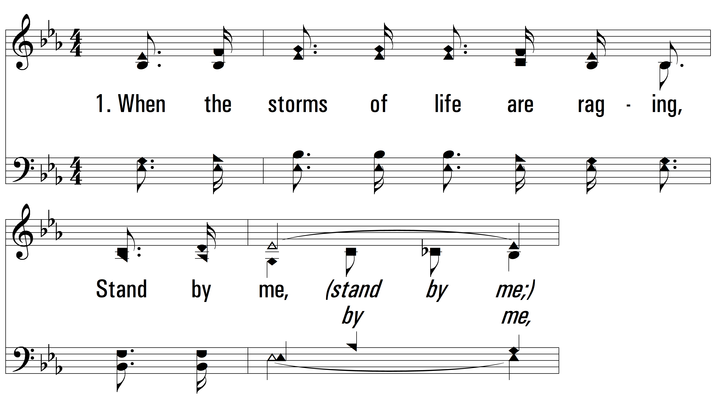
vs. 1 ~ Stand By Me

Slide 3
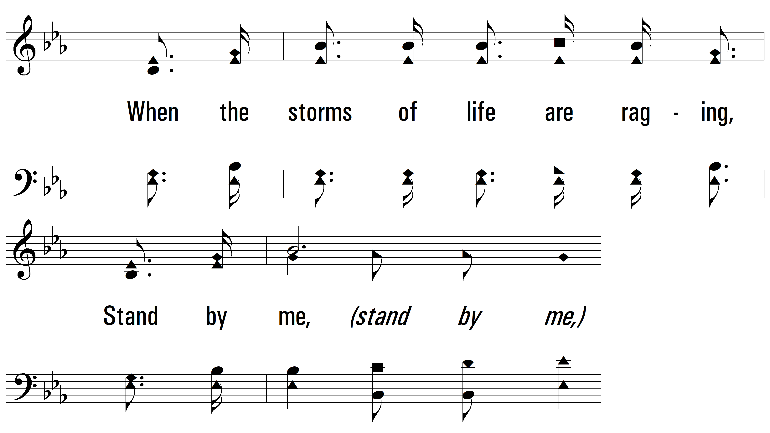
vs. 1

Slide 4
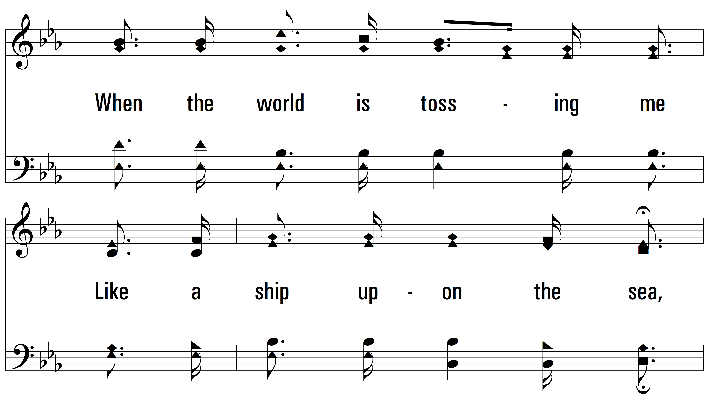
vs. 1

Slide 5
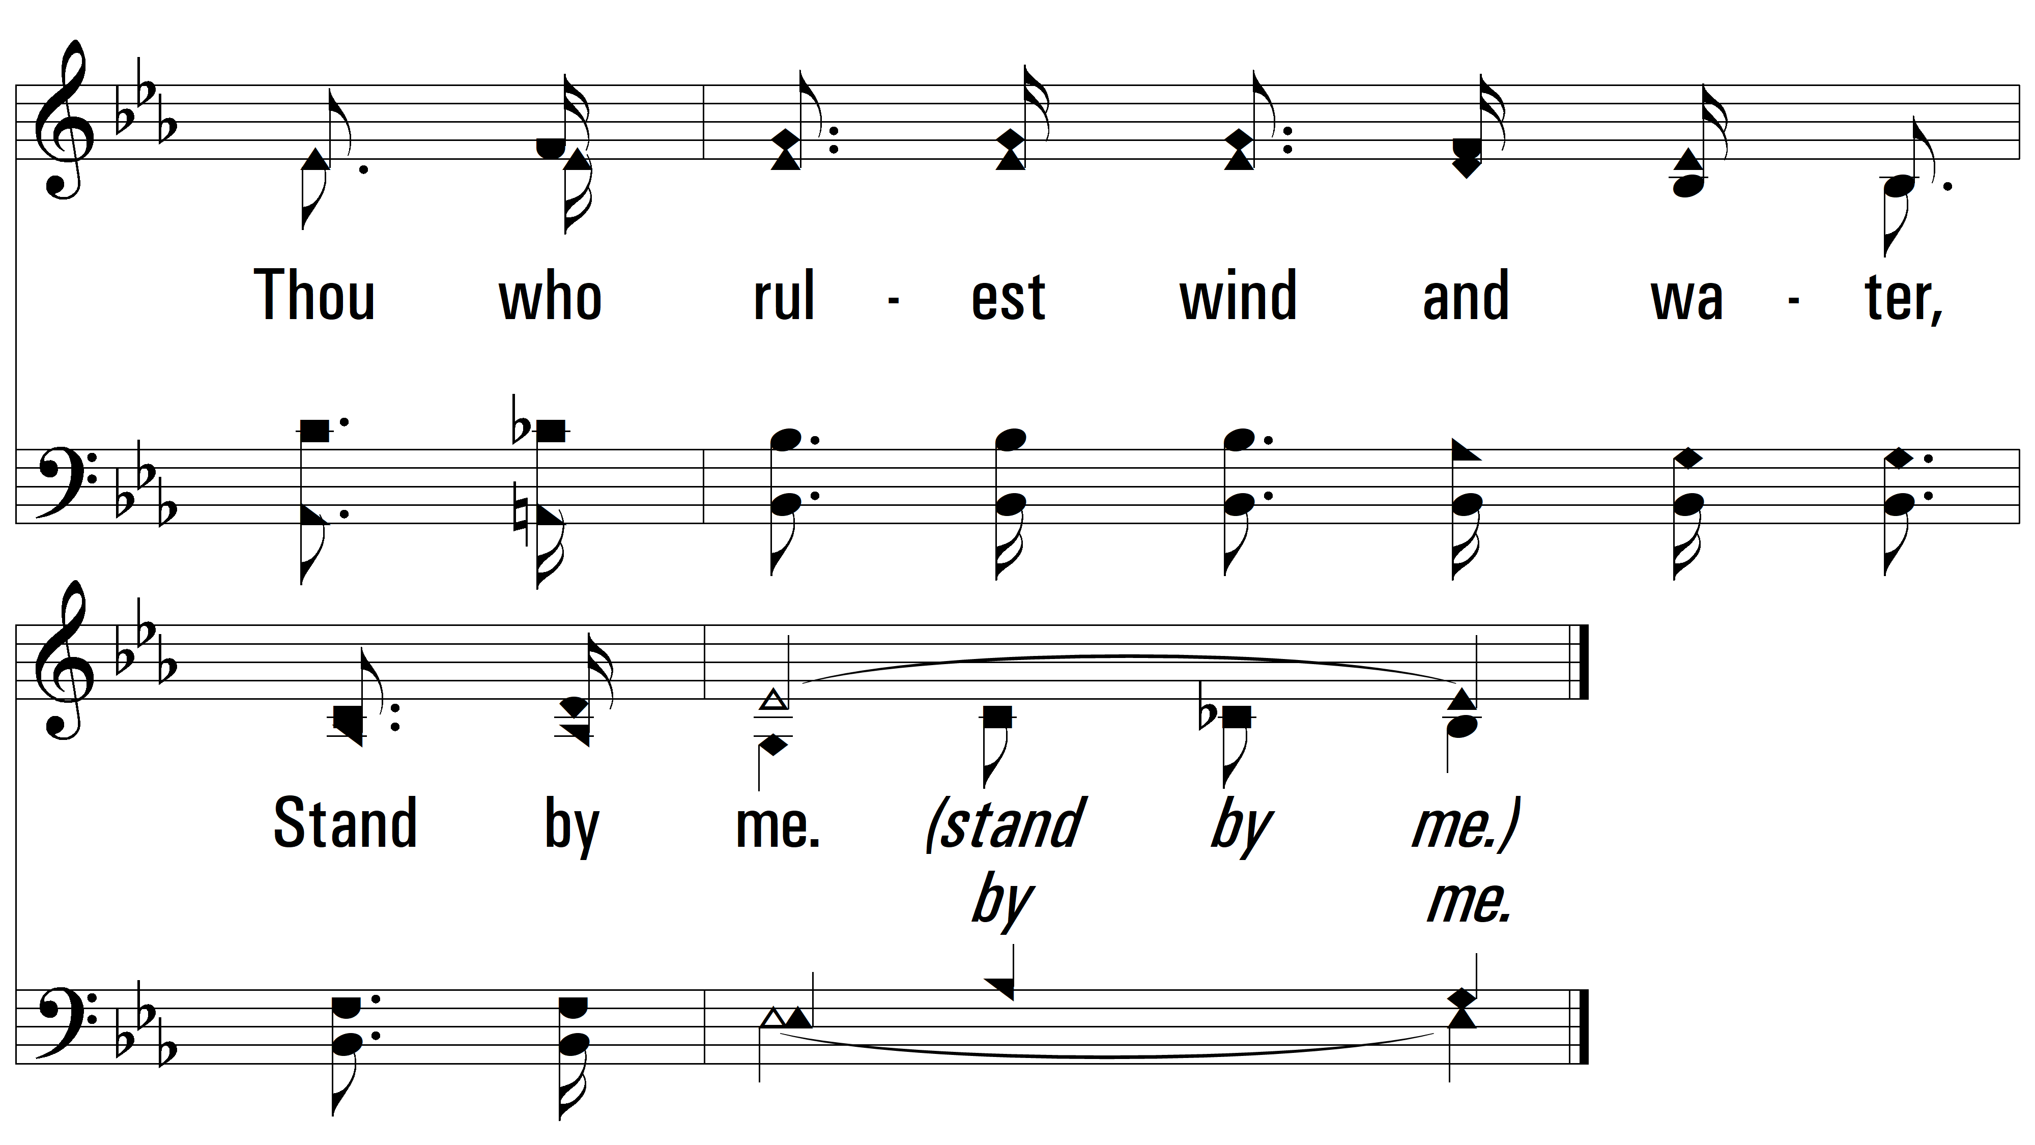
vs. 1

Slide 6
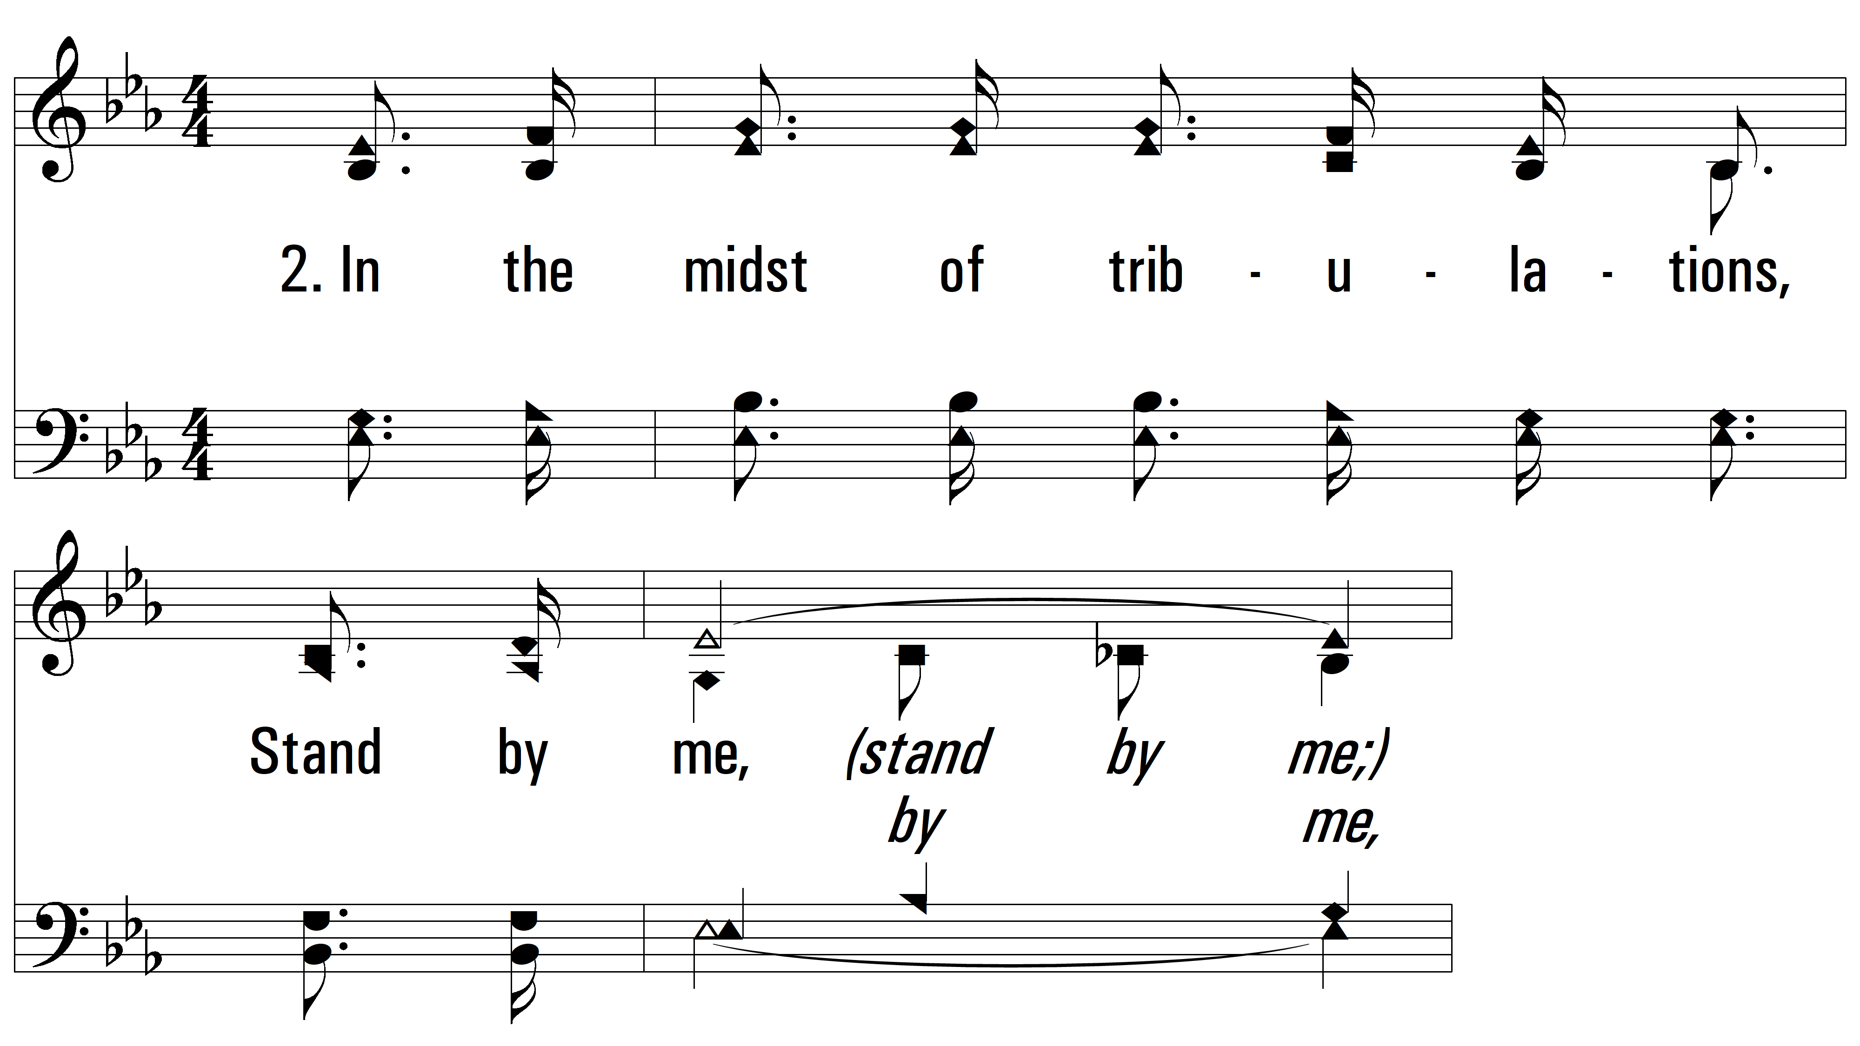
vs. 2 ~ Stand By Me

Slide 7
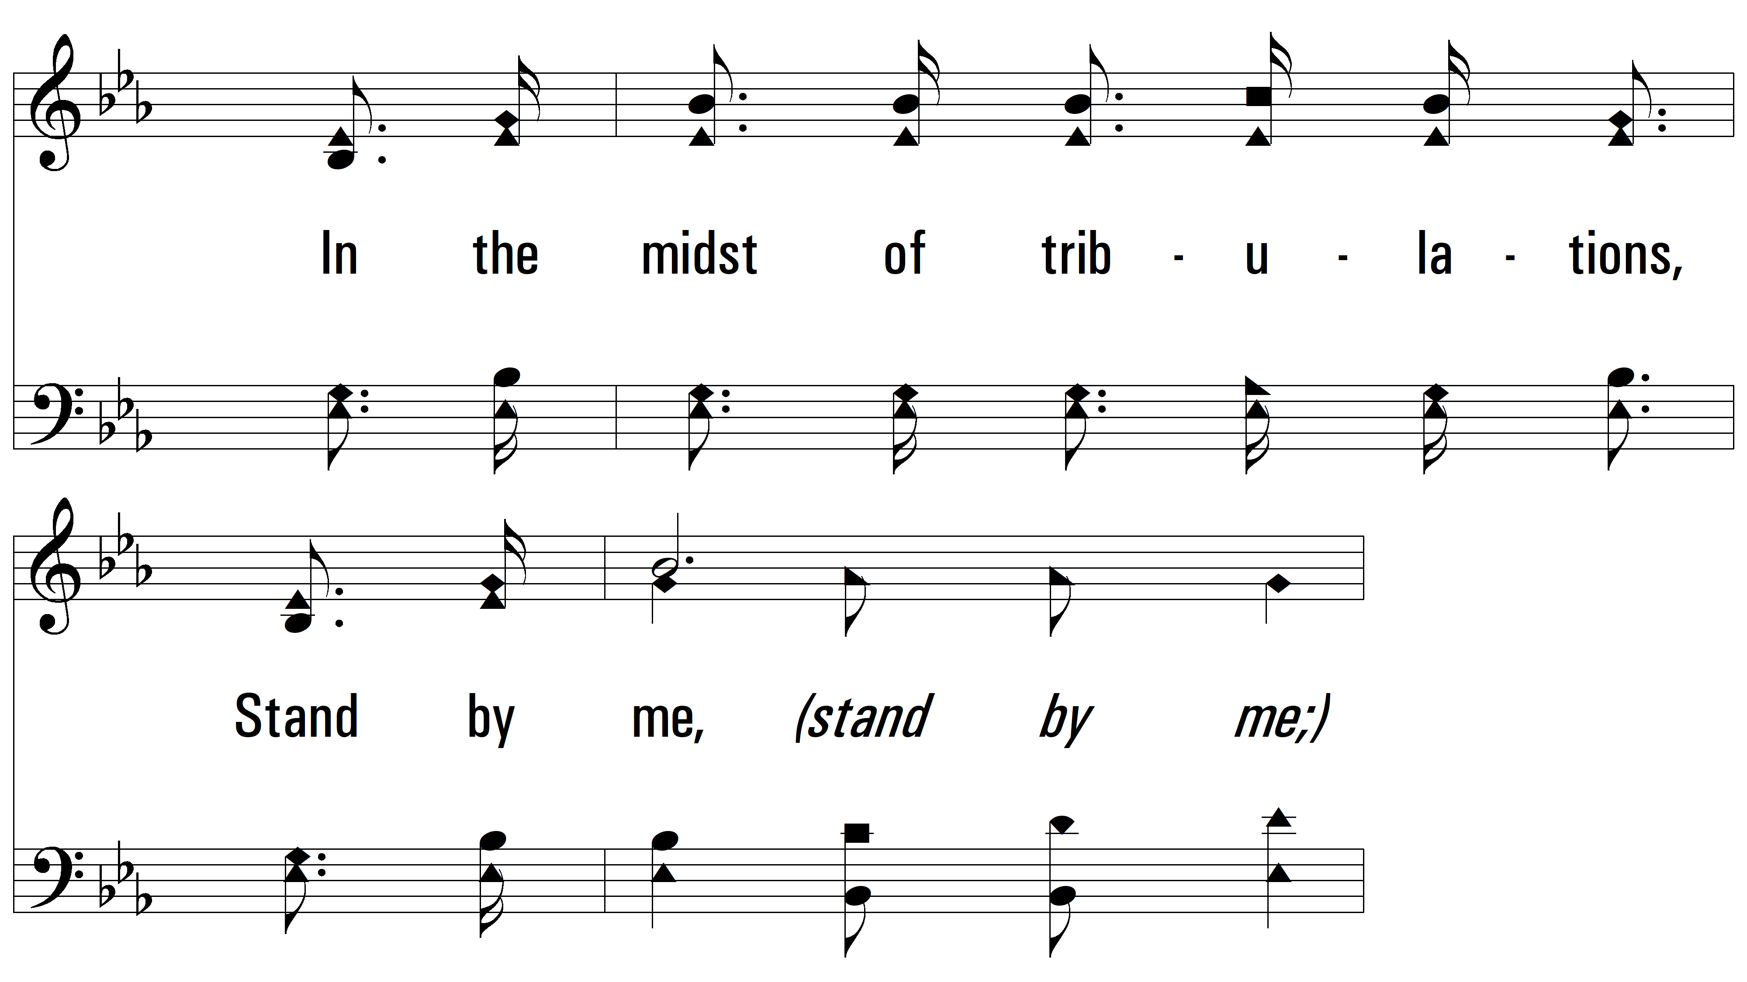
vs. 2

Slide 8
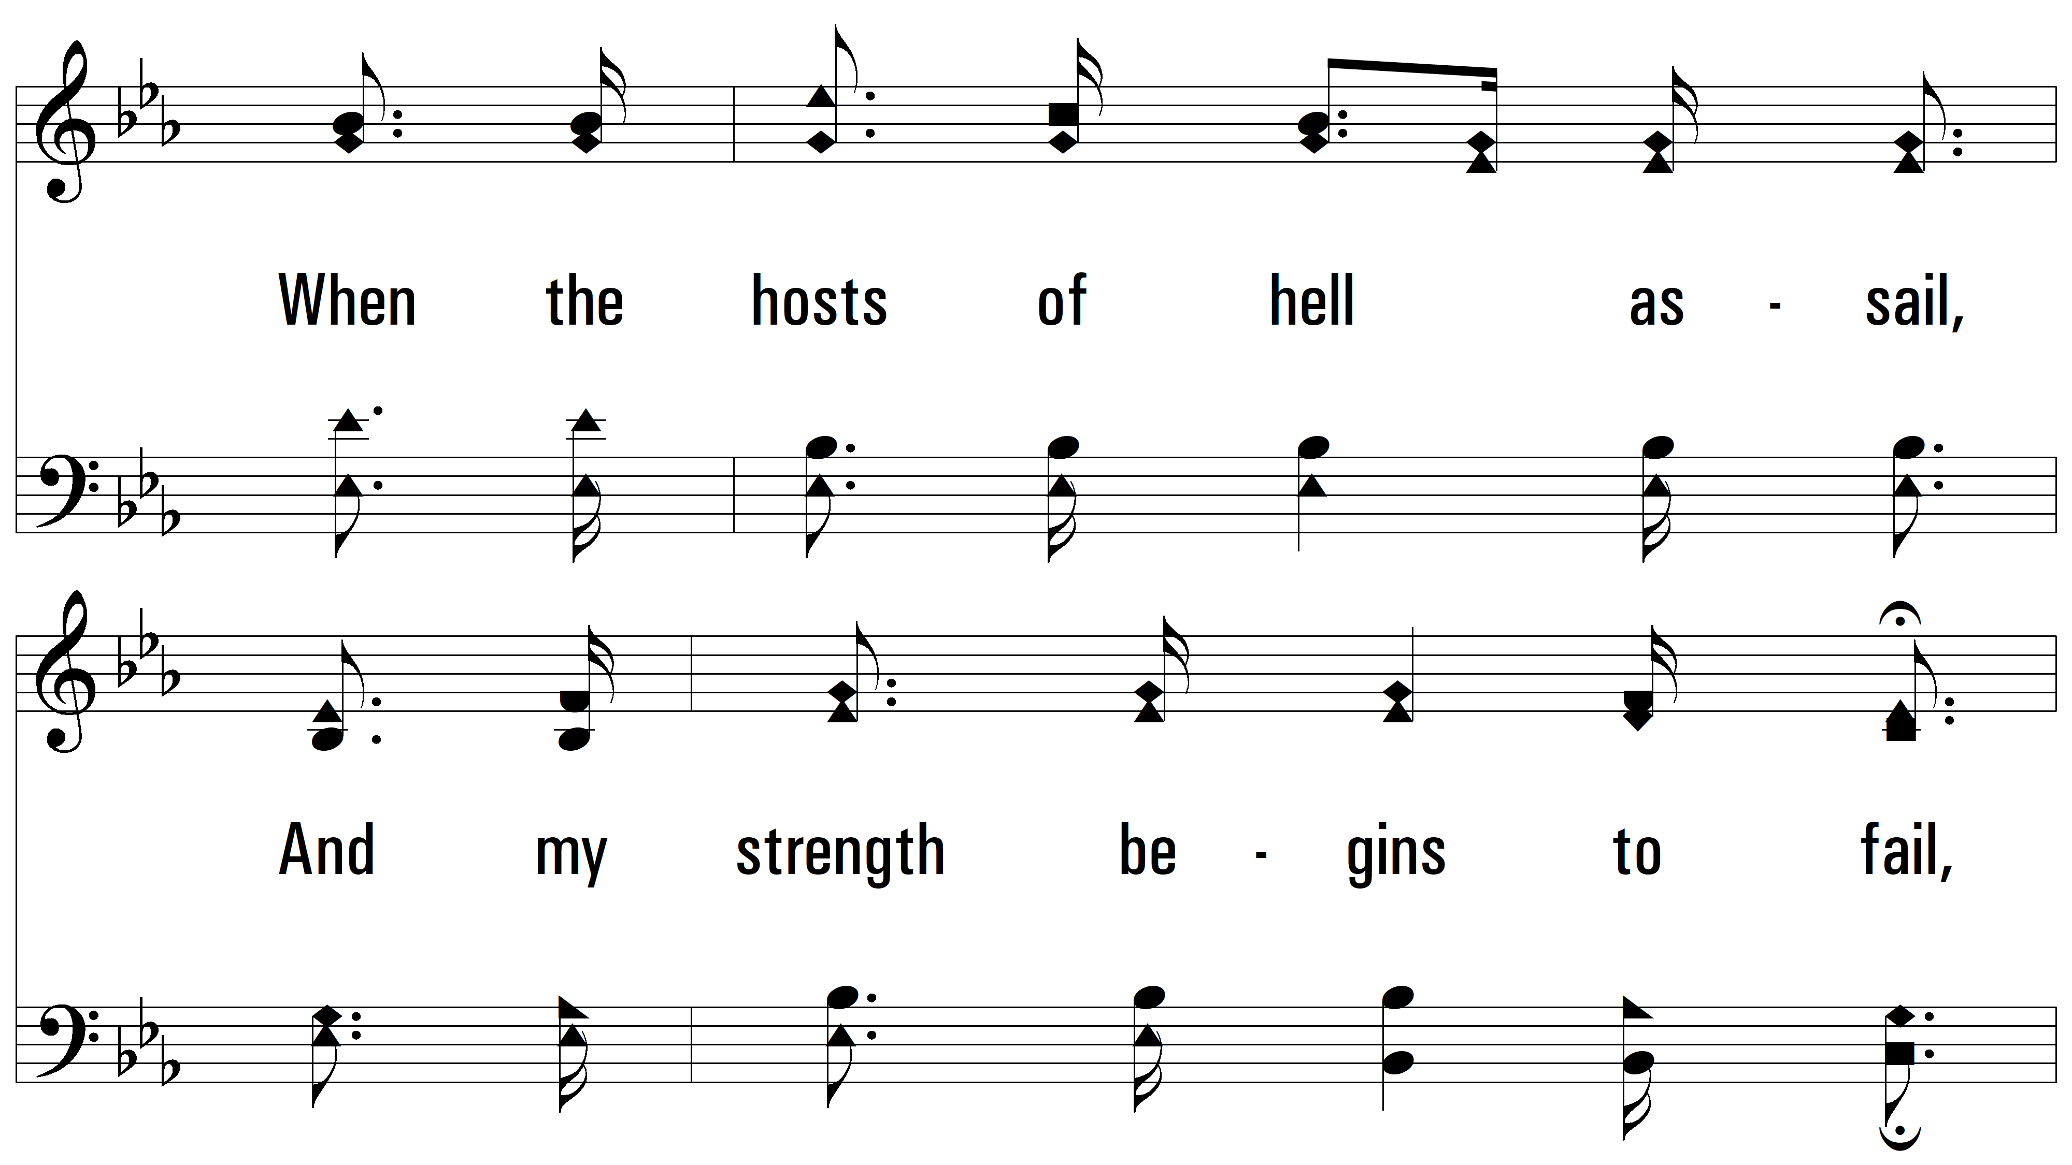
vs. 2

Slide 9
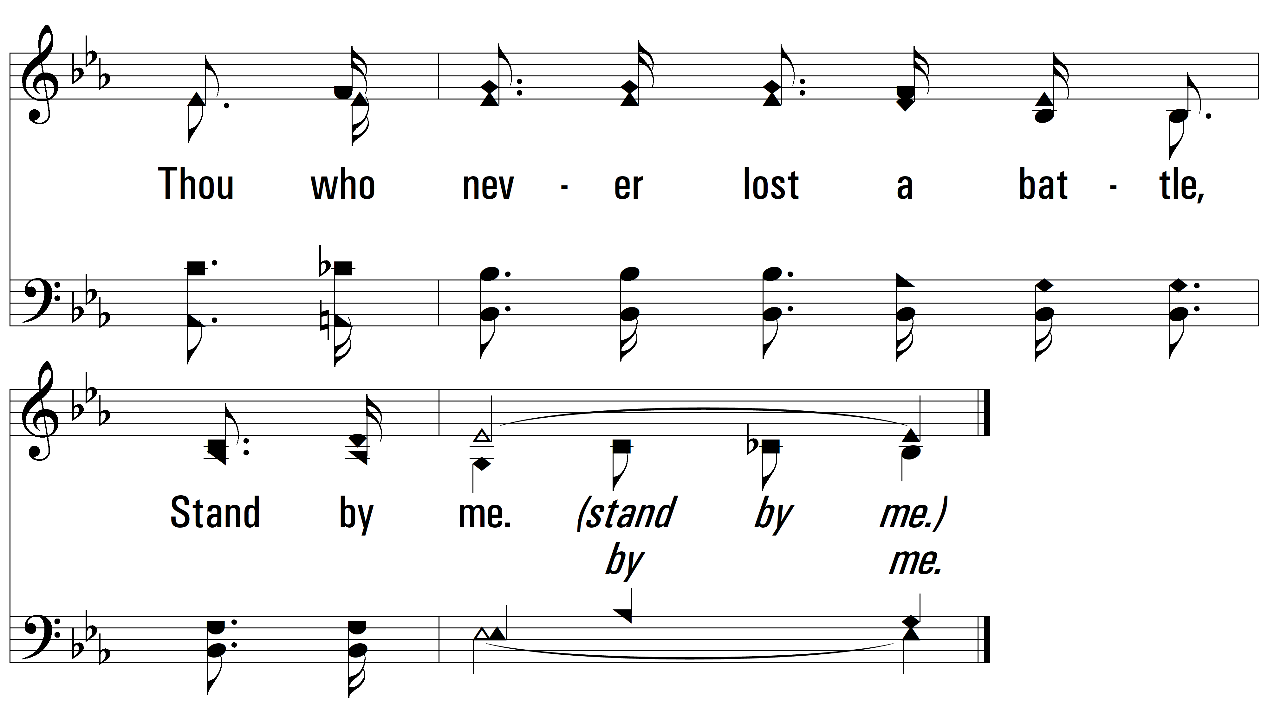
vs. 2

Slide 10
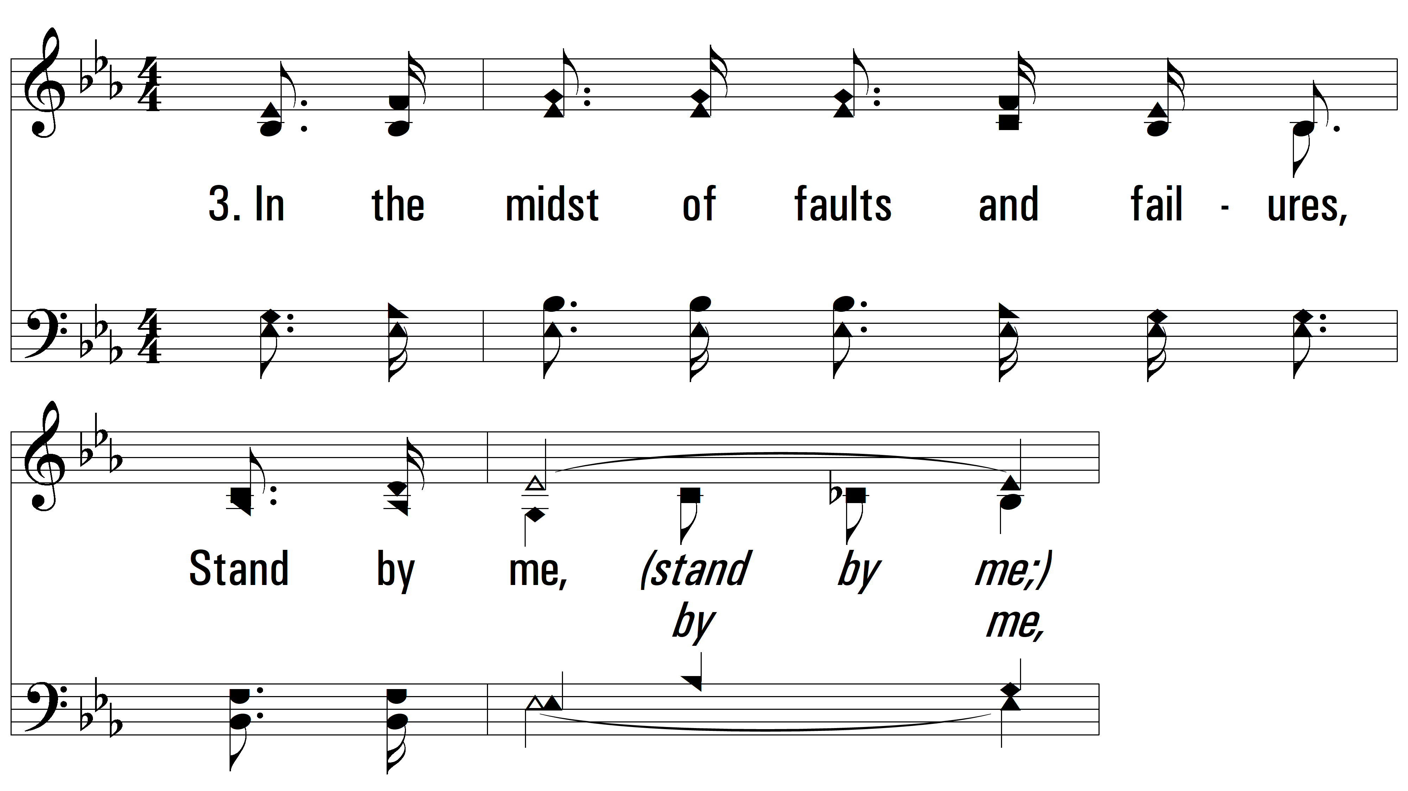
vs. 3 ~ Stand By Me

Slide 11
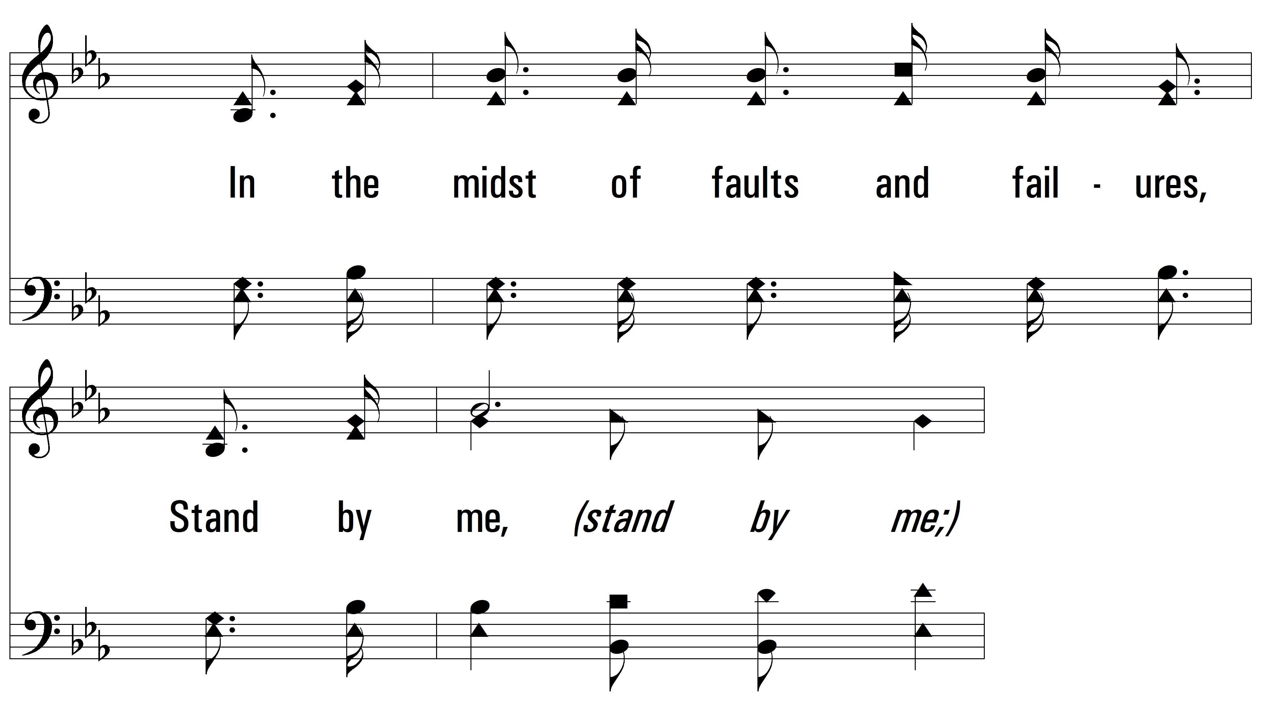
vs. 3

Slide 12
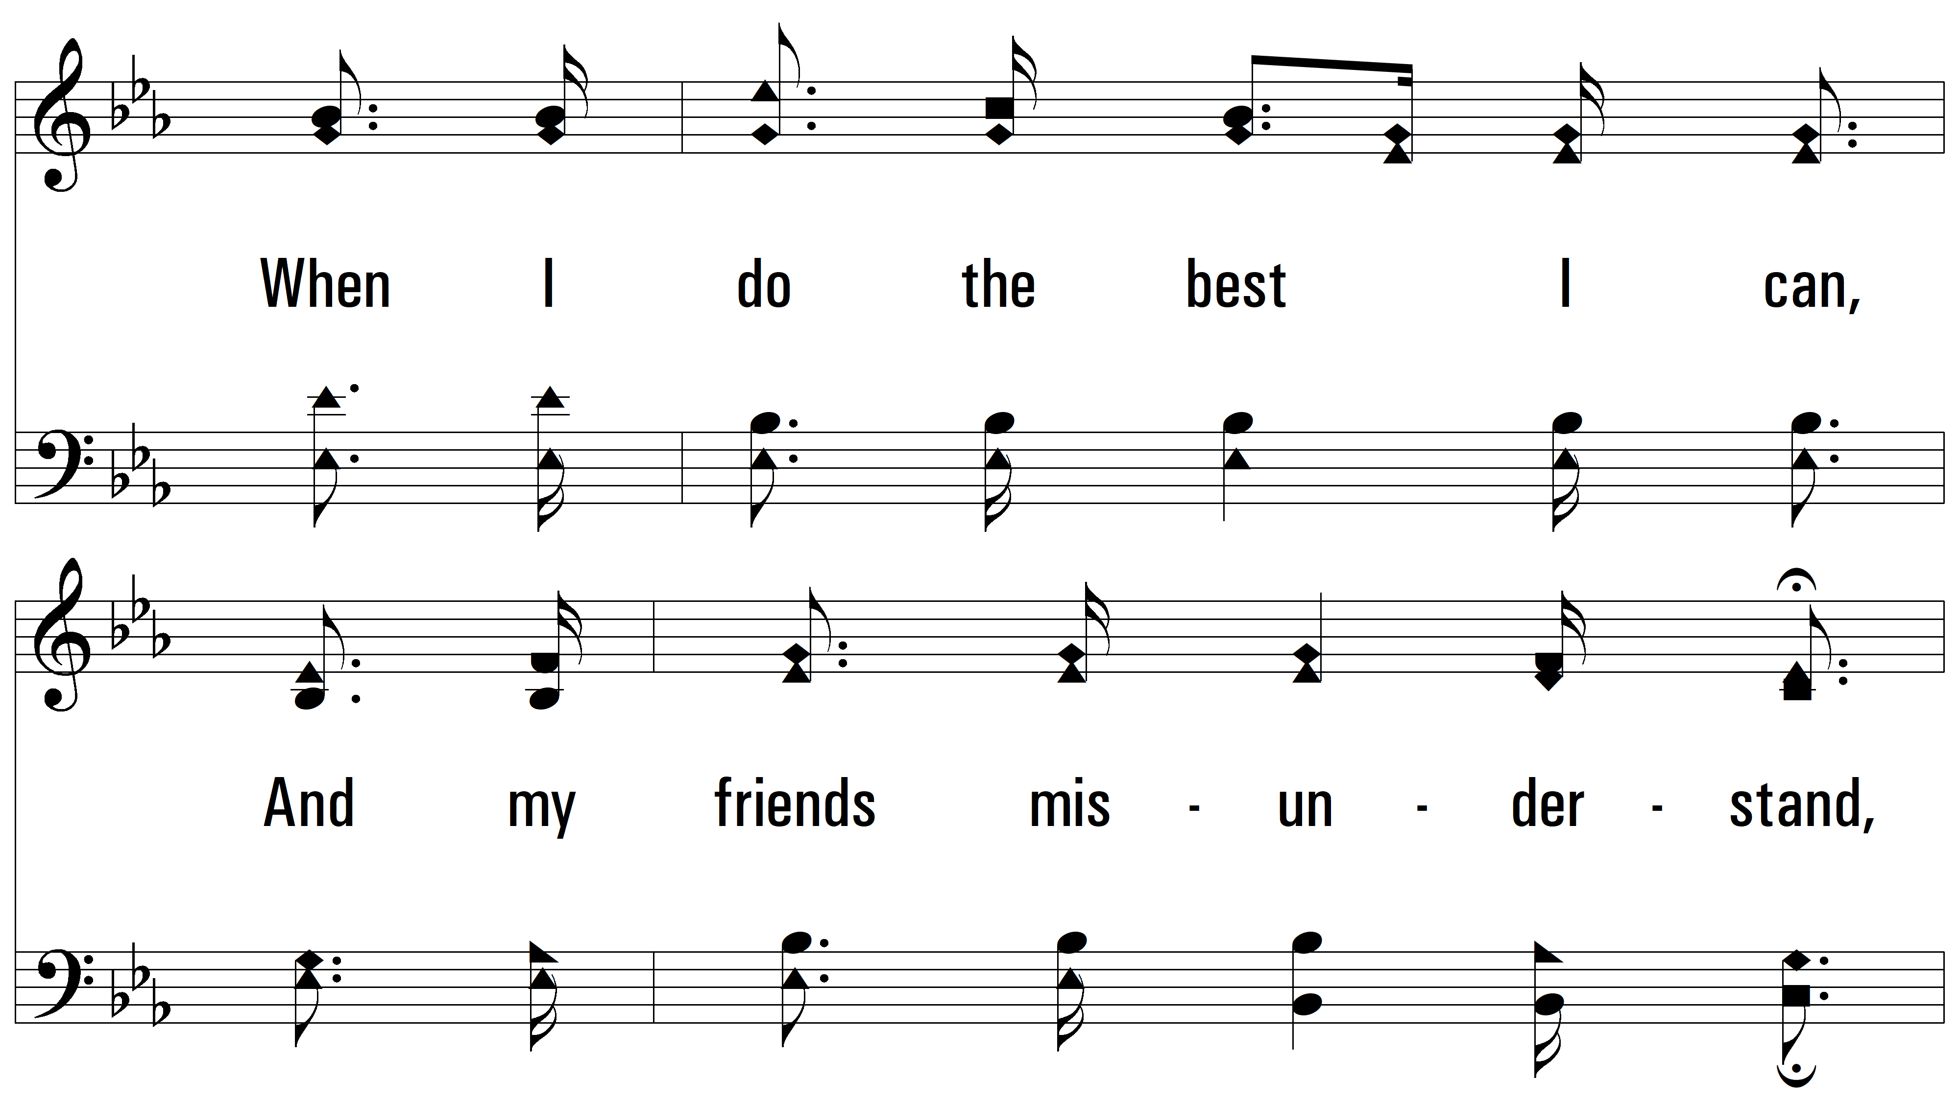
vs. 3

Slide 13
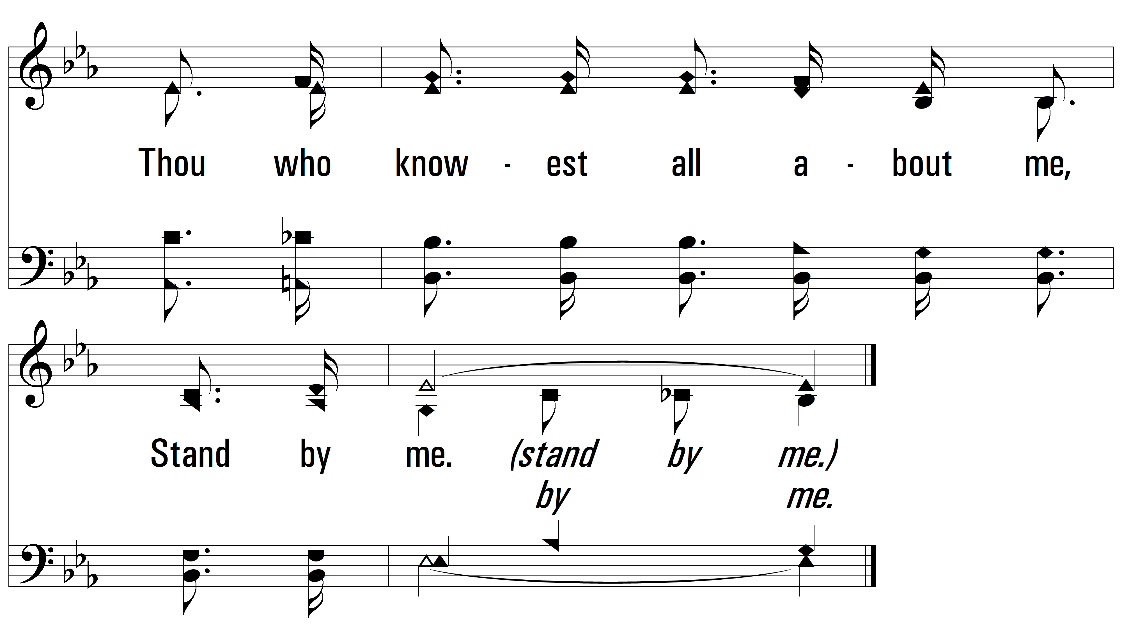
vs. 3

Slide 14
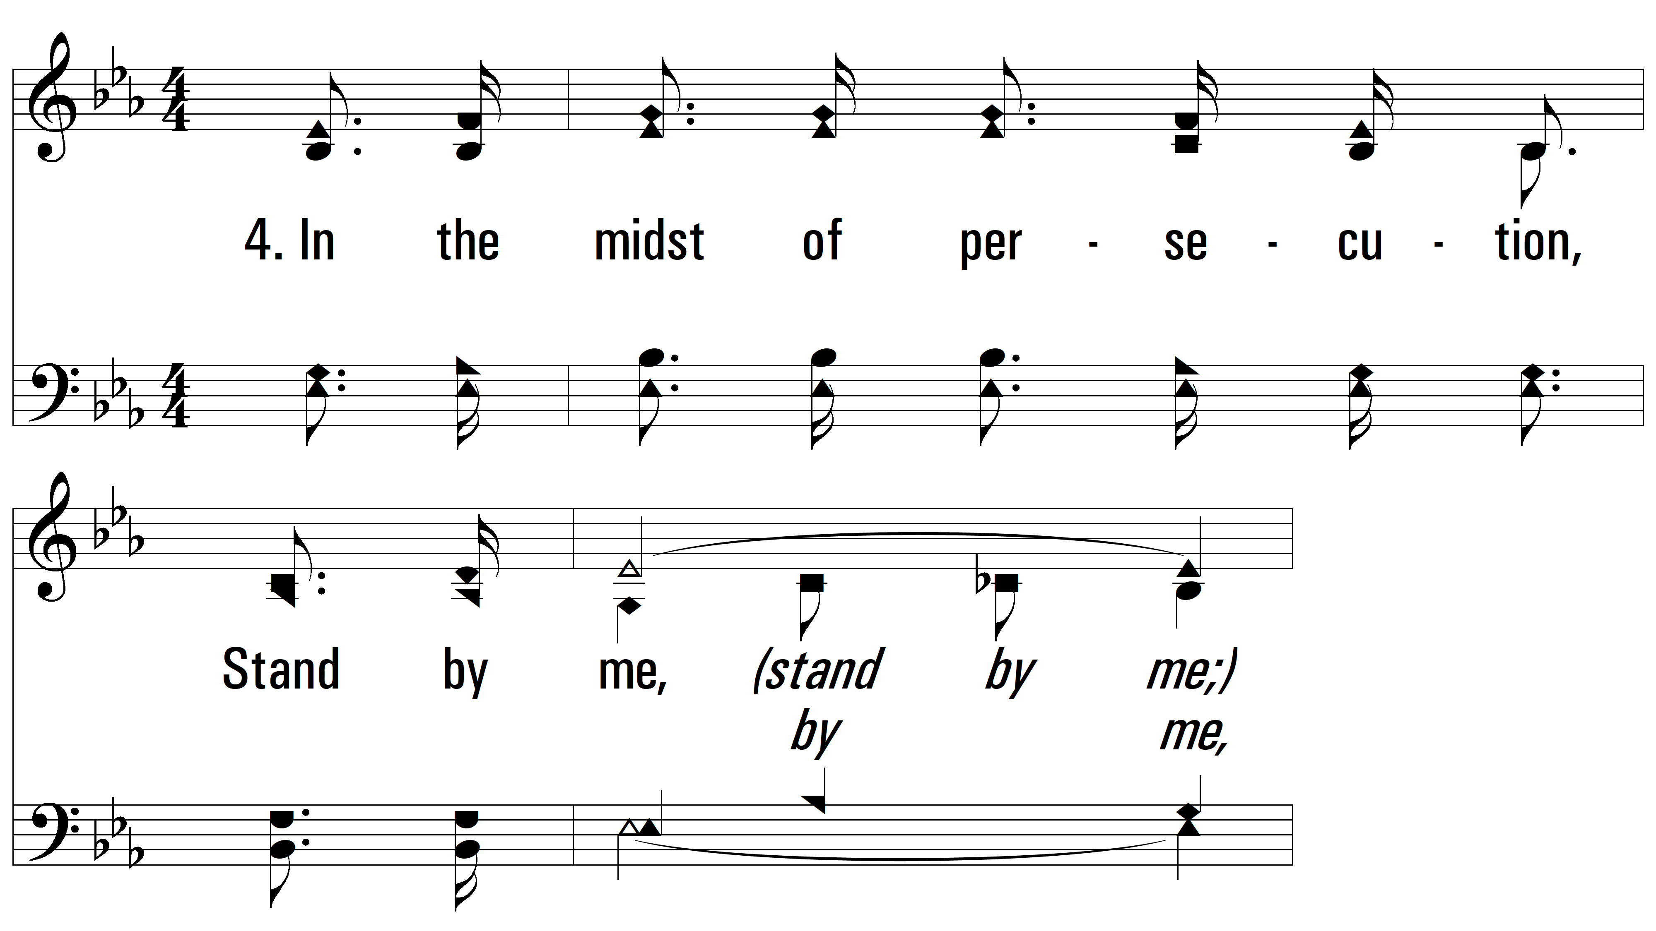
vs. 4 ~ Stand By Me

Slide 15
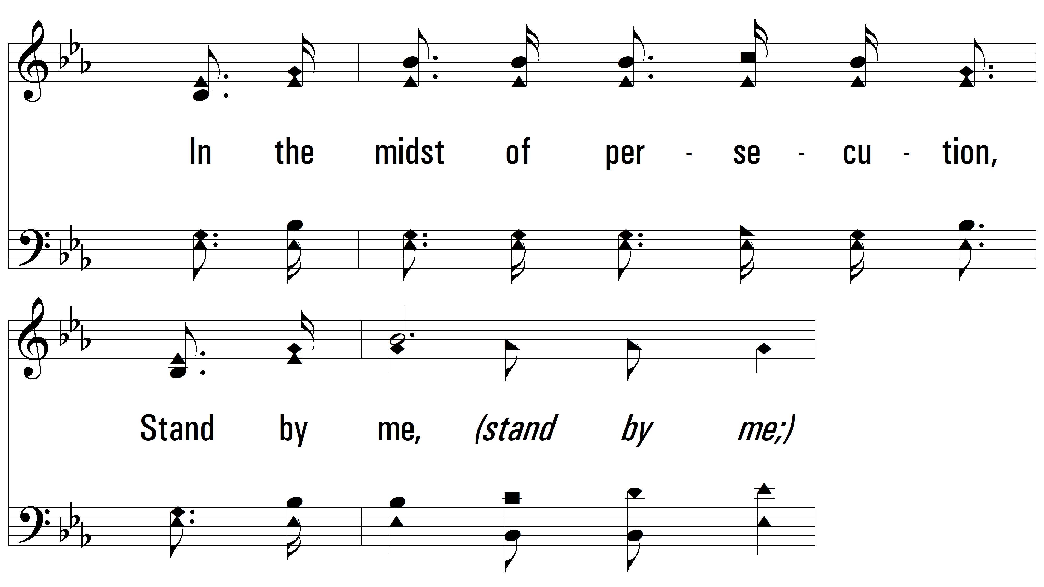
vs. 4

Slide 16
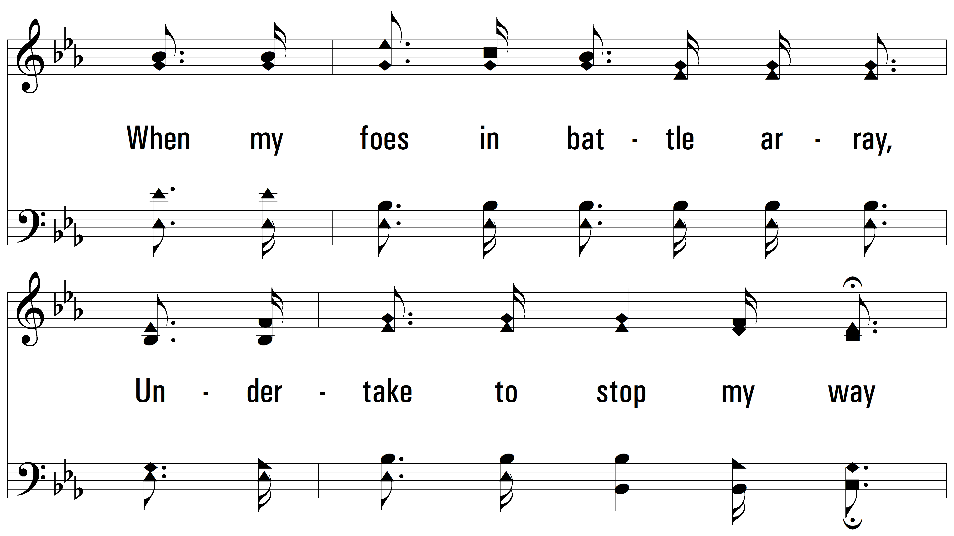
vs. 4

Slide 17
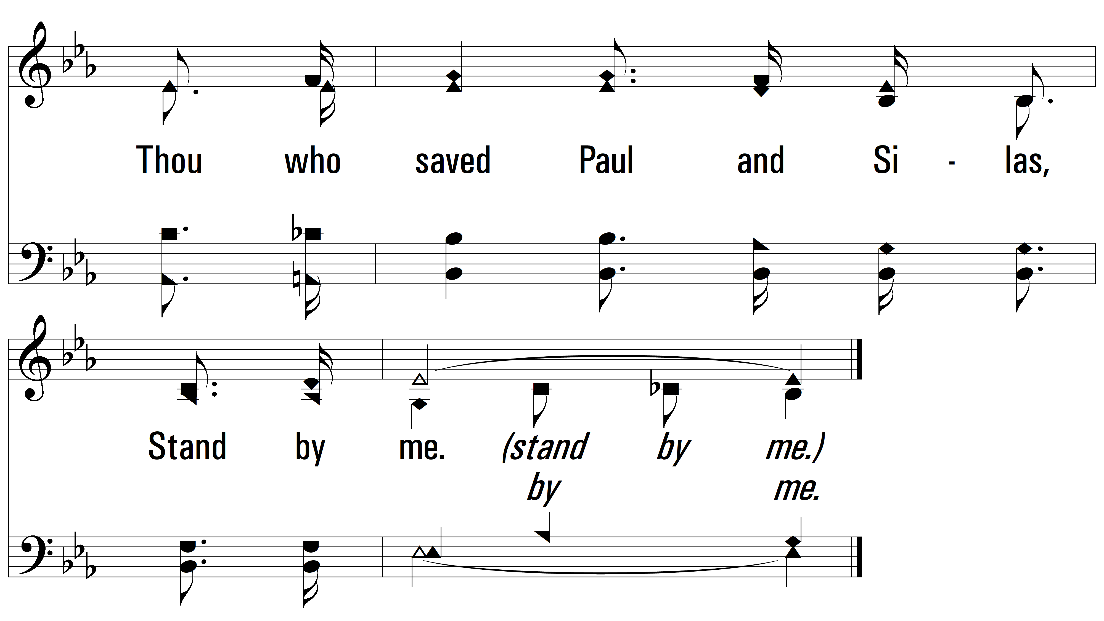
vs. 4

Slide 18
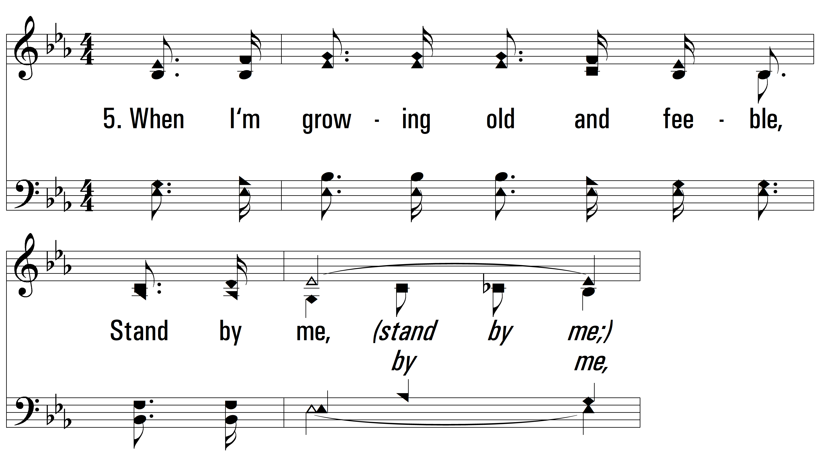
vs. 5 ~ Stand By Me

Slide 19
vs. 5

Slide 20
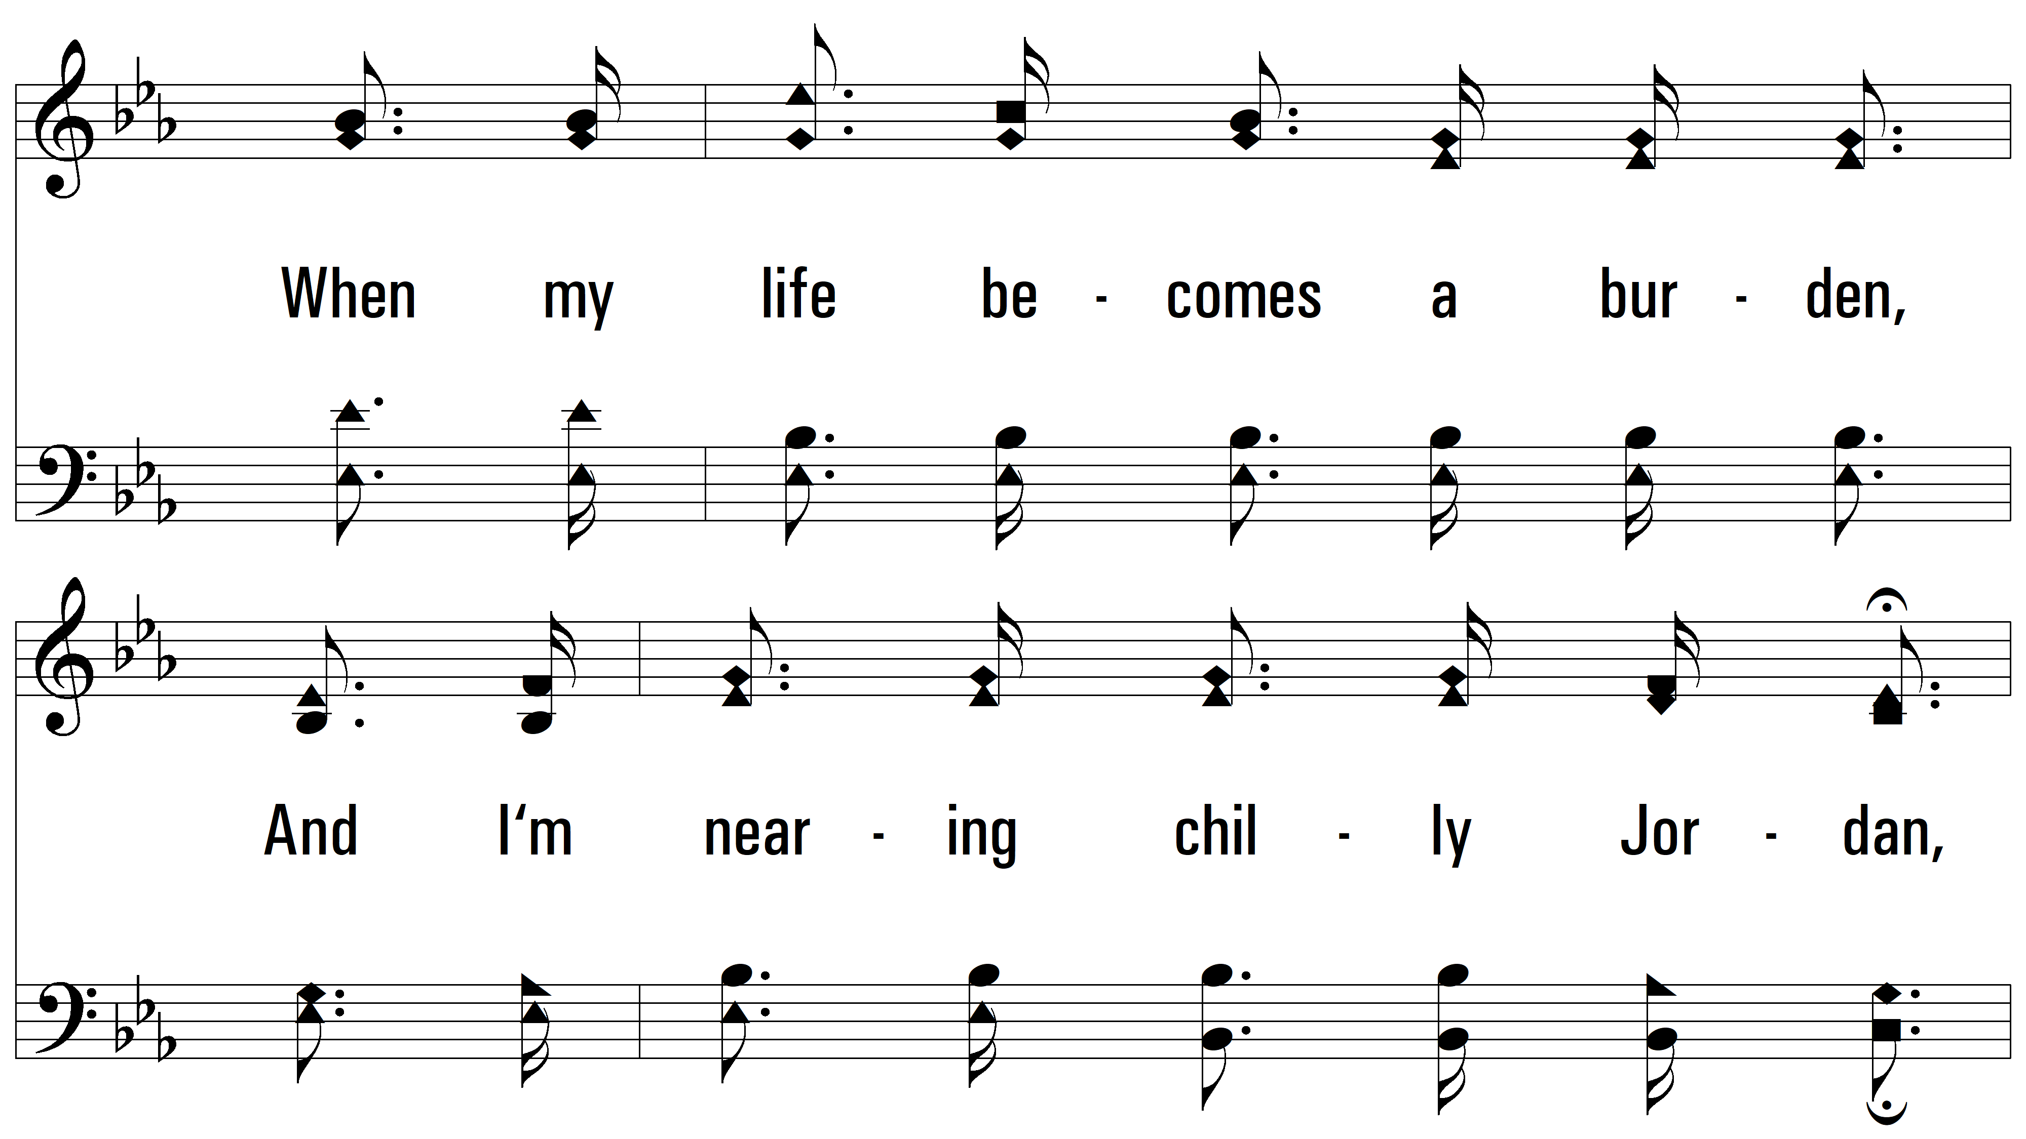
vs. 5

Slide 21
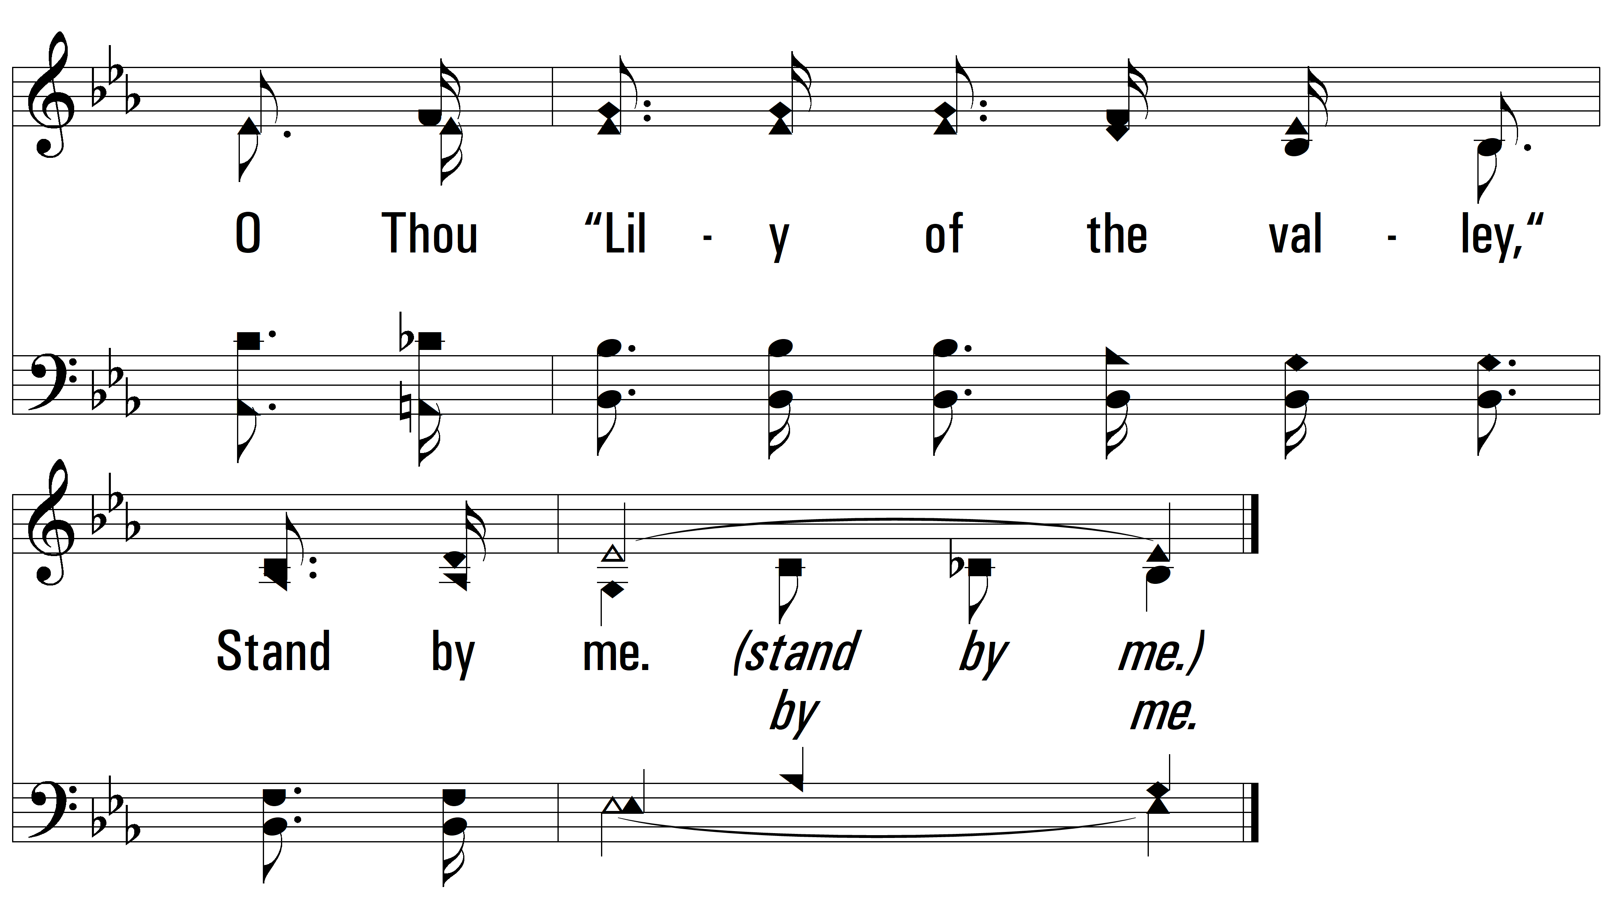
vs. 5
PDHymns.com
END

