Slide 1
Soul, A Savior Thou Art Needing
Words: | Jessie Brown Pounds (1887)
Music: | J. H. Fillmore (1887)
9/8
F/C - SOL
Verses: 3/Chorus
Lead - | SOL
Alto - | SOL
Tenor - | MI
Bass - | DO
PDHymns.com

Slide 2
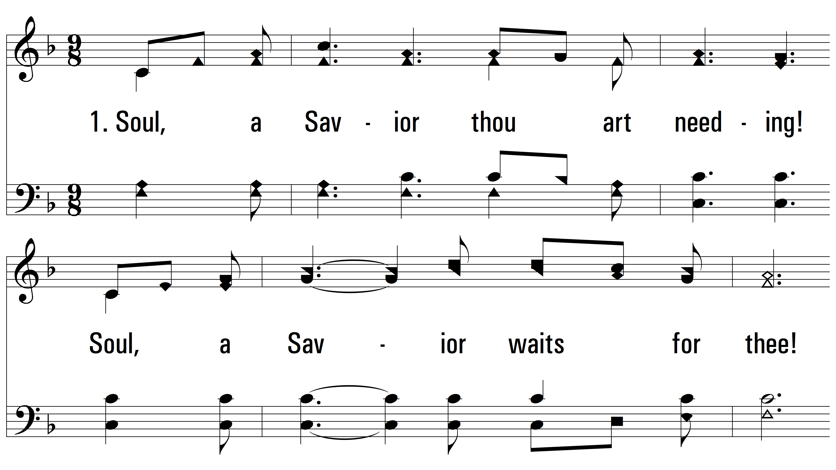
vs. 1 ~ Soul, A Savior Thou Art Needing

Slide 3
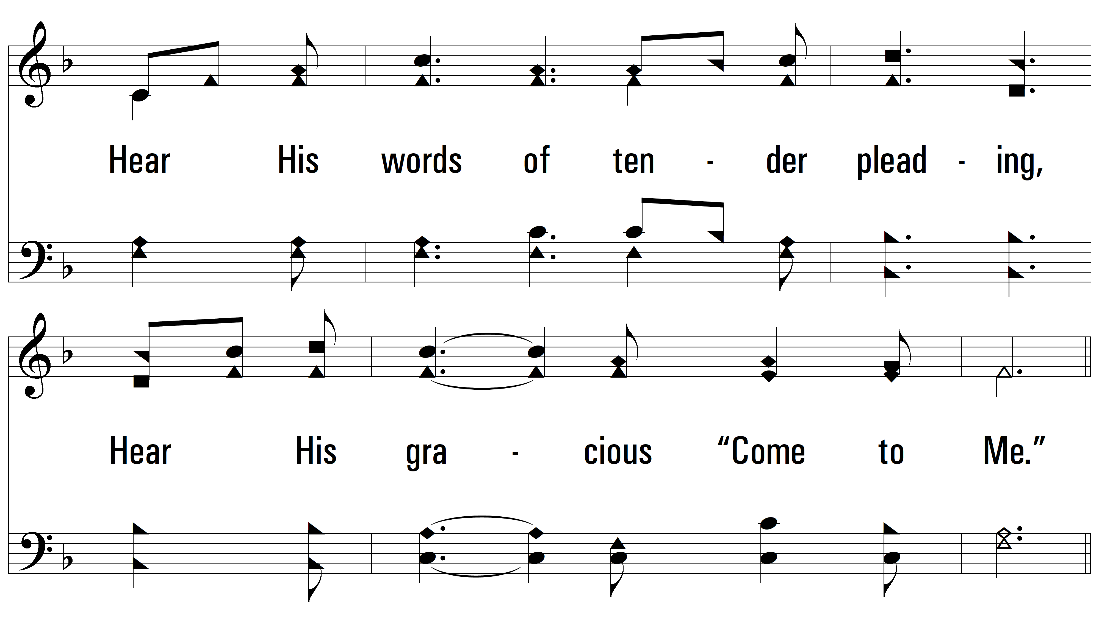
vs. 1

Slide 4
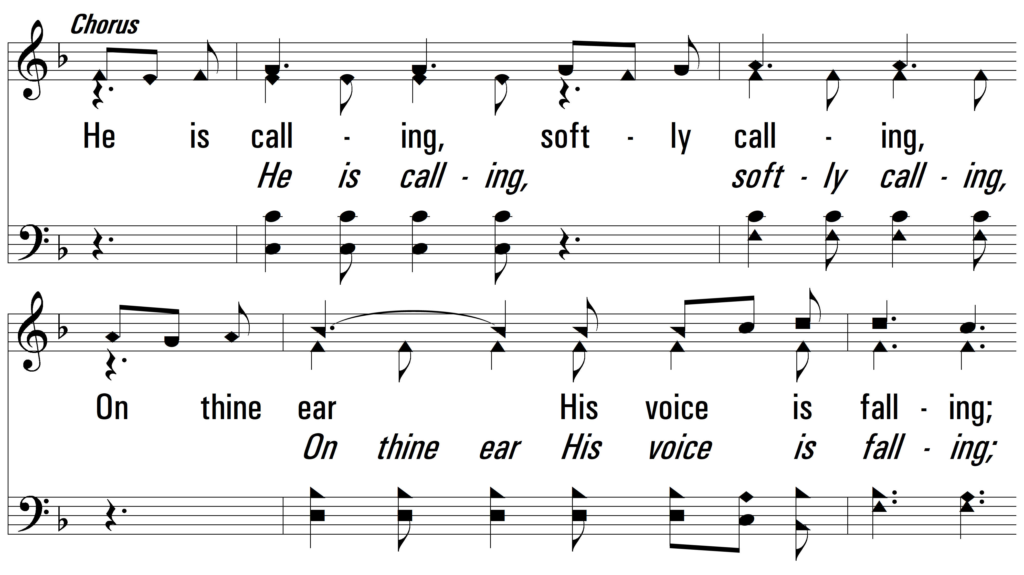
vs. 1

Slide 5
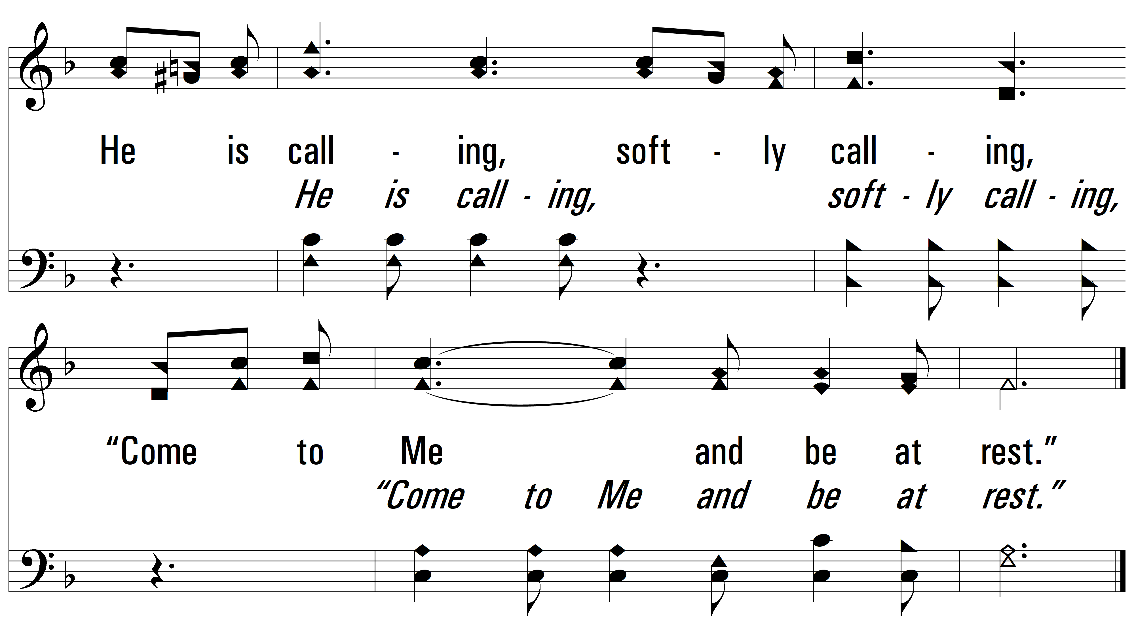
vs. 1

Slide 6
vs. 2 ~ Soul, A Savior Thou Art Needing

Slide 7
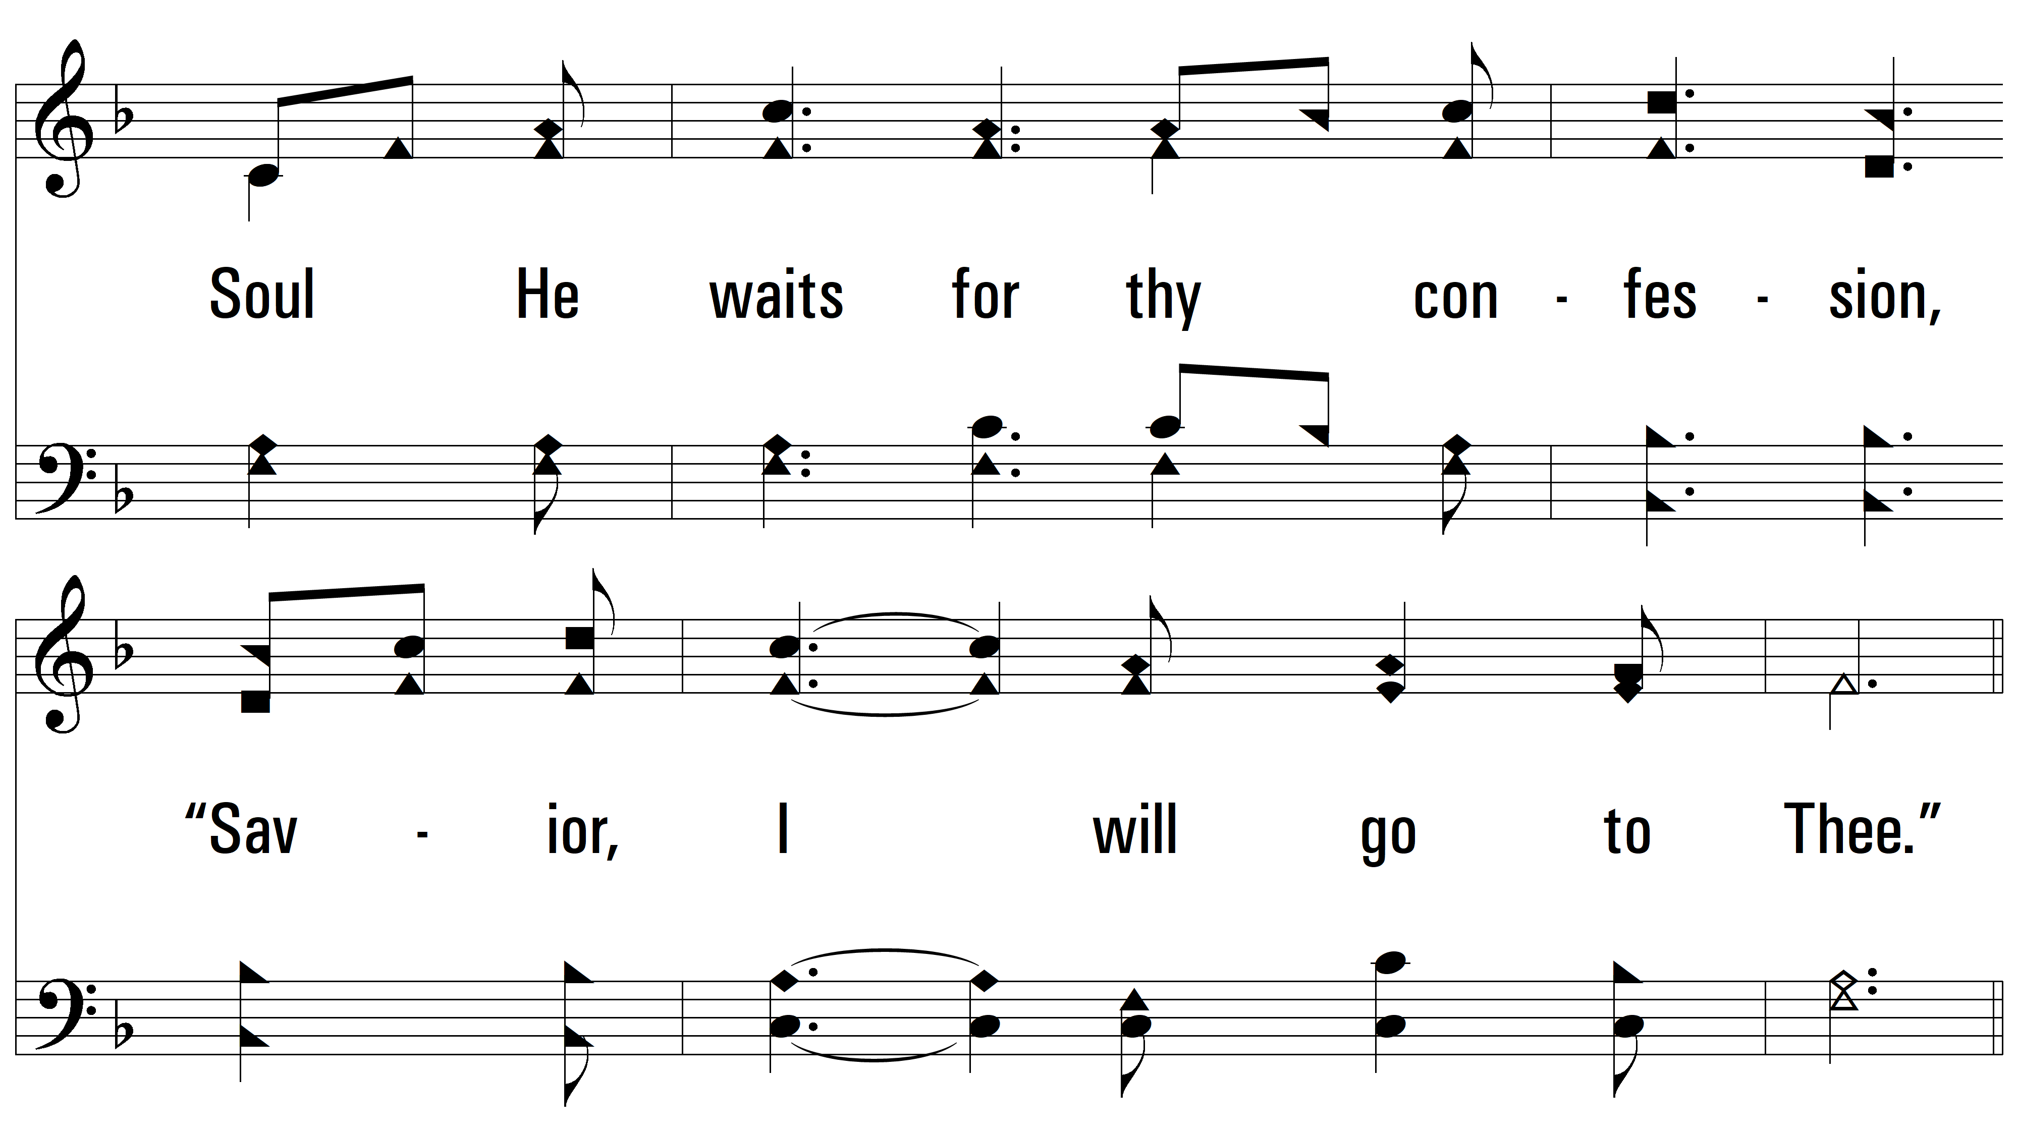
vs. 2

Slide 8
vs. 2

Slide 9
vs. 2

Slide 10
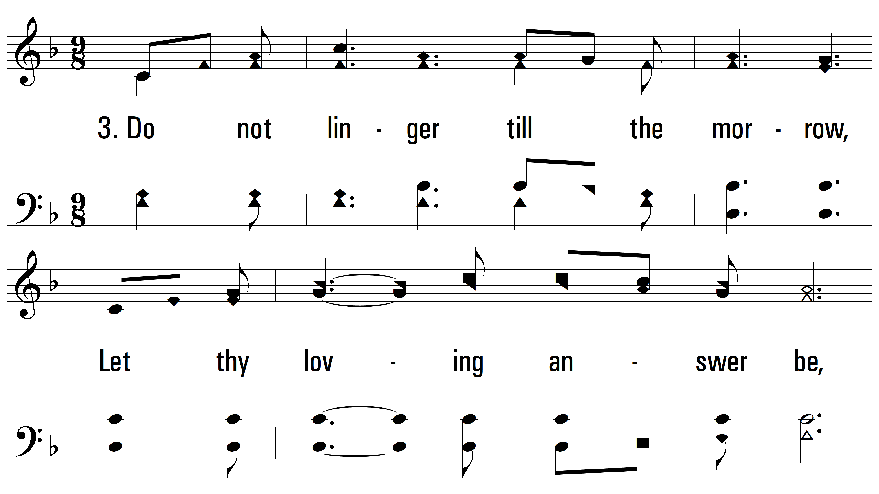
vs. 3 ~ Soul, A Savior Thou Art Needing

Slide 11
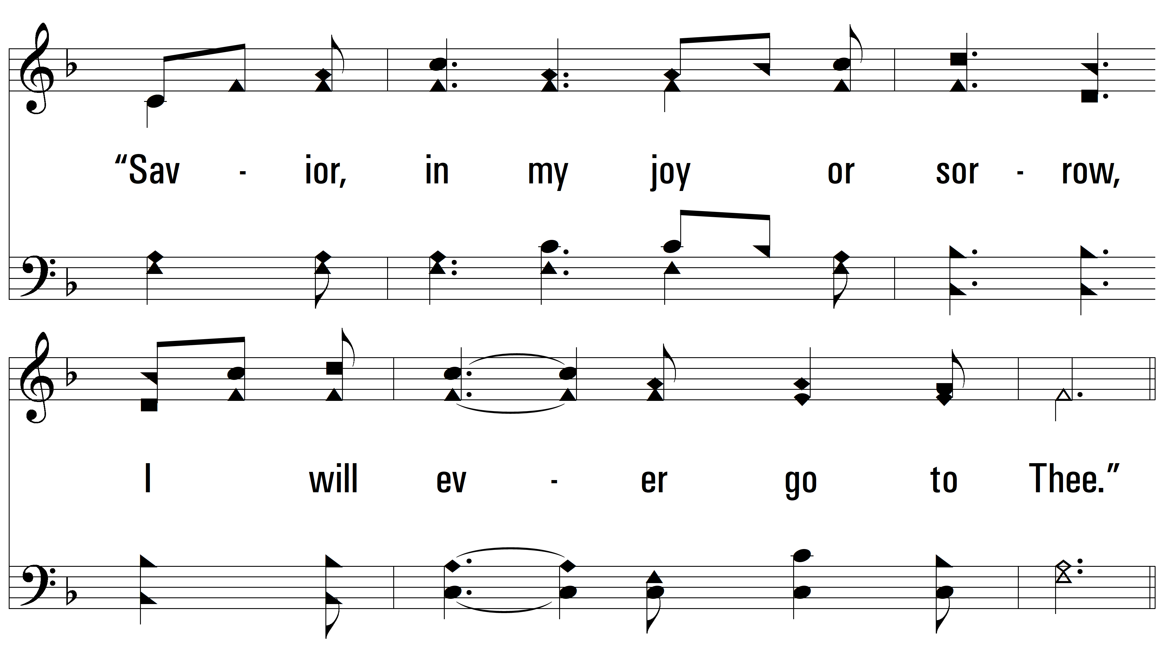
vs. 3

Slide 12
vs. 3

Slide 13
vs. 3
PDHymns.com
END

