Slide 1
Soldiers Of Christ, Arise
KIRKWOOD
SM
Words: | Charles Wesley (1742)
Music: | William B. Bradbury (1858)
4/4
F/F - DO
Verses: 5
Lead - | DO
Alto - | SOL
Tenor - | MI
Bass - | DO
PDHymns.com

Slide 2
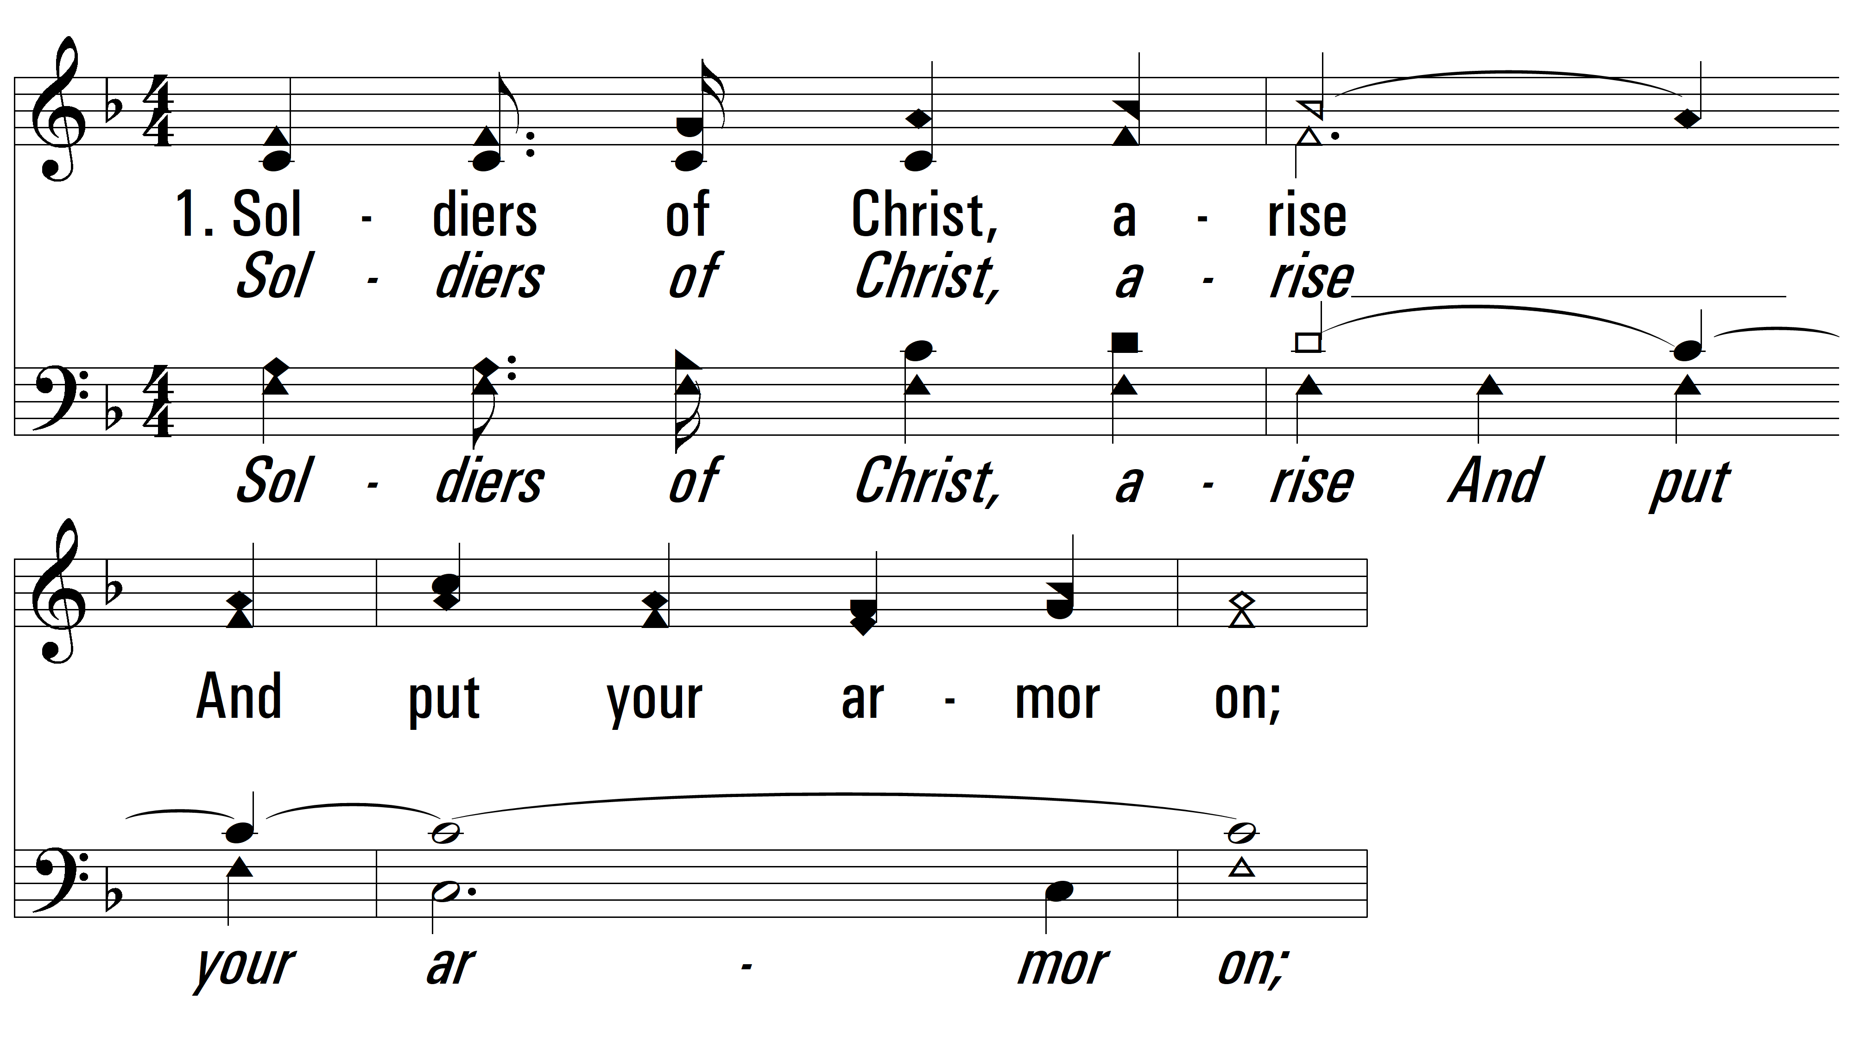
vs. 1 ~ Soldiers Of Christ, Arise

Slide 3
vs. 1

Slide 4
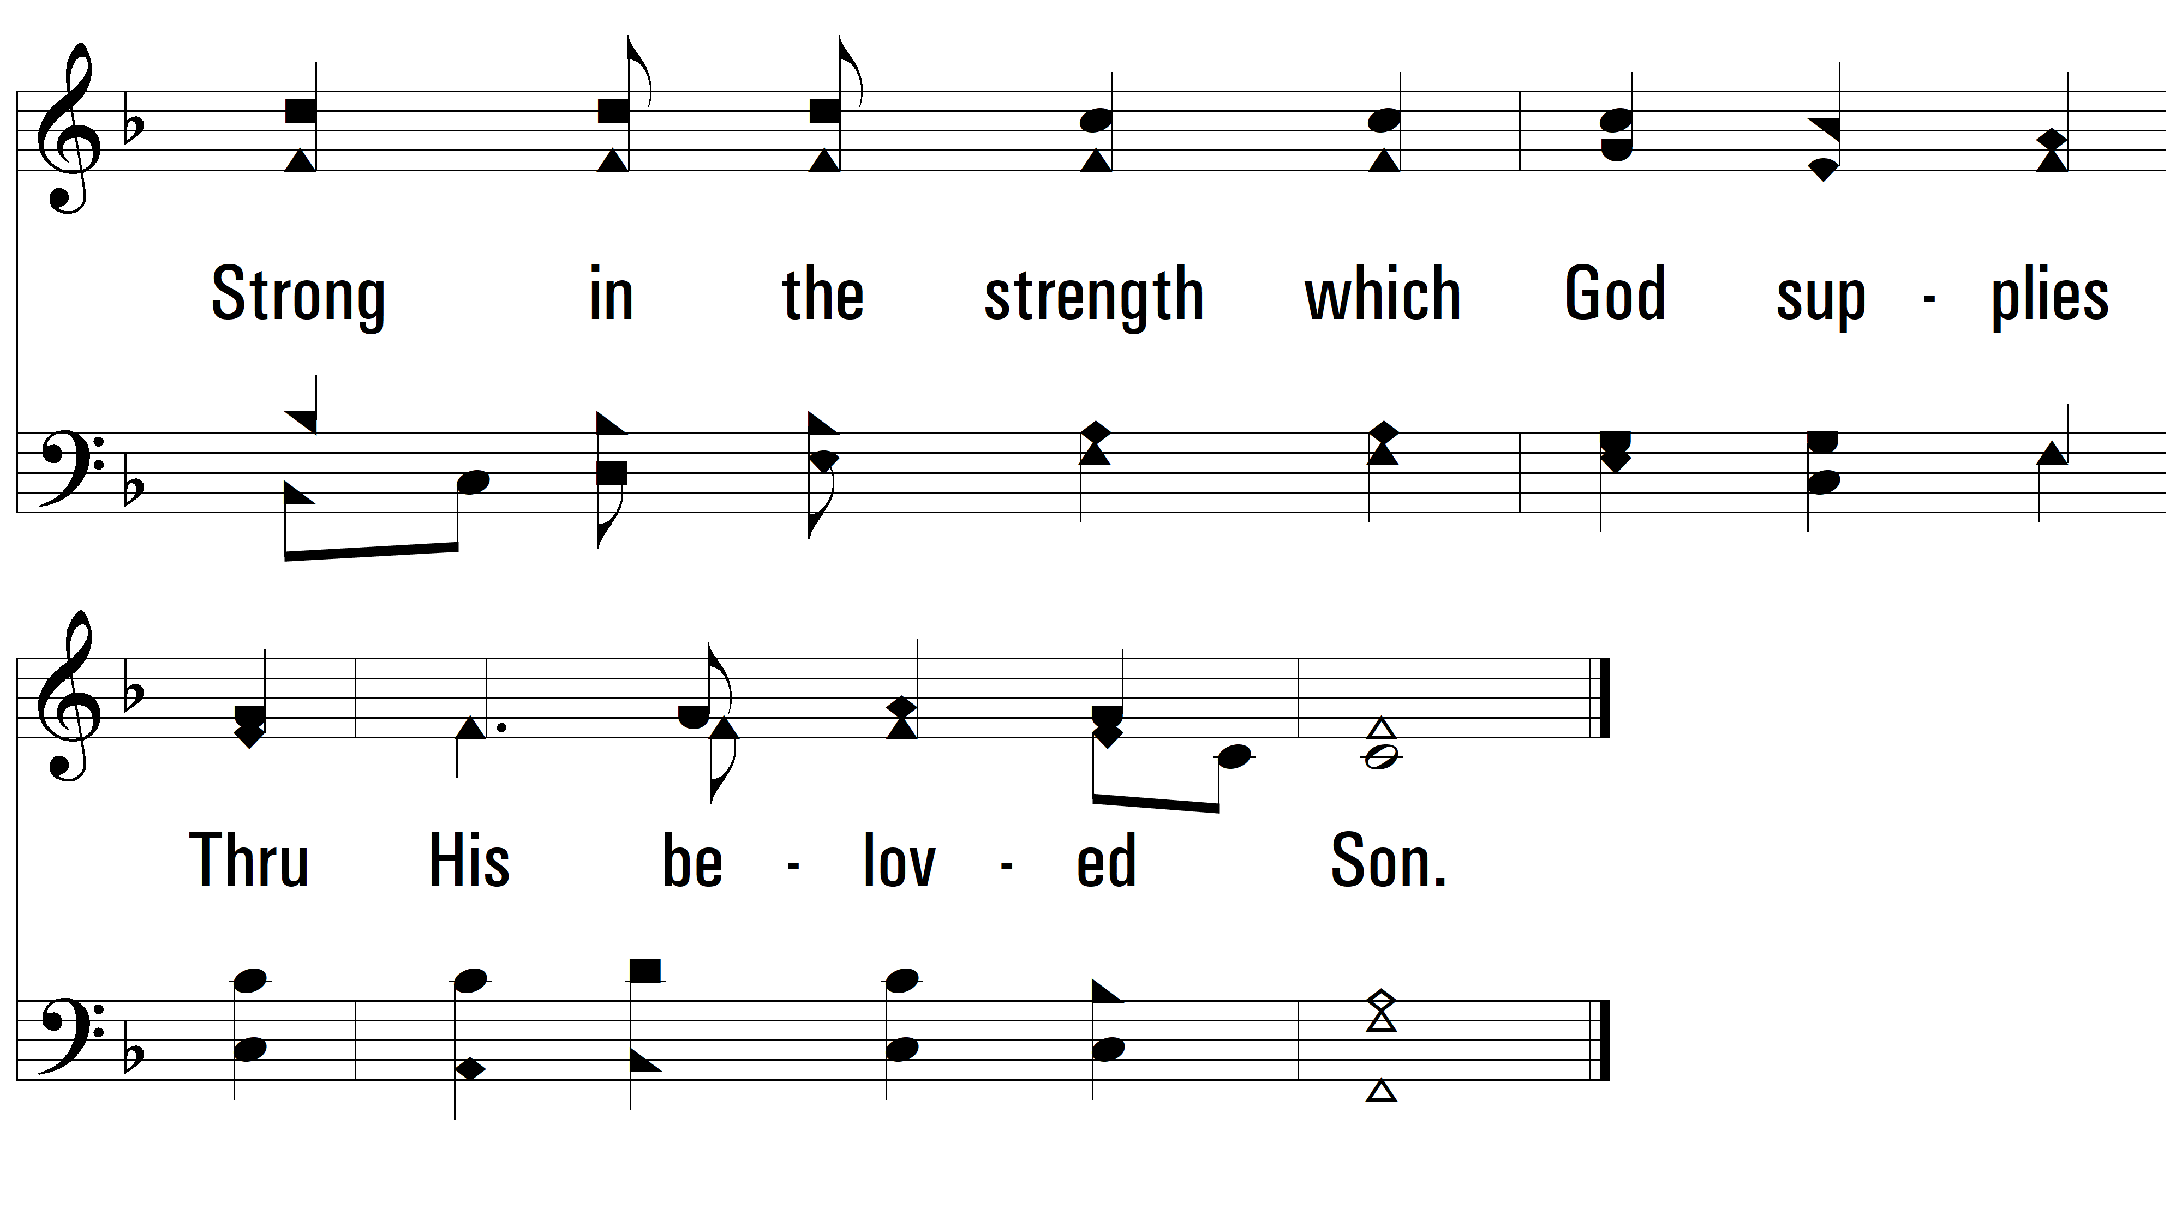
vs. 1

Slide 5
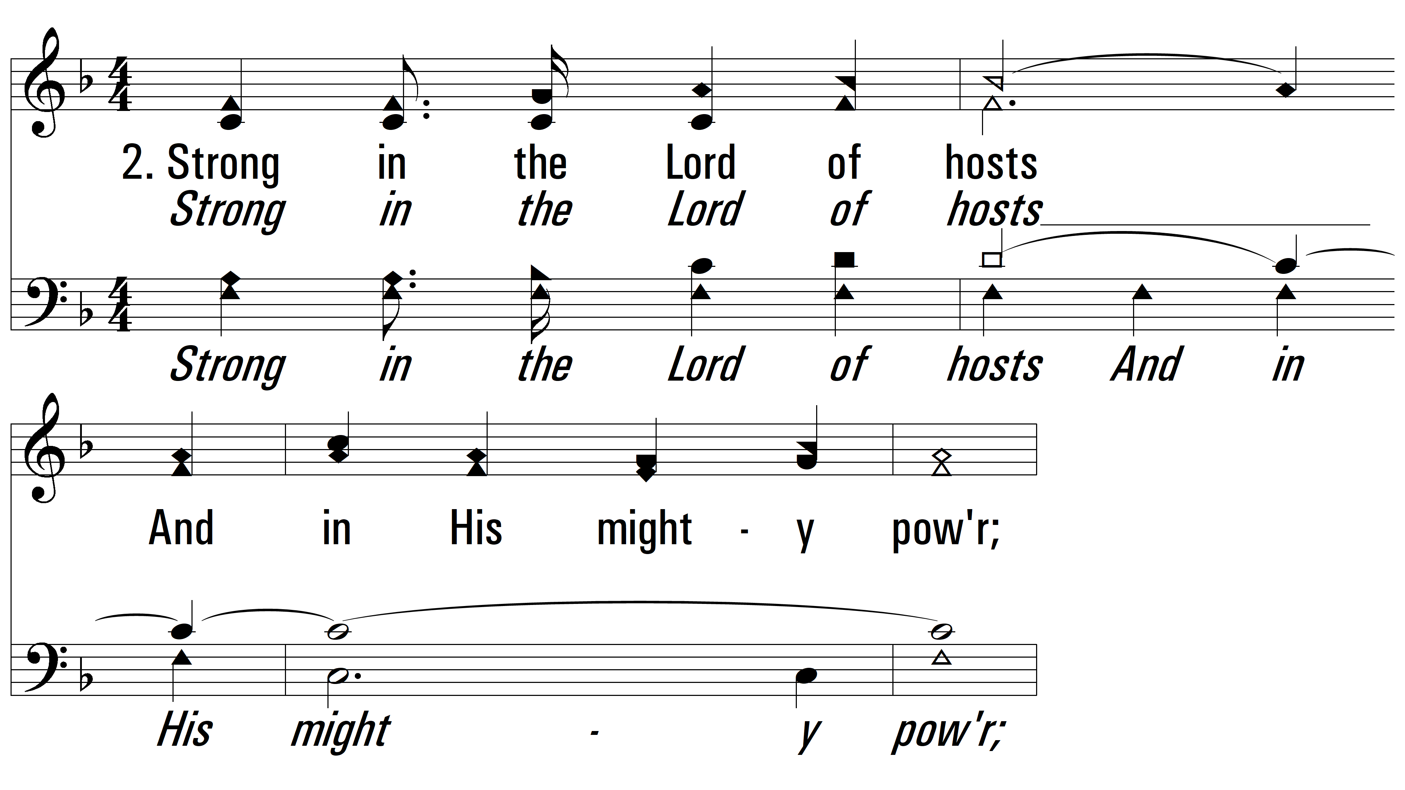
vs. 2 ~ Soldiers Of Christ, Arise

Slide 6
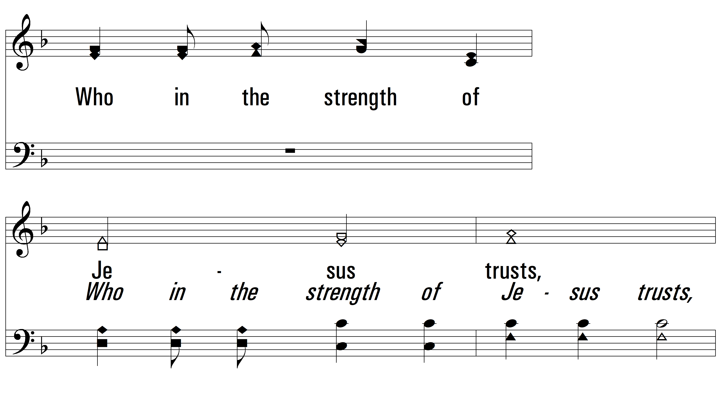
vs. 2

Slide 7
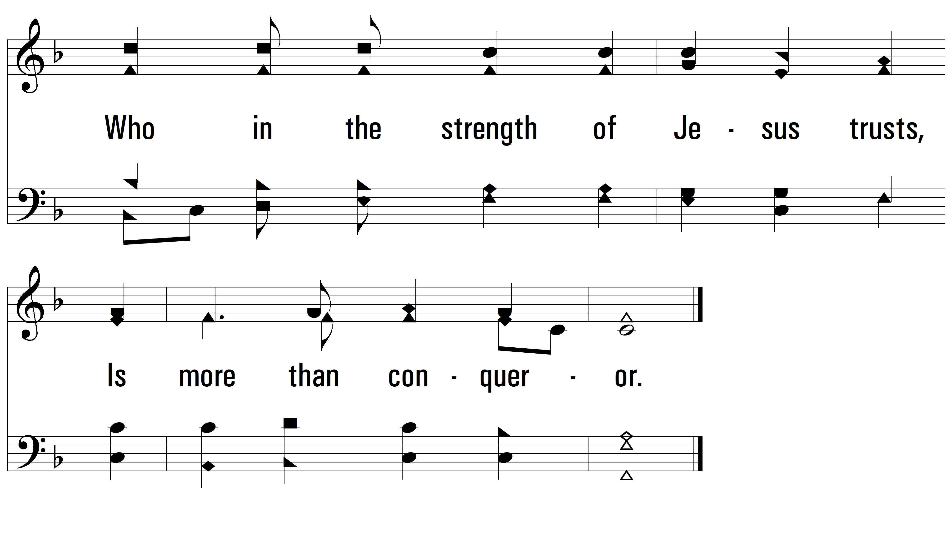
vs. 2

Slide 8
vs. 3 ~ Soldiers Of Christ, Arise

Slide 9
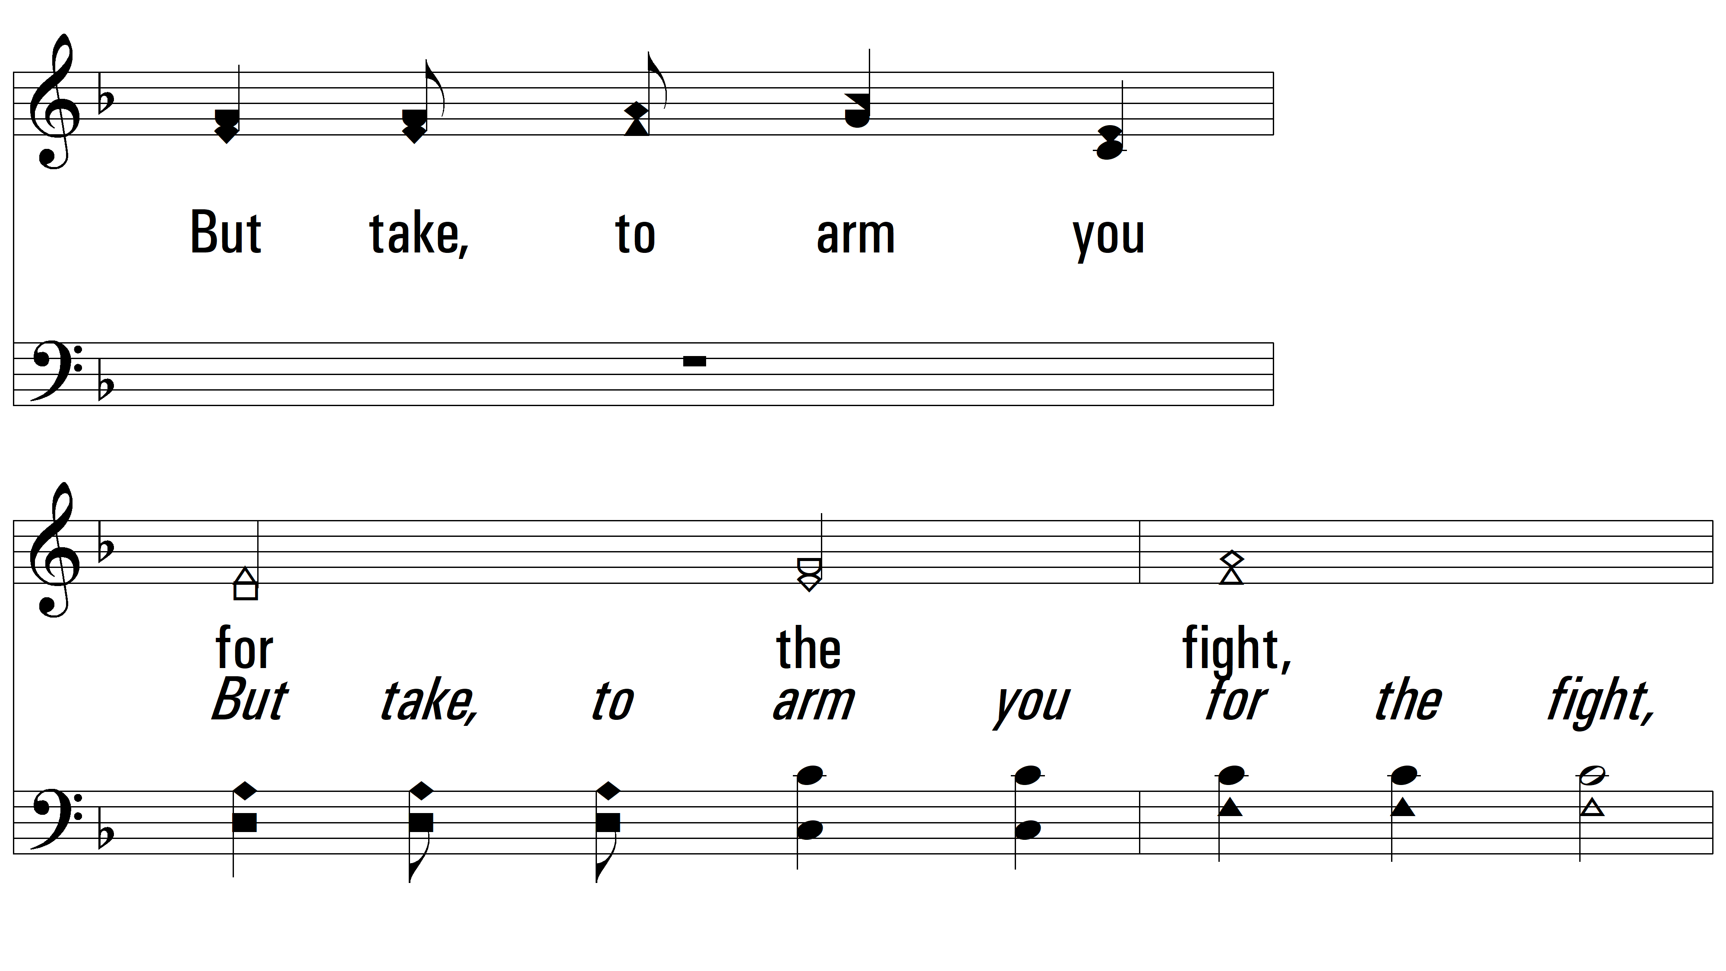
vs. 3

Slide 10
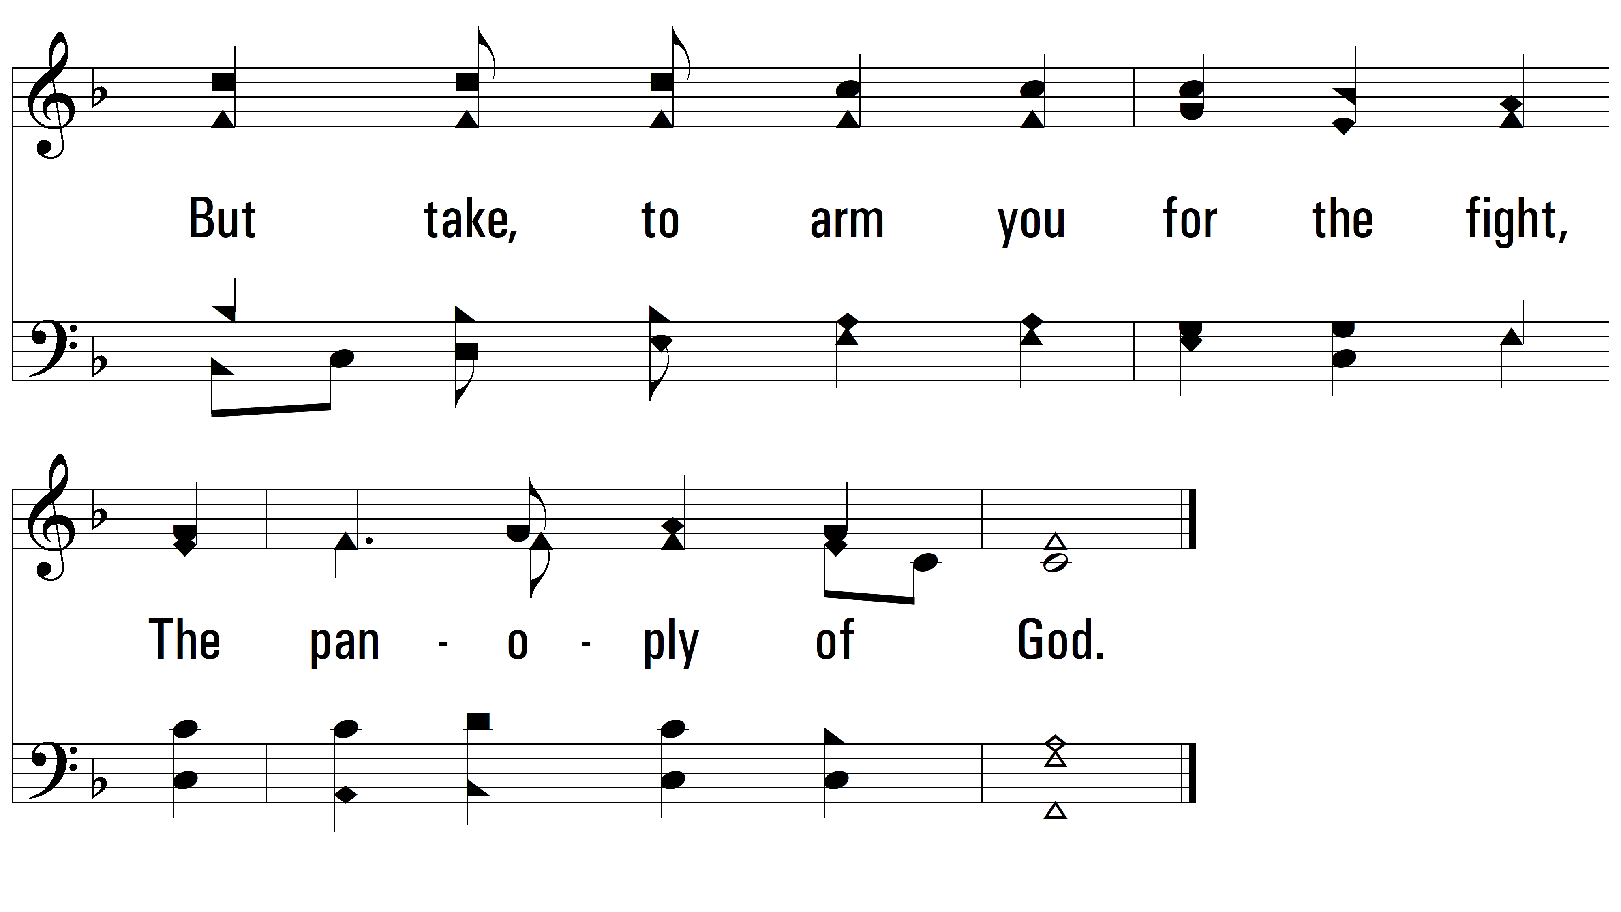
vs. 3

Slide 11
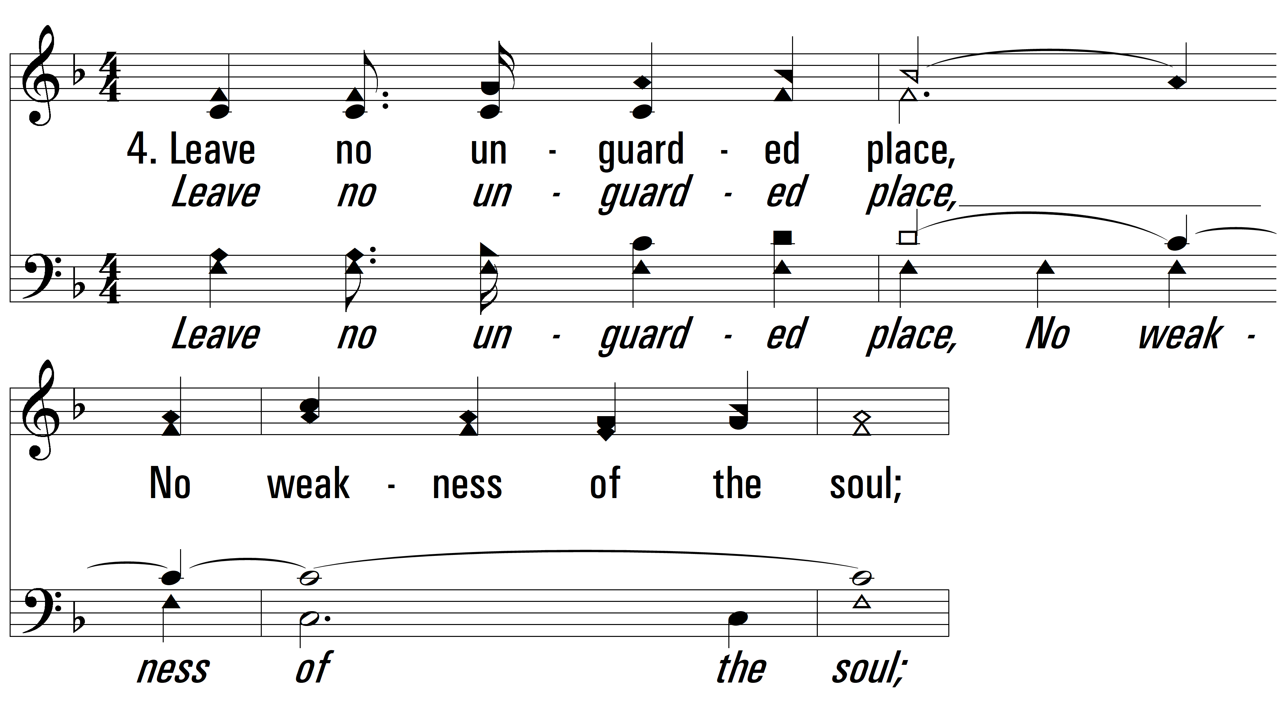
vs. 4 ~ Soldiers Of Christ, Arise

Slide 12
vs. 4

Slide 13
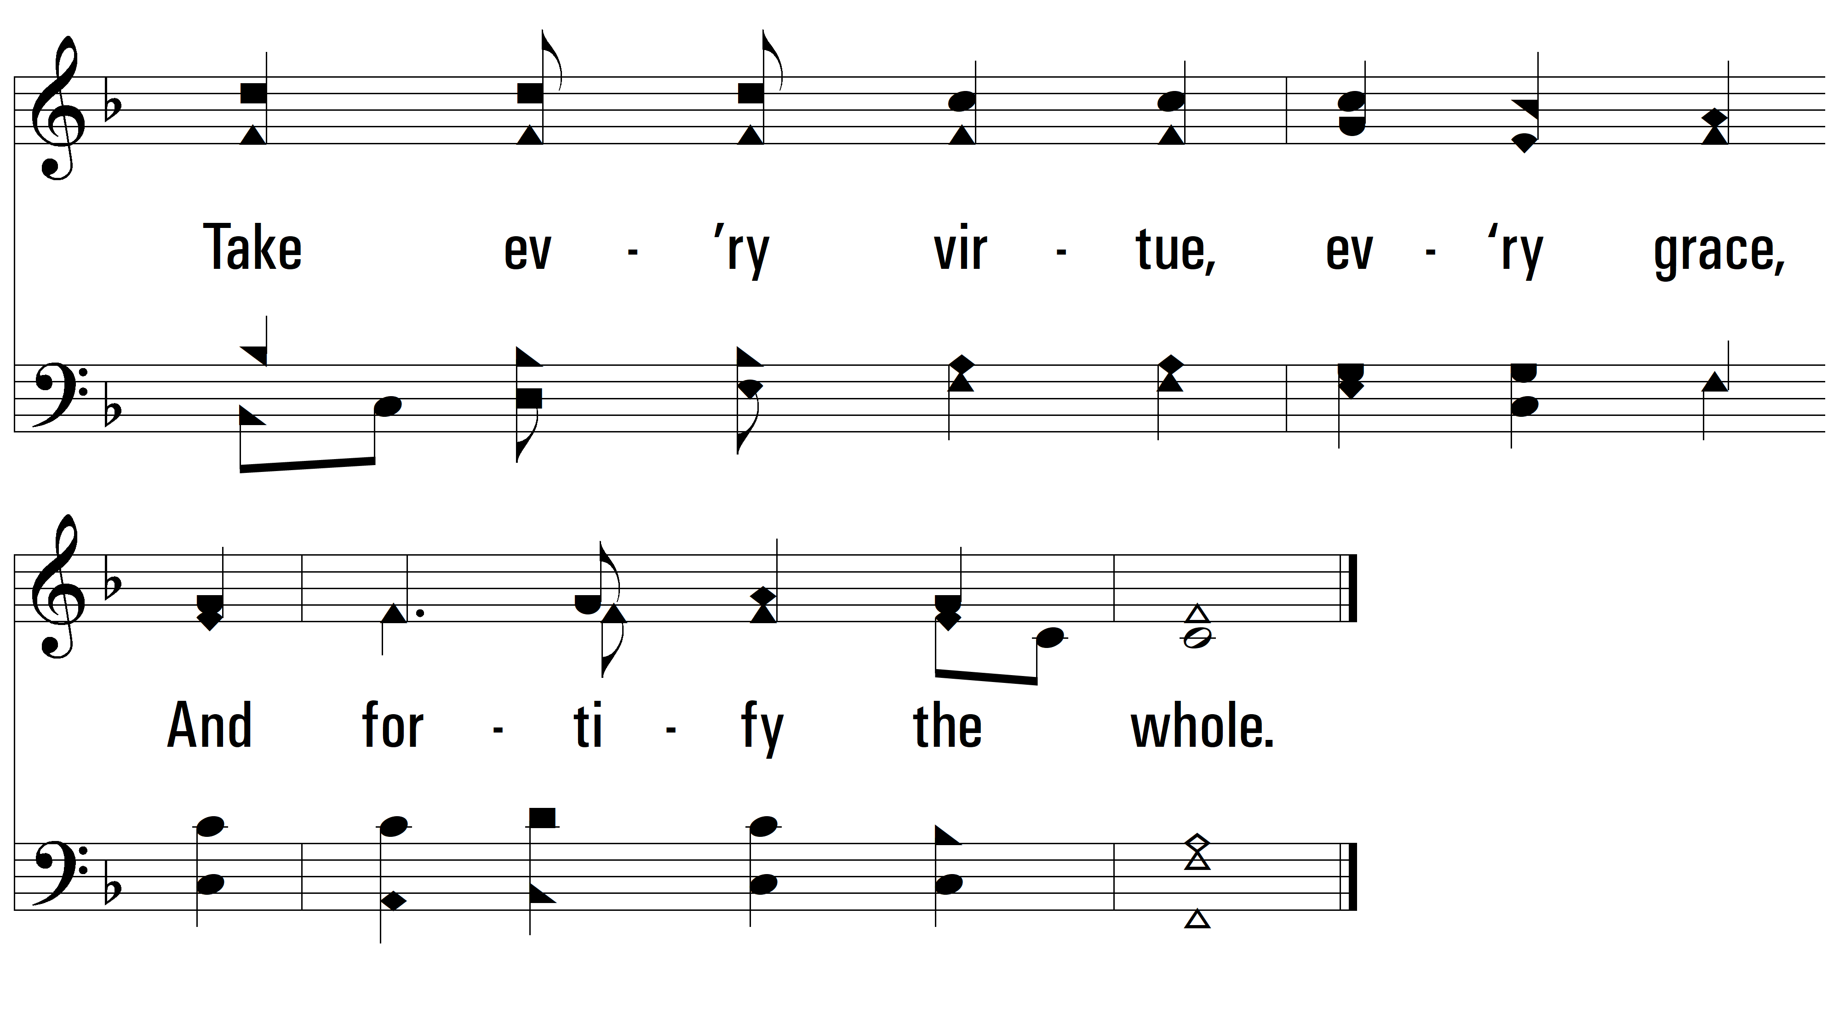
vs. 4

Slide 14
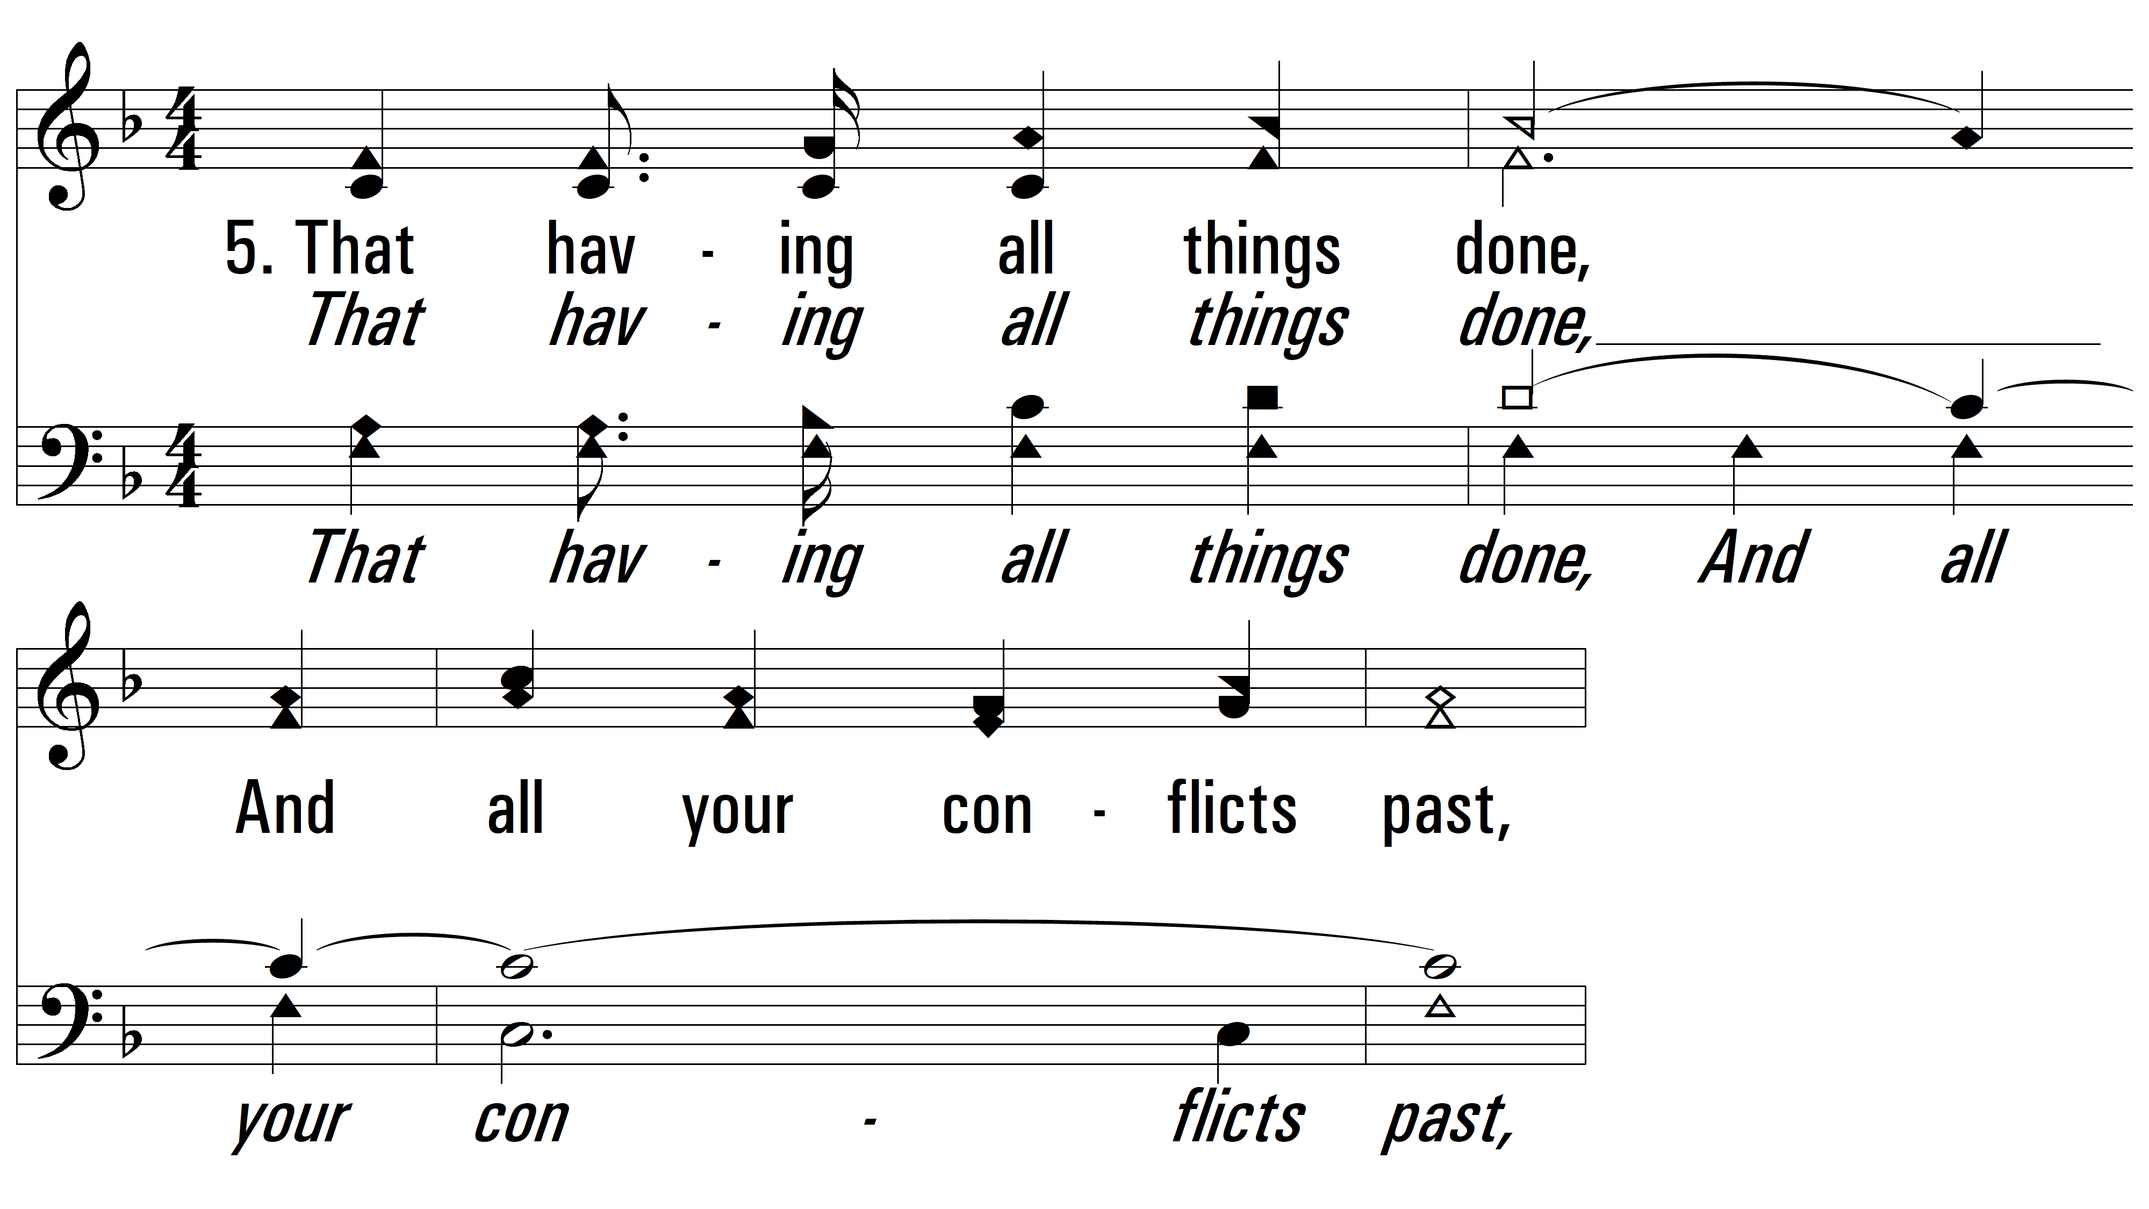
vs. 5 ~ Soldiers Of Christ, Arise

Slide 15
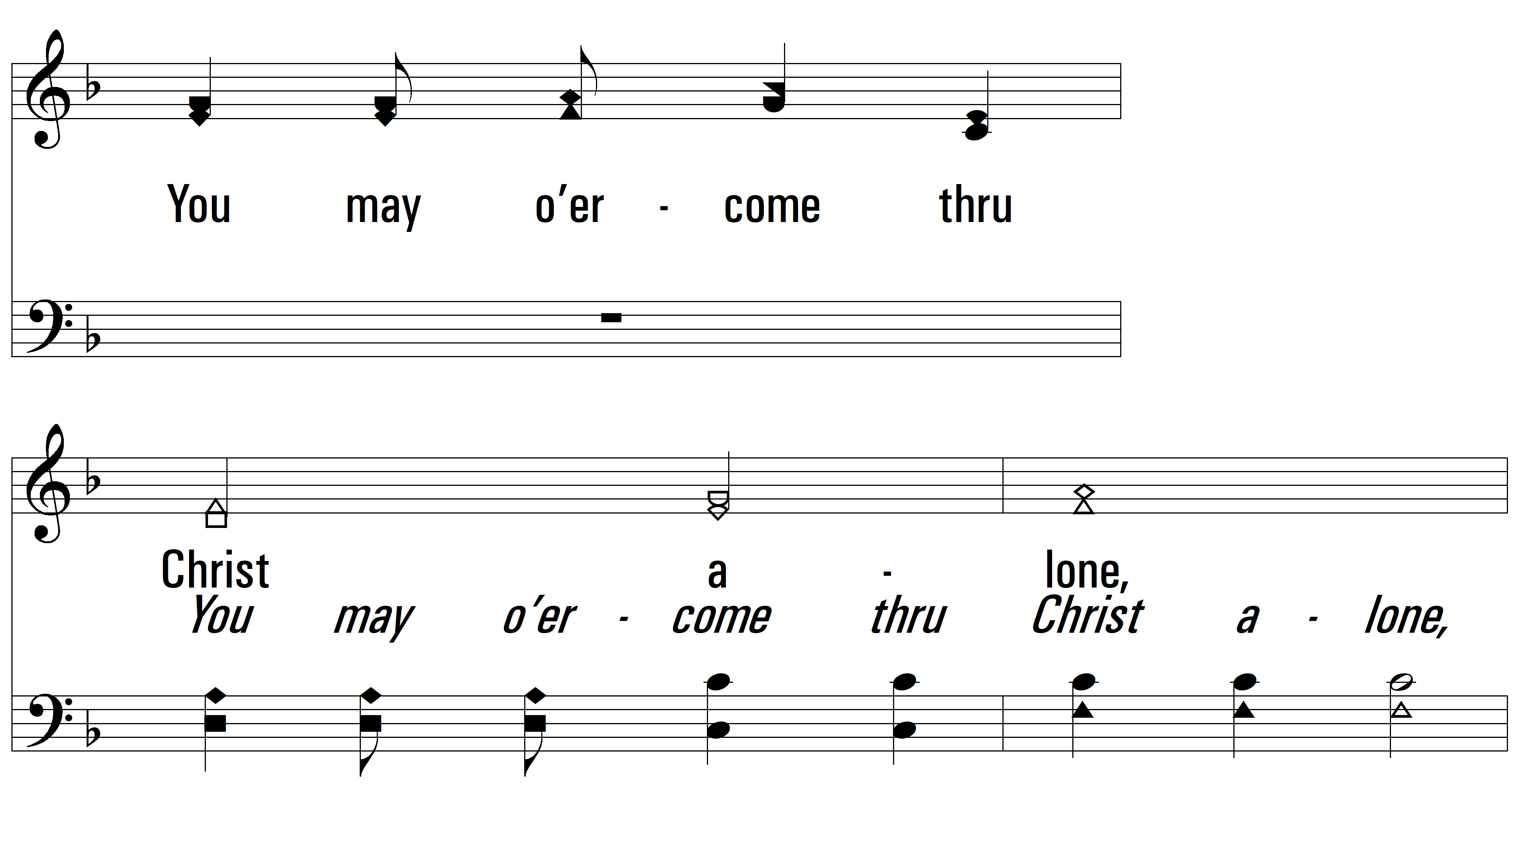
vs. 5

Slide 16
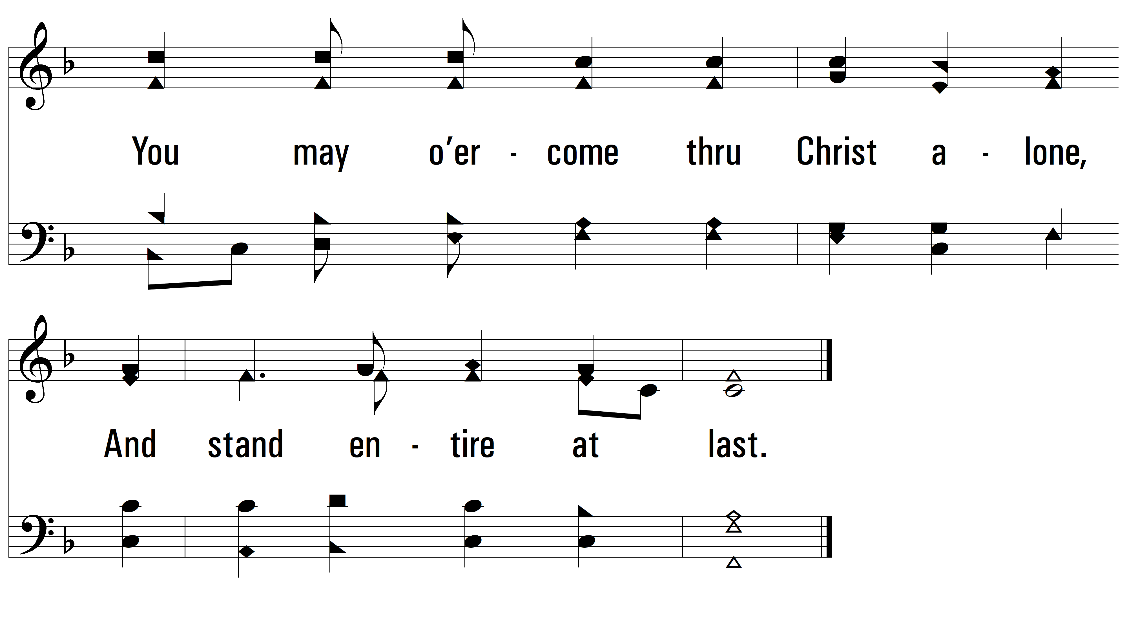
vs. 5
PDHymns.com
END

