Slide 1
Singing Redemption’s Song
(Angels Are Singing)
Words: | Tillit S. Teddlie (1923)
Music: | Tillit S. Teddlie (1923)
6/4
B^{b}/F - SOL
Verses: 3/Chorus
Lead - | SOL
Alto - | MI
Tenor - | DO
Bass - | DO
PDHymns.com

Slide 2
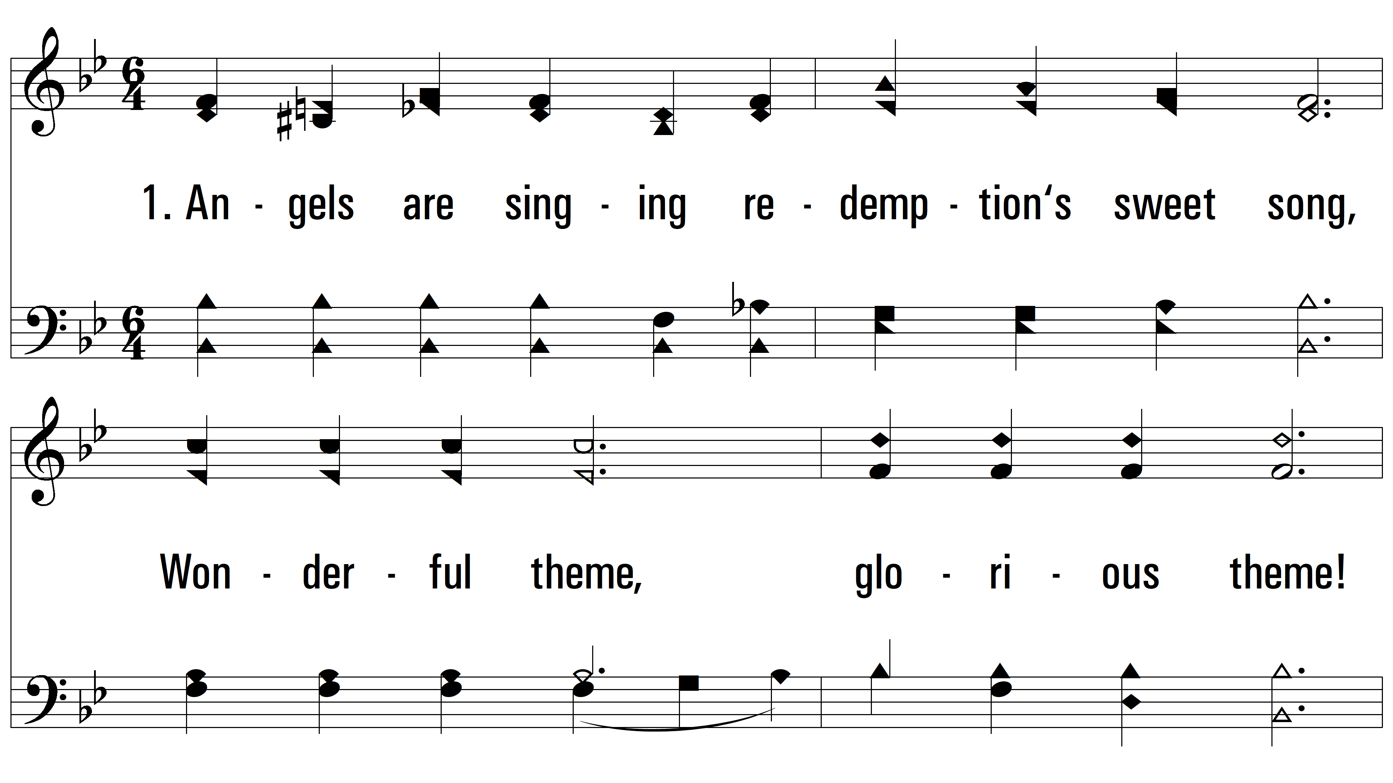
vs. 1 ~ Singing Redemption’s Song

Slide 3
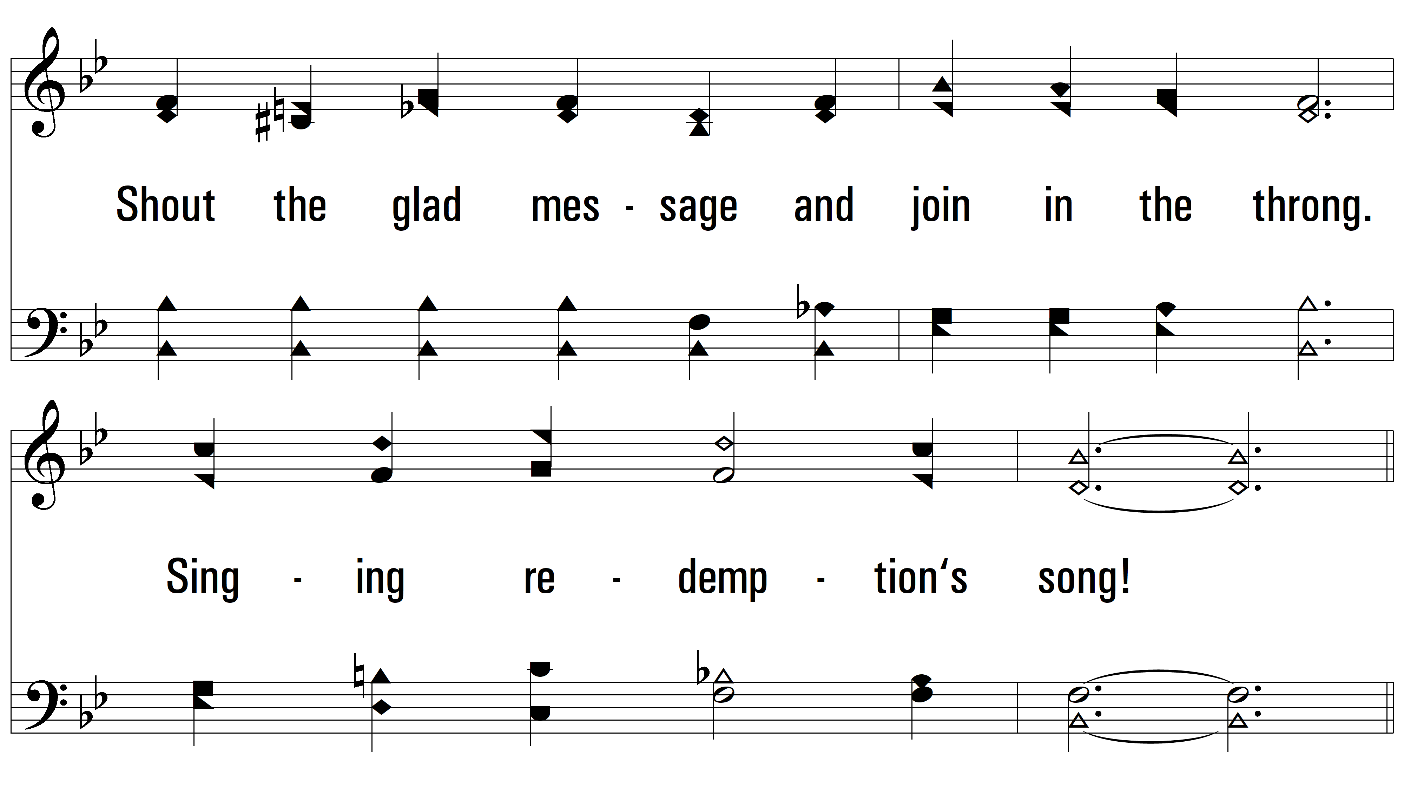
vs. 1

Slide 4
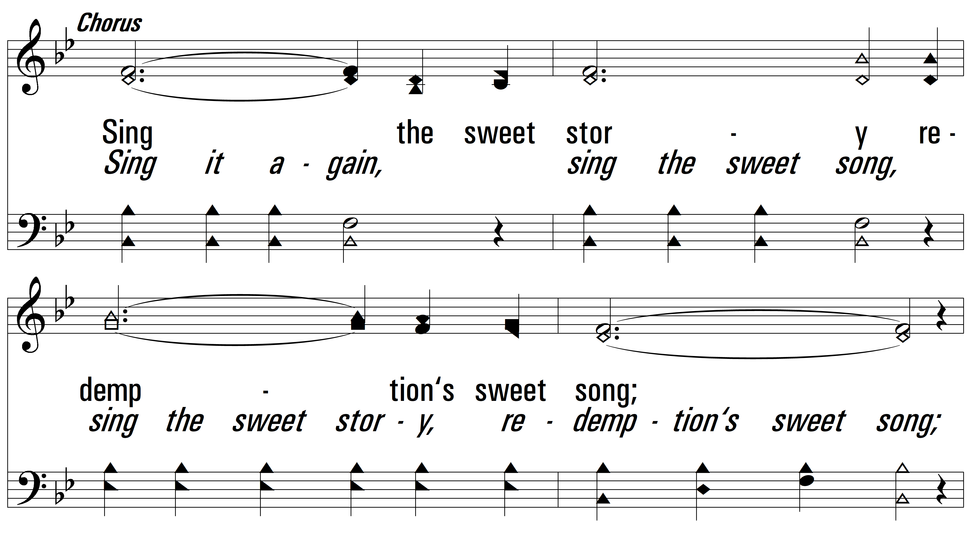
vs. 1

Slide 5
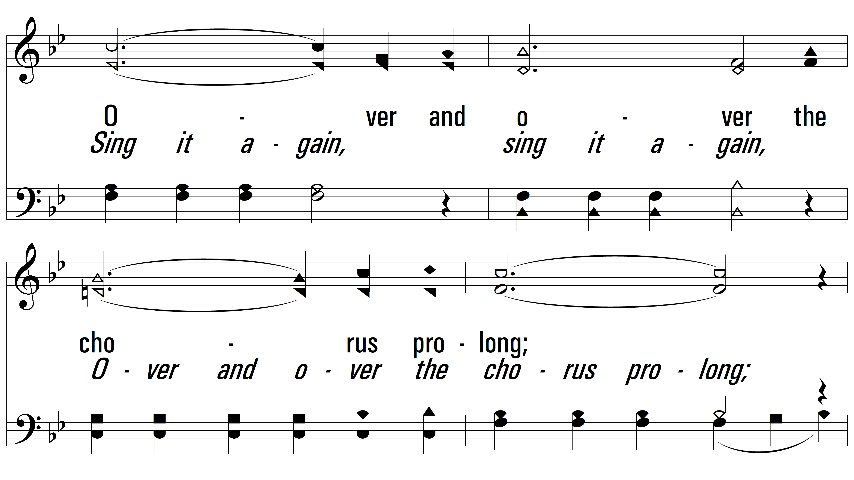
vs. 1

Slide 6
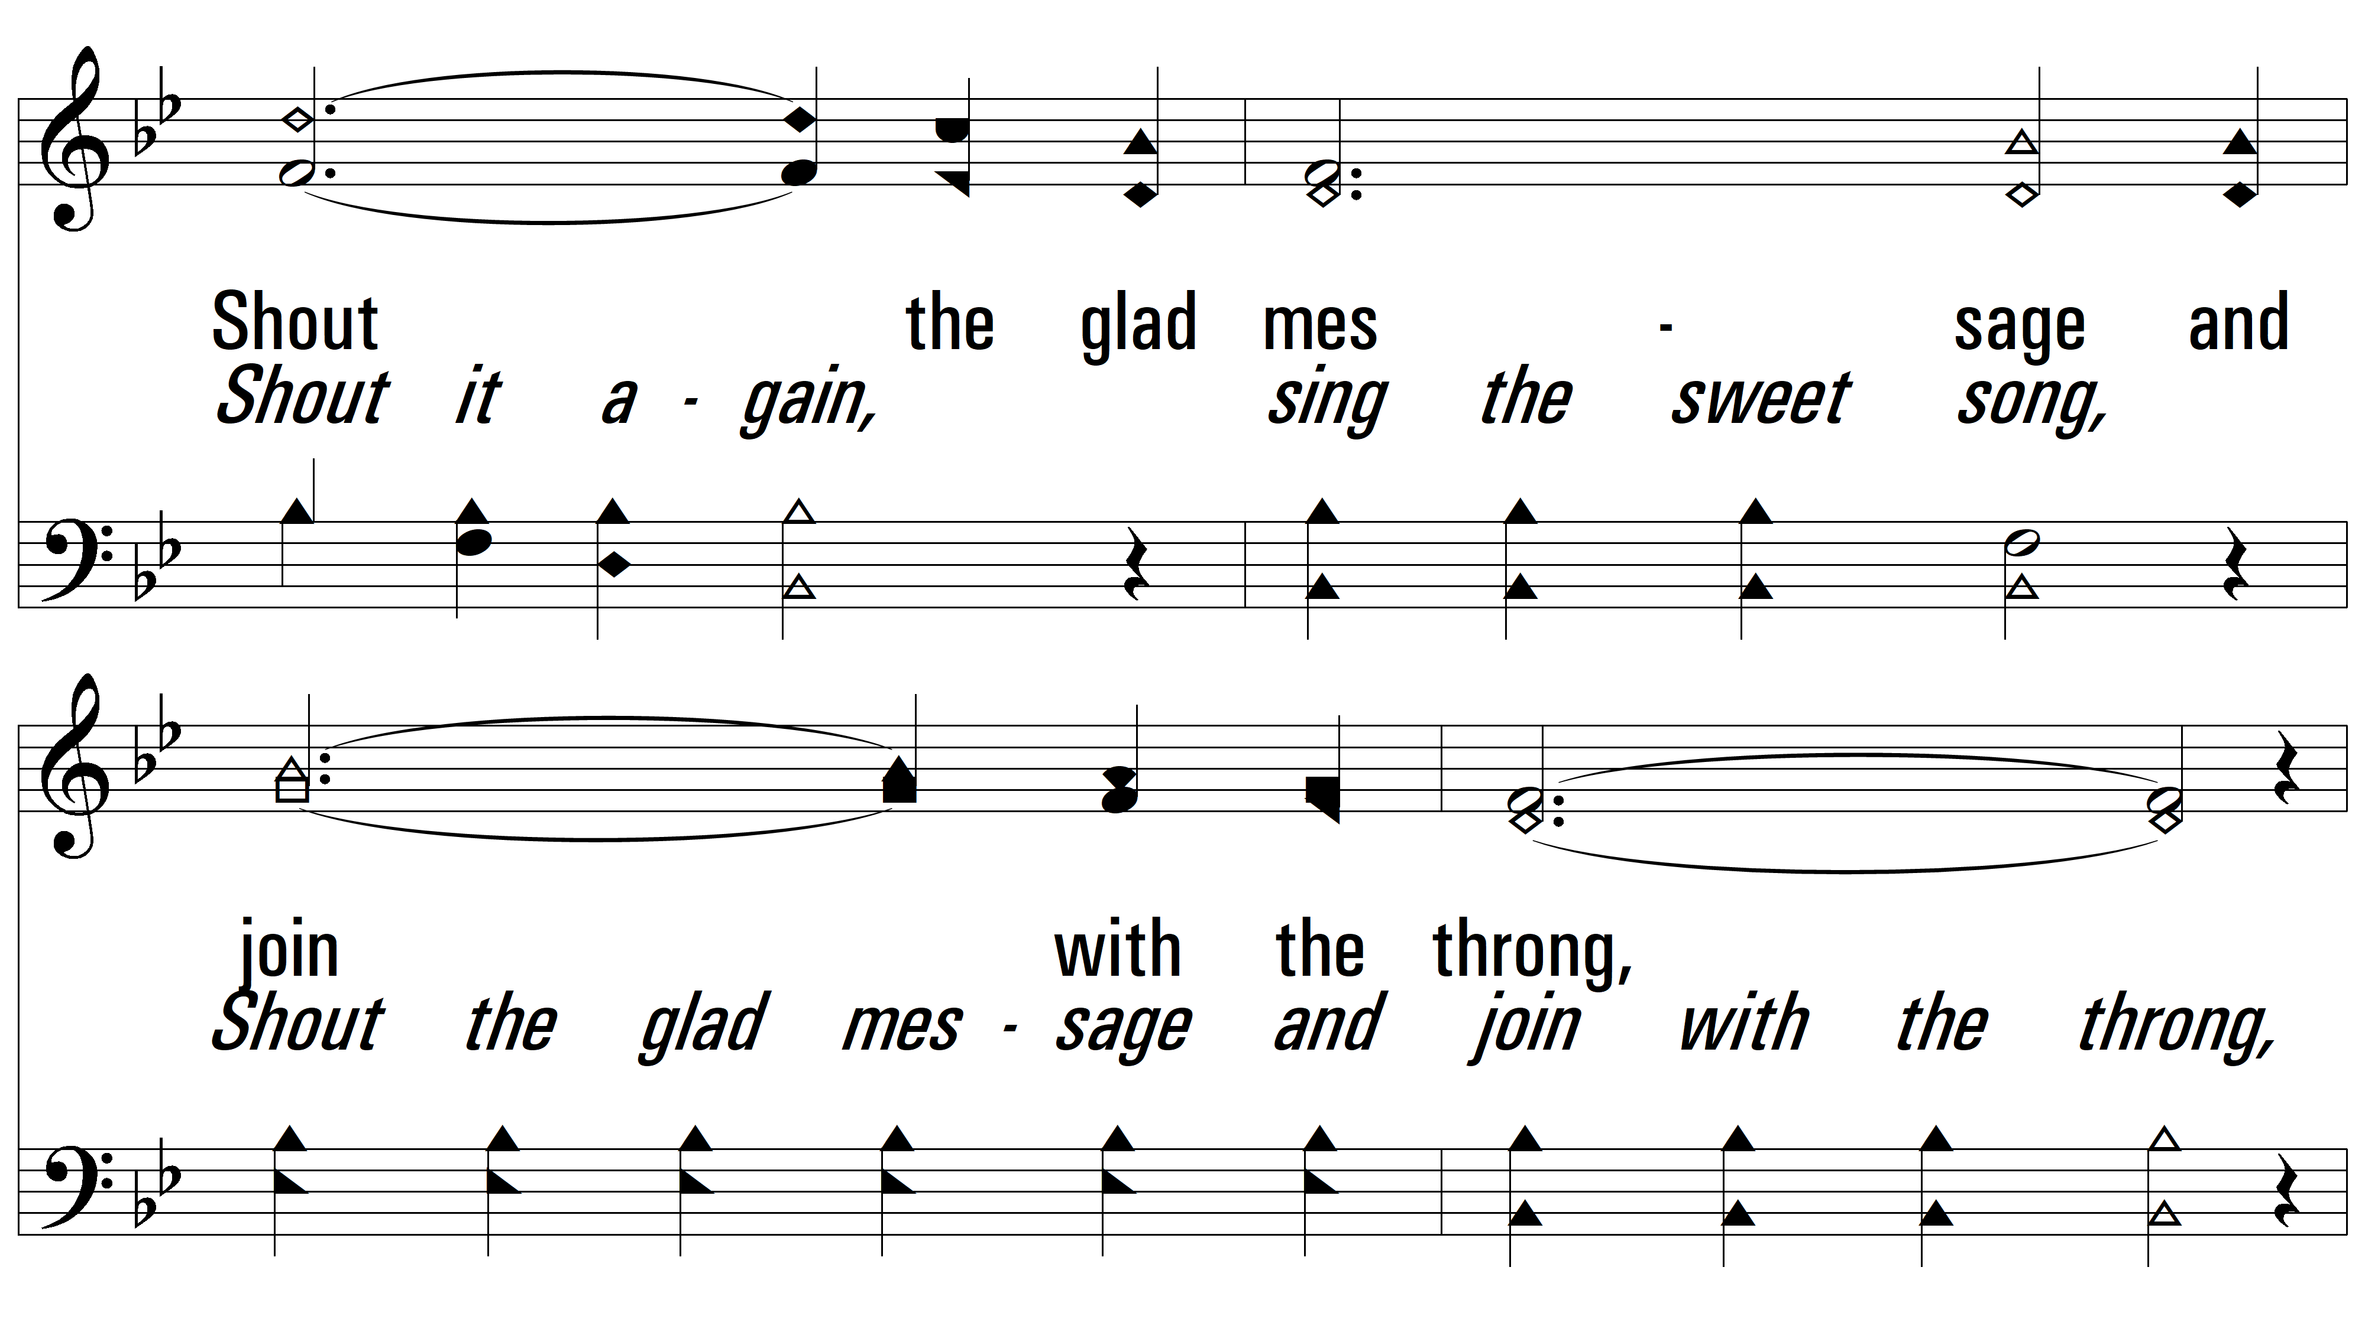
vs. 1

Slide 7
vs. 1

Slide 8
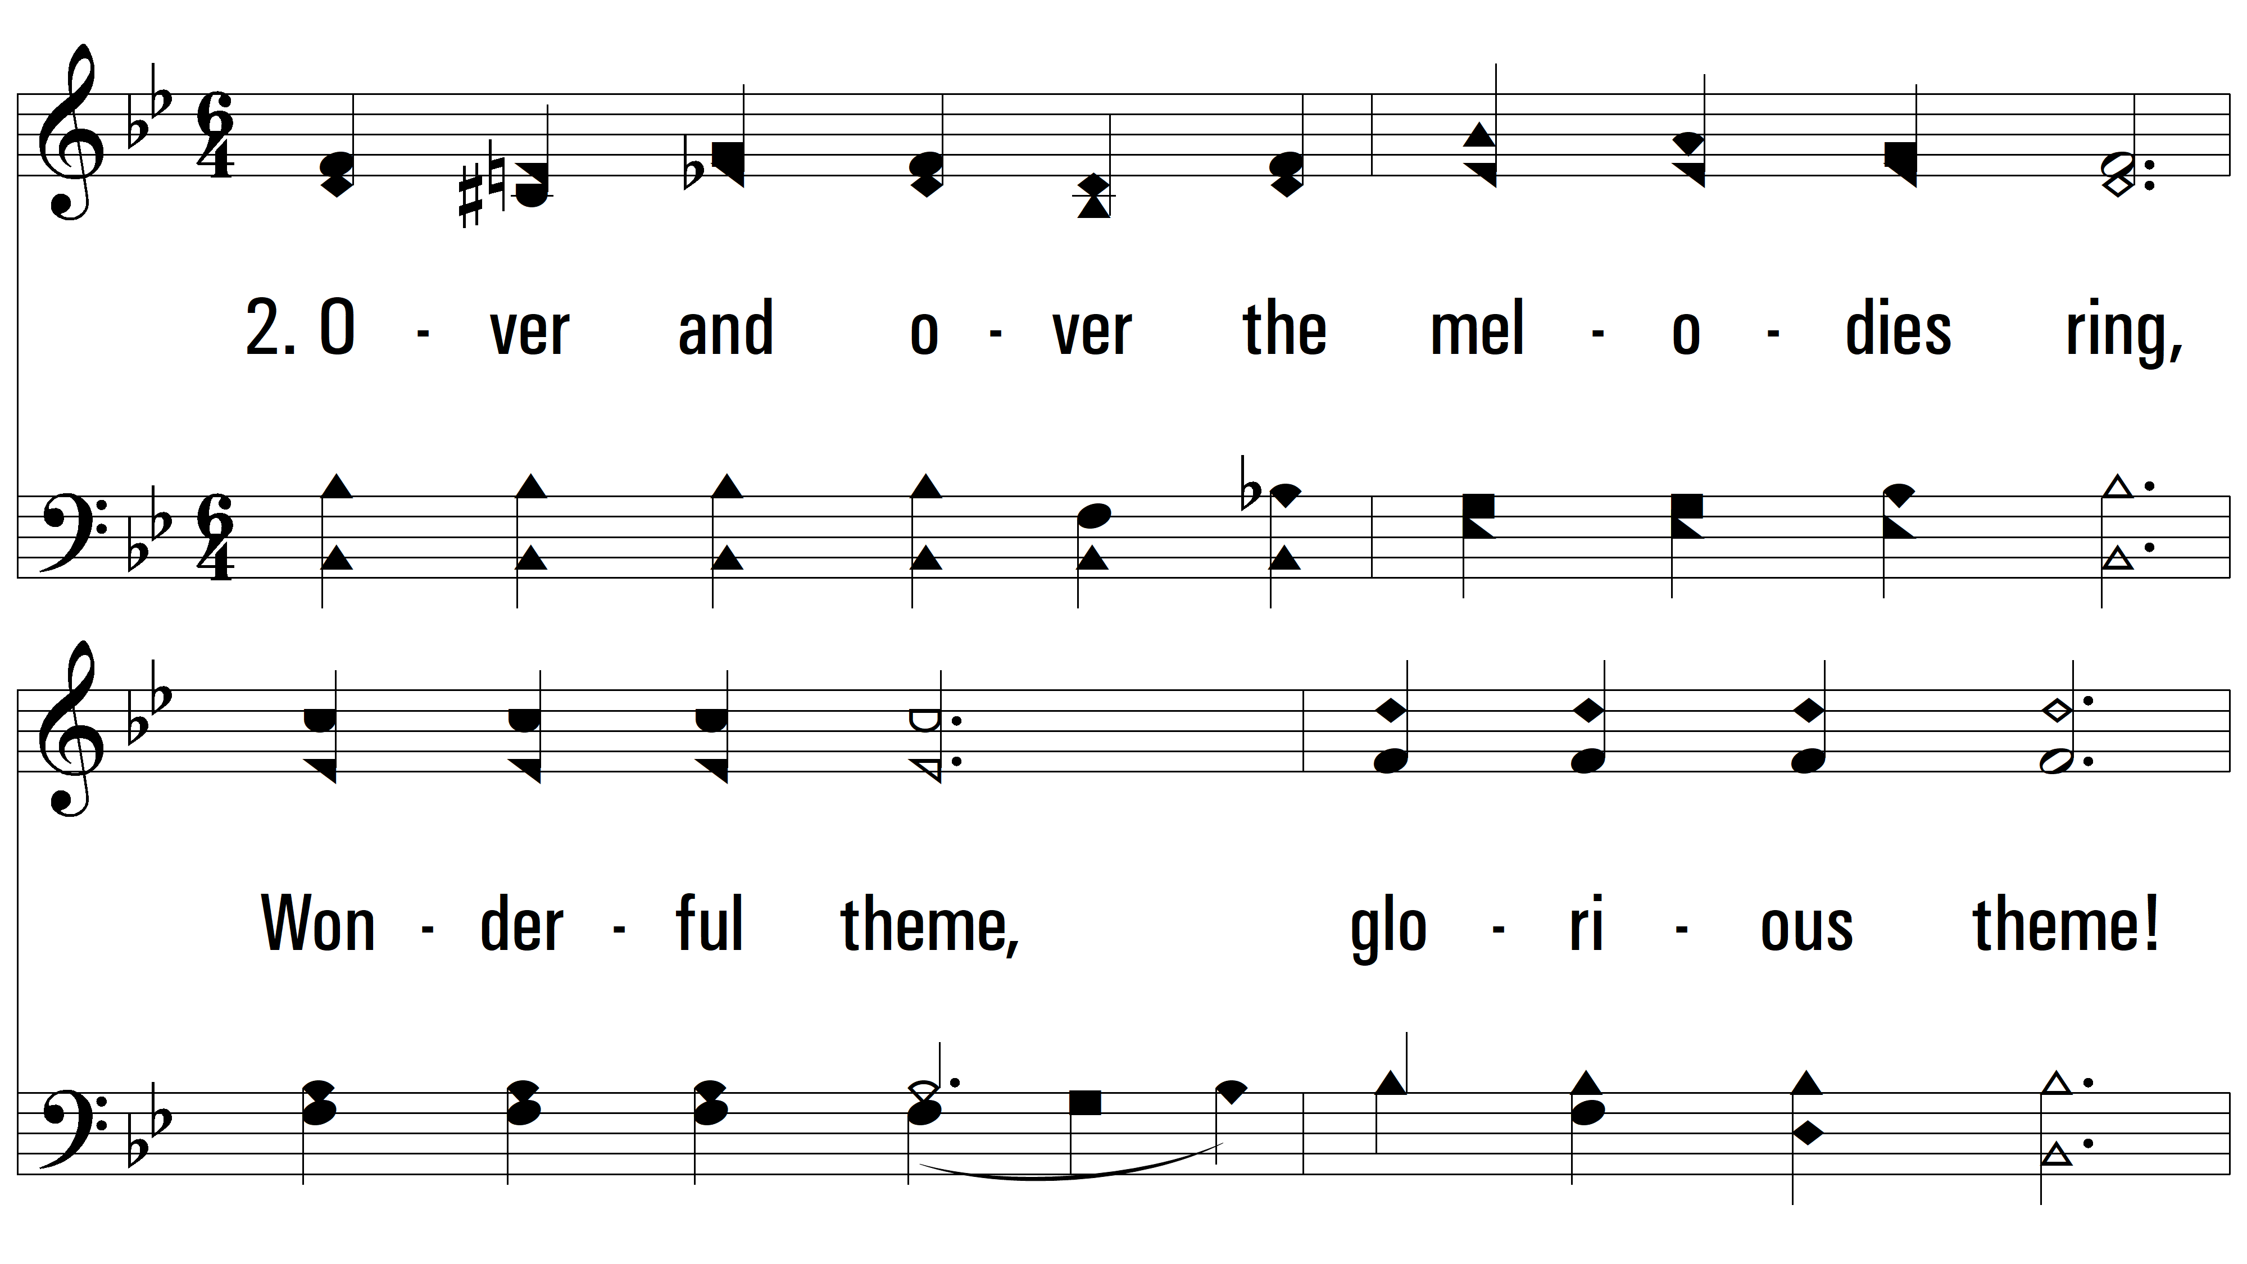
vs. 2 ~ Singing Redemption’s Song

Slide 9
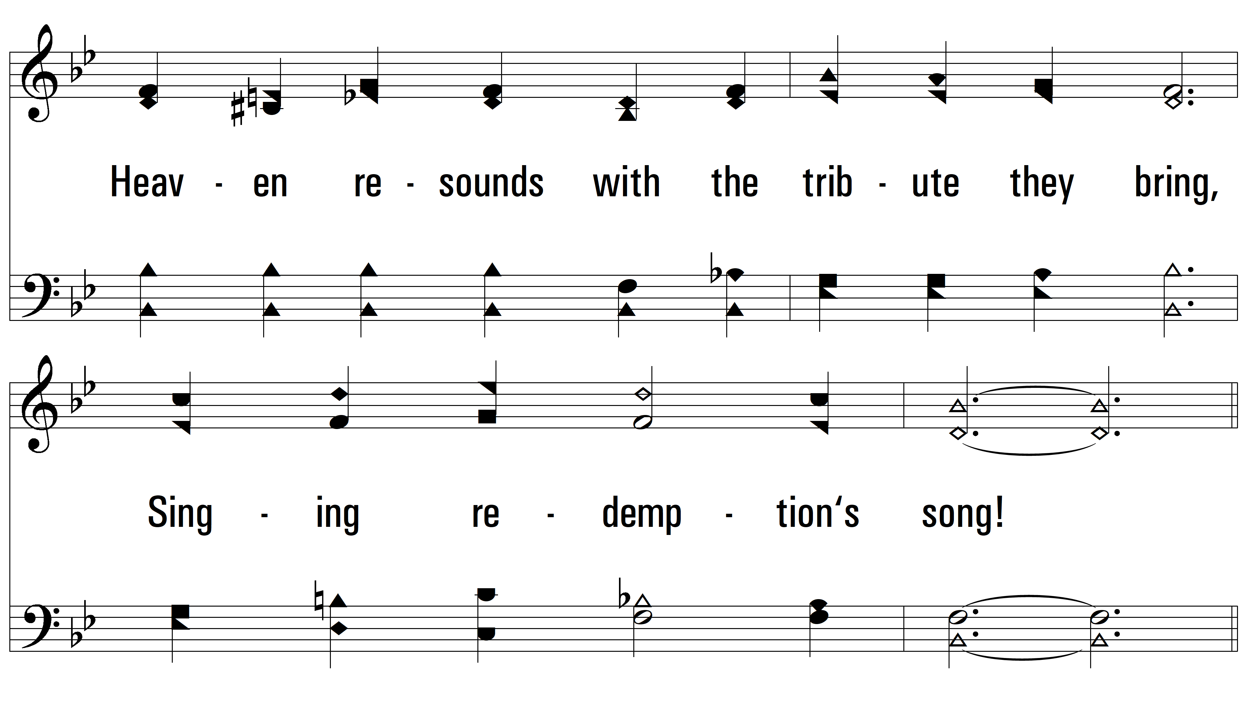
vs. 2

Slide 10
vs. 2

Slide 11
vs. 2

Slide 12
vs. 2

Slide 13
vs. 2

Slide 14
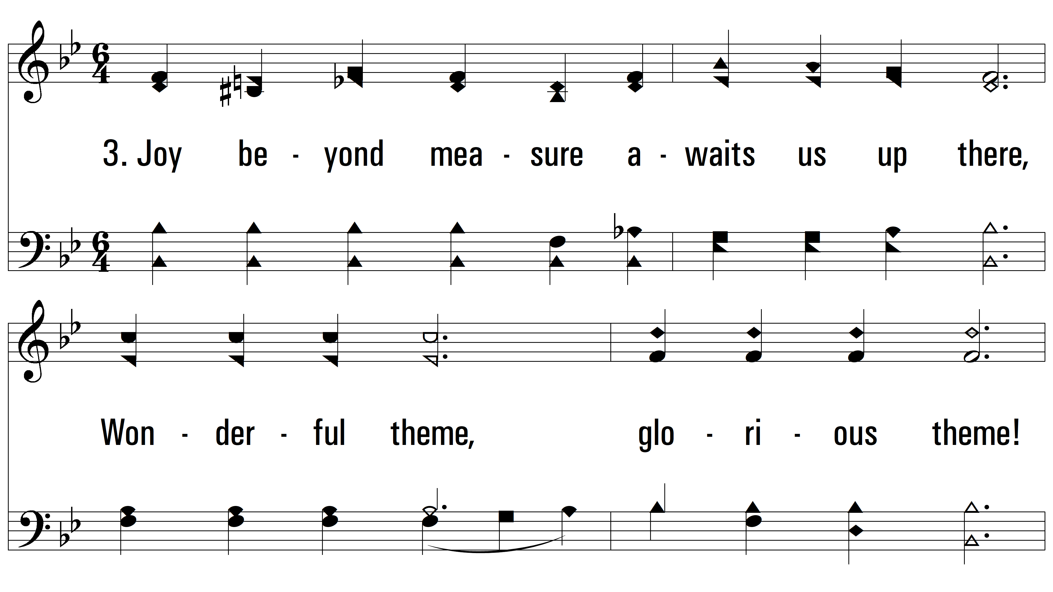
vs. 3 ~ Singing Redemption’s Song

Slide 15
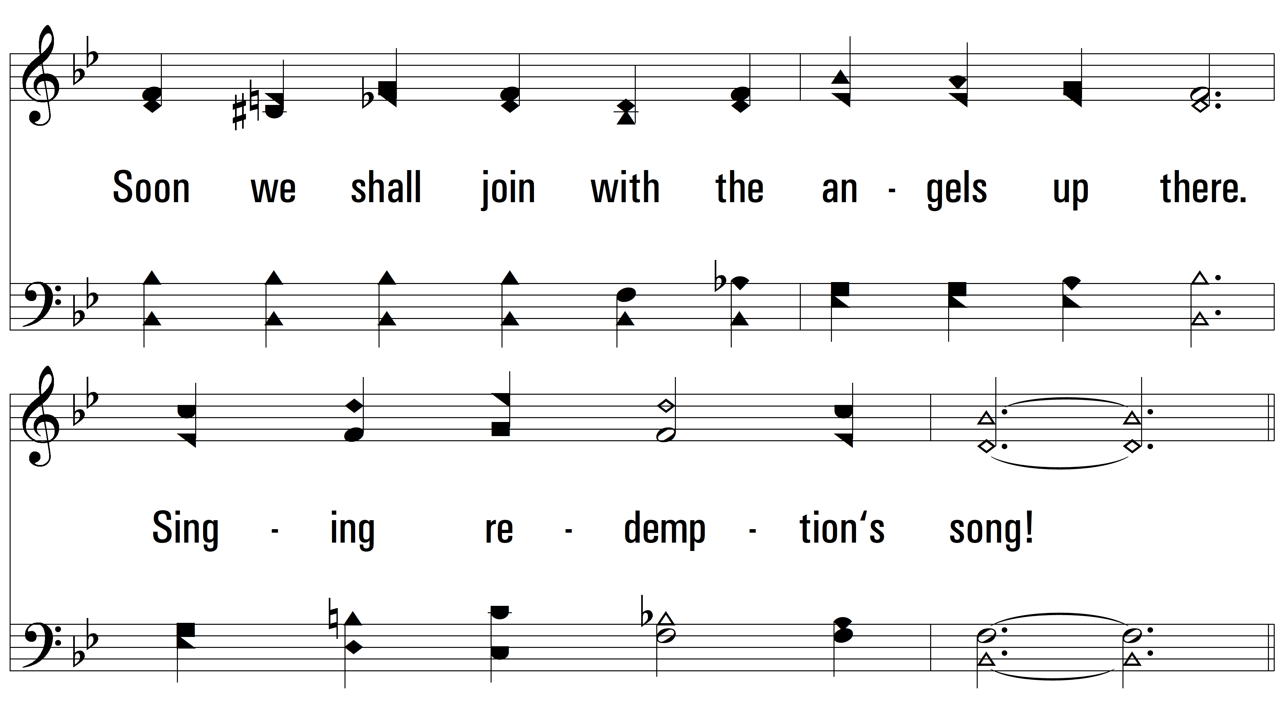
vs. 3

Slide 16
vs. 3

Slide 17
vs. 3

Slide 18
vs. 3

Slide 19
vs. 3
PDHymns.com
END

