Slide 1
Sing On, Ye Joyful Pilgrims
Words: | Fanny J. Crosby (1885)
Music: | John R. Sweney (1885)
4/4
F/C - SOL
Verses: 3/Chorus
Lead - | SOL
Alto - | DO
Tenor - | MI
Bass - | DO
PDHymns.com

Slide 2
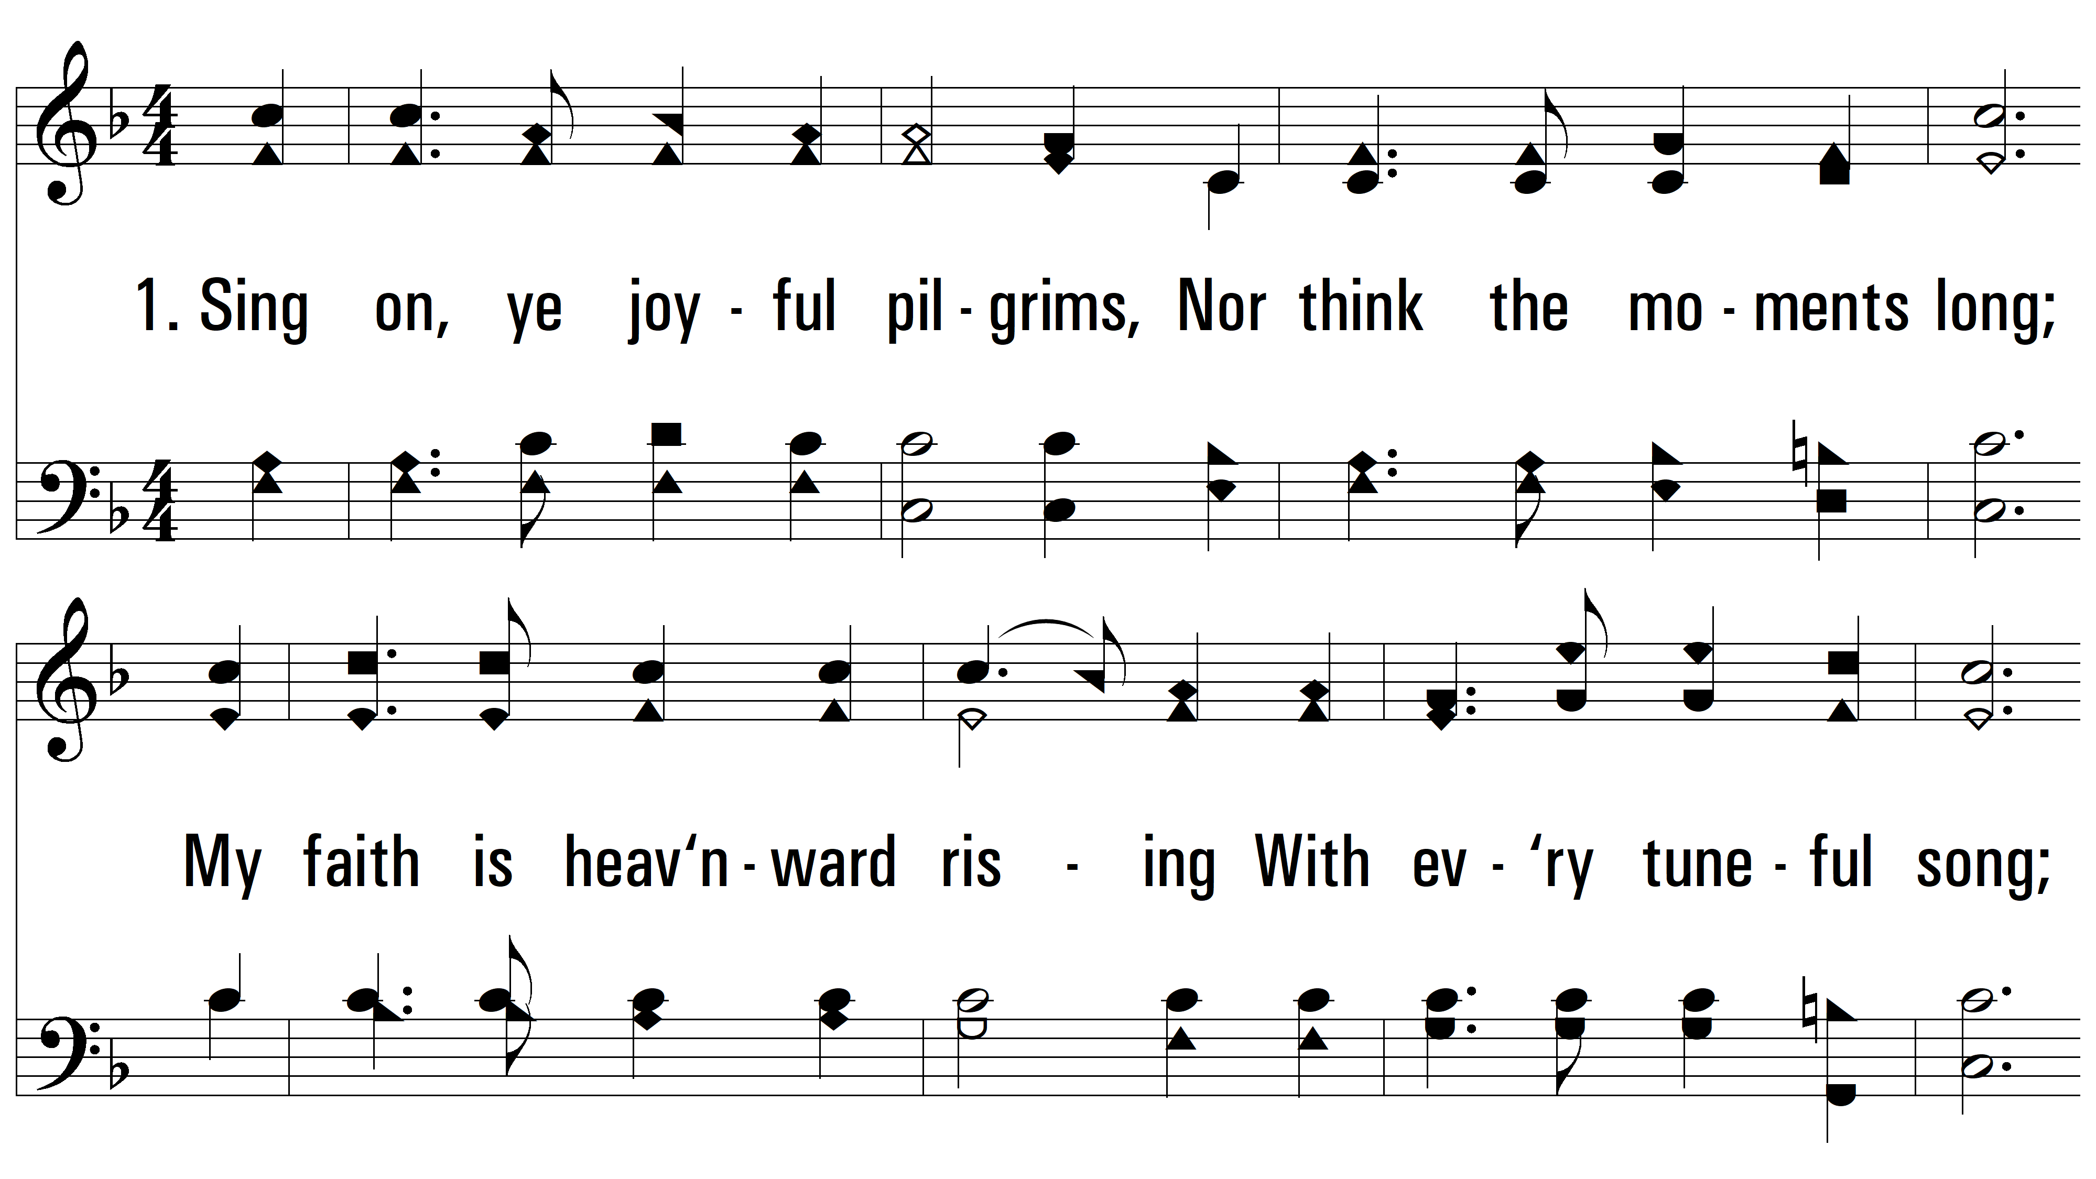
vs. 1 ~ Sing On, Ye Joyful Pilgrims

Slide 3
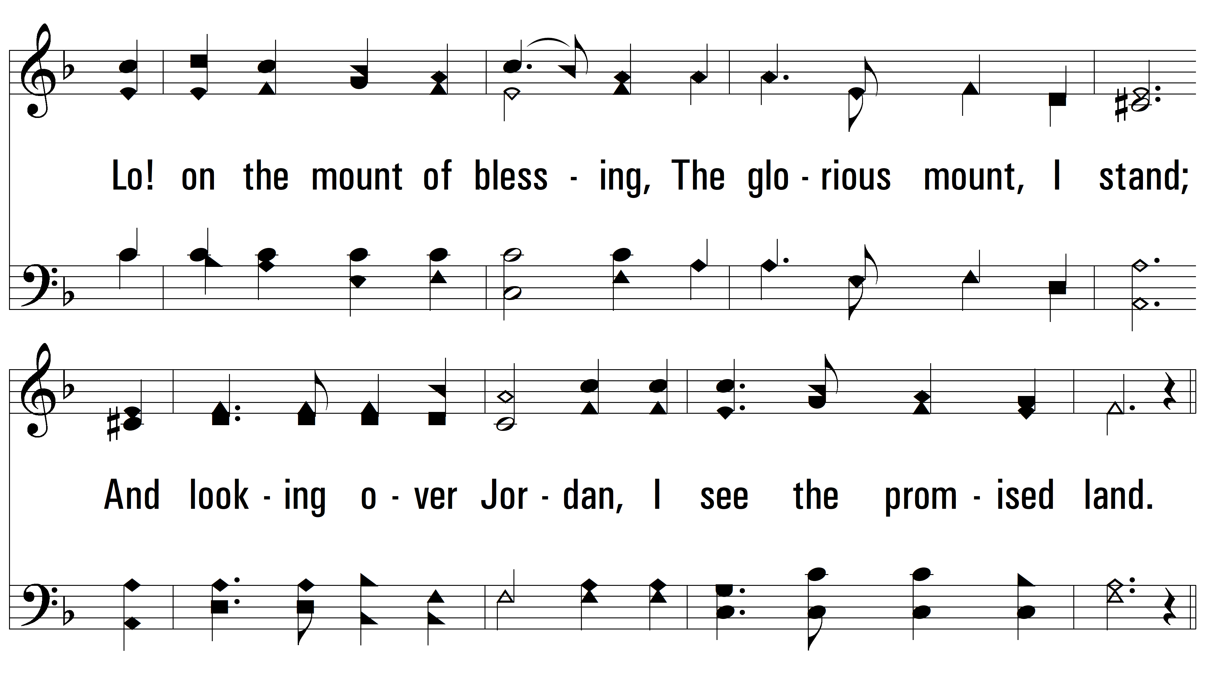
vs. 1

Slide 4
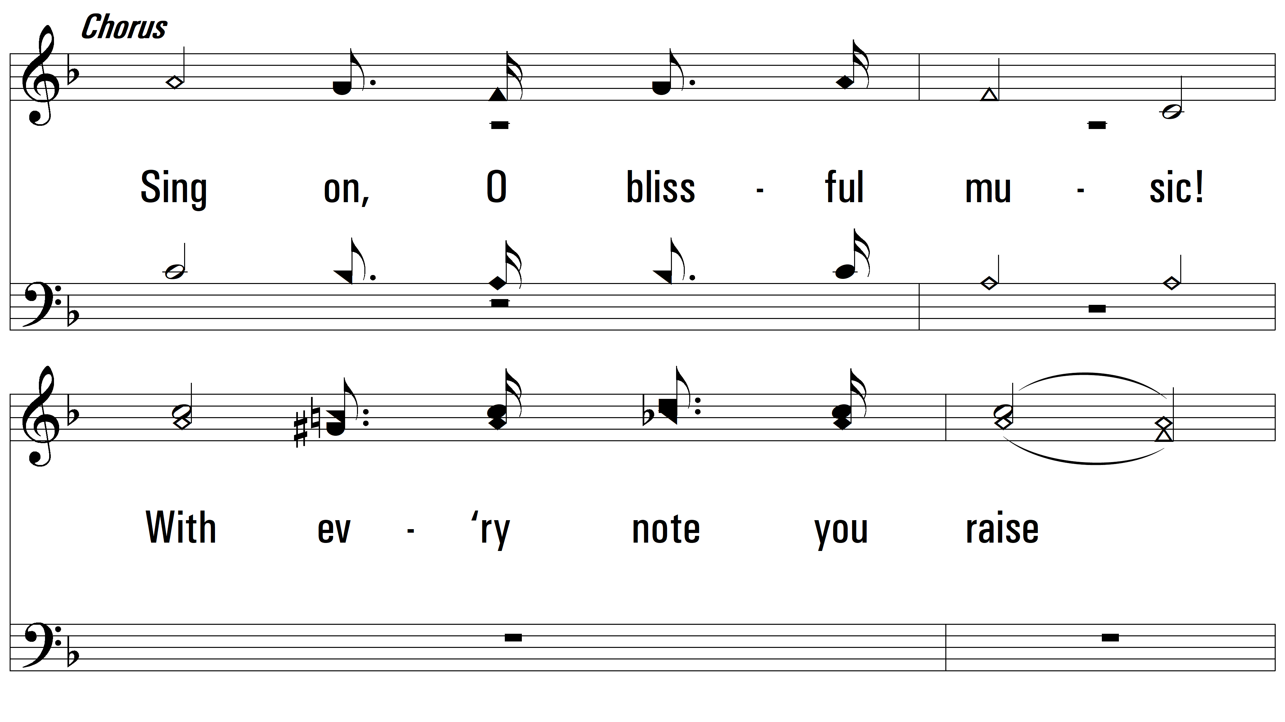
vs. 1

Slide 5
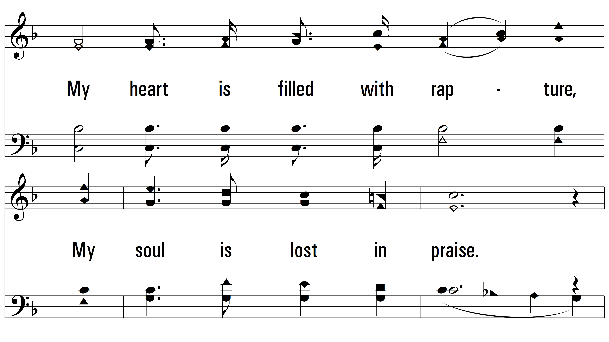
vs. 1

Slide 6
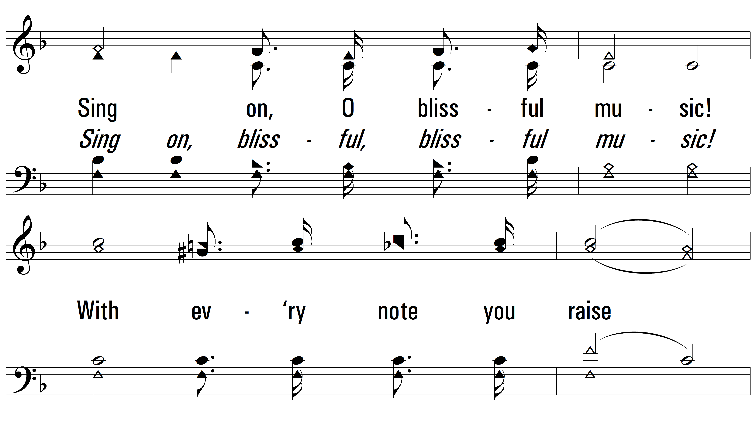
vs. 1

Slide 7
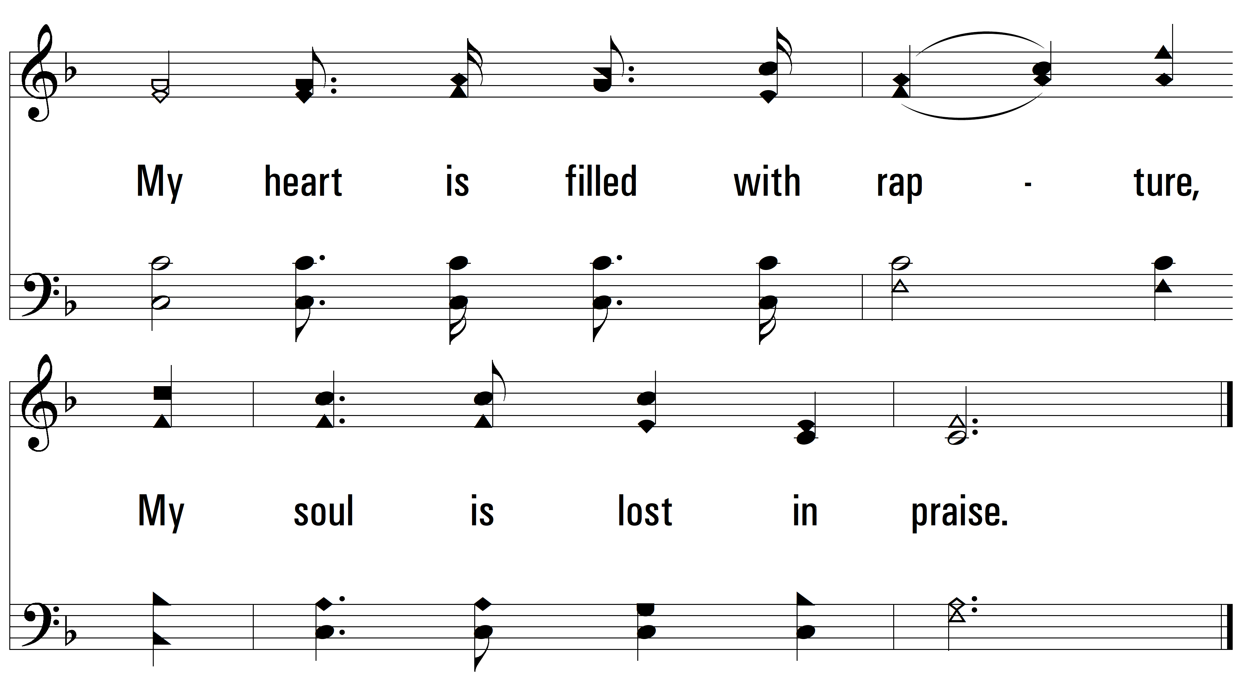
vs. 1

Slide 8
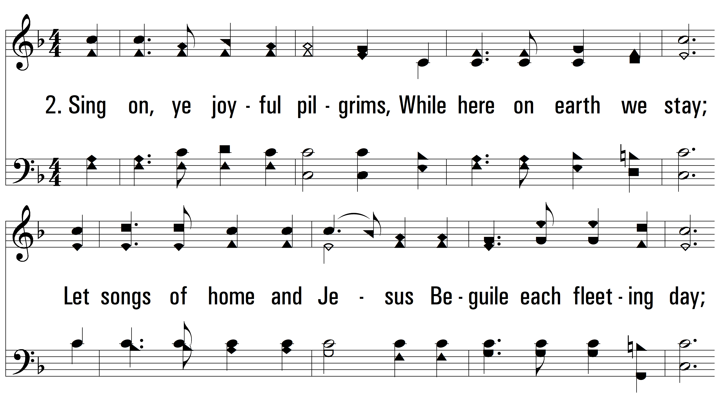
vs. 2 ~ Sing On, Ye Joyful Pilgrims

Slide 9
vs. 2

Slide 10
vs. 2

Slide 11
vs. 2

Slide 12
vs. 2

Slide 13
vs. 2

Slide 14
vs. 3 ~ Sing On, Ye Joyful Pilgrims

Slide 15
vs. 3

Slide 16
vs. 3

Slide 17
vs. 3

Slide 18
vs. 3

Slide 19
vs. 3
PDHymns.com
END

