Slide 1
Since I Have Been Redeemed
Words: | Edwin O. Excell (1884)
Music: | Edwin O. Excell (1884)
4/4
G/D - SOL
Verses: 5/Chorus
Lead - | SOL
Alto - | SOL
Tenor - | MI
Bass - | DO
PDHymns.com

Slide 2
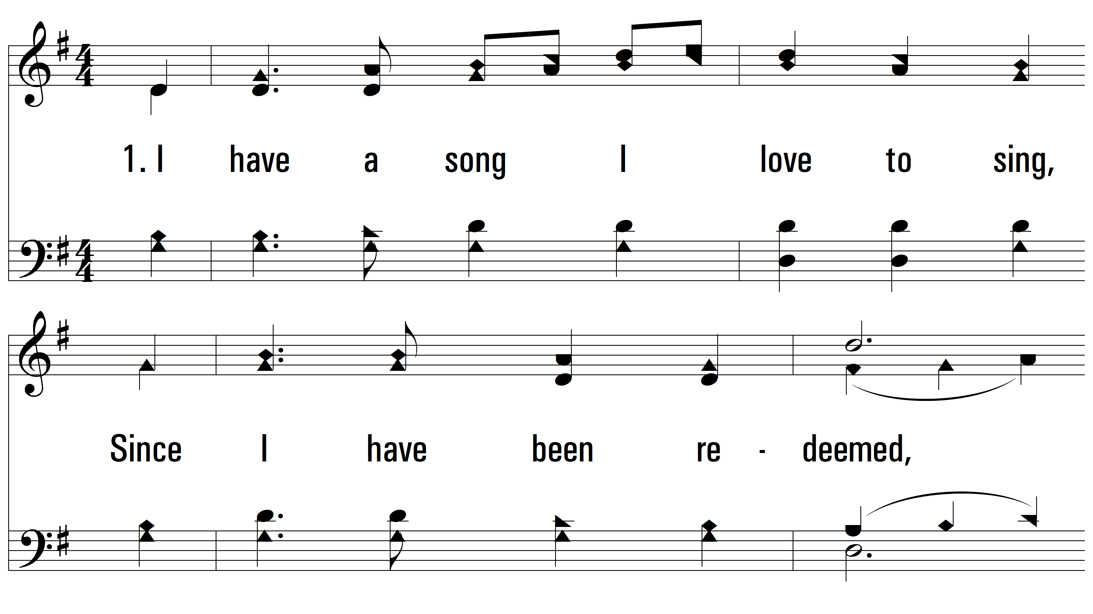
vs. 1 ~ Since I Have Been Redeemed

Slide 3
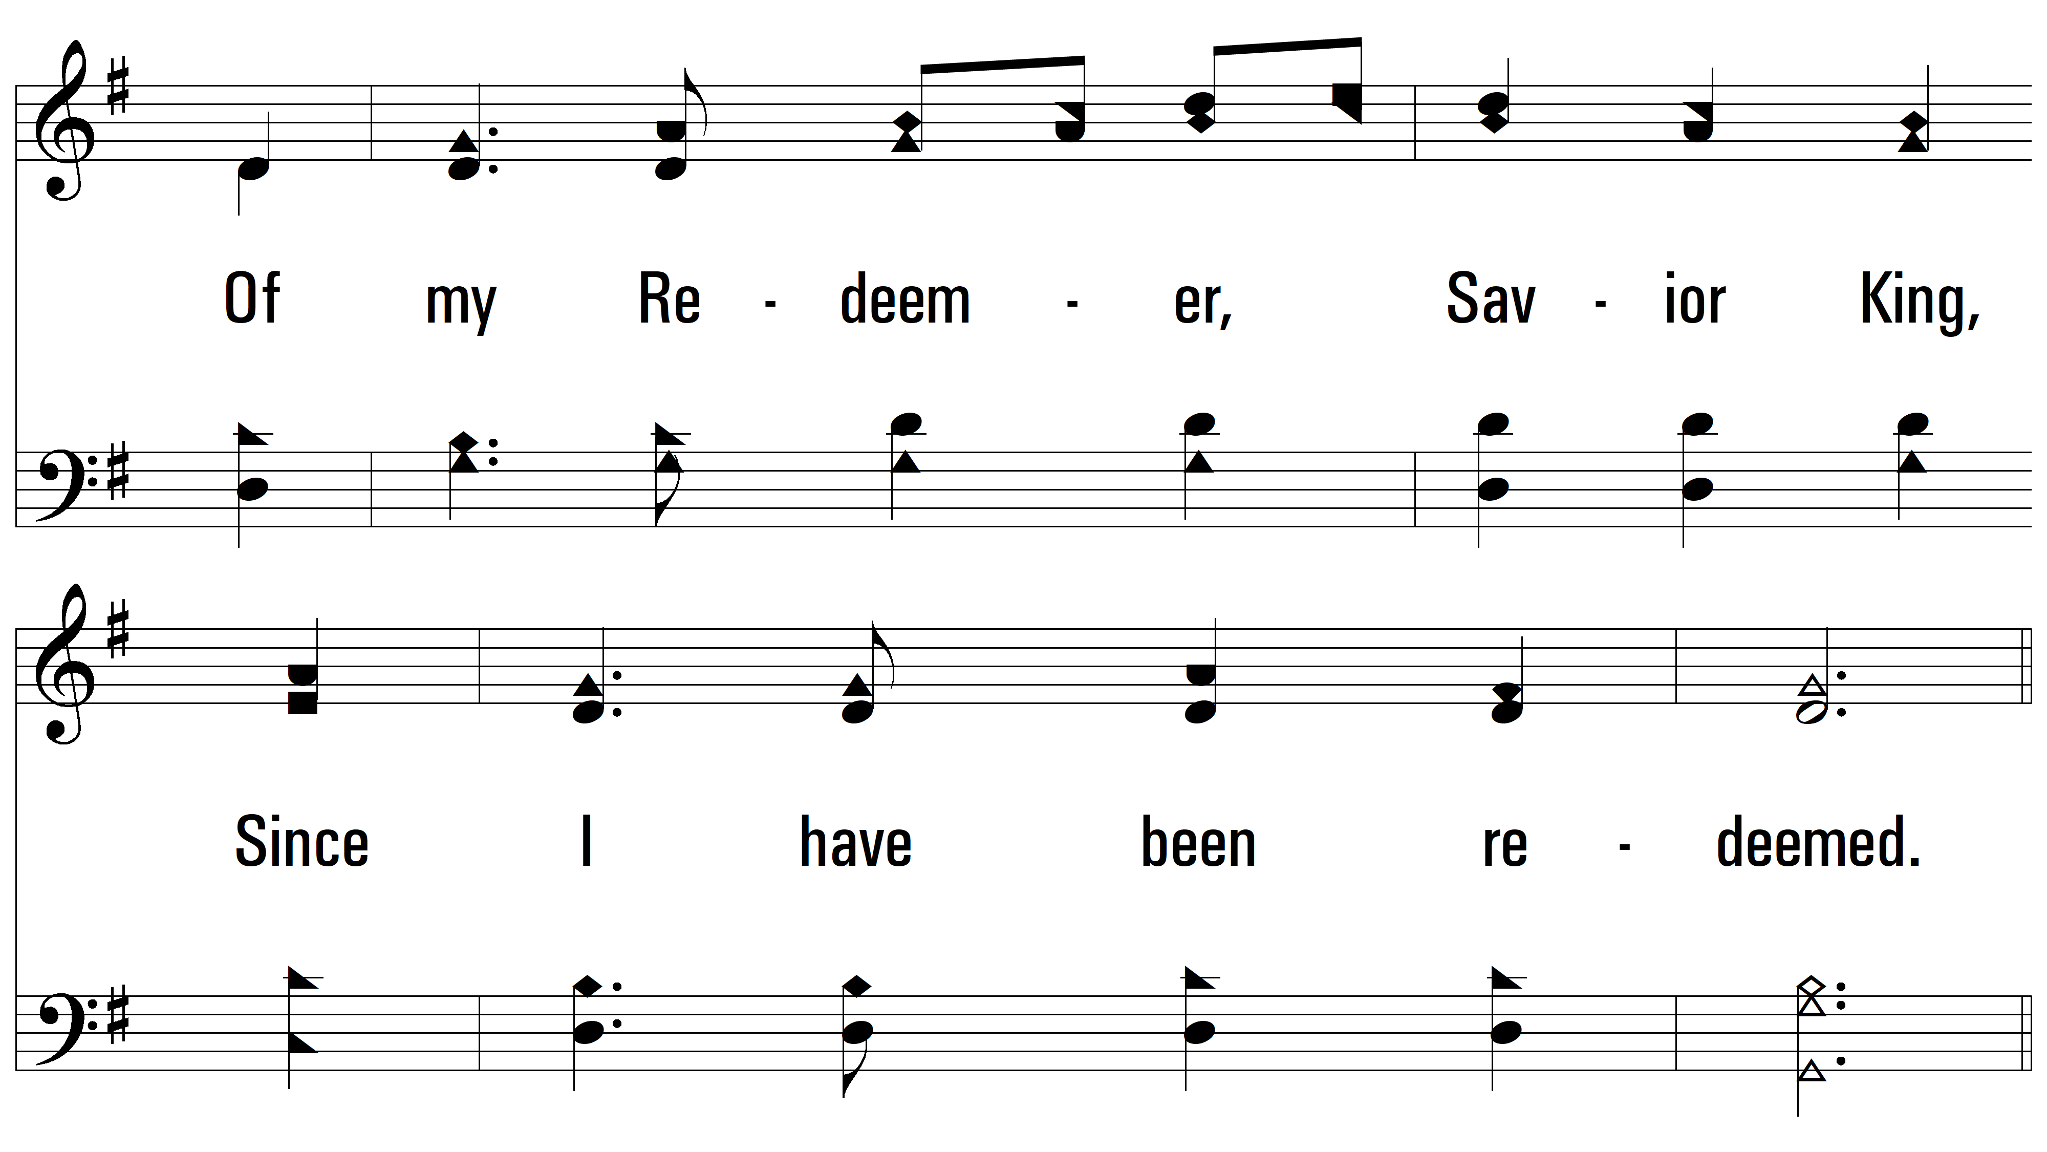
vs. 1

Slide 4
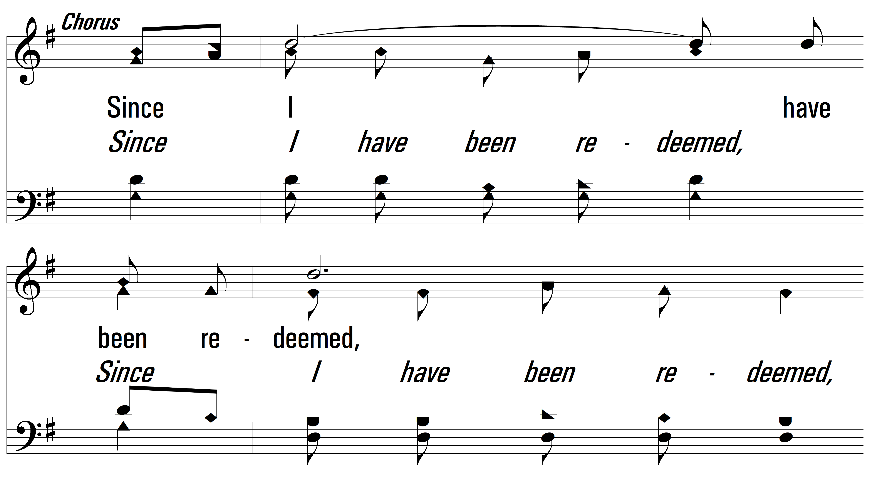
vs. 1

Slide 5
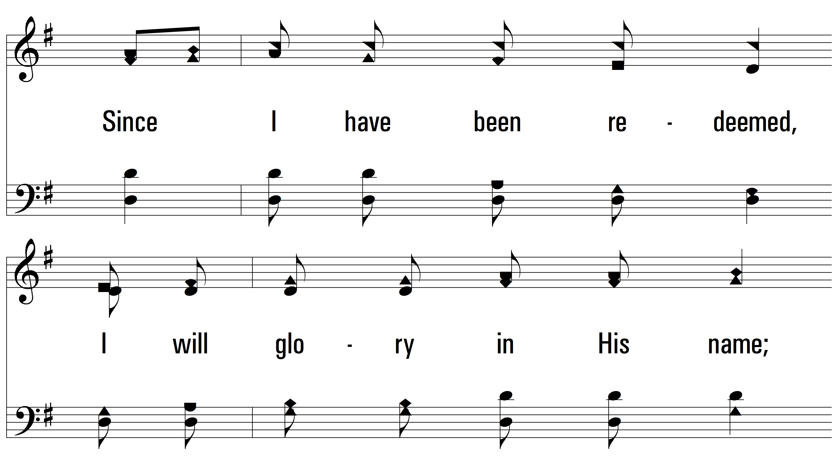
vs. 1

Slide 6
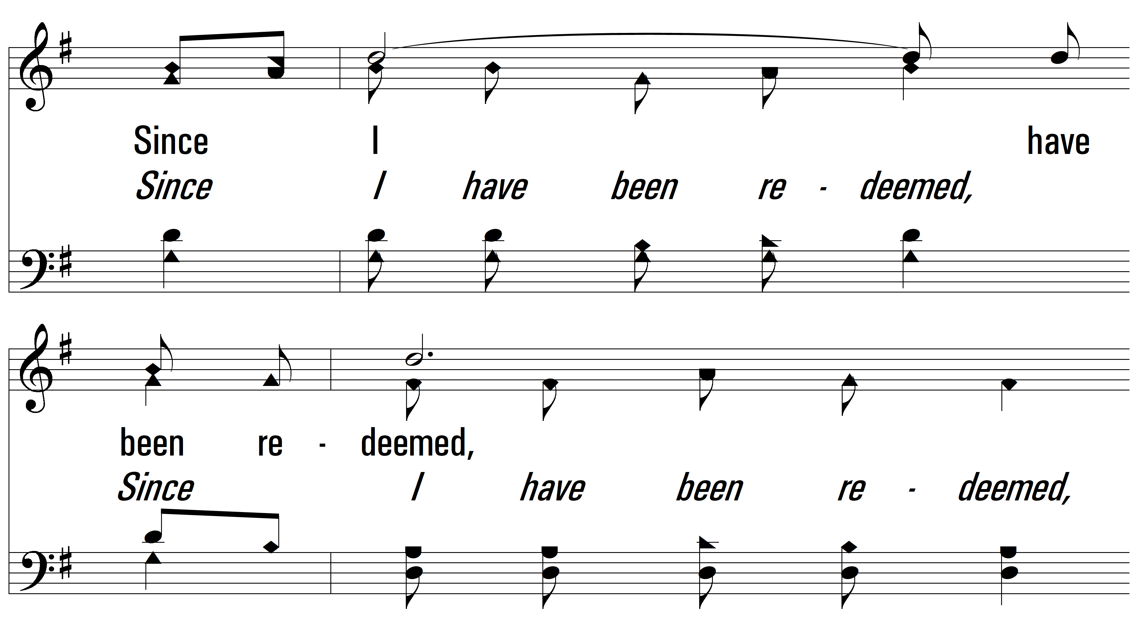
vs. 1

Slide 7
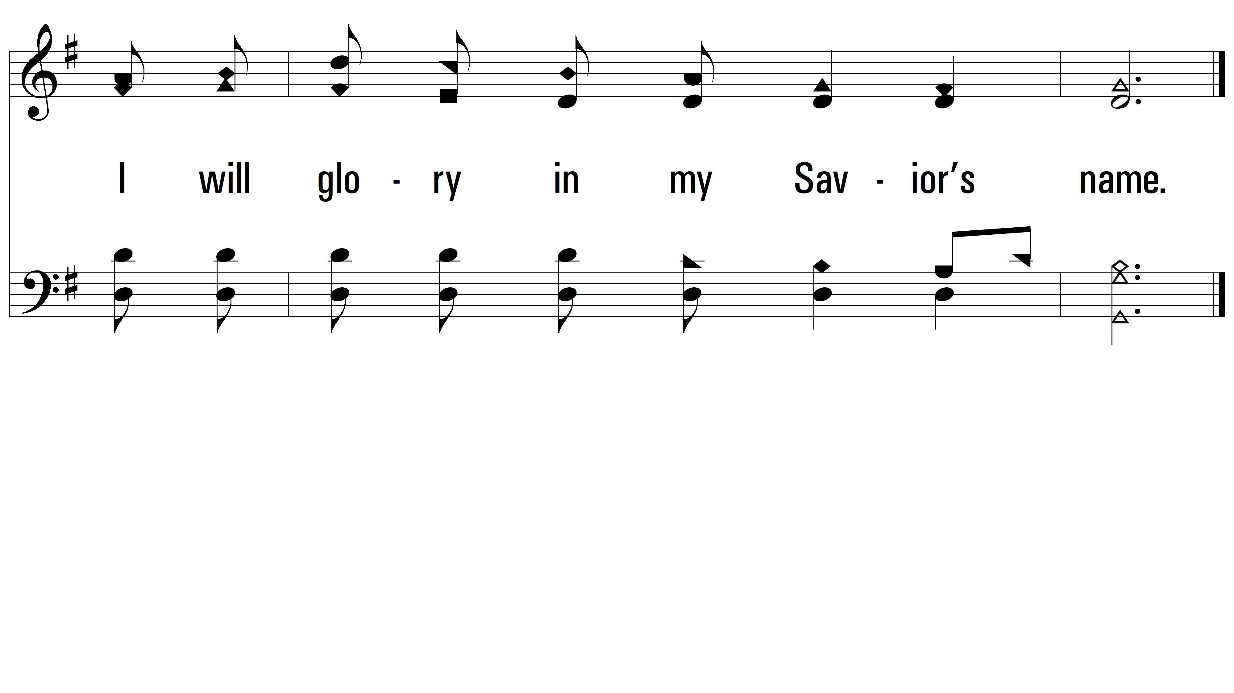
vs. 1

Slide 8
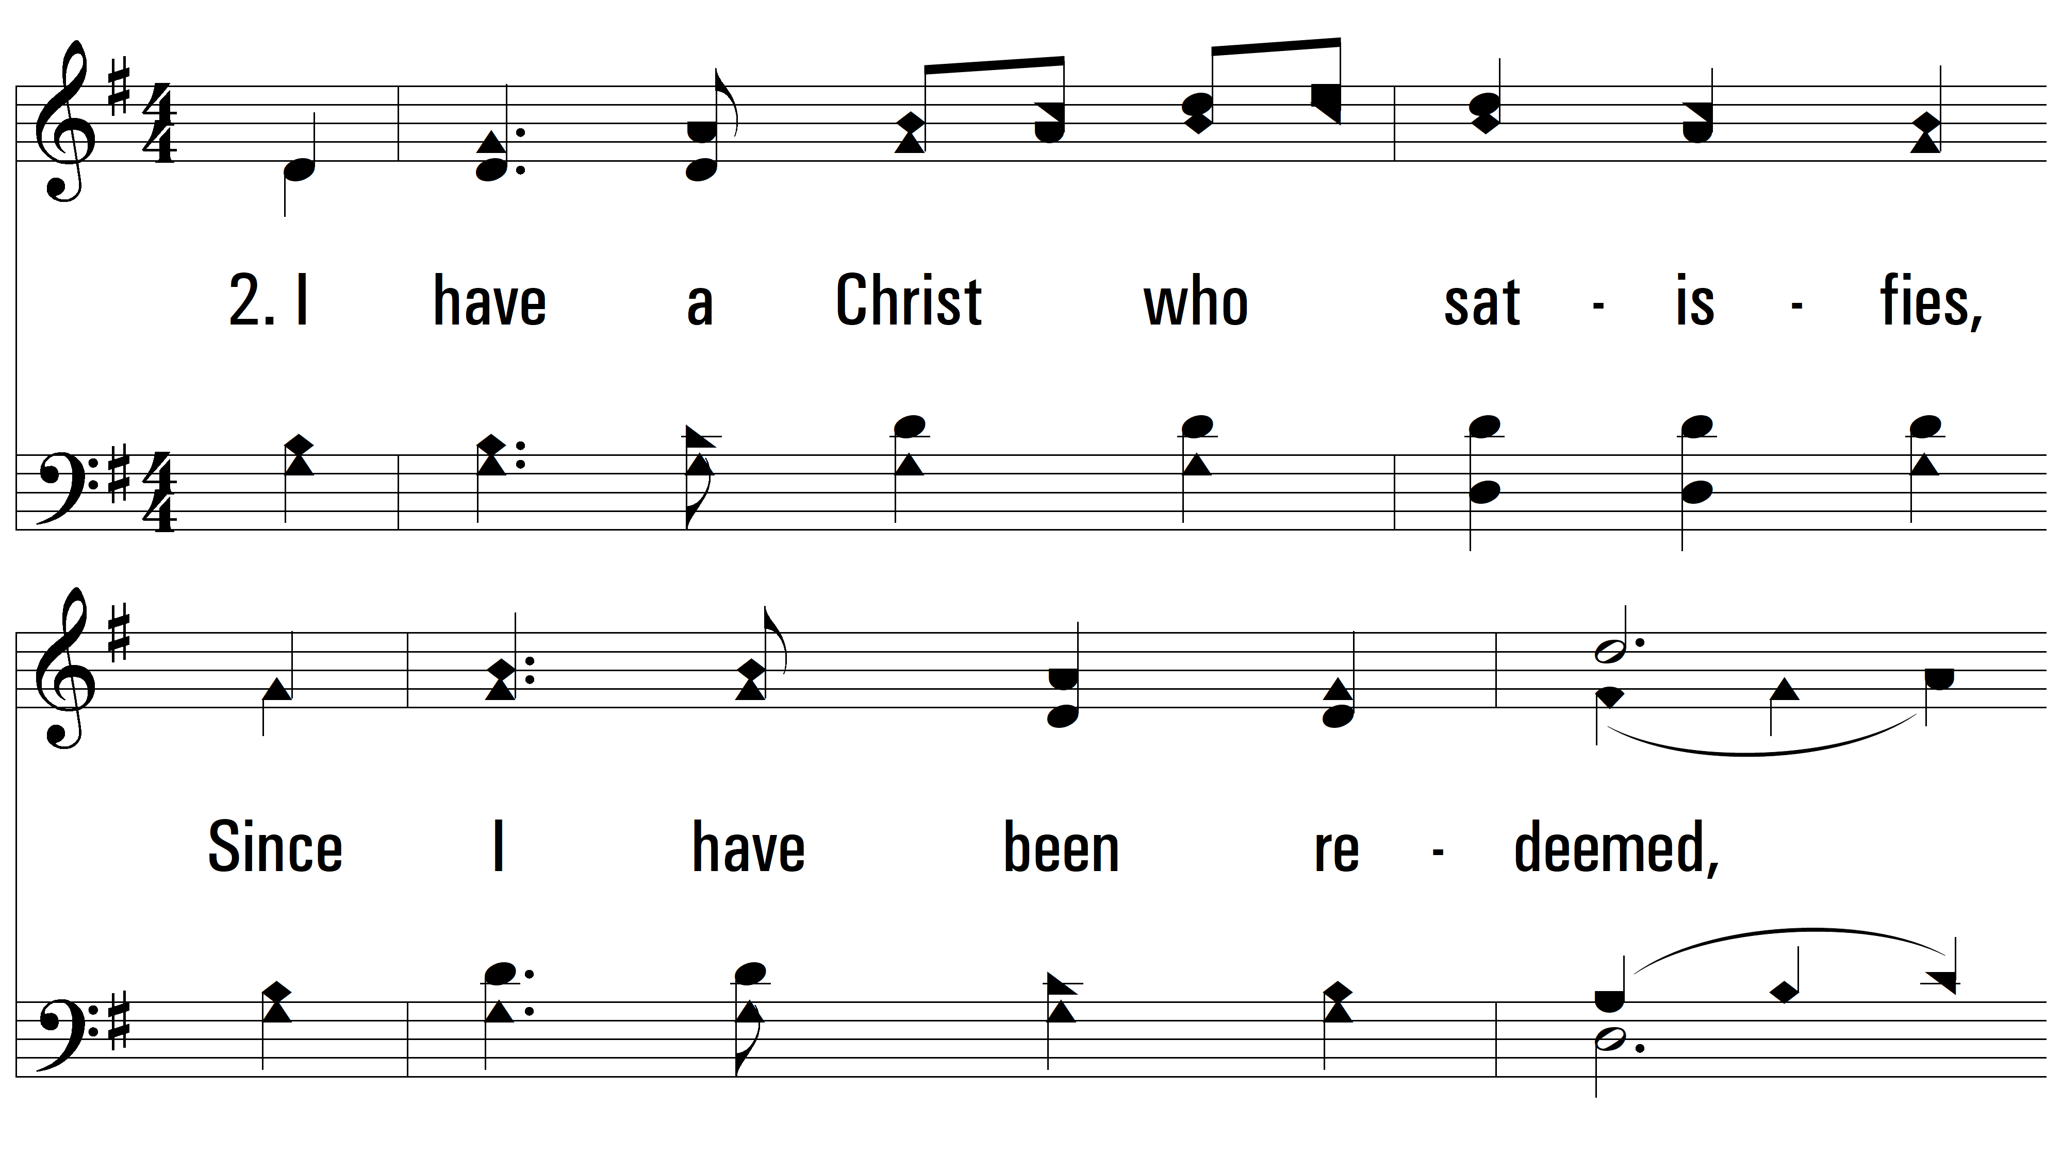
vs. 2 ~ Since I Have Been Redeemed

Slide 9
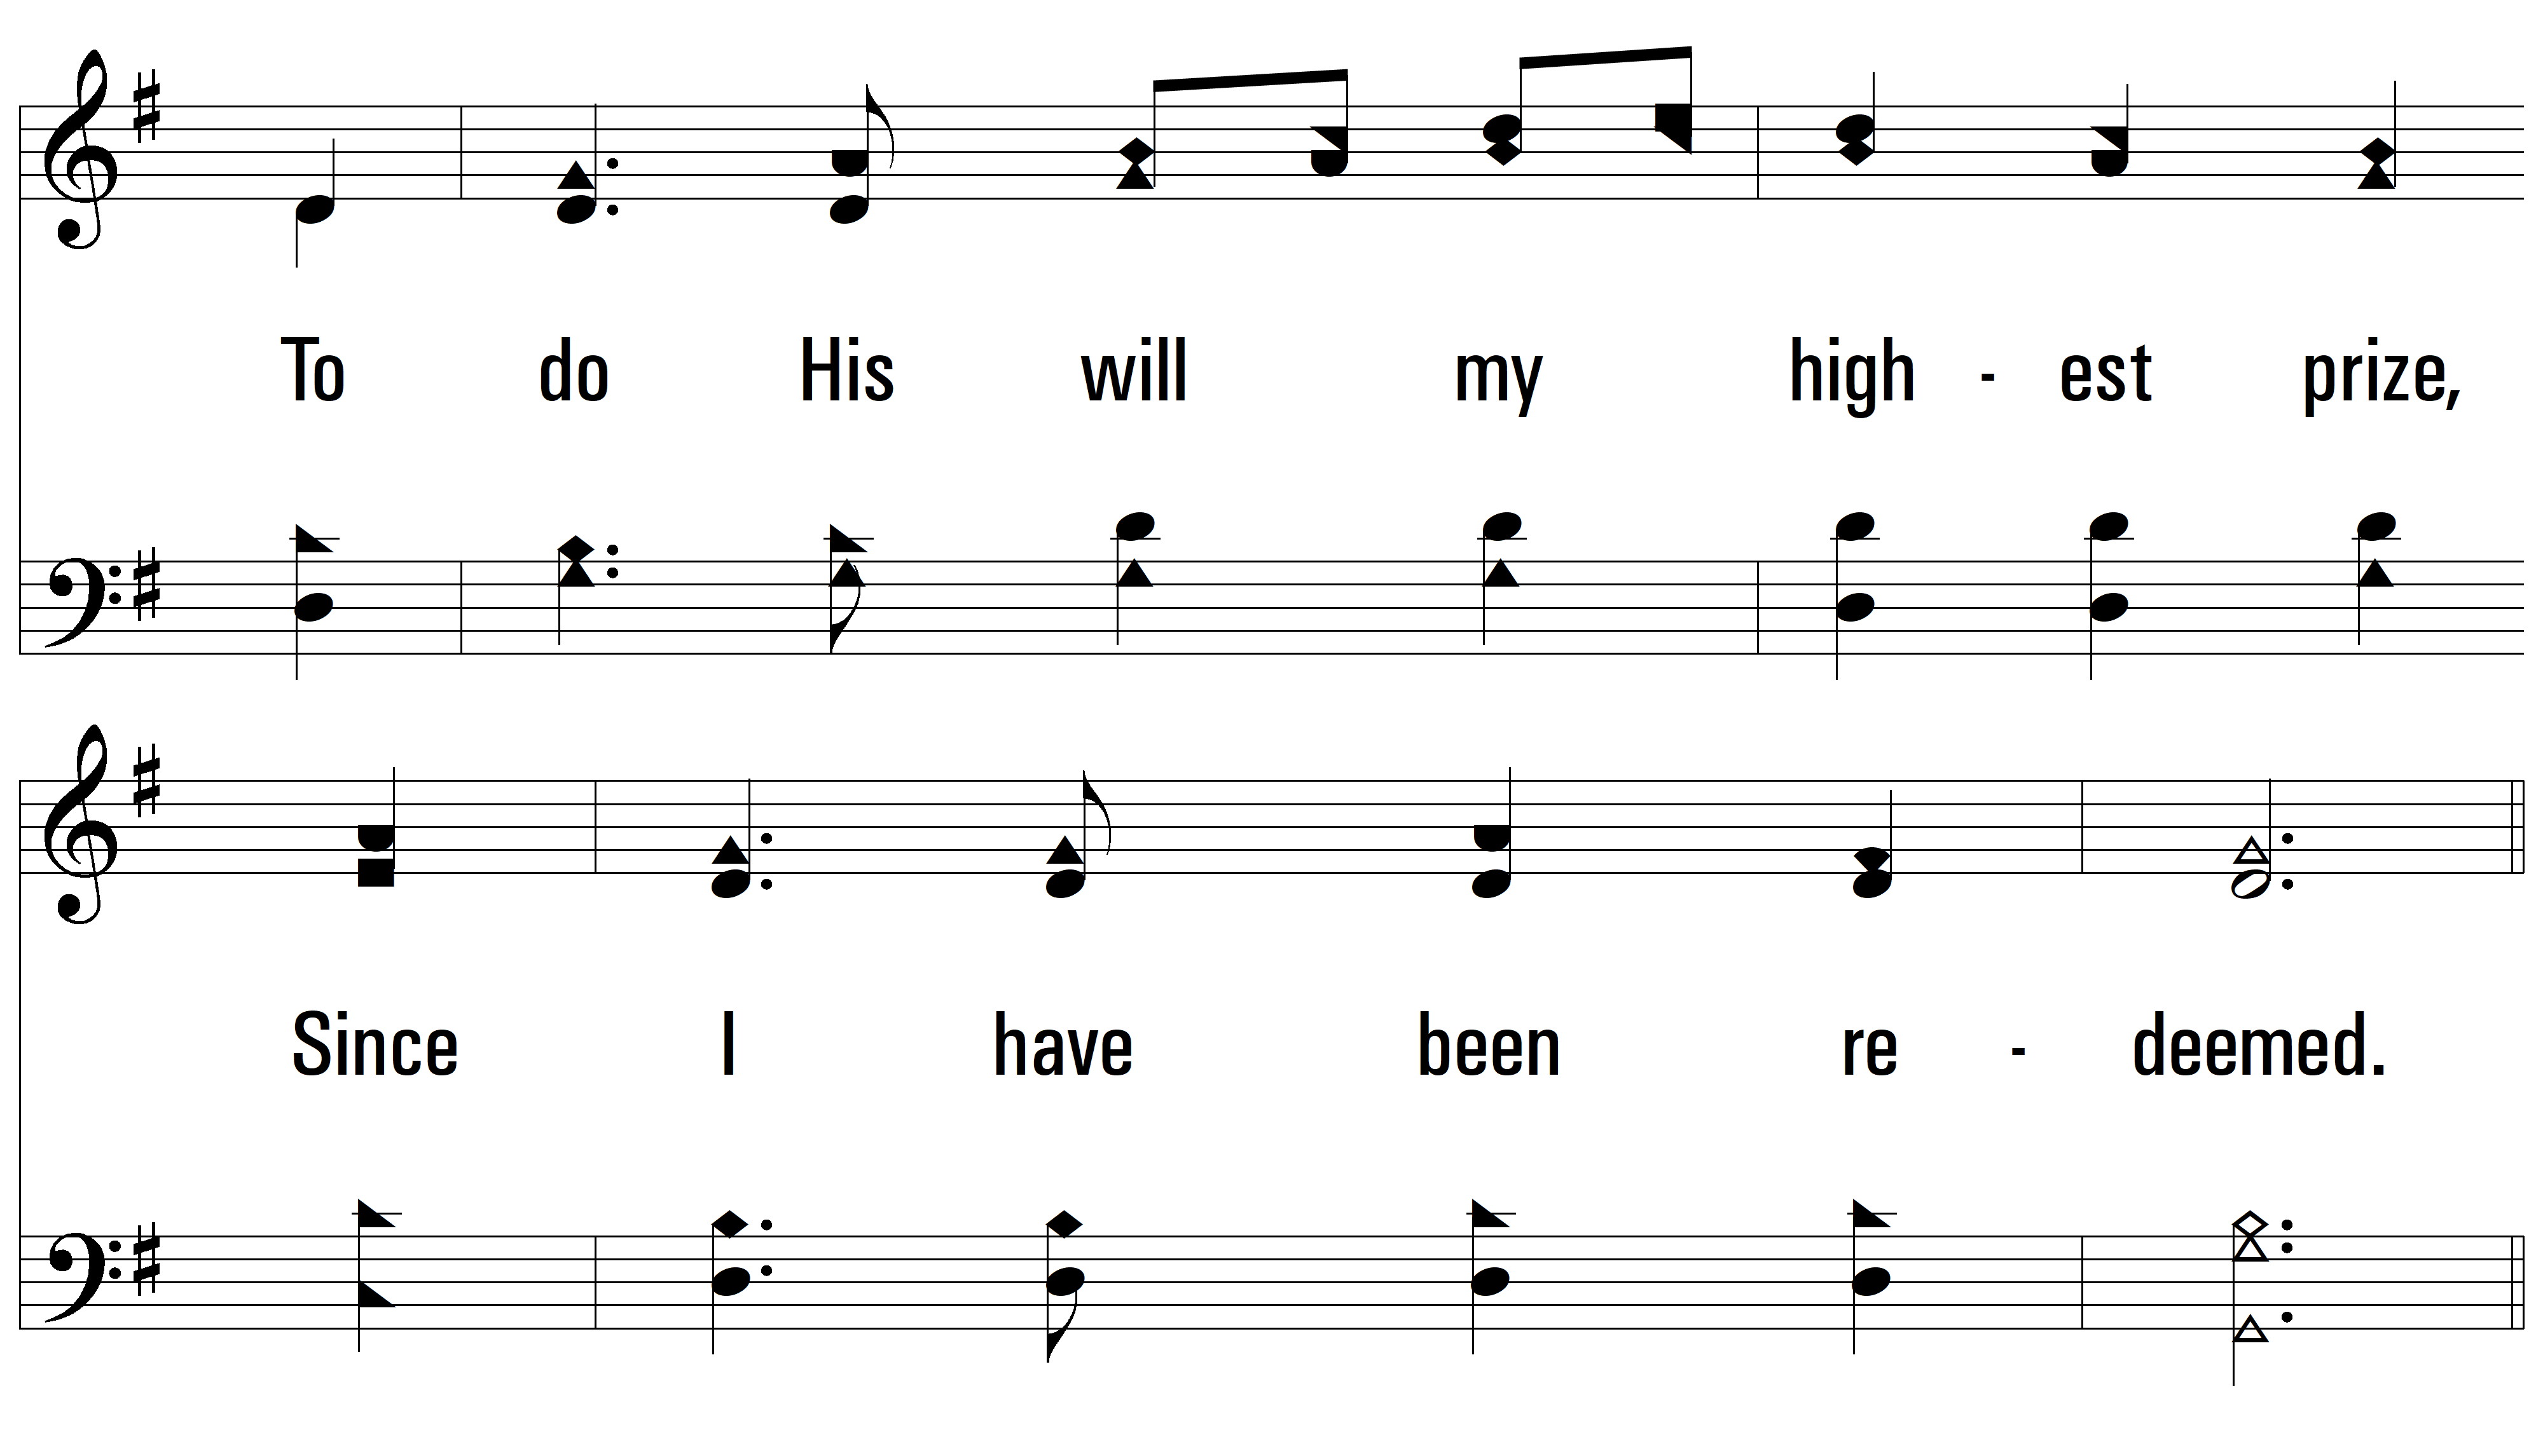
vs. 2

Slide 10
vs. 2

Slide 11
vs. 2

Slide 12
vs. 2

Slide 13
vs. 2

Slide 14
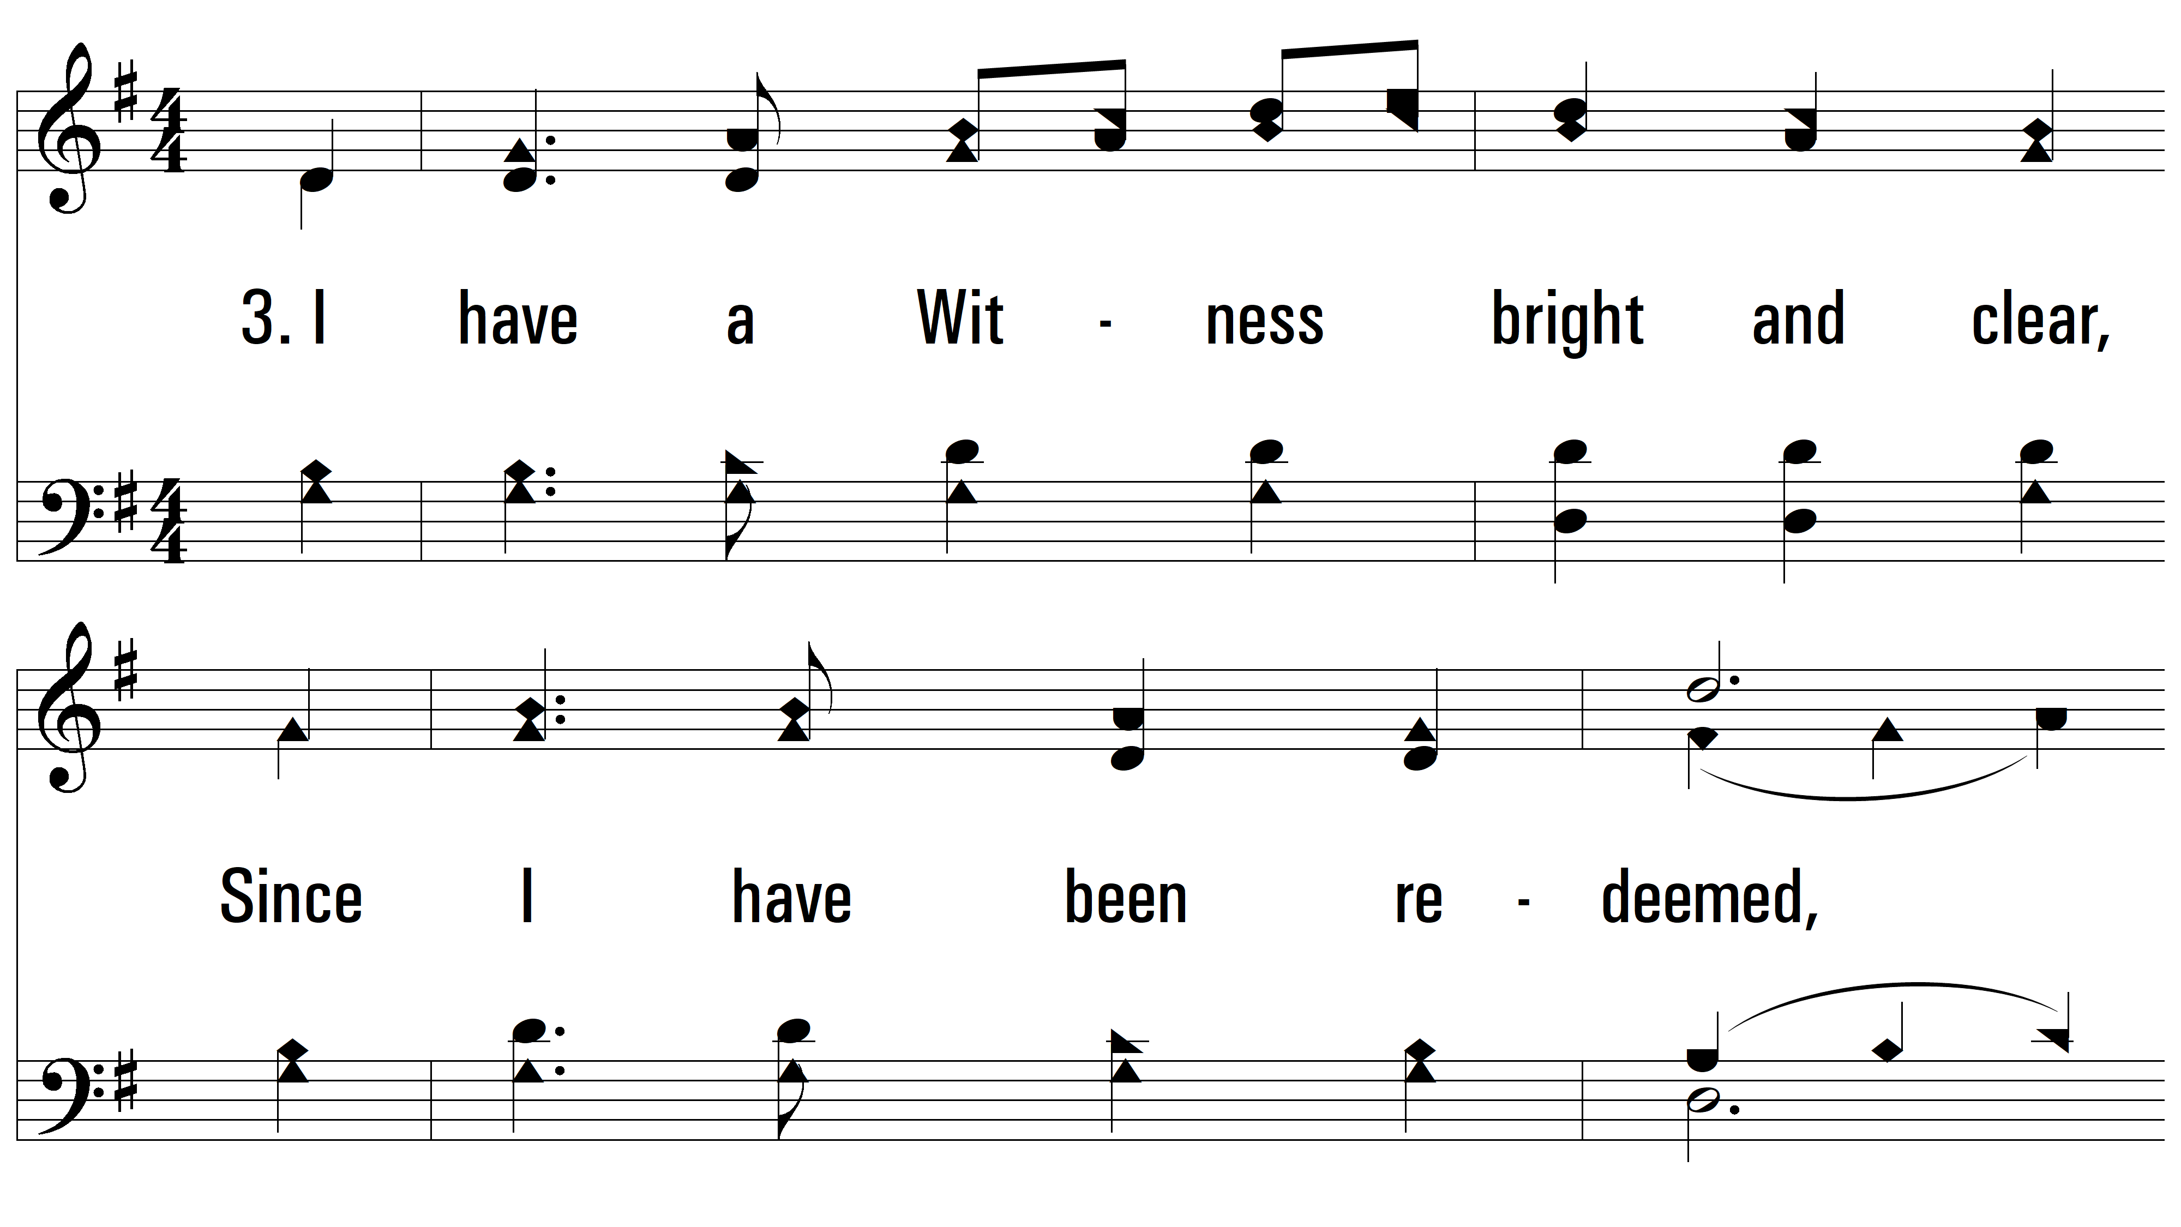
vs. 3 ~ Since I Have Been Redeemed

Slide 15
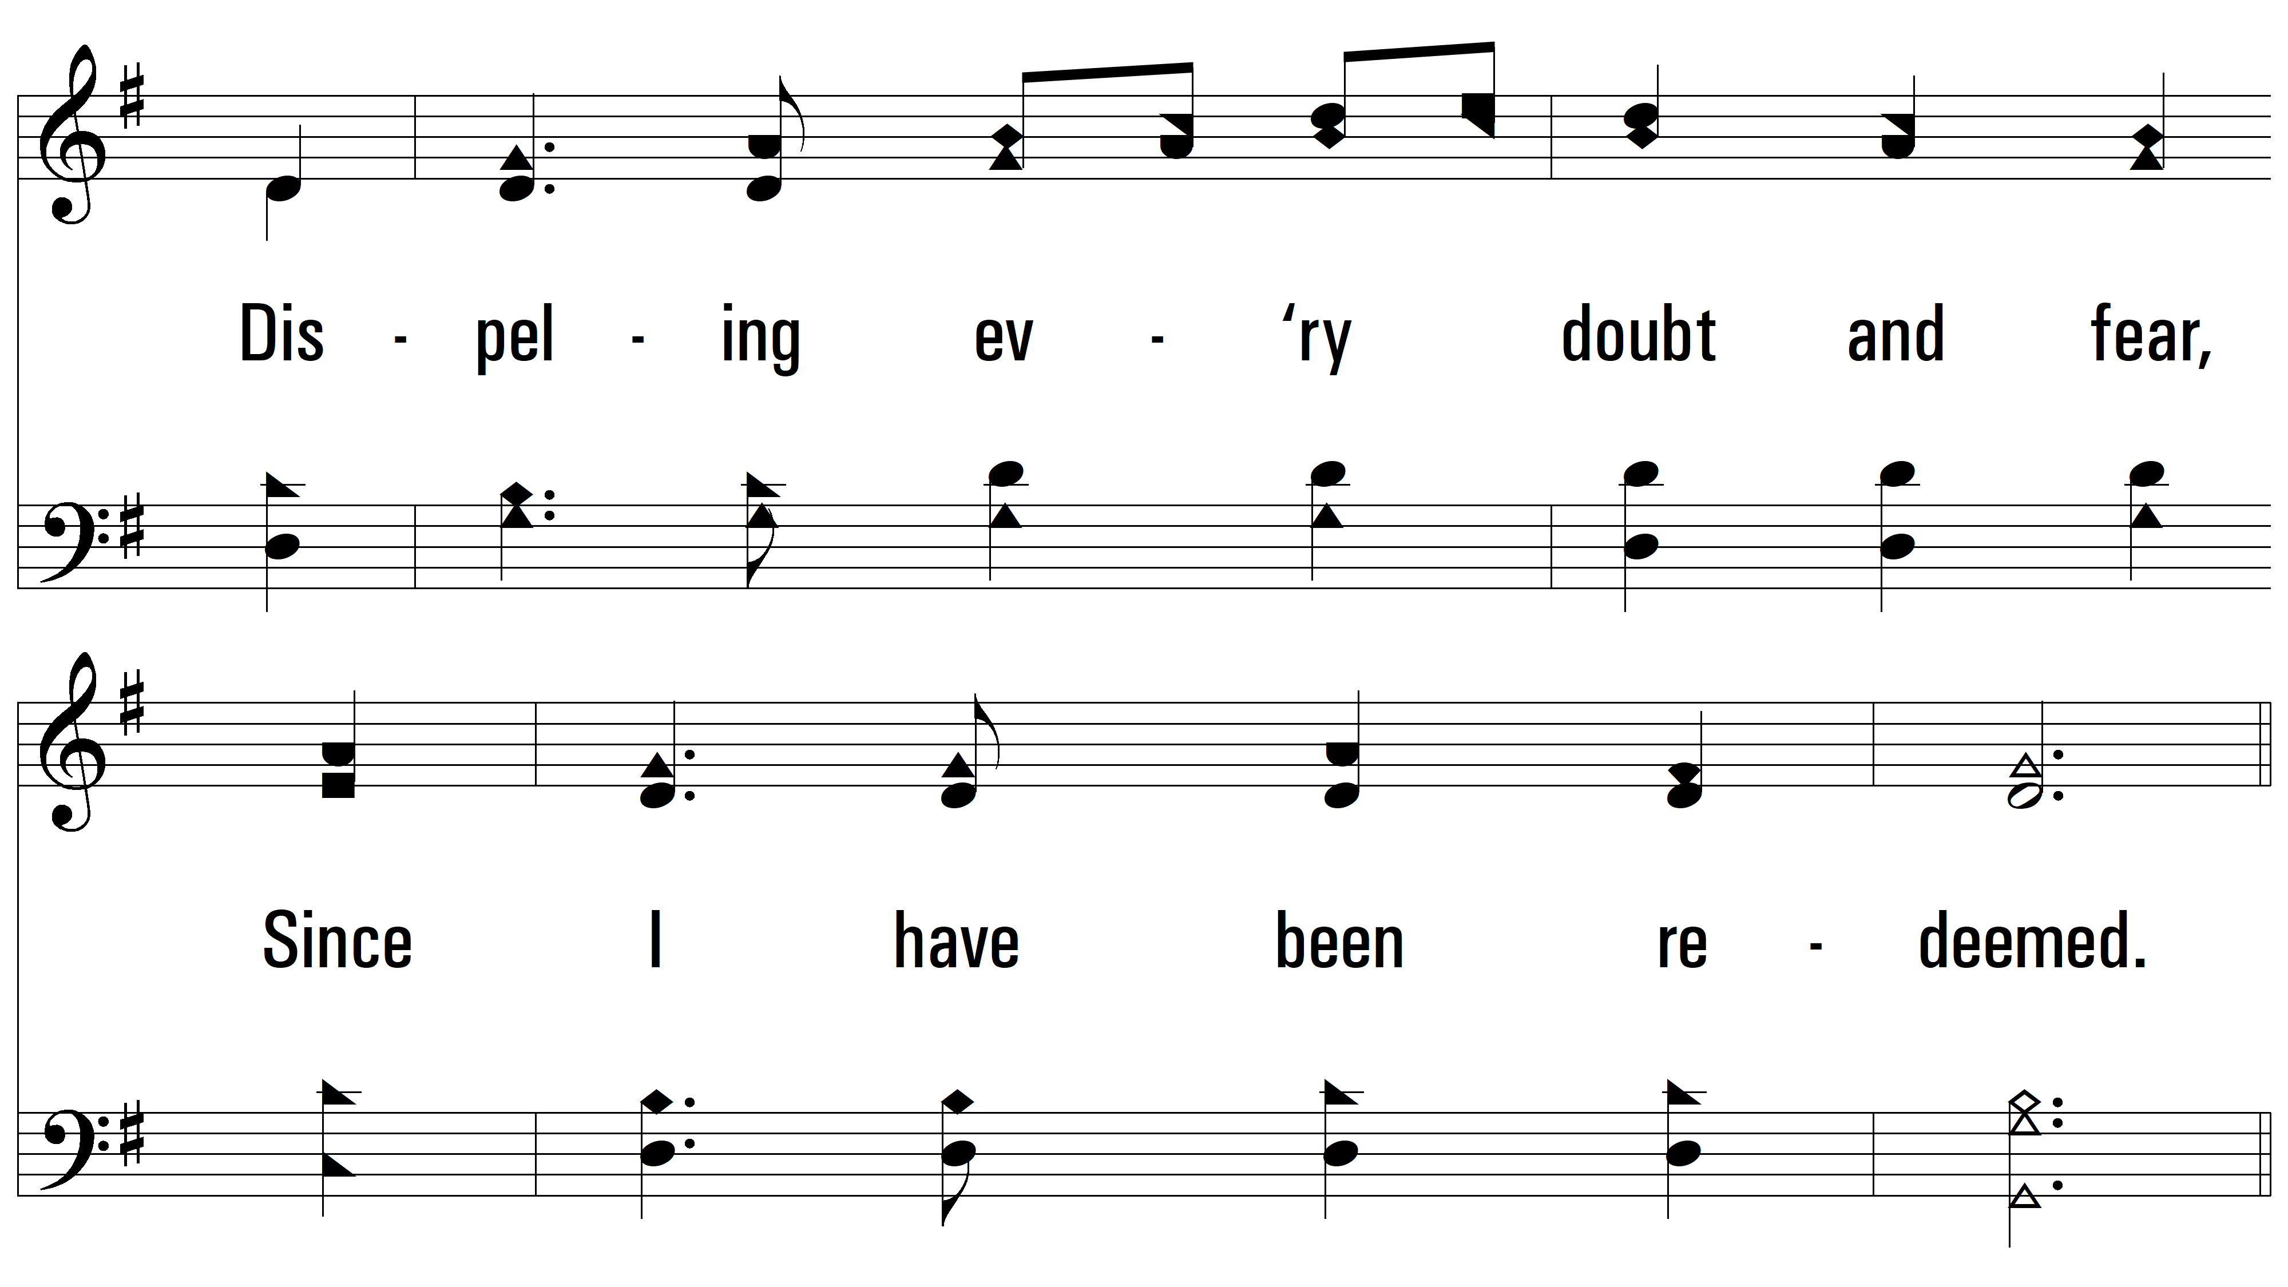
vs. 3

Slide 16
vs. 3

Slide 17
vs. 3

Slide 18
vs. 3

Slide 19
vs. 3

Slide 20
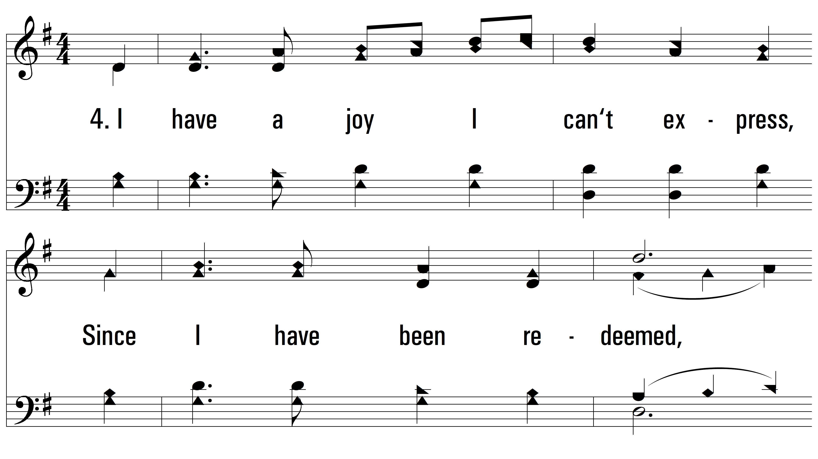
vs. 4 ~ Since I Have Been Redeemed

Slide 21
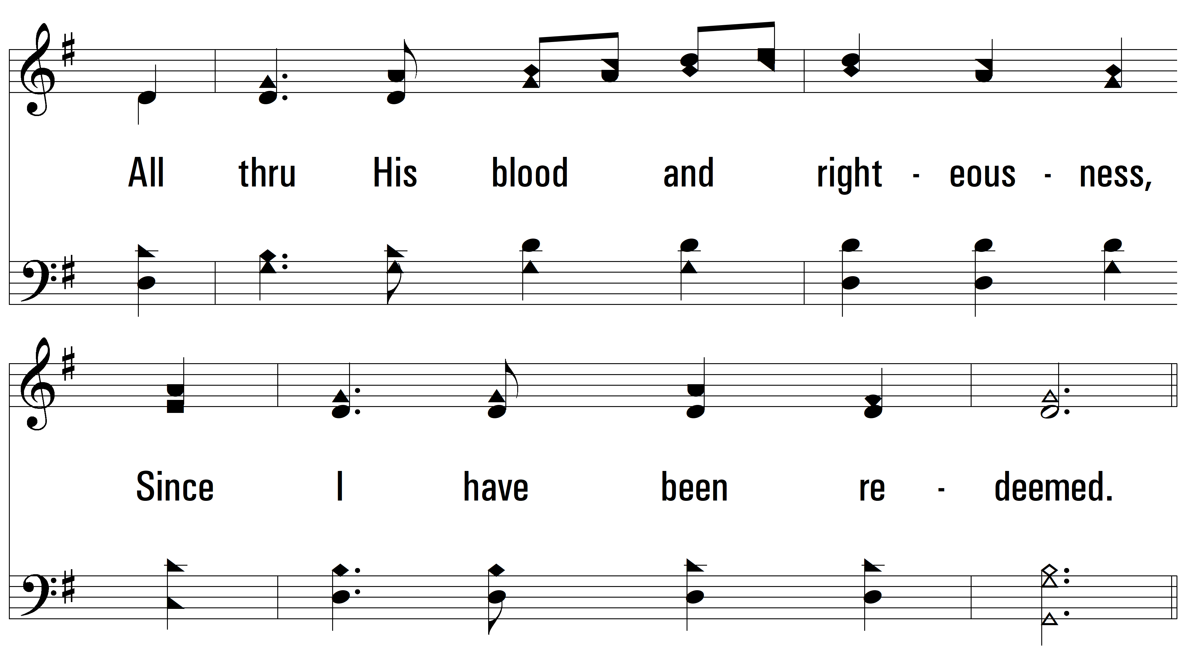
vs. 4

Slide 22
vs. 4

Slide 23
vs. 4

Slide 24
vs. 4

Slide 25
vs. 4

Slide 26
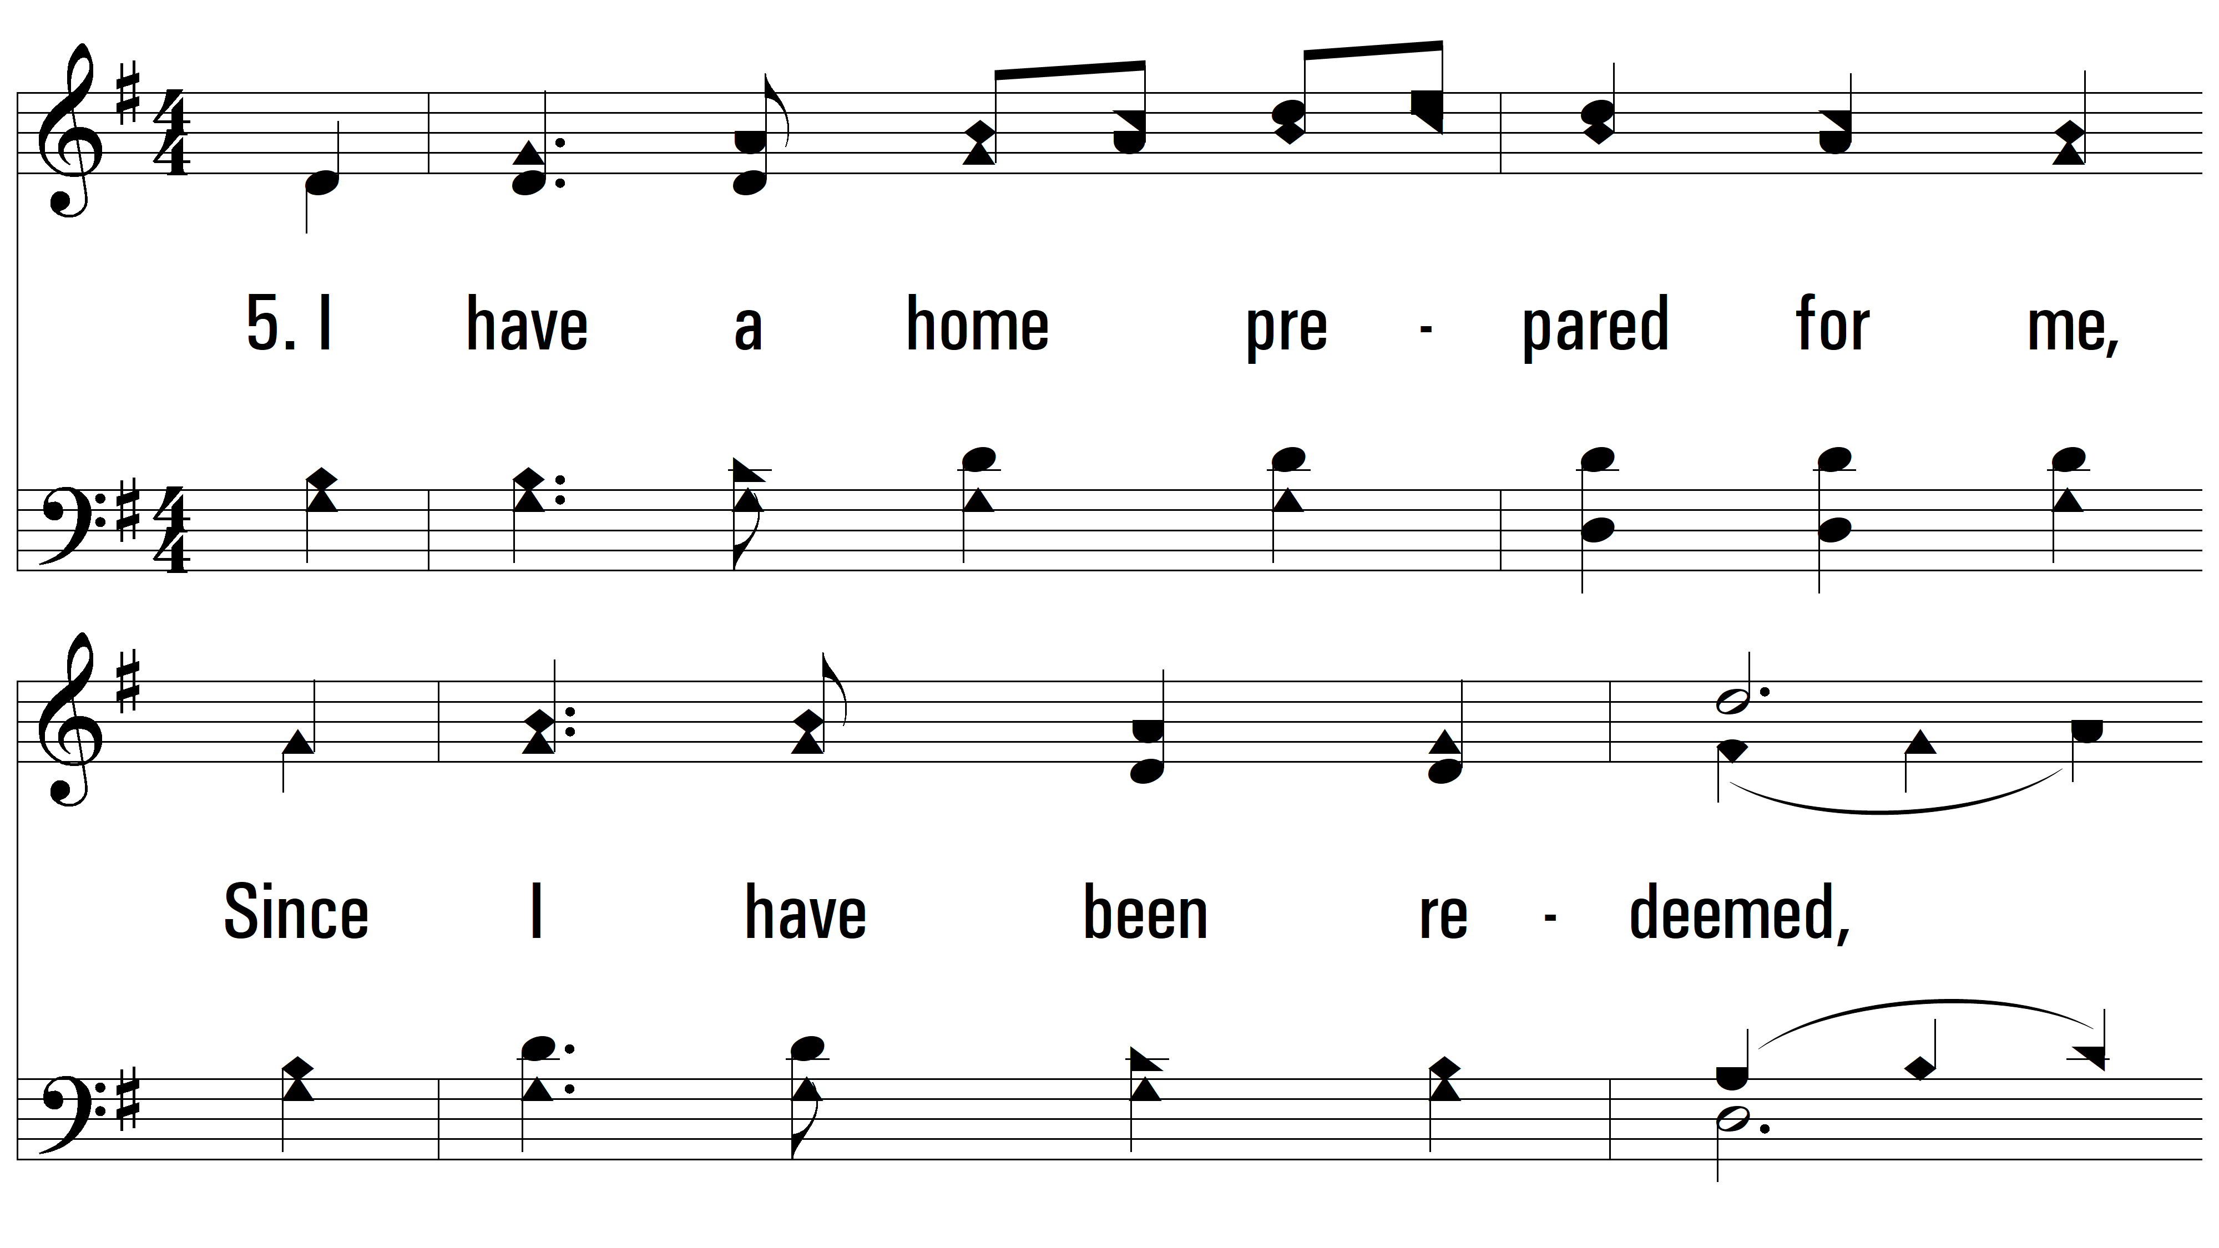
vs. 5 ~ Since I Have Been Redeemed

Slide 27
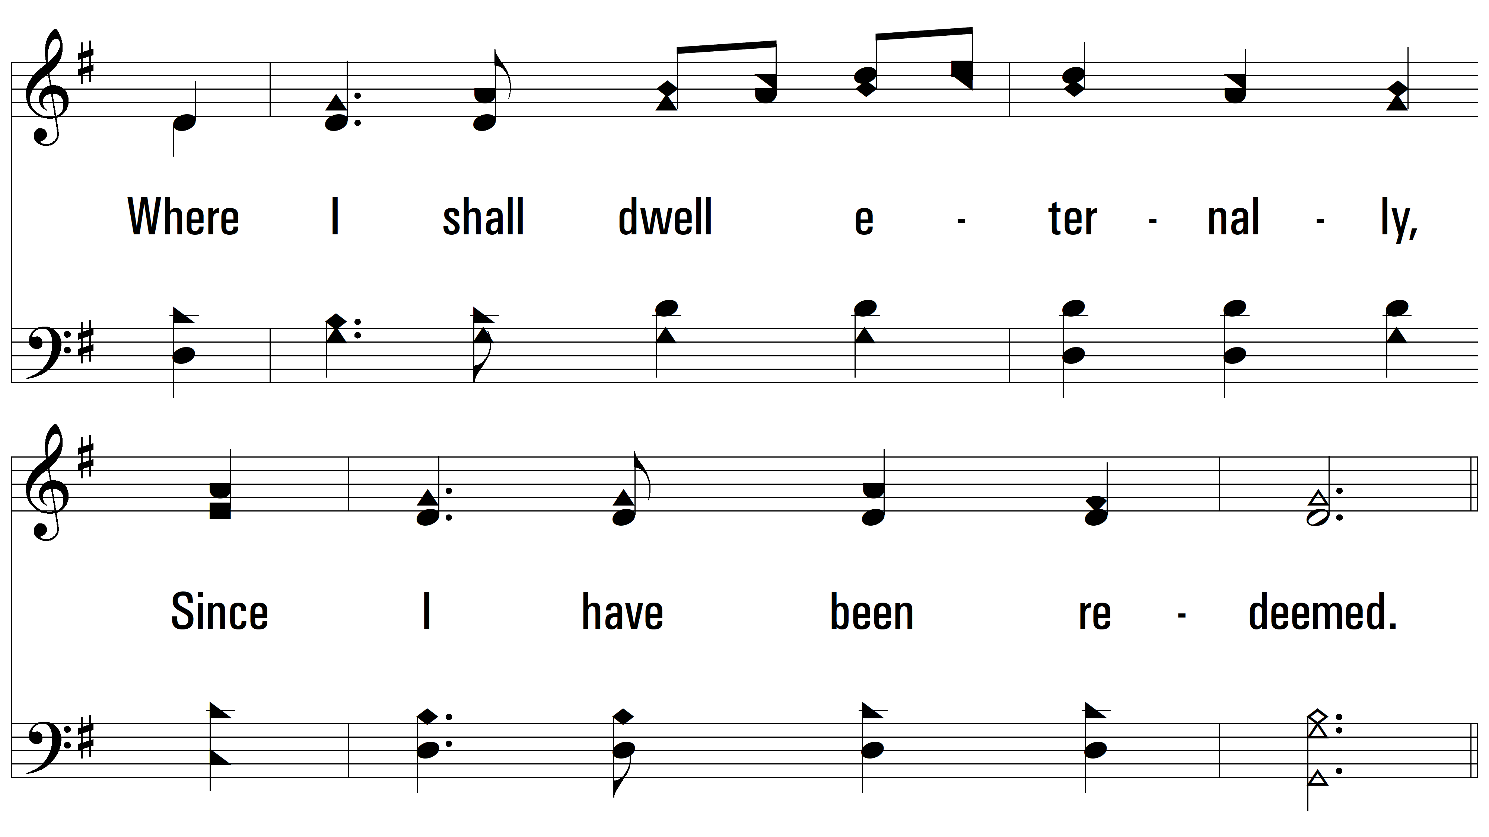
vs. 5

Slide 28
vs. 5

Slide 29
vs. 5

Slide 30
vs. 5

Slide 31
vs. 5
PDHymns.com
END

