Slide 1
Servant Song
Words: | Traditional
Music: | Traditional, vss. 2 & 3 by W. M. B.
3/4
F/C - SOL
Verses: 3
Lead - | SOL
Alto - | MI
Tenor - | SOL
Bass - | DO
PDHymns.com

Slide 2
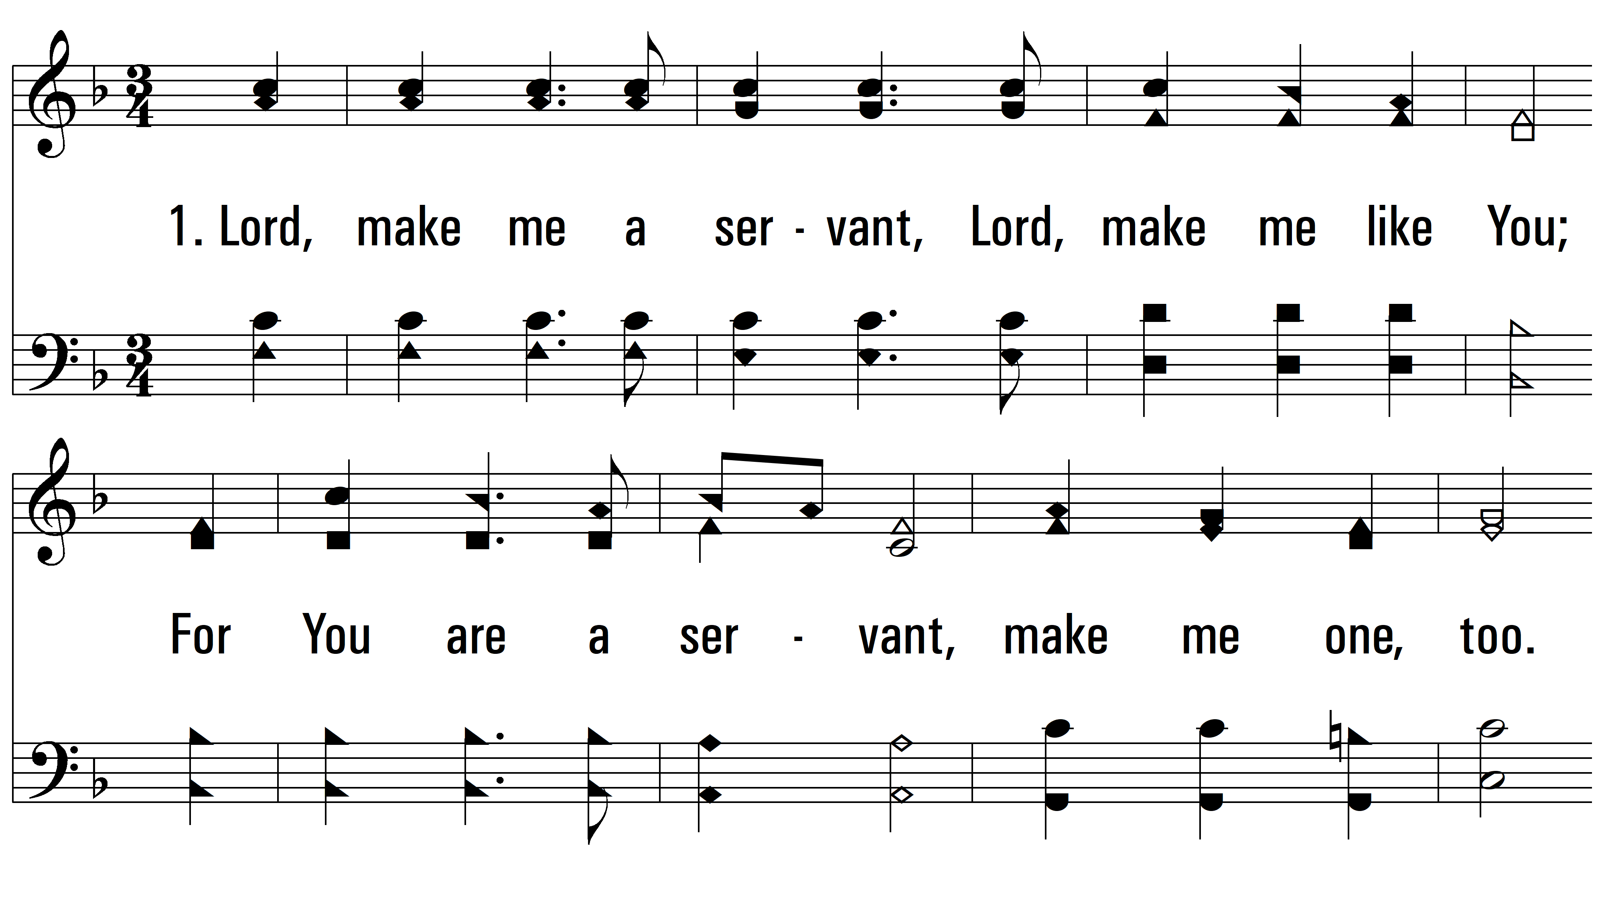
vs. 1 ~ Servant Song

Slide 3
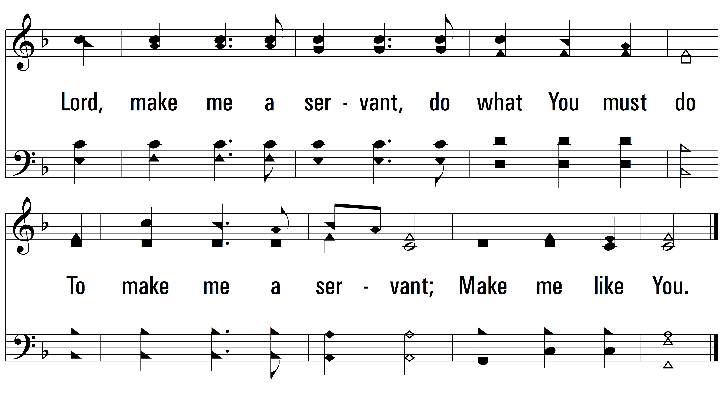
vs. 1

Slide 4
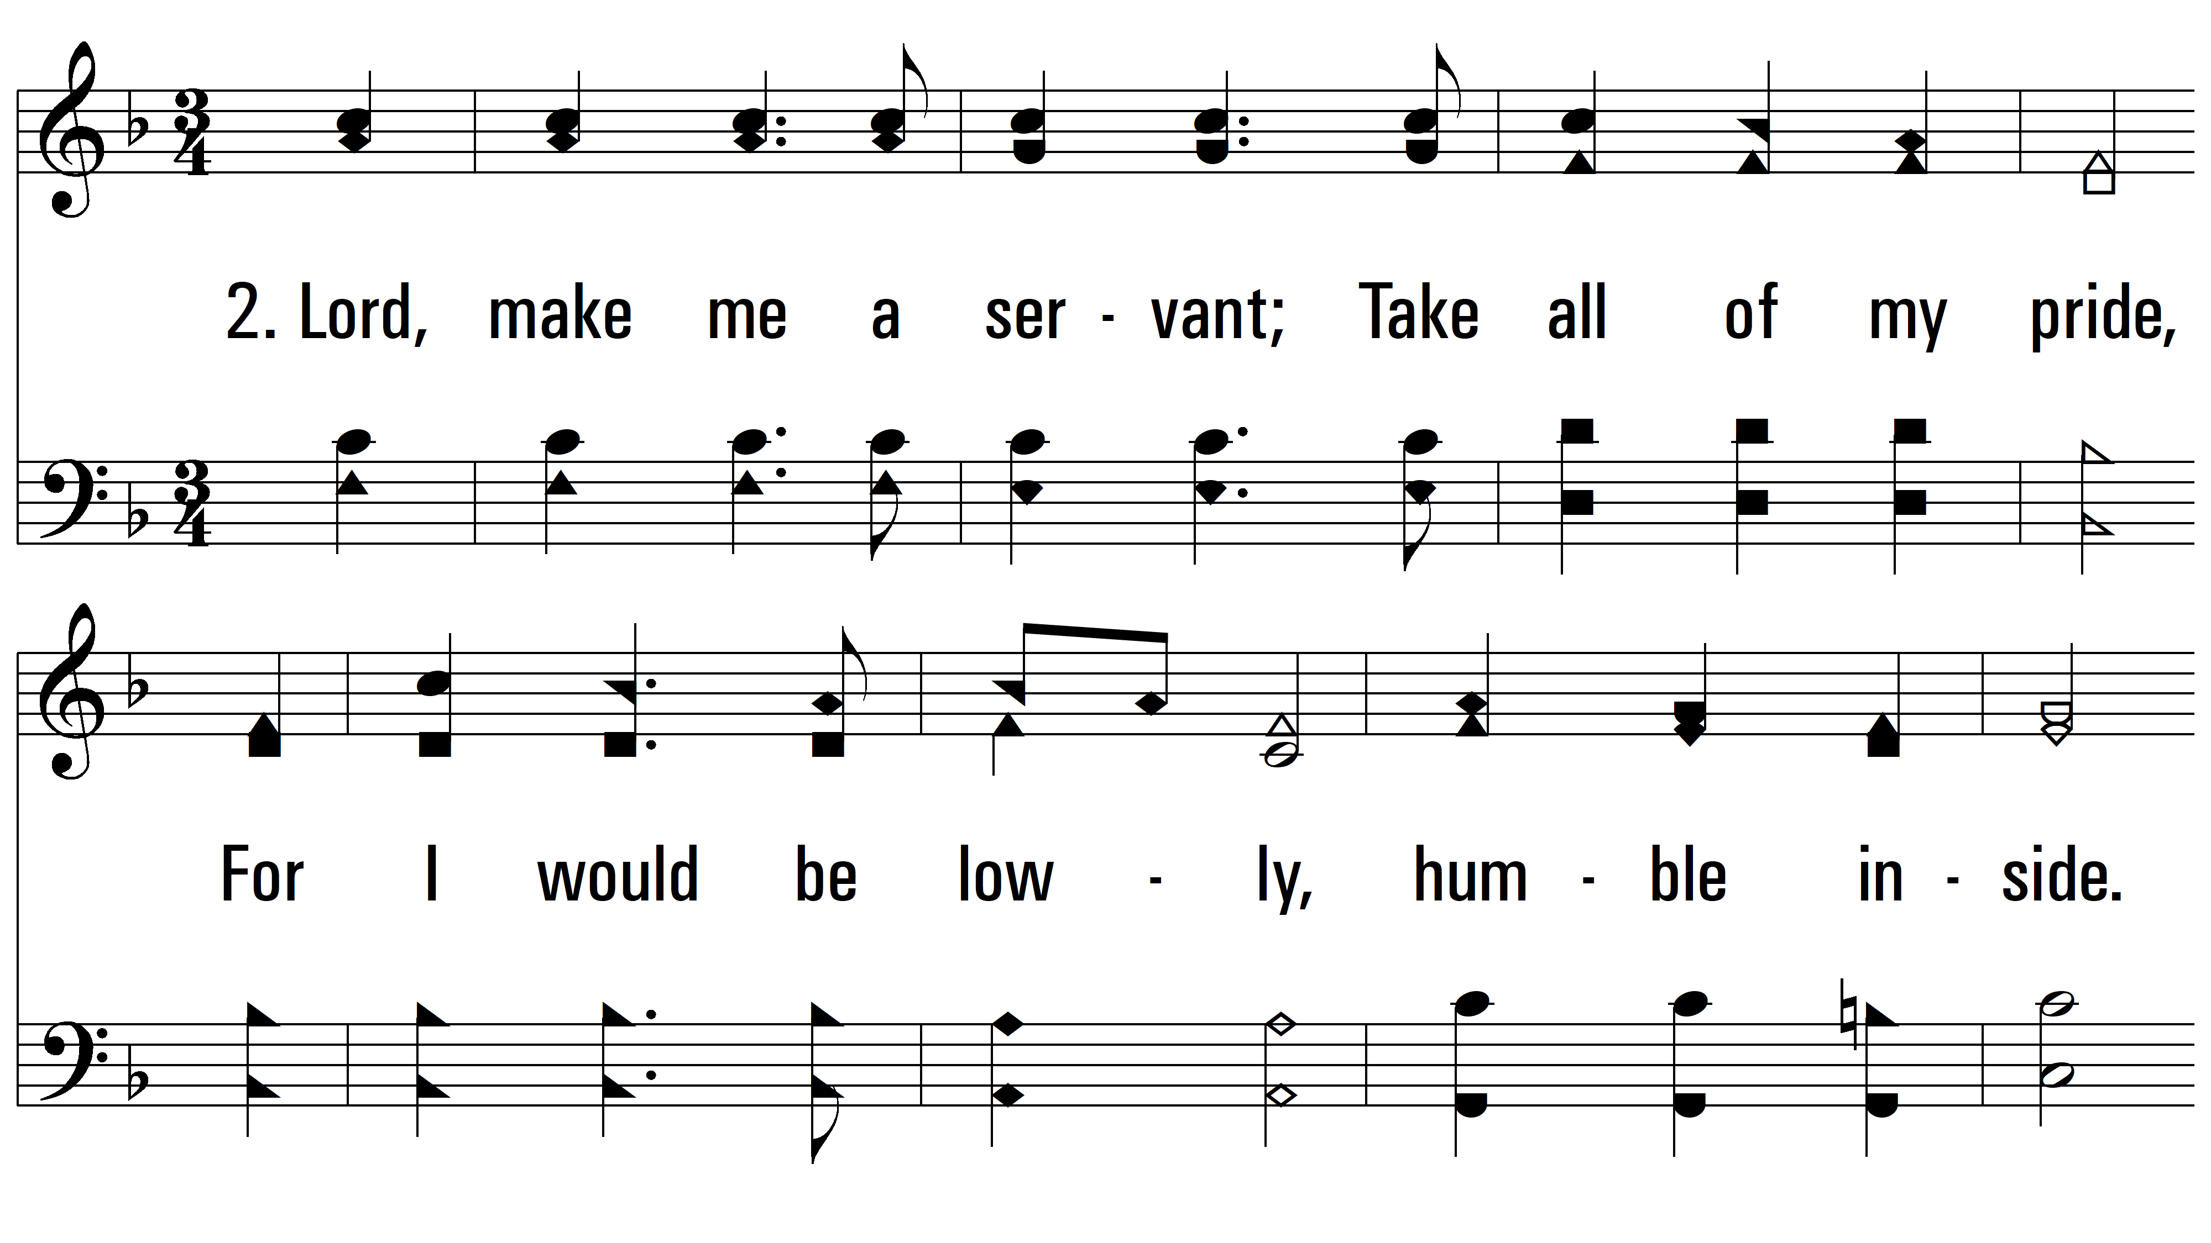
vs. 1 ~ Servant Song

Slide 5
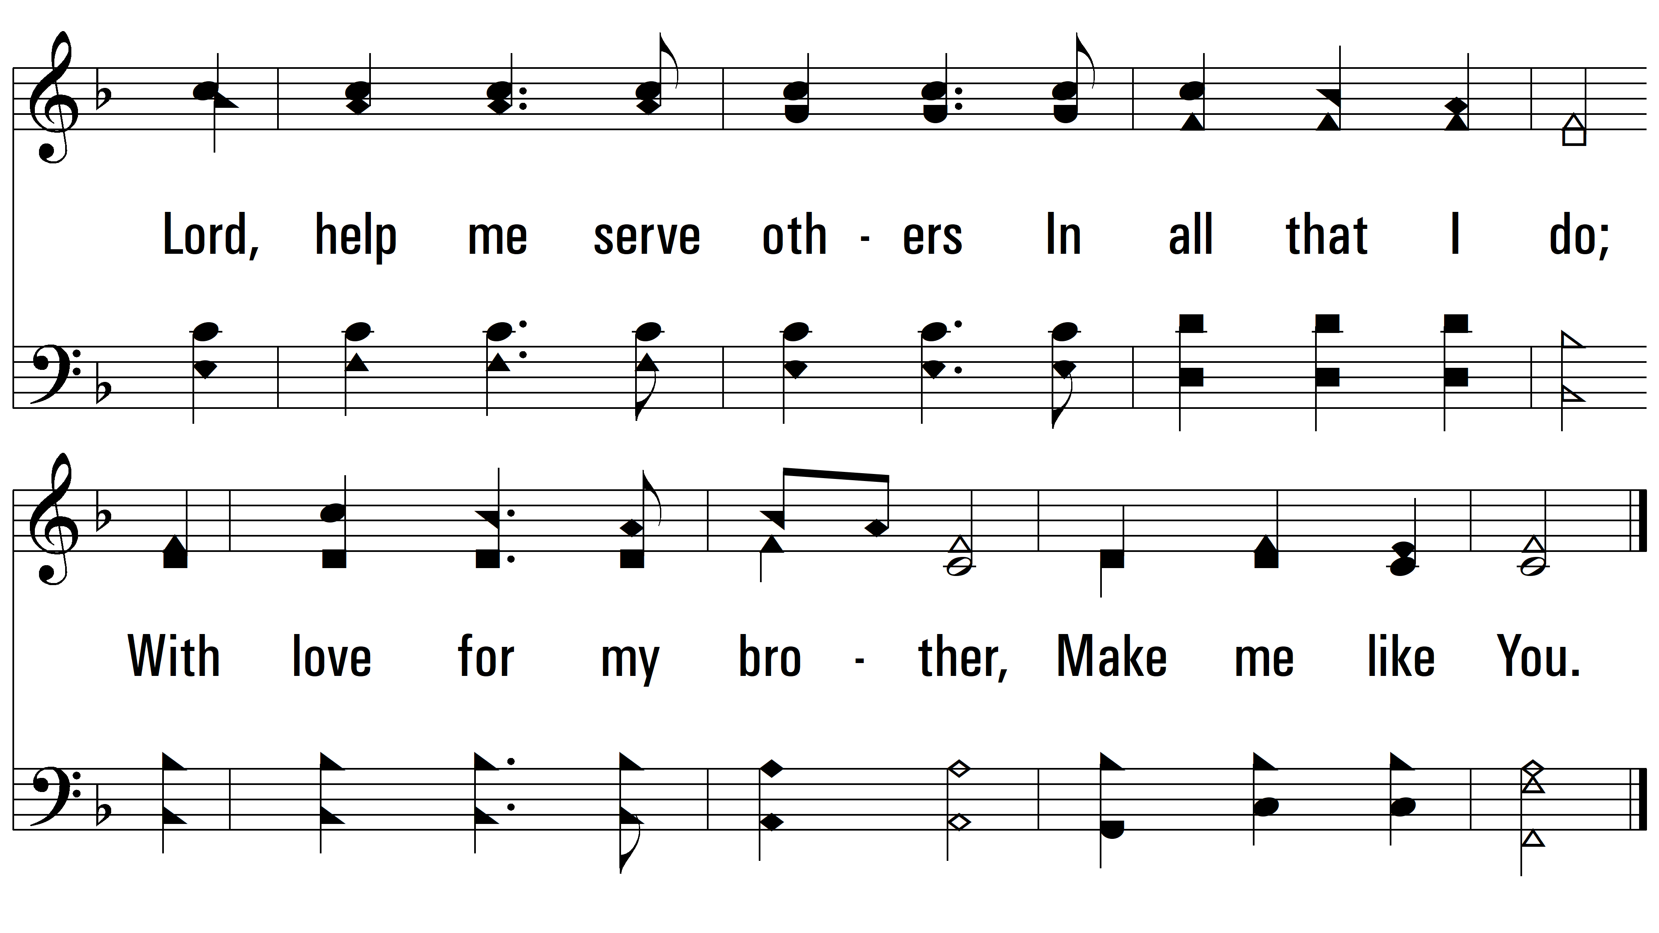
vs. 2

Slide 6
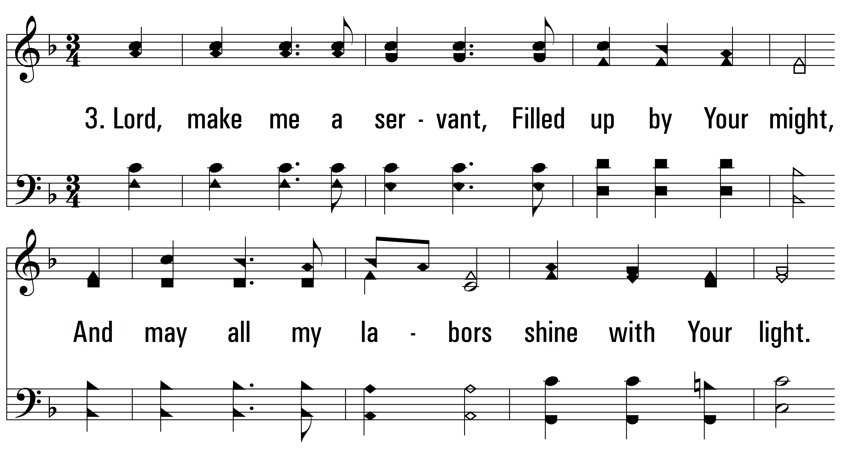
vs. 1 ~ Servant Song

Slide 7
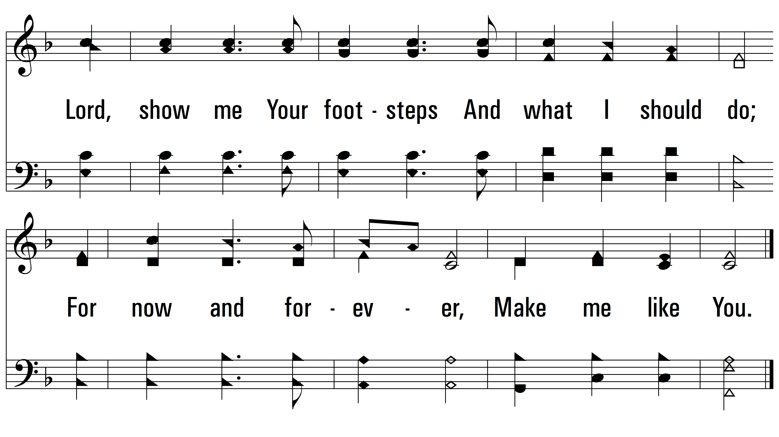
vs. 3
PDHymns.com
END

