Slide 1
Send The Light
Words: | Charles H. Gabriel (1890)
Music: | Charles H. Gabriel (1890)
4/4
A^{b}/E^{b} - SOL
Verses: 4/Chorus
Lead - | SOL
Alto - | MI
Tenor - | DO
Bass - | DO
PDHymns.com

Slide 2
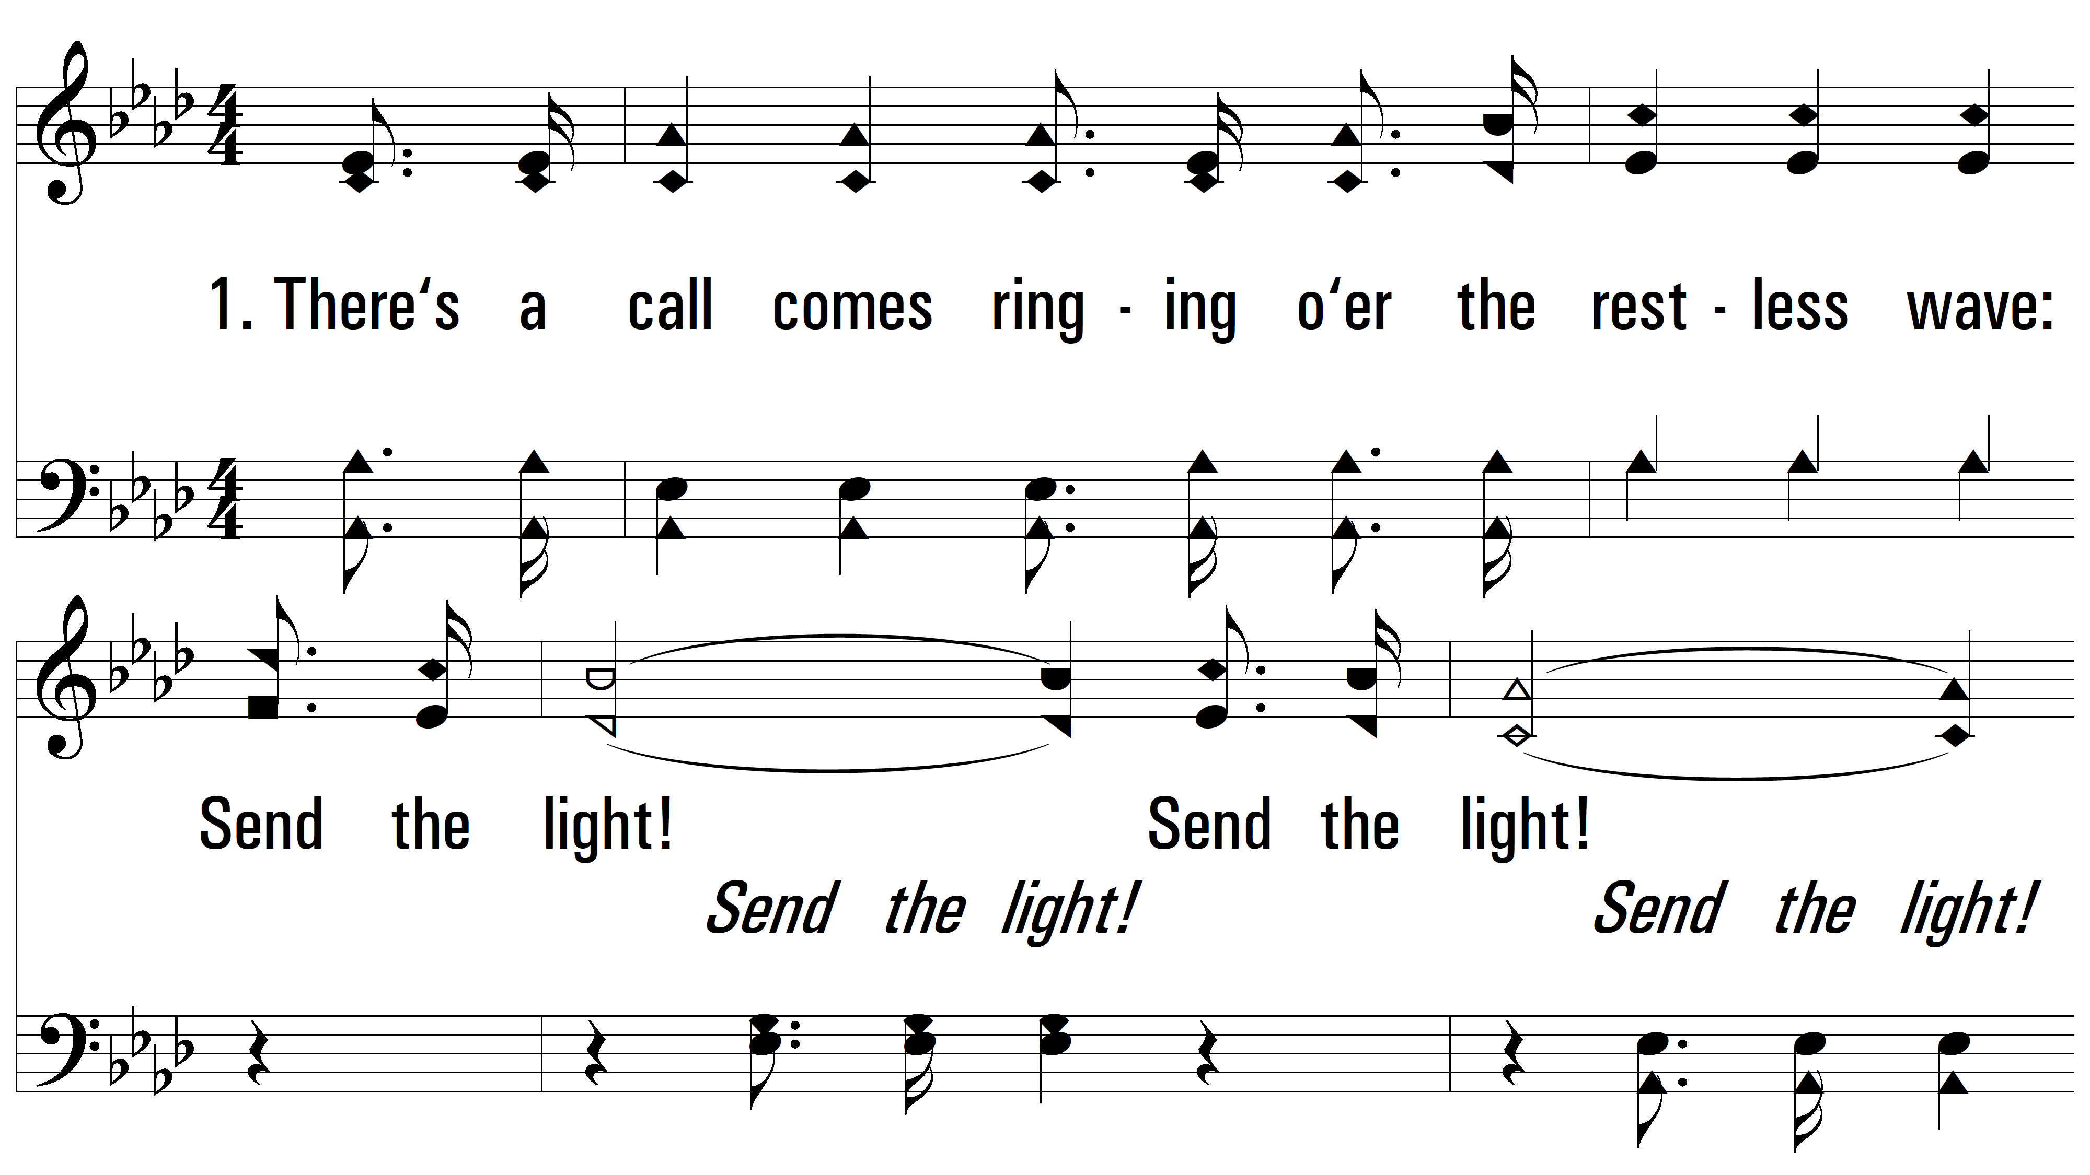
vs. 1 ~ Send The Light

Slide 3
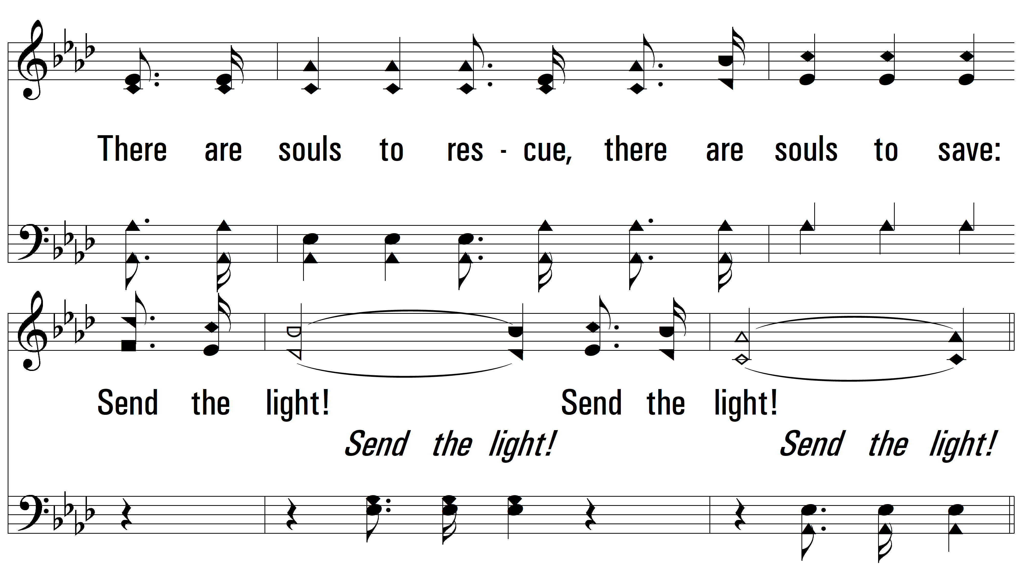
vs. 1

Slide 4
vs. 1

Slide 5
vs. 1

Slide 6
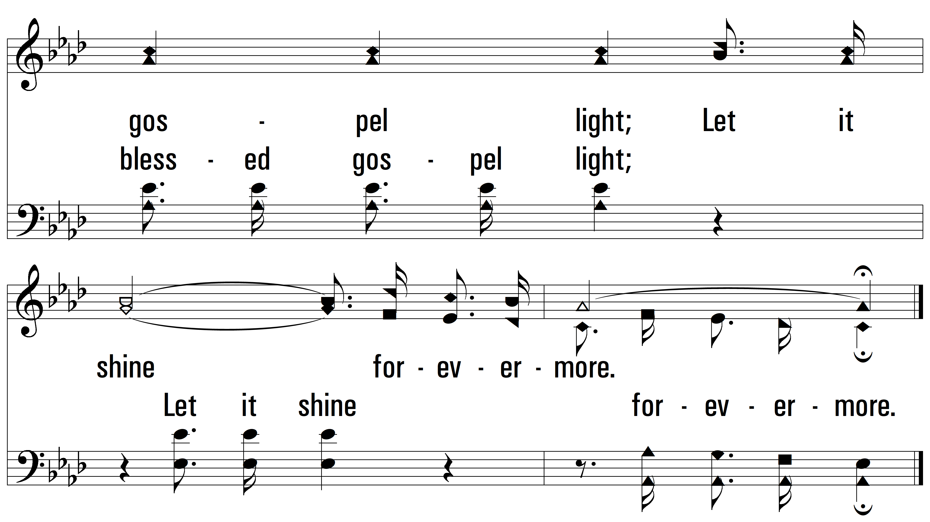
vs. 1

Slide 7
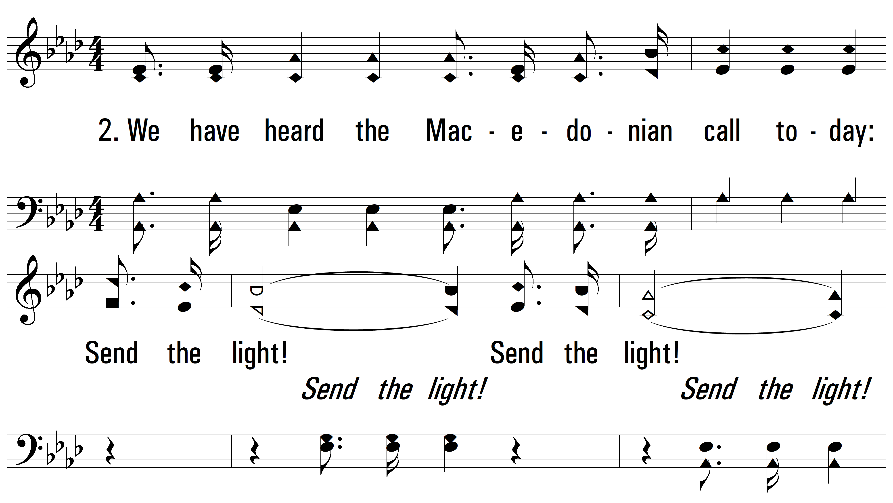
vs. 2 ~ Send The Light

Slide 8
vs. 2

Slide 9
vs. 2

Slide 10
vs. 2

Slide 11
vs. 2

Slide 12
vs. 3 ~ Send The Light

Slide 13
vs. 3

Slide 14
vs. 3

Slide 15
vs. 3

Slide 16
vs. 3

Slide 17
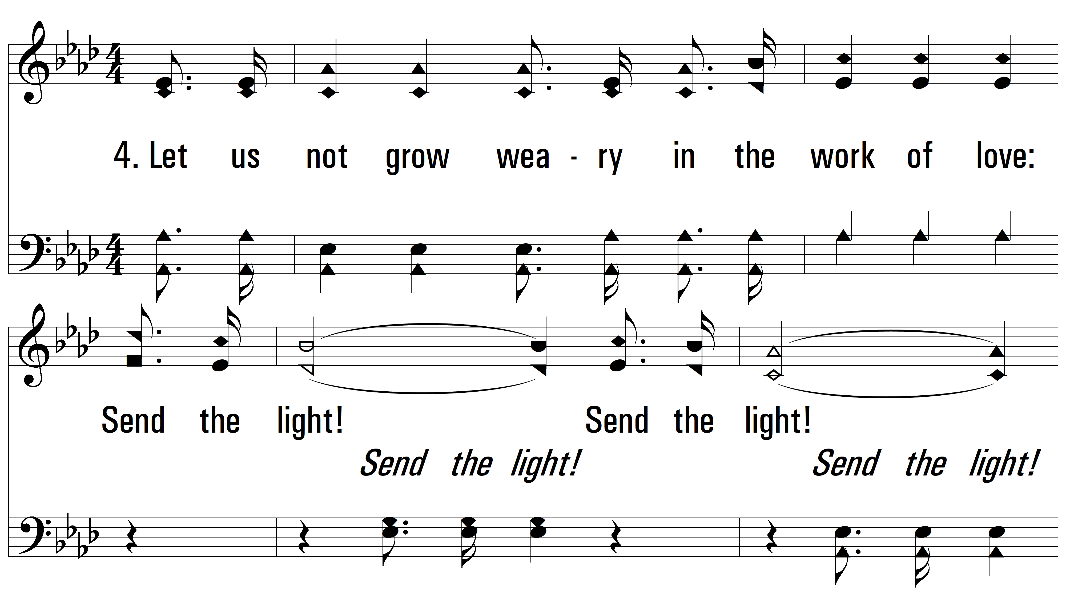
vs. 4 ~ Send The Light

Slide 18
vs. 4

Slide 19
vs. 4

Slide 20
vs. 4

Slide 21
vs. 4
PDHymns.com
END

