Slide 1
Seeking The Lost
Words: | W. A. Ogden (1886)
Music: | W. A. Ogden (1886)
9/8 + 12/8
B^{b}/F - SOL
Verses: 3/Chorus
Lead - | SOL
Alto - | MI
Tenor - | DO
Bass - | DO
PDHymns.com

Slide 2
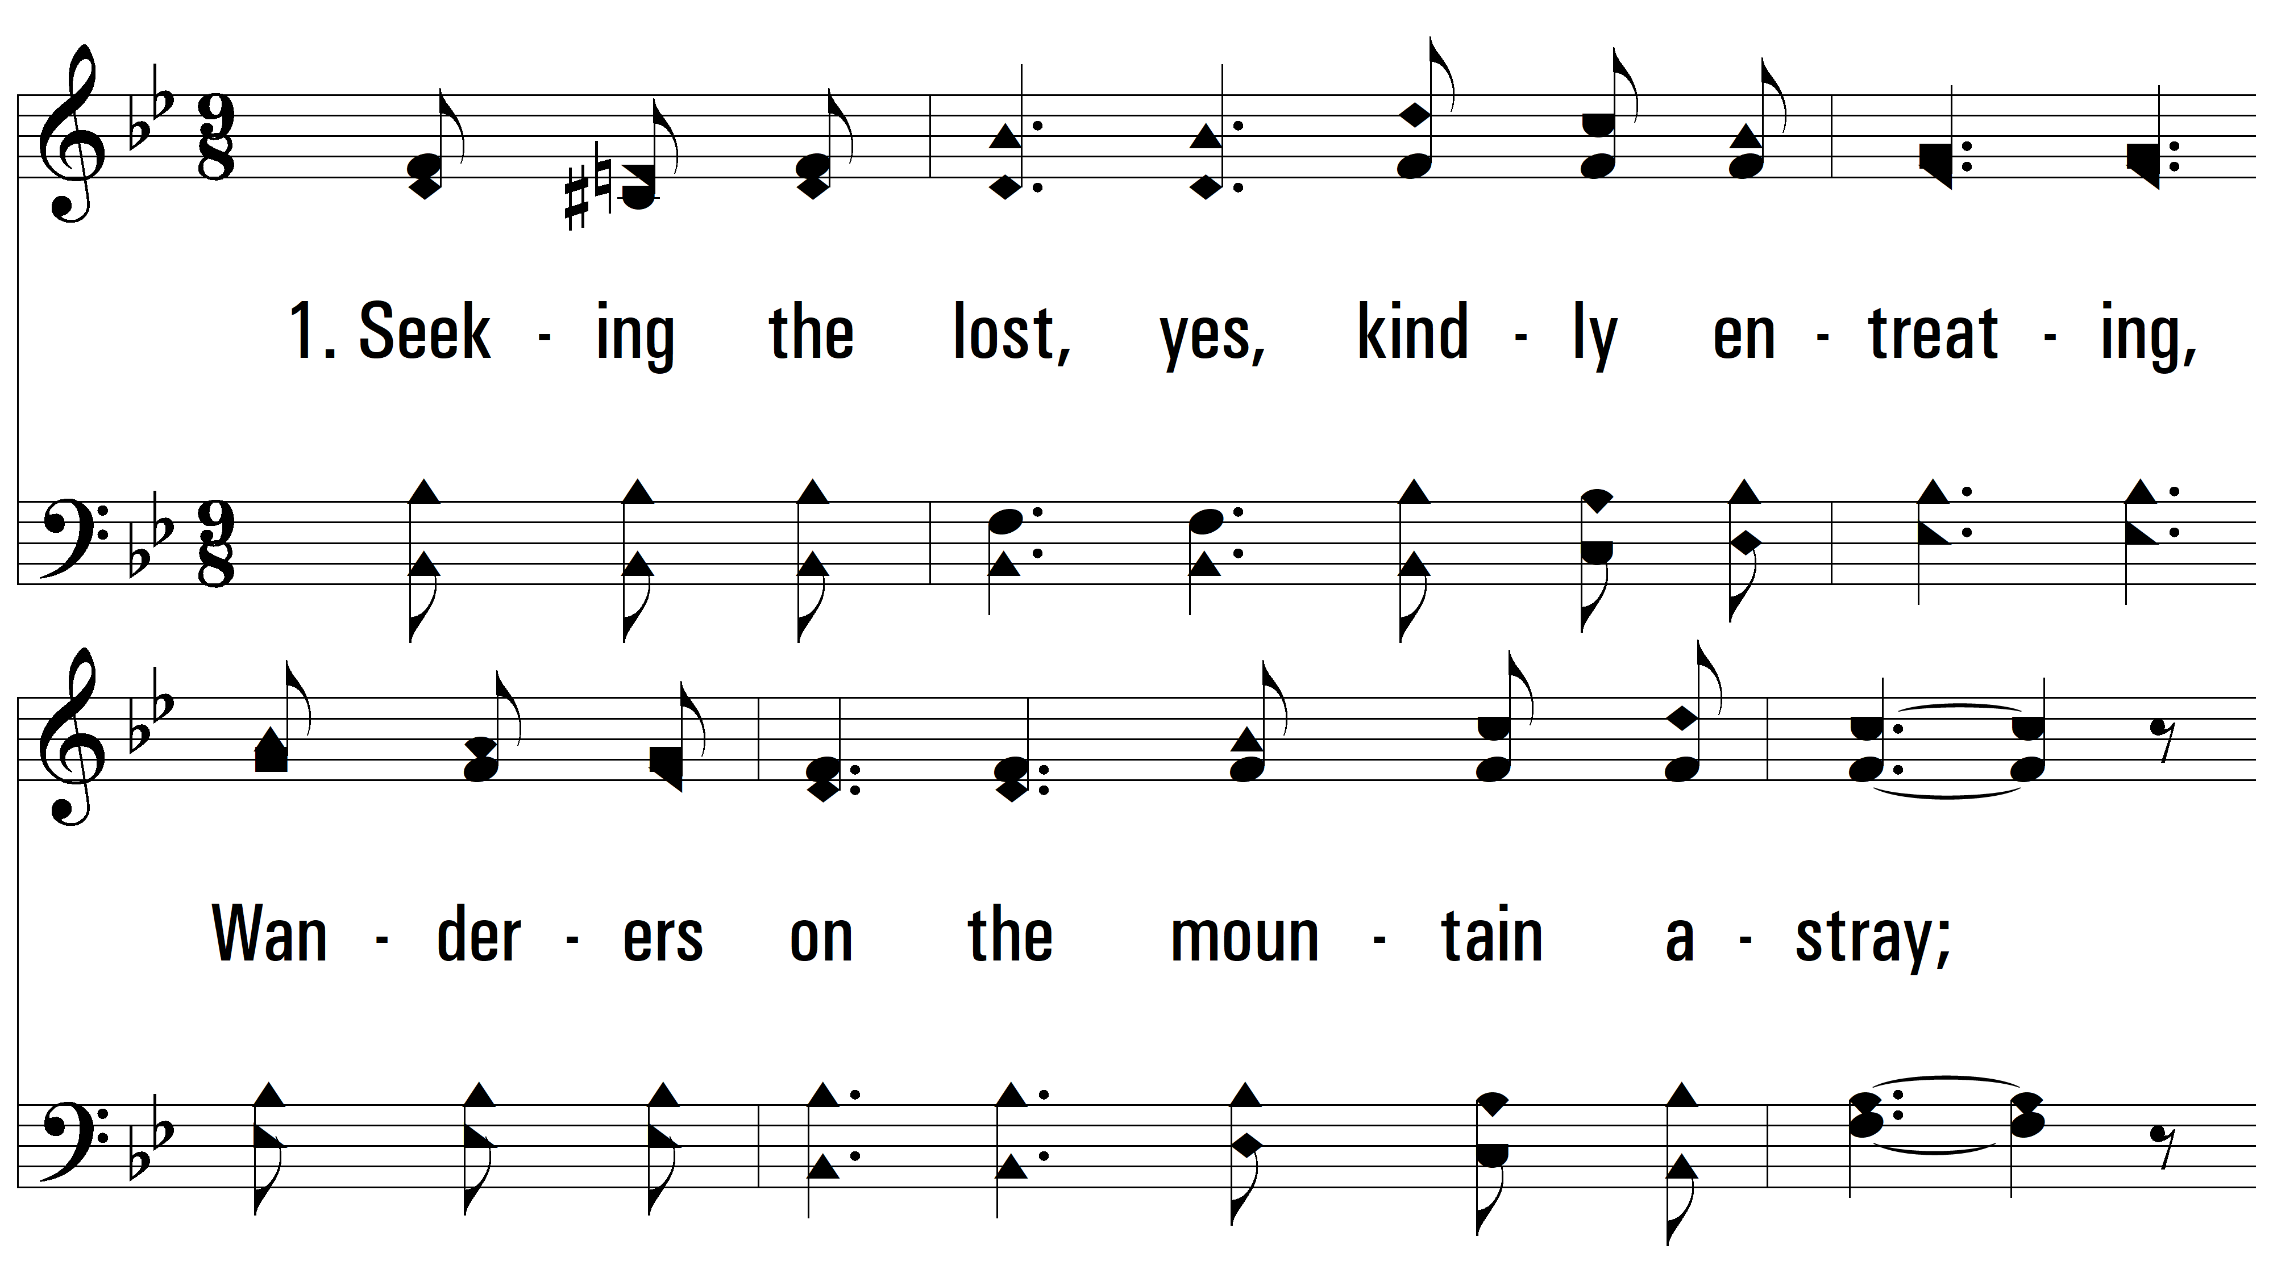
vs. 1 ~ Seeking The Lost

Slide 3
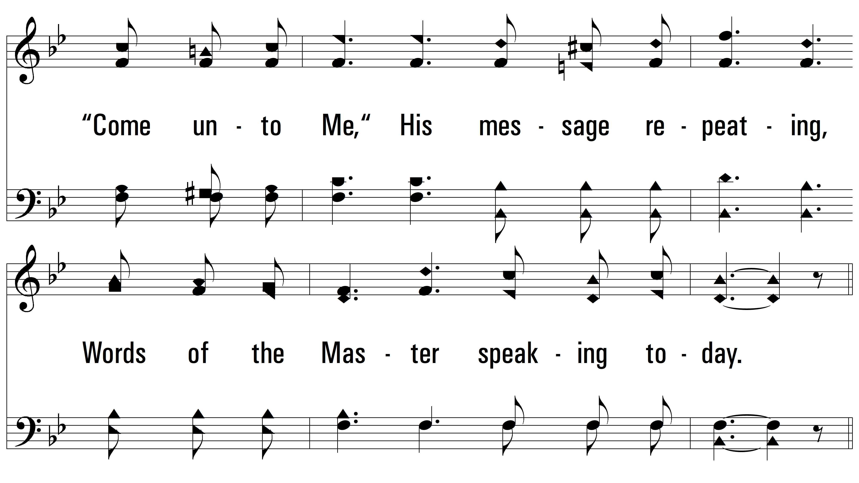
vs. 1

Slide 4
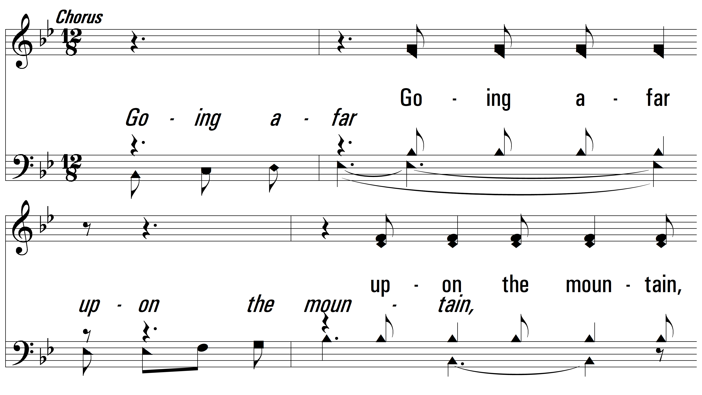
vs. 1

Slide 5
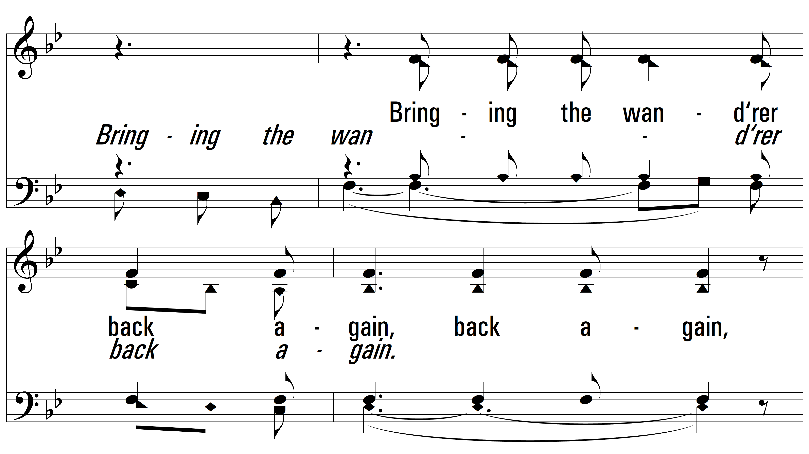
vs. 1

Slide 6
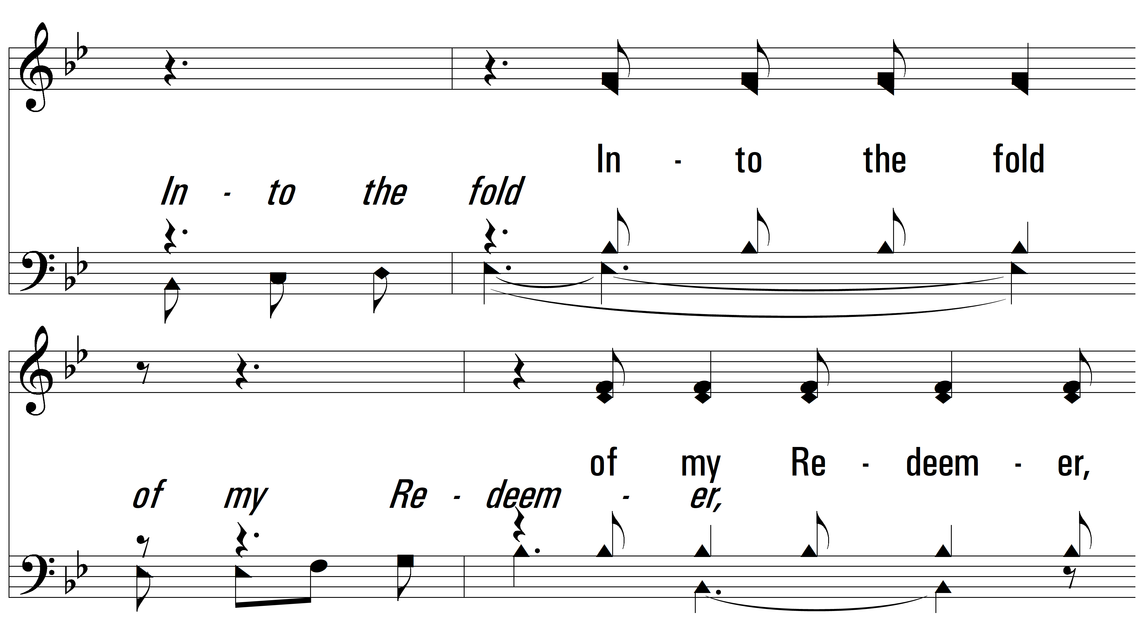
vs. 1

Slide 7
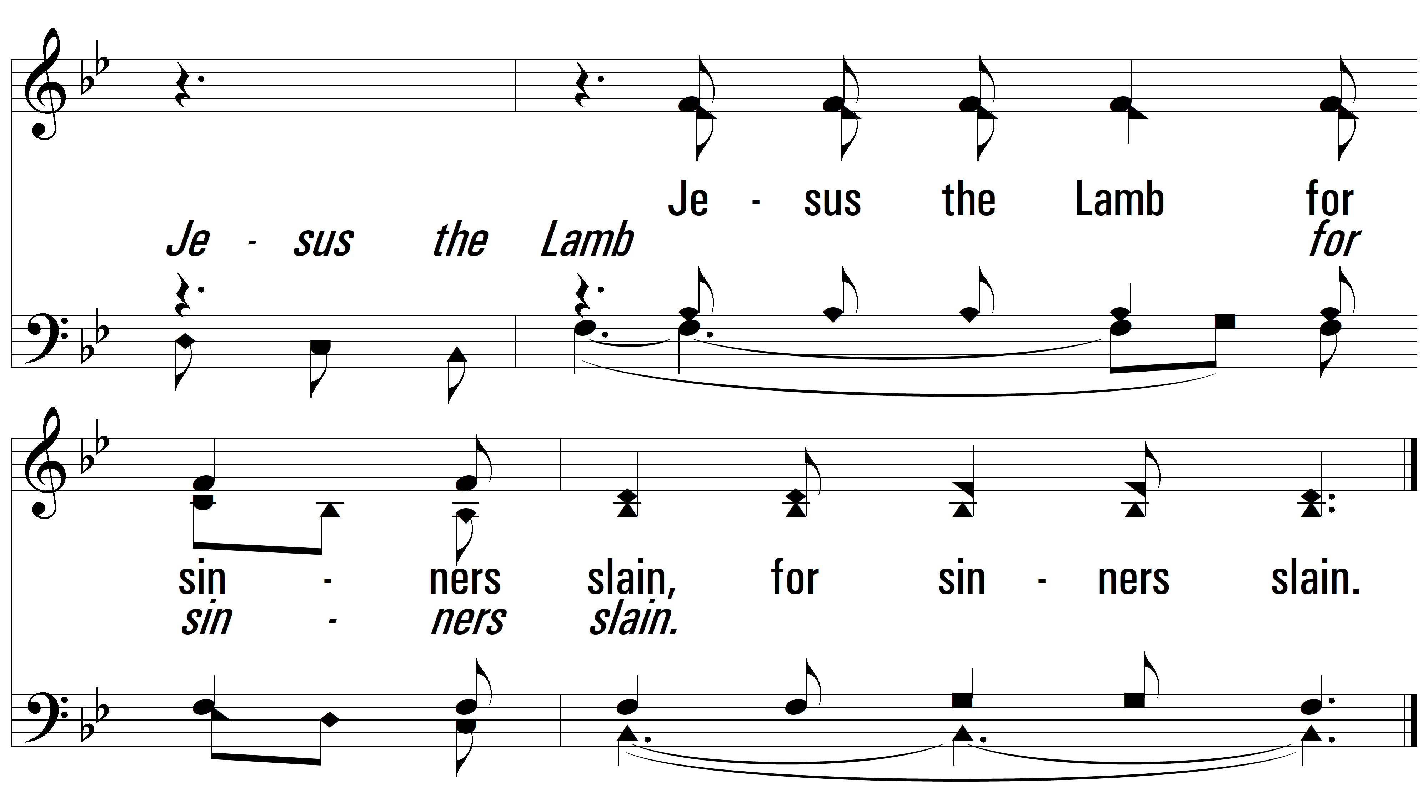
vs. 1

Slide 8
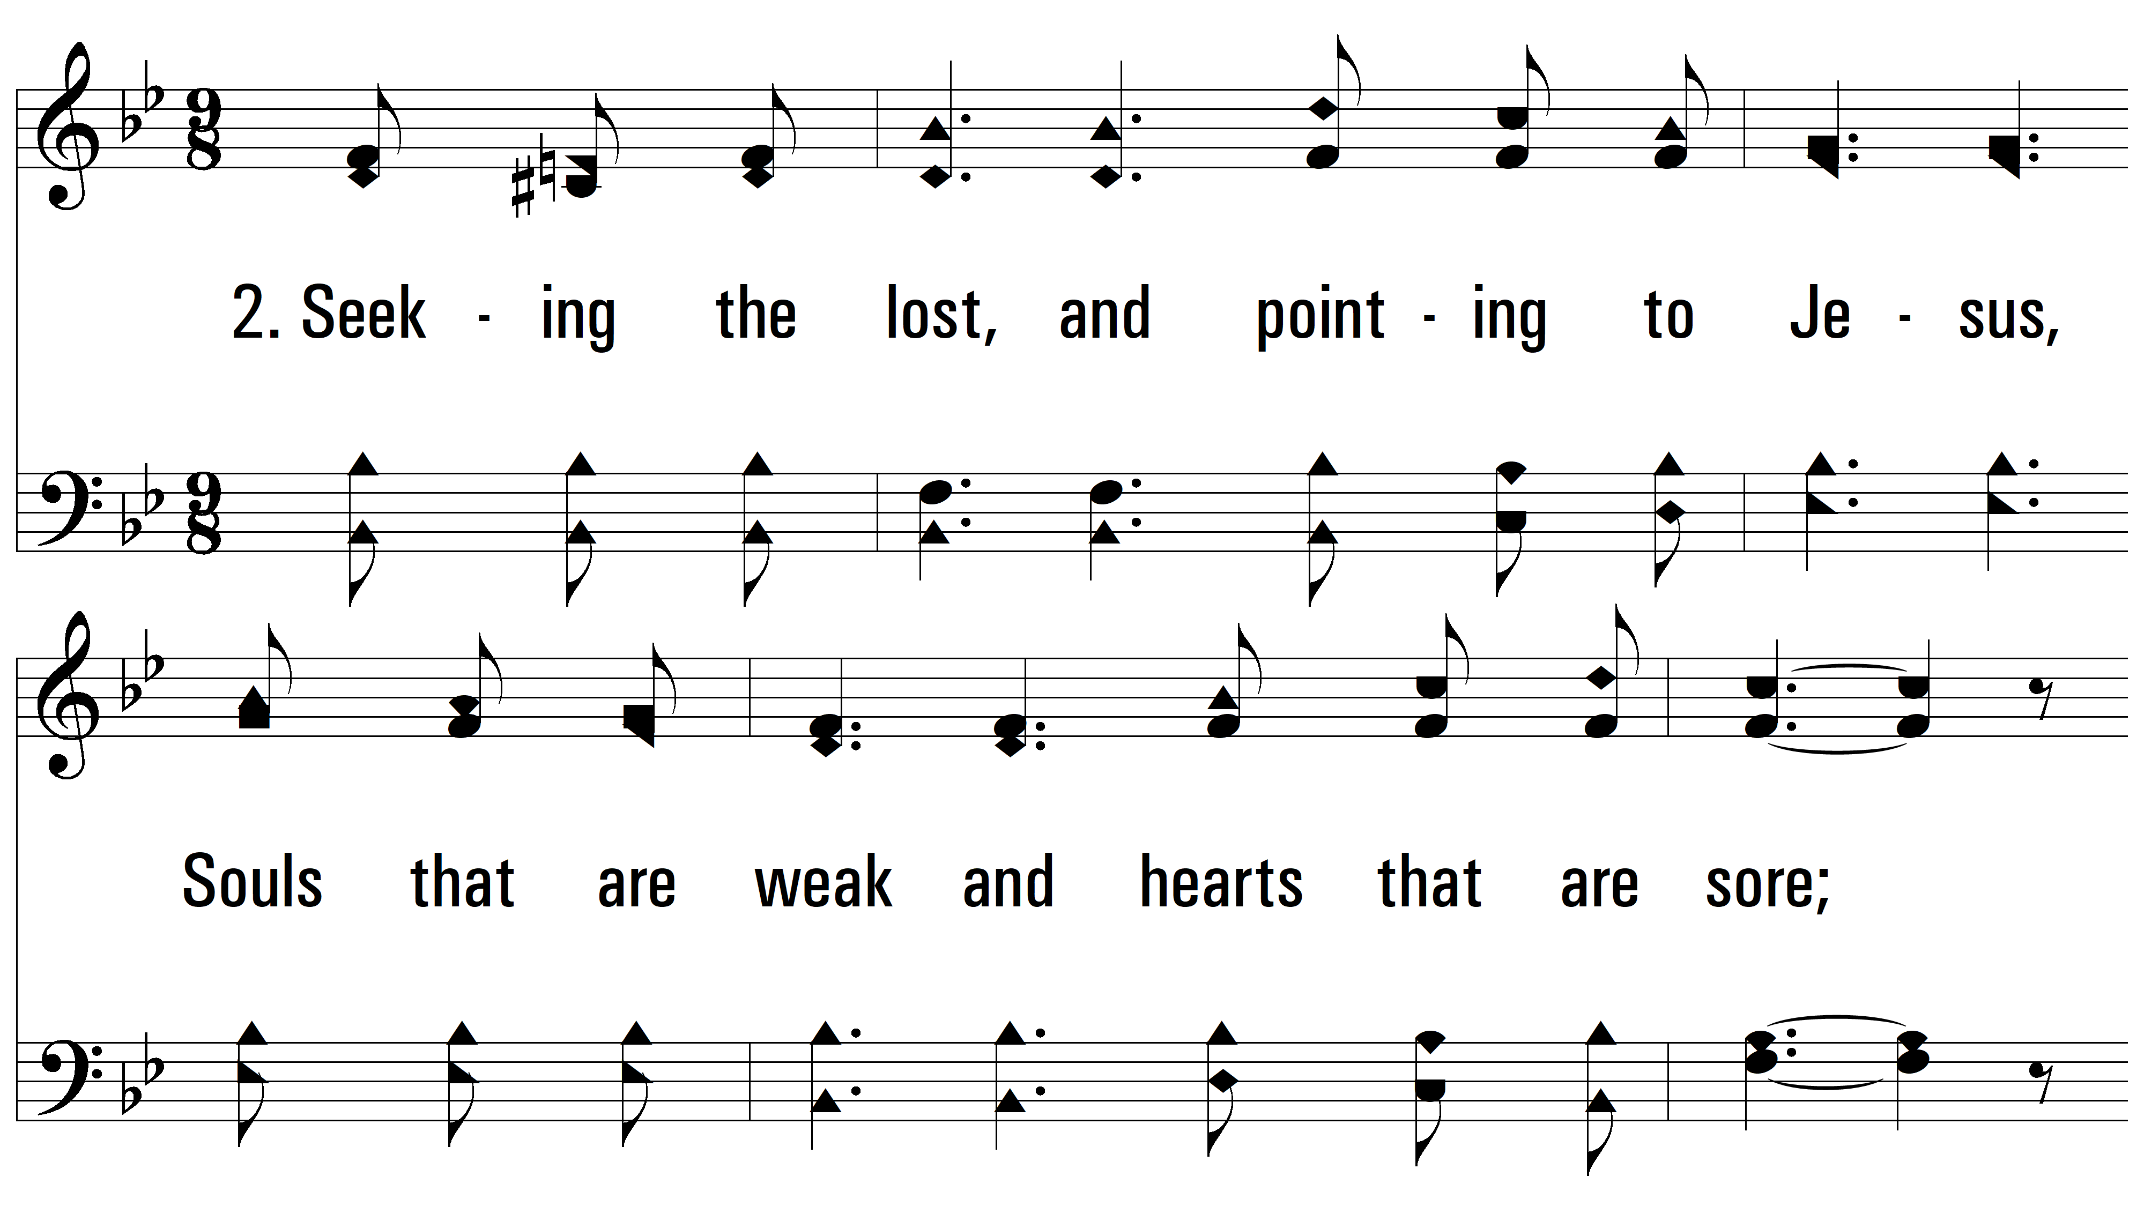
vs. 2 ~ Seeking The Lost

Slide 9
vs. 2

Slide 10
vs. 2

Slide 11
vs. 2

Slide 12
vs. 2

Slide 13
vs. 2

Slide 14
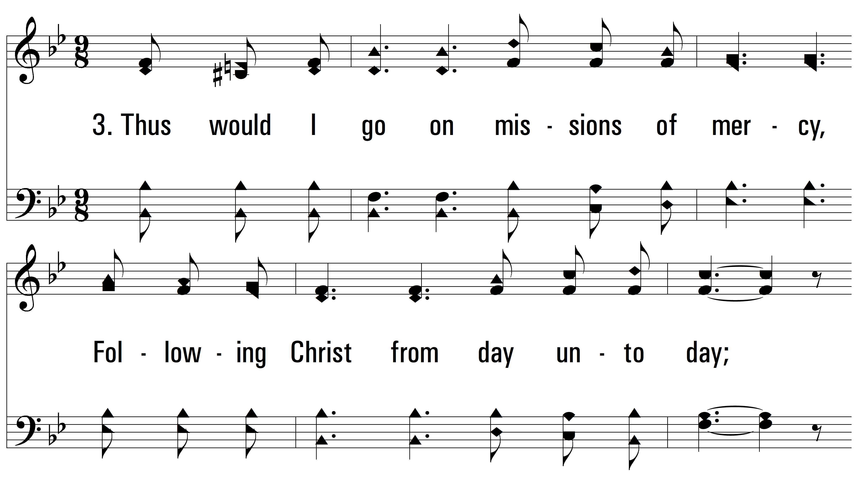
vs. 3~ Seeking The Lost

Slide 15
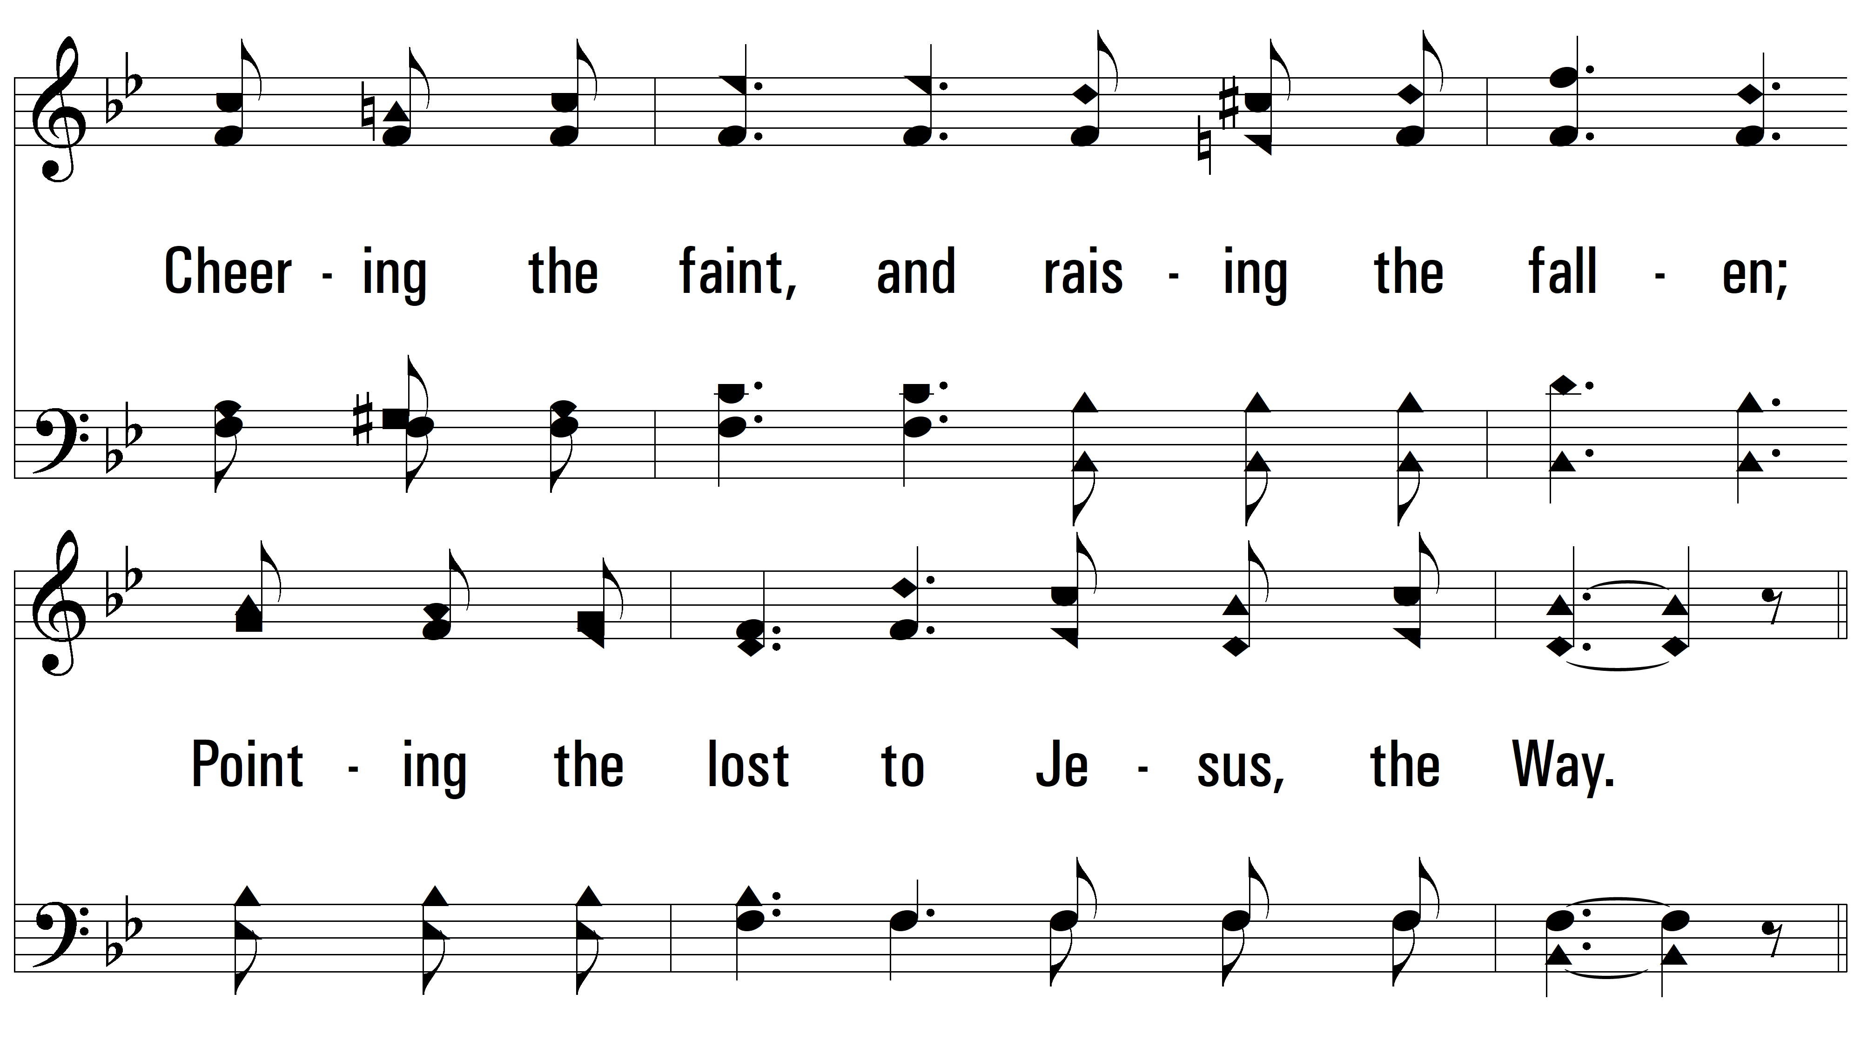
vs. 3

Slide 16
vs. 3

Slide 17
vs. 3

Slide 18
vs. 3

Slide 19
vs. 3
PDHymns.com
END

