Slide 1
Savior, Teach Me
SEYMOUR
7.7.7.7
Words: | Jane E. Leeson (1842)
Music: | Carl von Weber (1825)
2/4
F/A - MI
Verses: 3
Lead - | MI
Alto - | DO
Tenor - | SOL
Bass - | DO
PDHymns.com

Slide 2
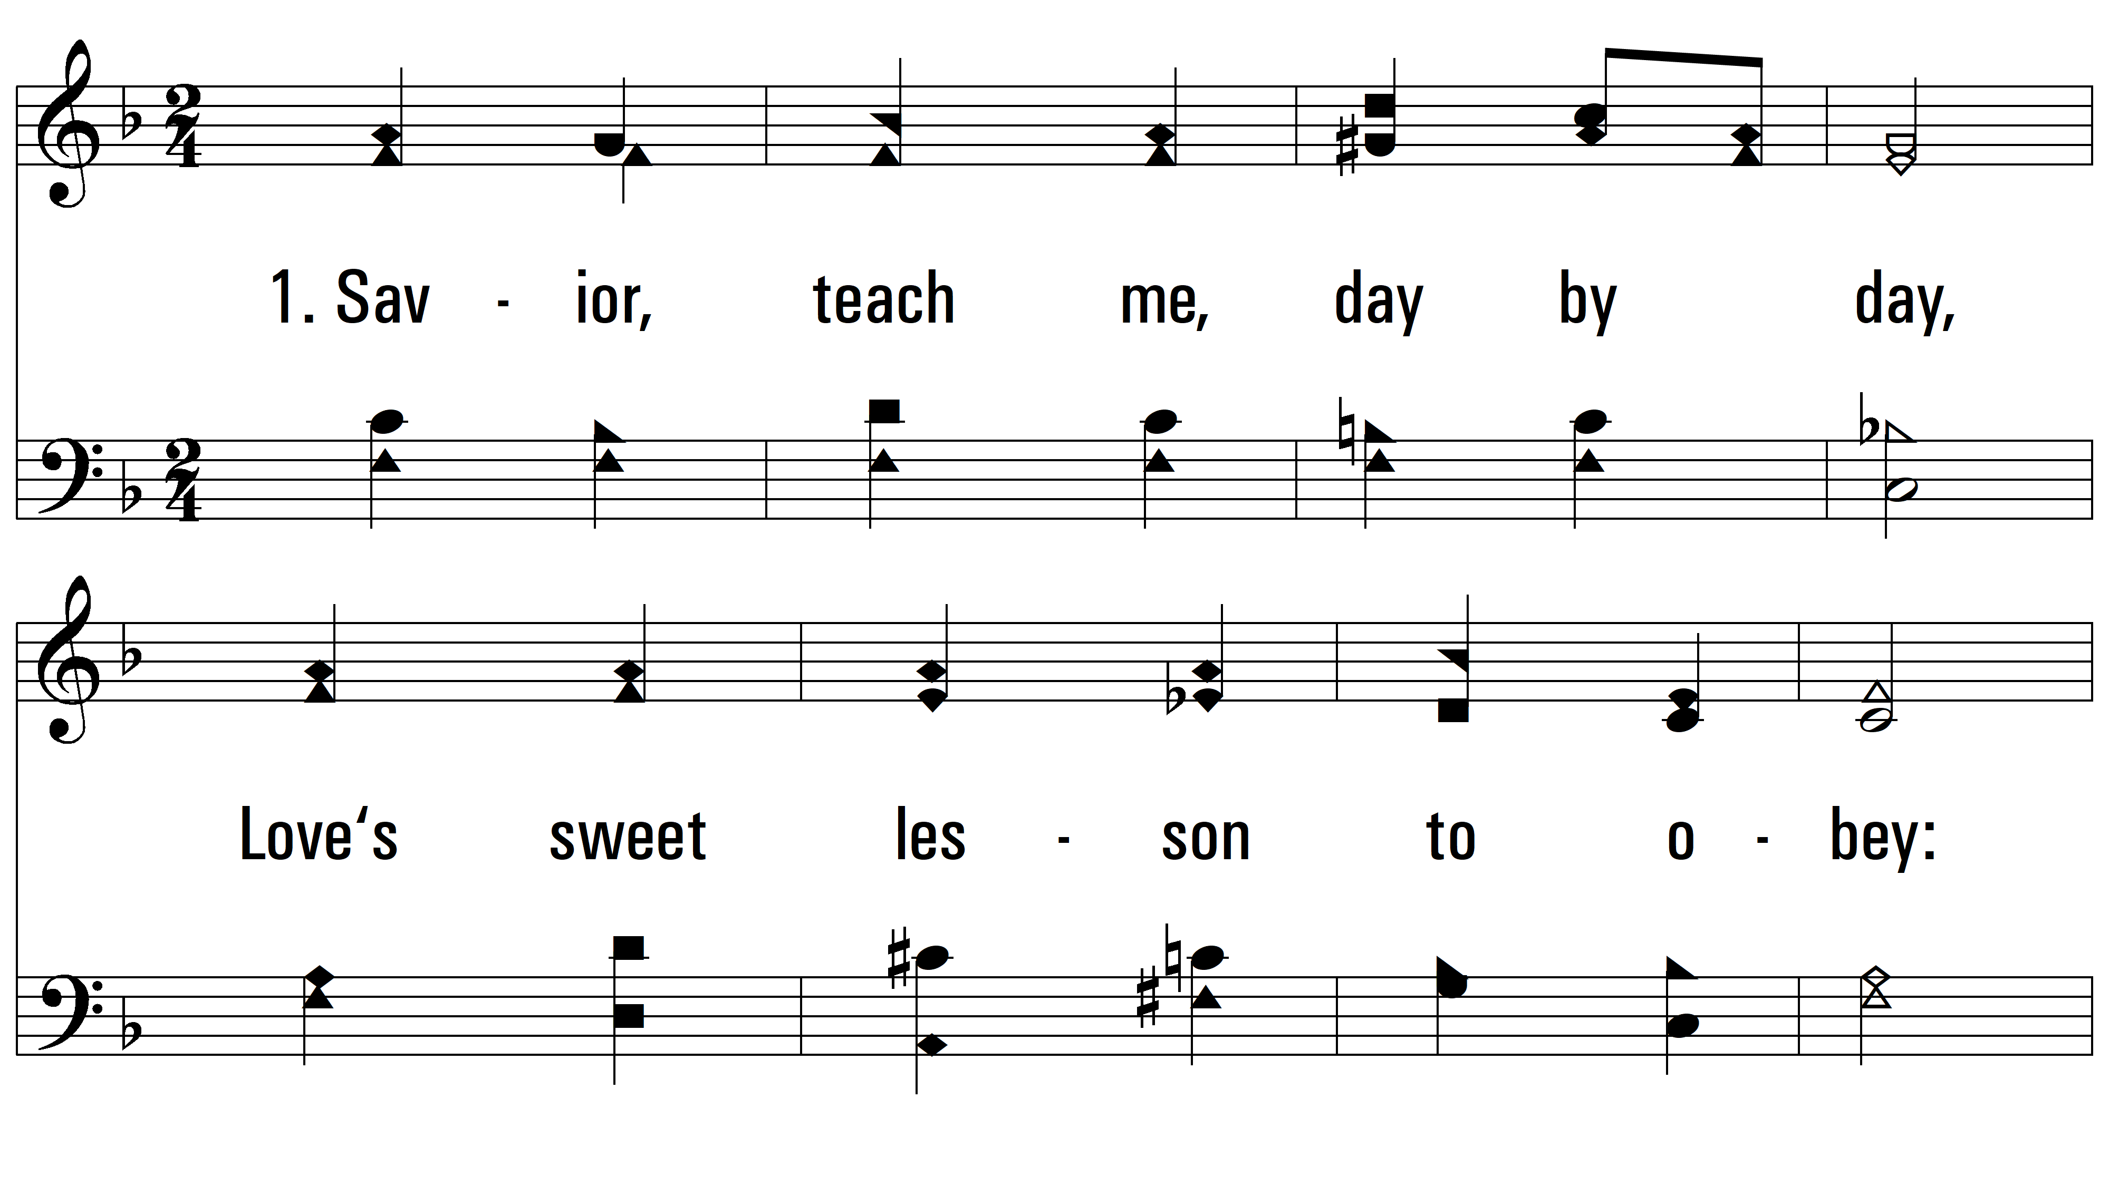
vs. 1 ~ Savior, Teach Me

Slide 3
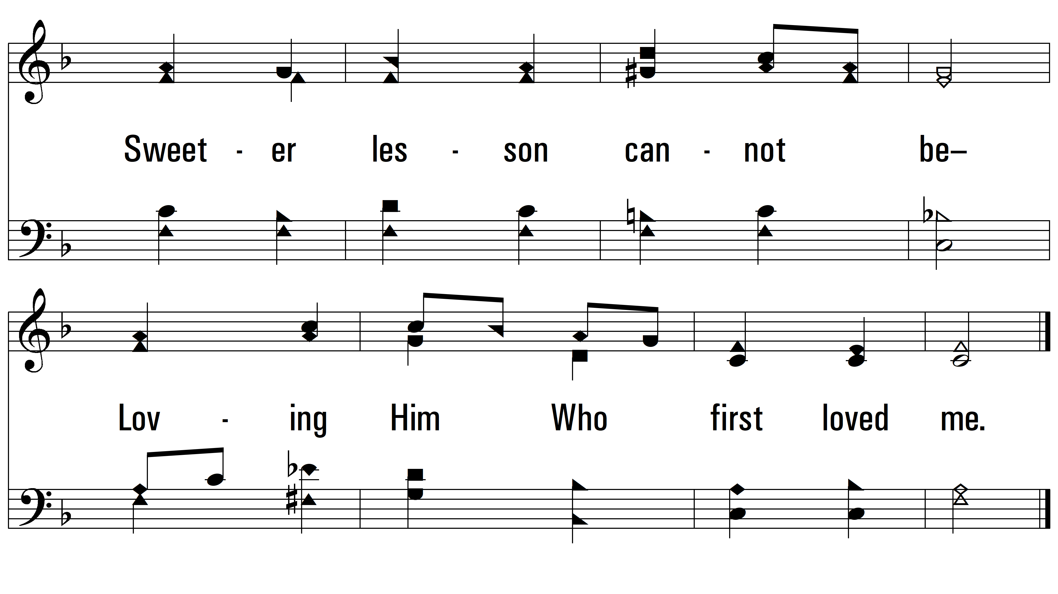
vs. 1

Slide 4
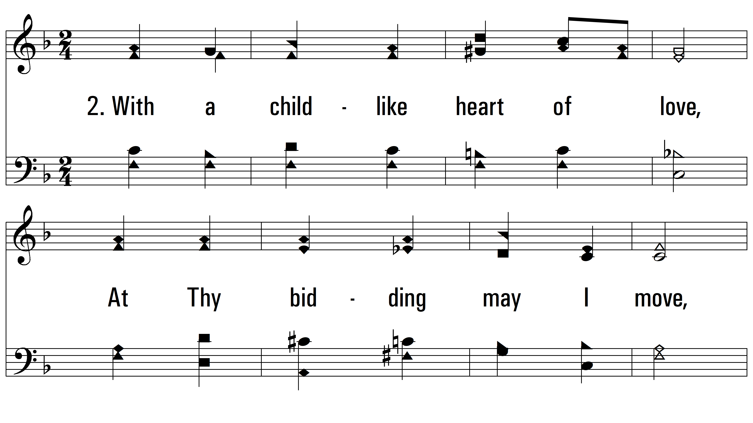
vs. 2 ~ Savior, Teach Me

Slide 5
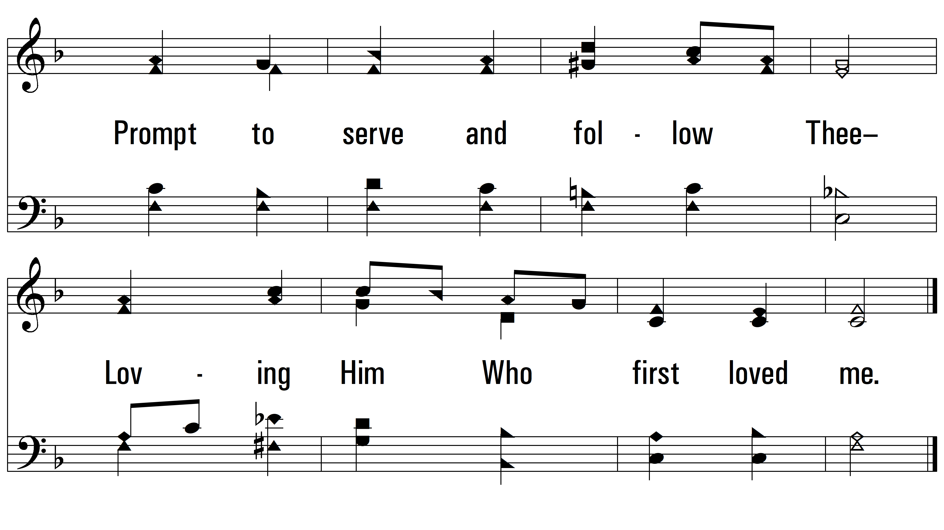
vs. 2

Slide 6
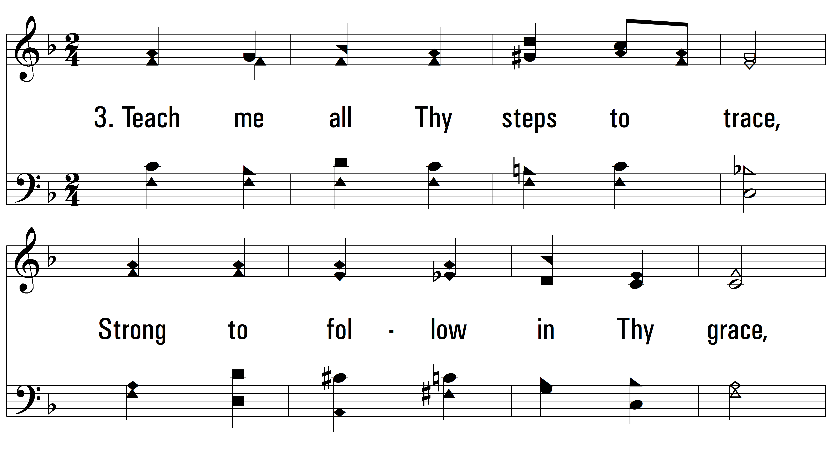
vs. 3 ~ Savior, Teach Me

Slide 7
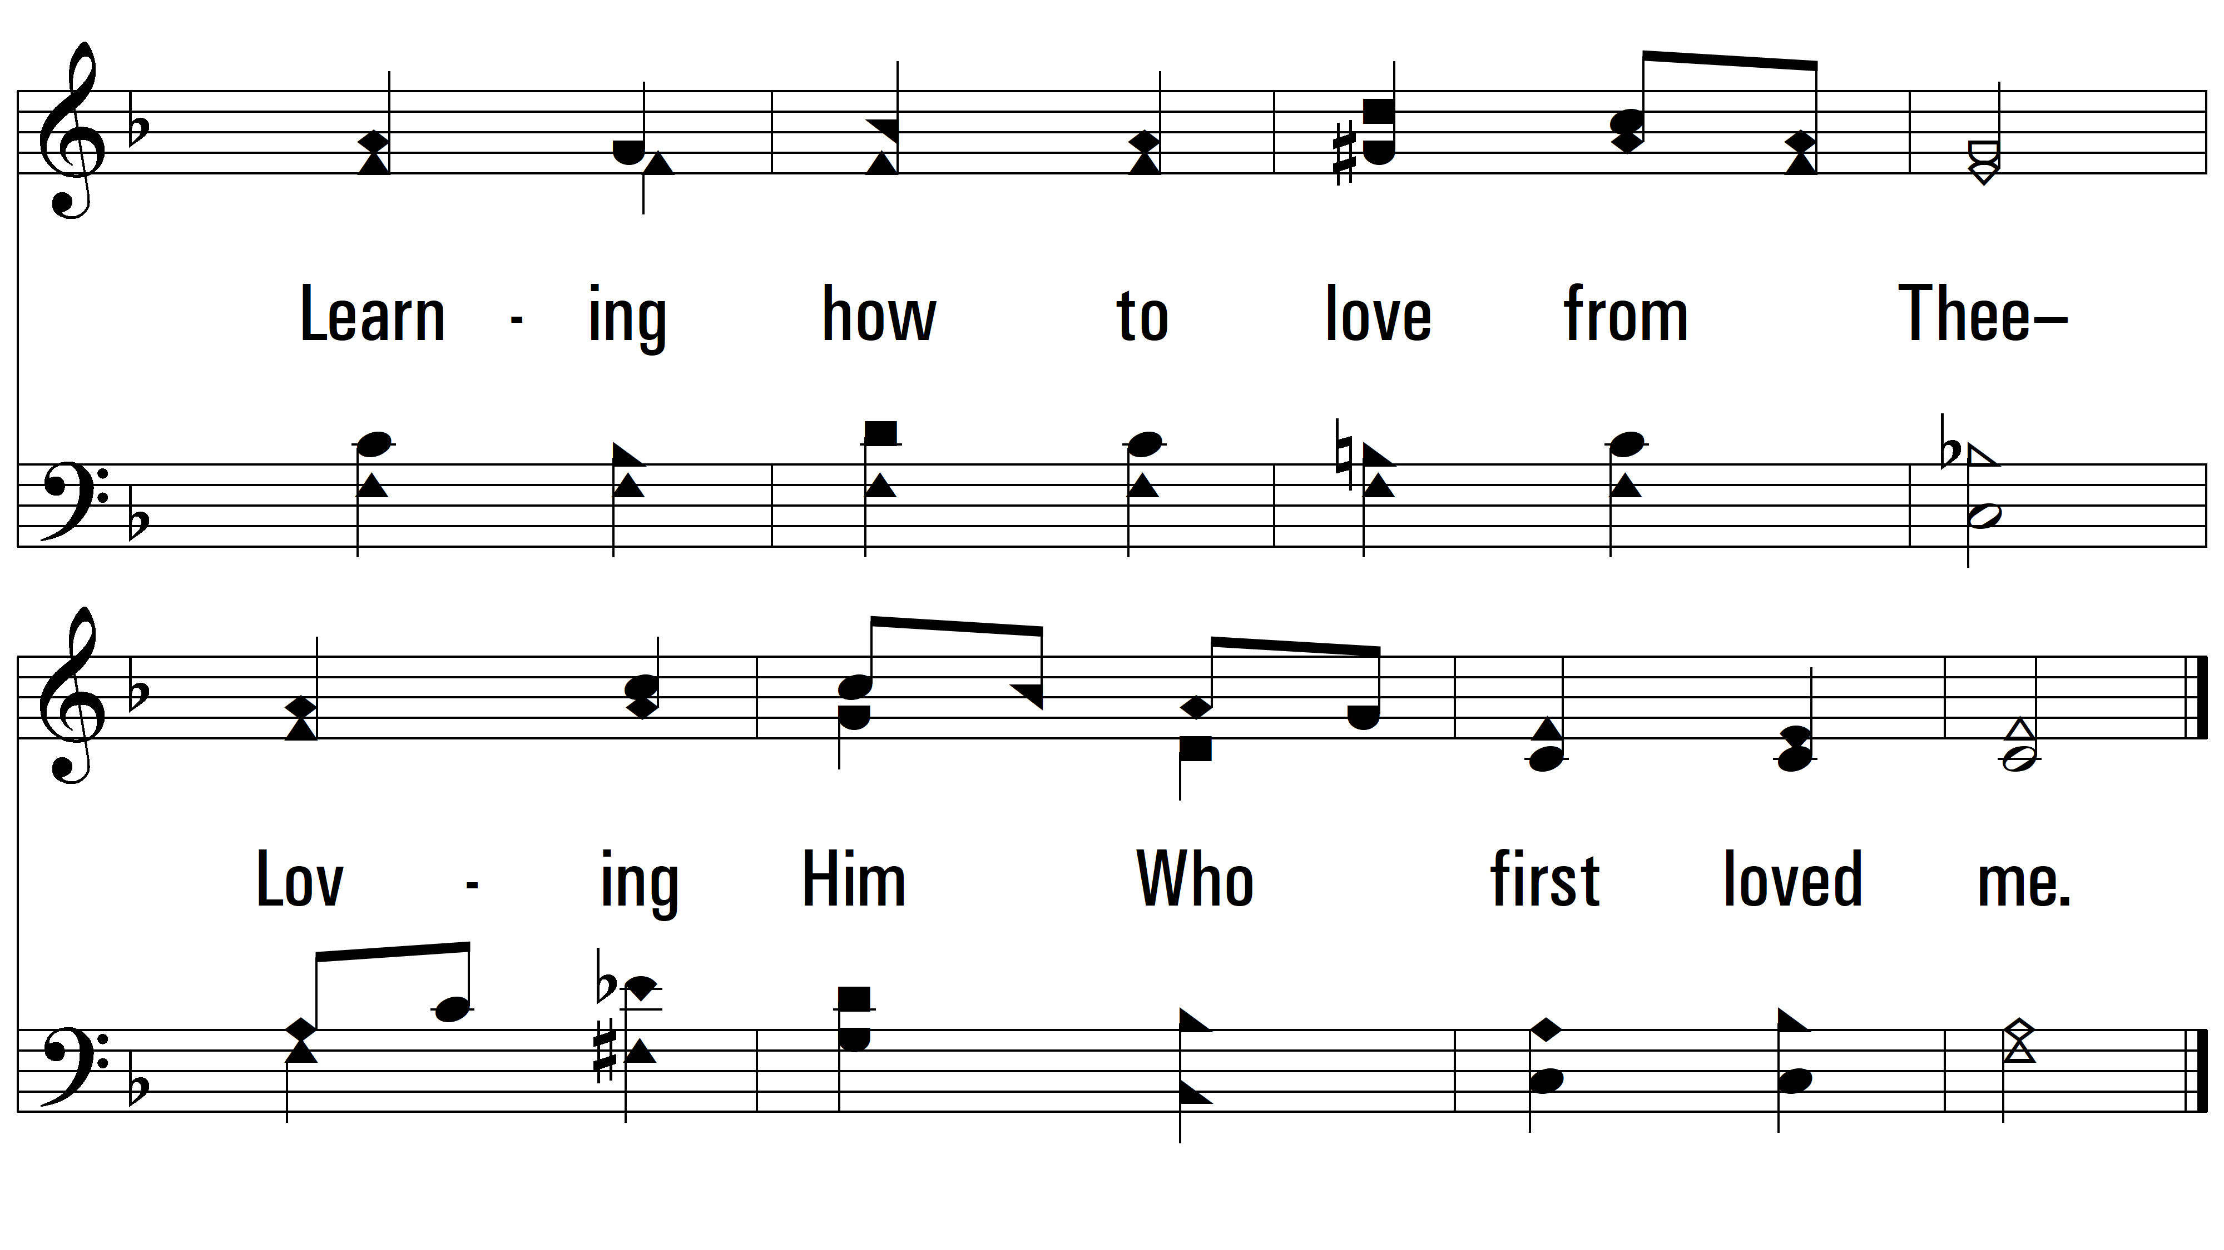
vs. 3
PDHymns.com
END

