Slide 1
Savior, Like A Shepherd Lead Us
BRADBURY
8.7.8.7.4.7
Words: | Dorothy A. Thrupp (1836)
Music: | William B. Bradbury (1859)
4/4
E^{b}/G - MI
Verses: 4/Chorus
Lead - | MI
Alto - | DO
Tenor - | SOL
Bass - | DO
PDHymns.com

Slide 2
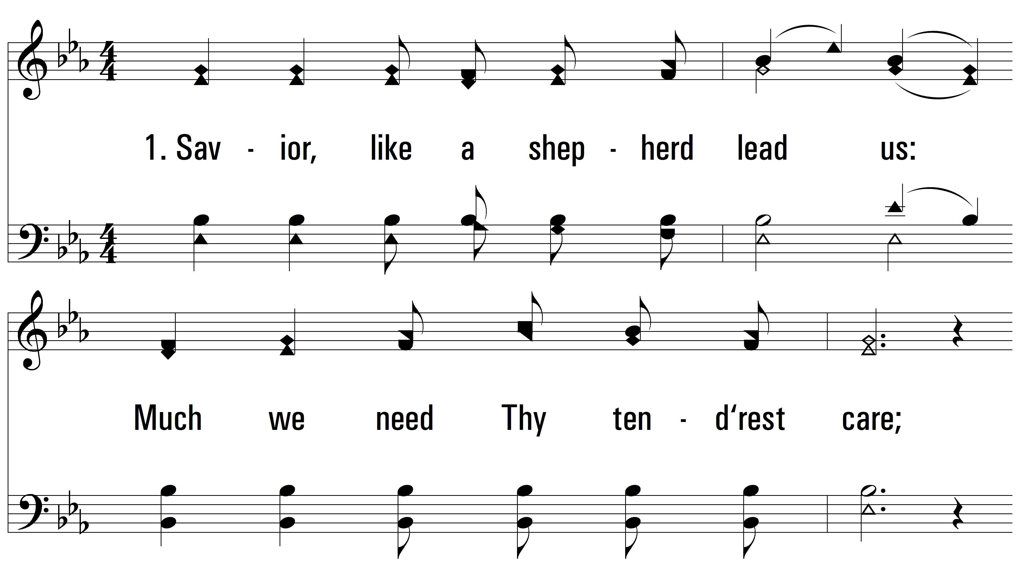
vs. 1 ~ Savior, Like A Shepherd Lead Us

Slide 3
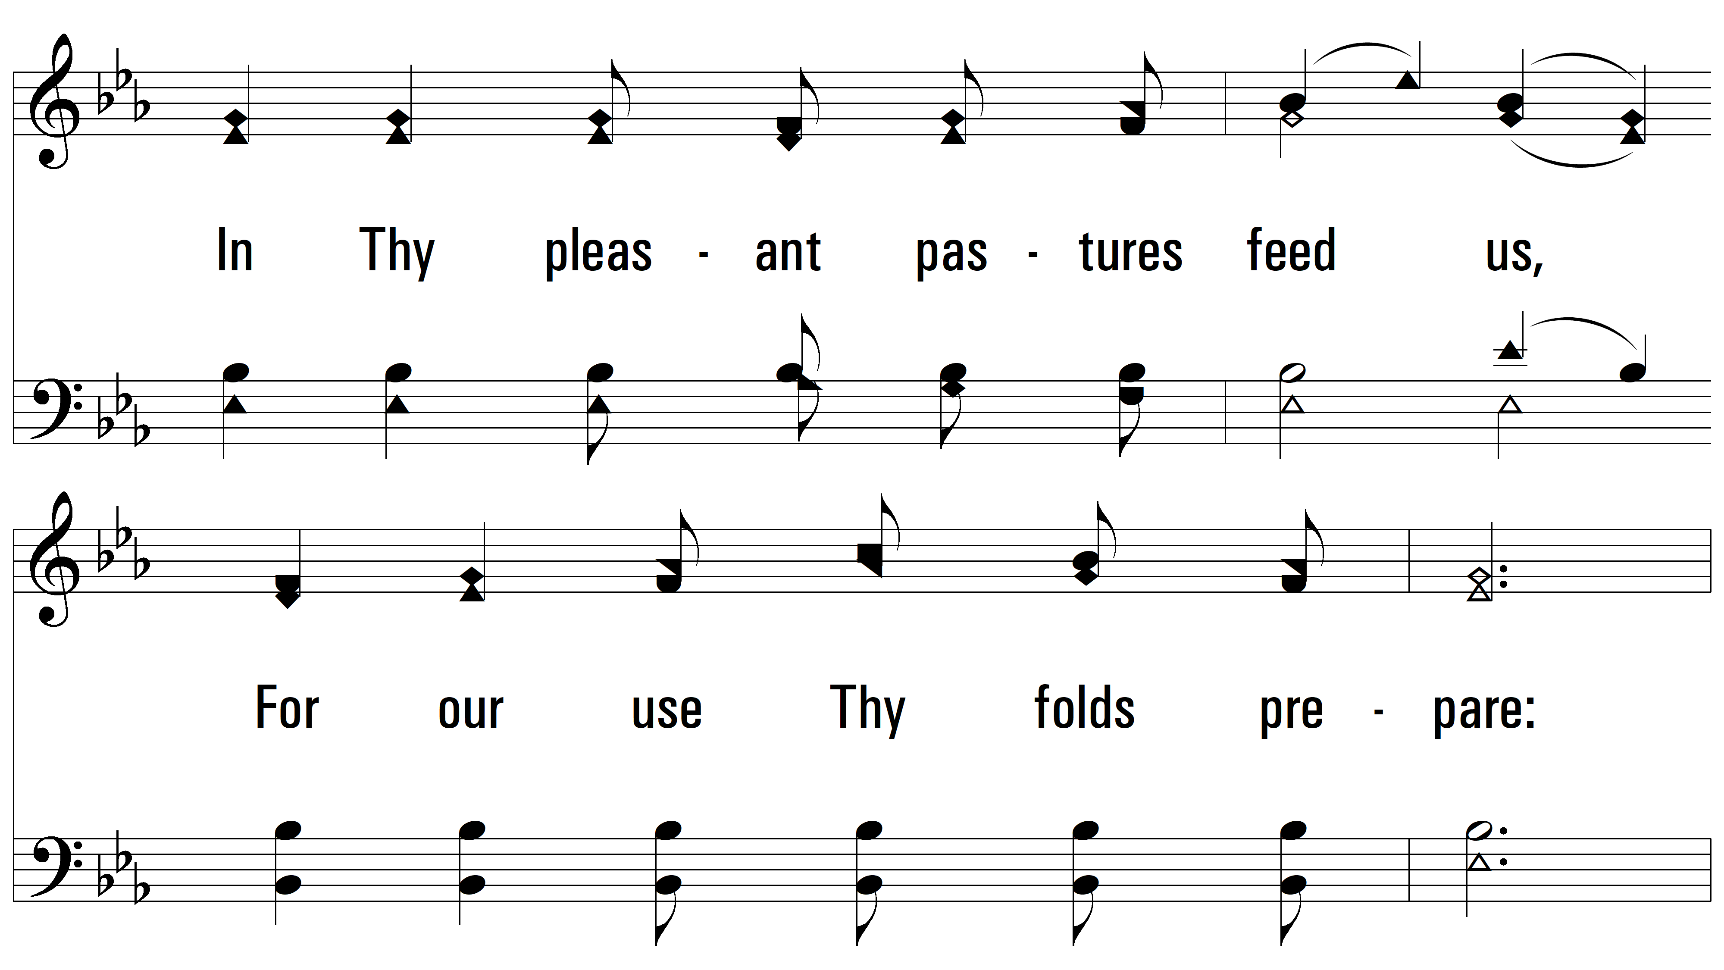
vs. 1

Slide 4
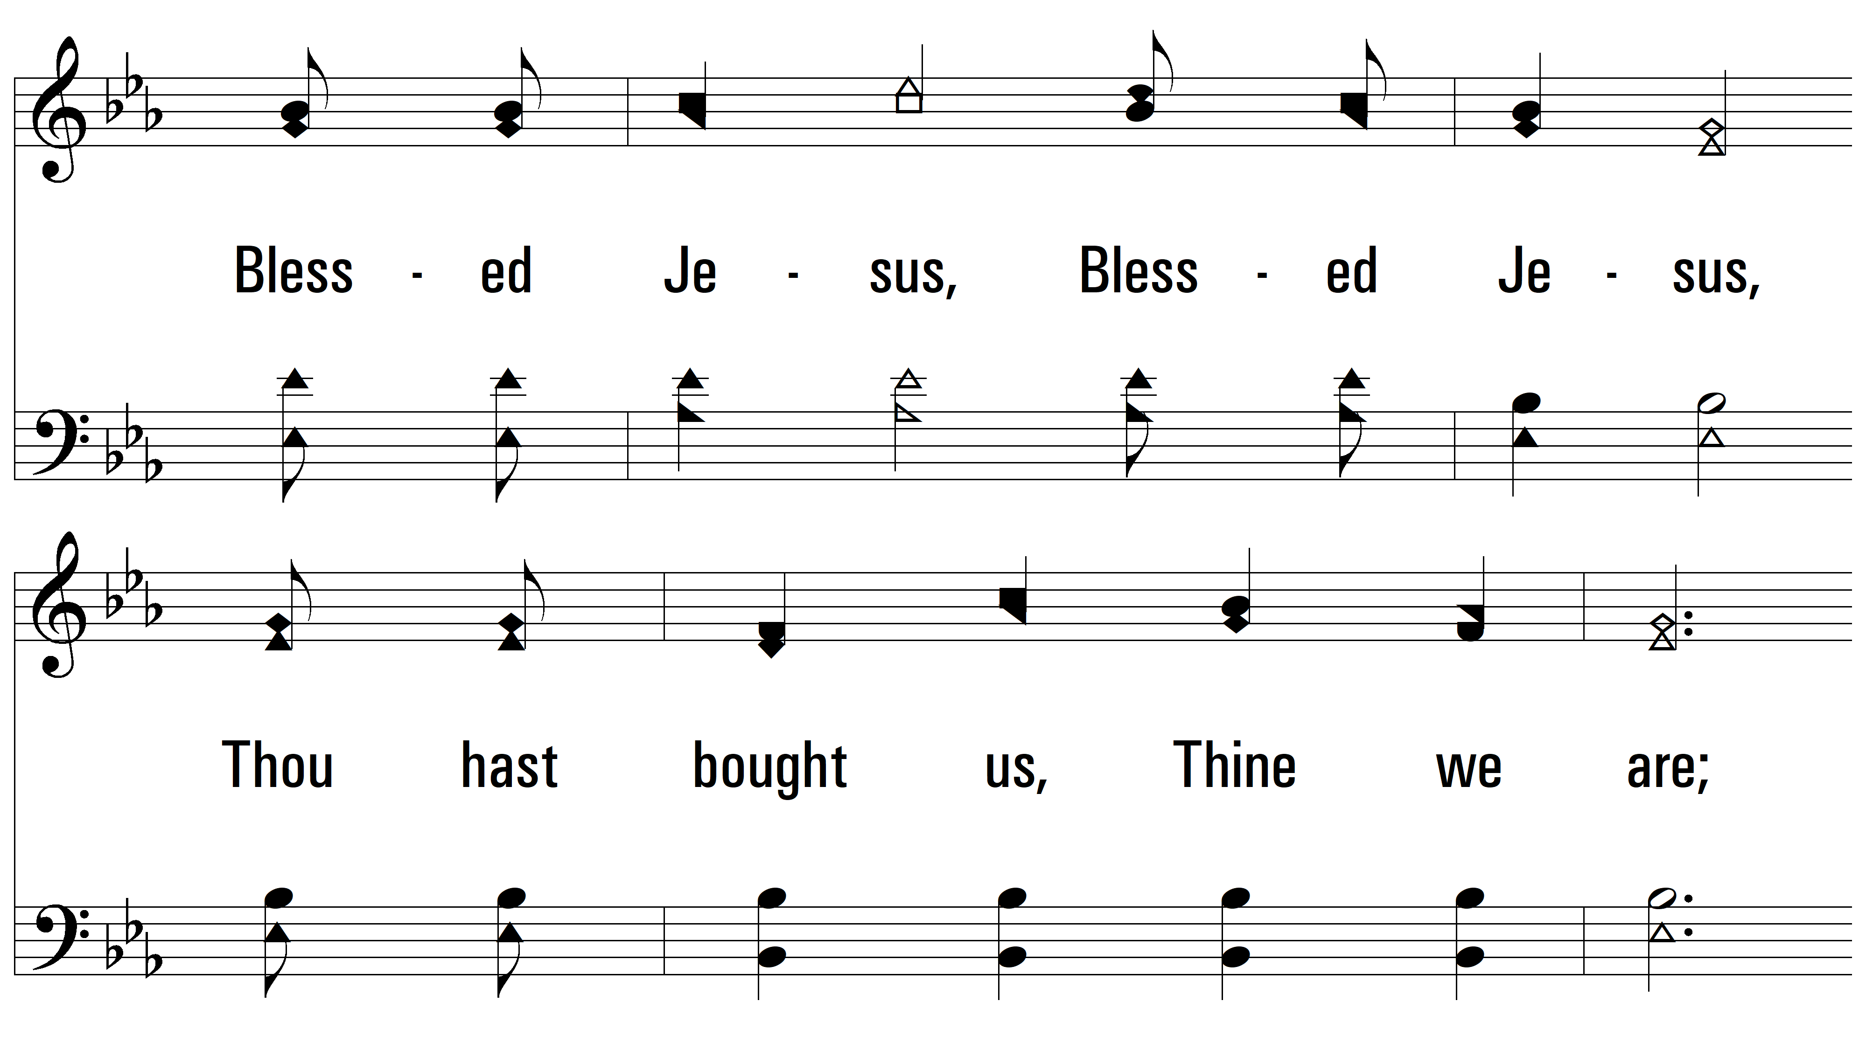
vs. 1

Slide 5
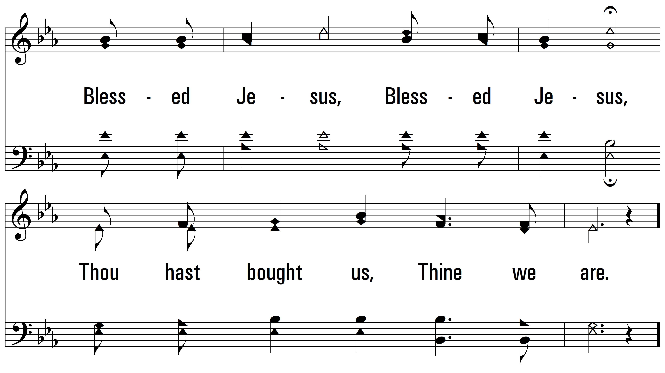
vs. 1

Slide 6
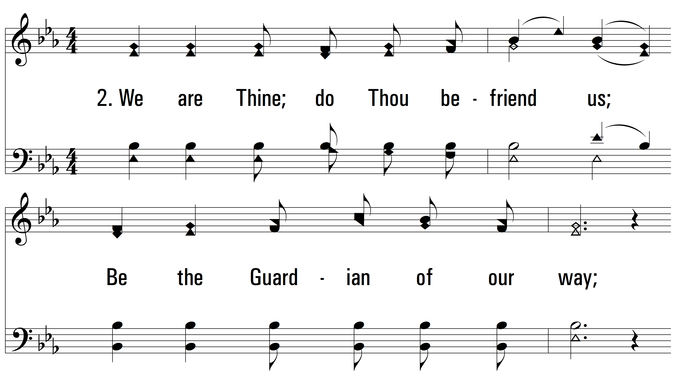
vs. 2 ~ Savior, Like A Shepherd Lead Us

Slide 7
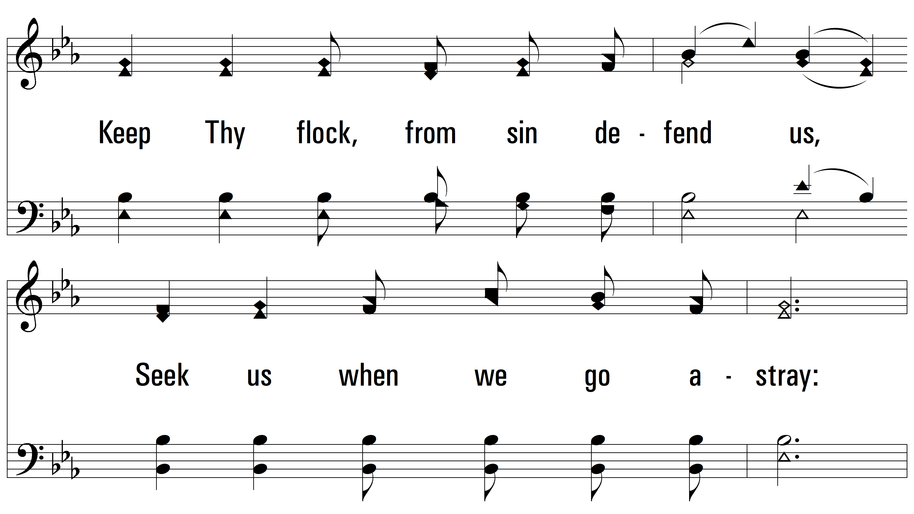
vs. 2

Slide 8
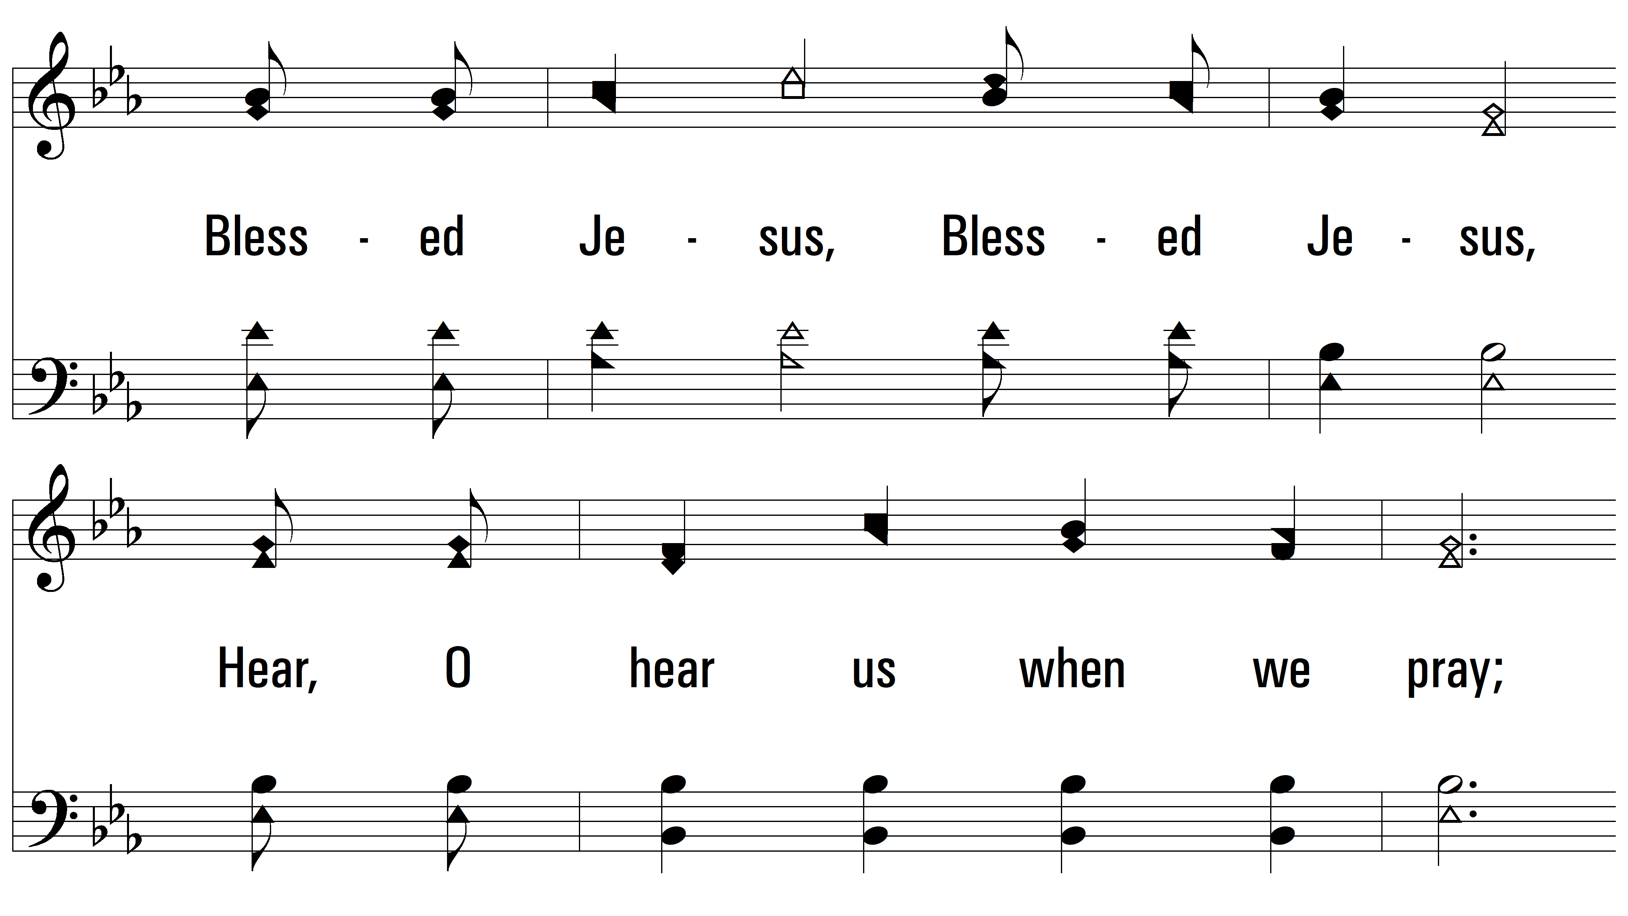
vs. 2

Slide 9
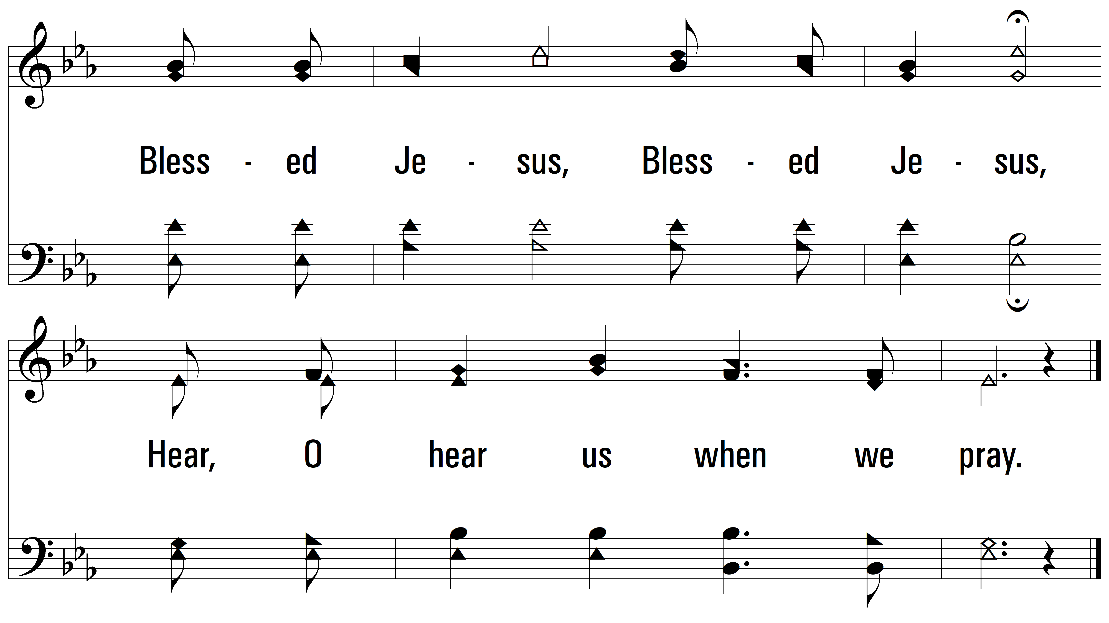
vs. 2

Slide 10
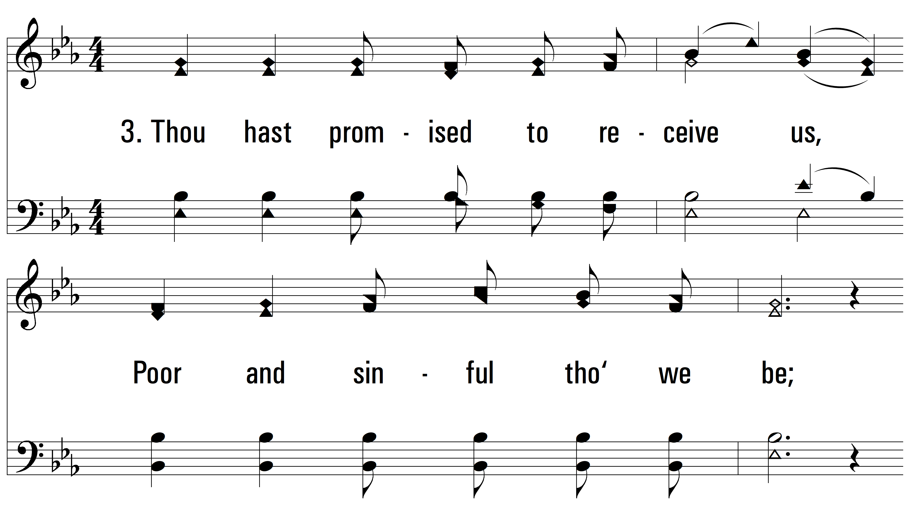
vs. 3 ~ Savior, Like A Shepherd Lead Us

Slide 11
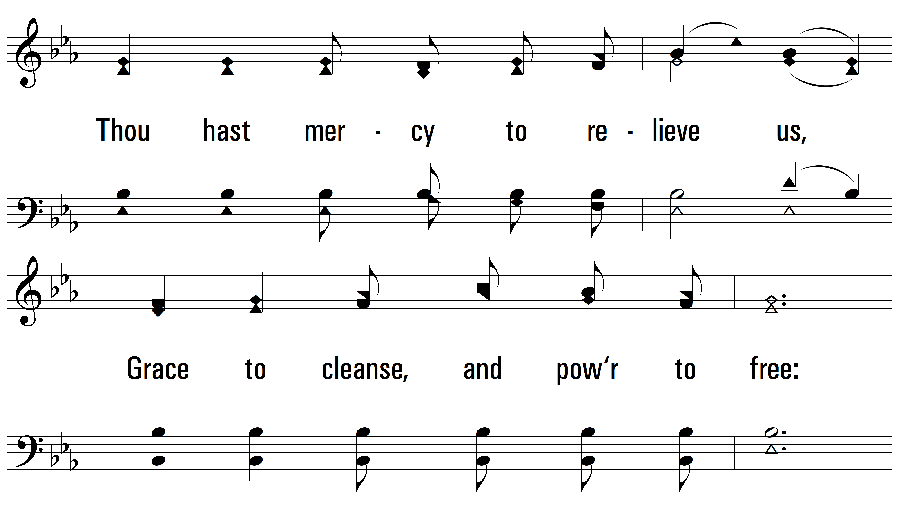
vs. 3

Slide 12
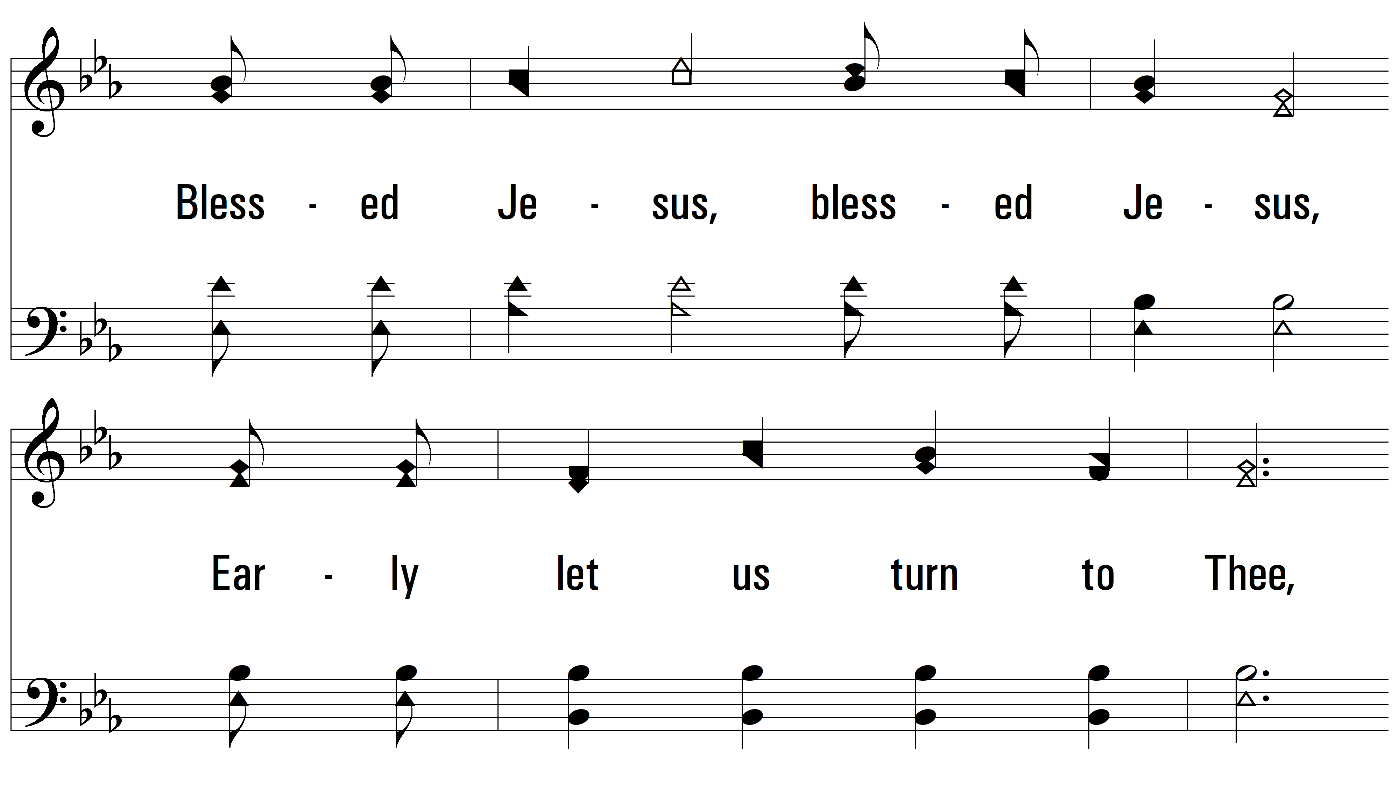
vs. 3

Slide 13
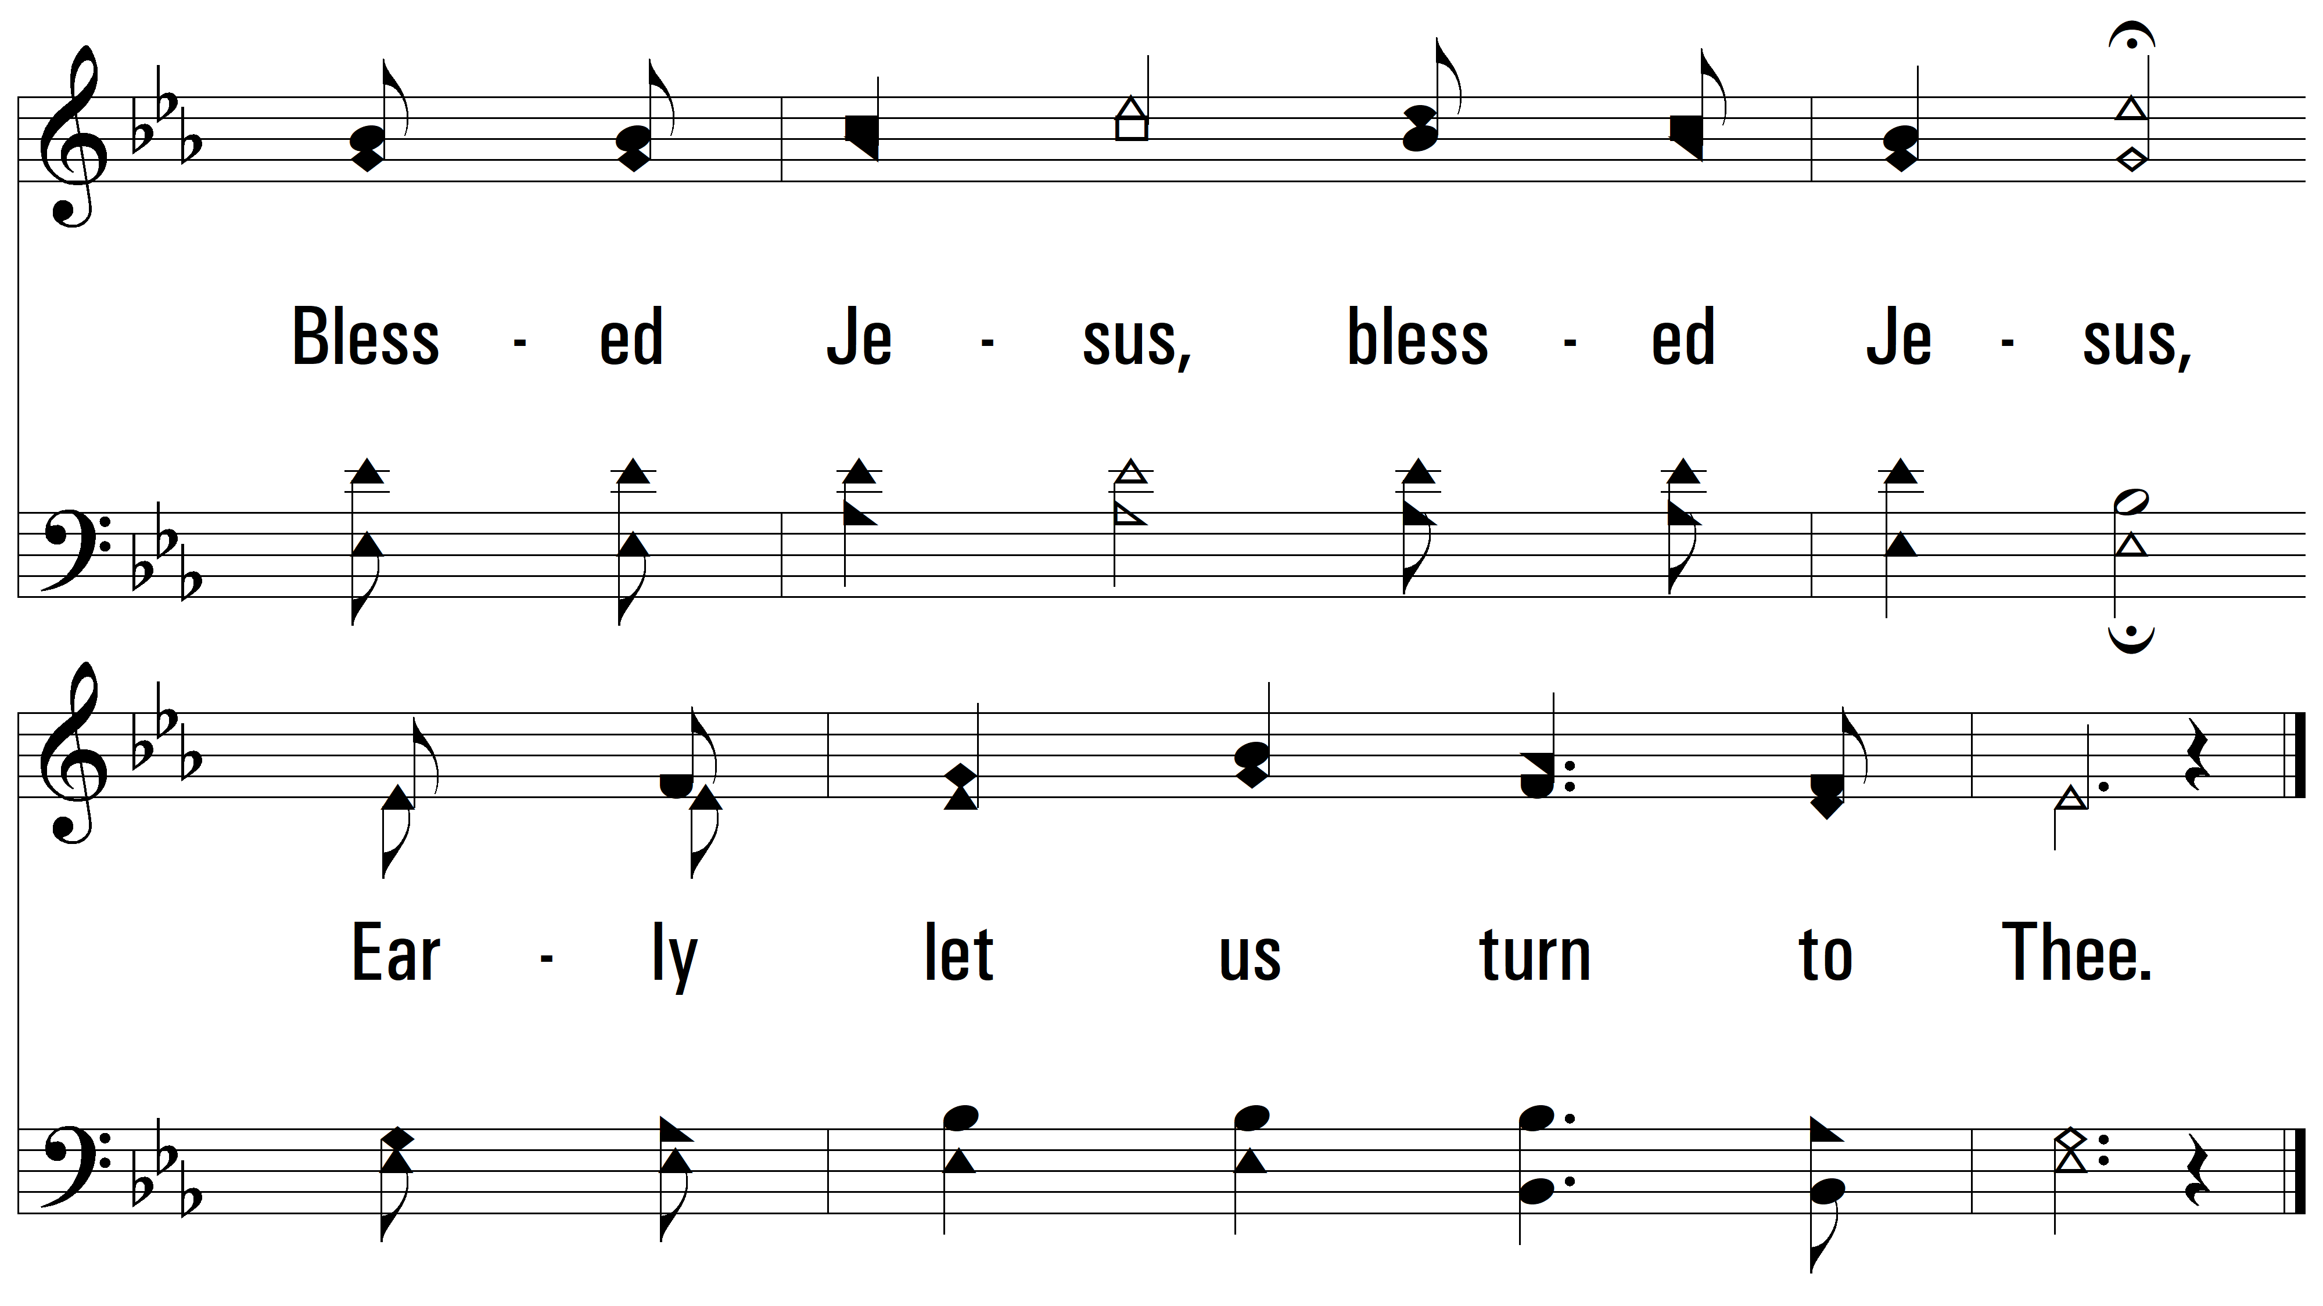
vs. 3

Slide 14
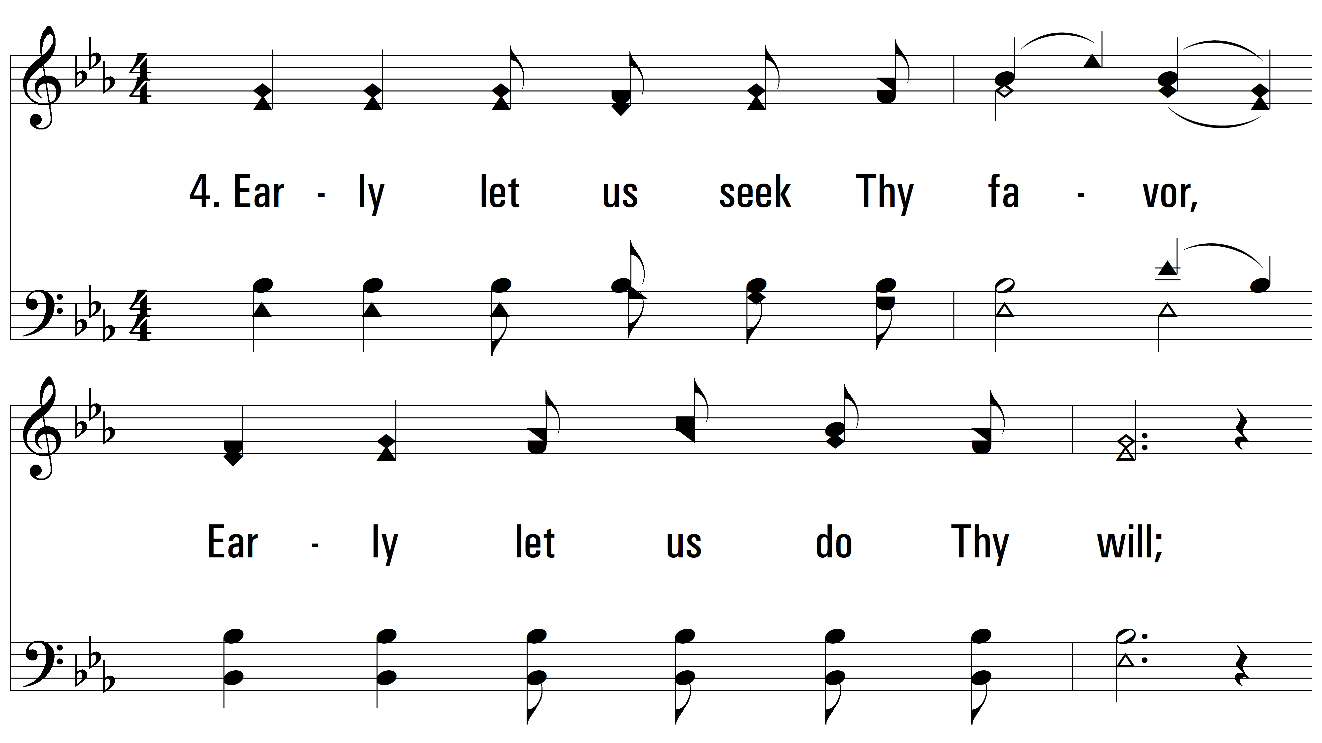
vs. 4 ~ Savior, Like A Shepherd Lead Us

Slide 15
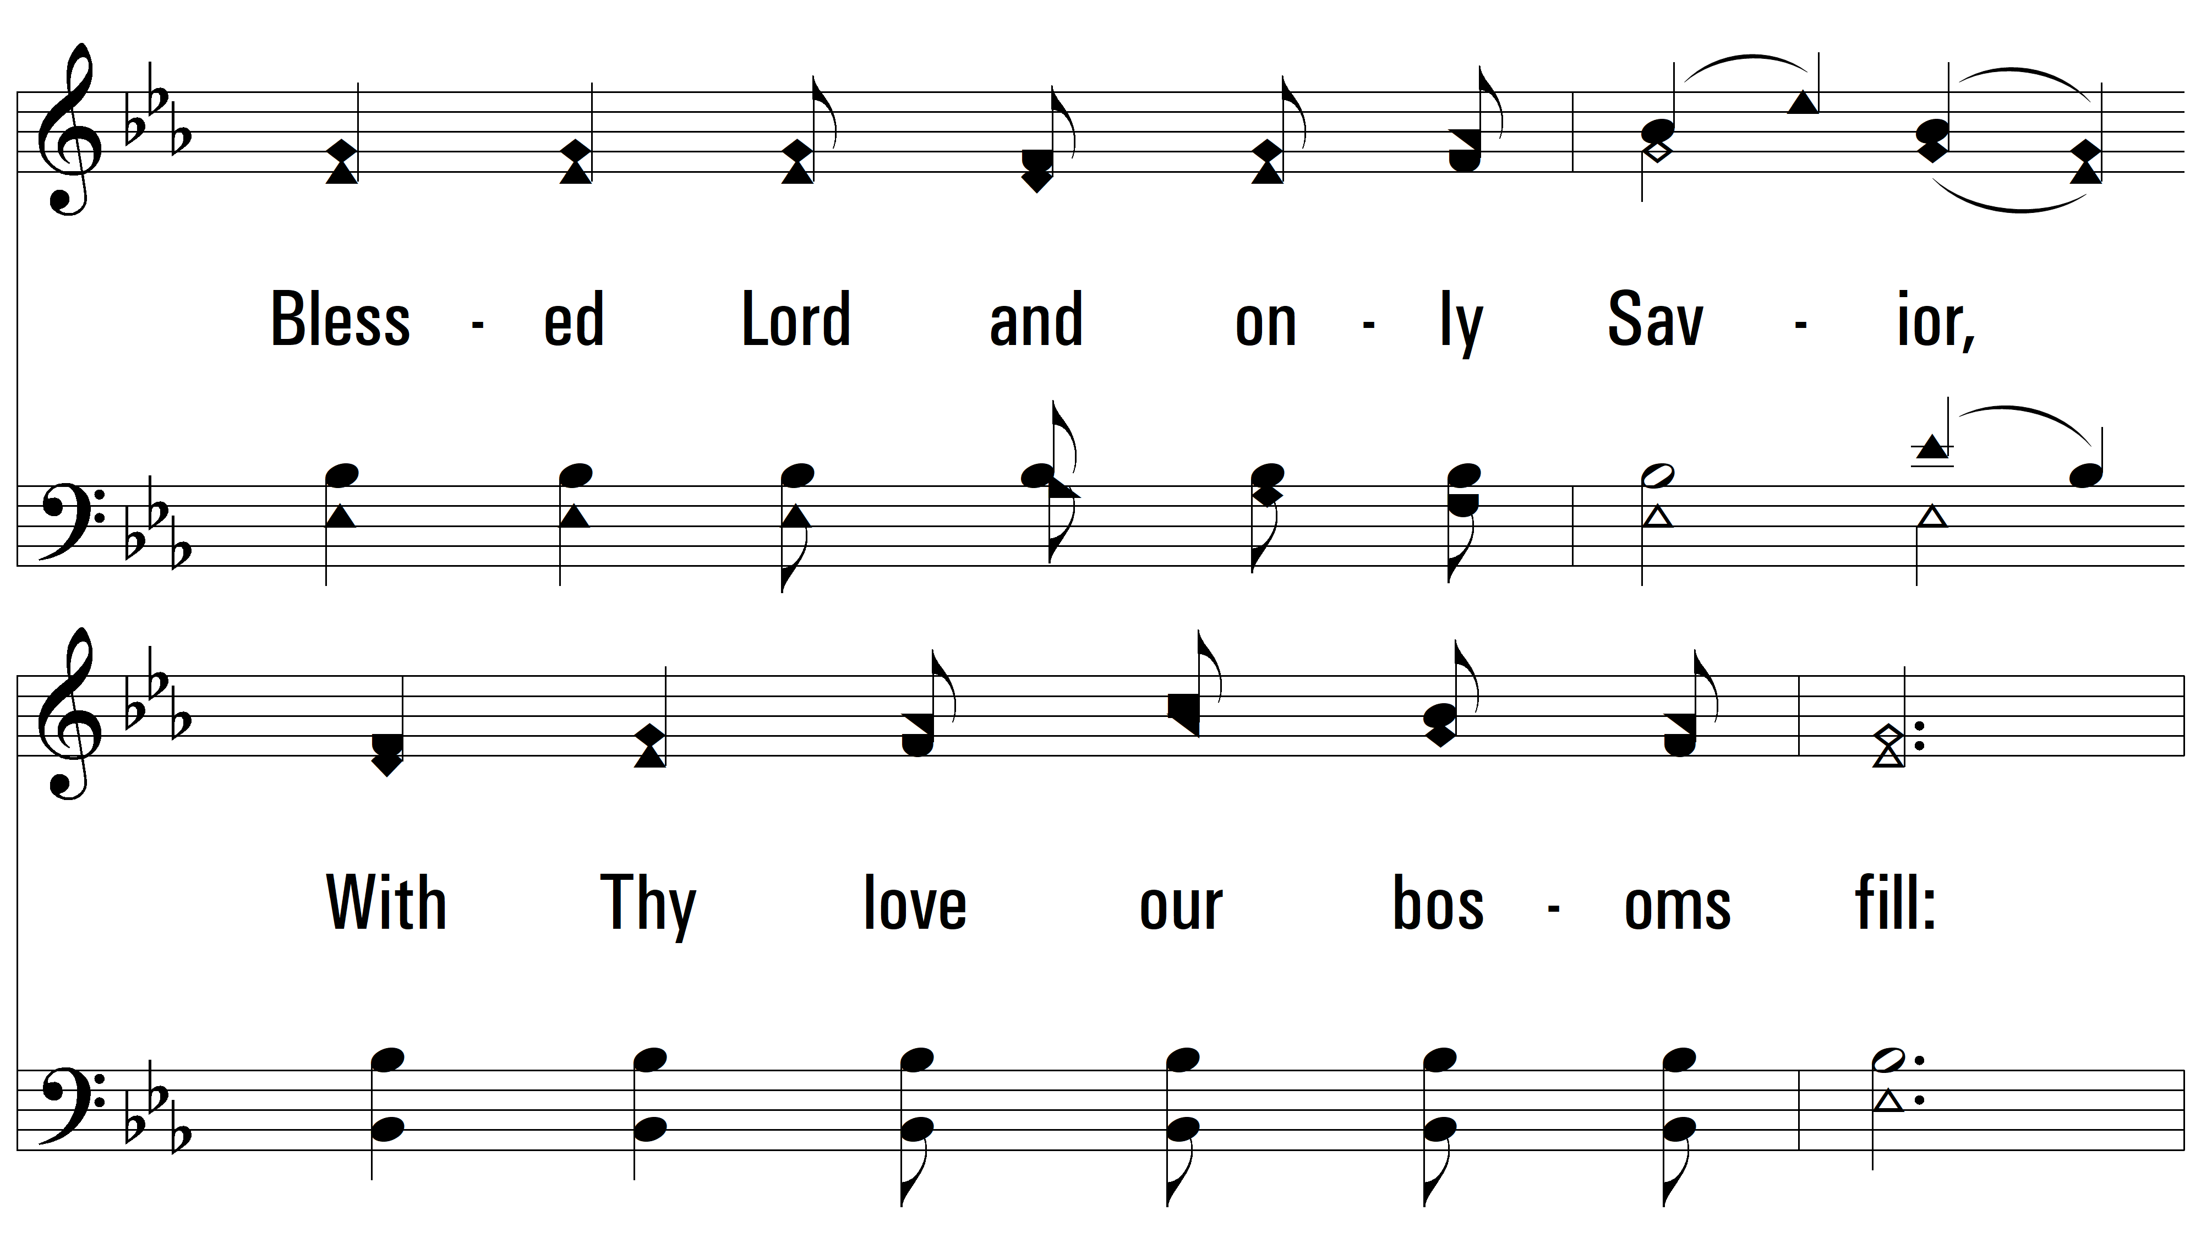
vs. 4

Slide 16
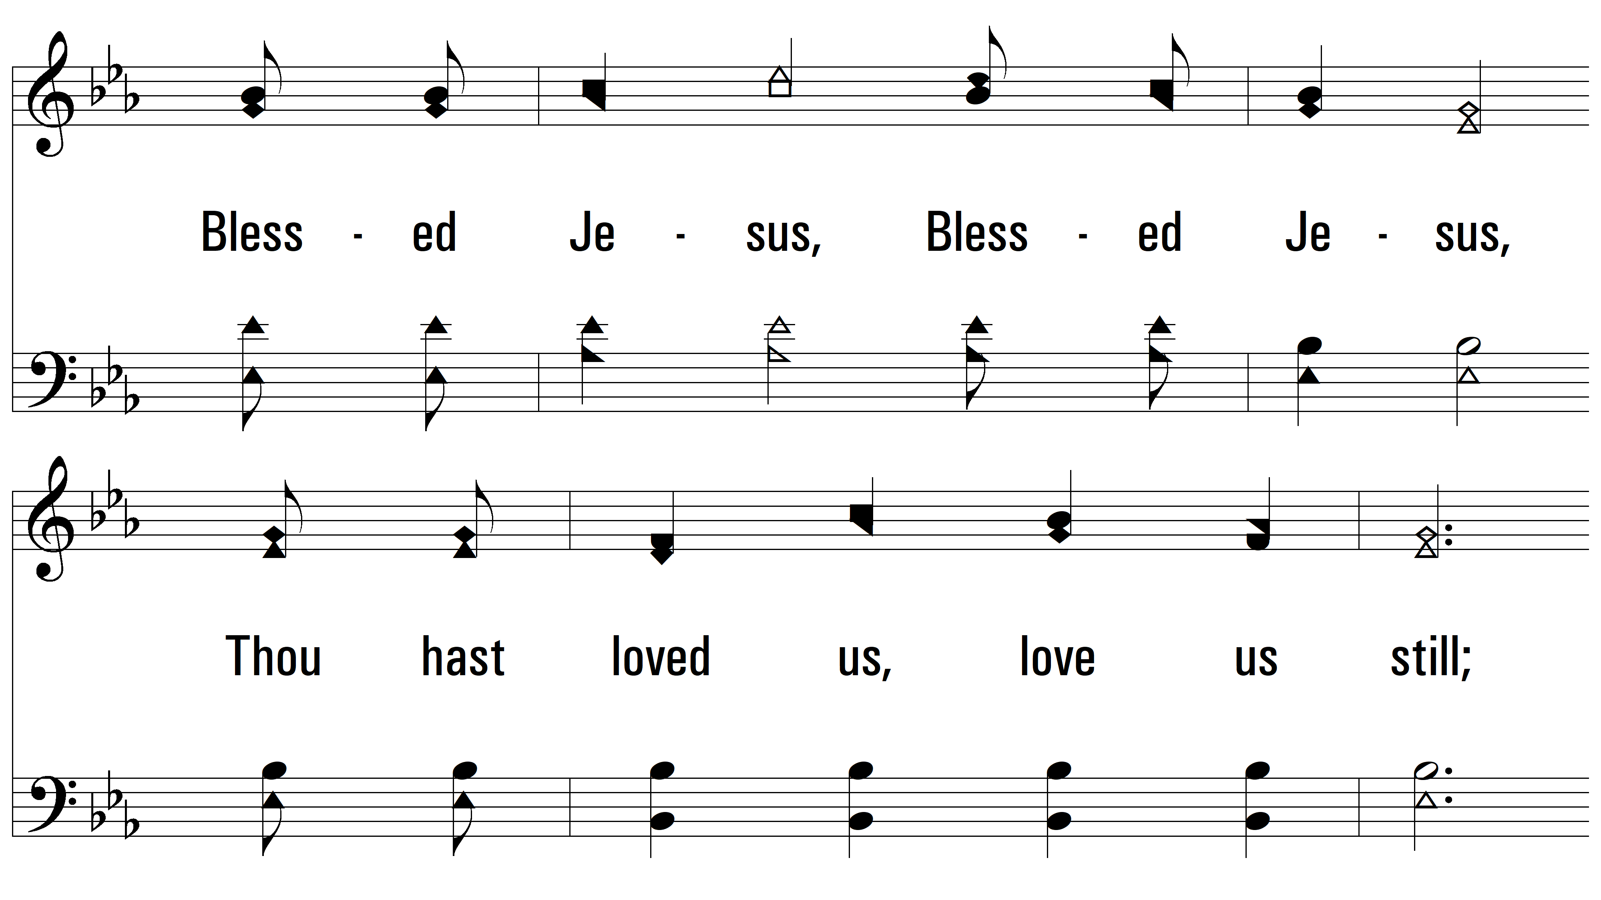
vs. 4

Slide 17
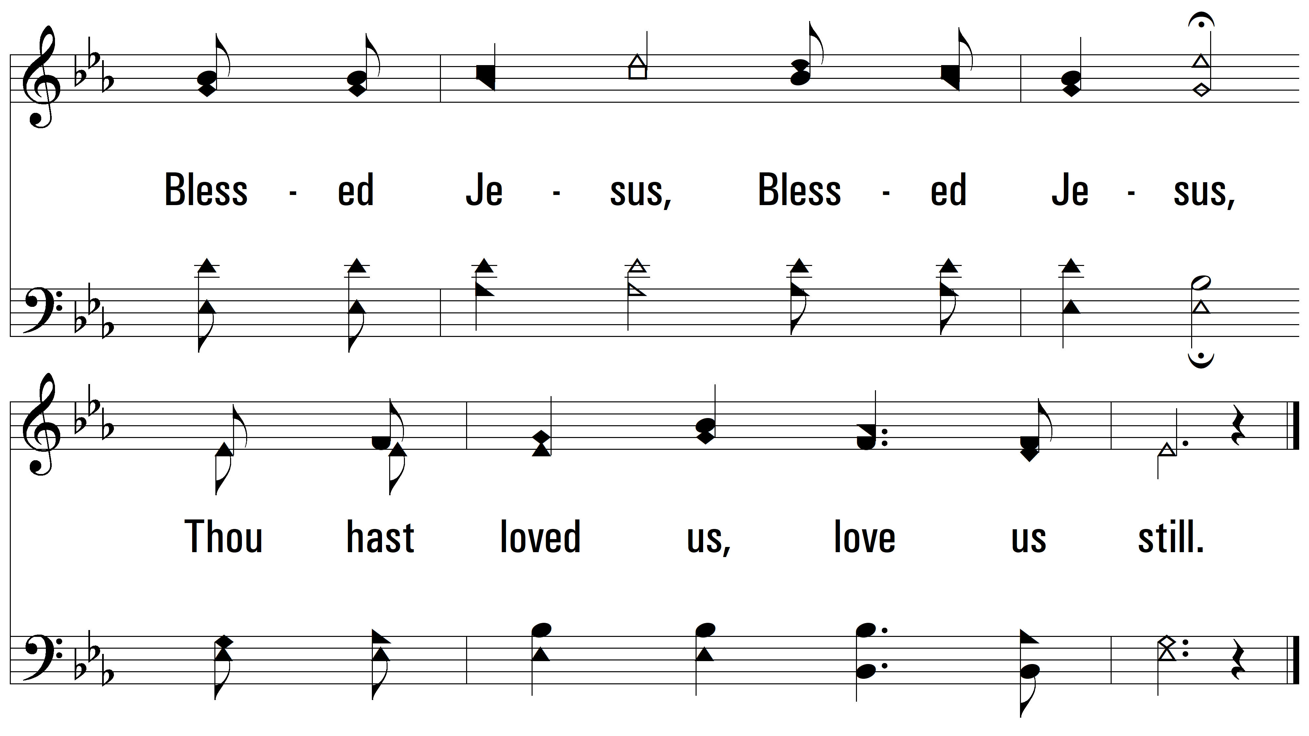
vs. 4
PDHymns.com
END

