Slide 1
Savior, Lead Me Lest I Stray
Words: | Frank M. Davis (1882)
Music: | Frank M. Davis (1882)
4/4
D^{b}/A^{b} - SOL
Verses: 3/Chorus
Lead - | SOL
Alto - | MI
Tenor - | DO
Bass - | DO
PDHymns.com

Slide 2
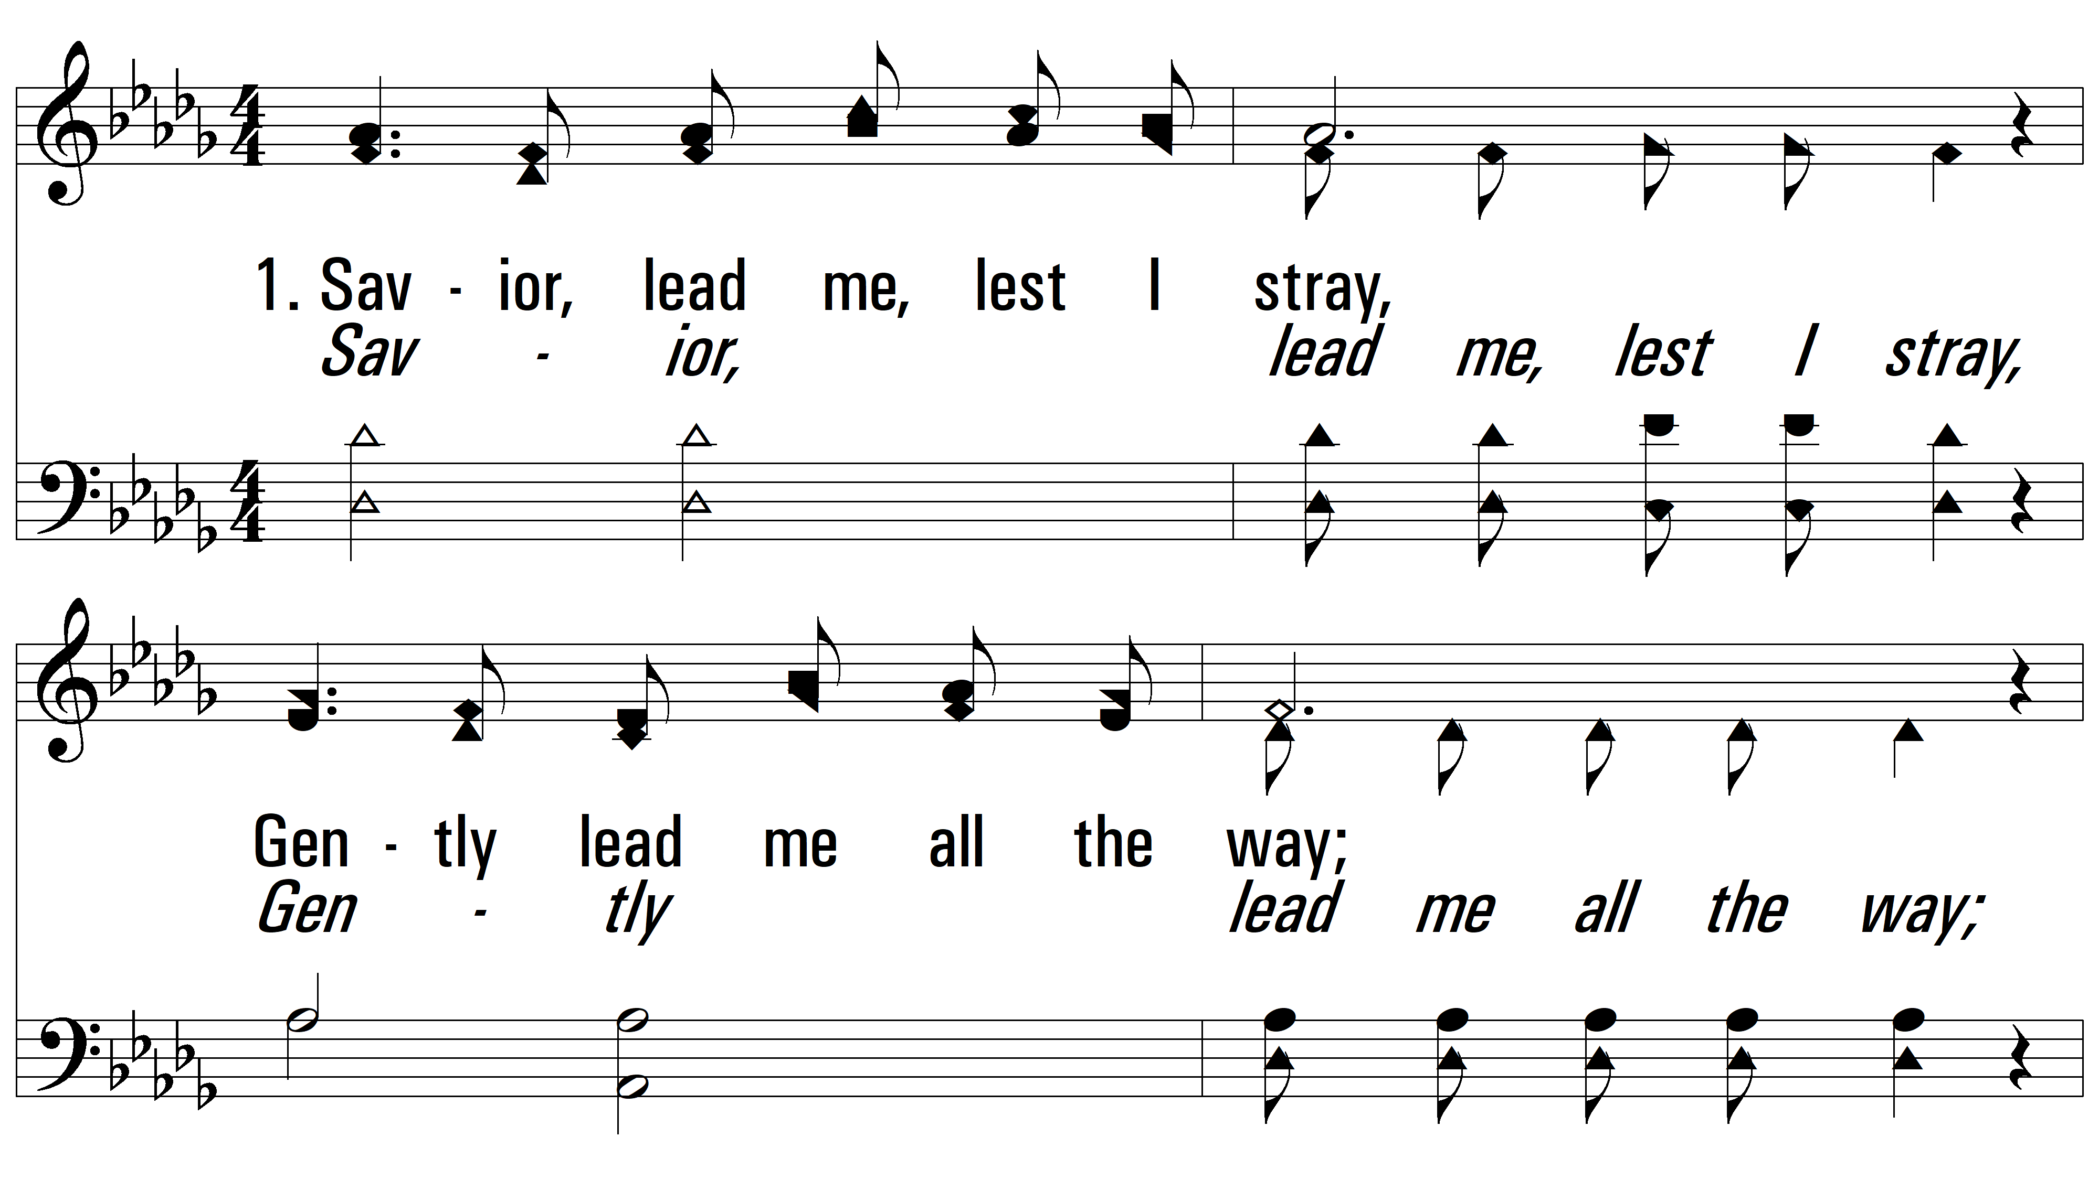
vs. 1 ~ Savior, Lead Me Lest I Stray

Slide 3
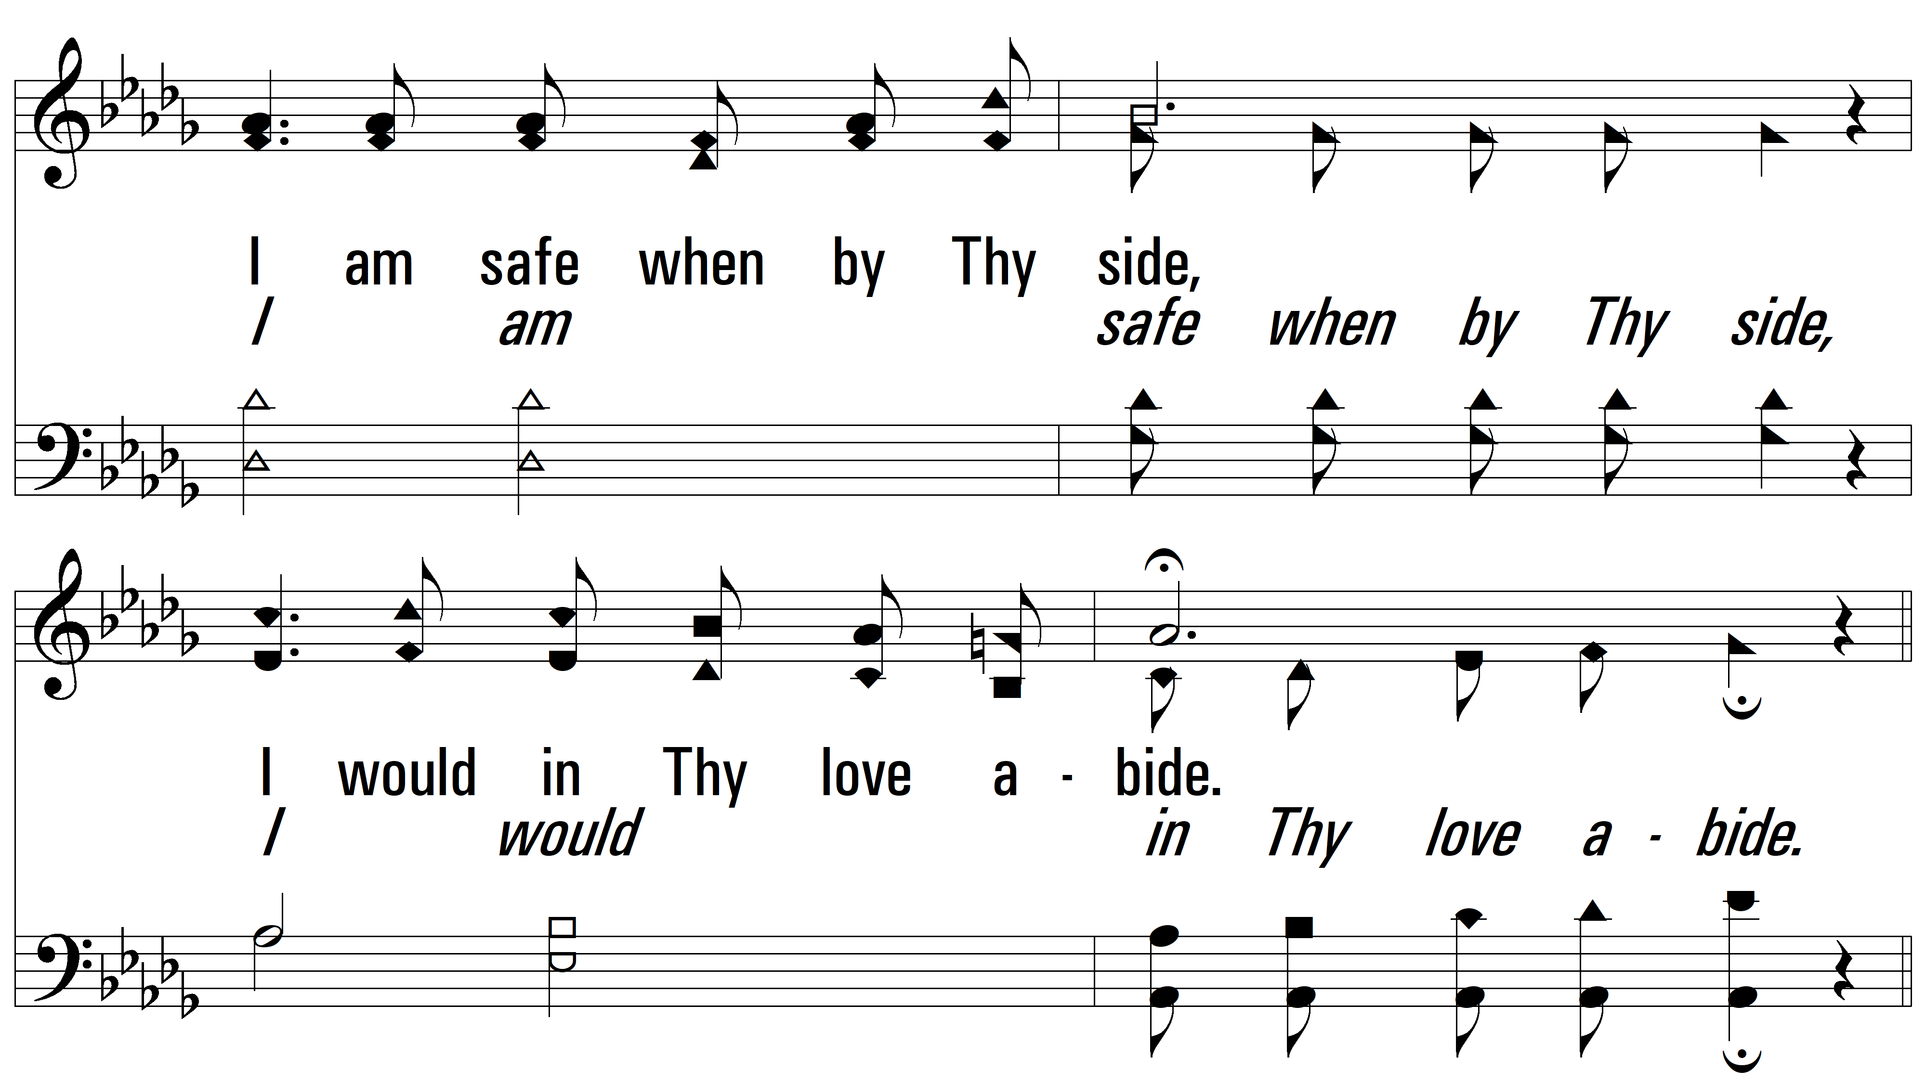
vs. 1

Slide 4
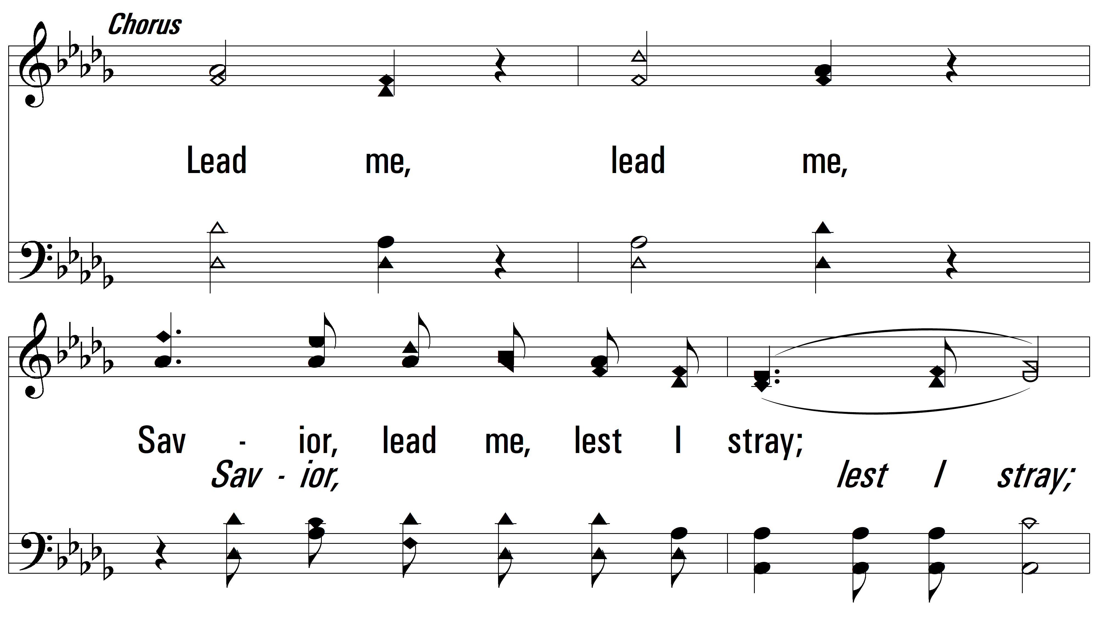
vs. 1

Slide 5
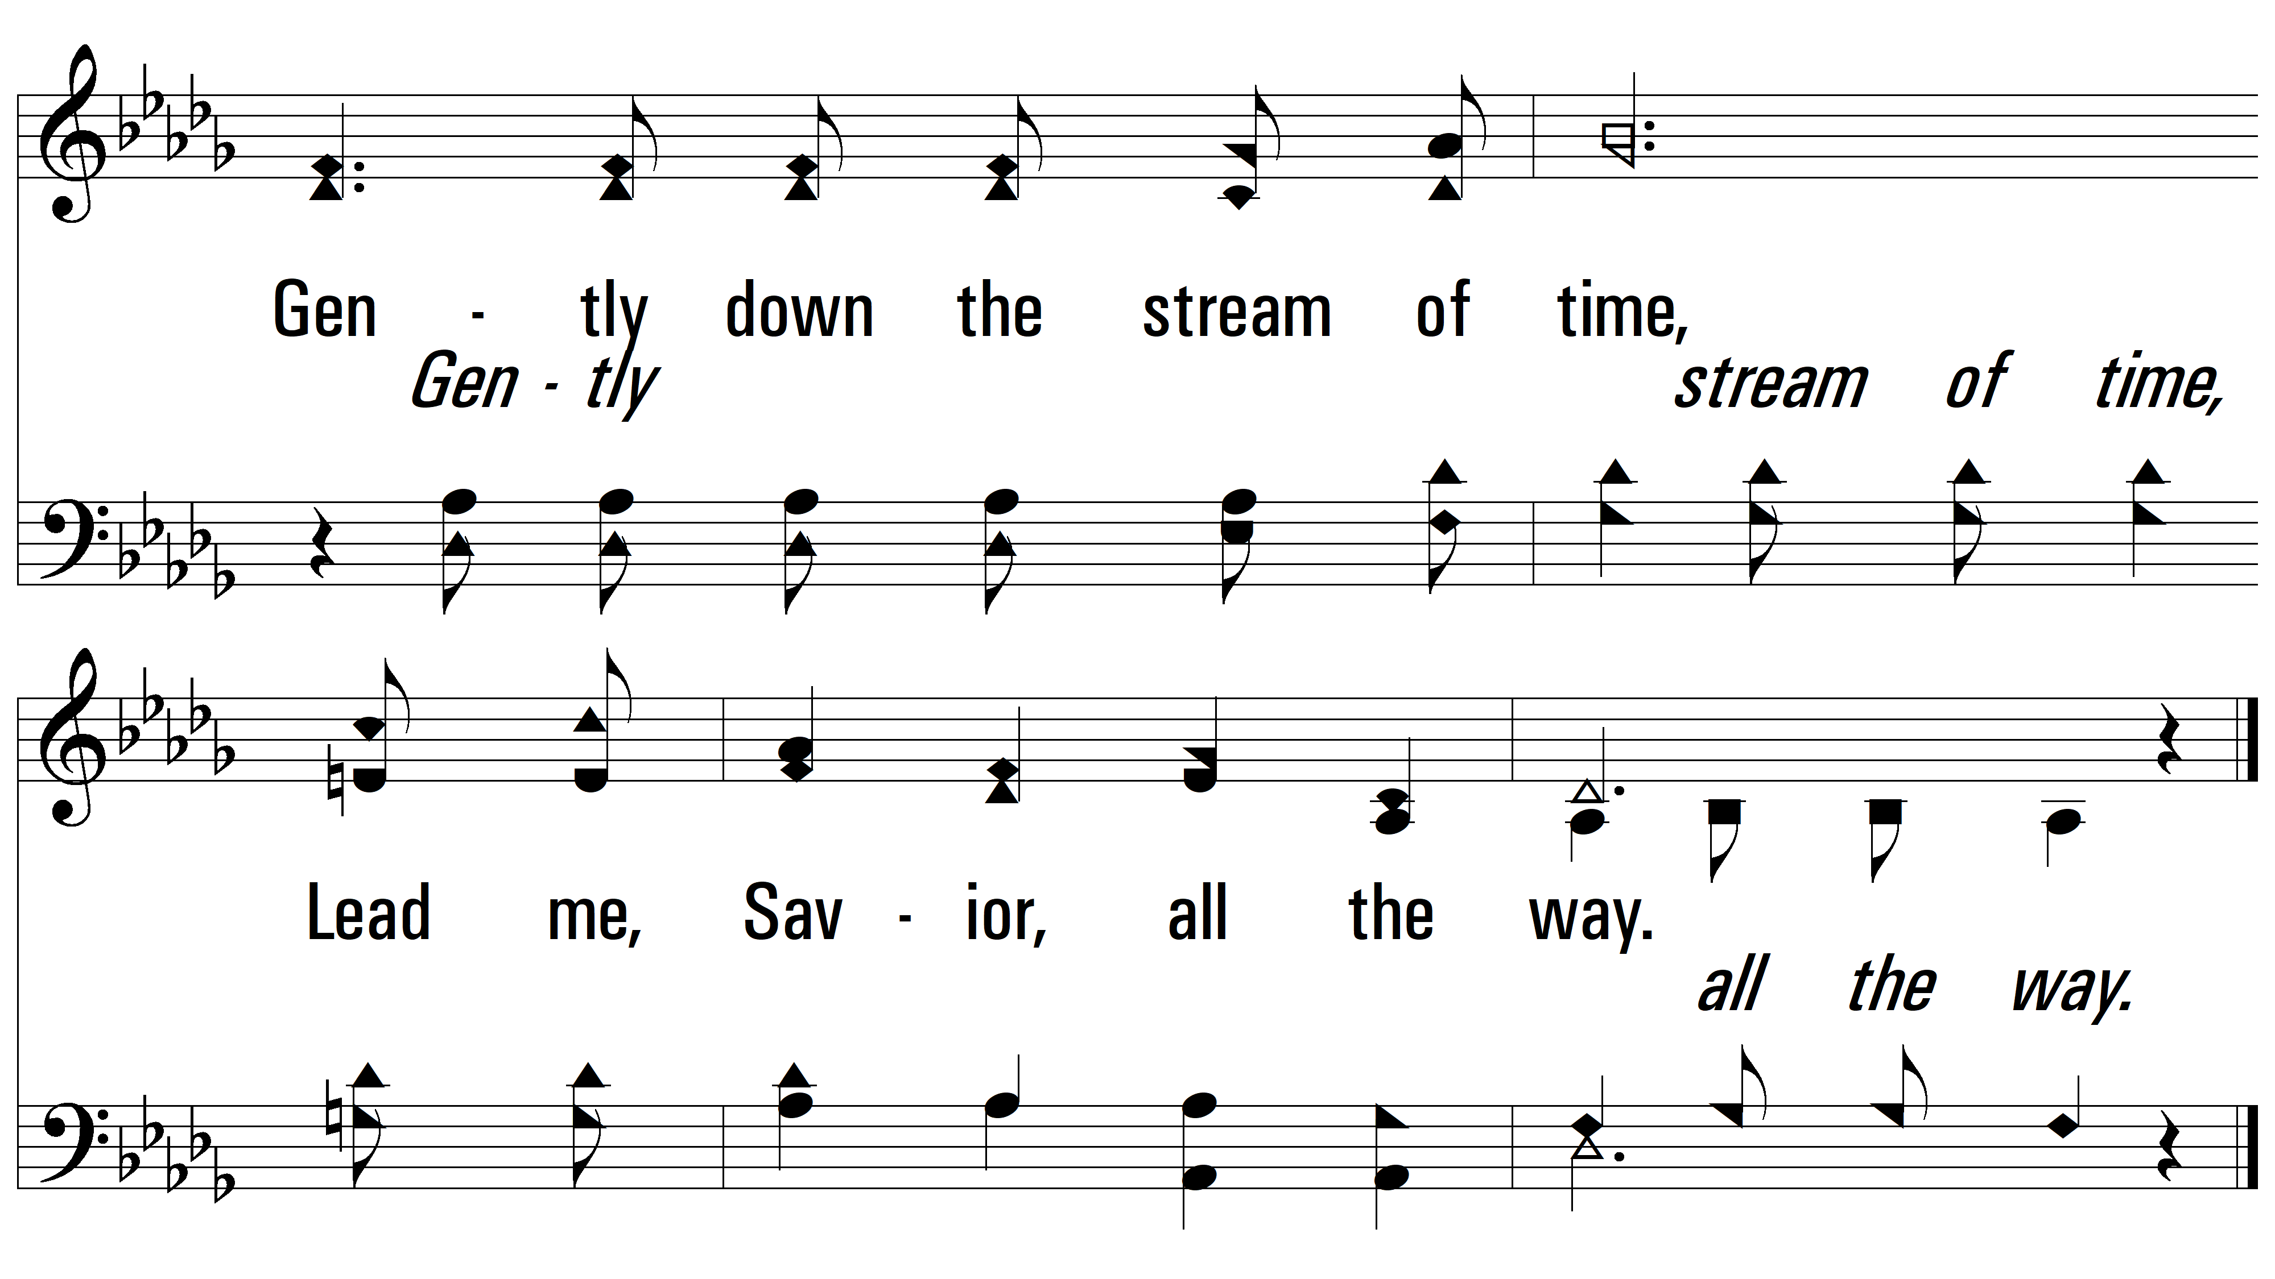
vs. 1

Slide 6
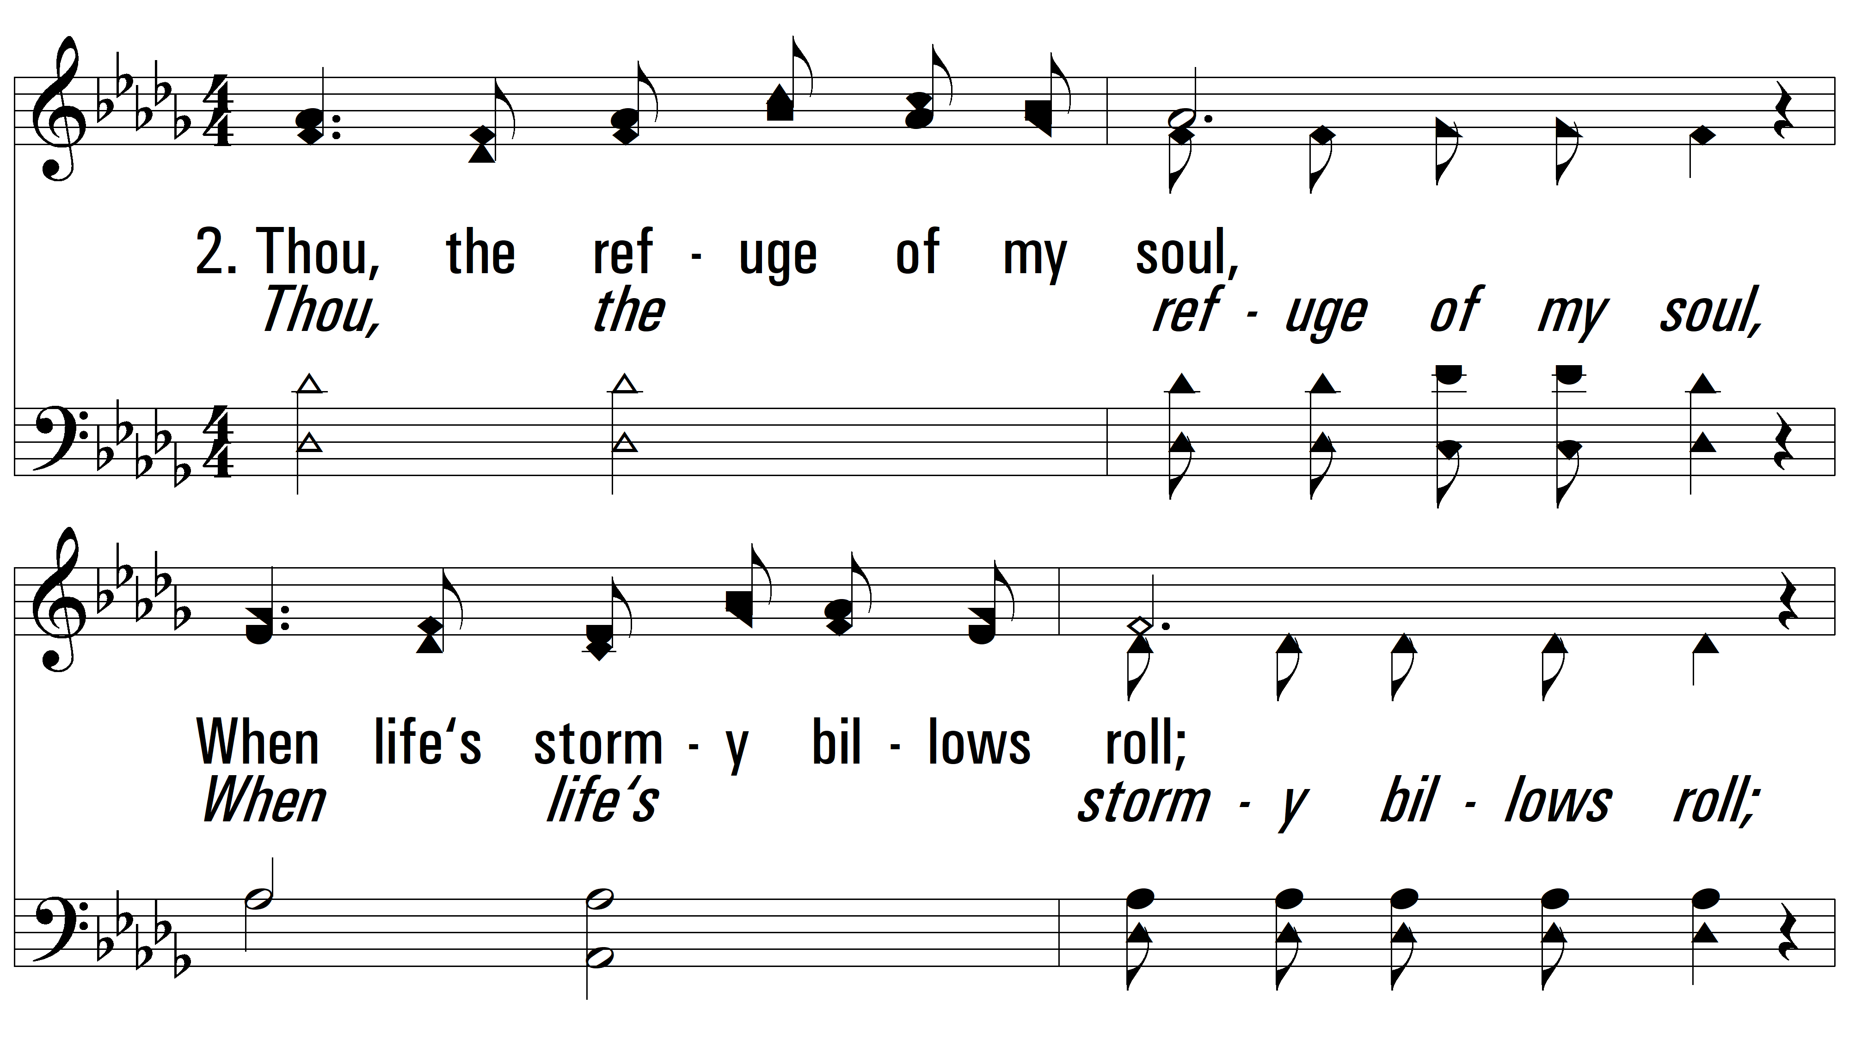
vs. 2 ~ Savior, Lead Me Lest I Stray

Slide 7
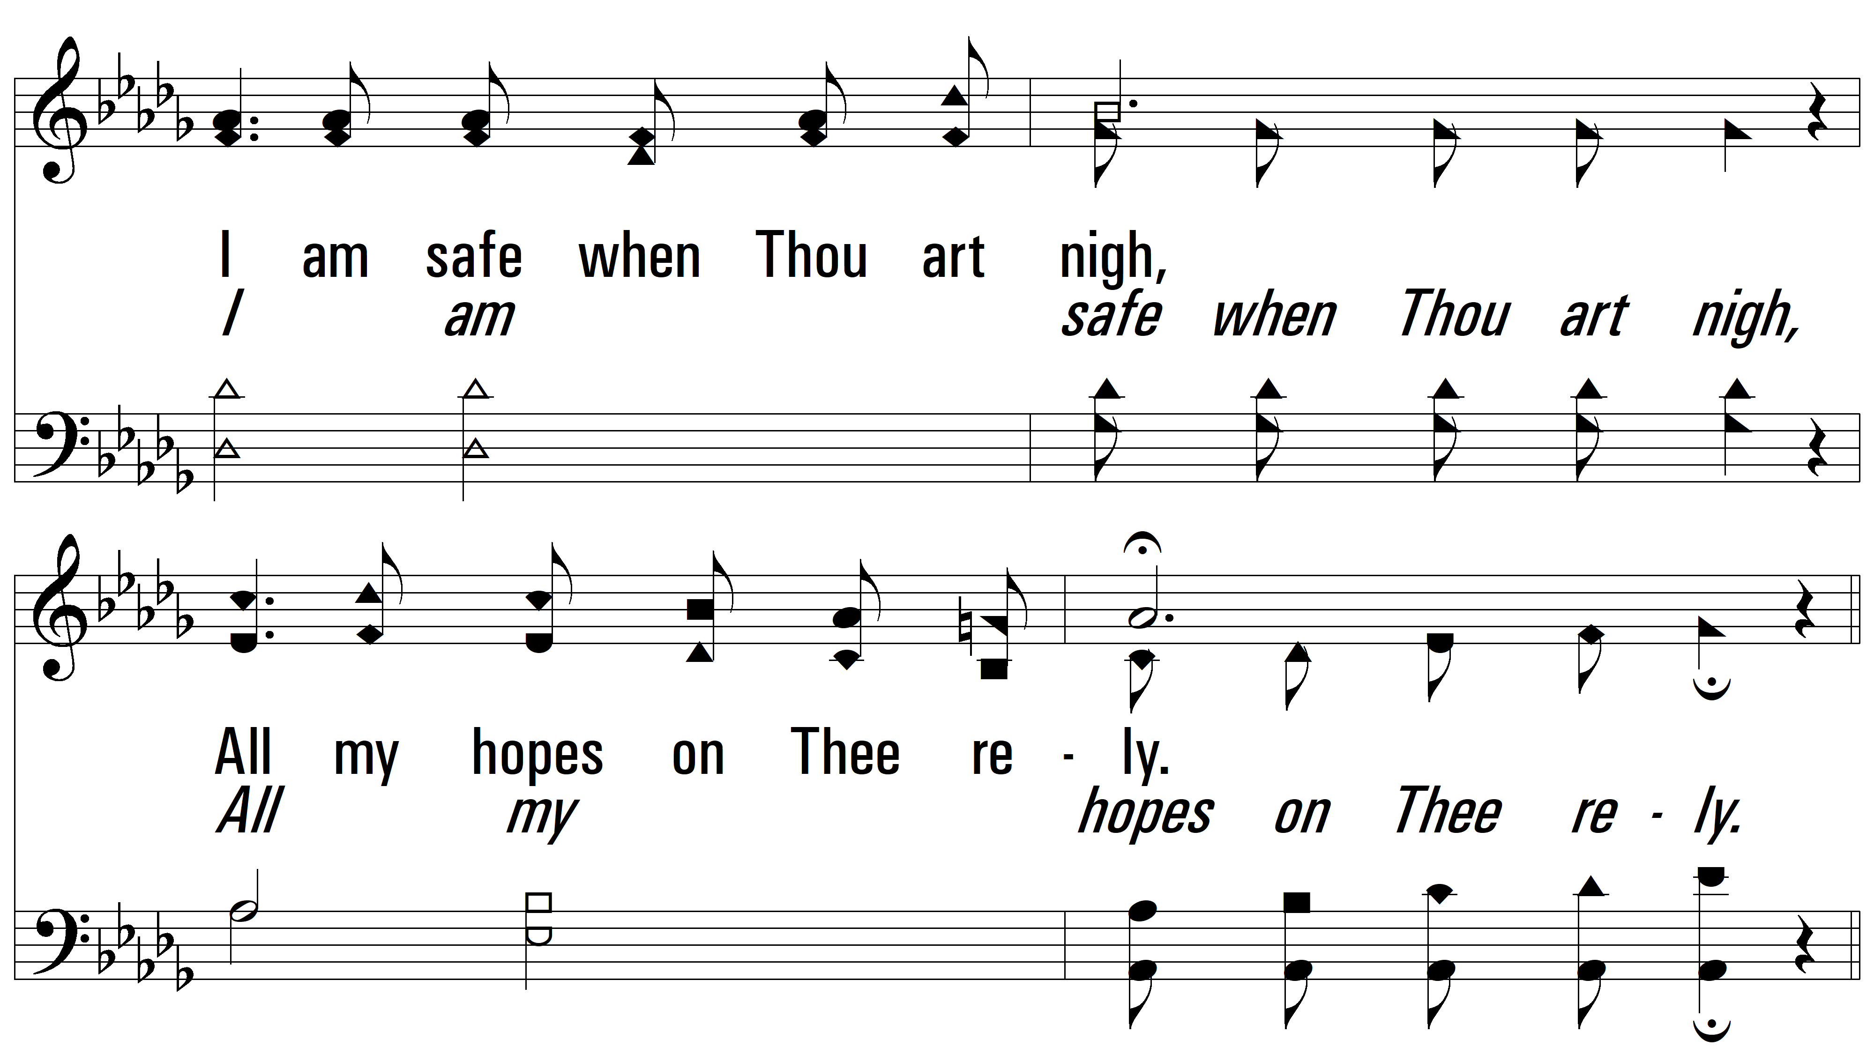
vs. 2

Slide 8
vs. 2

Slide 9
vs. 2

Slide 10
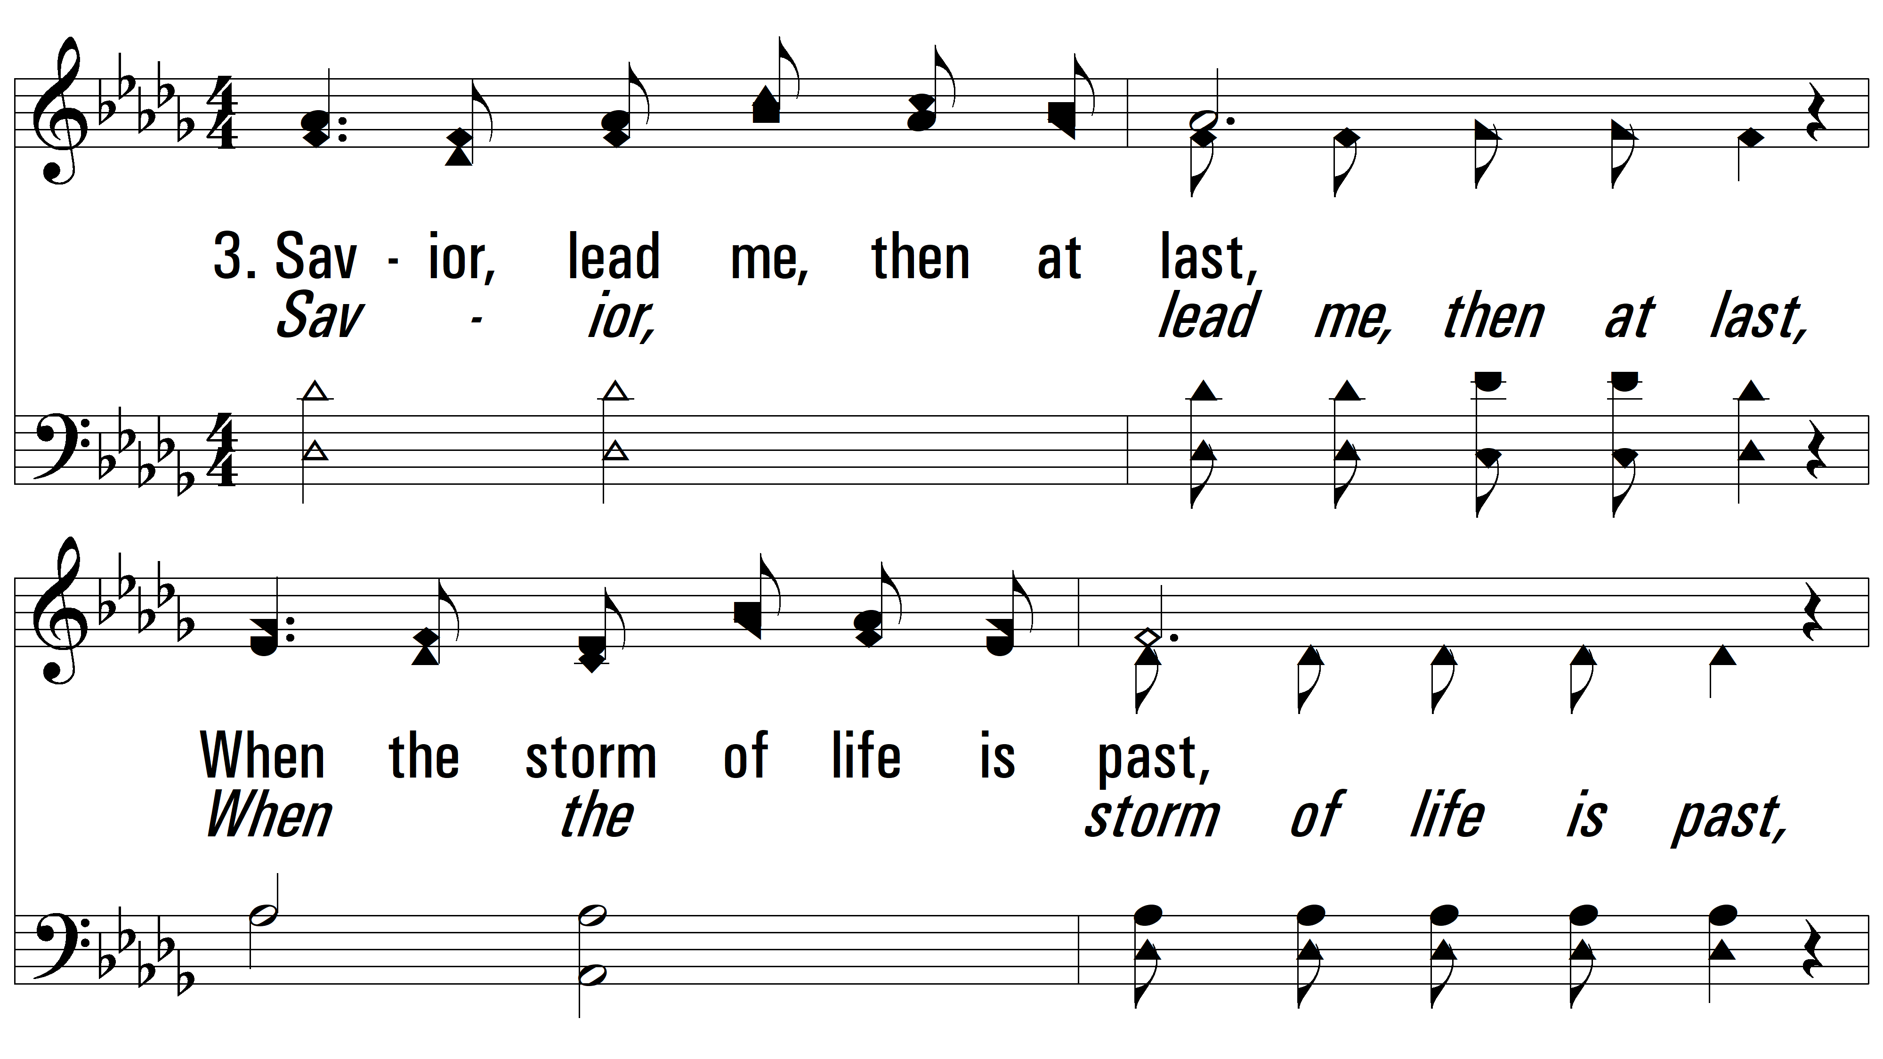
vs. 3 ~ Savior, Lead Me Lest I Stray

Slide 11
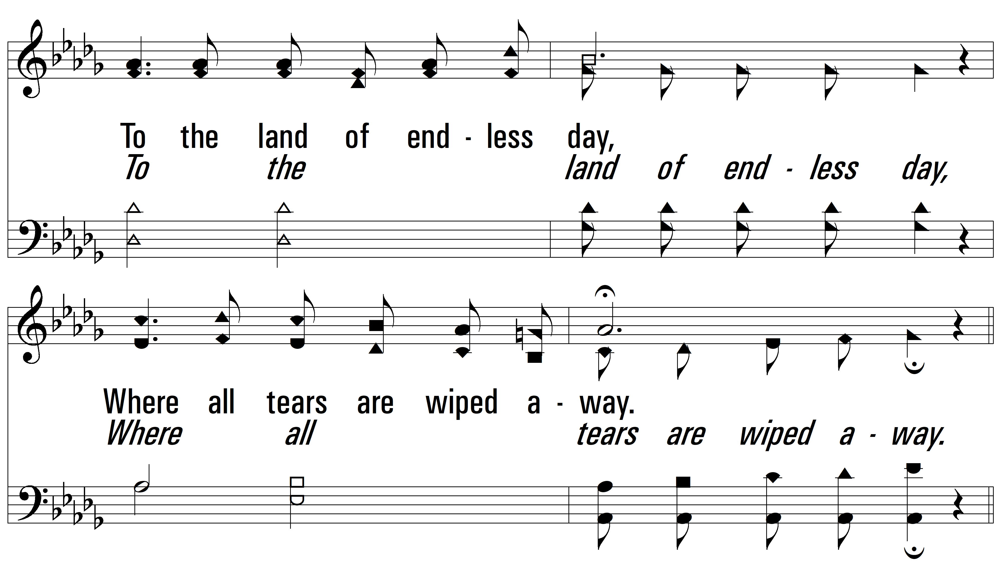
vs. 3

Slide 12
vs. 3

Slide 13
vs. 3
PDHymns.com
END

