Slide 1
Savior, Grant Me Rest And Peace
BATEMAN
7.7.7.7
Words: | Lucinda M. Bateman (1877)
Music: | J. H. Fillmore (1877)
3/4
G/D - SOL
Verses: 3
Lead - | SOL
Alto - | SOL
Tenor - | MI
Bass - | DO
PDHymns.com

Slide 2
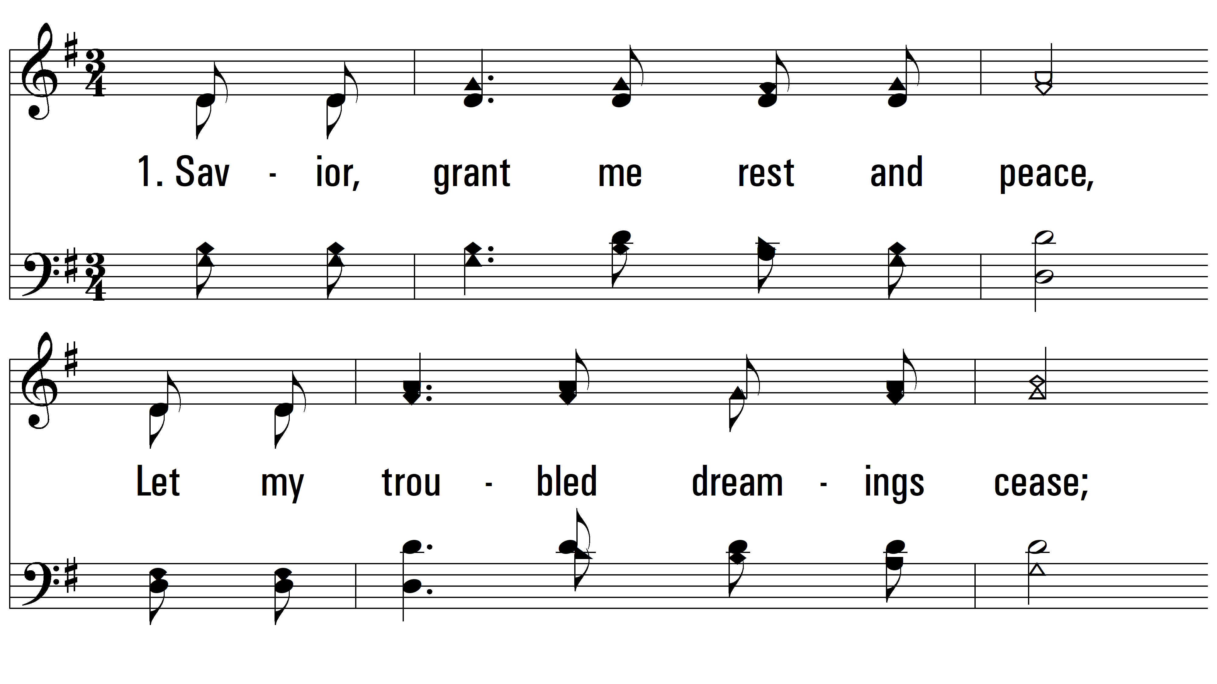
vs. 1 ~ Savior, Grant Me Rest And Peace

Slide 3
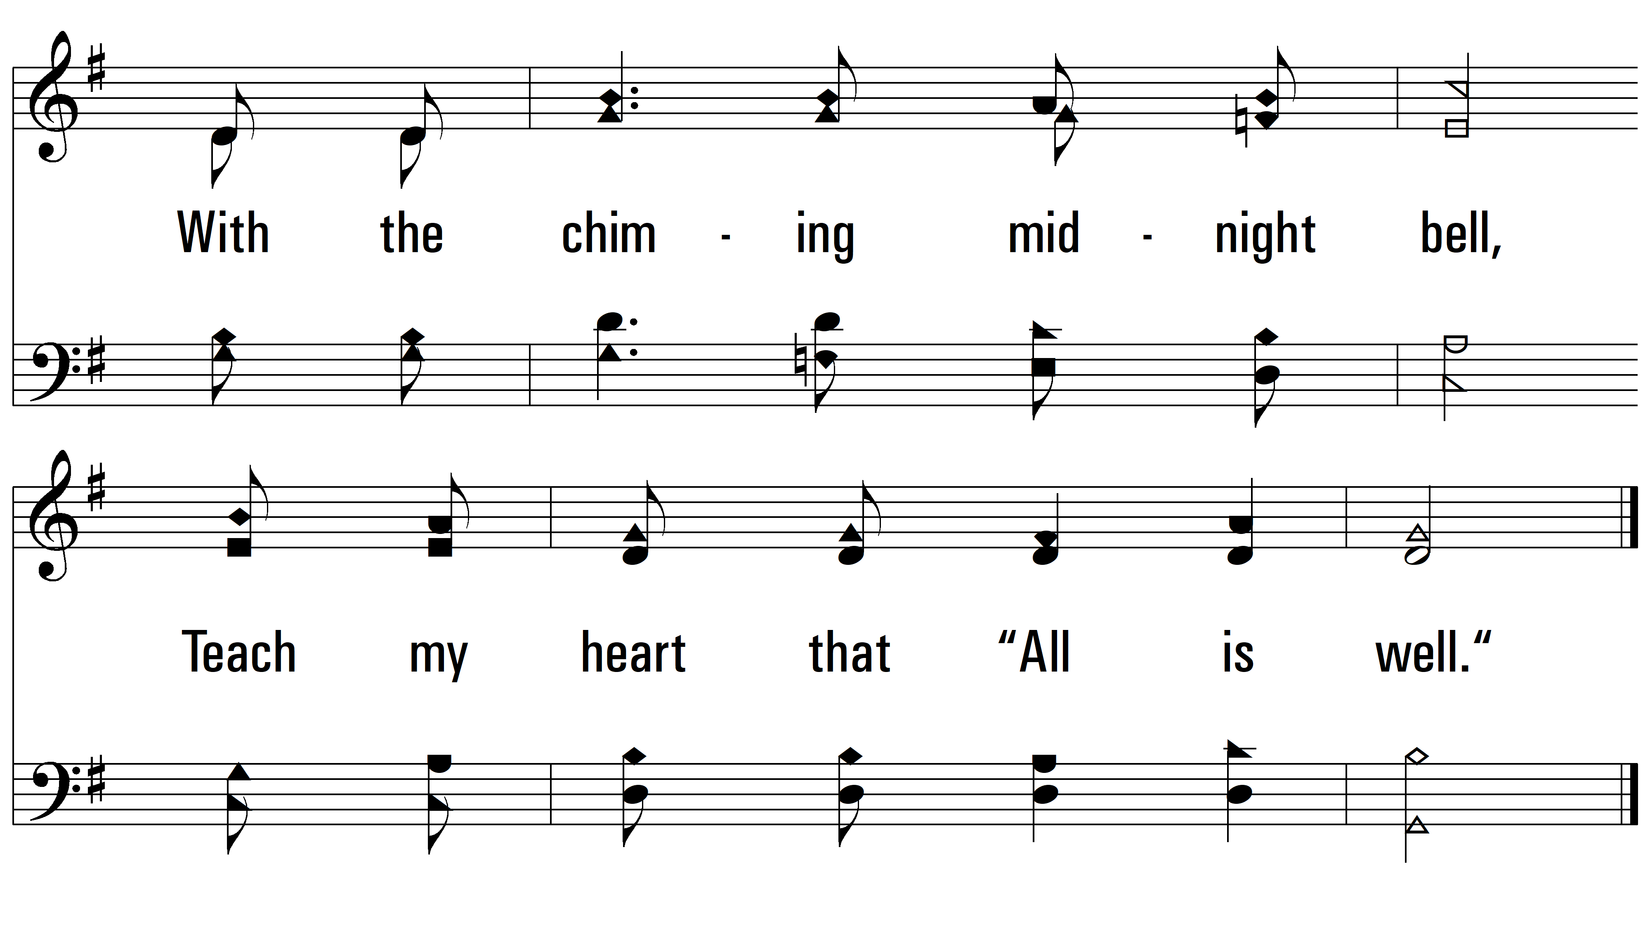
vs. 1

Slide 4
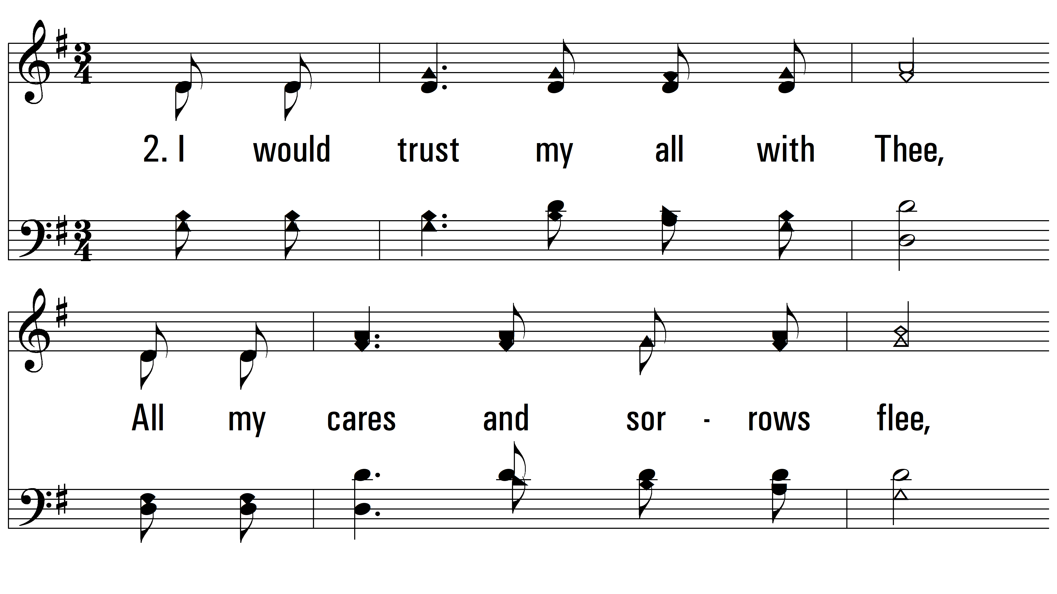
vs. 2 ~ Savior, Grant Me Rest And Peace

Slide 5
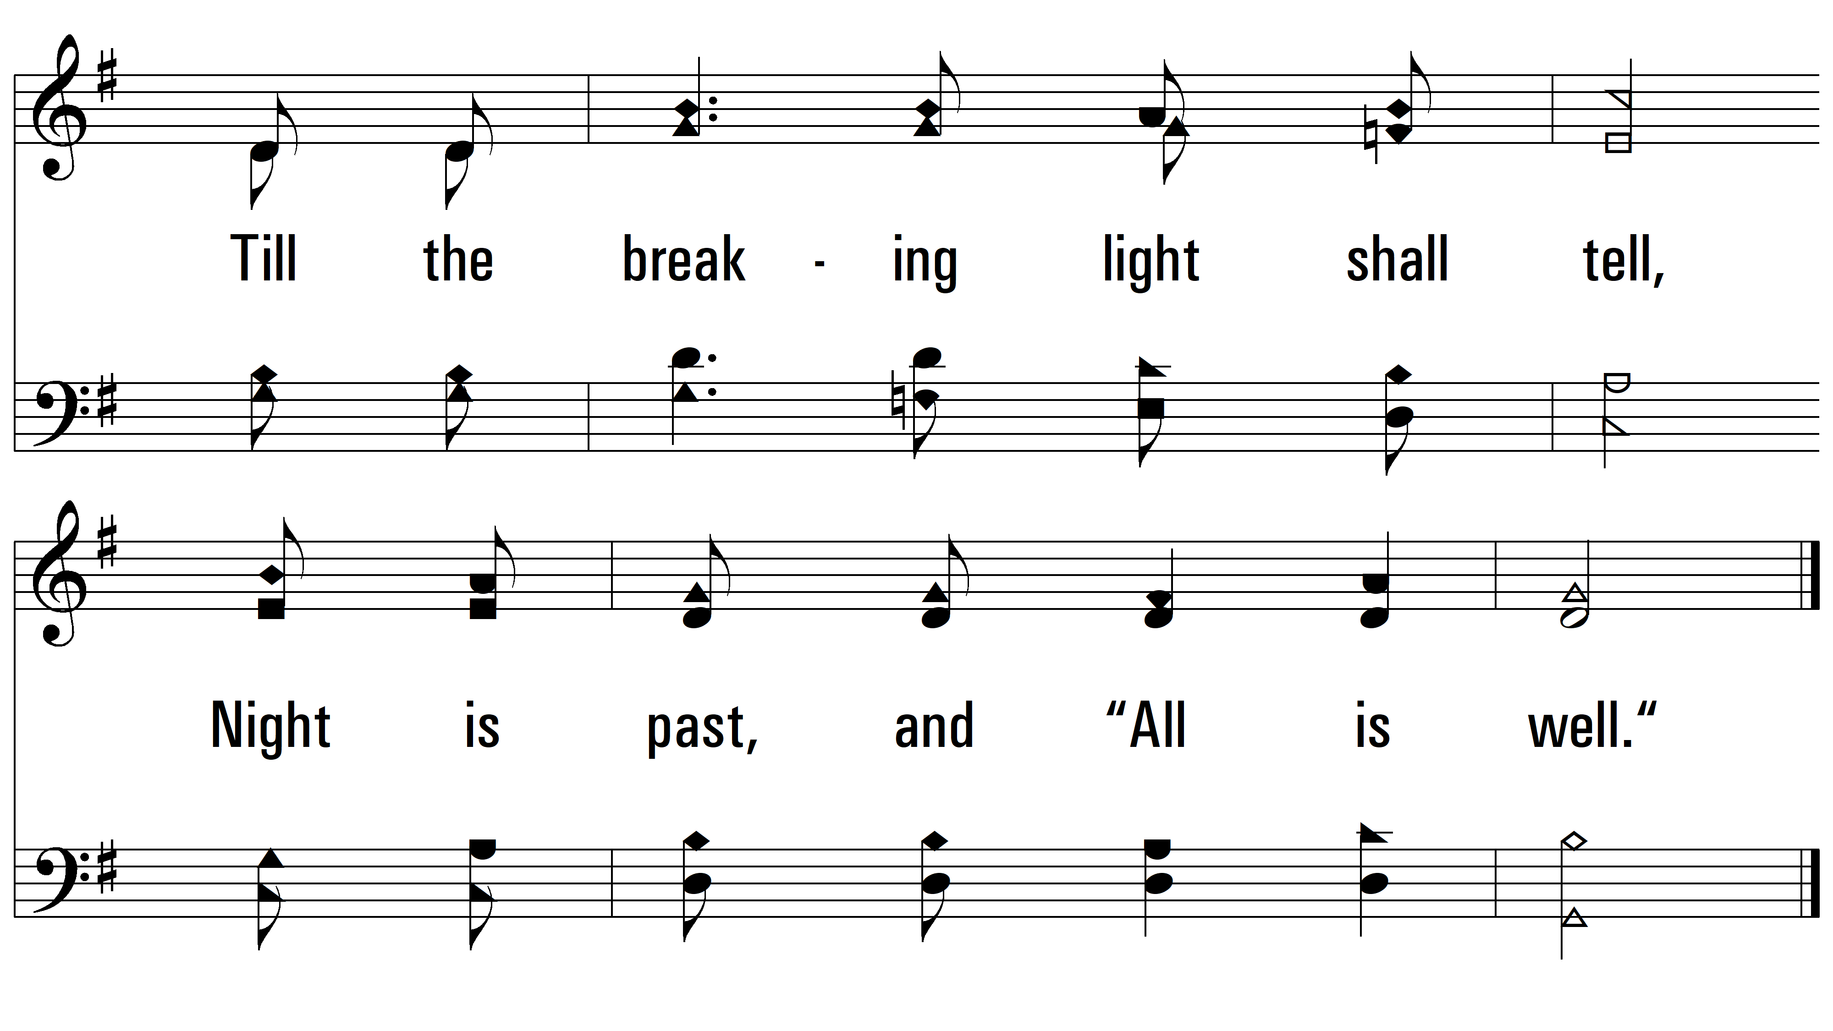
vs. 2

Slide 6
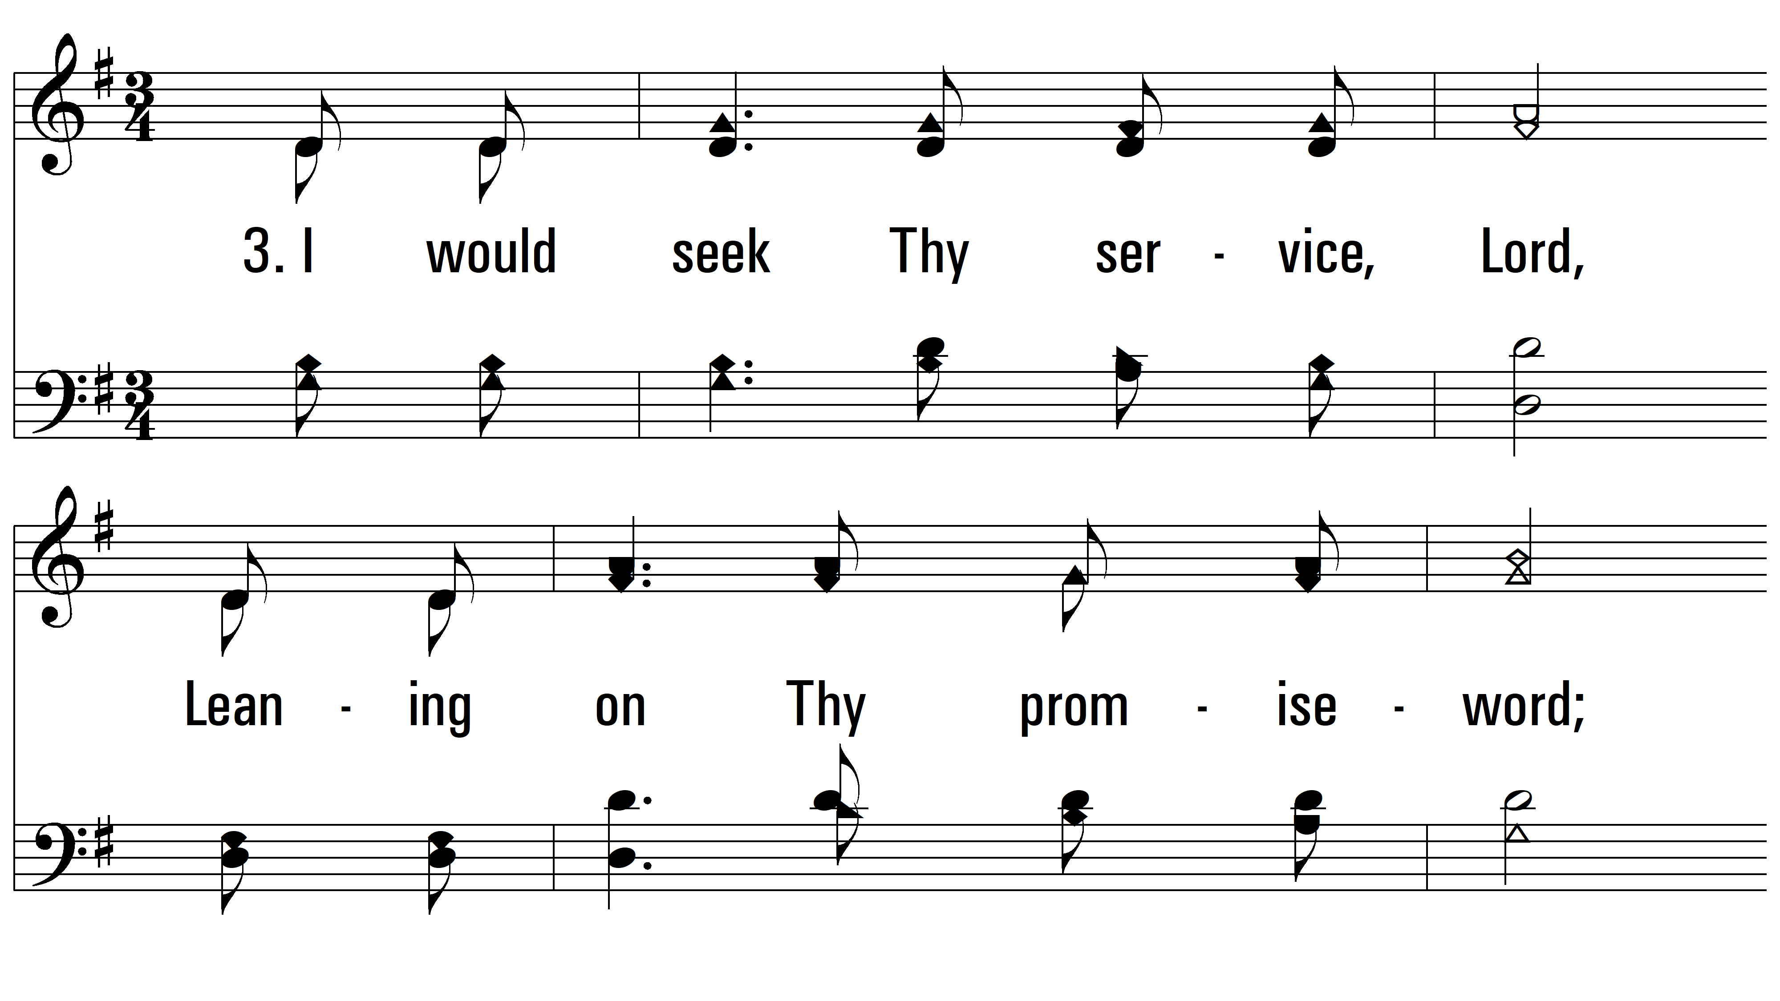
vs. 3 ~ Savior, Grant Me Rest And Peace

Slide 7
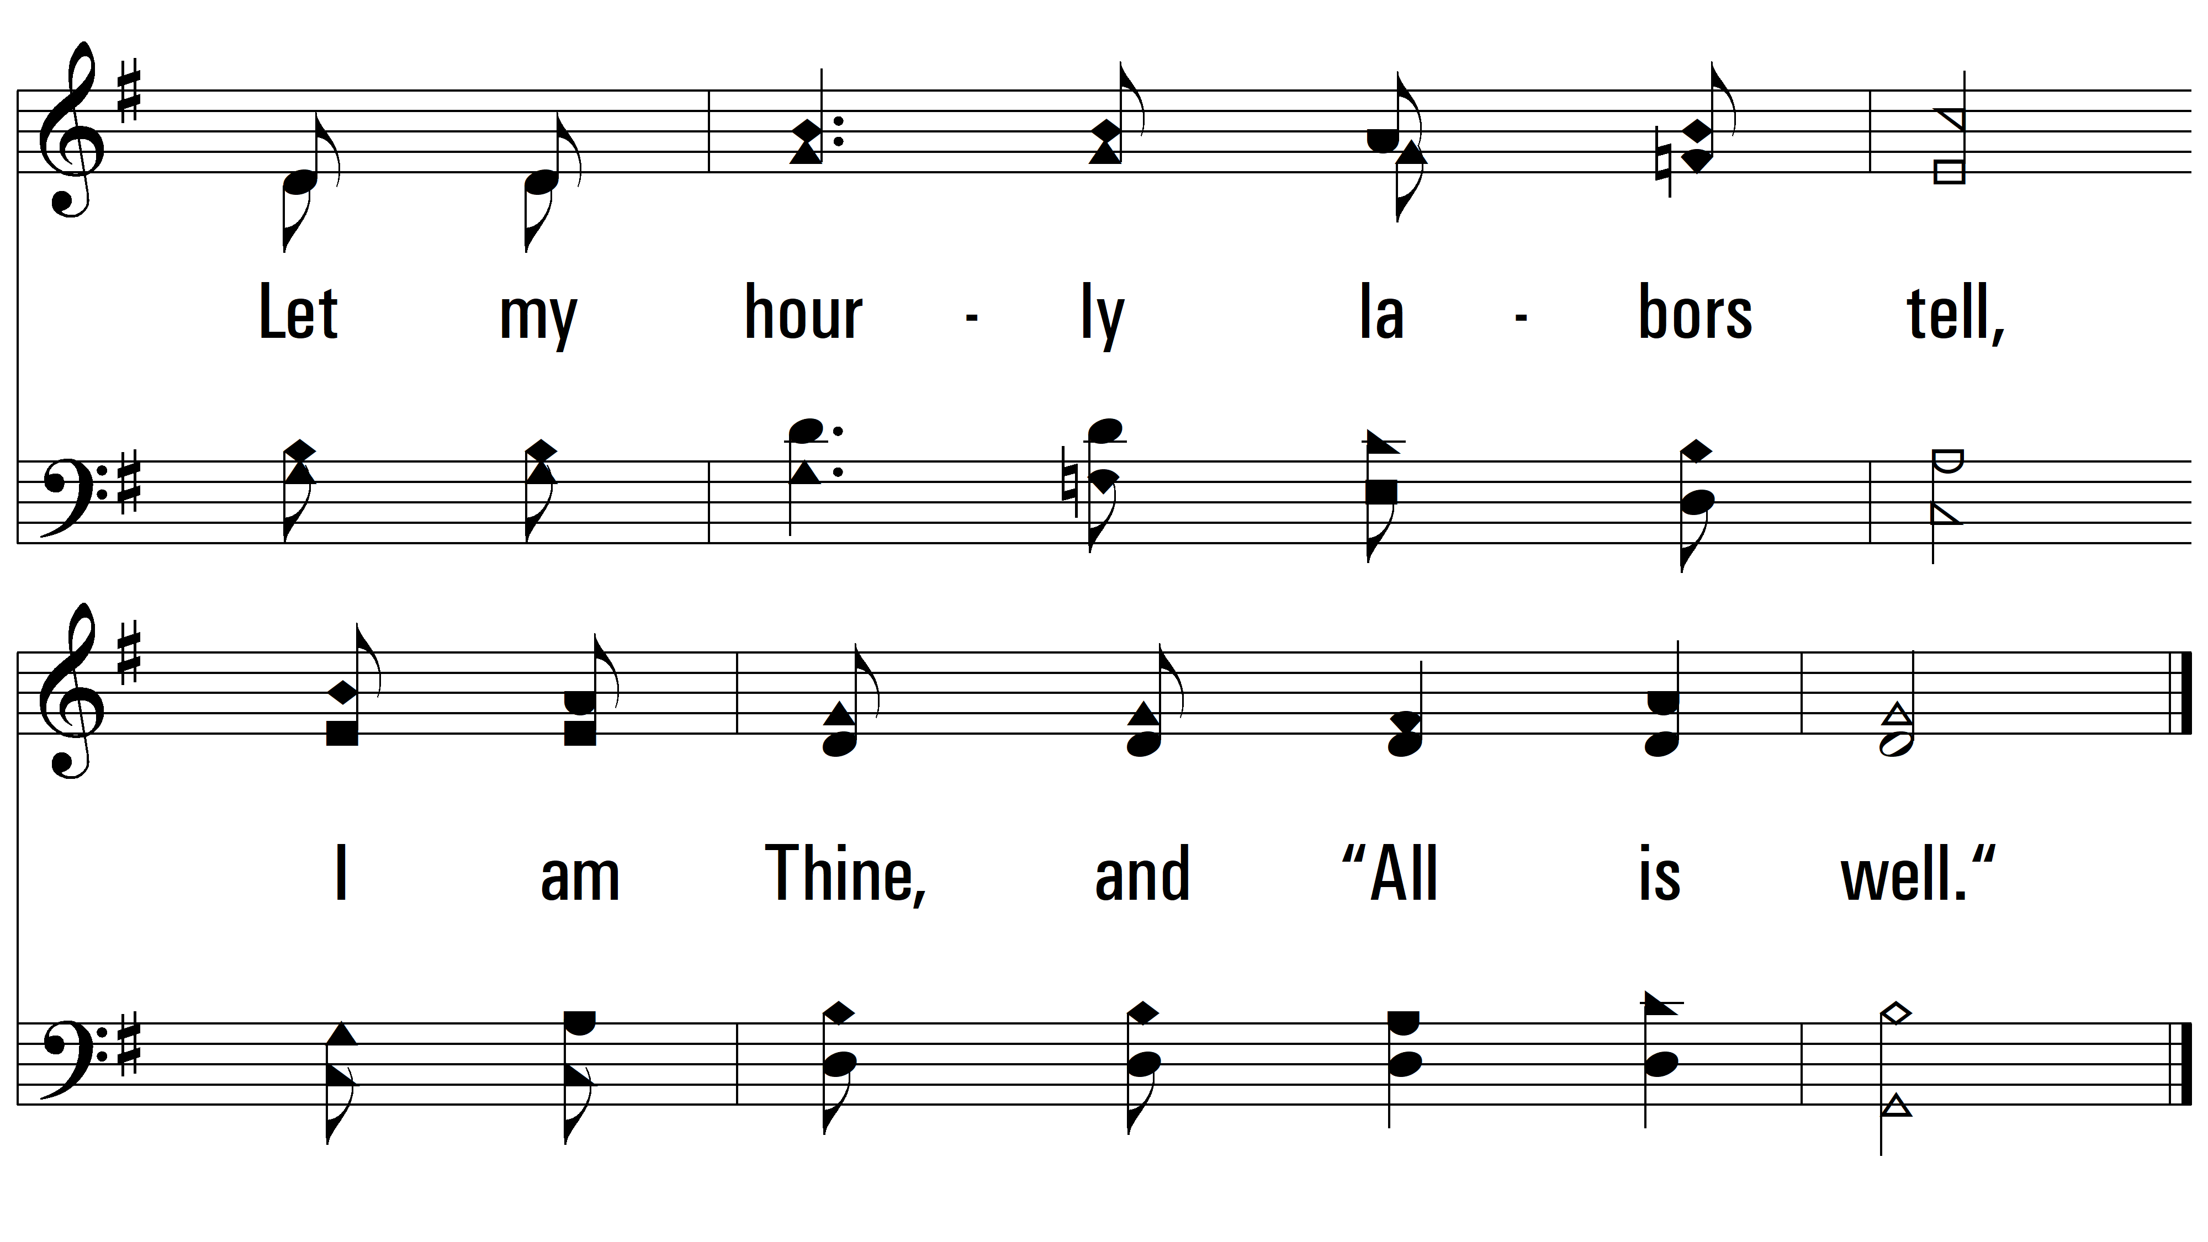
vs. 3
PDHymns.com
END

