Slide 1
Savior, Breathe An Evening Blessing
EVENING PRAYER
7.7.7.7.7.7
Words: | James Edmeston (1820)
Music: | George C. Stebbins (1878)
2/4
B^{b}/F - SOL
Verses: 4
Lead - | SOL
Alto - | MI
Tenor - | SOL
Bass - | DO
PDHymns.com

Slide 2
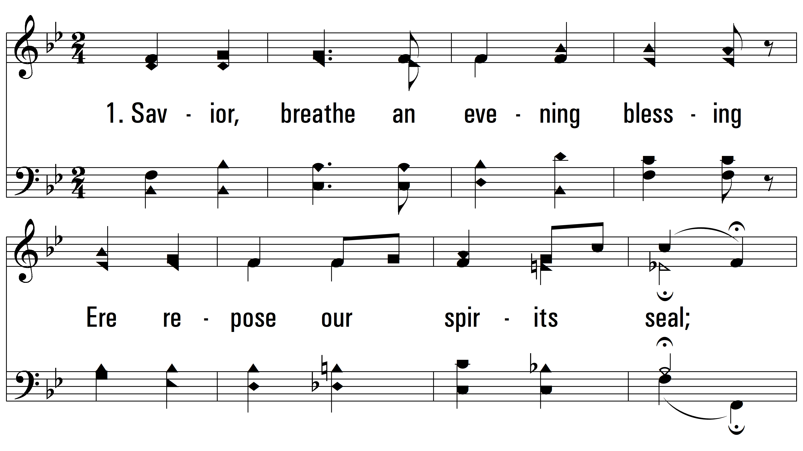
vs. 1 ~ Savior, Breathe An Evening Blessing

Slide 3
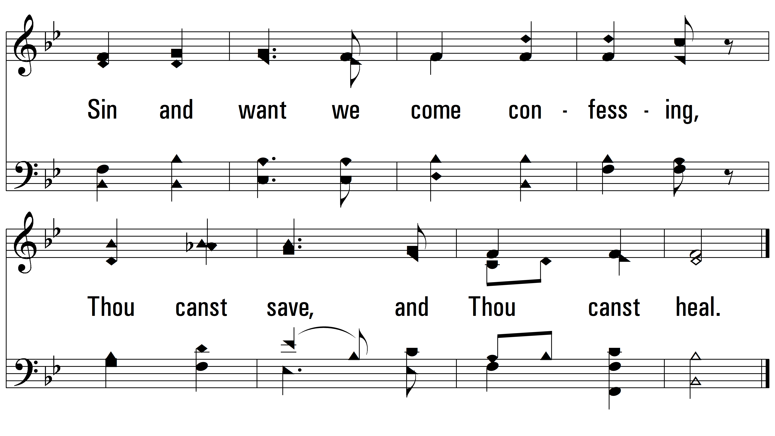
vs. 1

Slide 4
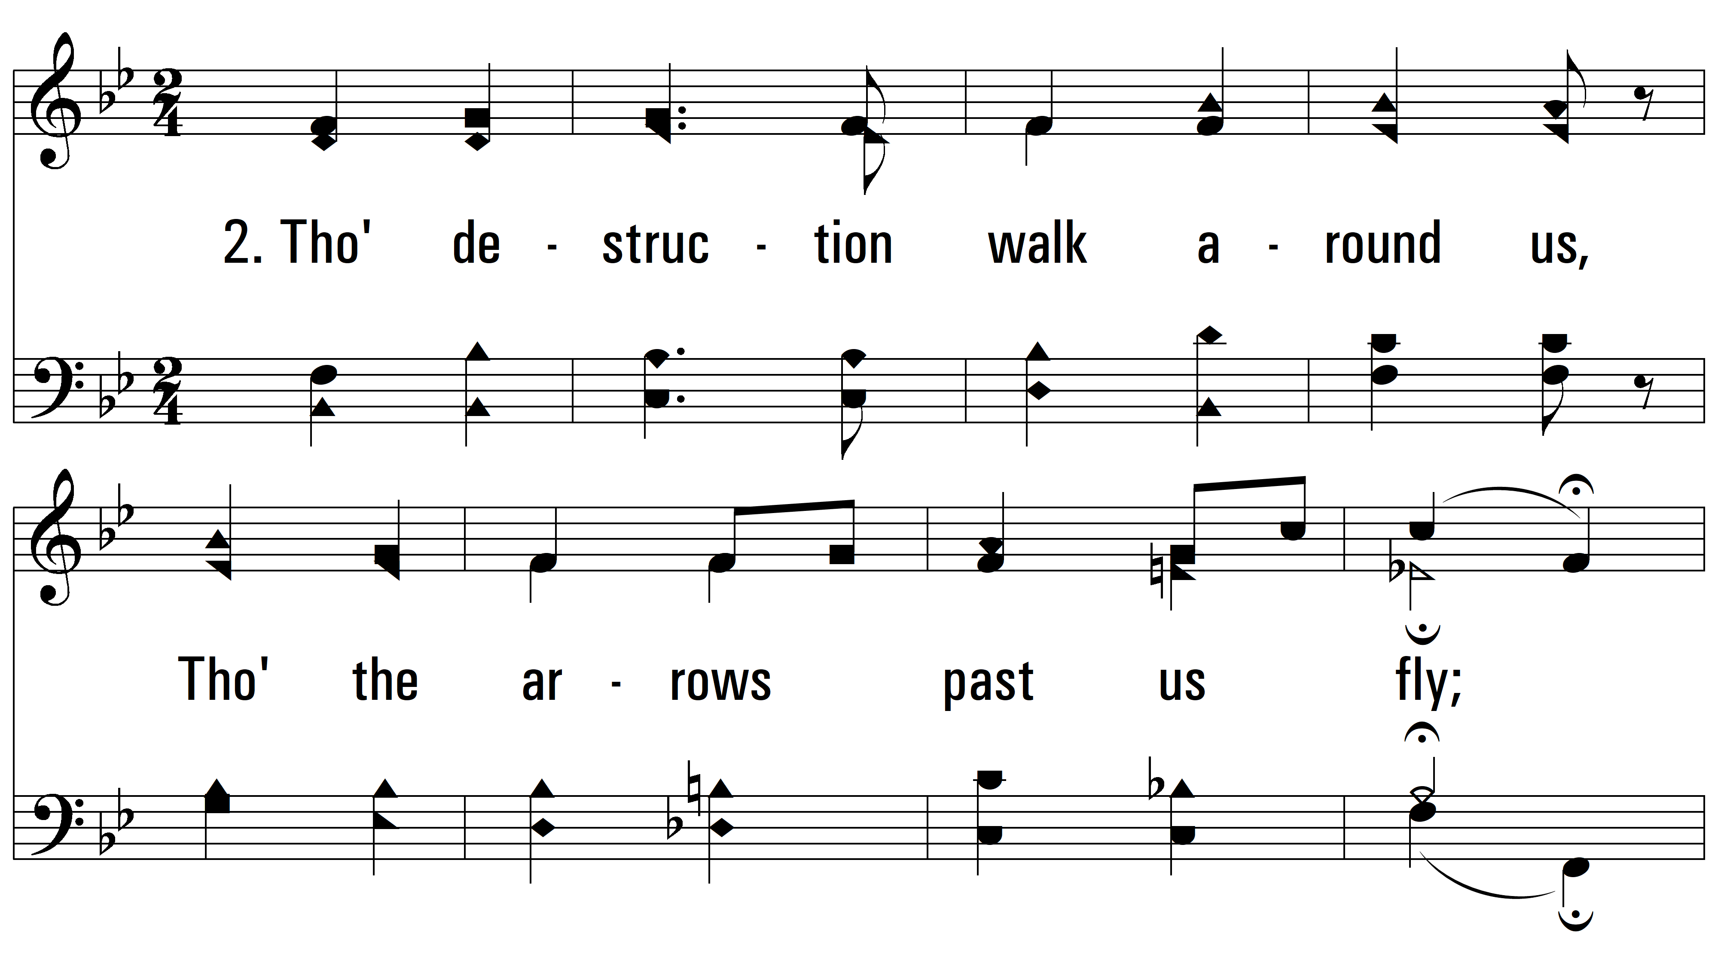
vs. 2~ Savior, Breathe An Evening Blessing

Slide 5
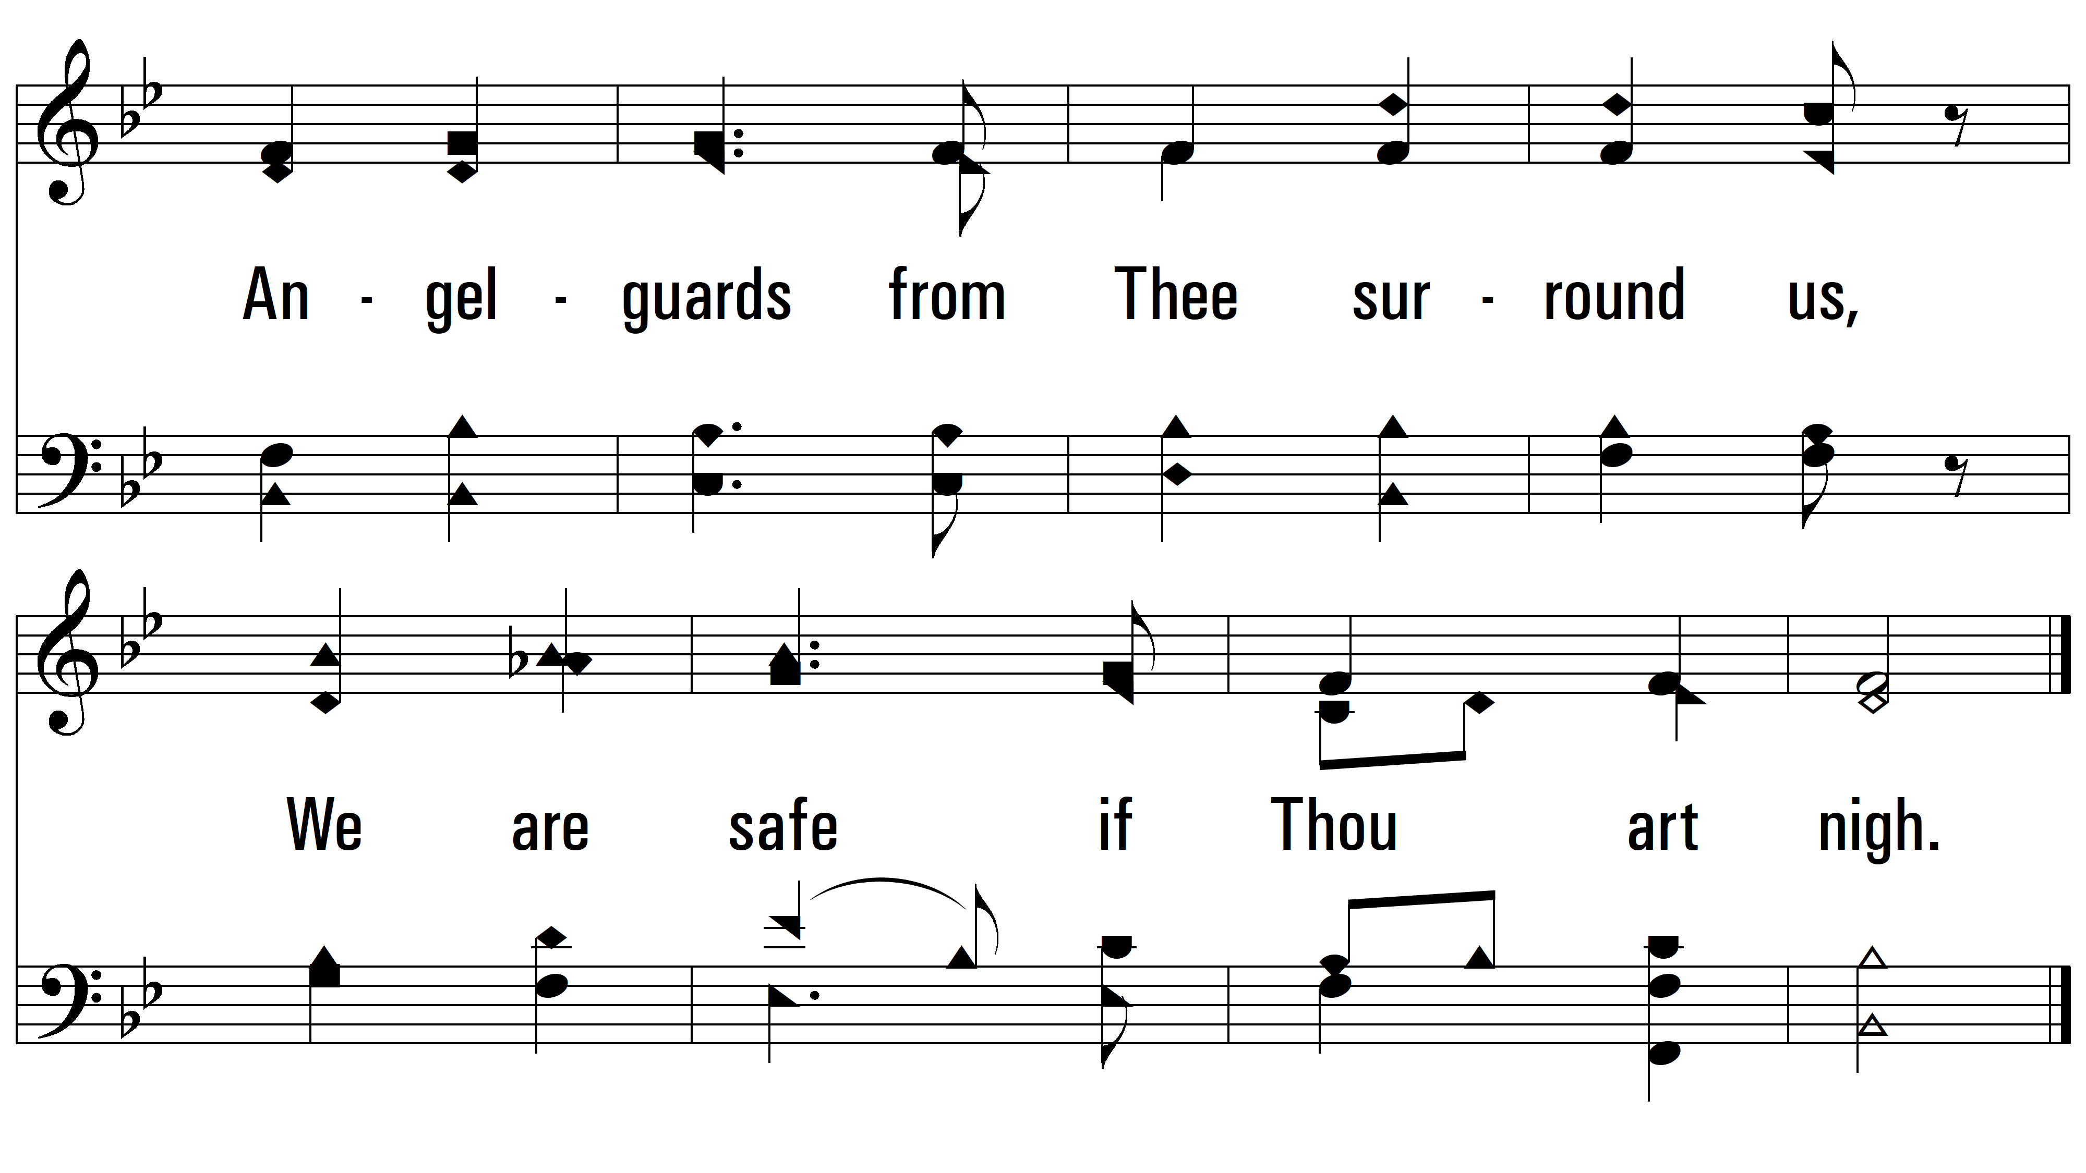
vs. 2

Slide 6
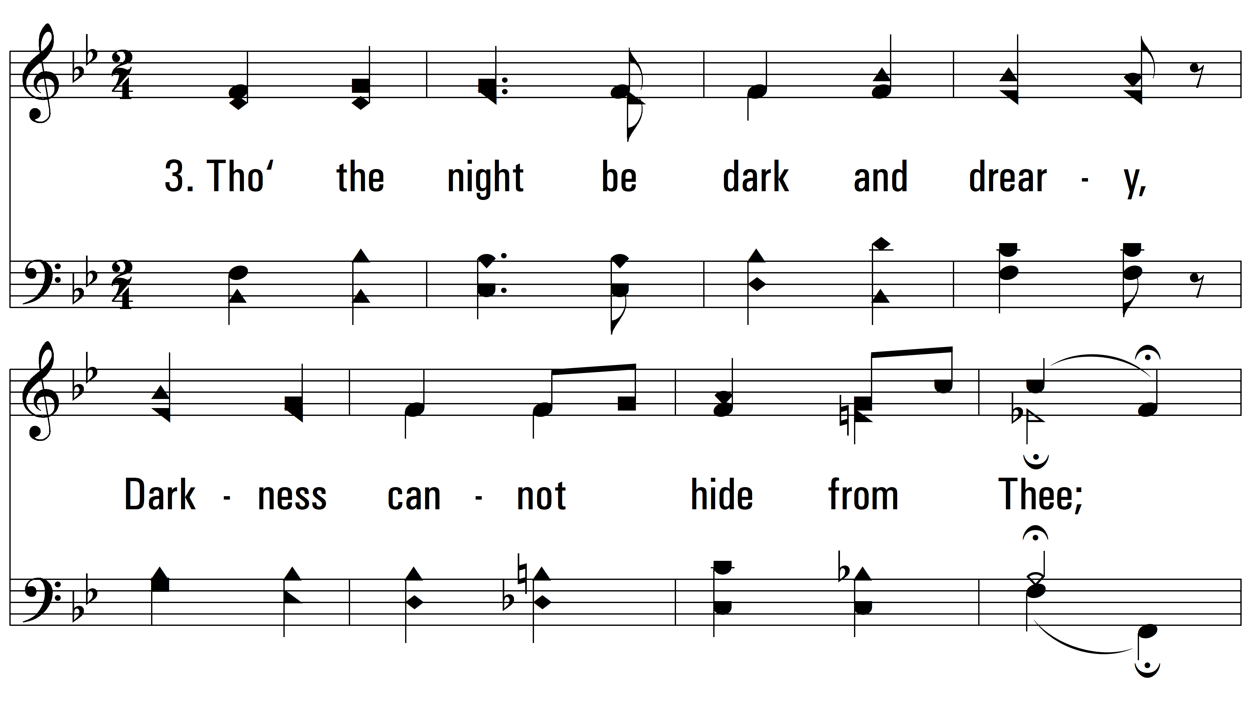
vs. 3 ~ Savior, Breathe An Evening Blessing

Slide 7
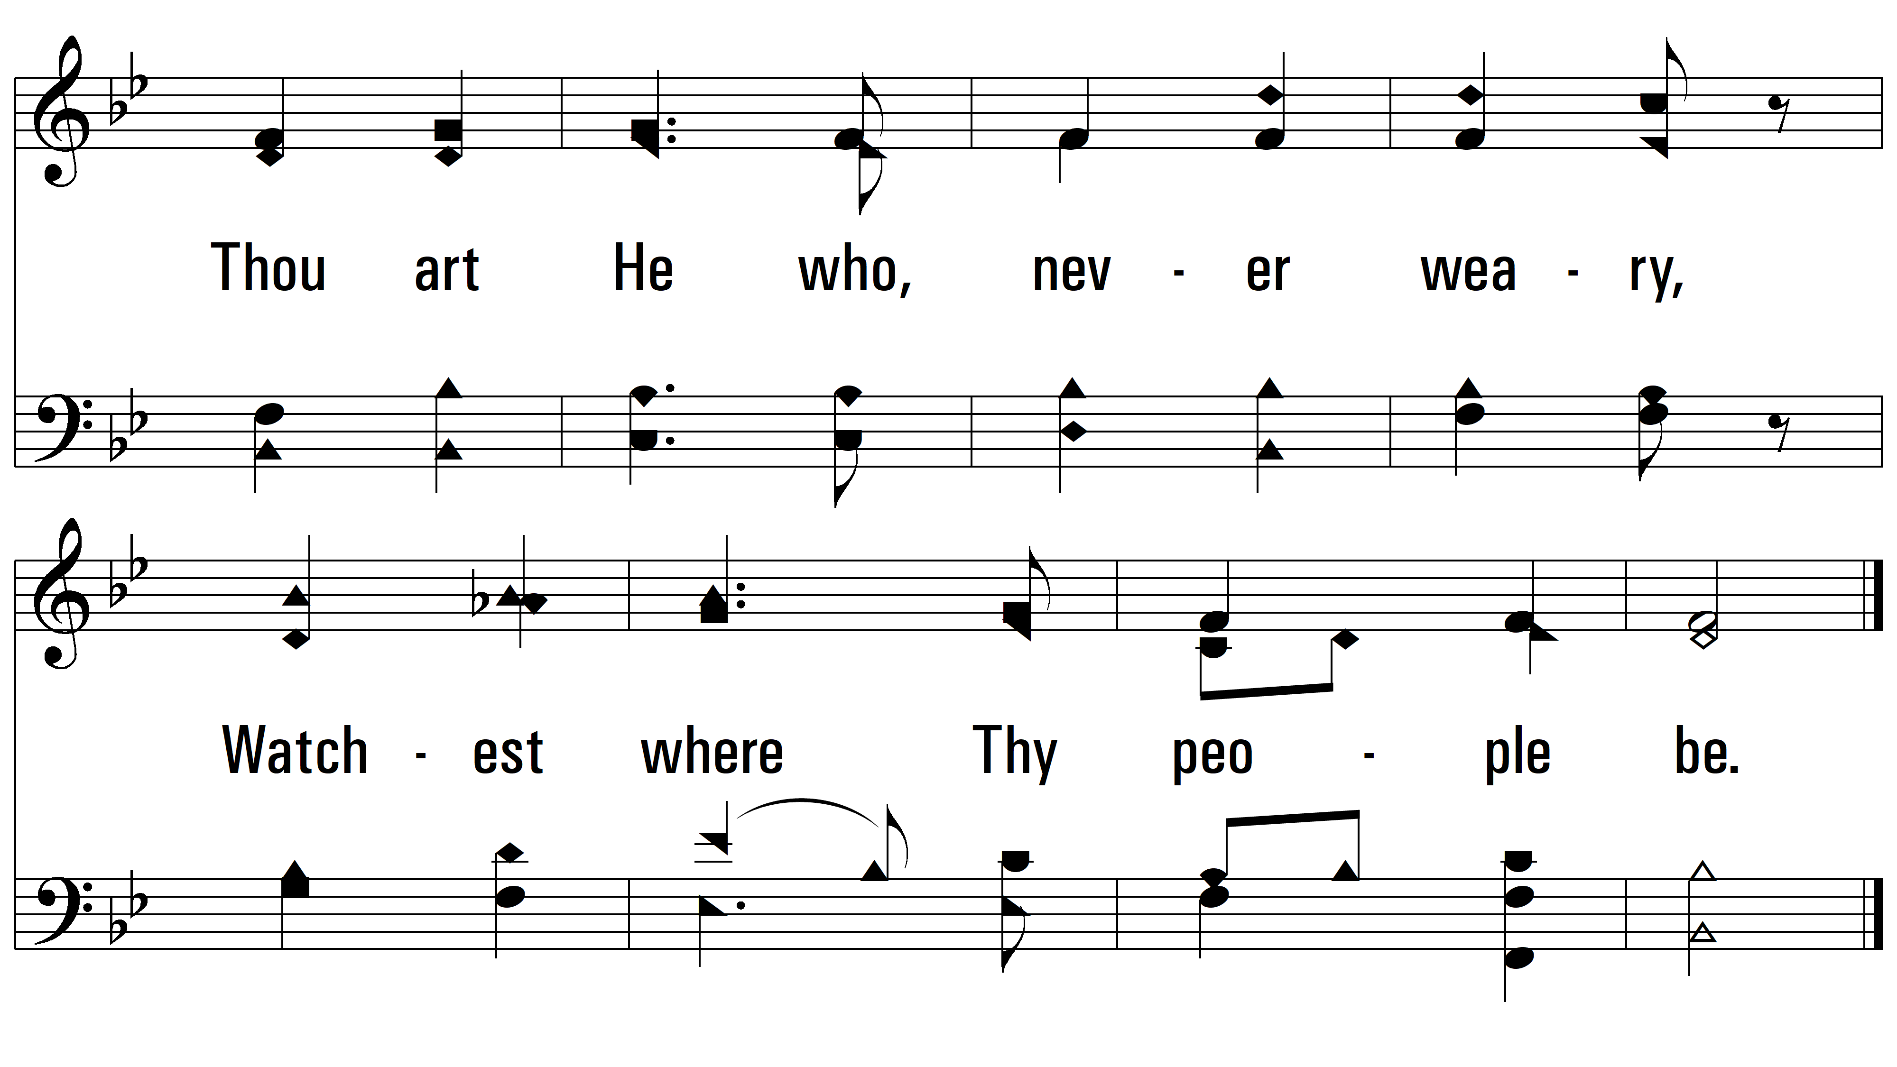
vs. 3

Slide 8
vs. 4 ~ Savior, Breathe An Evening Blessing

Slide 9
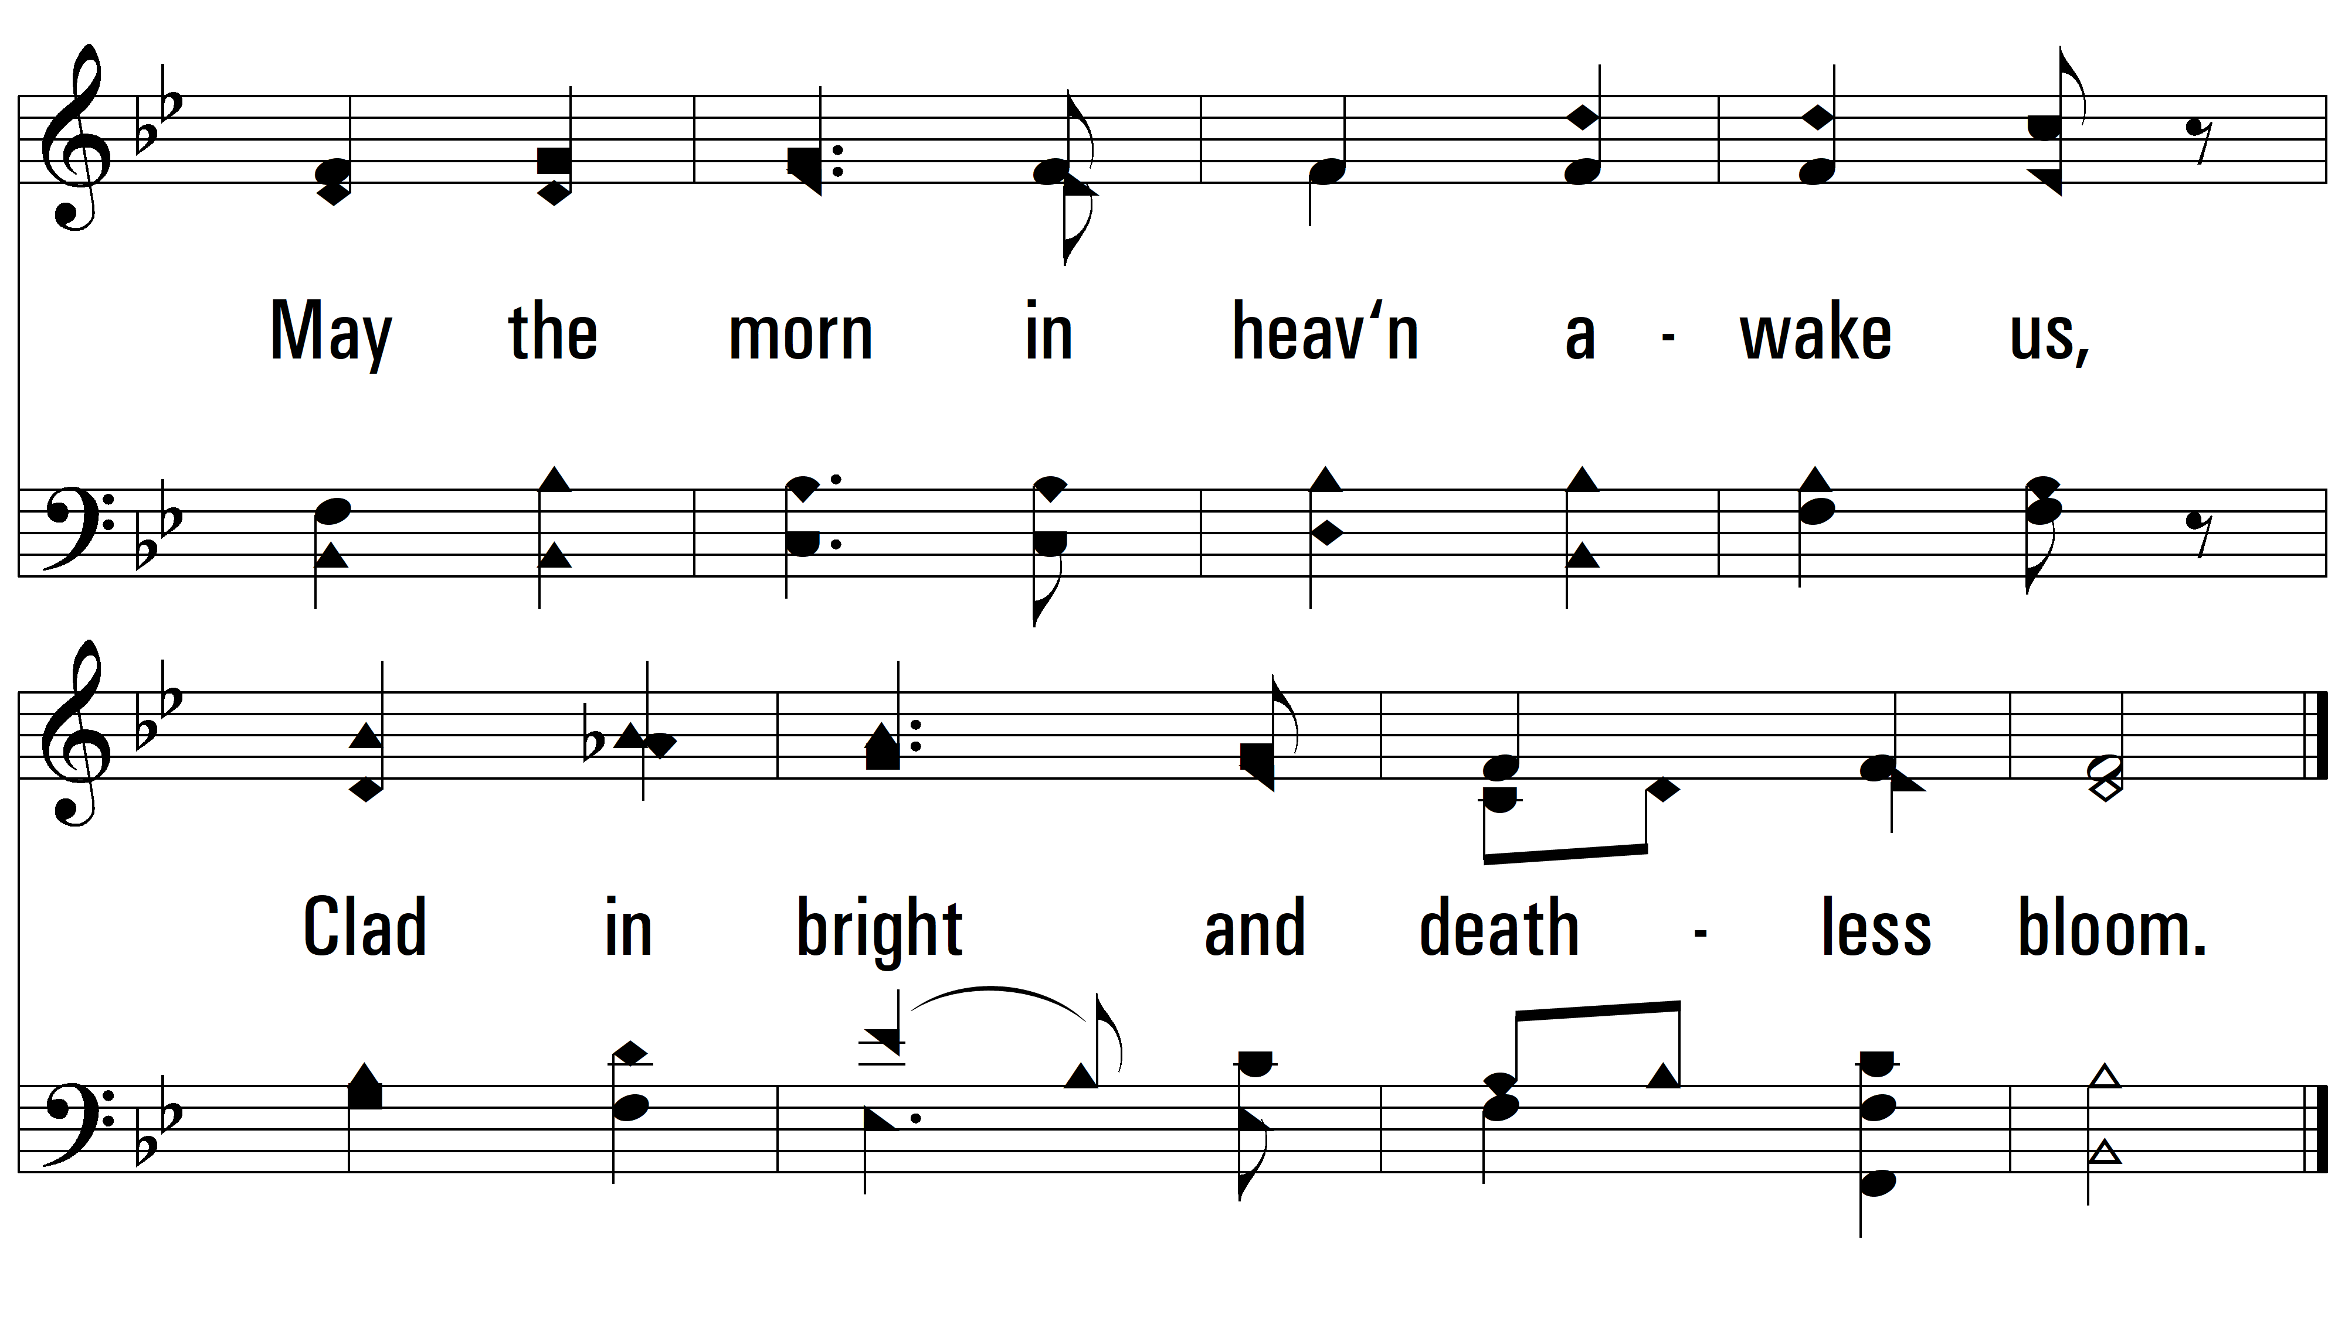
vs. 4
PDHymns.com
END

