Slide 1
Saved By The Blood Of The Crucified One
(Saved By The Blood)
Words: | S. J. Henderson (1903)
Music: | Daniel B. Towner (1903)
6/4
D/A - SOL
Verses: 4/Chorus
Lead - | SOL
Alto - | DO
Tenor - | MI
Bass - | DO
PDHymns.com

Slide 2
vs. 1 ~ Saved By The Blood Of The Crucified One

Slide 3
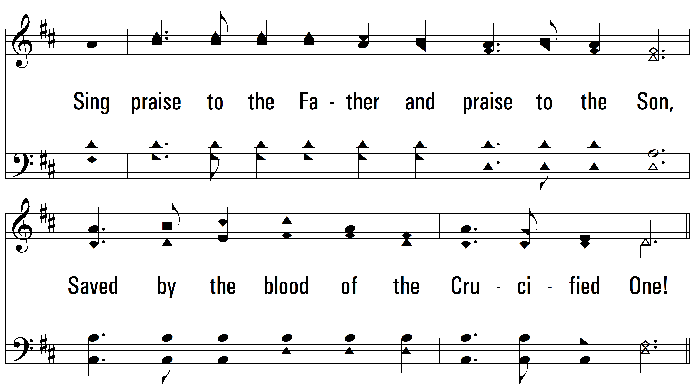
vs. 1

Slide 4
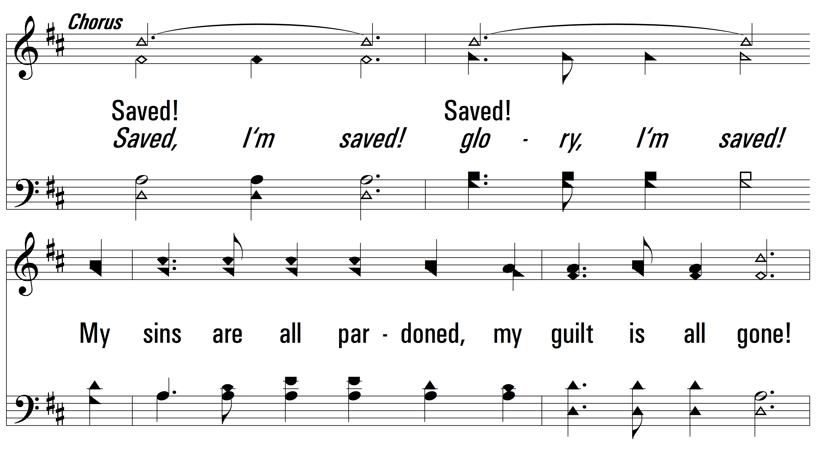
vs. 1

Slide 5
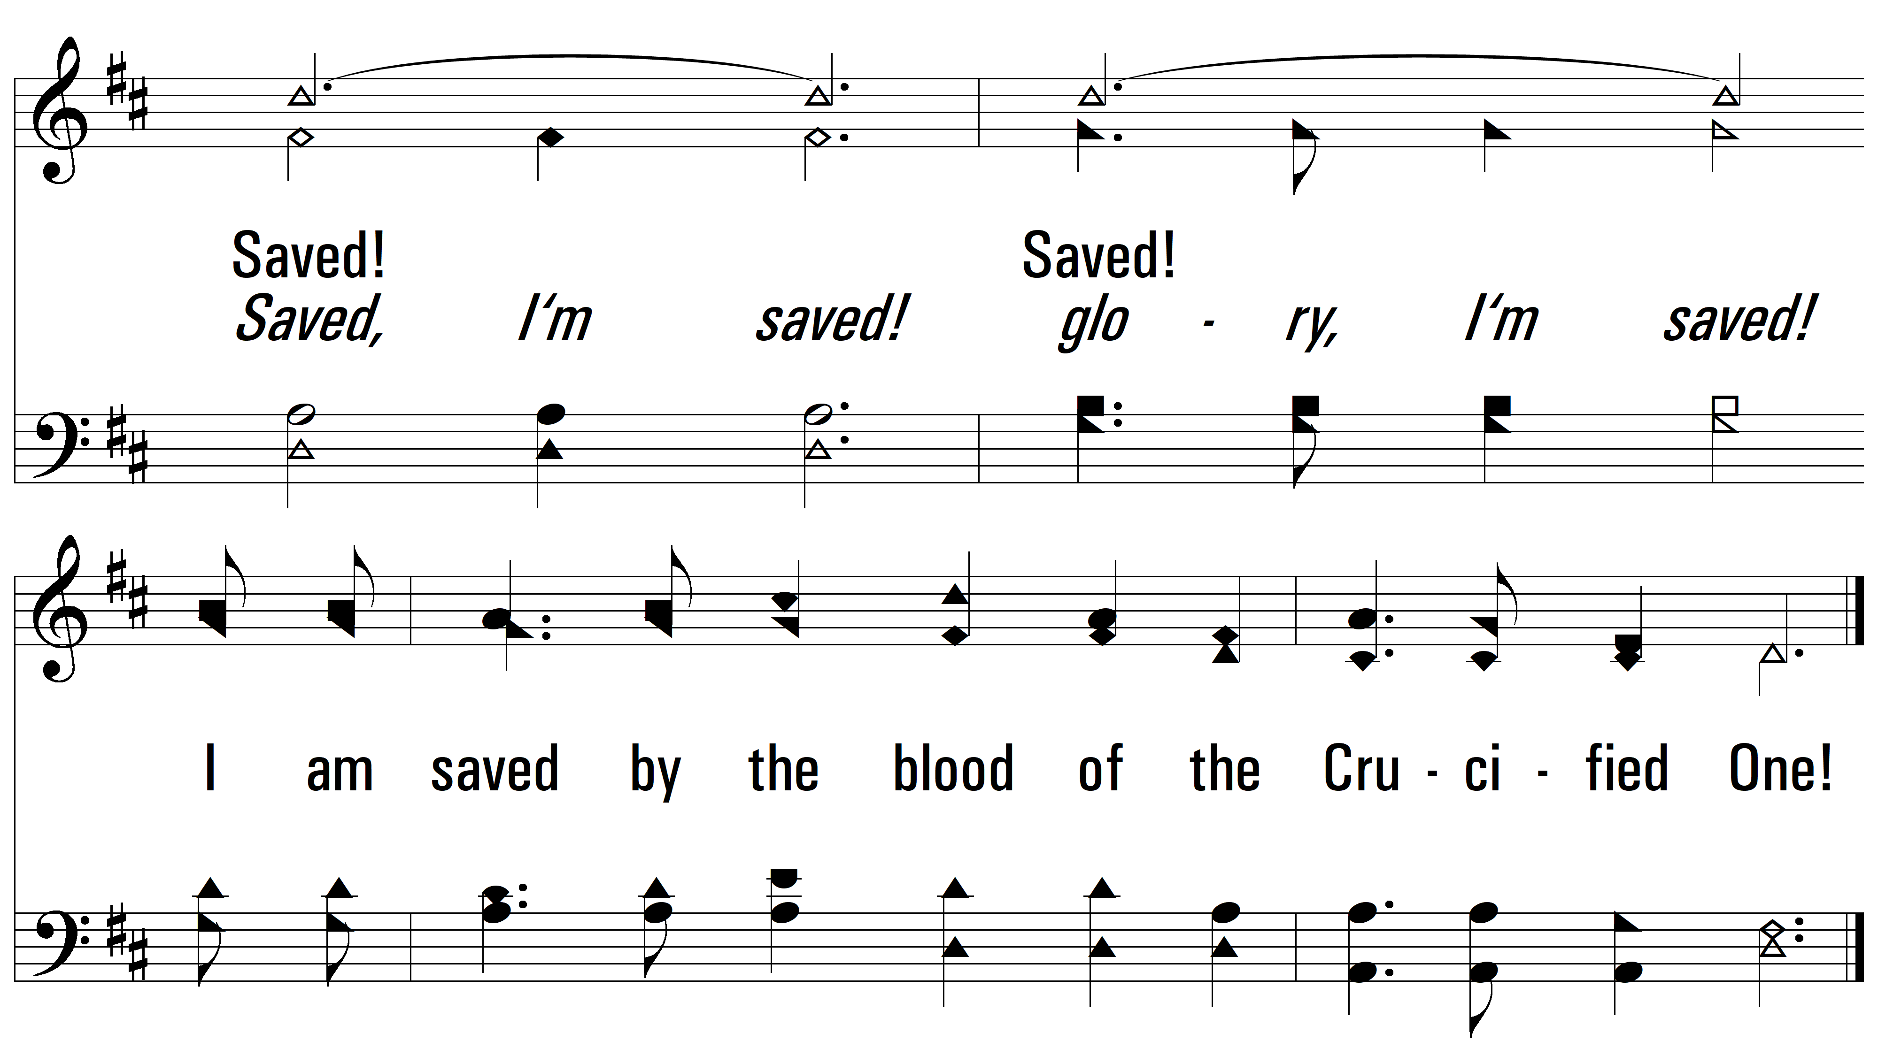
vs. 1

Slide 6
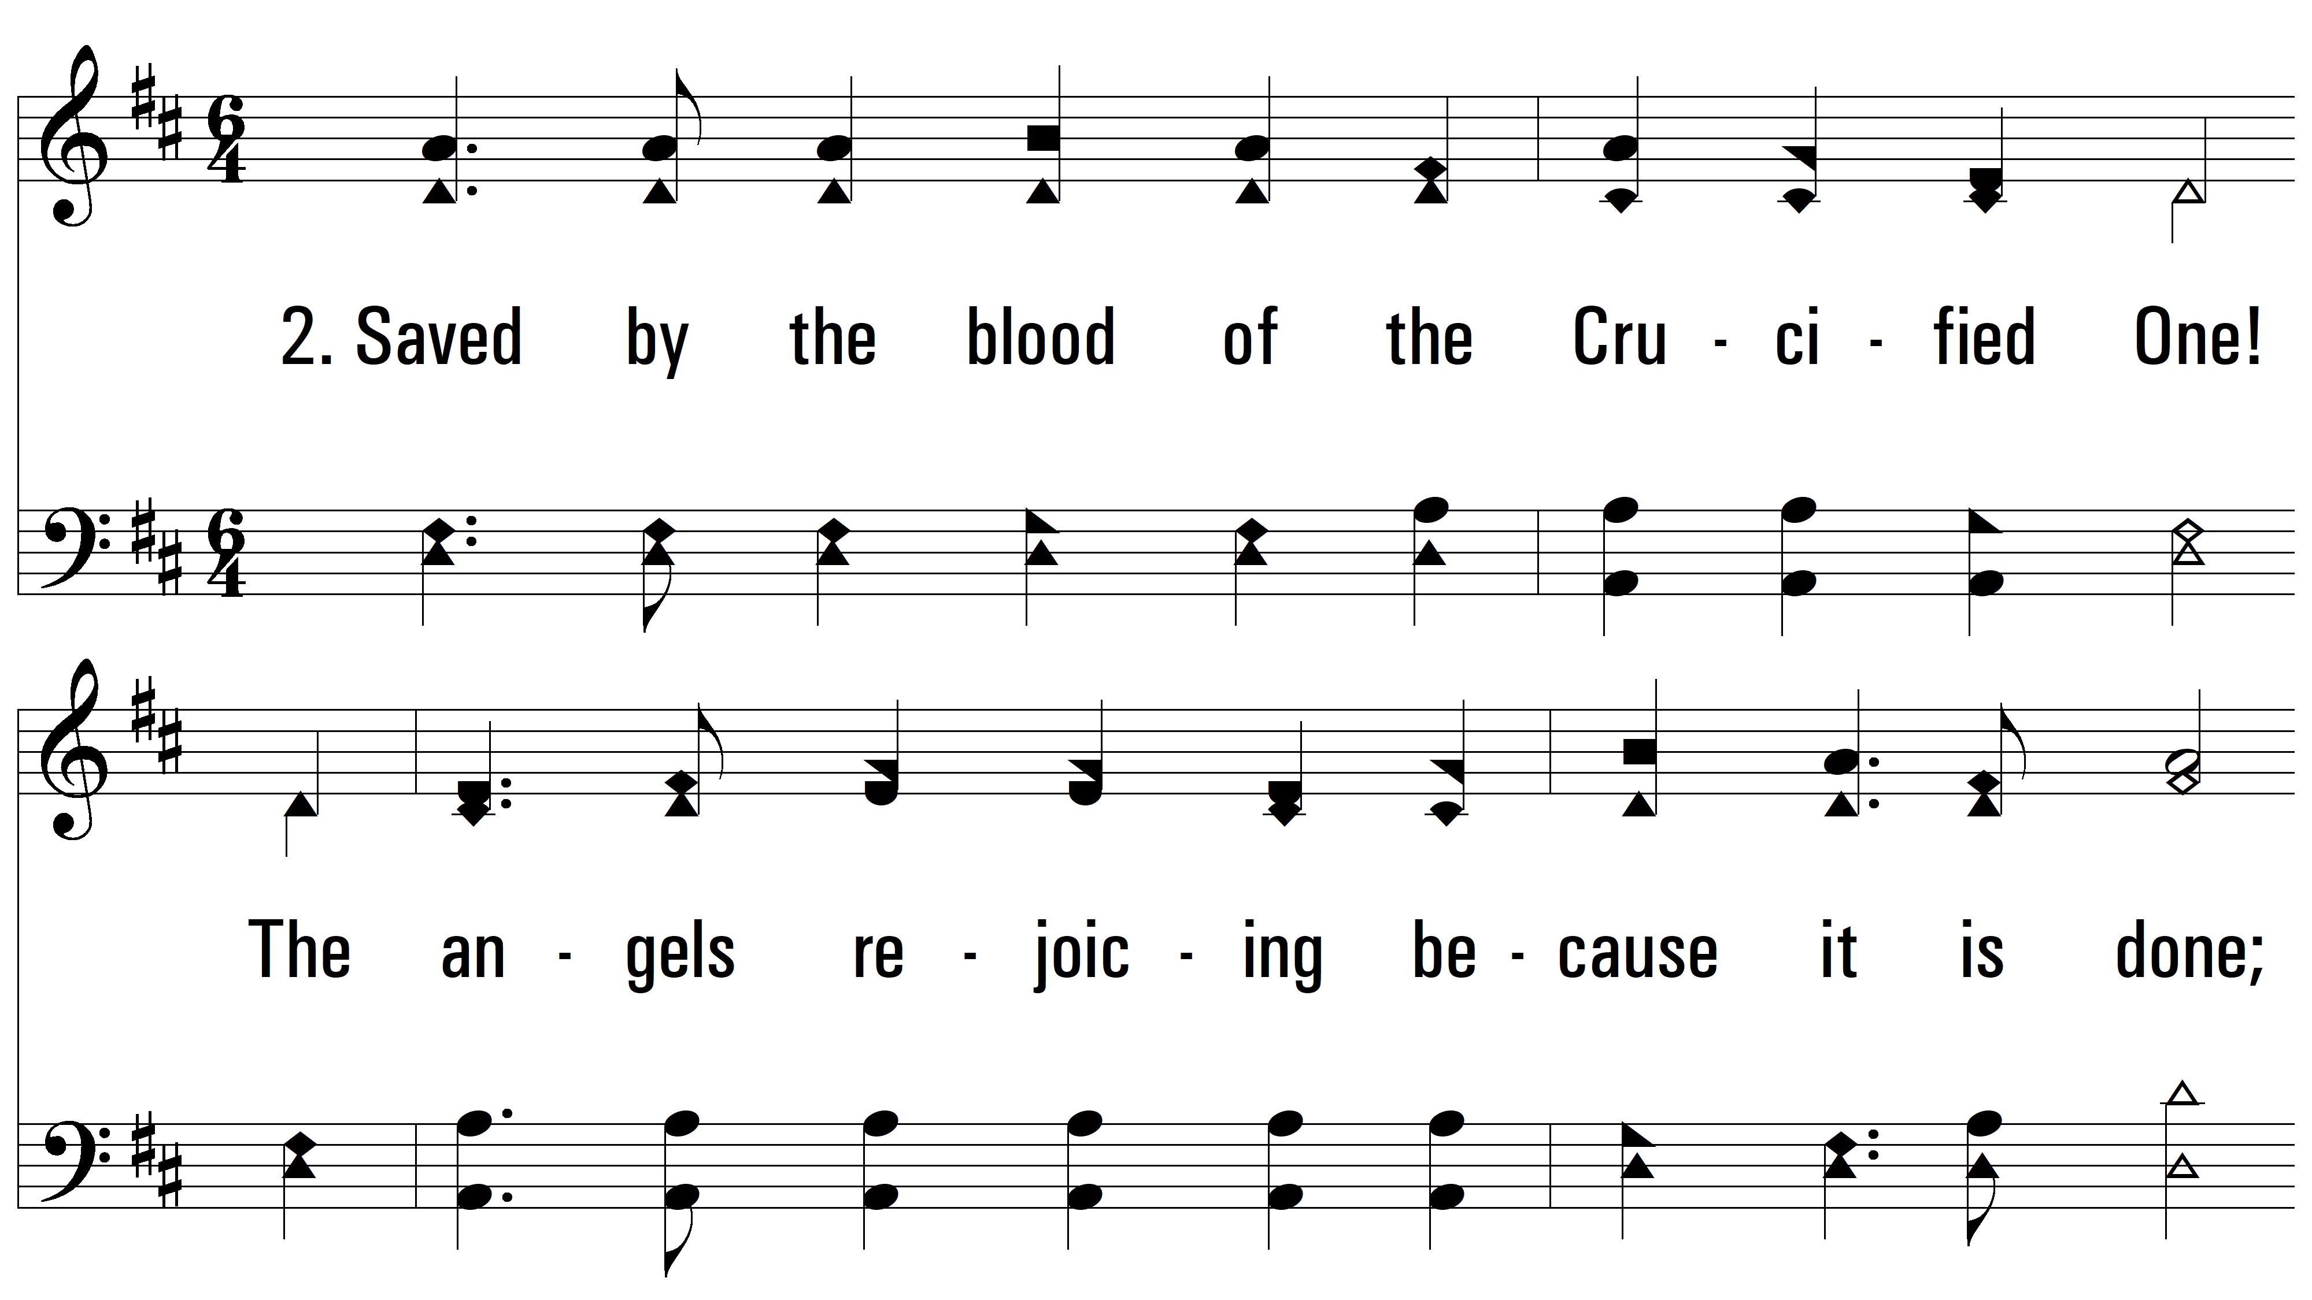
vs. 2 ~ Saved By The Blood Of The Crucified One

Slide 7
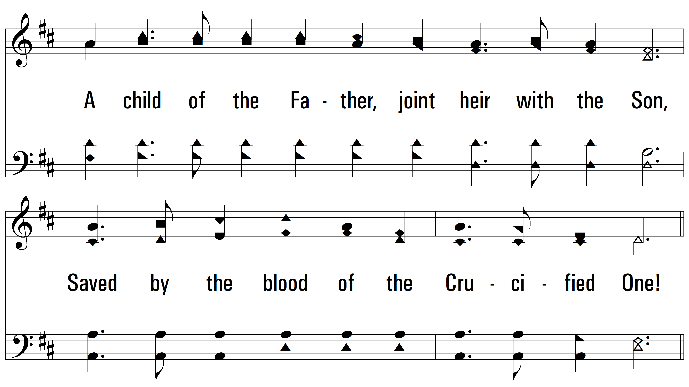
vs. 2

Slide 8
vs. 2

Slide 9
vs. 2

Slide 10
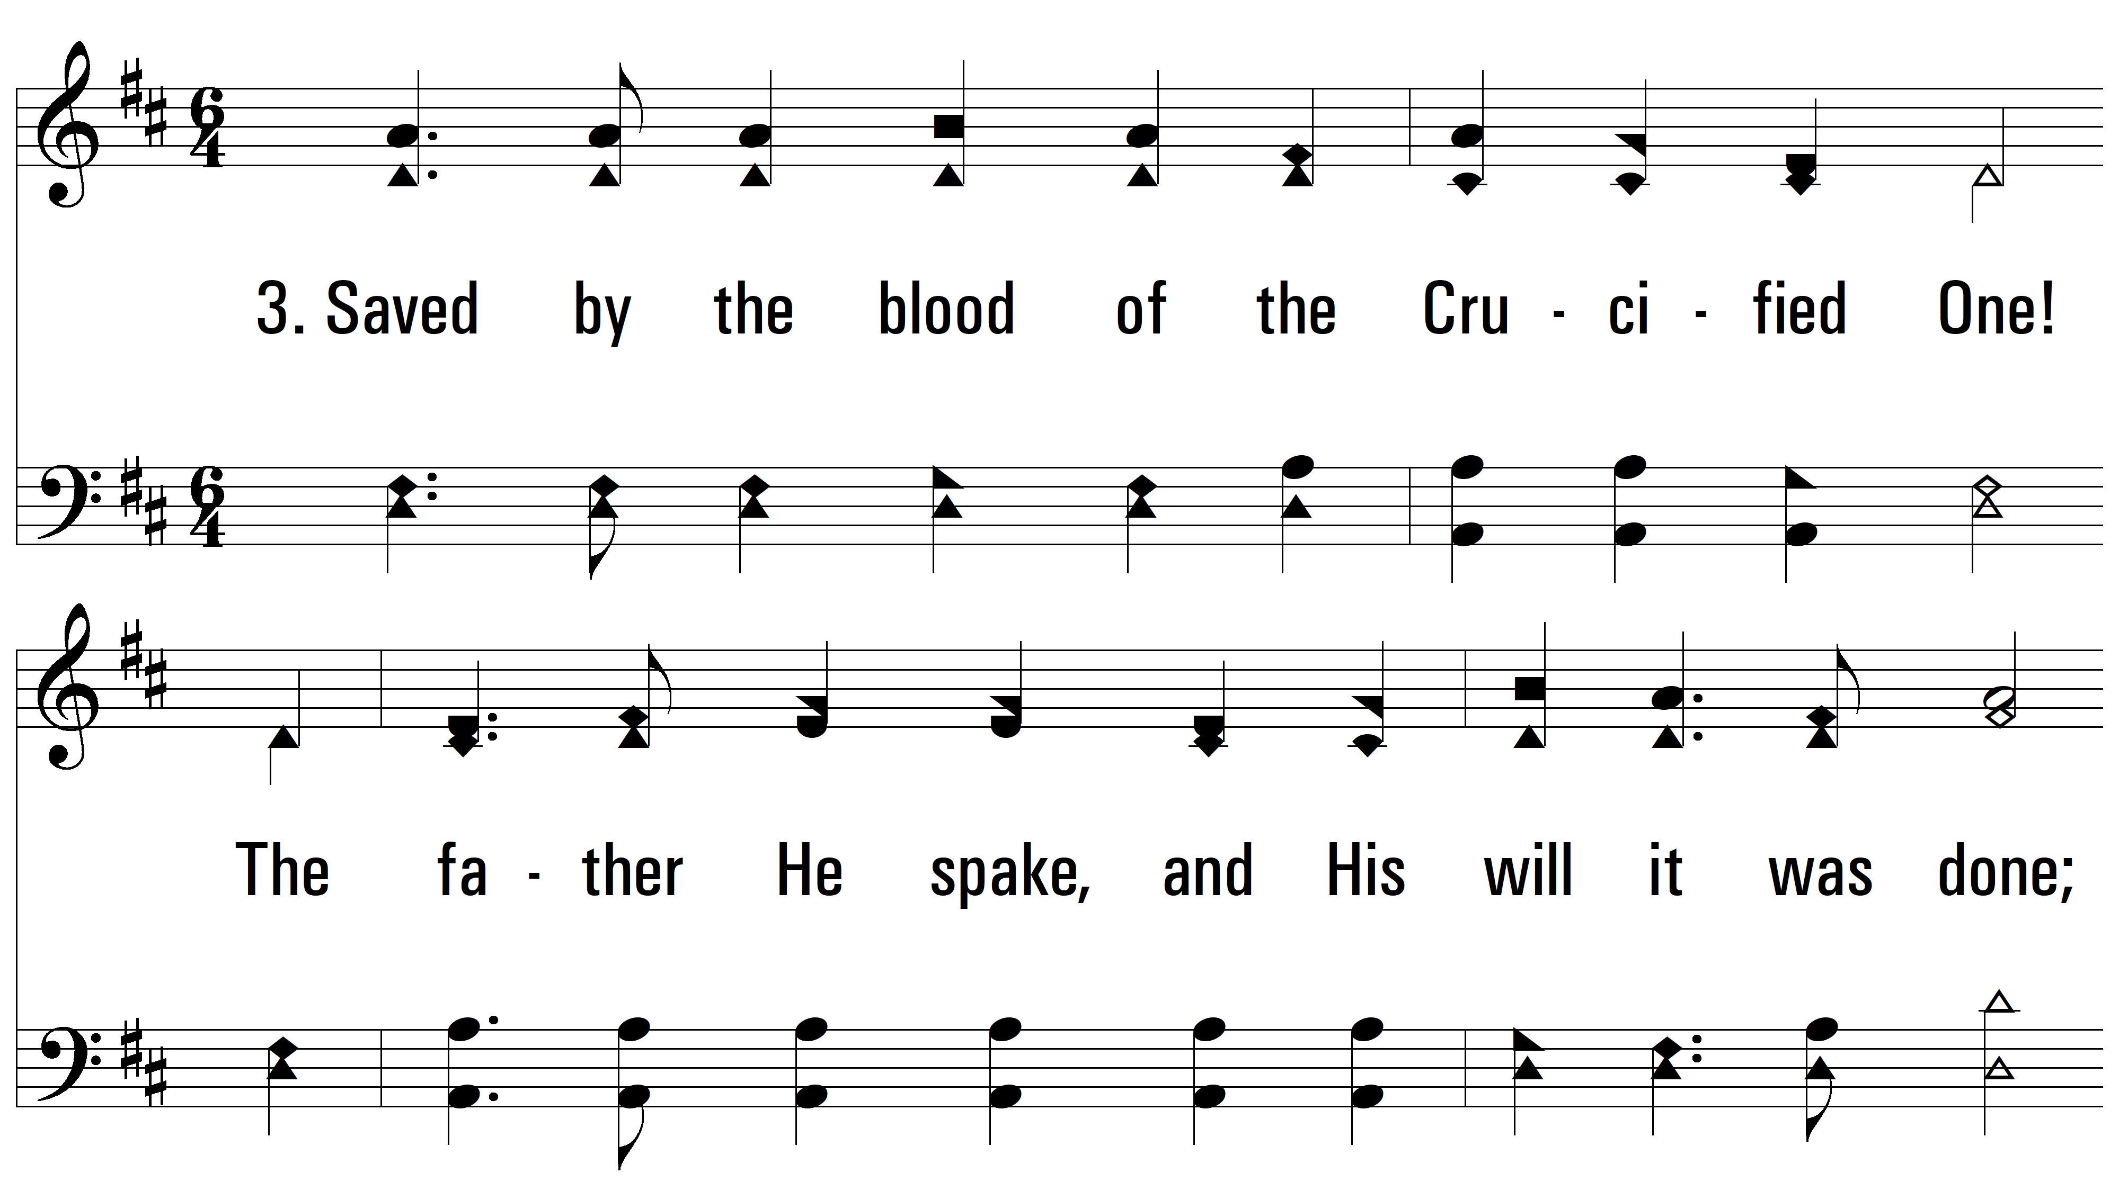
vs. 3 ~ Saved By The Blood Of The Crucified One

Slide 11
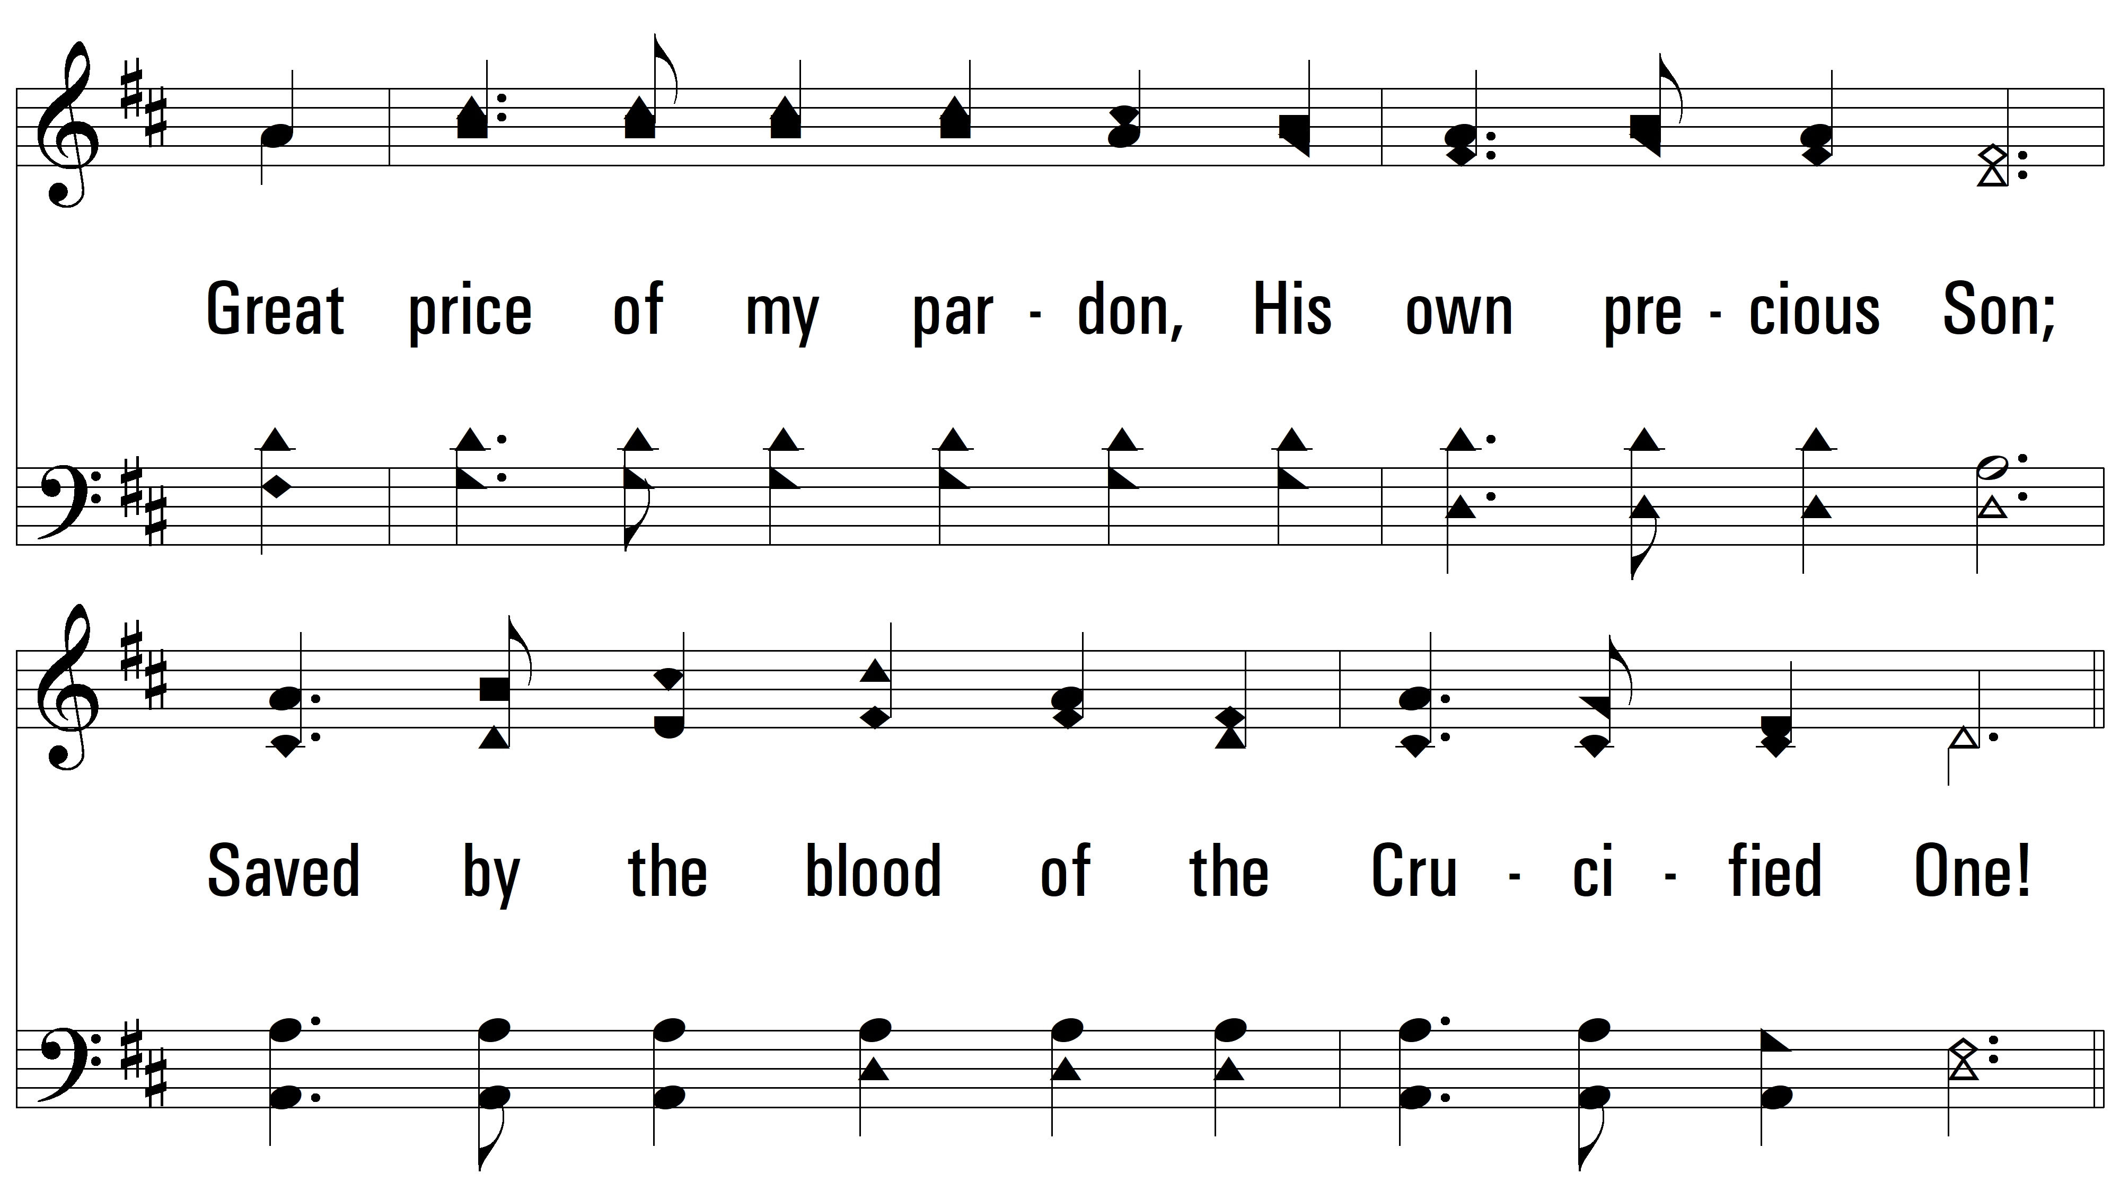
vs. 3

Slide 12
vs. 3

Slide 13
vs. 3

Slide 14
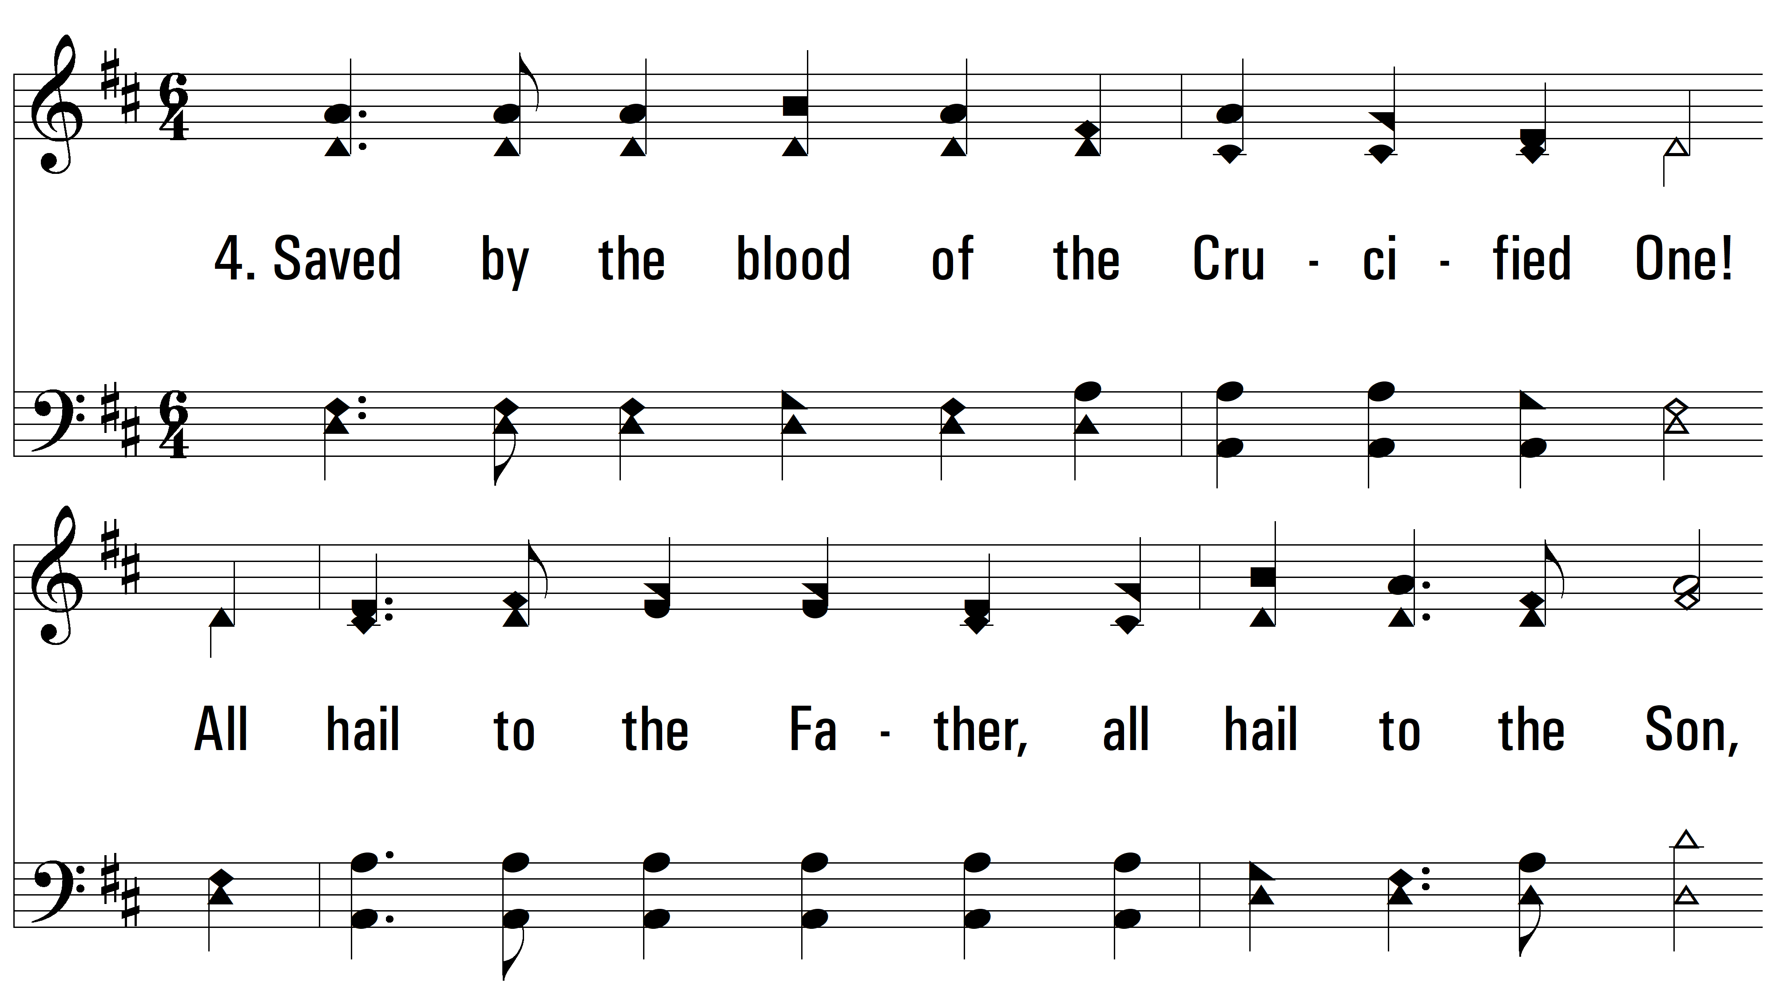
vs. 4 ~ Saved By The Blood Of The Crucified One

Slide 15
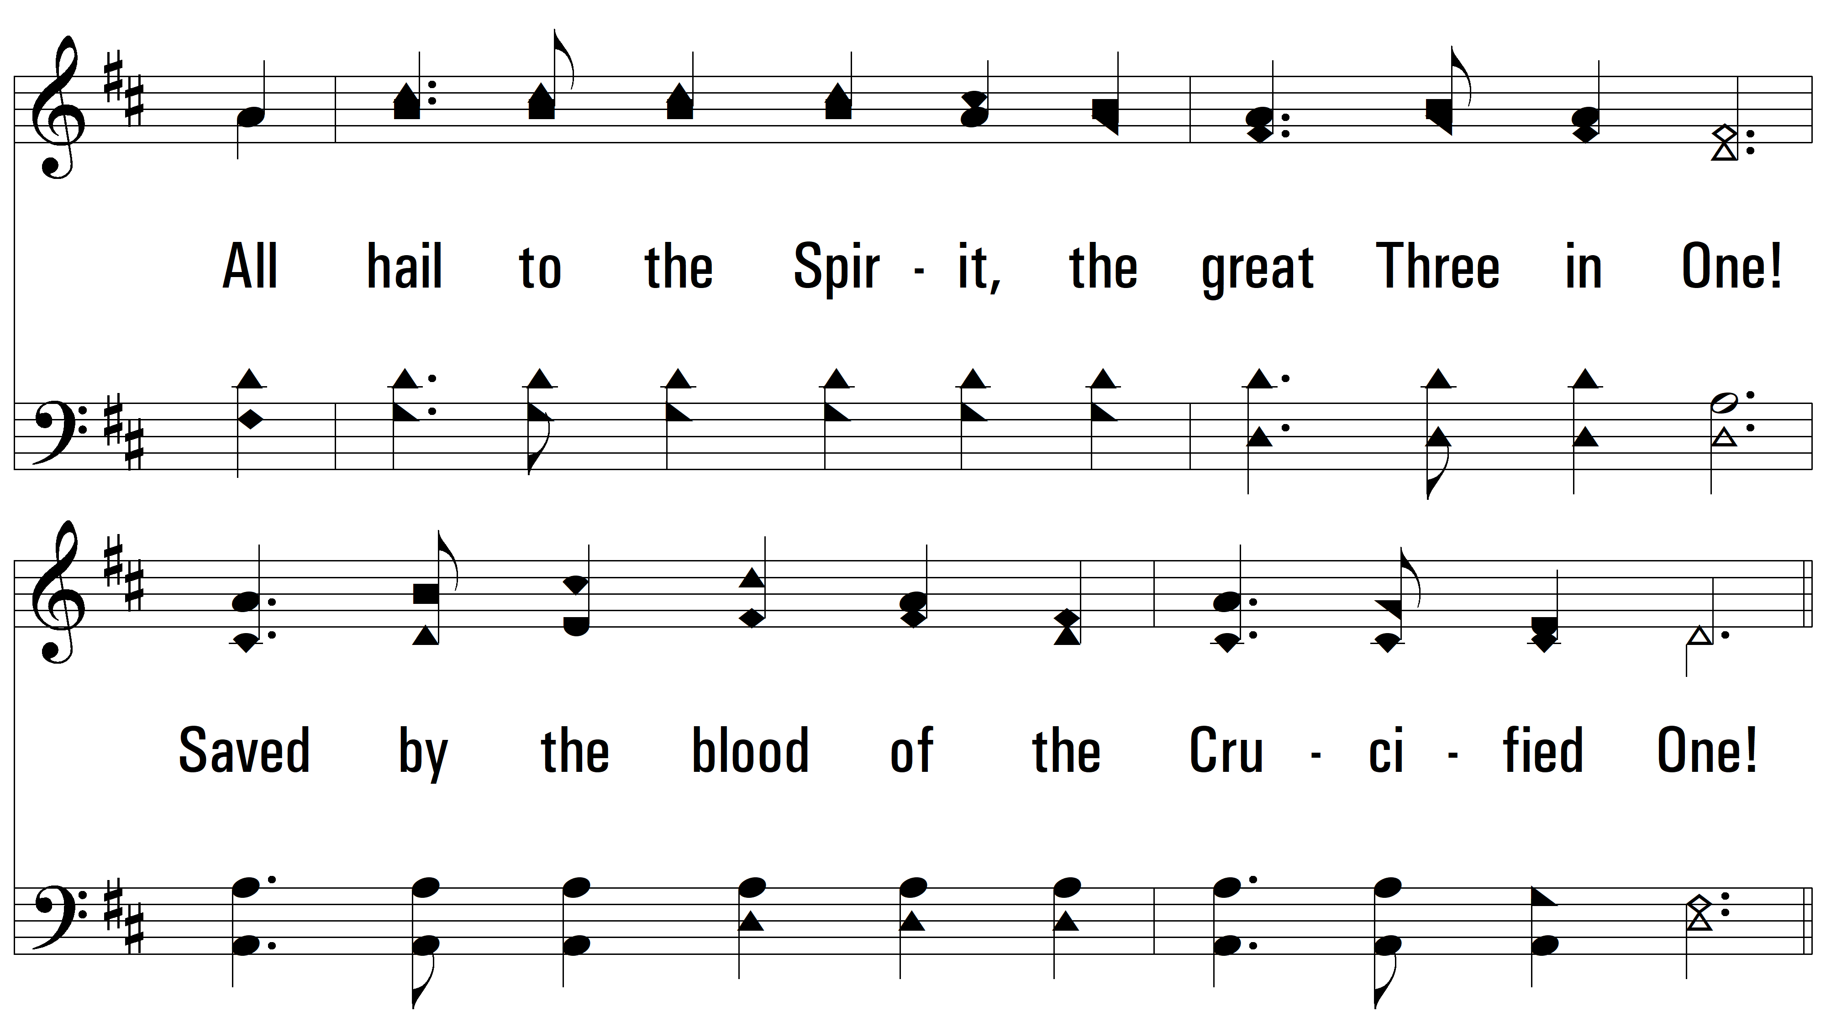
vs. 4

Slide 16
vs. 4

Slide 17
vs. 4
PDHymns.com
END

