Slide 1
Safe In The Harbor
Words: | Sharon Cummings
Music: | Tillit S. Teddlie
6/4
F/A - MI
Verses: 3
Lead - | MI
Alto - | DO
Tenor - | SOL
Bass - | DO
PDHymns.com

Slide 2
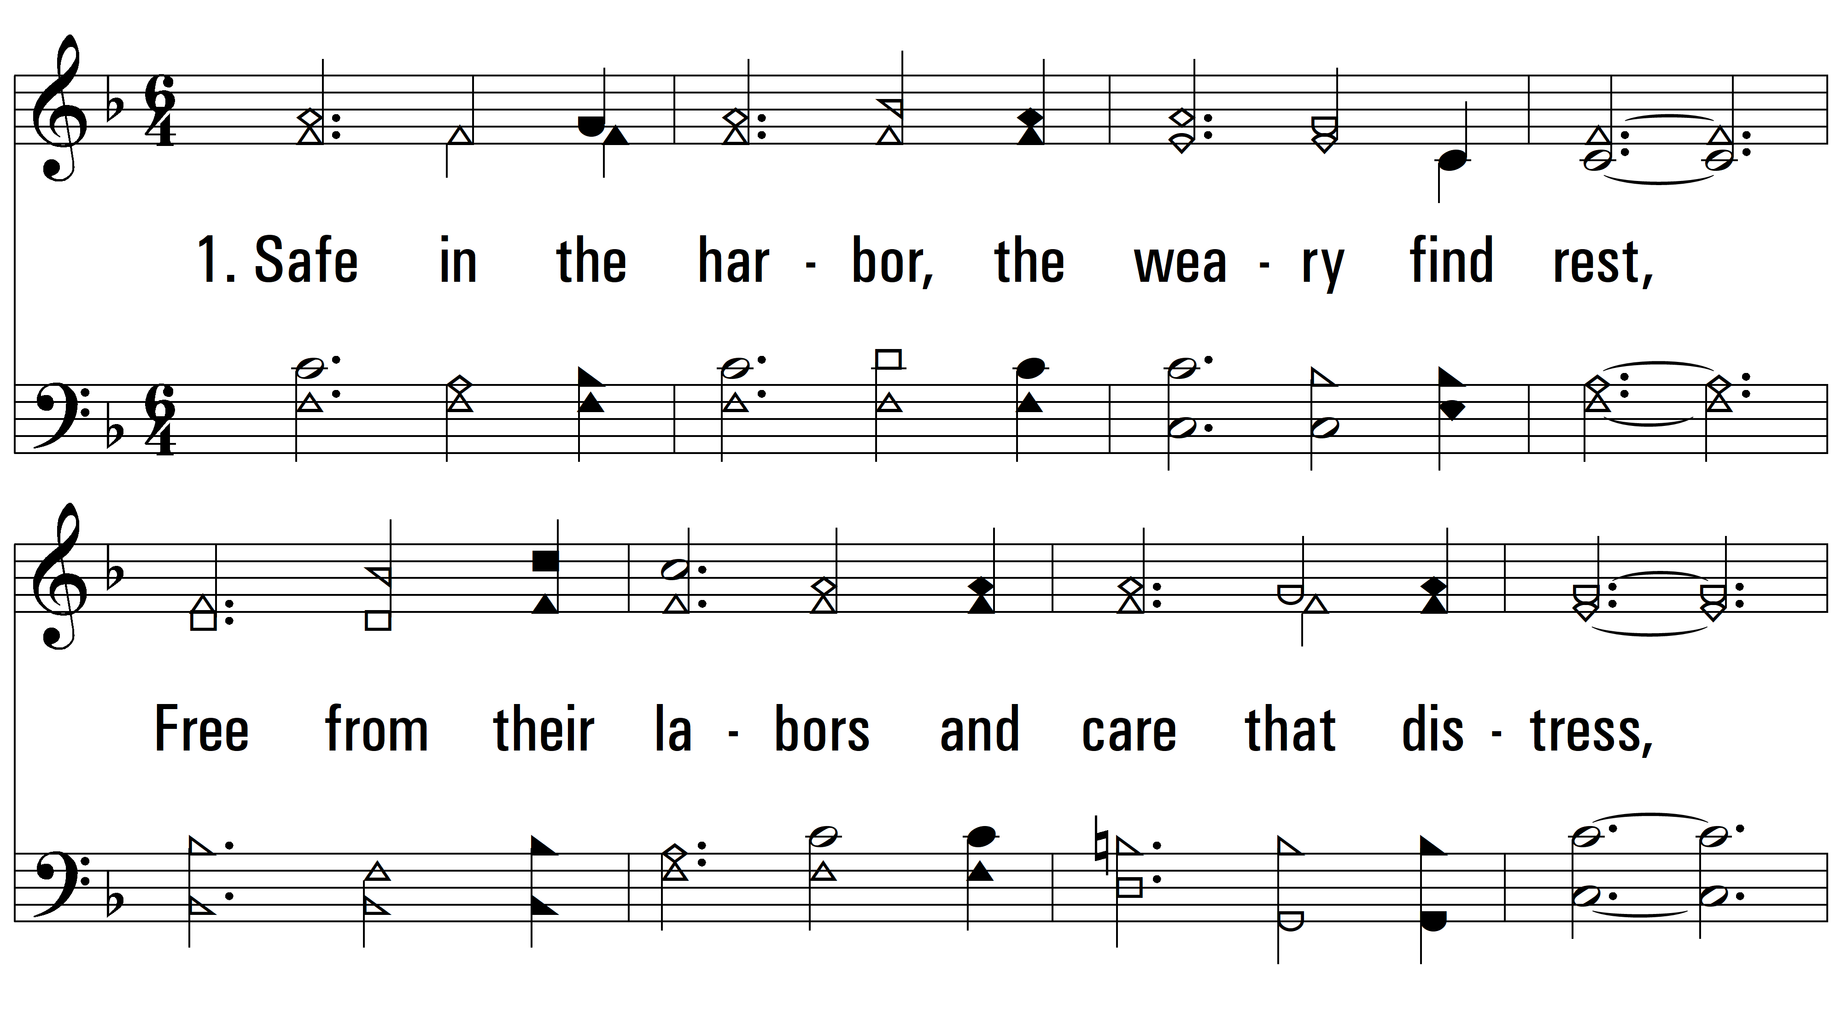
vs. 1 ~ Safe In The Harbor

Slide 3
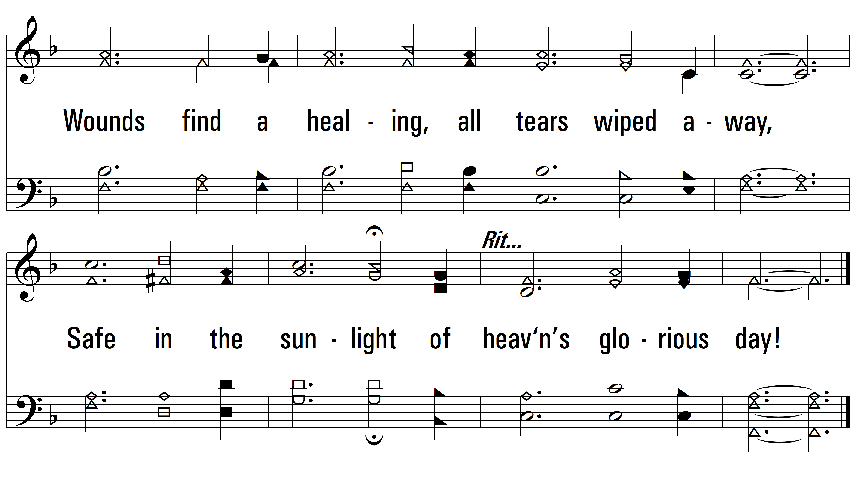
vs. 1

Slide 4
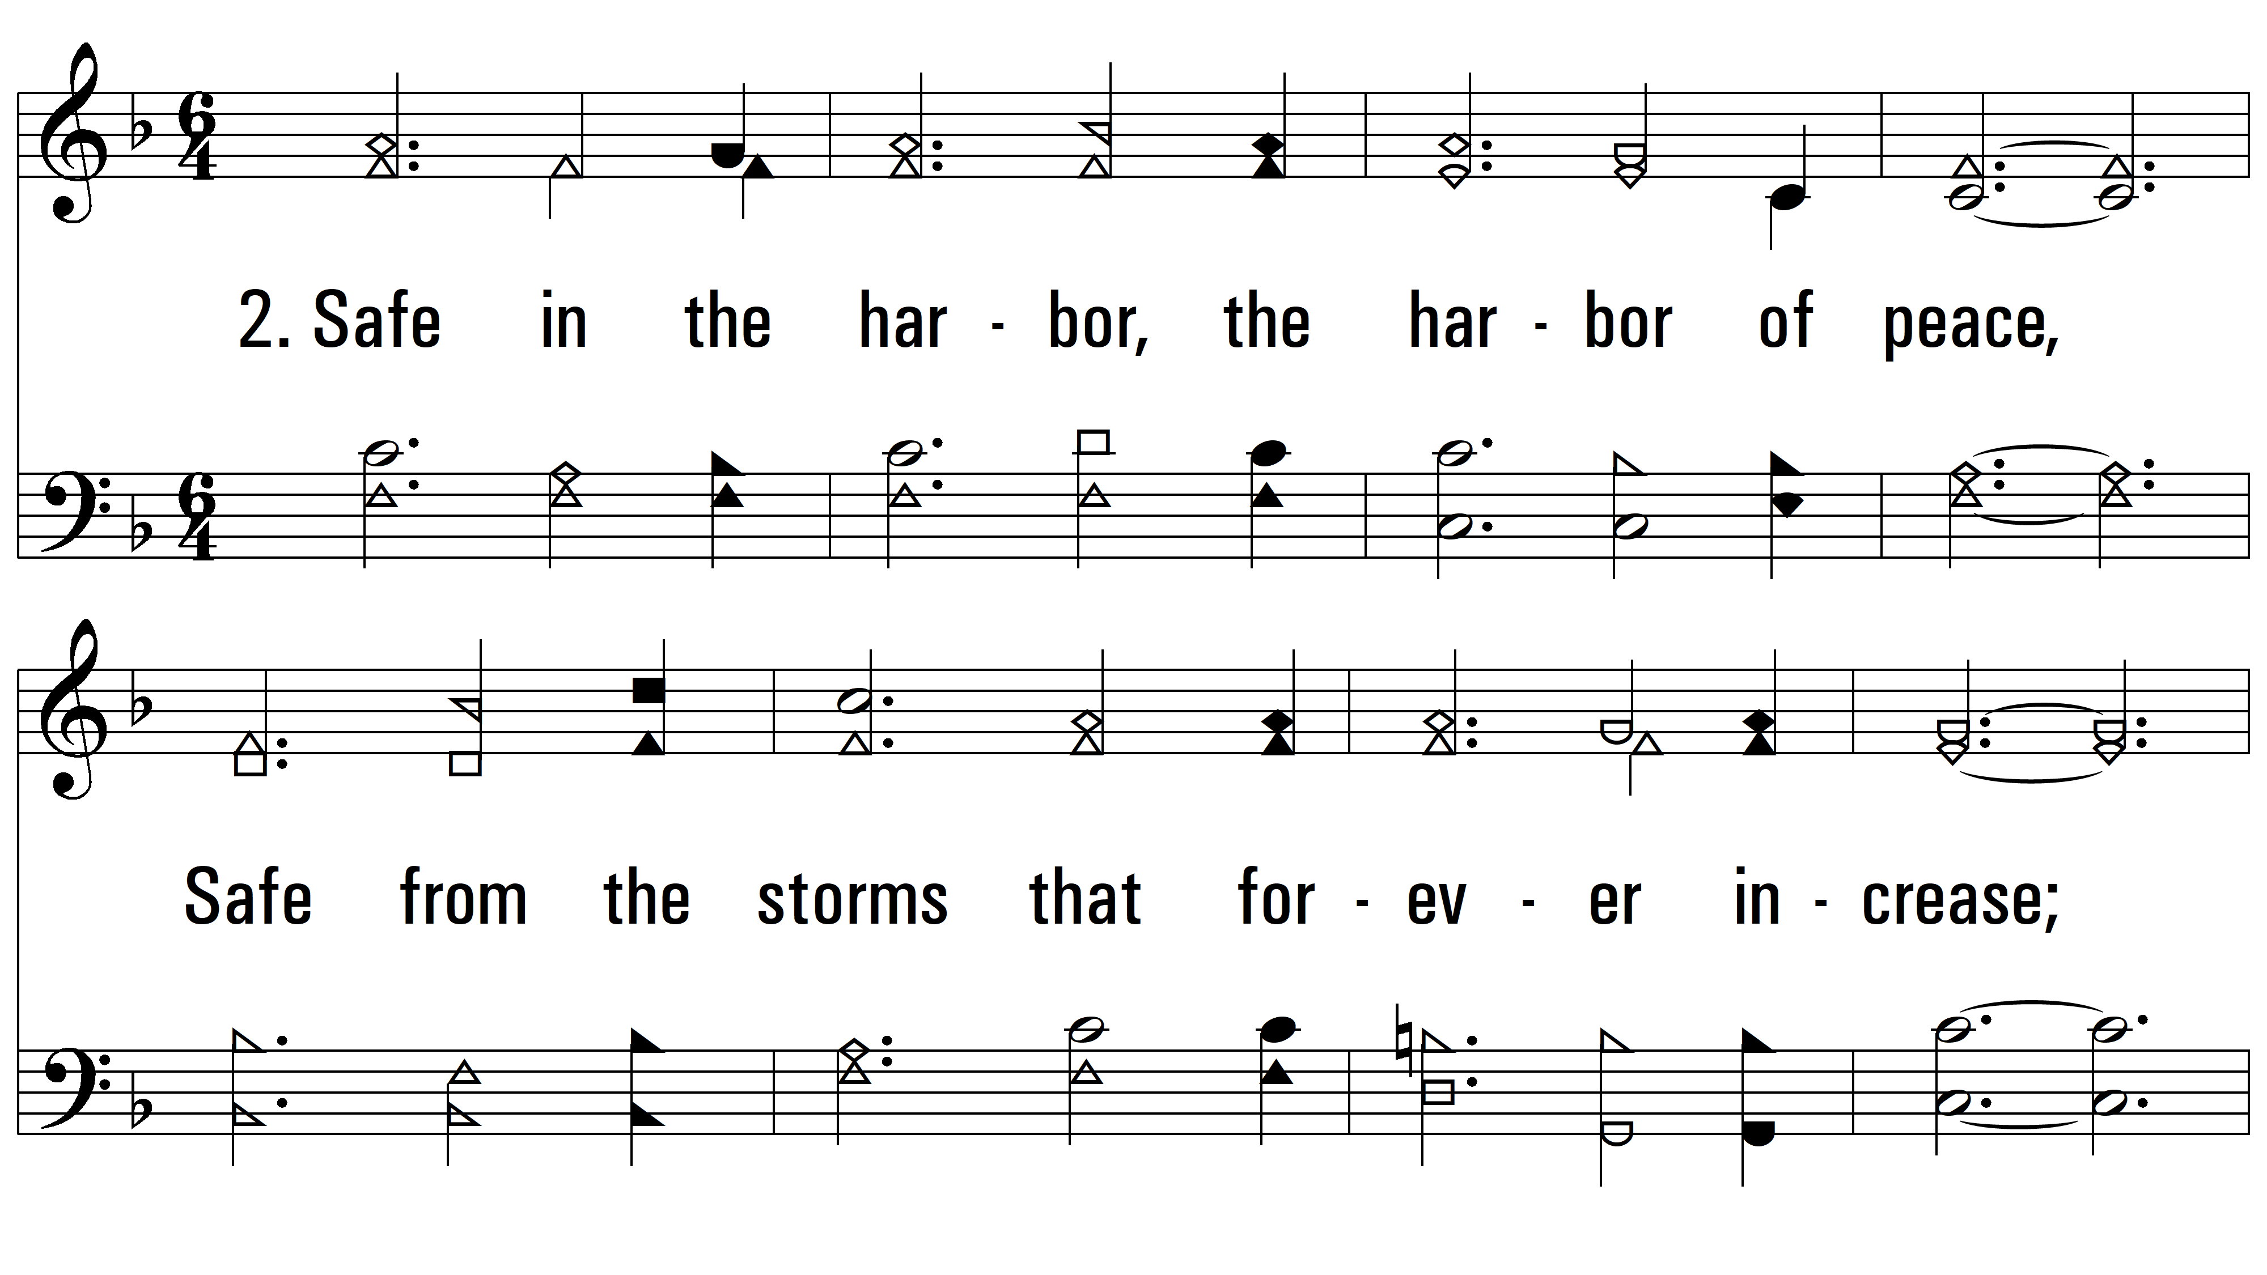
vs. 2 ~ Safe In The Harbor

Slide 5
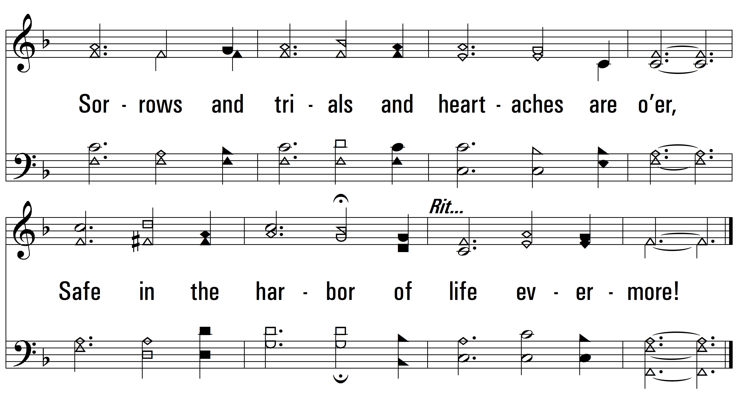
vs. 2

Slide 6
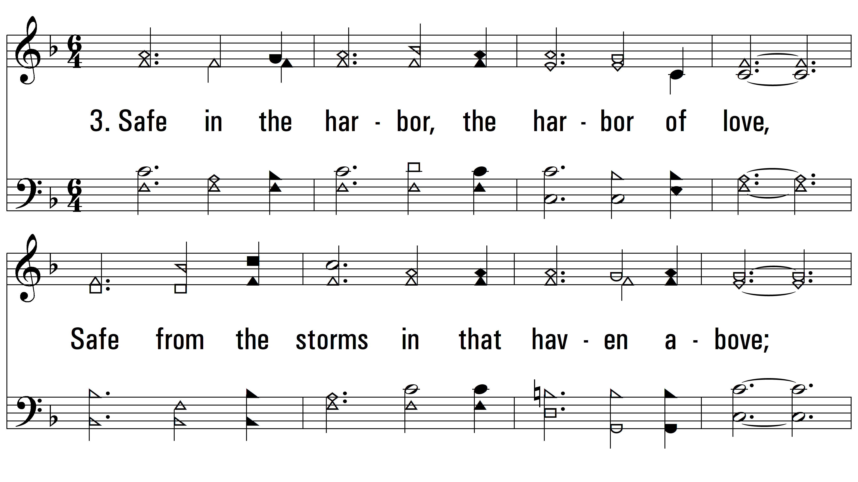
vs. 3 ~ Safe In The Harbor

Slide 7
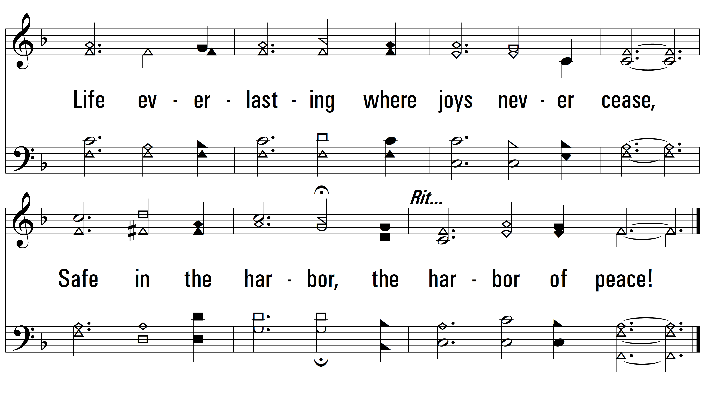
vs. 3
PDHymns.com
END

