Slide 1
Rock Of Ages
TOPLADY
7.7.7.7.7.7
Words: | Augustus M. Toplady (1776)
Music: | Thomas Hastings (1830)
3/4
B^{b}/F - SOL
Verses: 3
Lead - | SOL
Alto - | MI
Tenor - | DO
Bass - | DO
PDHymns.com

Slide 2
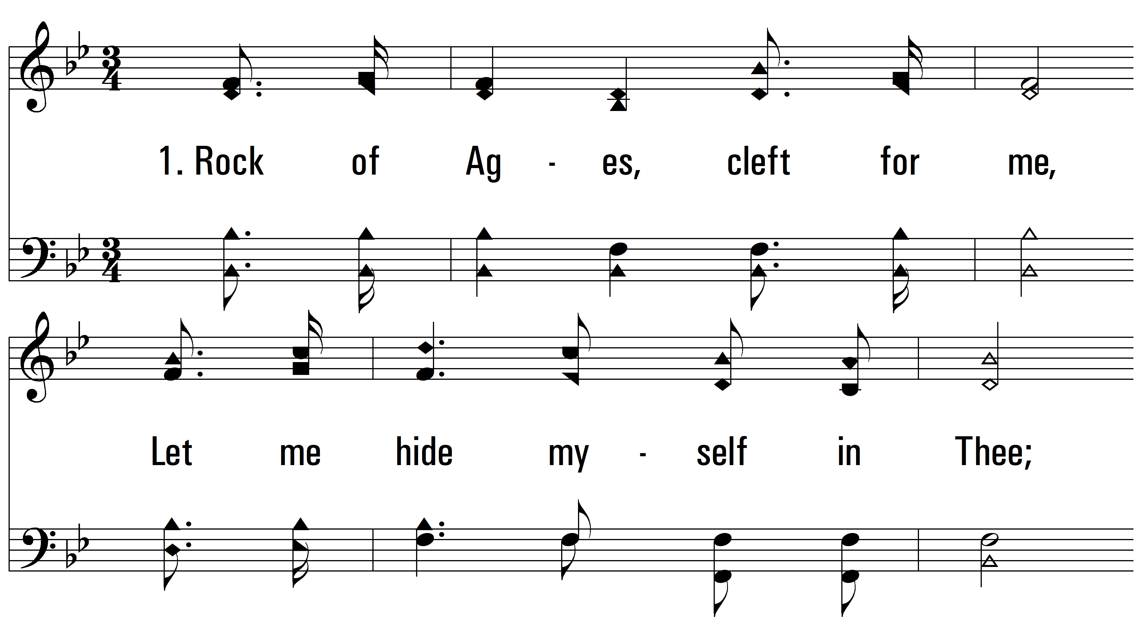
vs. 1 ~ Rock Of Ages

Slide 3
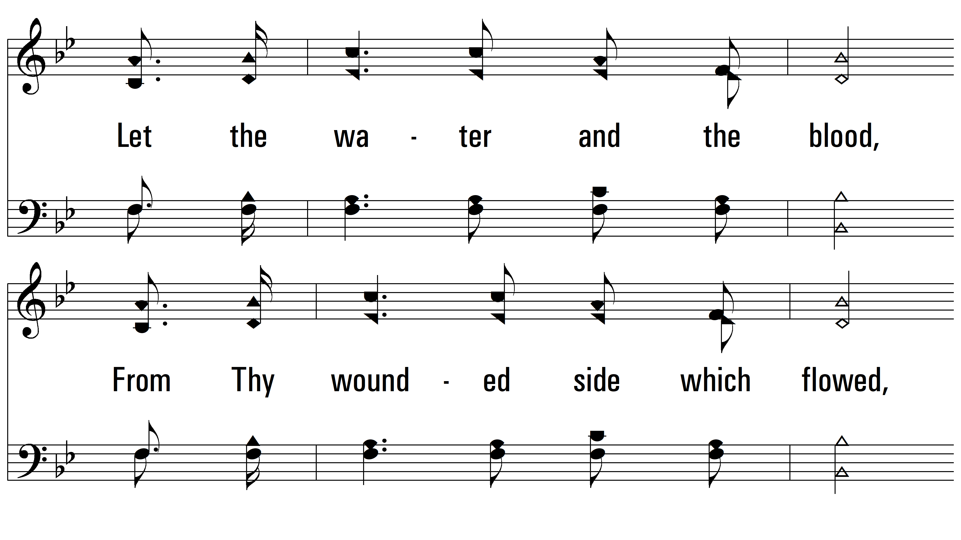
vs. 1

Slide 4
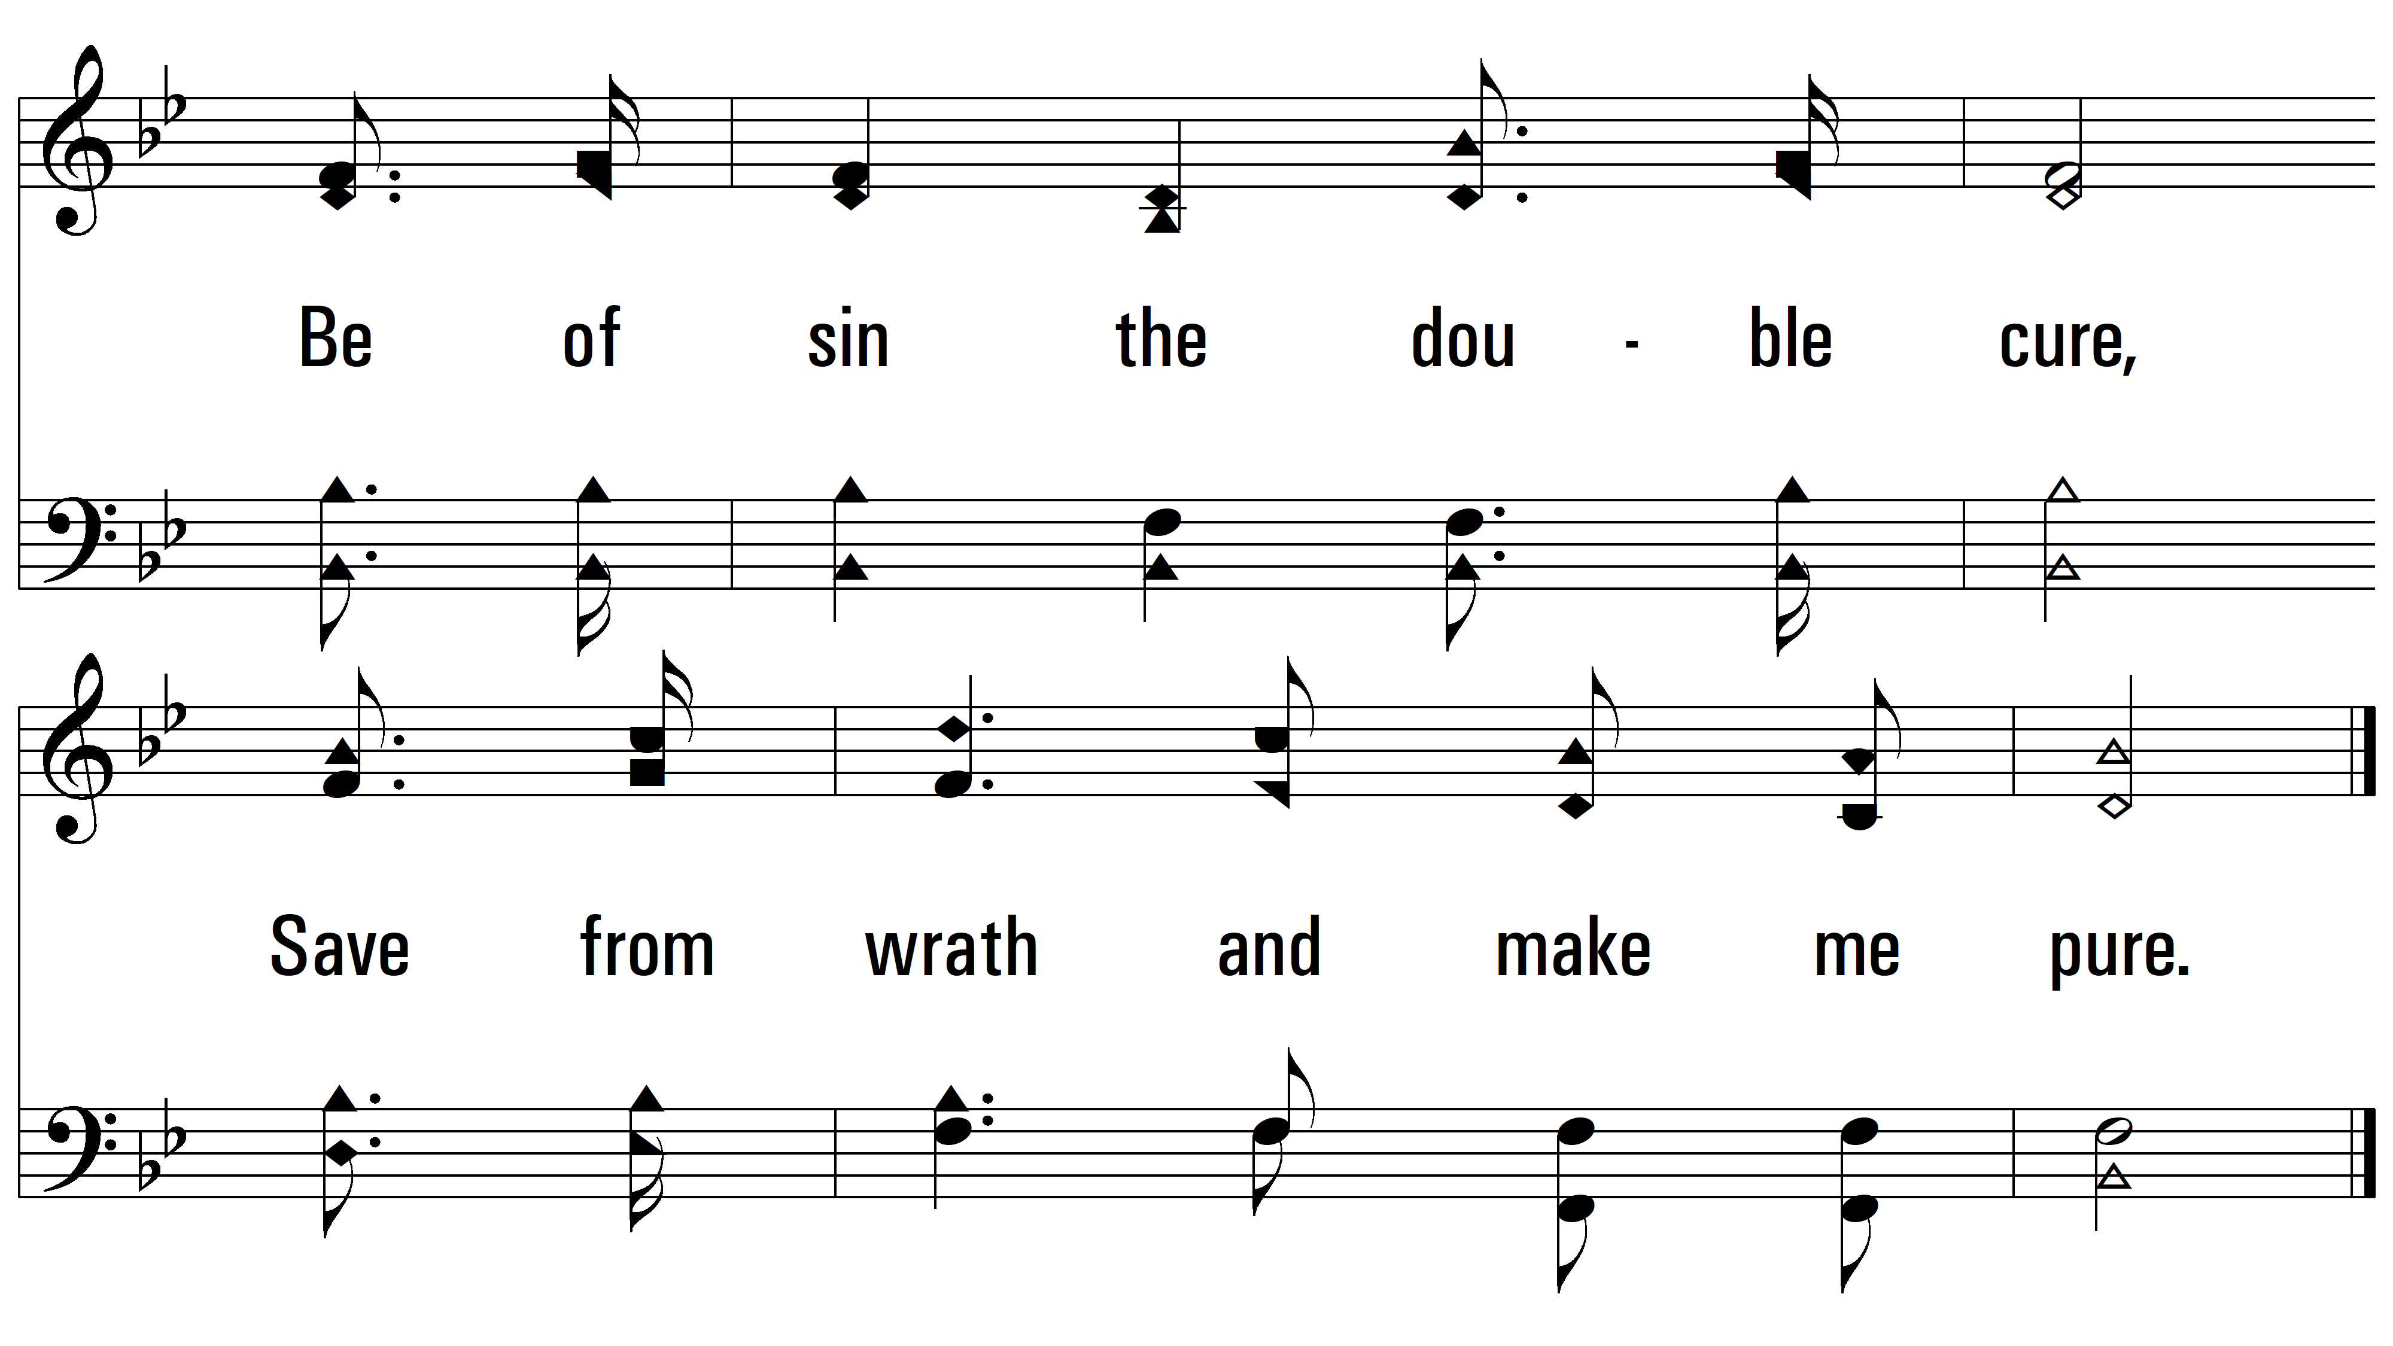
vs. 1

Slide 5
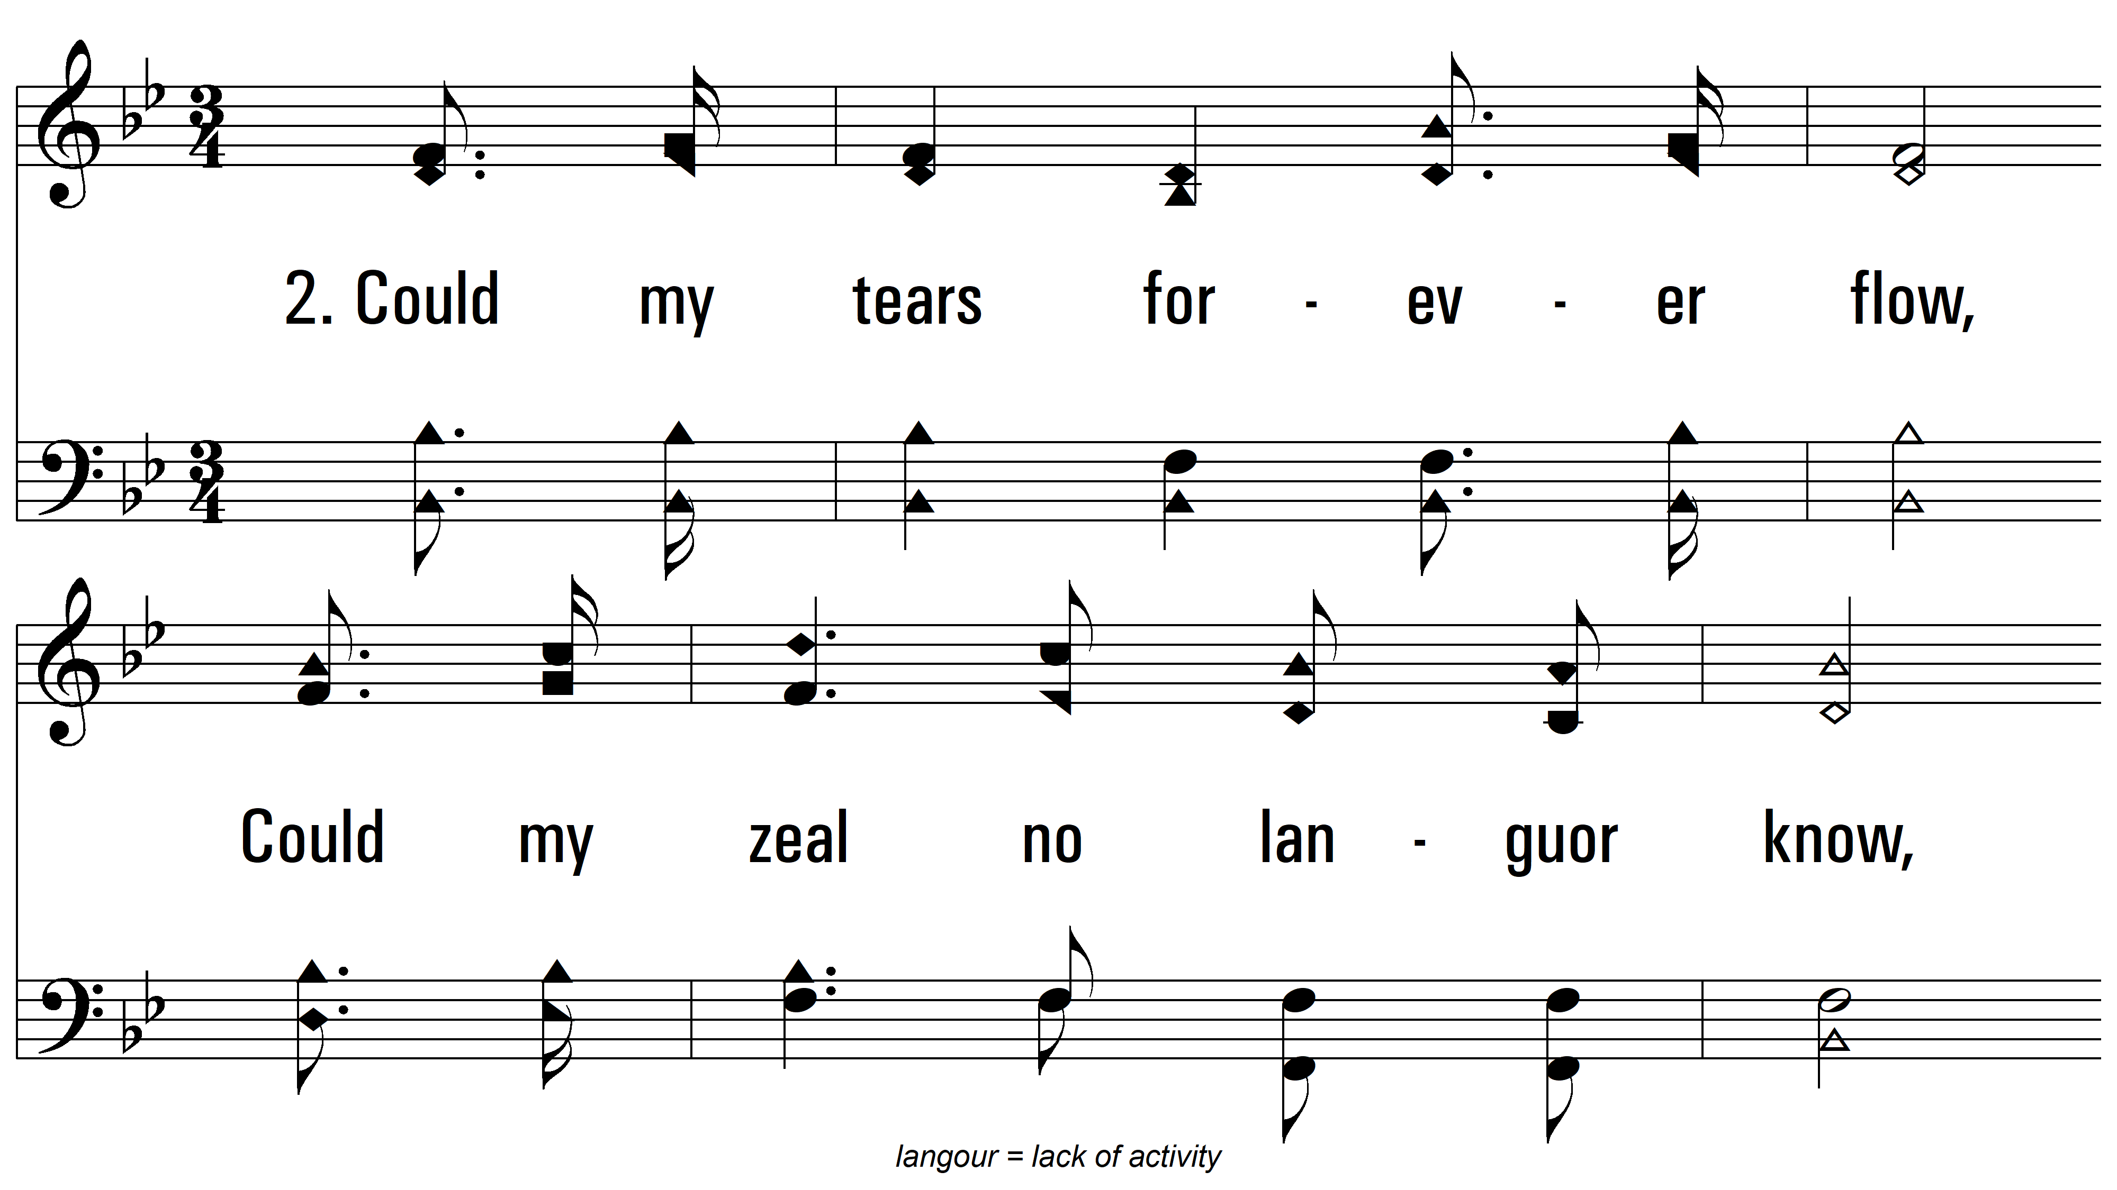
vs. 2 ~ Rock Of Ages

Slide 6
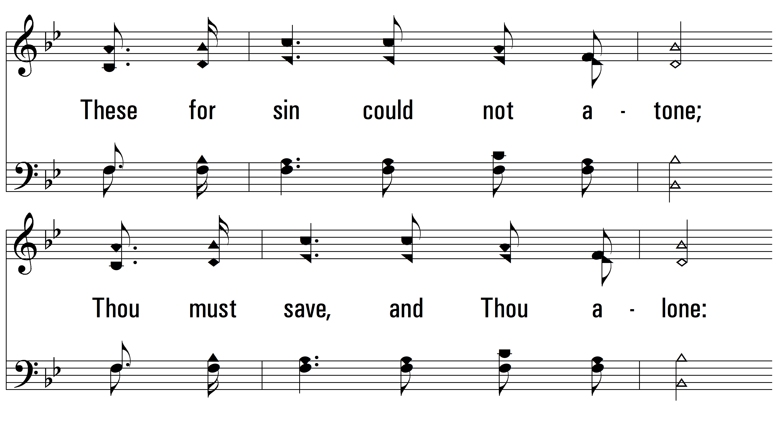
vs. 2

Slide 7
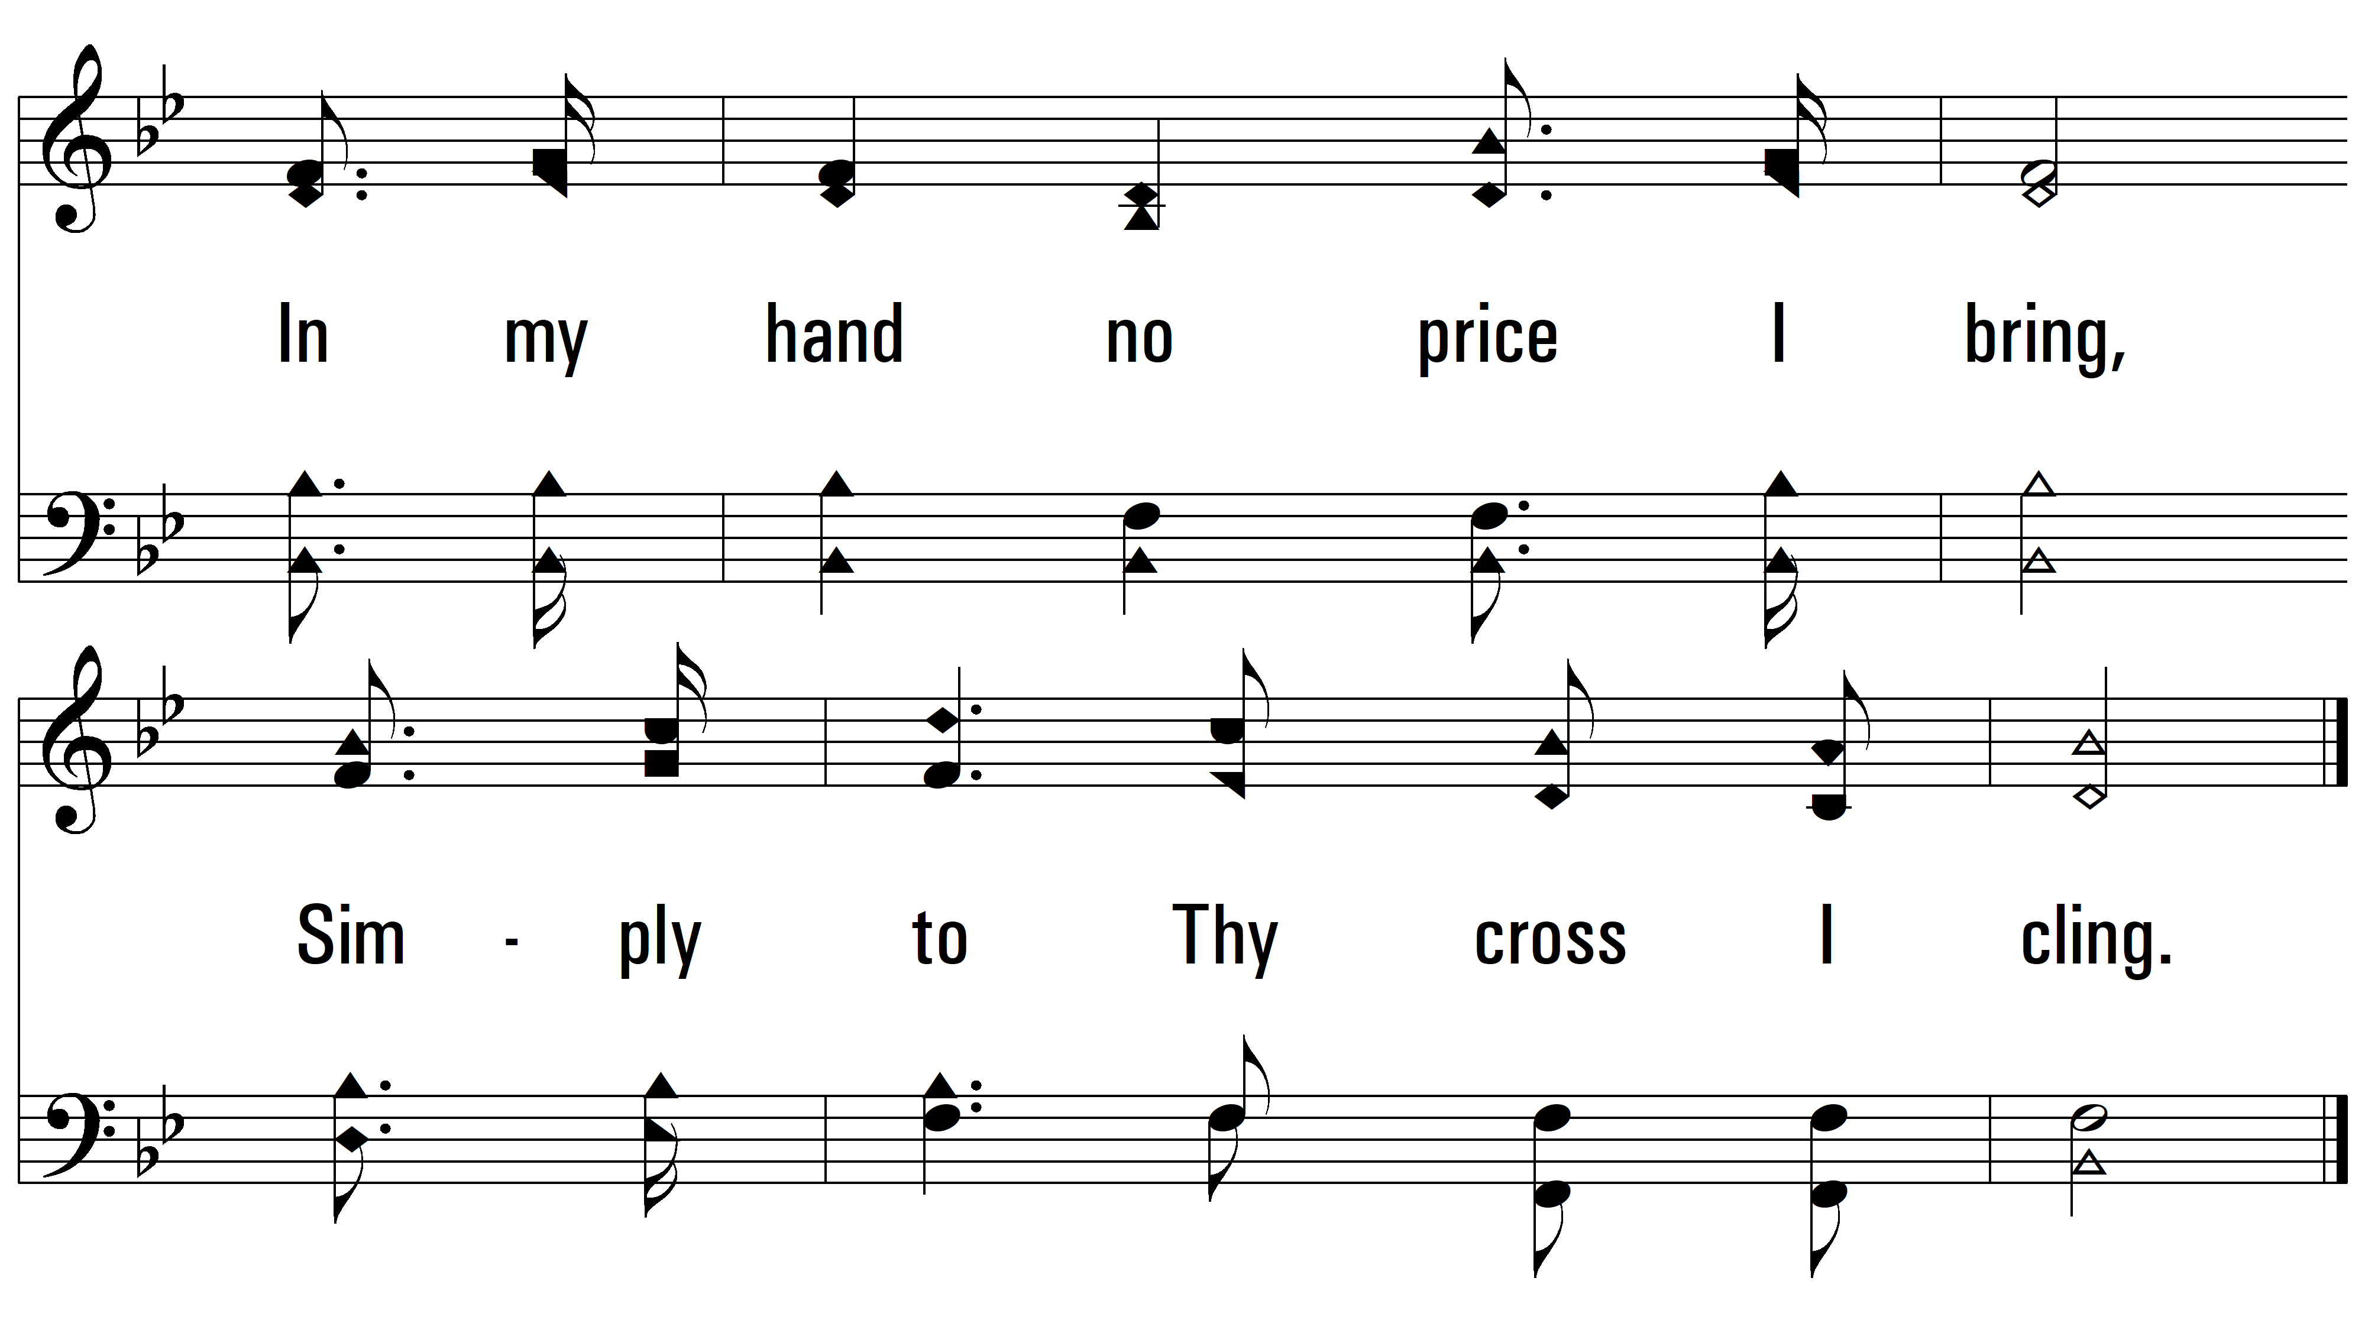
vs. 2

Slide 8
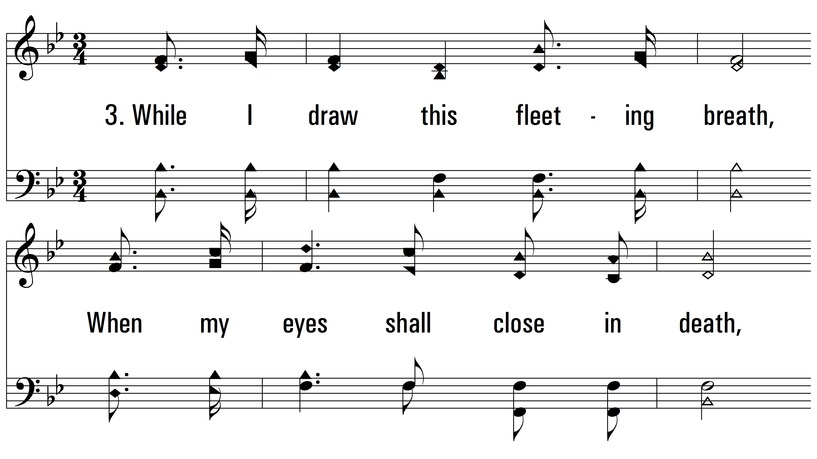
vs. 3 ~ Rock Of Ages

Slide 9
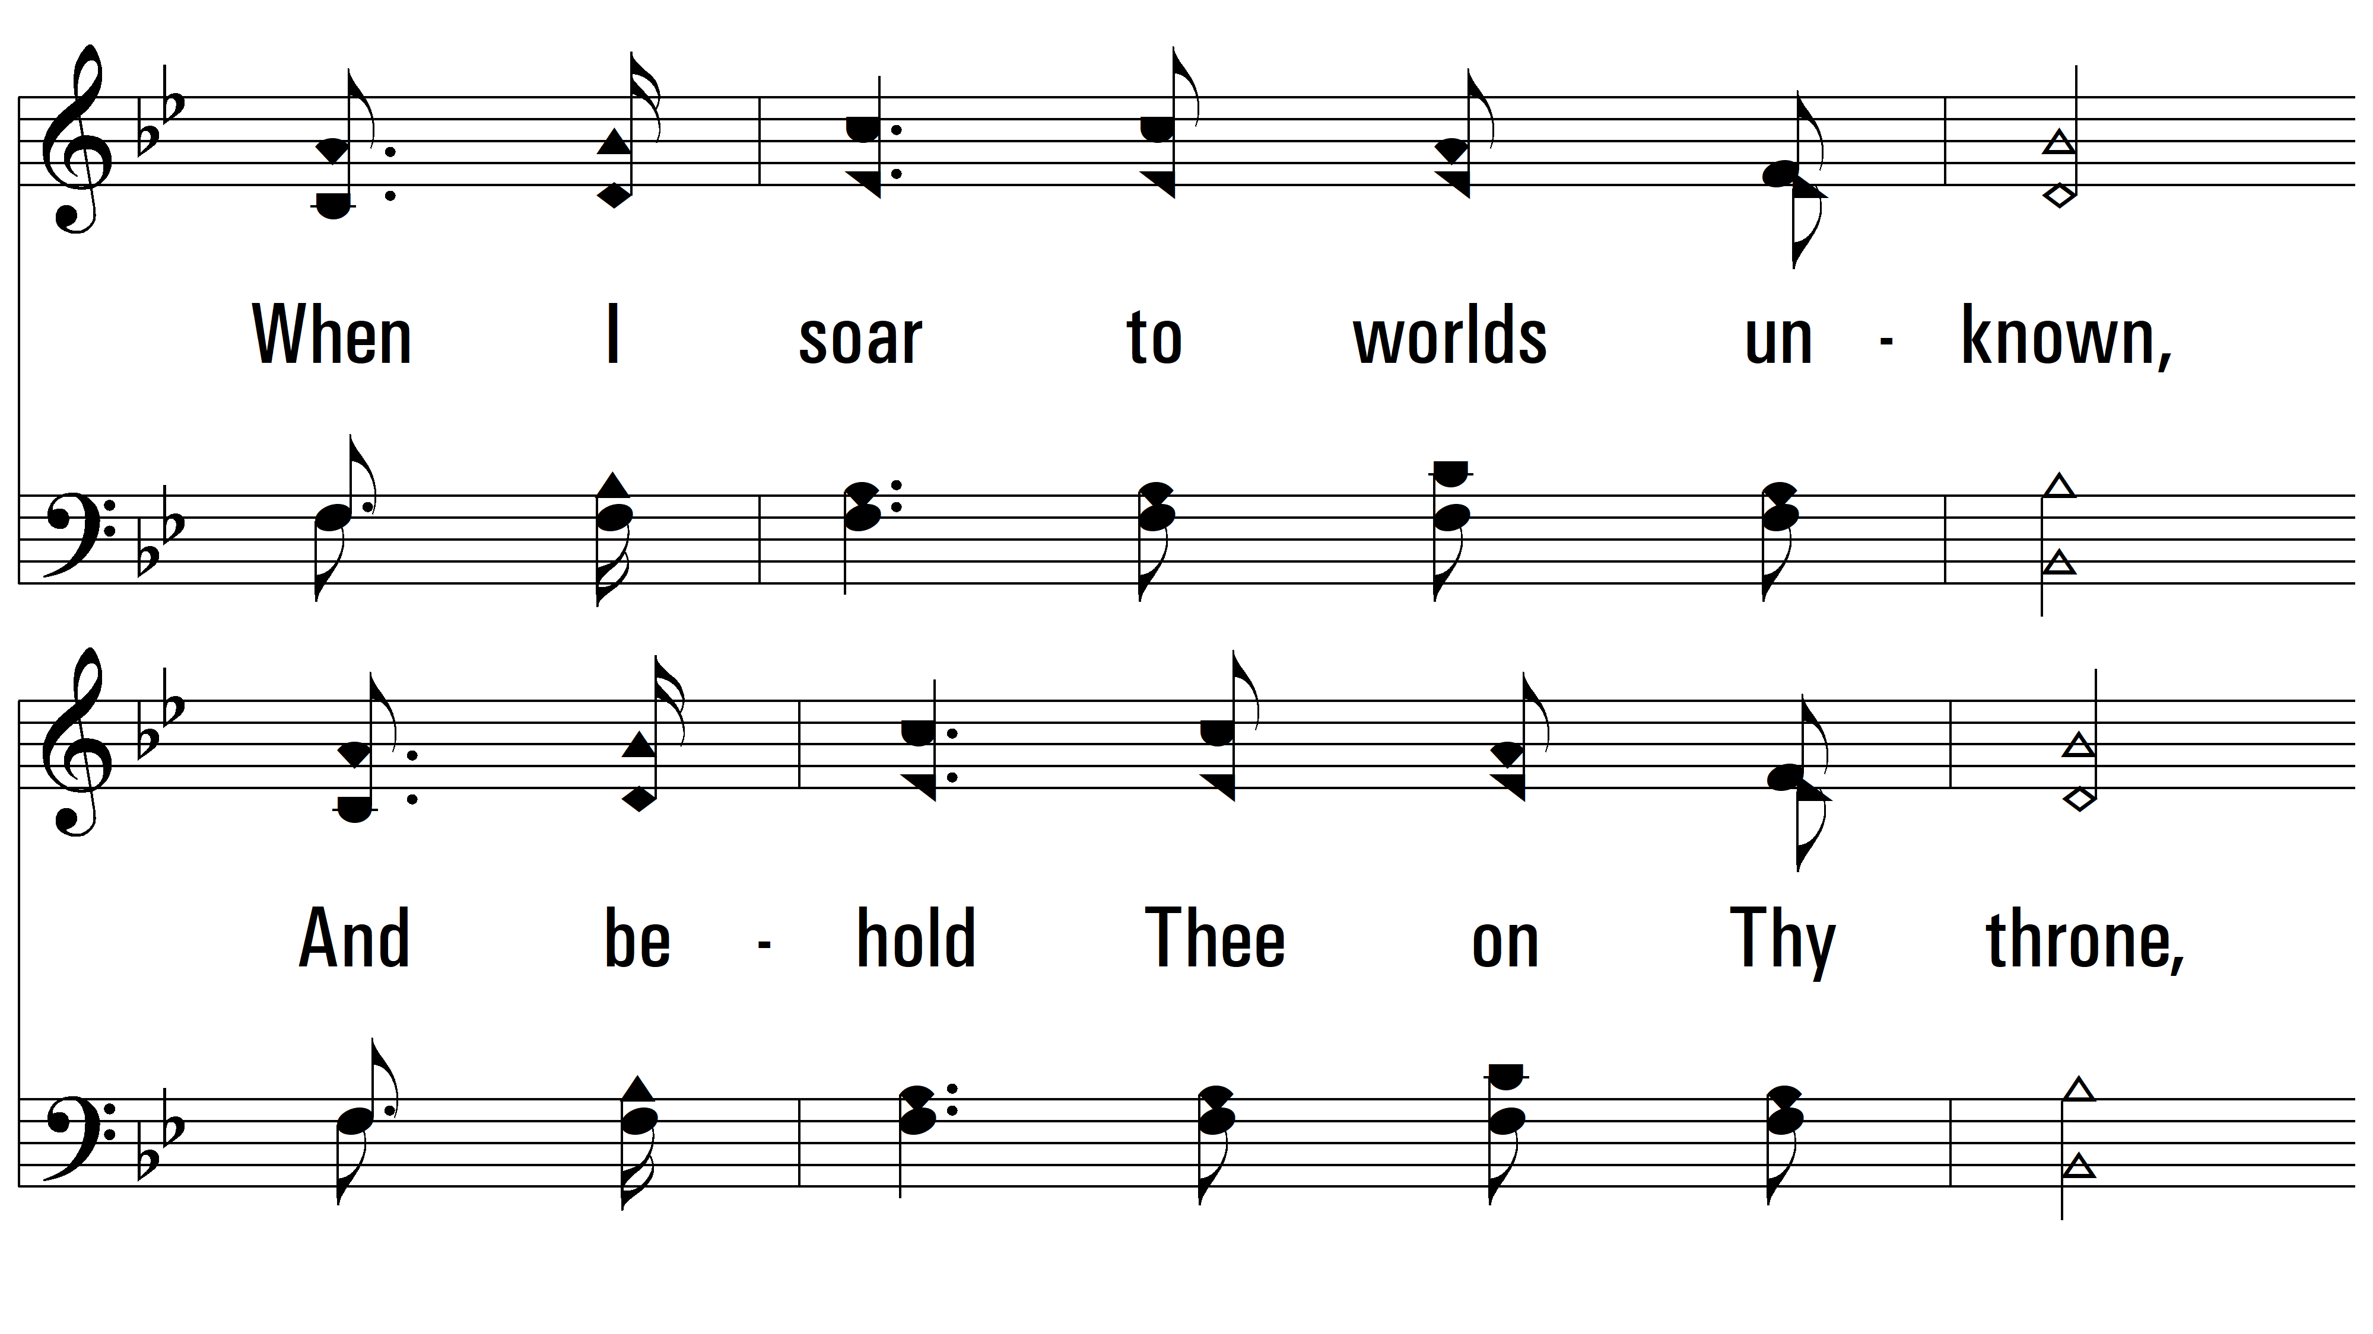
vs. 3

Slide 10
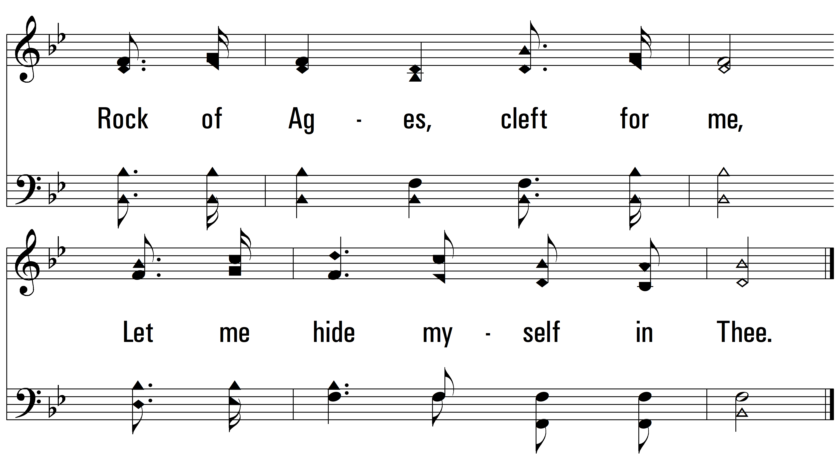
vs. 3
PDHymns.com
END

