Slide 1
Rise Up, O Men of God!
ST. THOMAS
SM
Words: | William P. Merrill (1911)
Music: | Aaron Williams (1763)
4/4
G/D - SOL
Verses: 4
Lead - | SOL
Alto - | SOL
Tenor - | DO
Bass - | DO
PDHymns.com

Slide 2
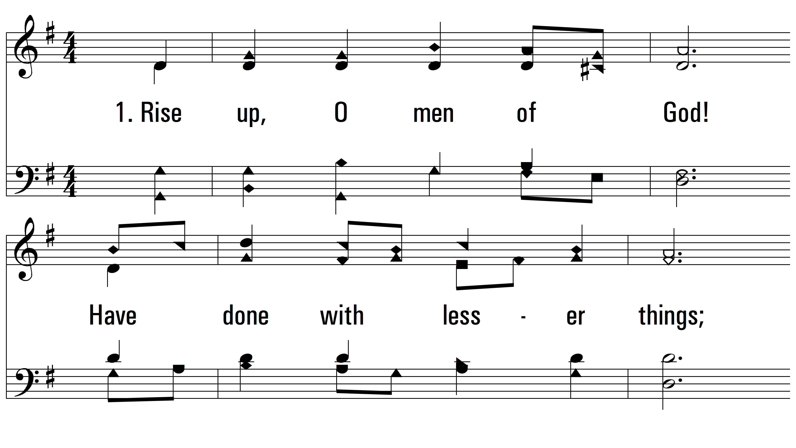
vs. 1 ~ Rise Up, O Men of God!

Slide 3
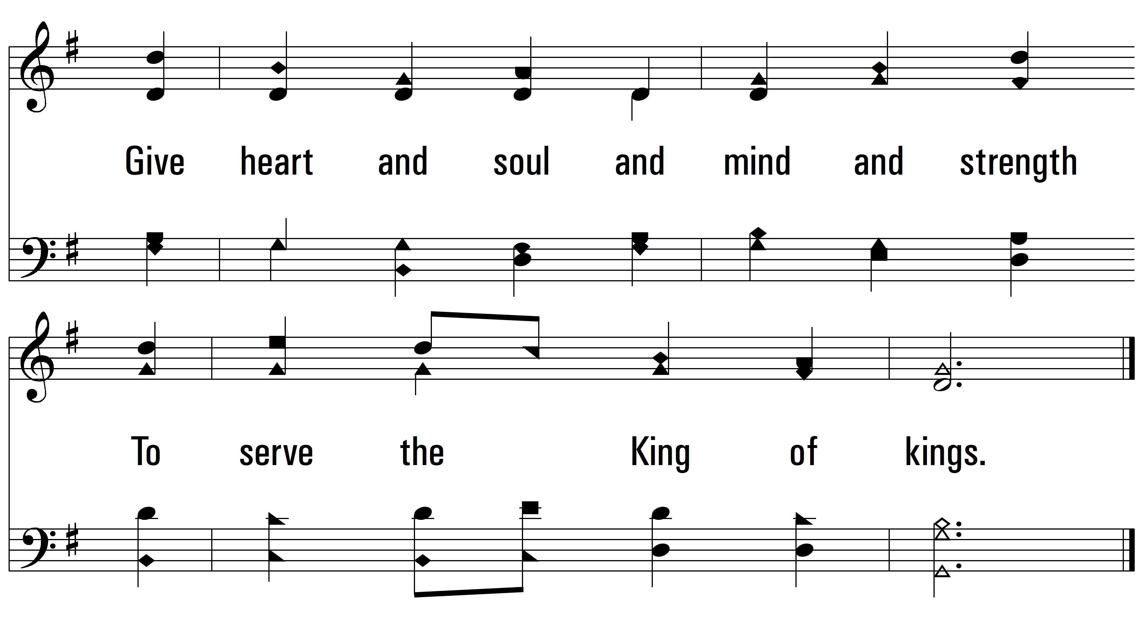
vs. 1

Slide 4
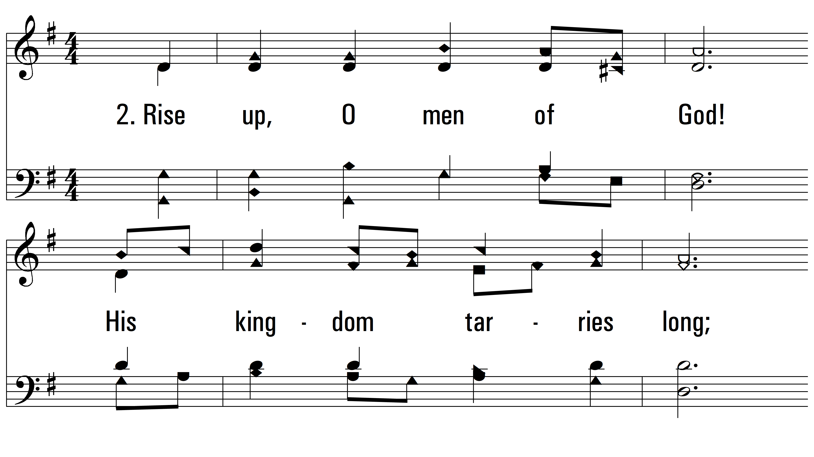
vs. 2 ~ Rise Up, O Men of God!

Slide 5
vs. 2

Slide 6
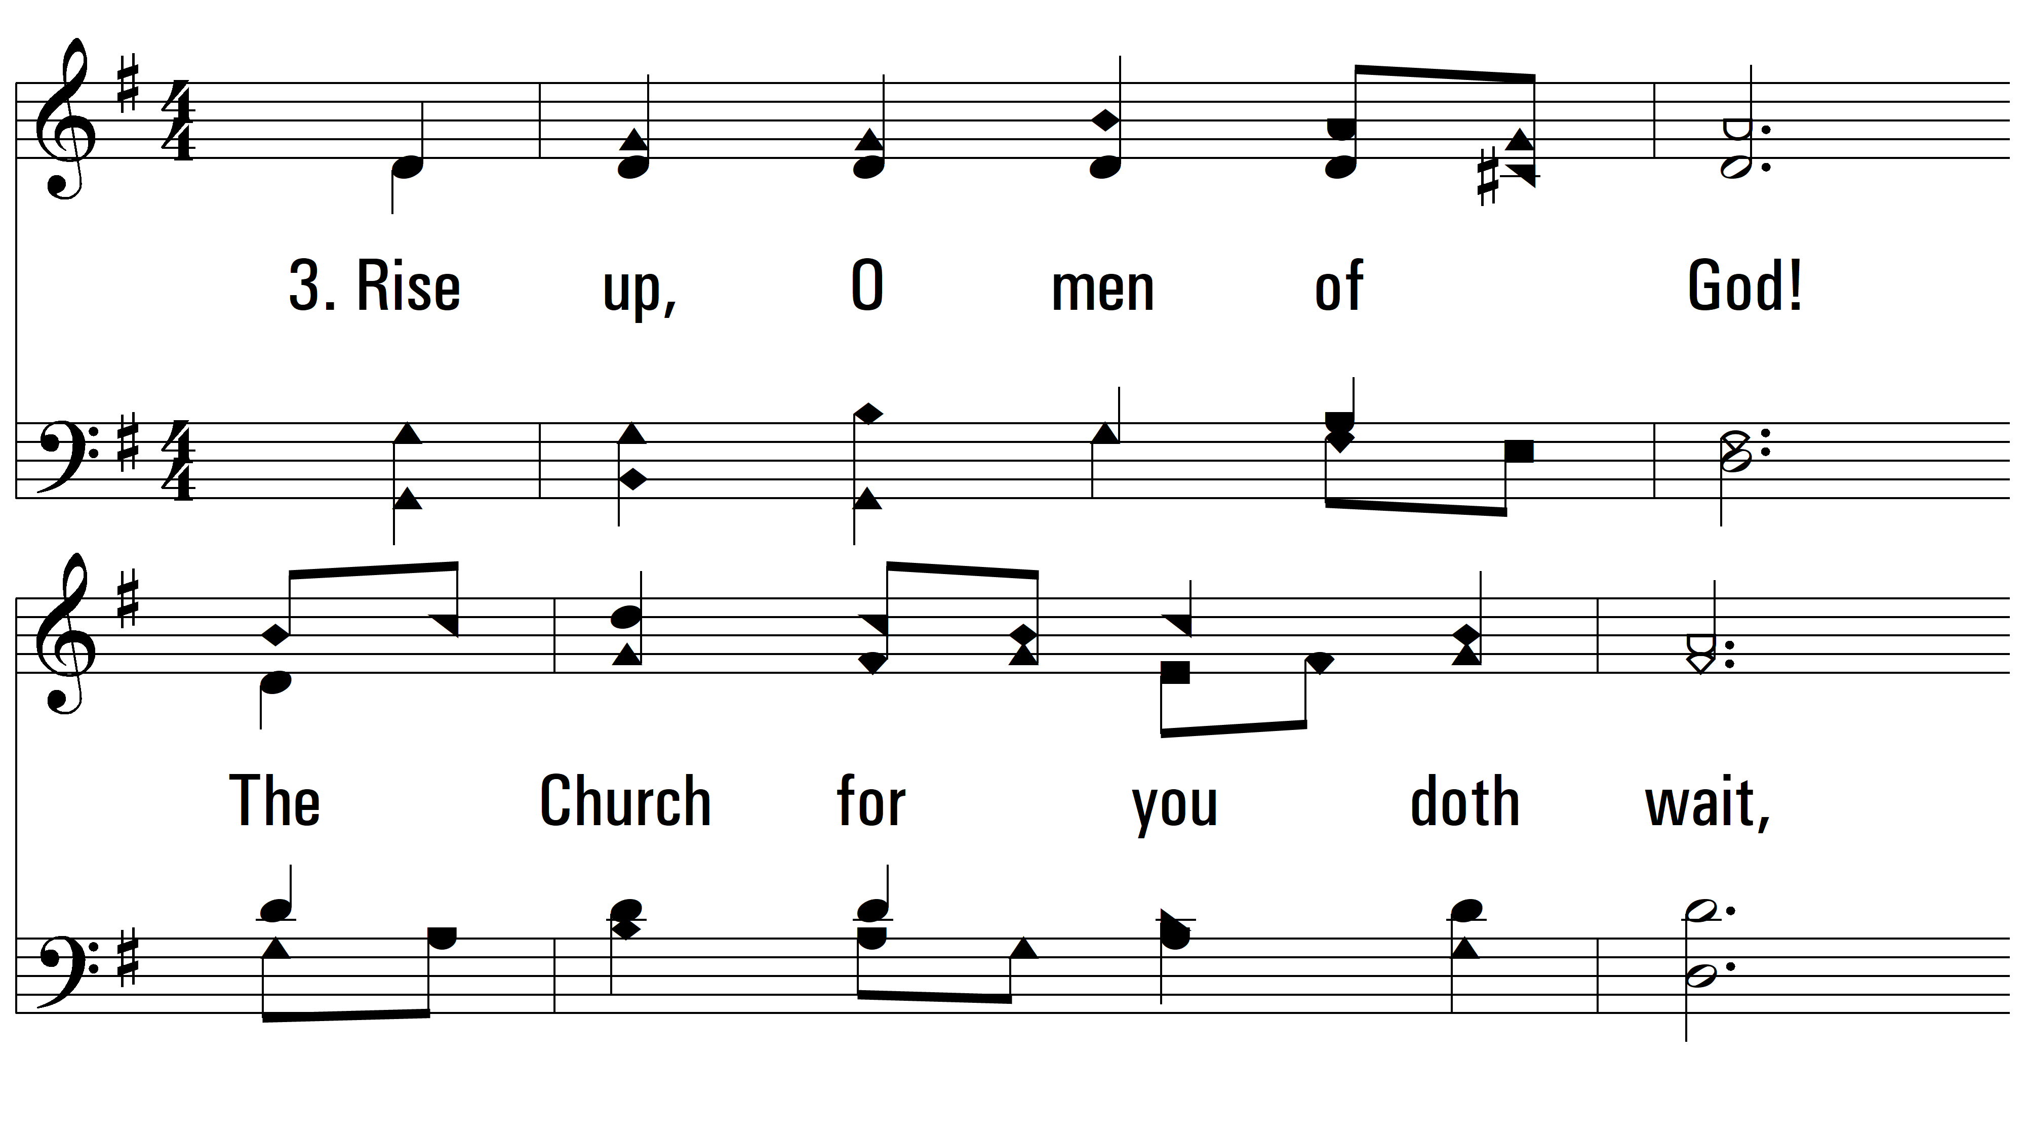
vs. 3 ~ Rise Up, O Men of God!

Slide 7
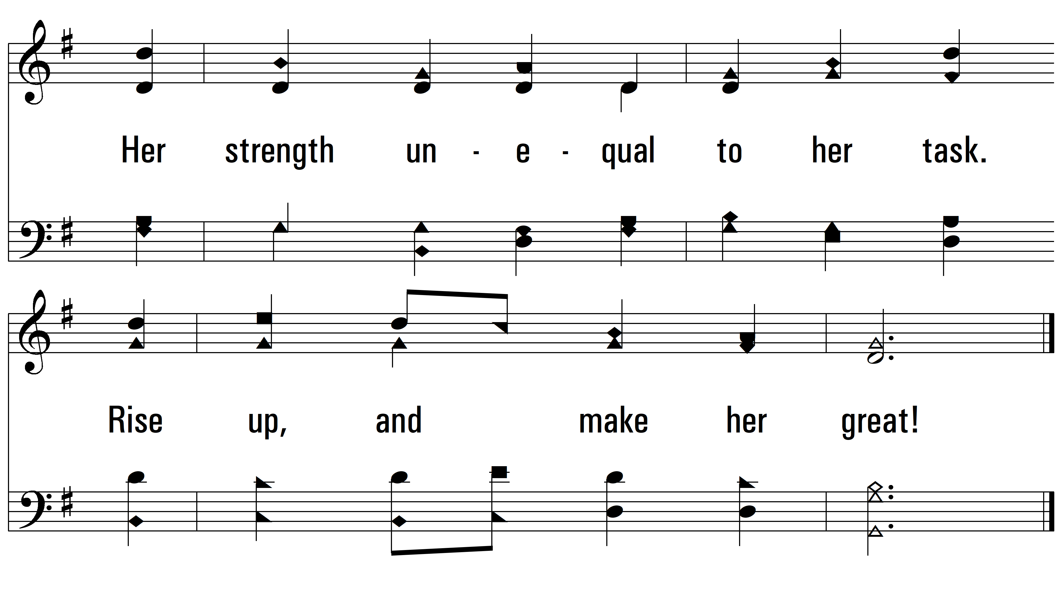
vs. 3

Slide 8
vs. 4 ~ Rise Up, O Men of God!

Slide 9
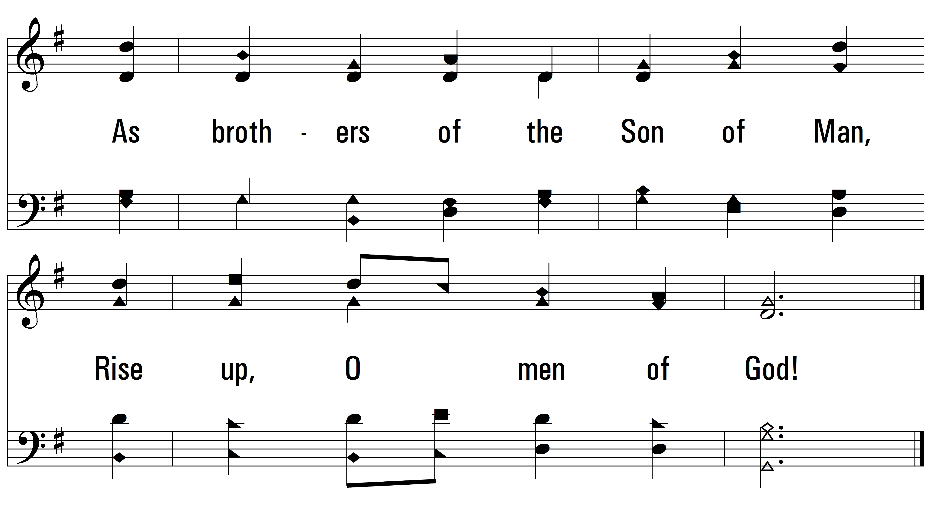
vs. 4
PDHymns.com
END

