Slide 1
Revive Us Again
(We Praise Thee, O God)
Words: | William P. MacKay (1863)
Music: | J. J. Husband (c. 1820)
3/4
G/D - SOL
Verses: 5/Chorus
Lead - | SOL
Alto - | SOL
Tenor - | MI
Bass - | DO
PDHymns.com

Slide 2
vs. 1 ~ Revive Us Again

Slide 3
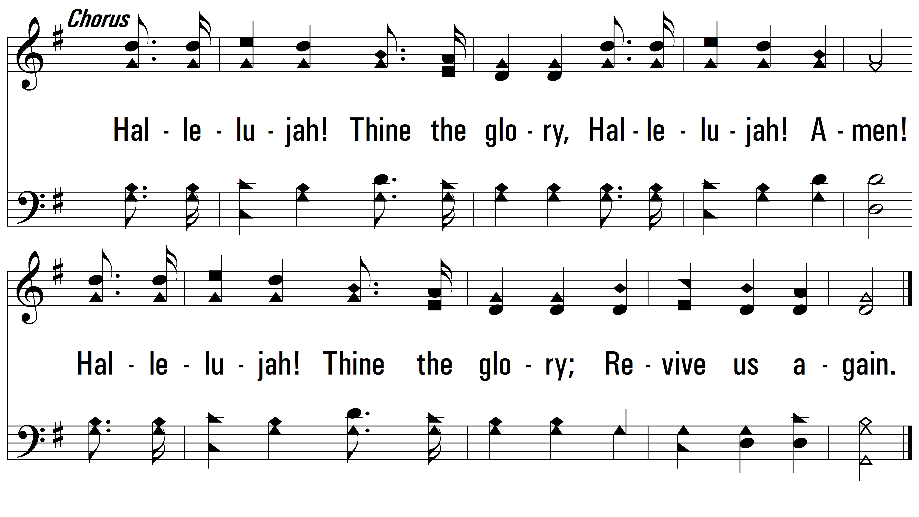
vs. 1

Slide 4
vs. 2 ~ Revive Us Again

Slide 5
vs. 2

Slide 6
vs. 3 ~ Revive Us Again

Slide 7
vs. 3

Slide 8
vs. 4 ~ Revive Us Again

Slide 9
vs. 4

Slide 10
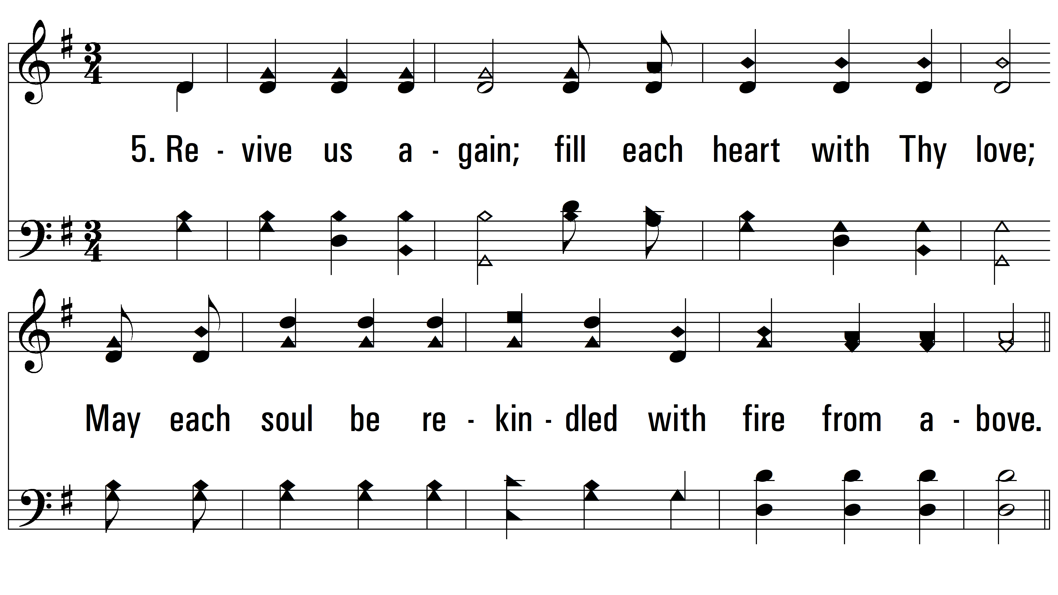
vs. 5 ~ Revive Us Again

Slide 11
vs. 5
PDHymns.com
END

