Slide 1
Rescue The Perishing
Words: | Fanny J. Crosby (1869)
Music: | William H. Doane (1869)
4/4
B^{b}/F - SOL
Verses: 3/Chorus
Lead - | SOL
Alto - | MI
Tenor - | DO
Bass - | DO
PDHymns.com

Slide 2
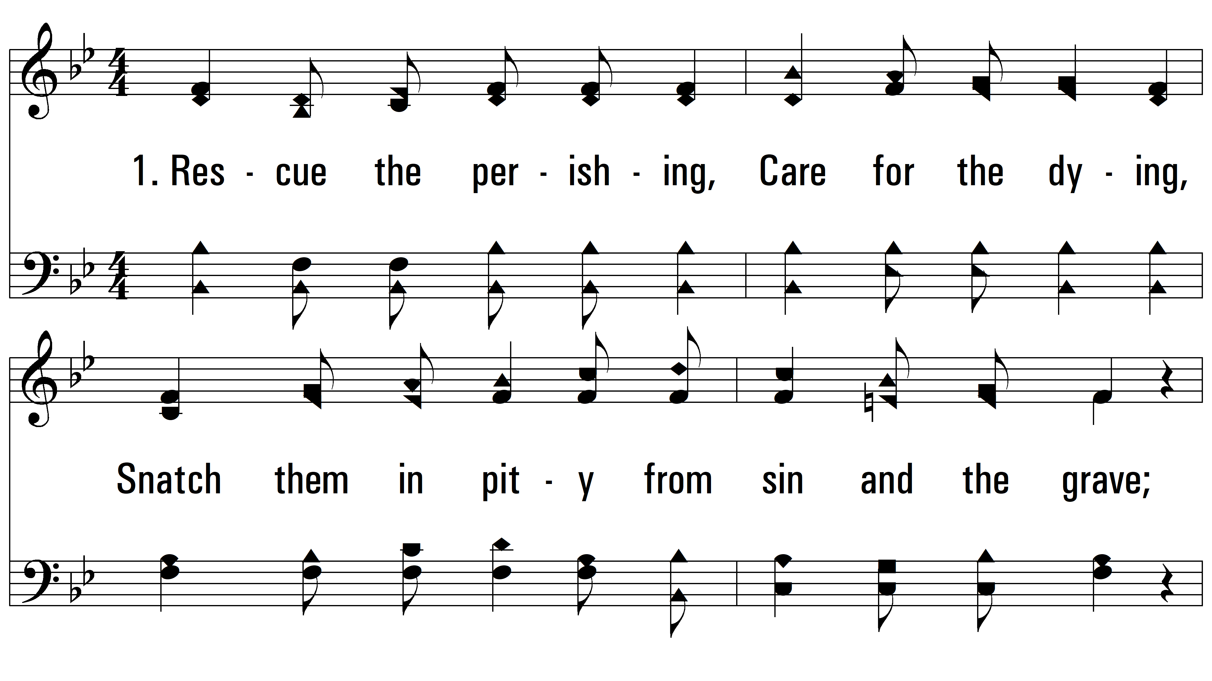
vs. 1 ~ Rescue The Perishing

Slide 3
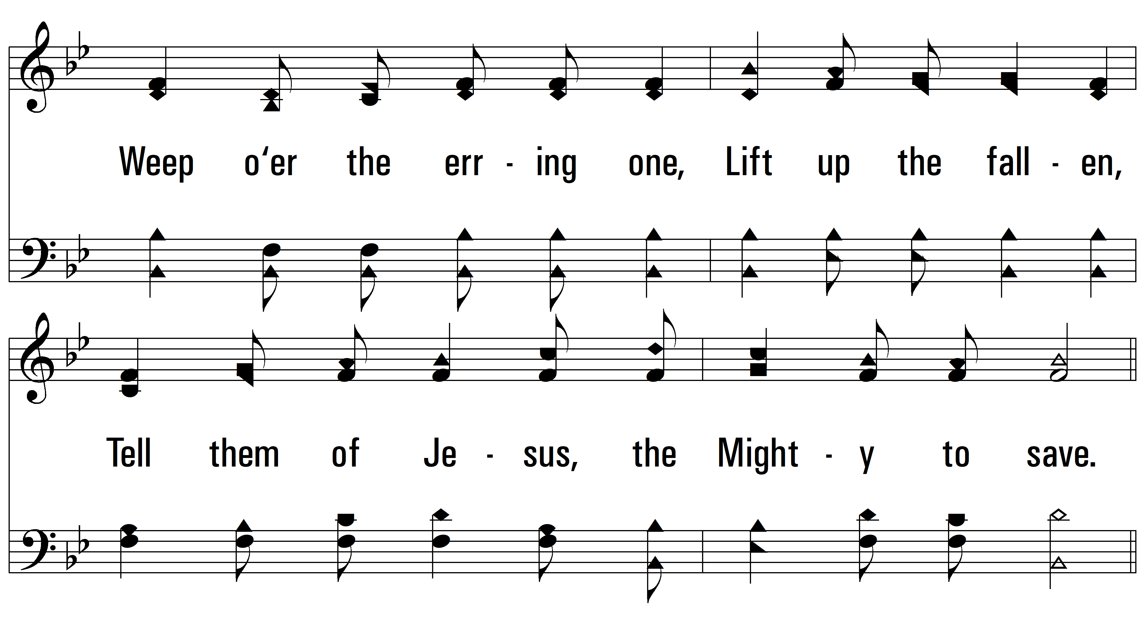
vs. 1

Slide 4
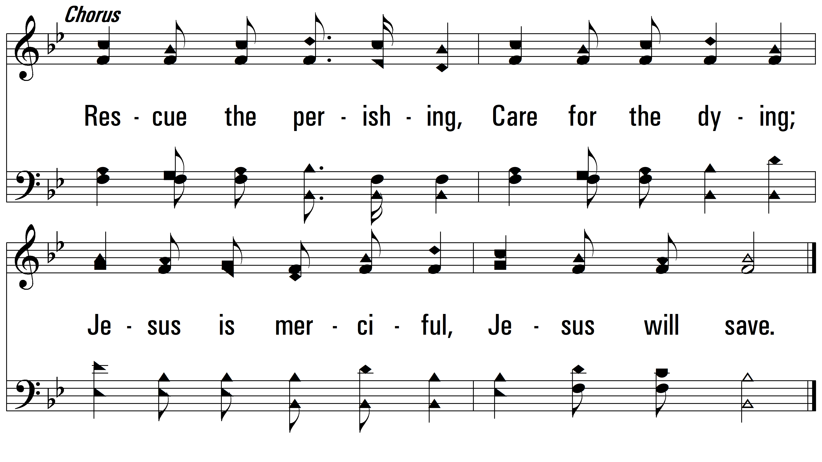
vs. 1

Slide 5
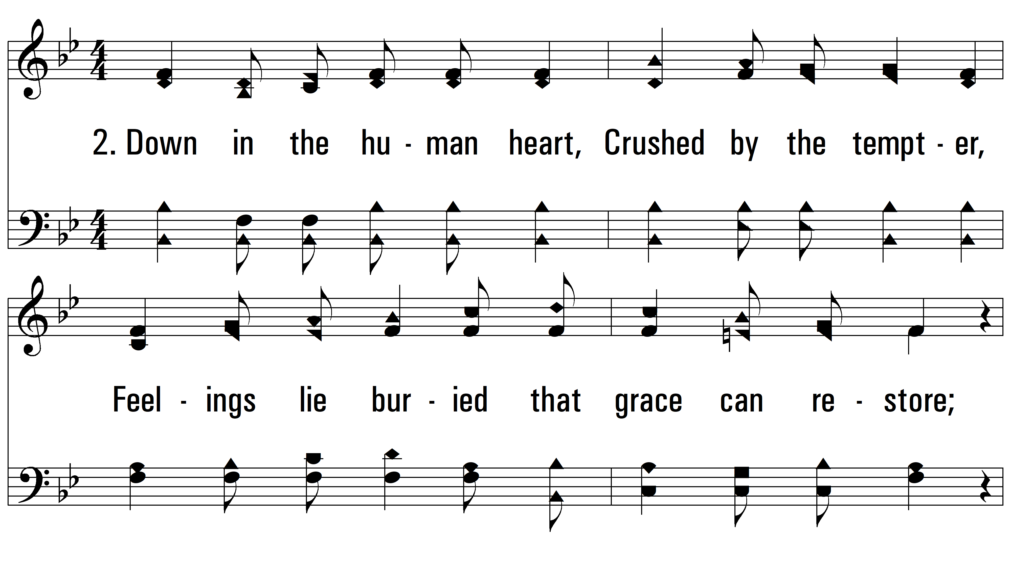
vs. 2 ~ Rescue The Perishing

Slide 6
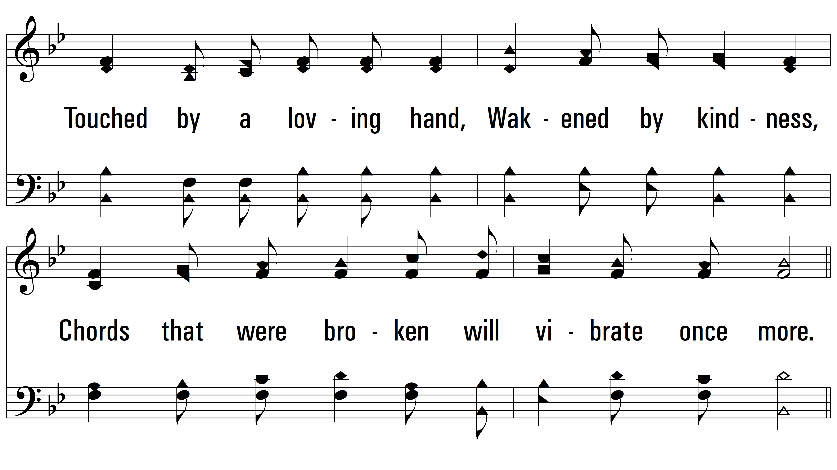
vs. 2

Slide 7
vs. 2

Slide 8
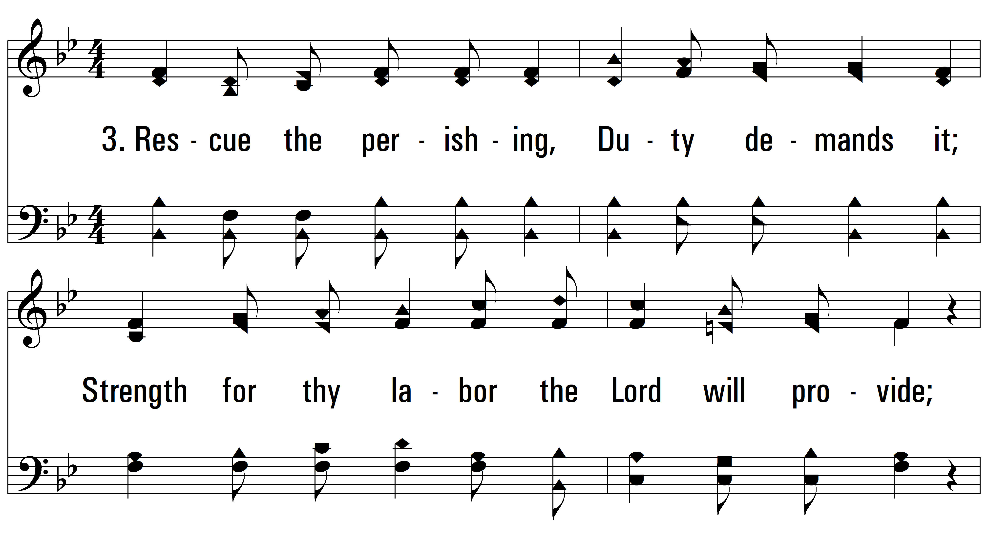
vs. 3 ~ Rescue The Perishing

Slide 9
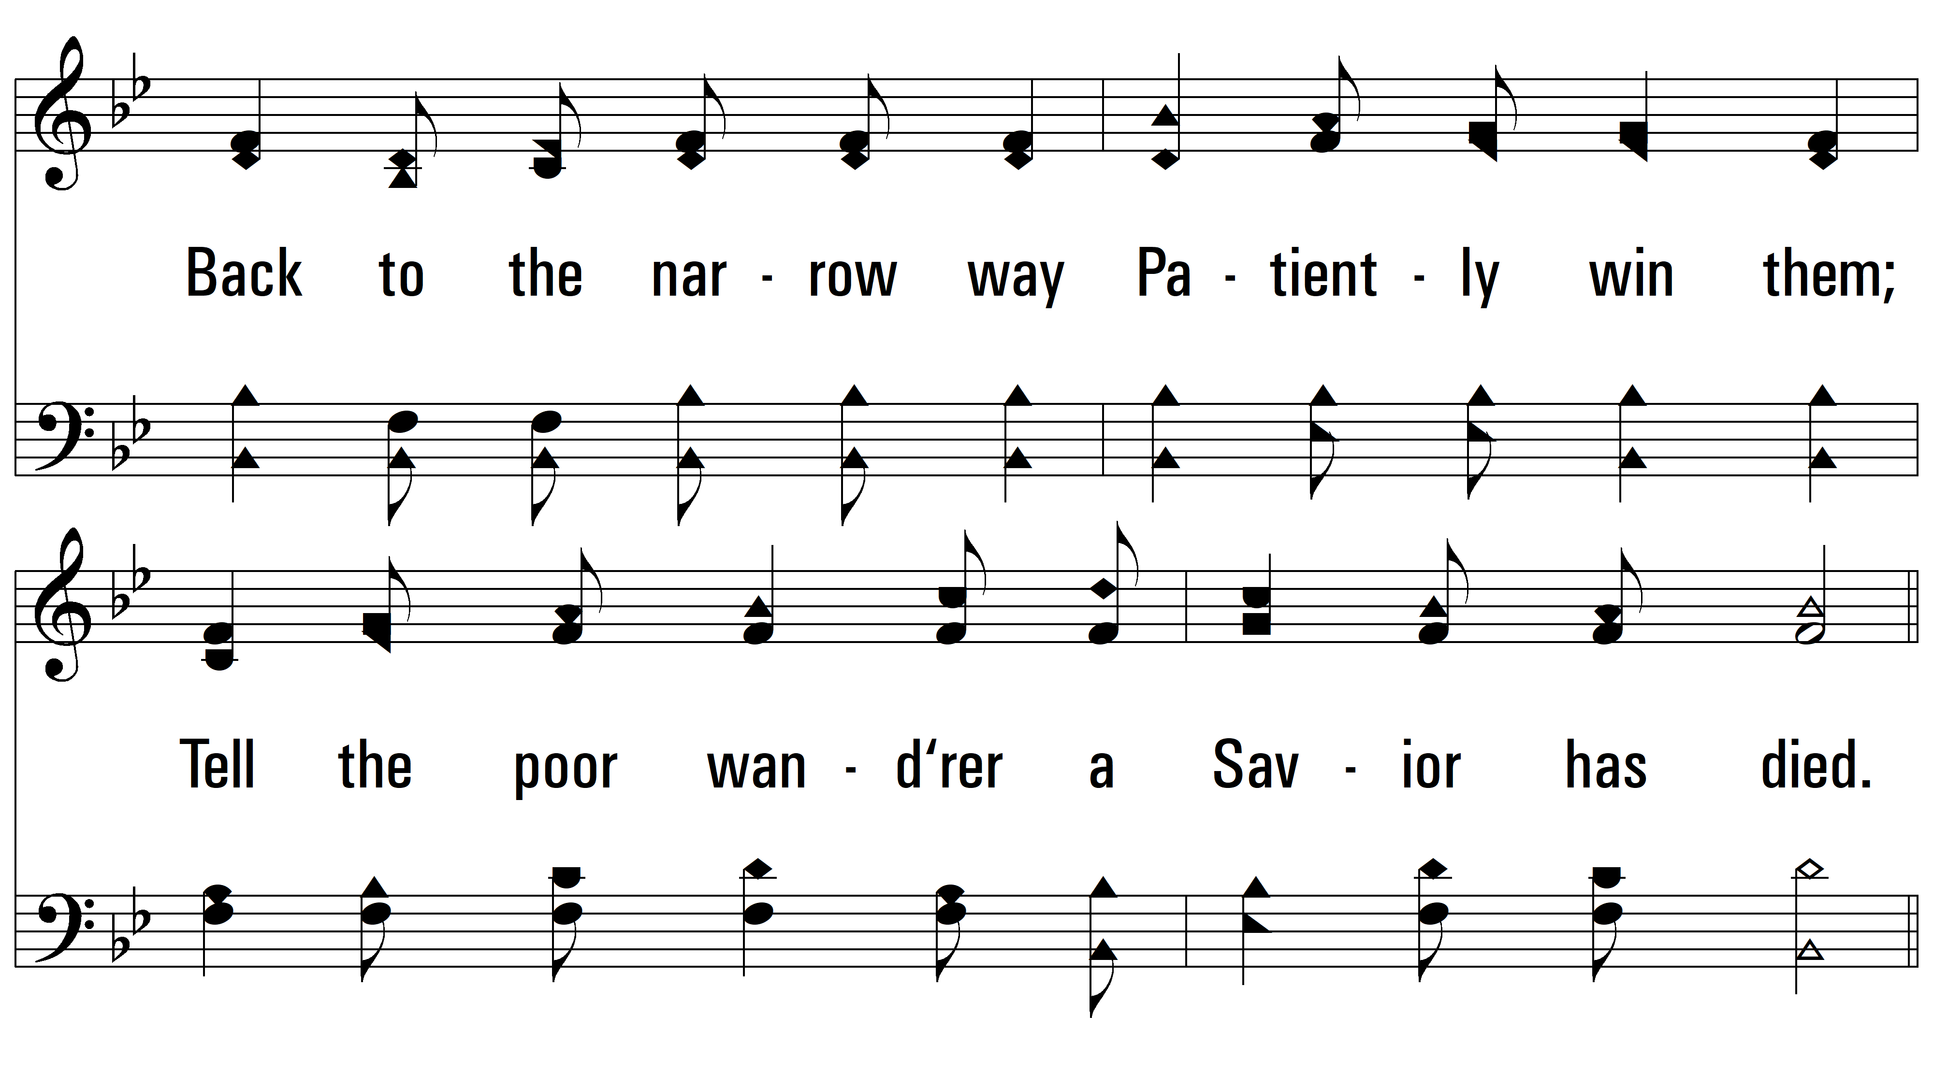
vs. 3

Slide 10
vs. 3
PDHymns.com
END

