Slide 1
Purer Yet And Purer
LYNDHURST
6.5.6.5.D
Words: | J. W. Von Goethe (1858)
Music: | S. J. Vail (1883)
4/4
A^{b}/E^{b} - SOL
Verses: 3
Lead - | SOL
Alto - | MI
Tenor - | DO
Bass - | DO
PDHymns.com

Slide 2
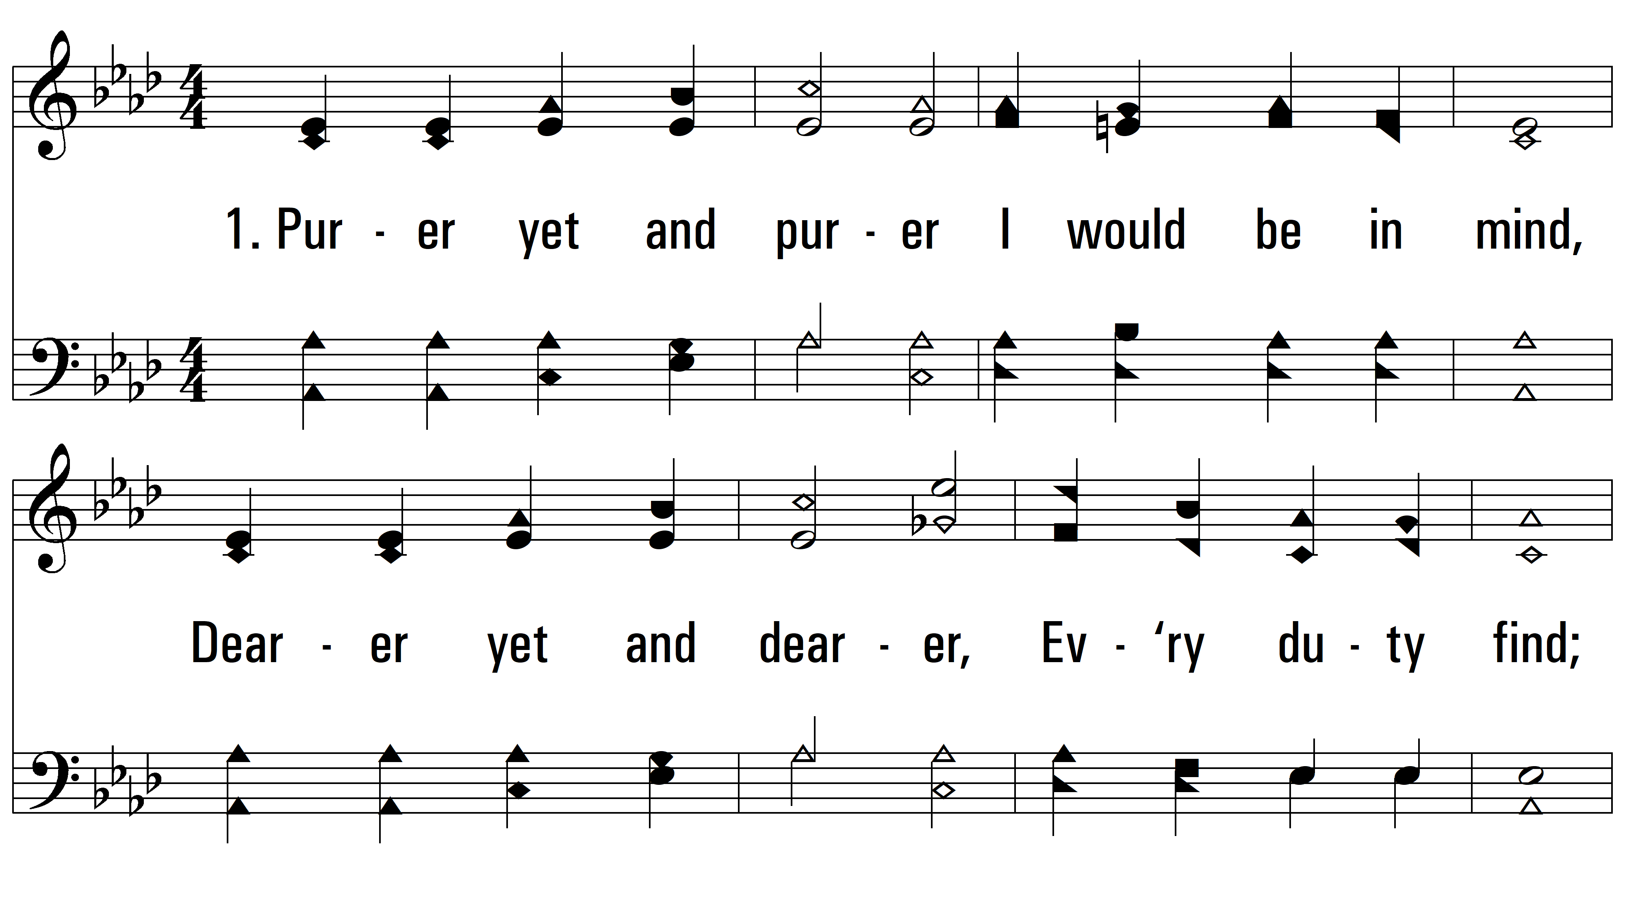
vs. 1 ~ Purer Yet And Purer

Slide 3
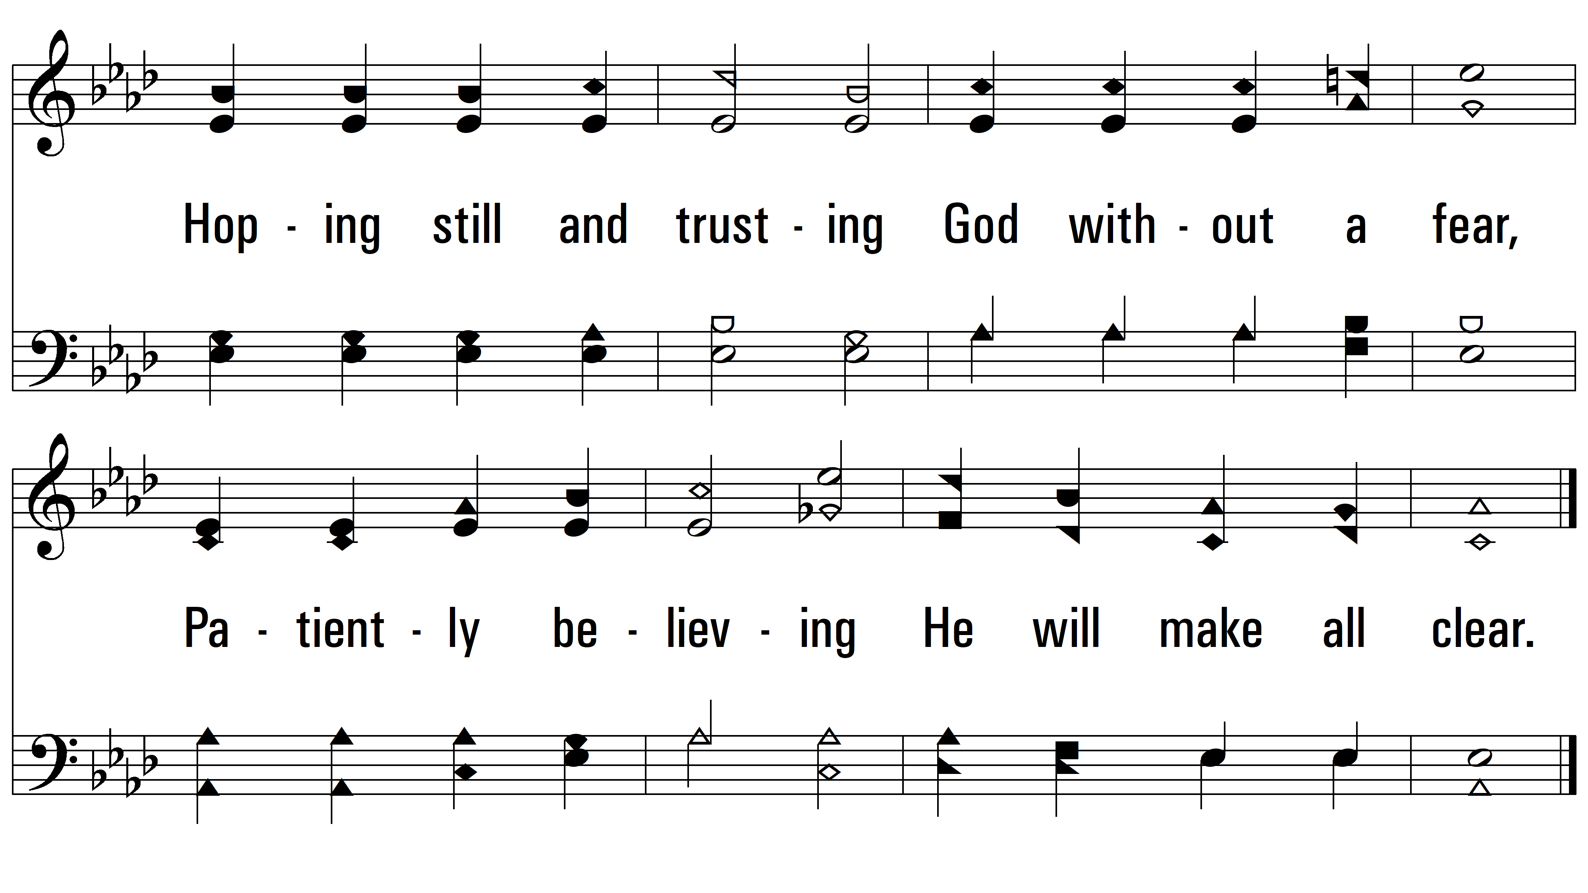
vs. 1

Slide 4
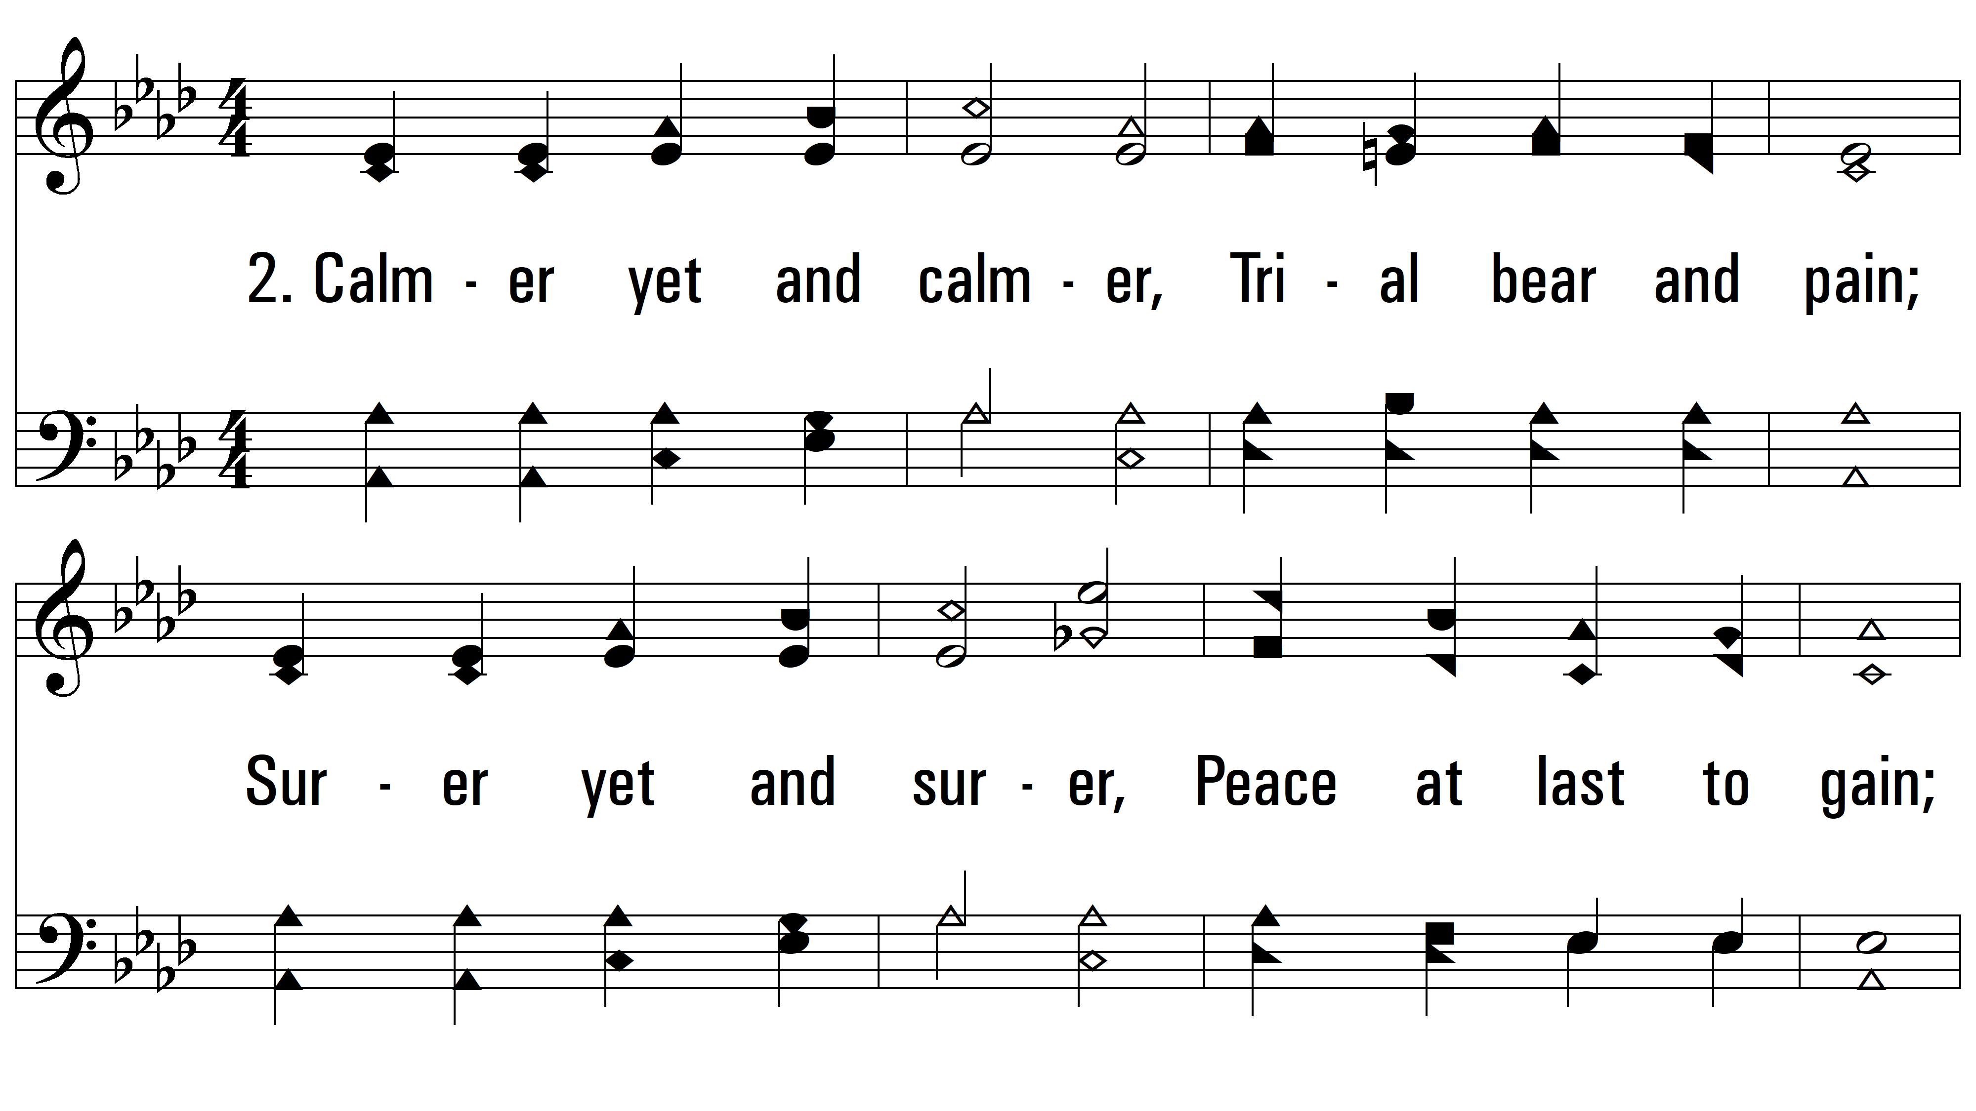
vs. 2 ~ Purer Yet And Purer

Slide 5
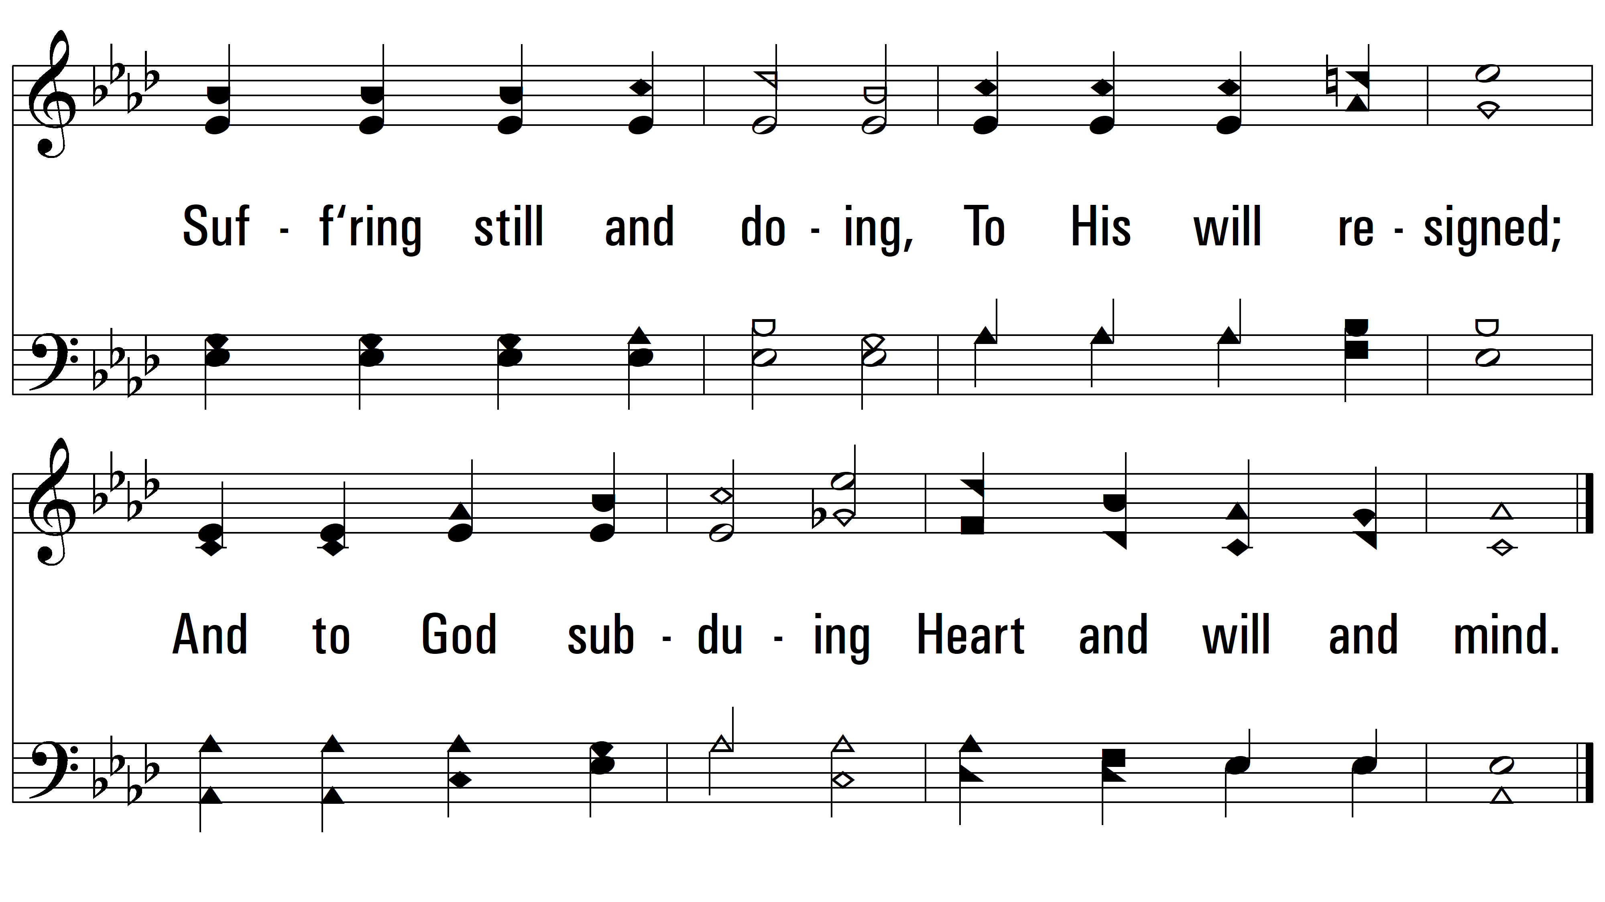
vs. 2

Slide 6
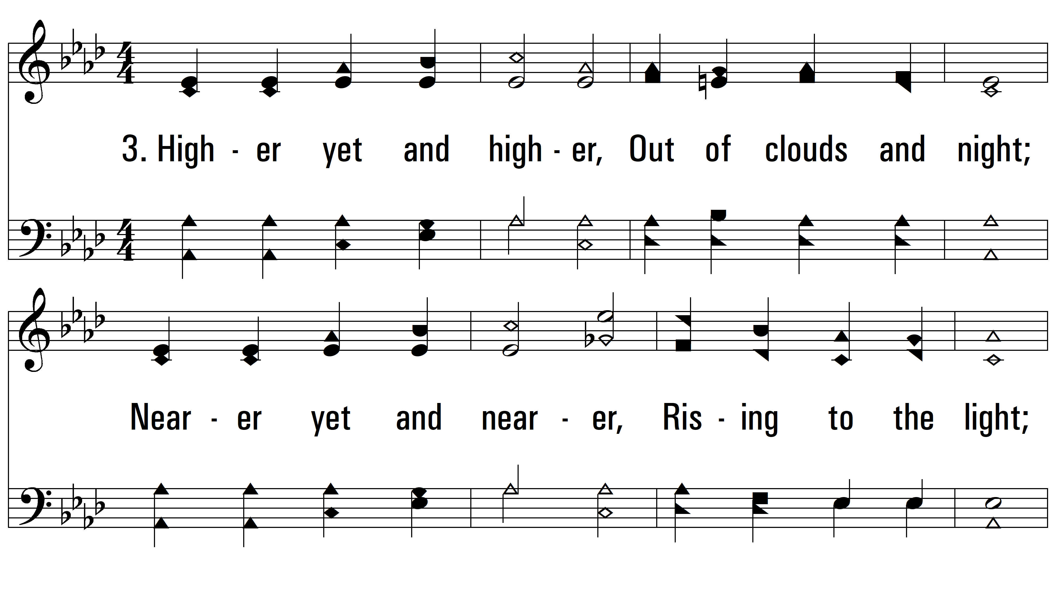
vs. 3 ~ Purer Yet And Purer

Slide 7
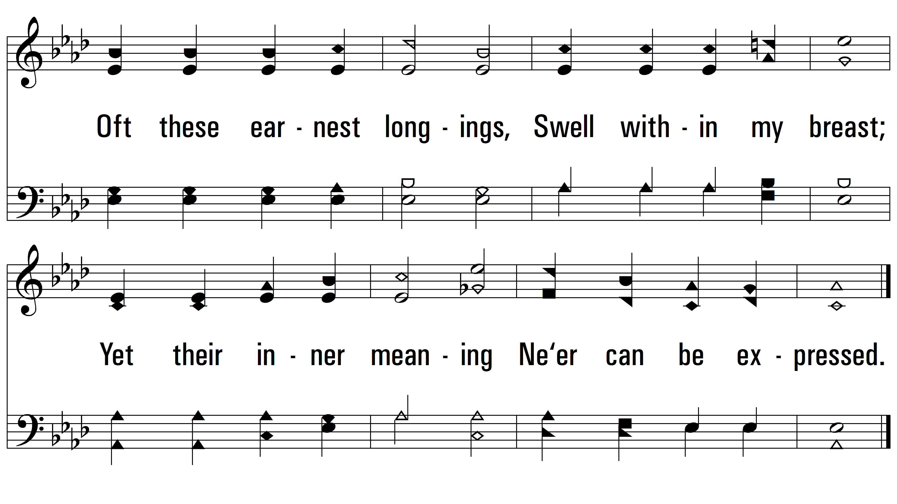
vs. 3
PDHymns.com
END

