Slide 1
Purer In Heart, O God
GRATITUDE
6.4.6.4.6.6.4.4
Words: | Mrs. A. L. Davison (1877)
Music: | J. H. Filmore (1877)
4/4
G/B - MI
Verses: 3
Lead - | MI
Alto - | SOL
Tenor - | DO
Bass - | DO
PDHymns.com

Slide 2
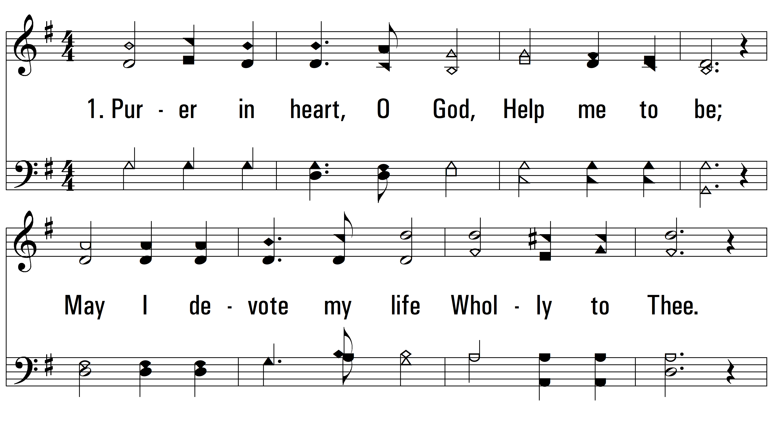
vs. 1 ~ Purer In Heart, O God

Slide 3
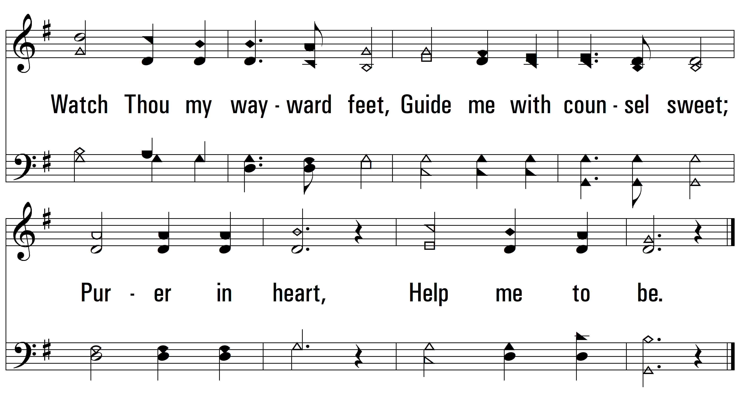
vs. 1

Slide 4
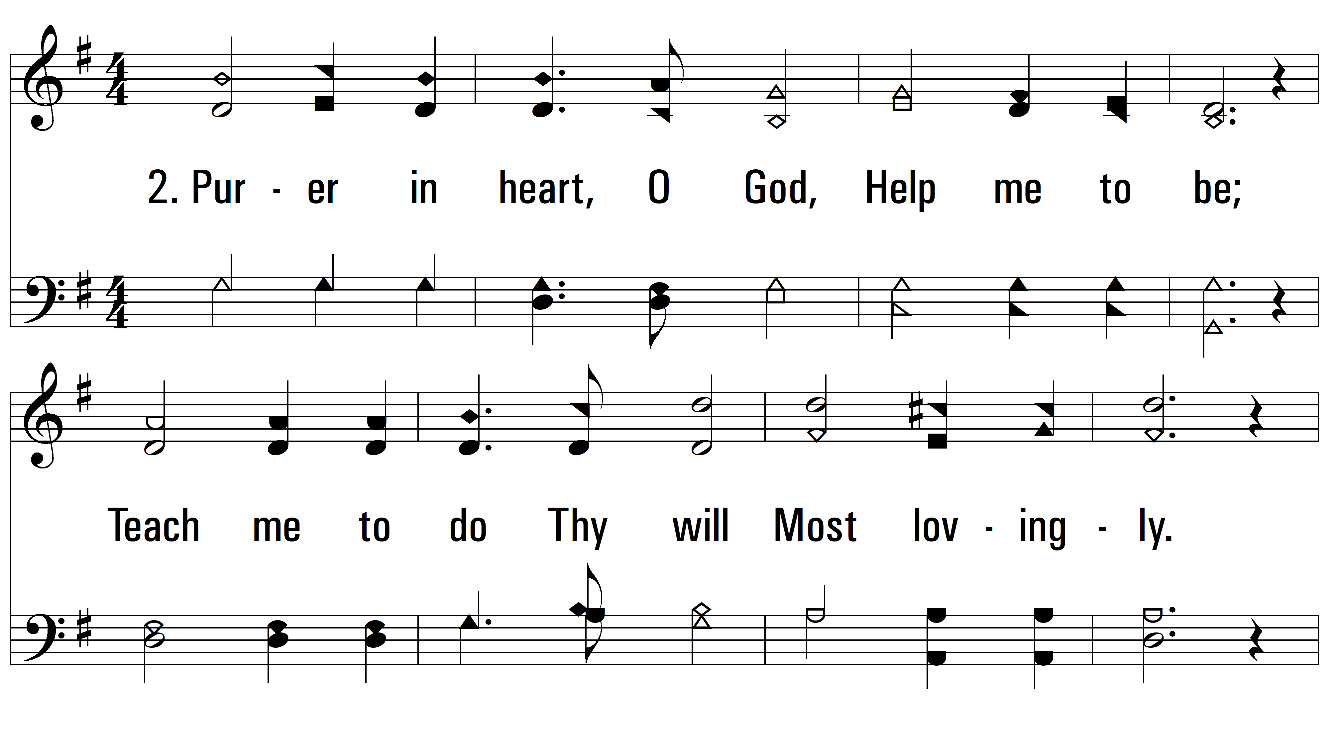
vs. 2 ~ Purer In Heart, O God

Slide 5
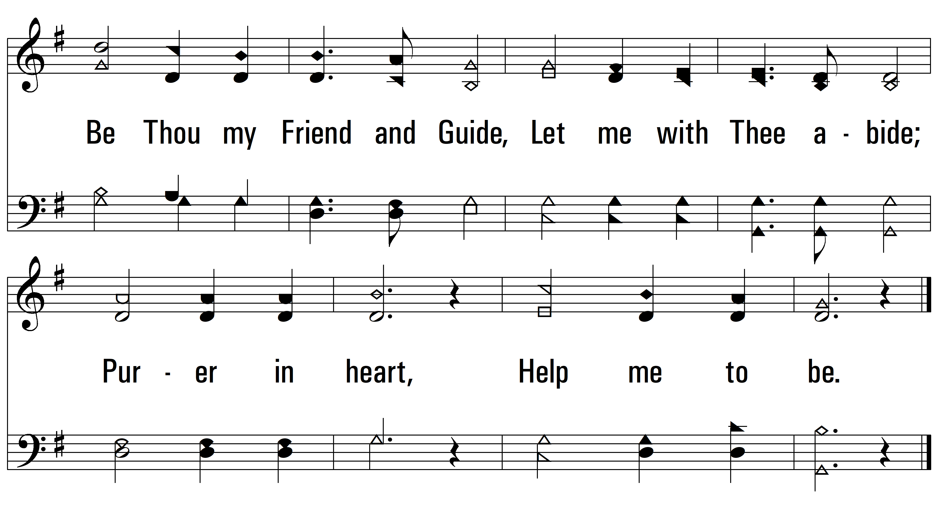
vs. 2

Slide 6
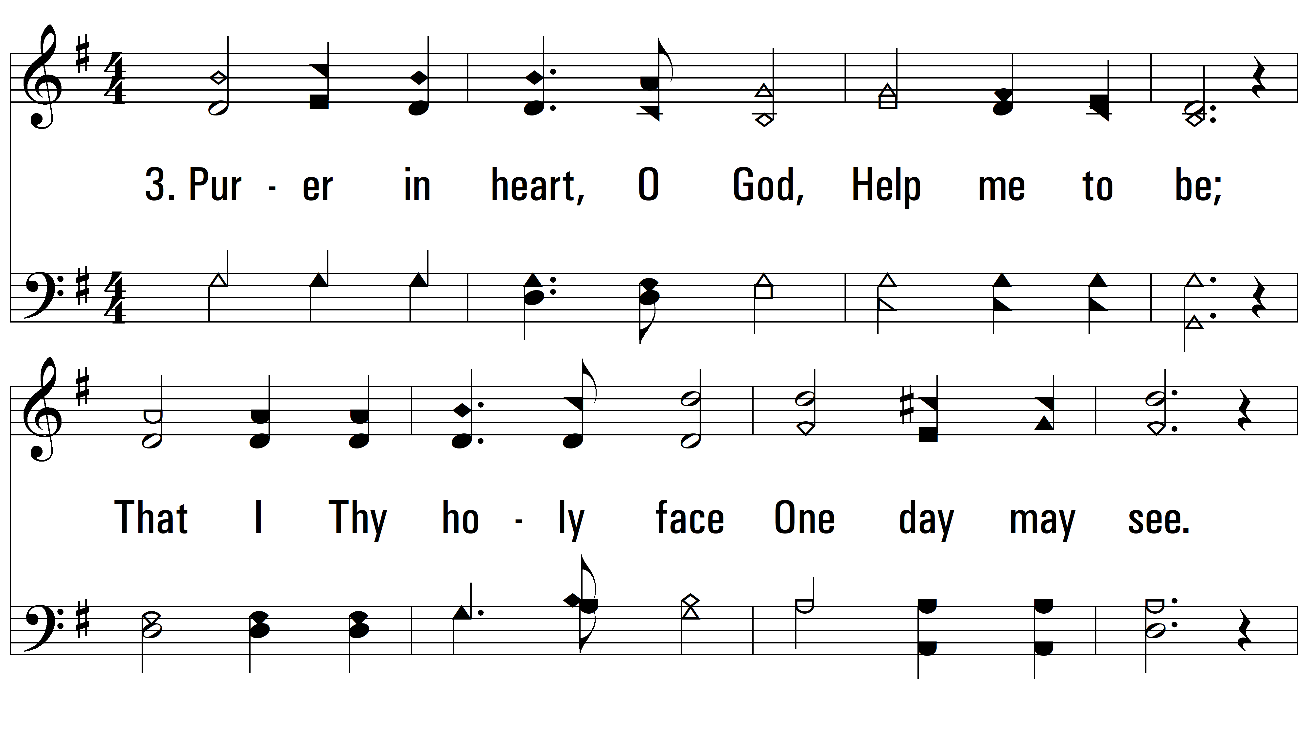
vs. 3 ~ Purer In Heart, O God

Slide 7
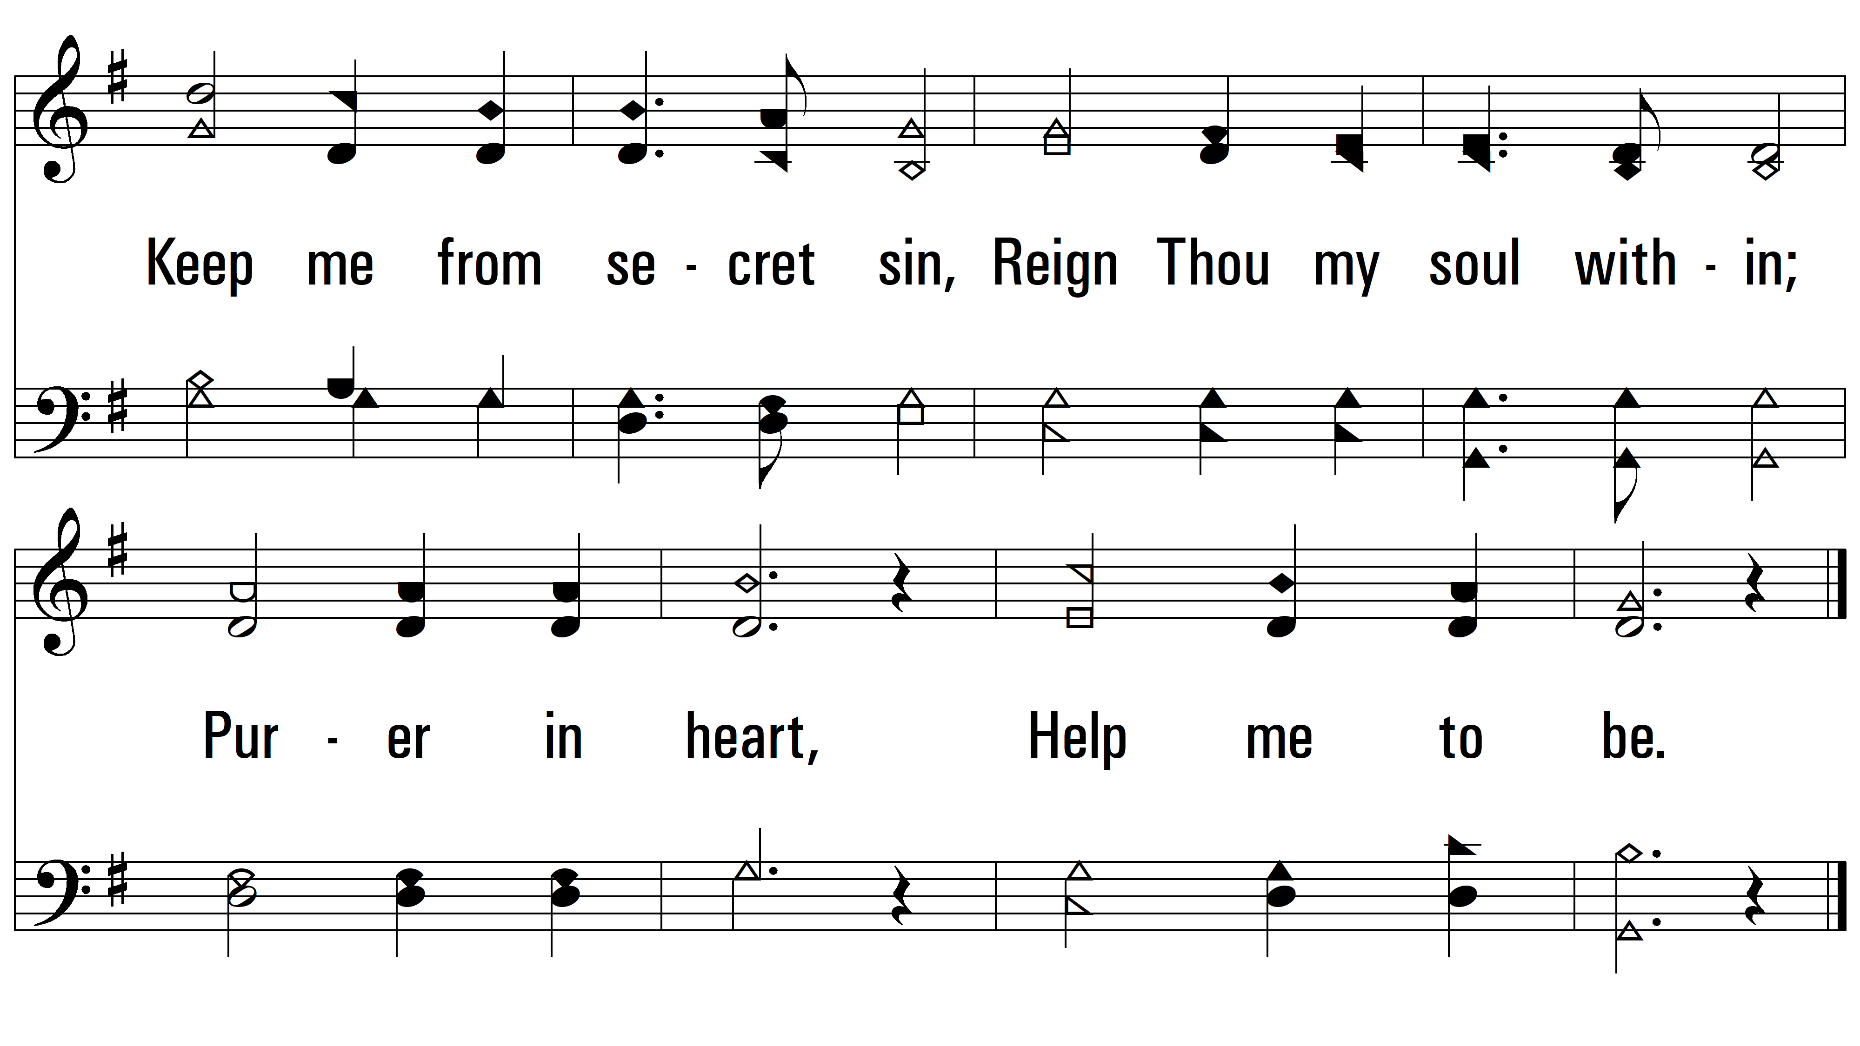
vs. 3
PDHymns.com
END

