Slide 1
Prince Of Peace! Control My Will
HATFIELD
7.7.7.7
Words: | Mary A. S. Barber (1838)
Music: | W. T. Porter (1874)
3/8
E^{b}/G - MI
Verses: 3
Lead - | MI
Alto - | DO
Tenor - | SOL
Bass - | DO
PDHymns.com

Slide 2
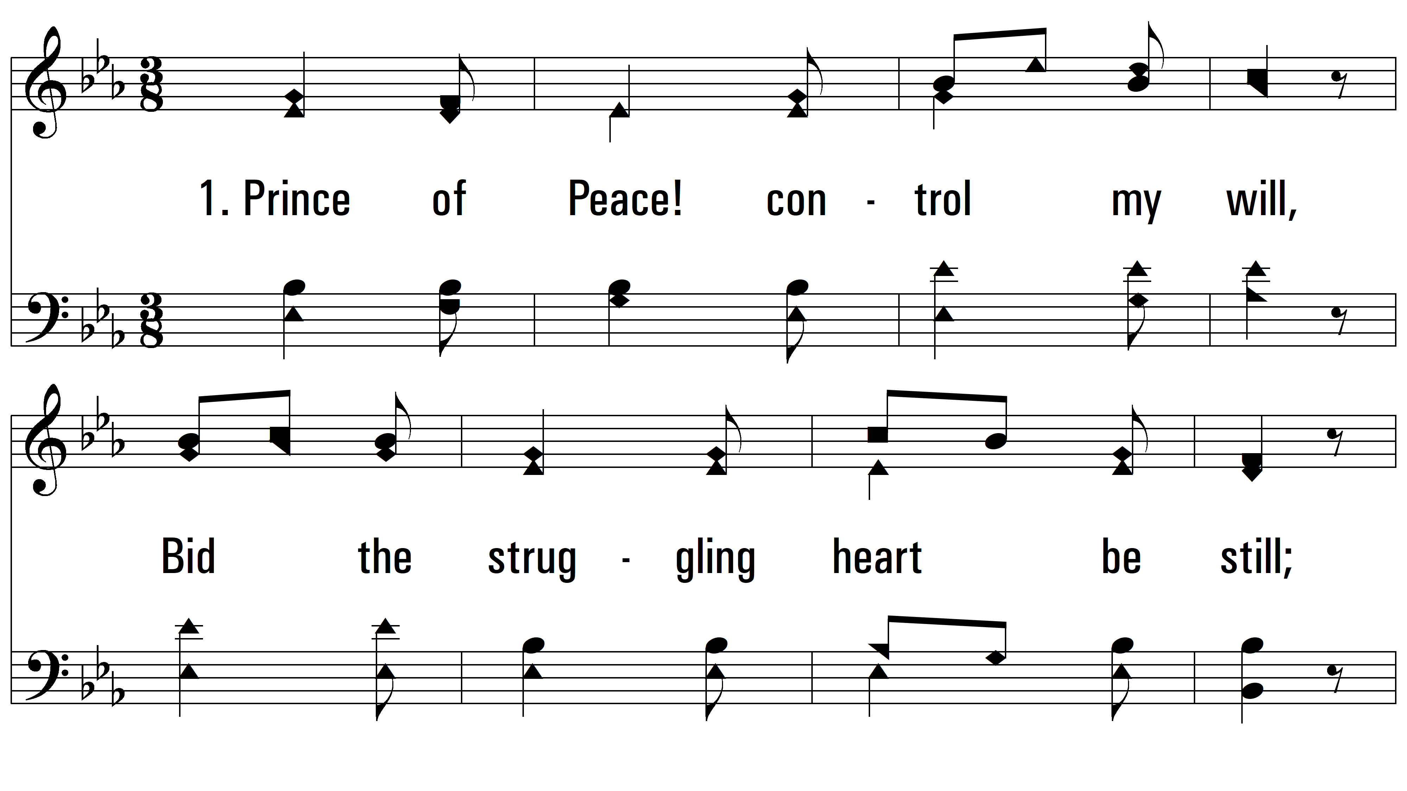
vs. 1 ~ Prince Of Peace! Control My Will

Slide 3
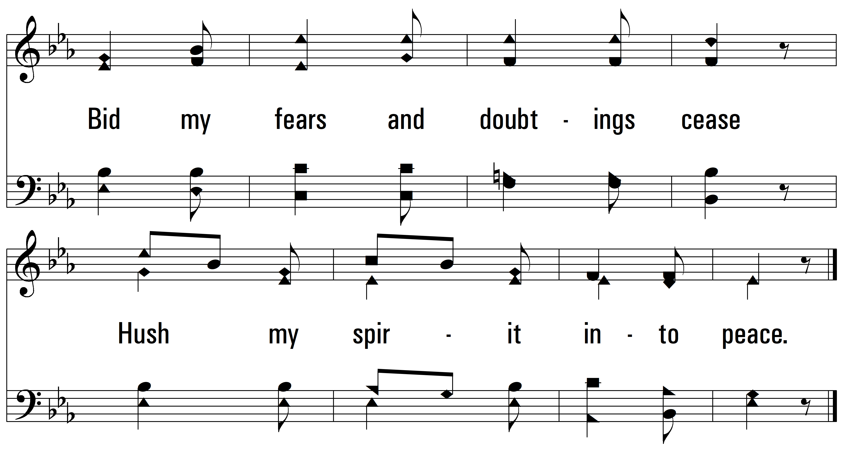
vs. 1

Slide 4
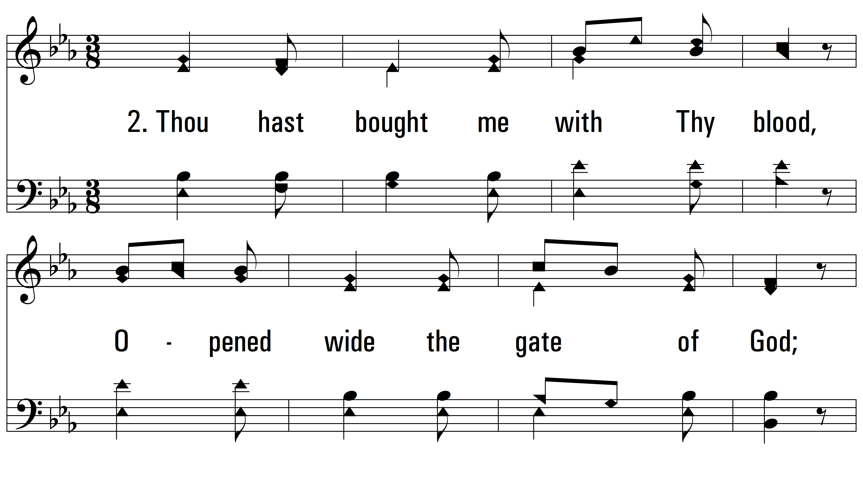
vs. 2 ~ Prince Of Peace! Control My Will

Slide 5
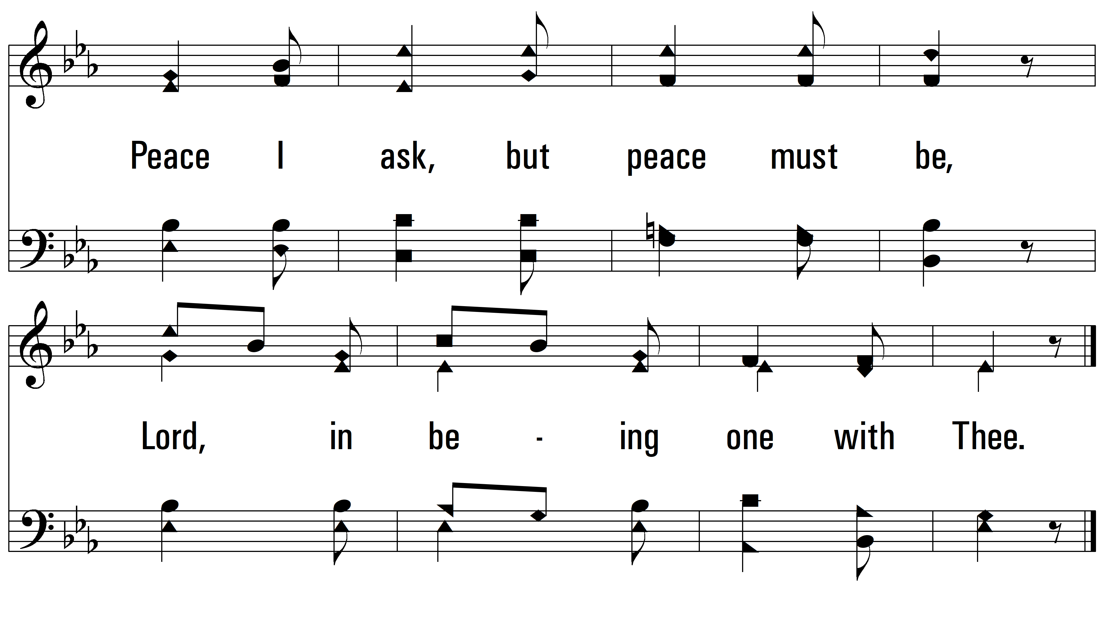
vs. 2

Slide 6
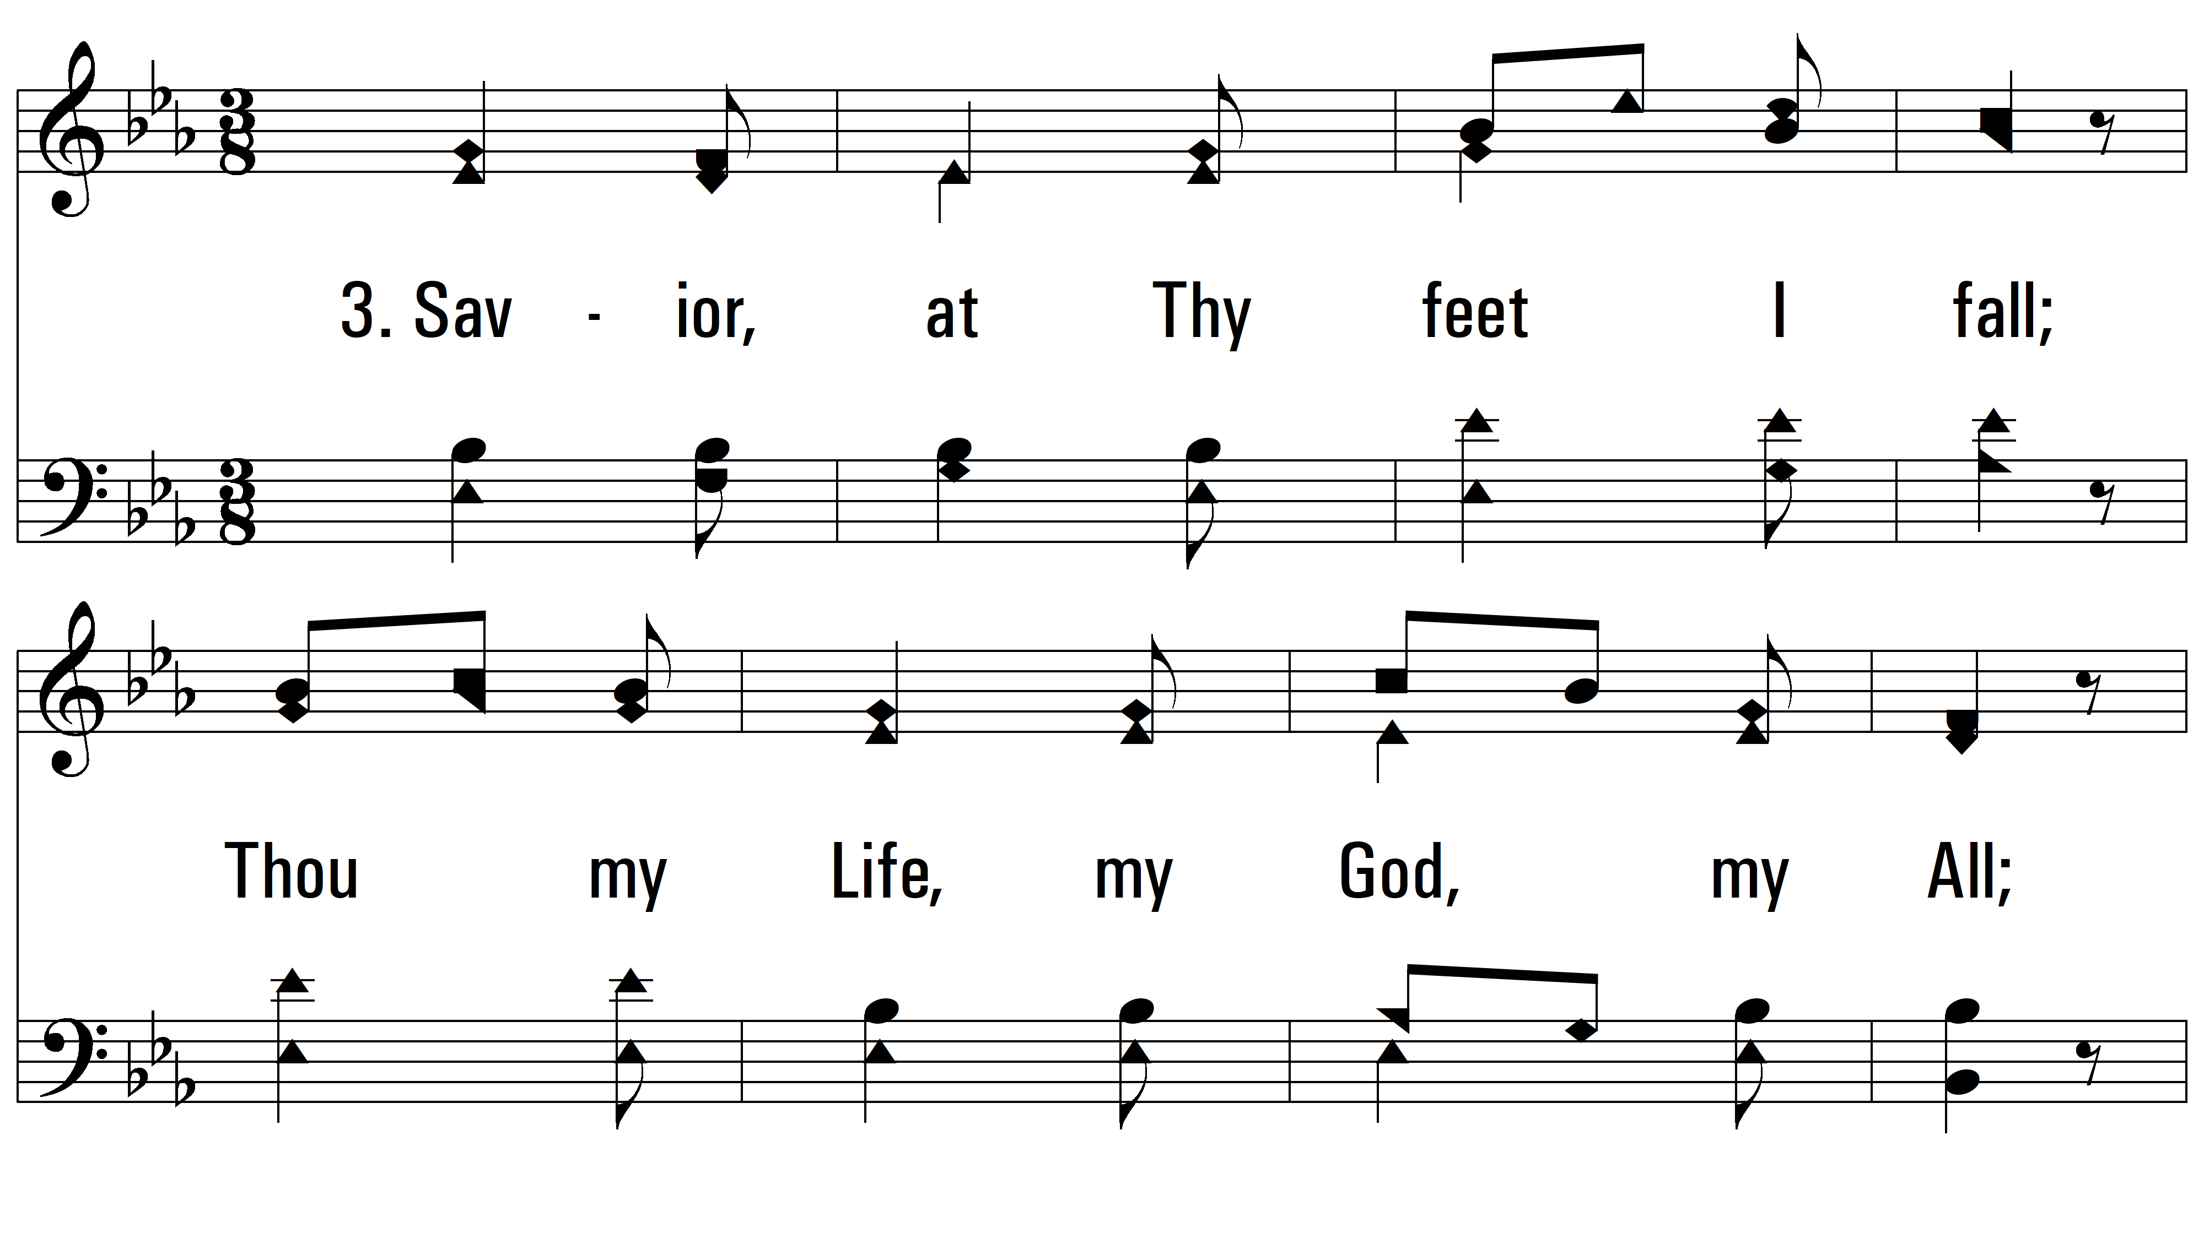
vs. 3 ~ Prince Of Peace! Control My Will

Slide 7
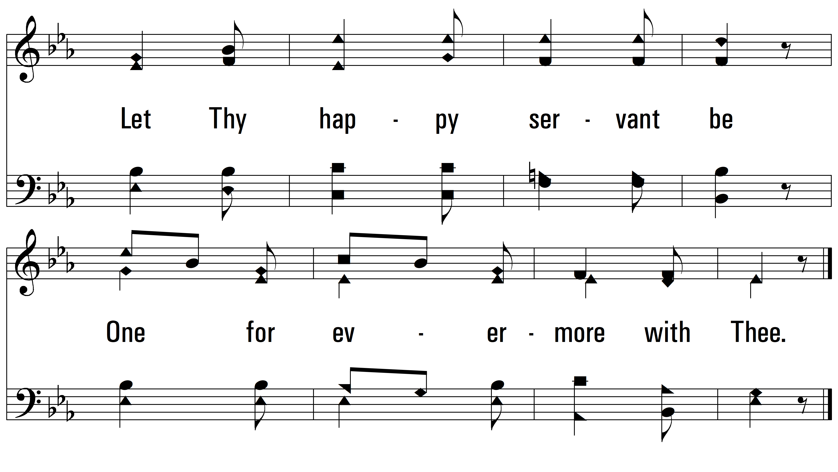
vs. 3
PDHymns.com
END

