Slide 1
Precious Words (Precious Forever)
Words: | Mrs. Loula K. Rodgers
Music: | R. M. McIntosh (1881)
6/8
A/E - SOL
Verses: 3/Chorus
Lead - | SOL
Alto - | MI
Tenor - | DO
Bass - | DO
PDHymns.com

Slide 2
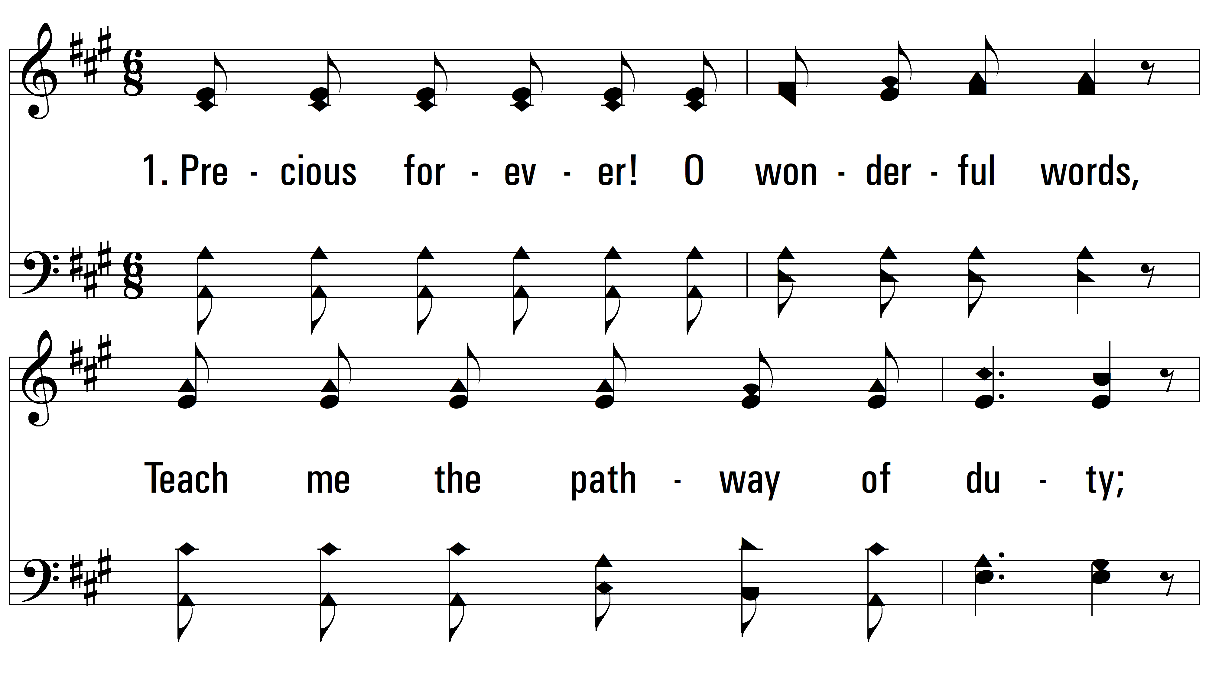
vs. 1 ~ Precious Words (Precious Forever)

Slide 3
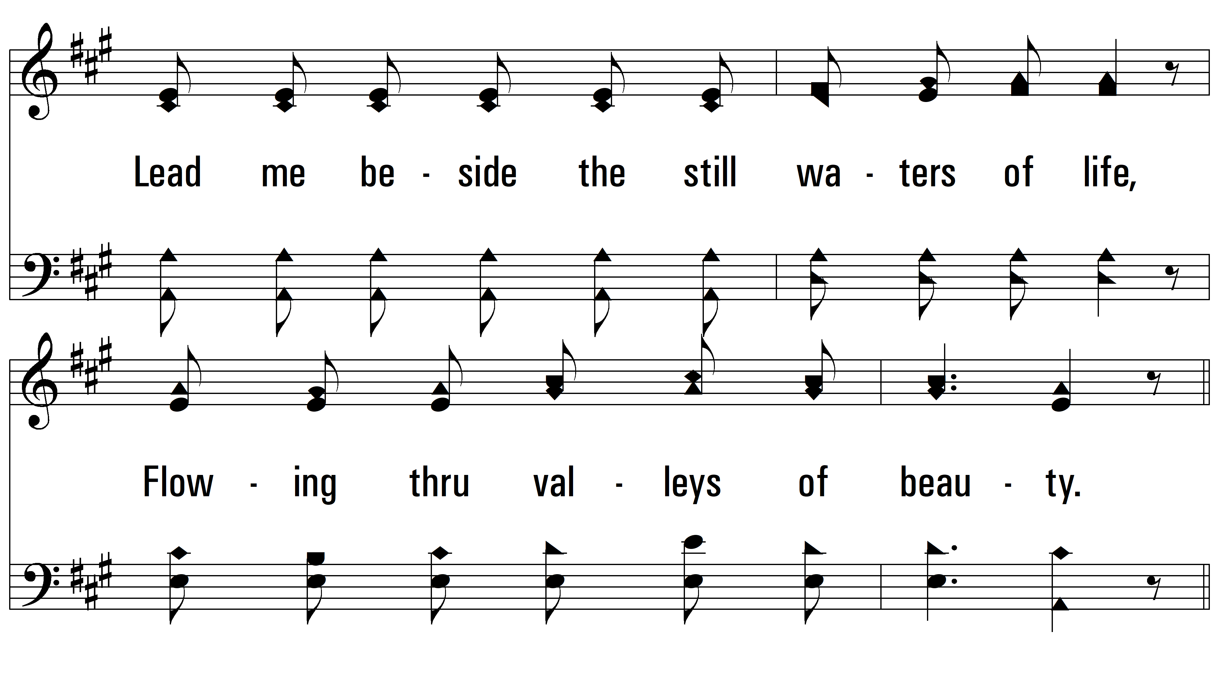
vs. 1

Slide 4
vs. 1

Slide 5
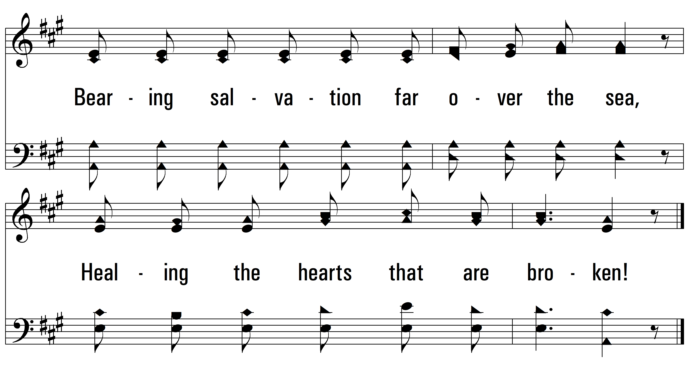
vs. 1

Slide 6
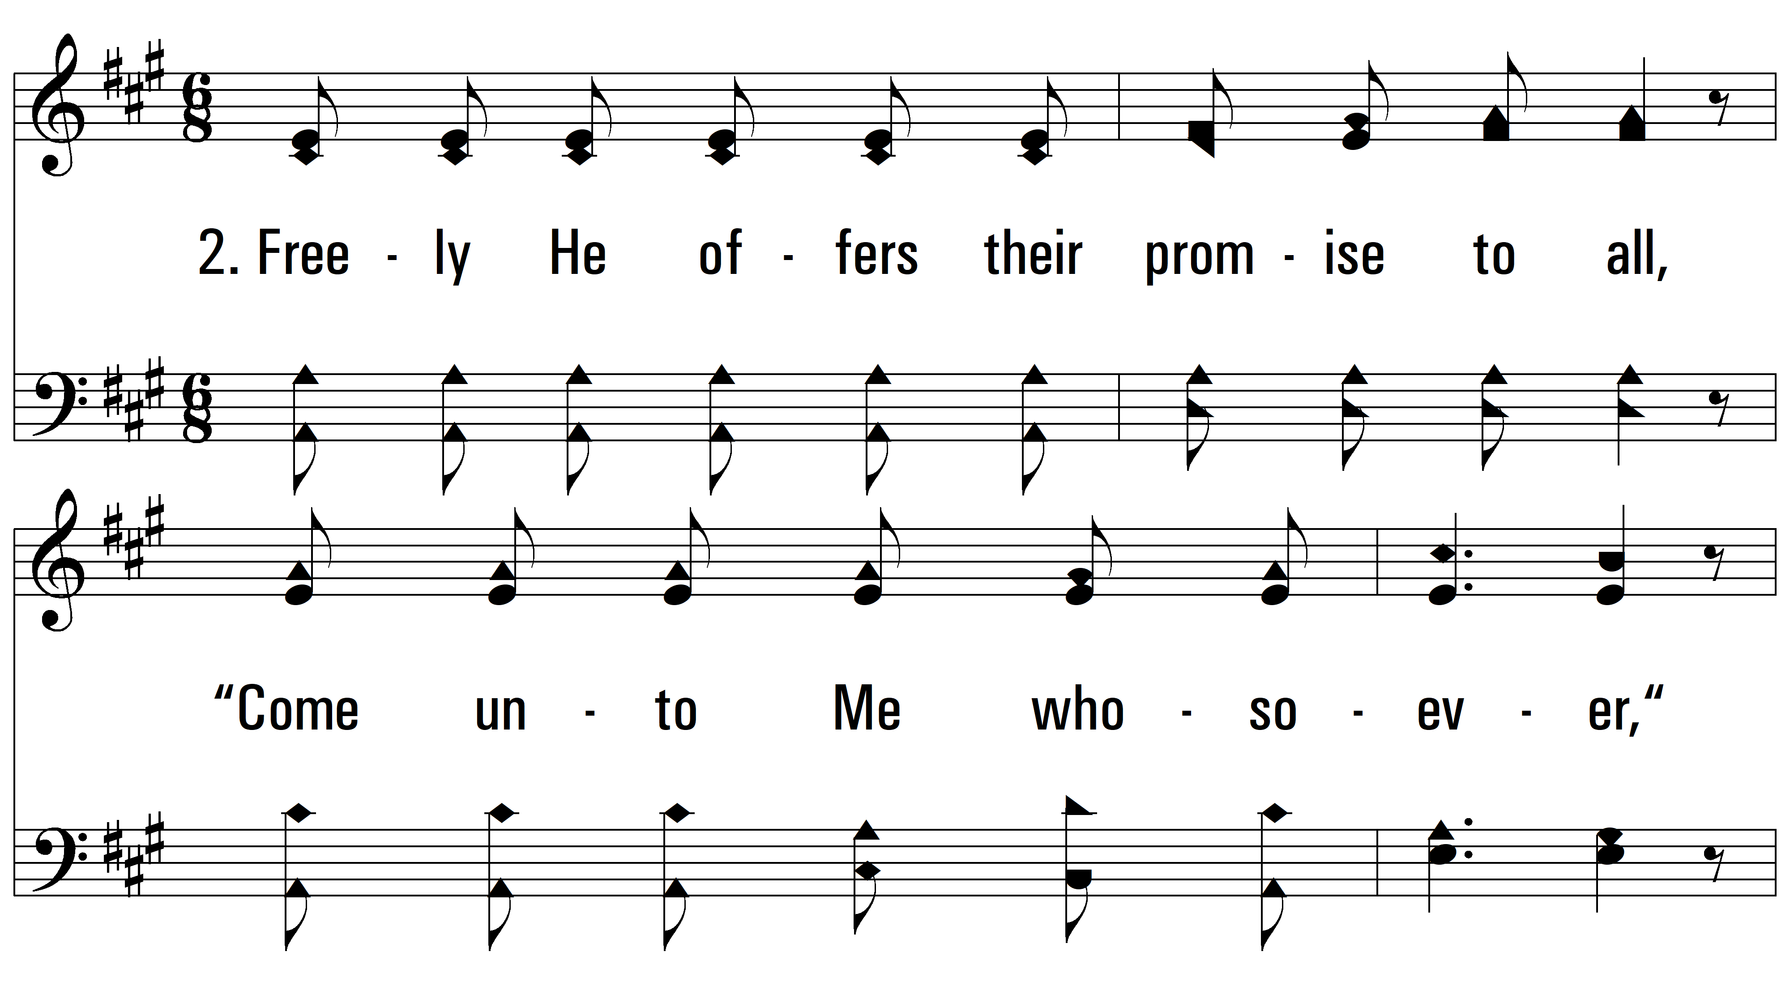
vs. 2 ~ Precious Words (Precious Forever)

Slide 7
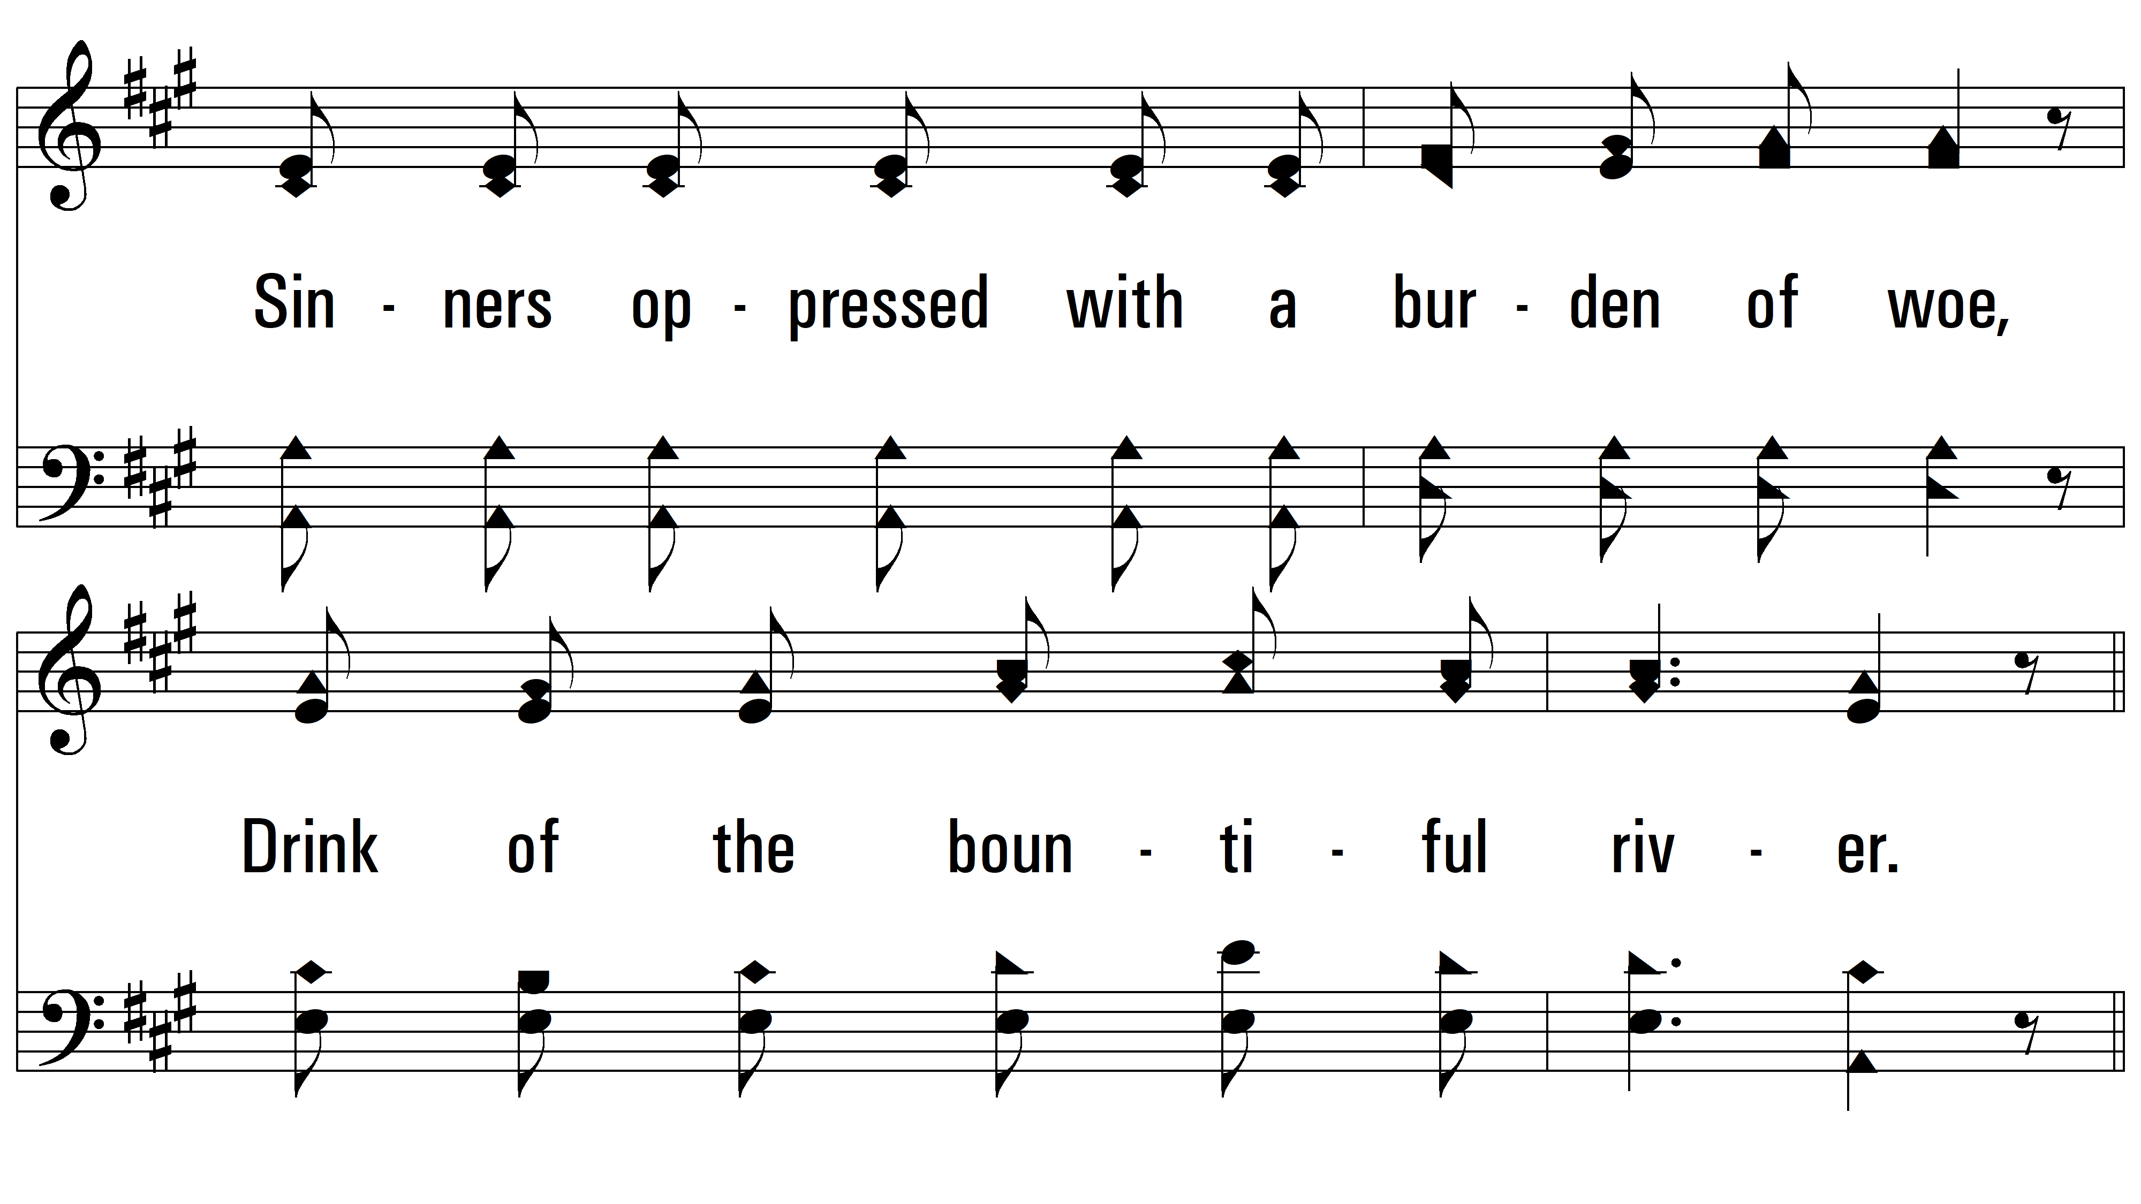
vs. 2

Slide 8
vs. 2

Slide 9
vs. 2

Slide 10
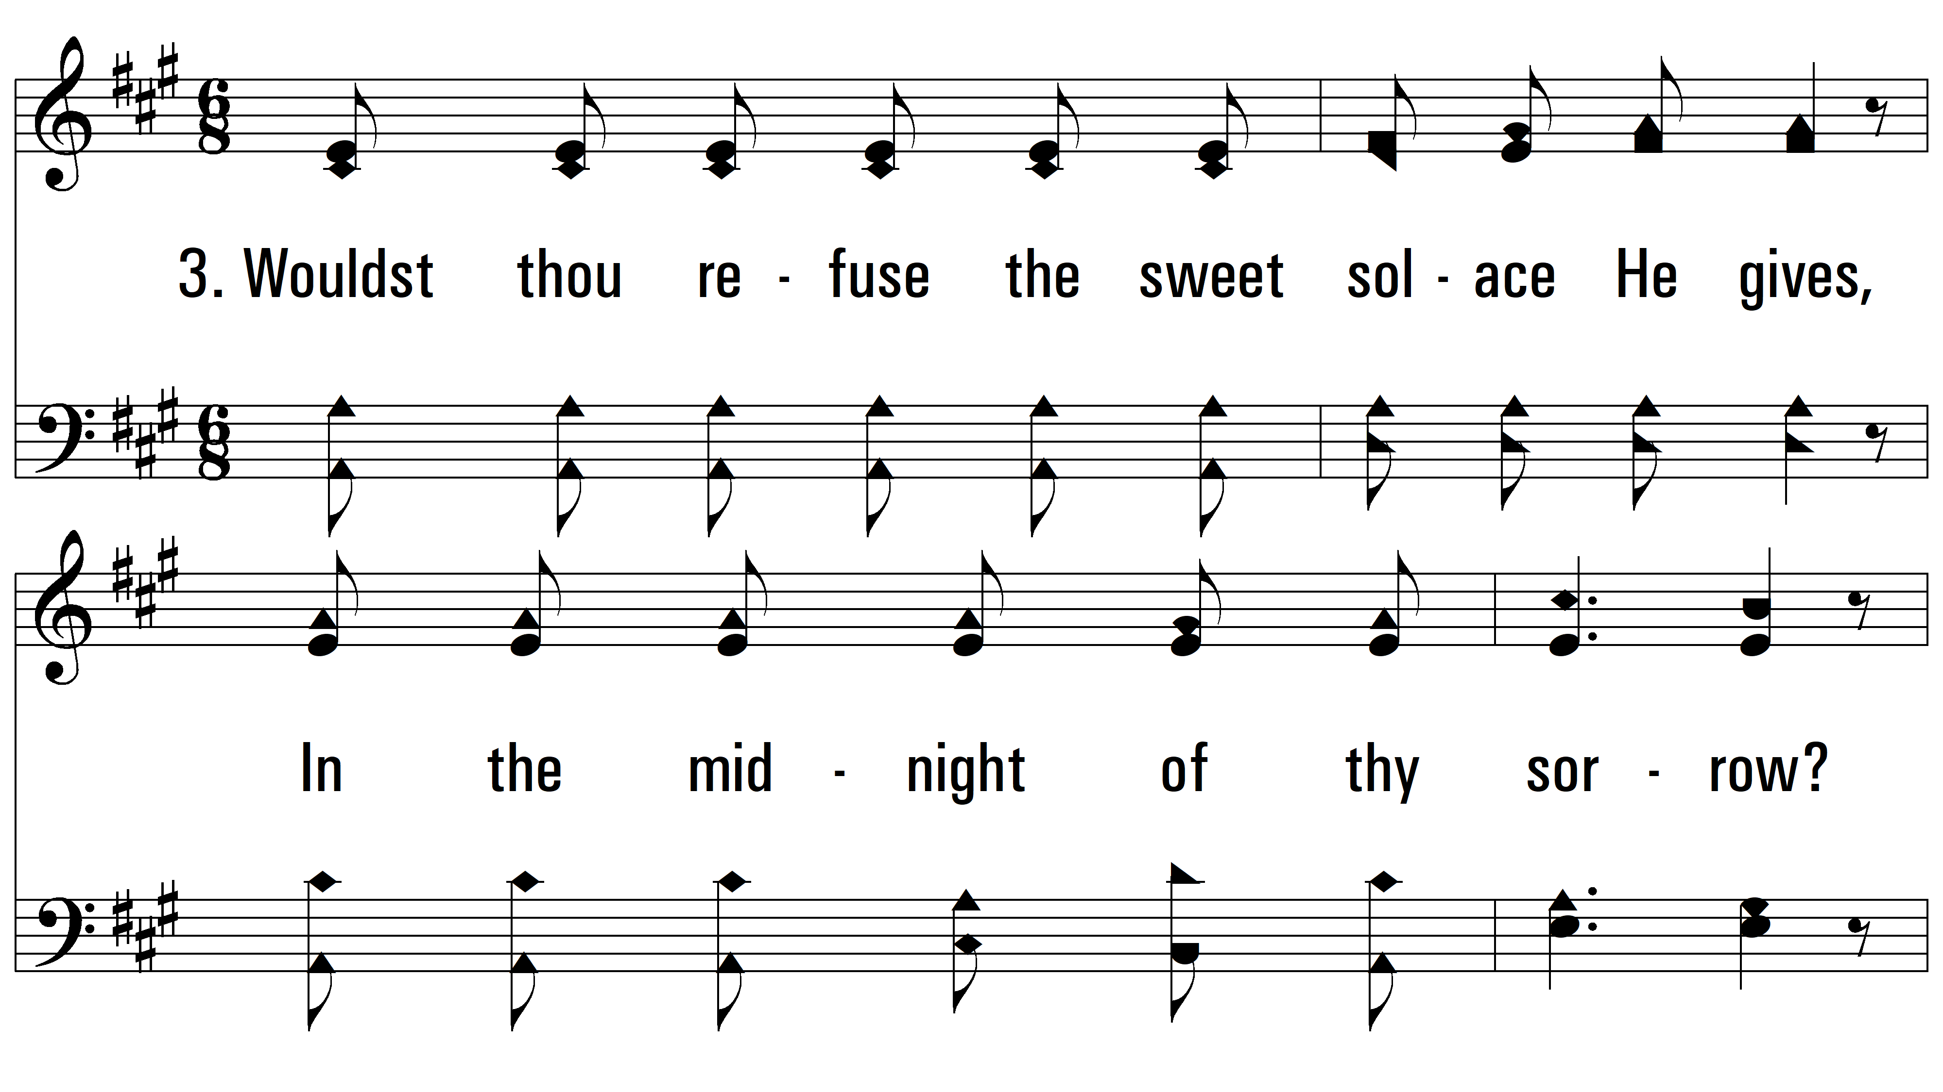
vs. 3 ~ Precious Words (Precious Forever)

Slide 11
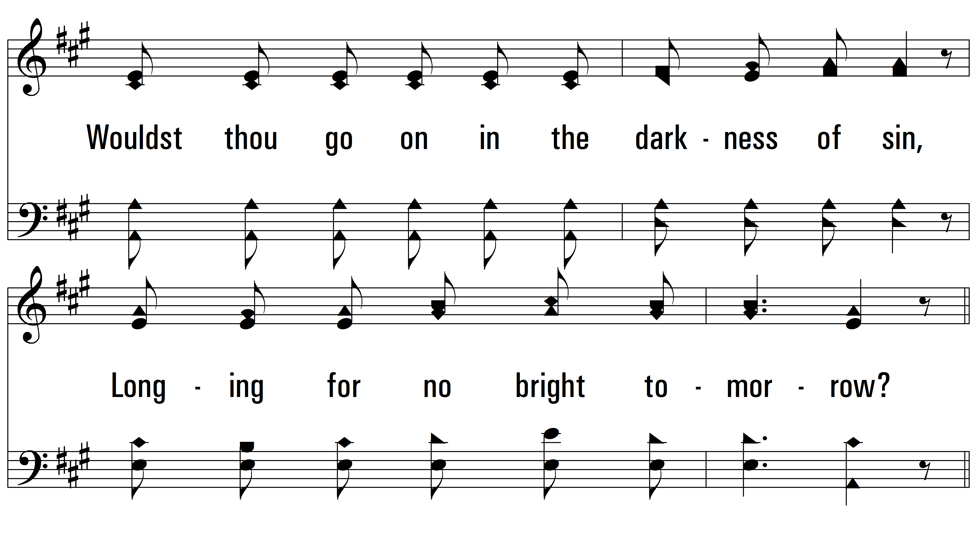
vs. 3

Slide 12
vs. 3

Slide 13
vs. 3
PDHymns.com
END

