Slide 1
Praise to God, Immortal Praise
PLEYEL’S HYMN
7.7.7.7
Words: | Anna L. Barbauld (1772)
Music: | Ignaz J. Pleyel (1791)
2/4
G/B - MI
Verses: 3
Lead - | MI
Alto - | DO
Tenor - | SOL
Bass - | DO
PDHymns.com

Slide 2
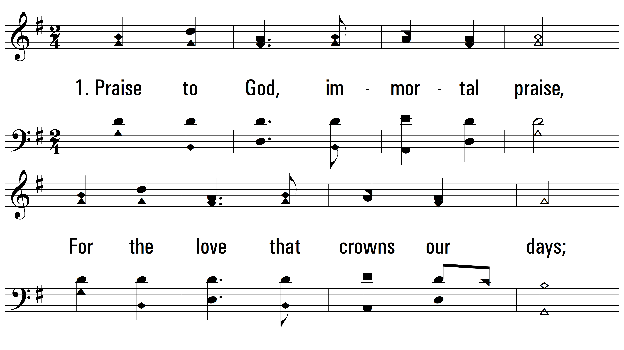
vs. 1 ~ Praise to God, Immortal Praise

Slide 3
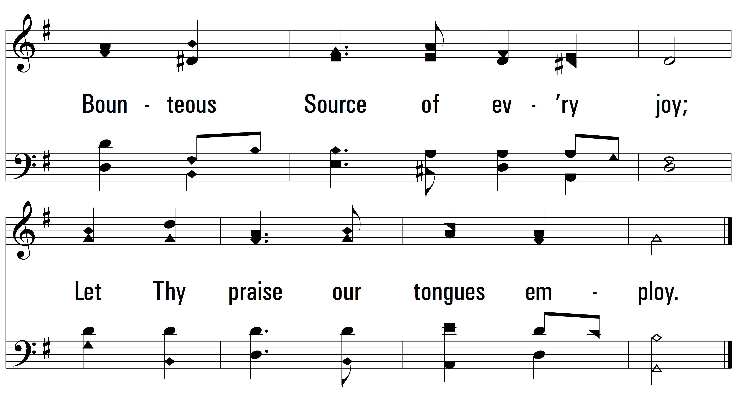
vs. 1

Slide 4
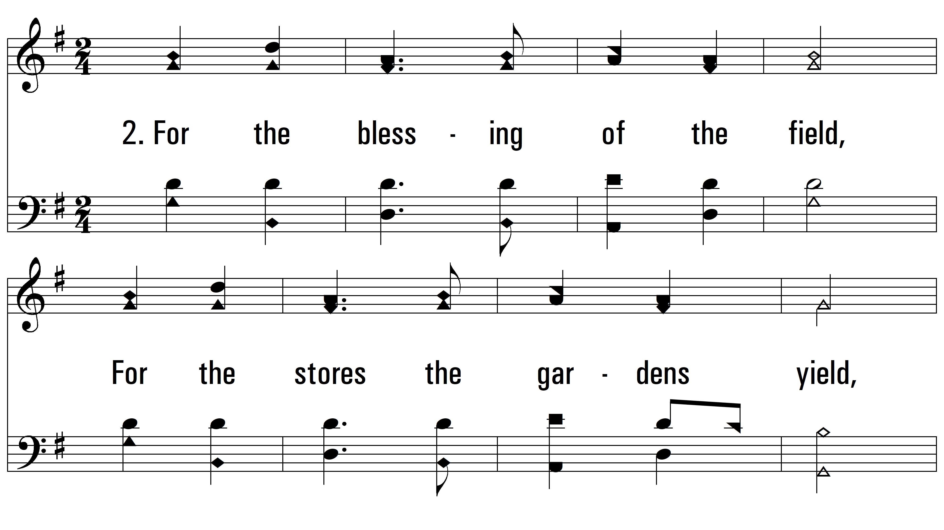
vs. 2 ~ Praise to God, Immortal Praise

Slide 5
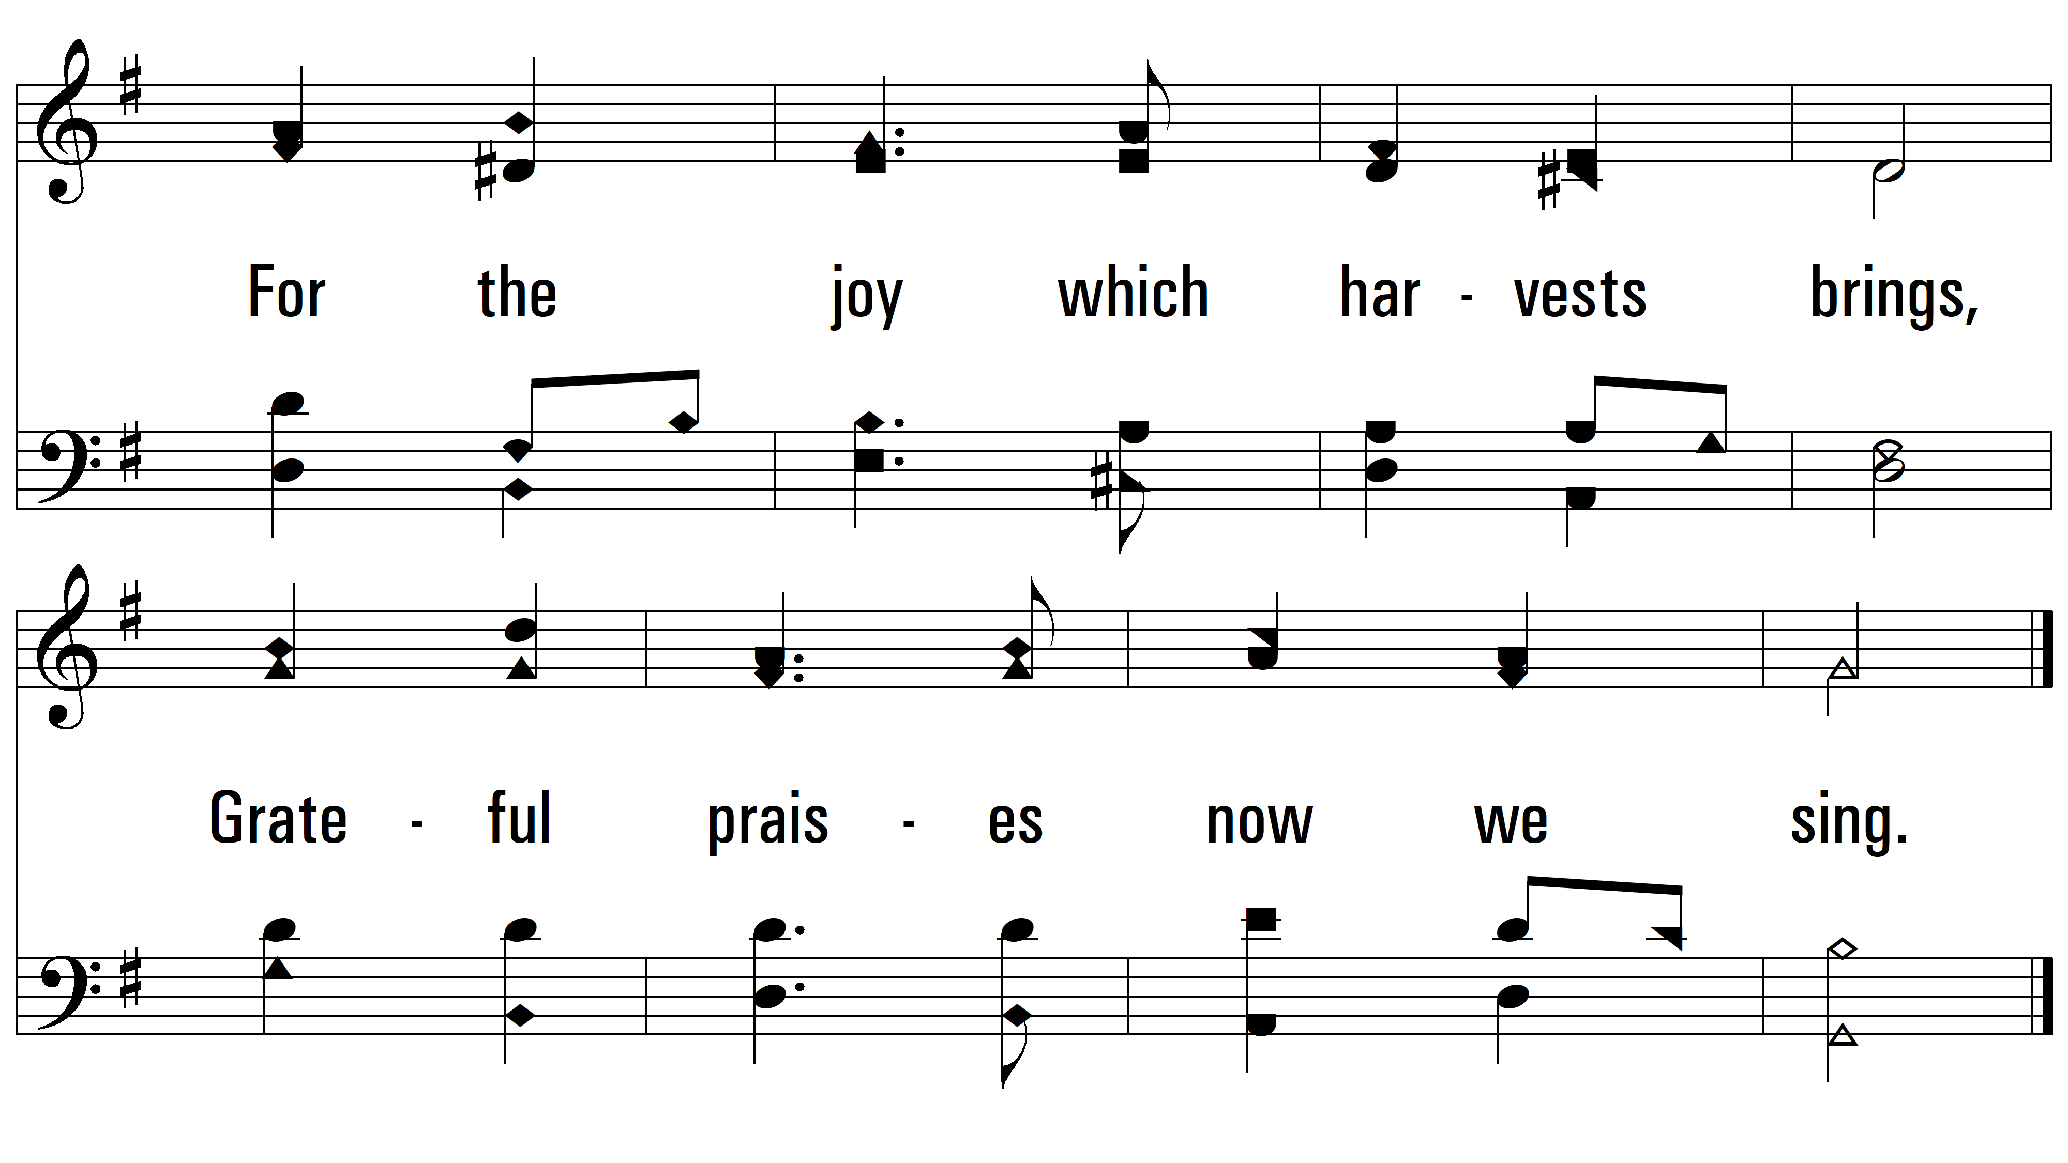
vs. 2

Slide 6
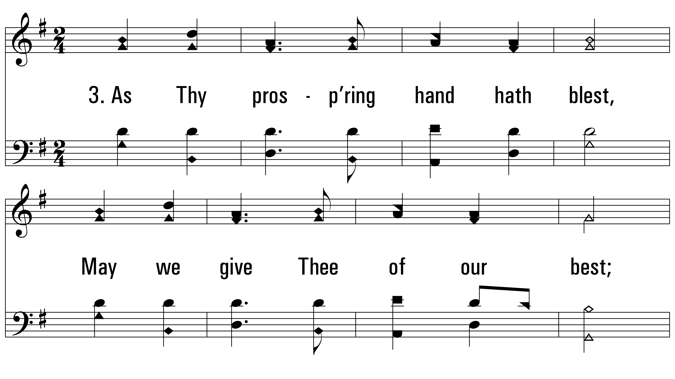
vs. 3 ~ Praise to God, Immortal Praise

Slide 7
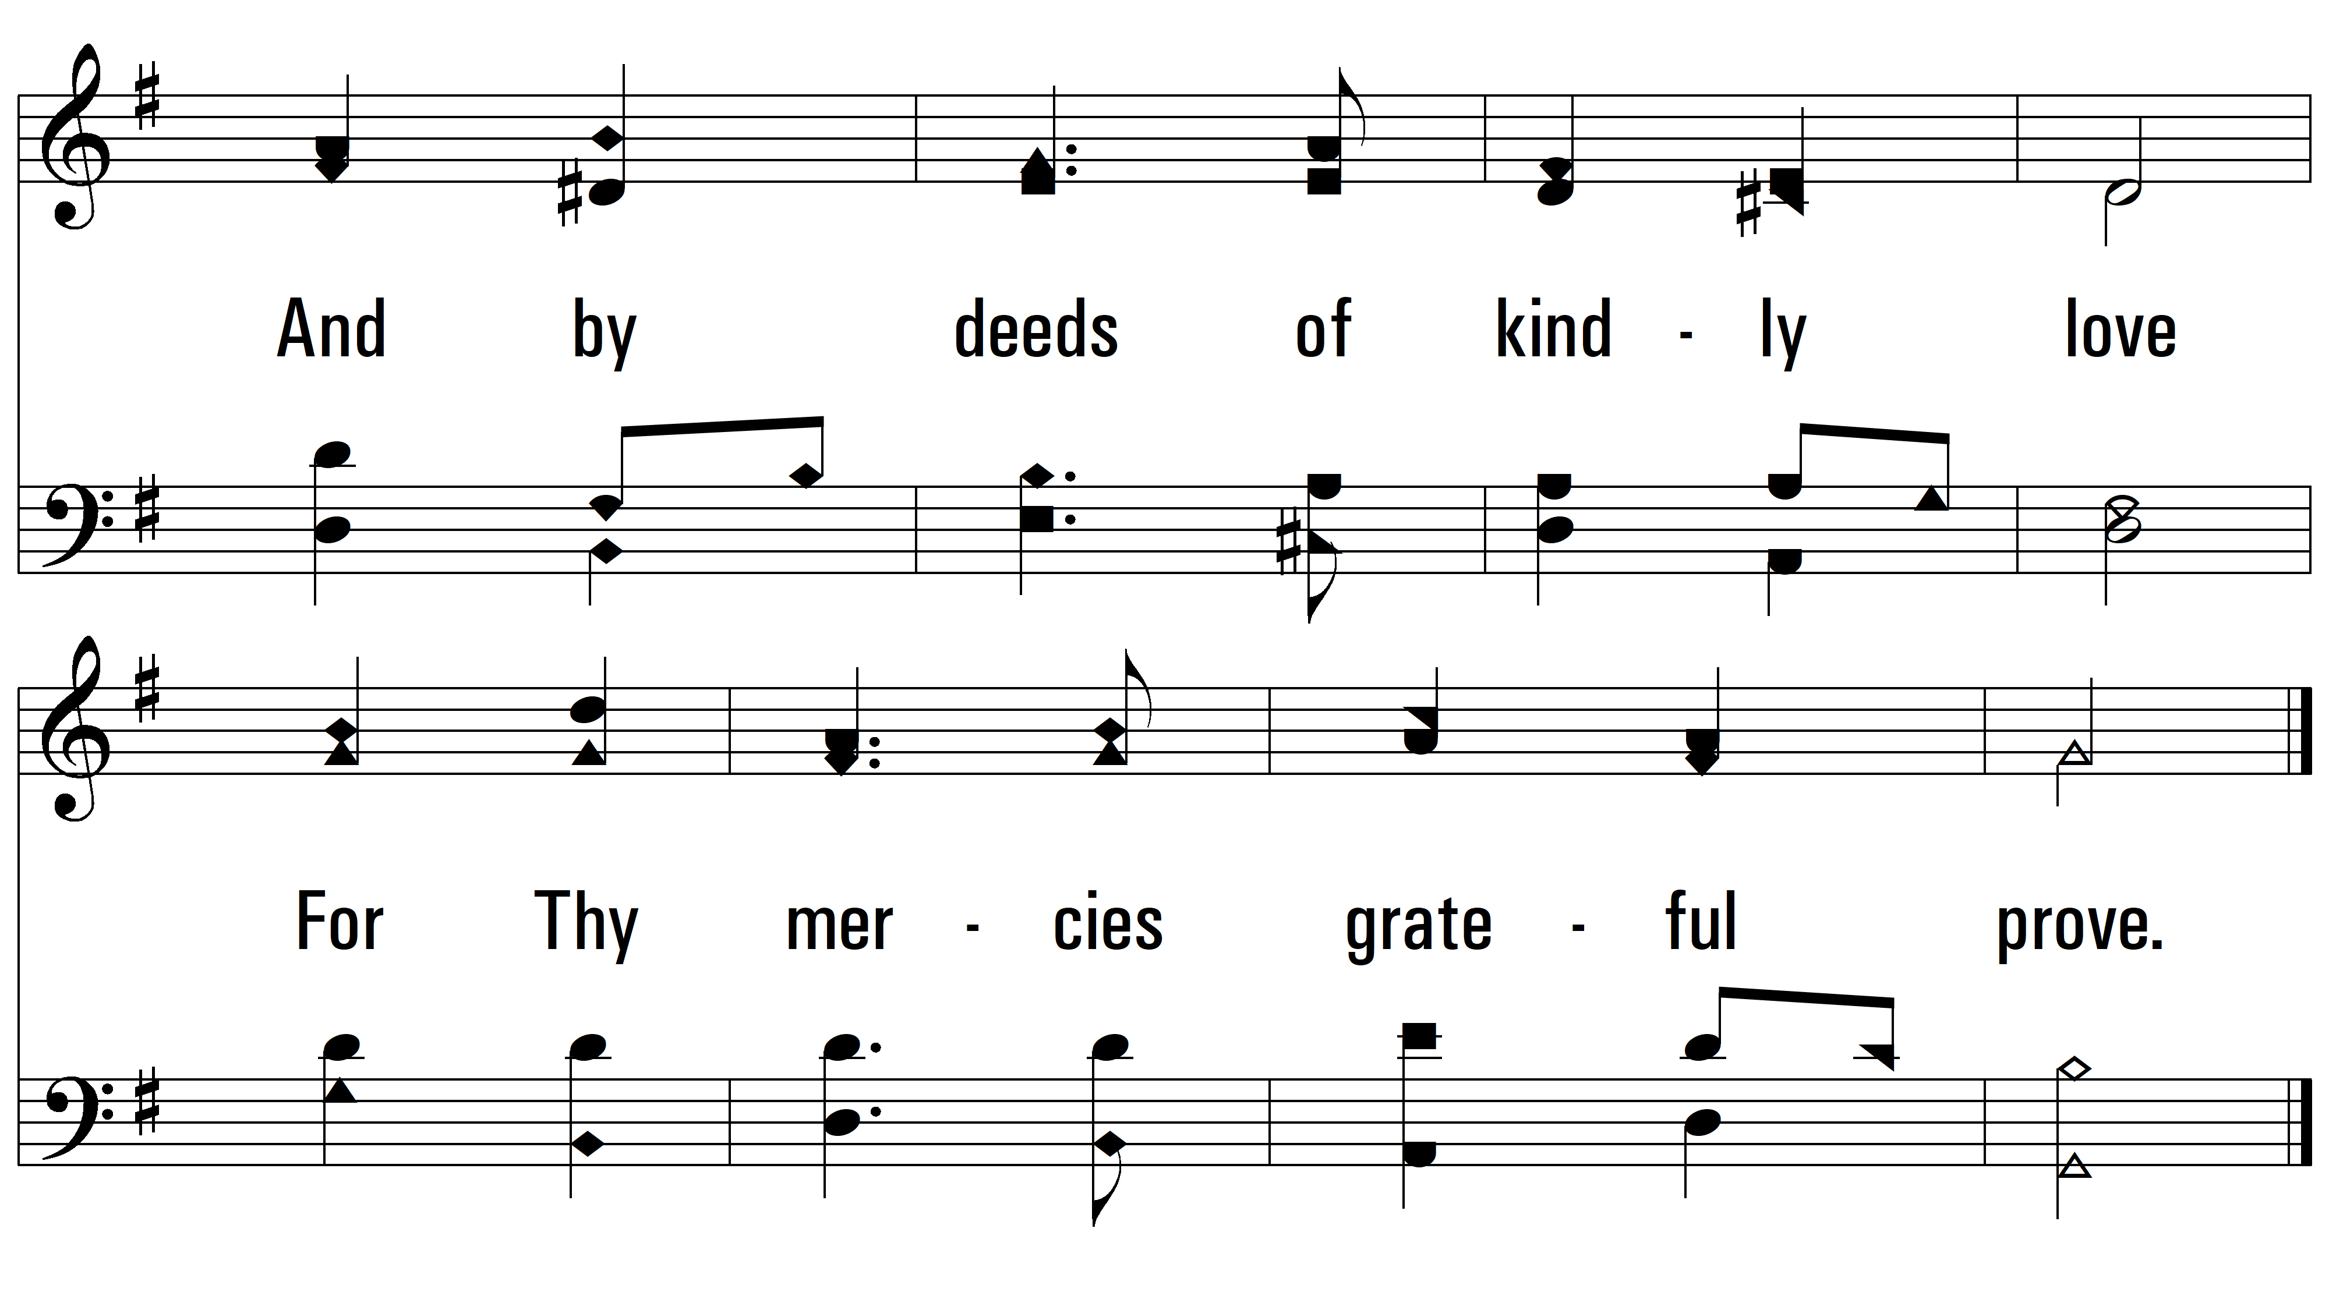
vs. 3
PDHymns.com
END

