Slide 1
Praise The Lord
PEREZ
8.7.8.7
Words: | J. Kempthorne (1796)
Music: | Lowell Mason (1841)
4/4
B^{b}/F - SOL
Verses: 4/Chorus
Lead - | SOL
Alto - | MI
Tenor - | DO
Bass - | DO
PDHymns.com

Slide 2
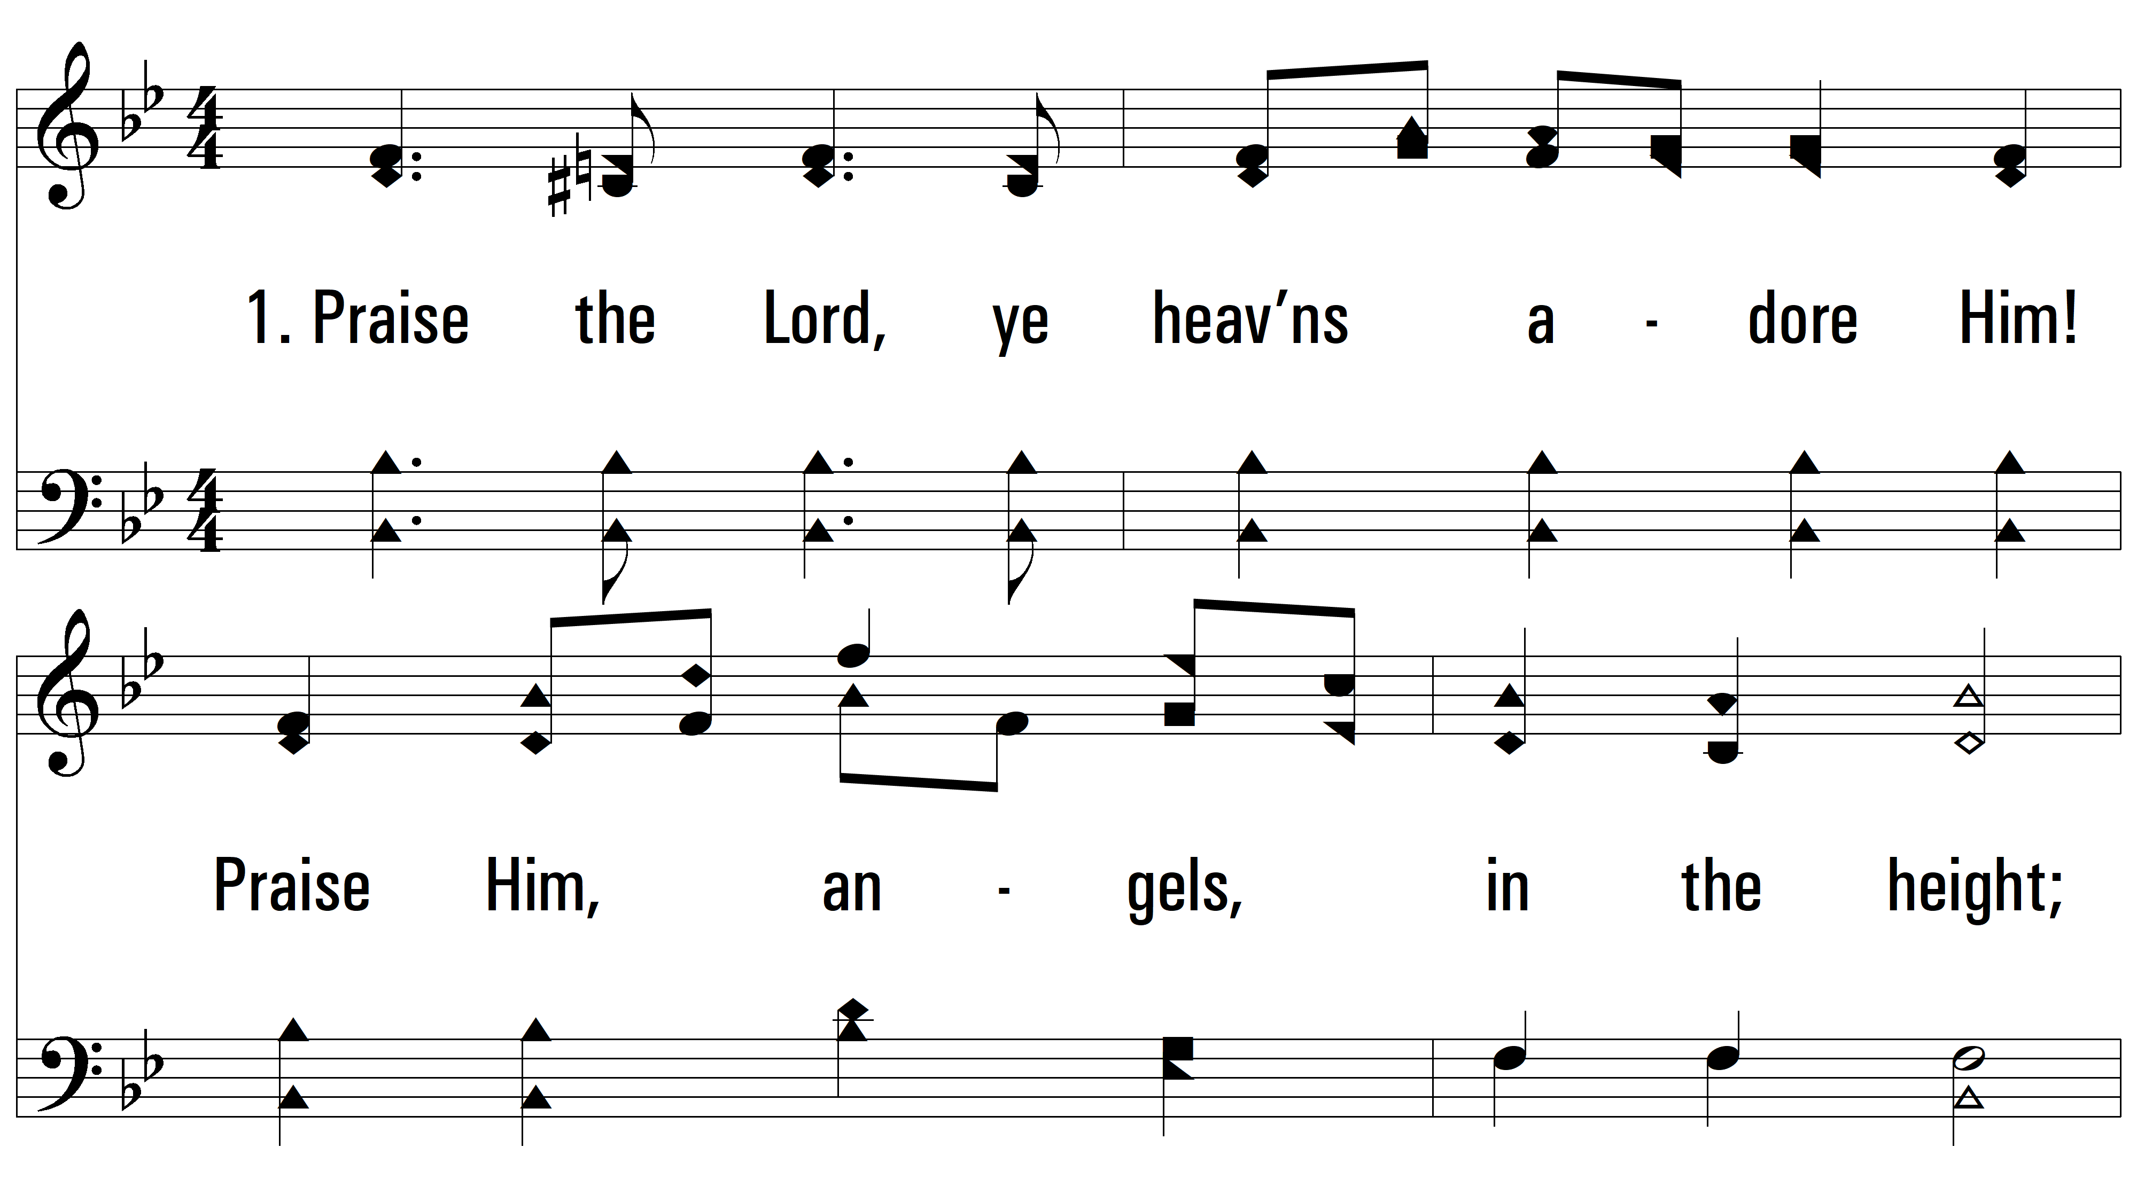
vs. 1 ~ Praise The Lord

Slide 3
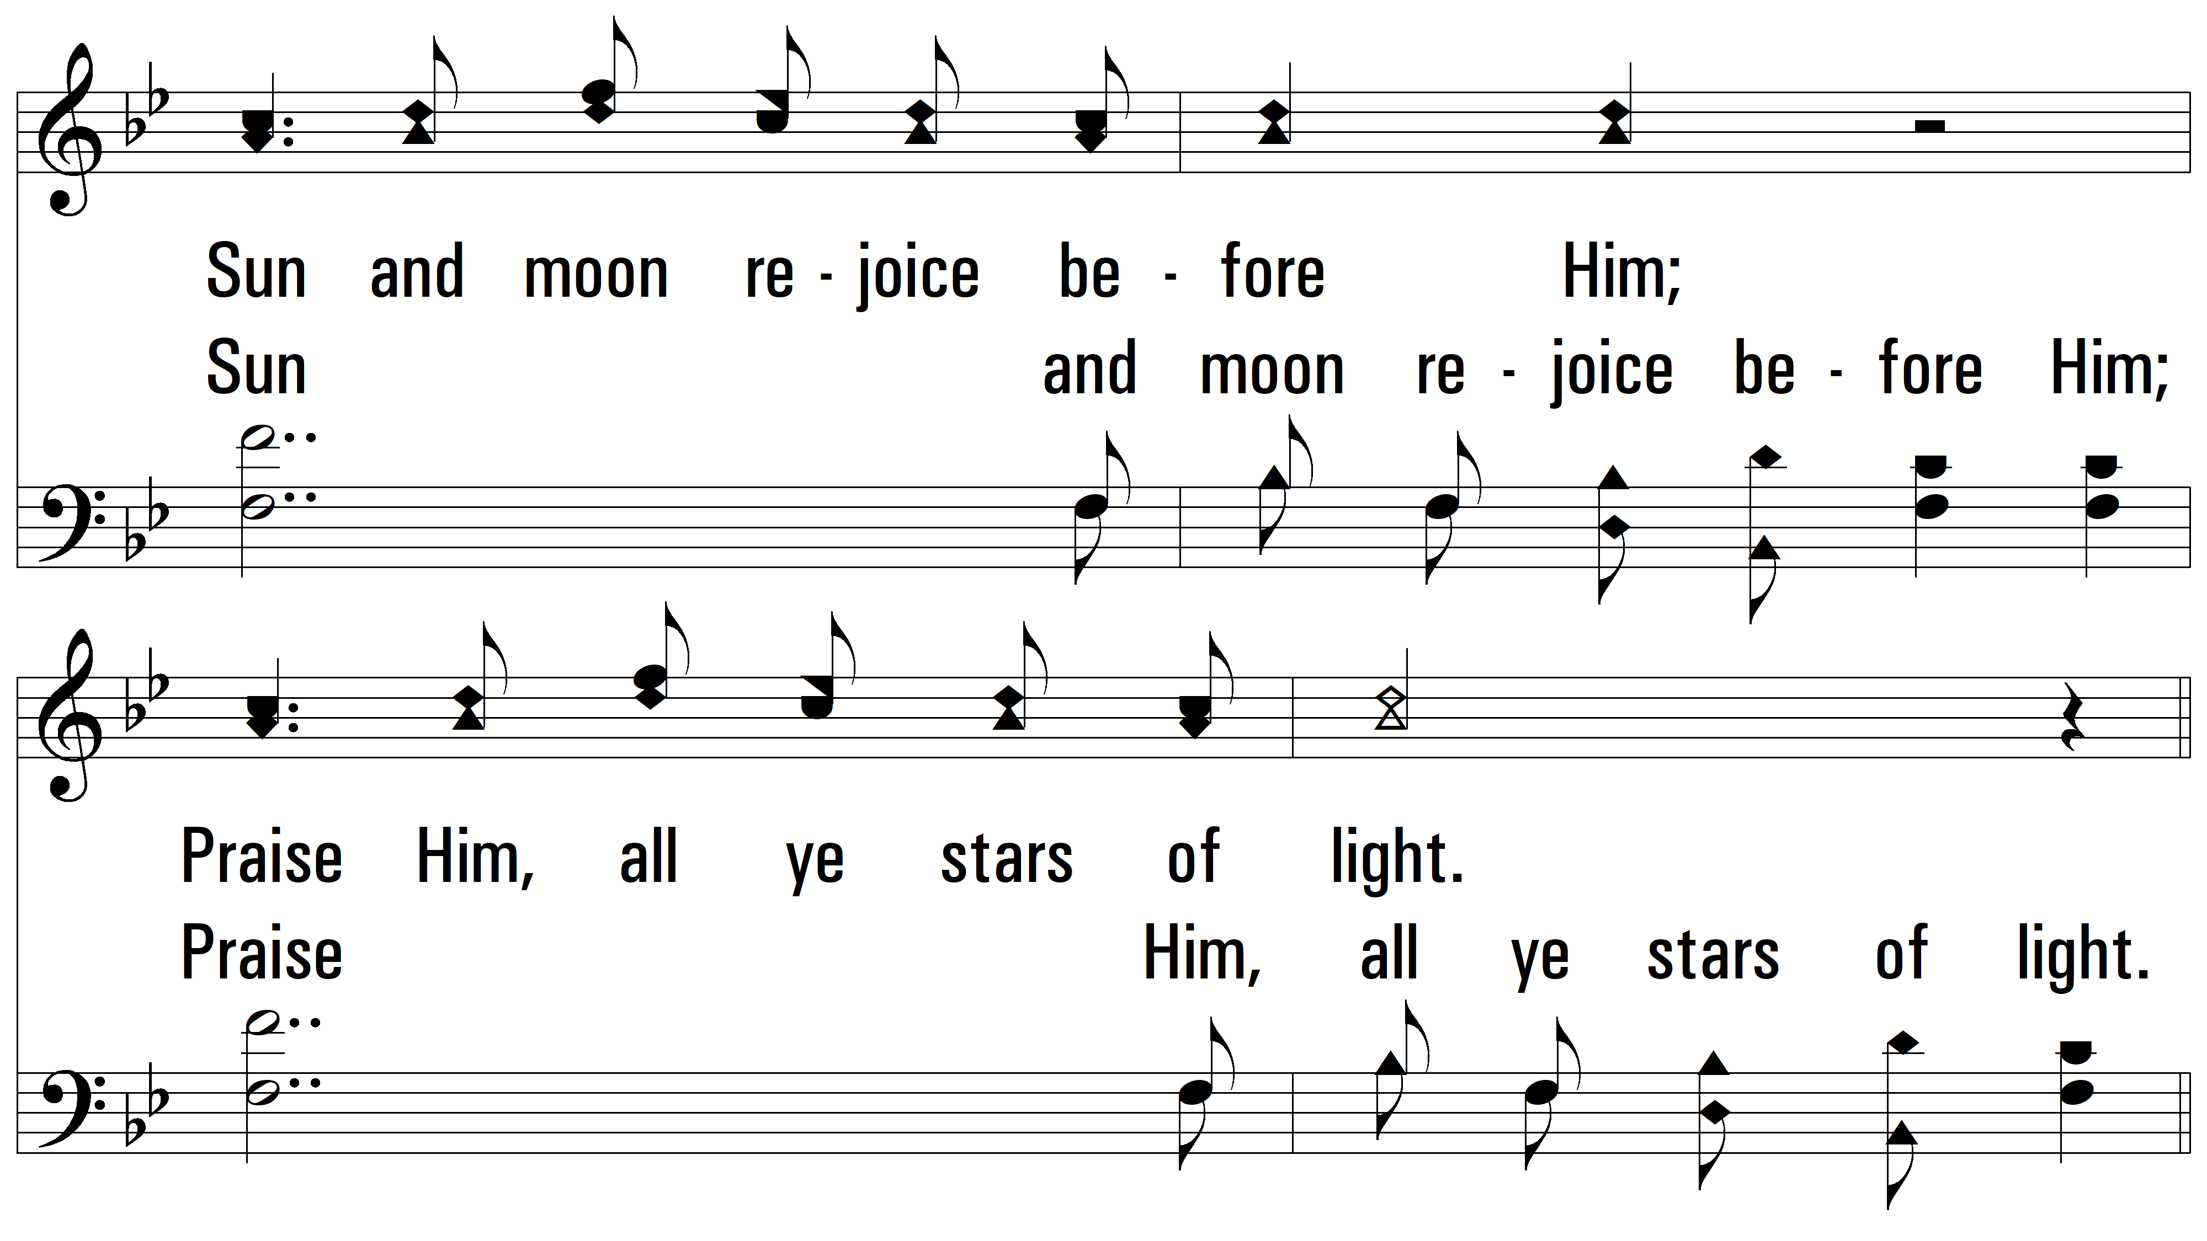
vs. 1

Slide 4
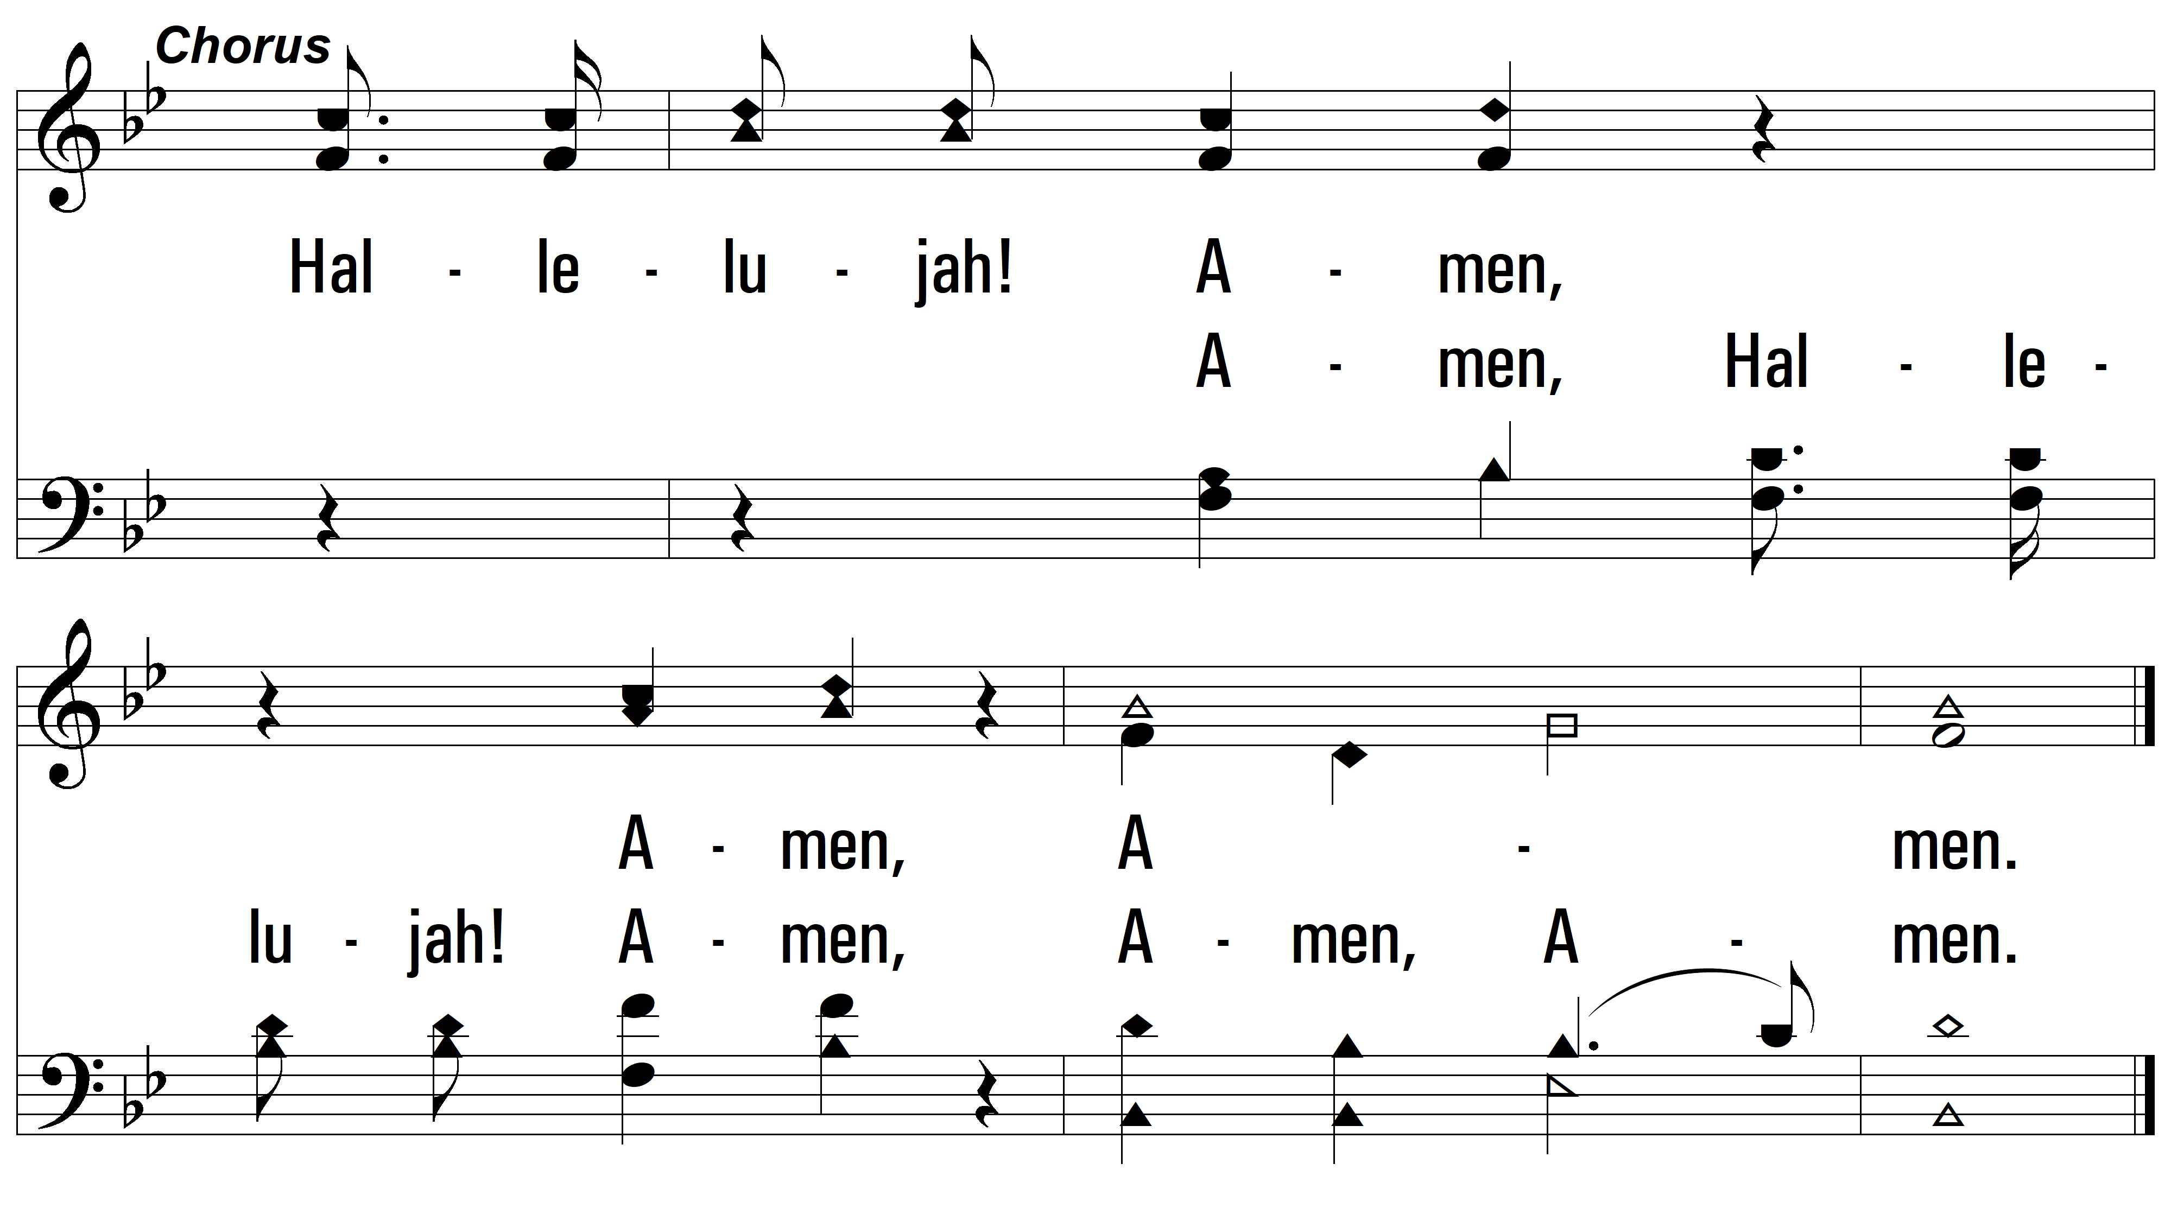
vs. 1

Slide 5
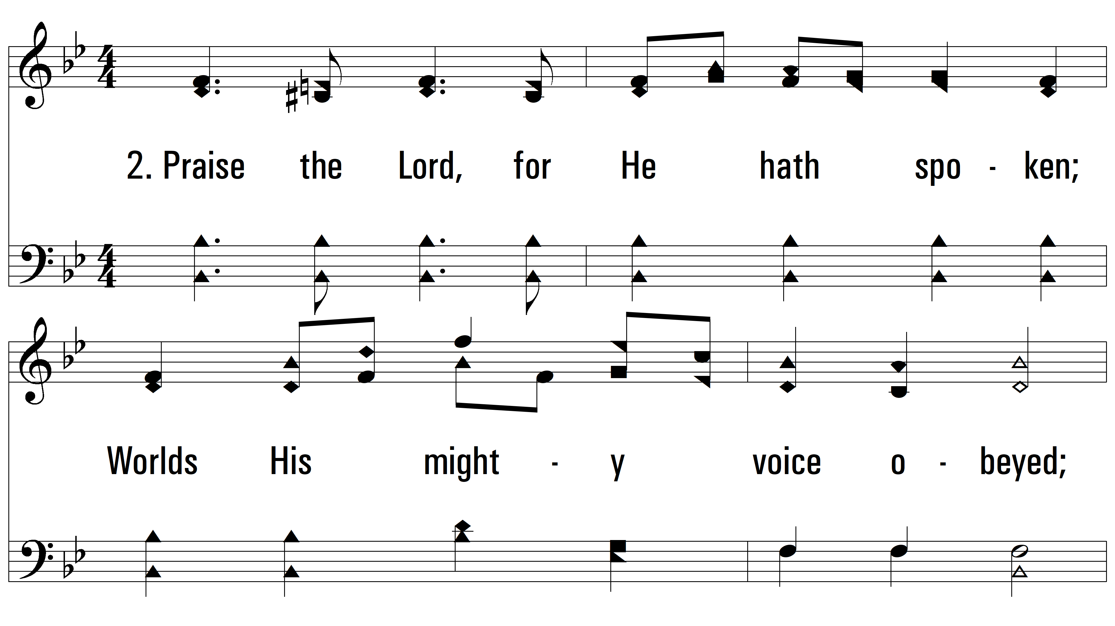
vs. 2 ~ Praise The Lord

Slide 6
vs. 2

Slide 7
vs. 2

Slide 8
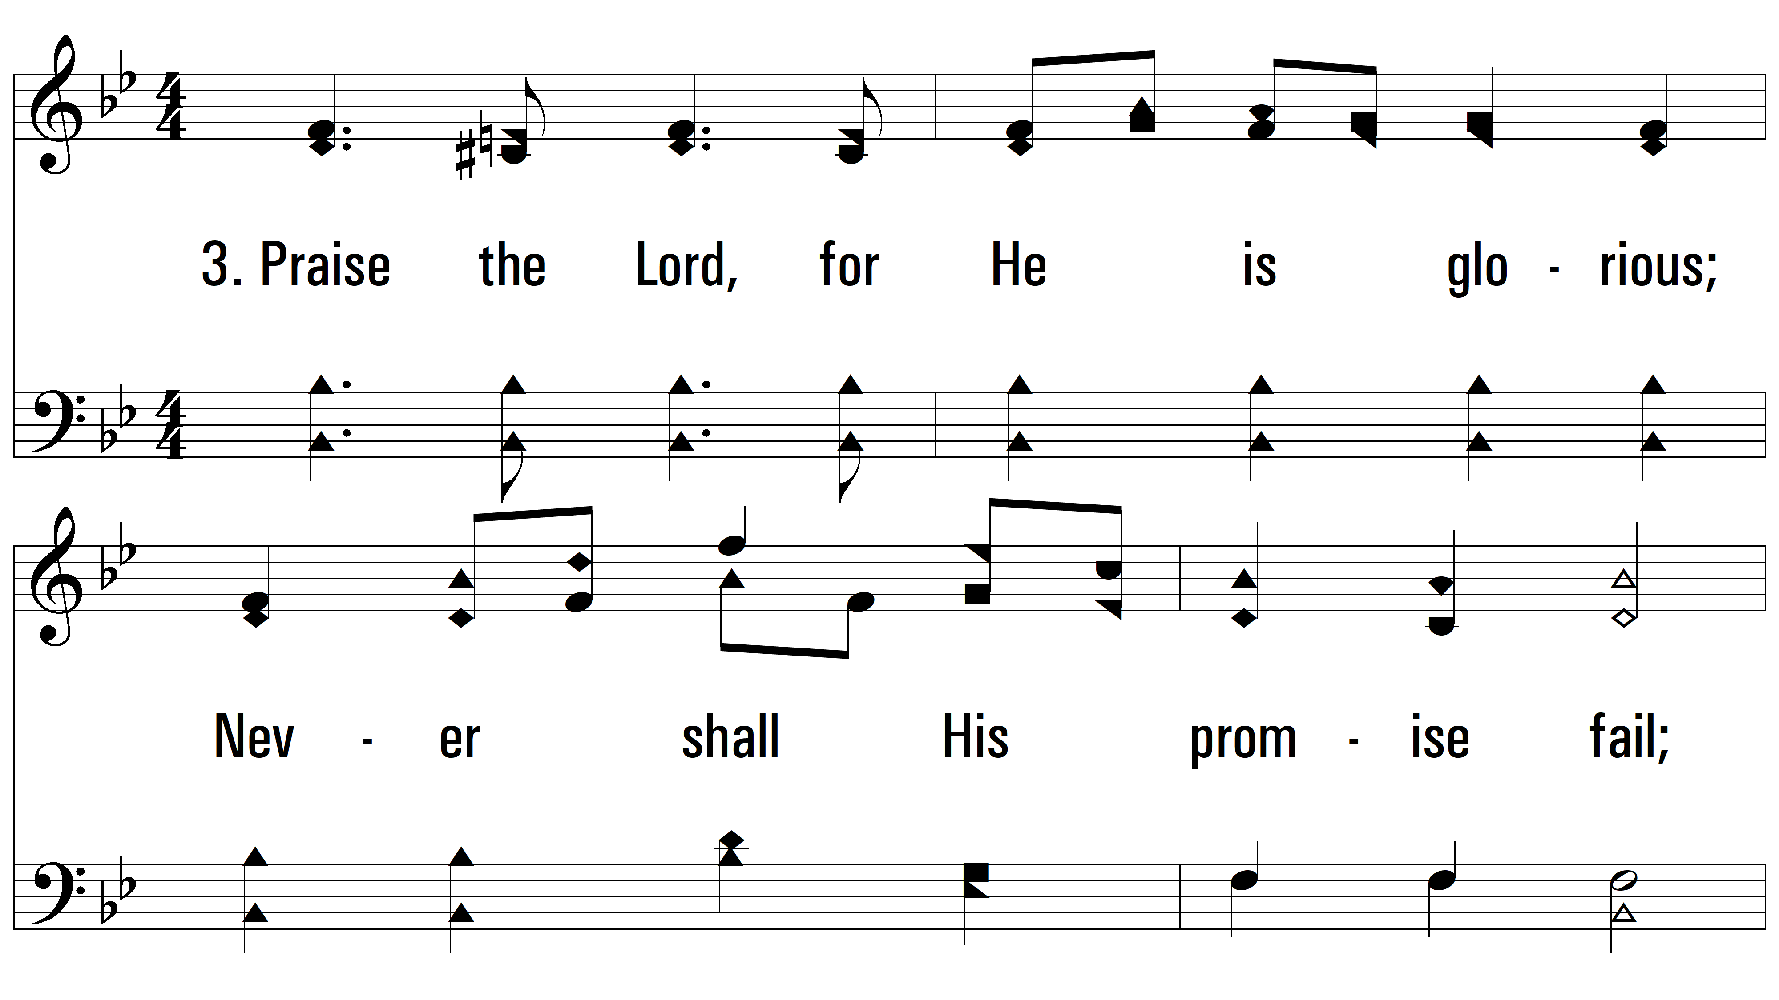
vs. 3 ~ Praise The Lord

Slide 9
vs. 3

Slide 10
vs. 3

Slide 11
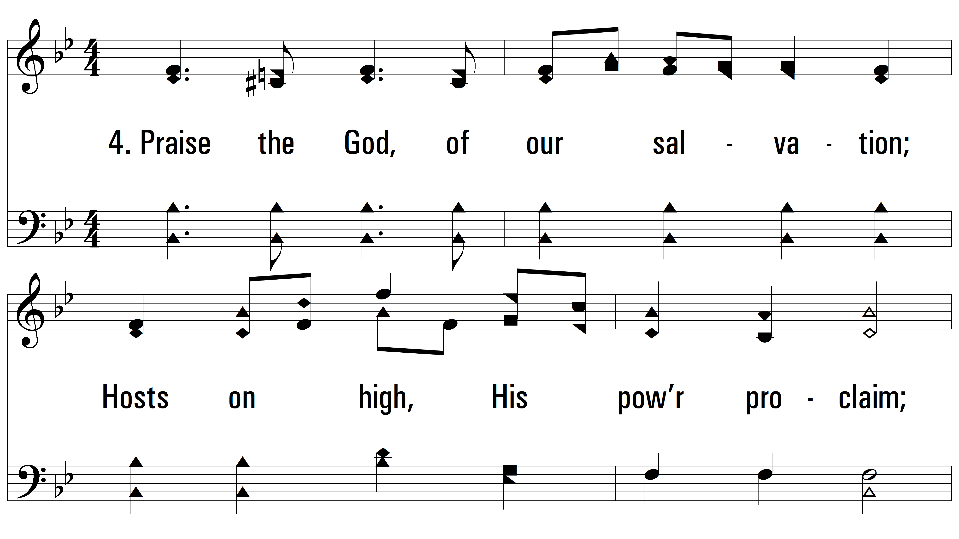
vs. 4 ~ Praise The Lord

Slide 12
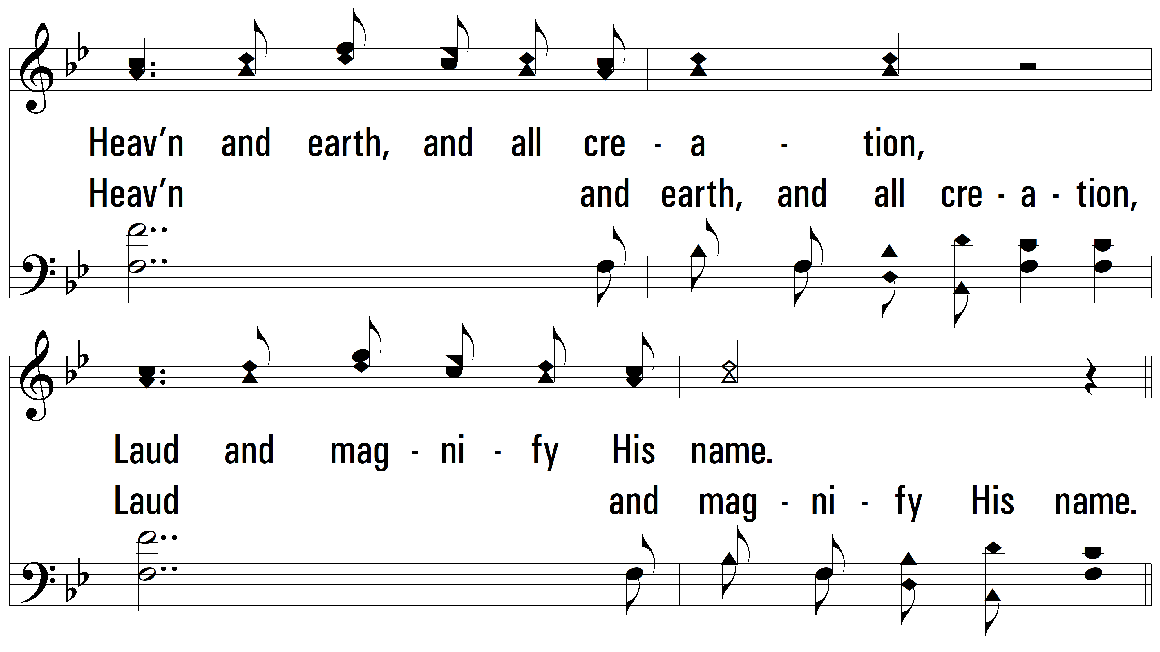
vs. 4

Slide 13
vs. 4
PDHymns.com
END

