Slide 1
Praise God
Words: | Traditional
Music: | Traditional
4/4
D/F# - MI
Verses: 4
Lead - | MI
Alto - | DO
Tenor - | MI
Bass - | DO
PDHymns.com

Slide 2
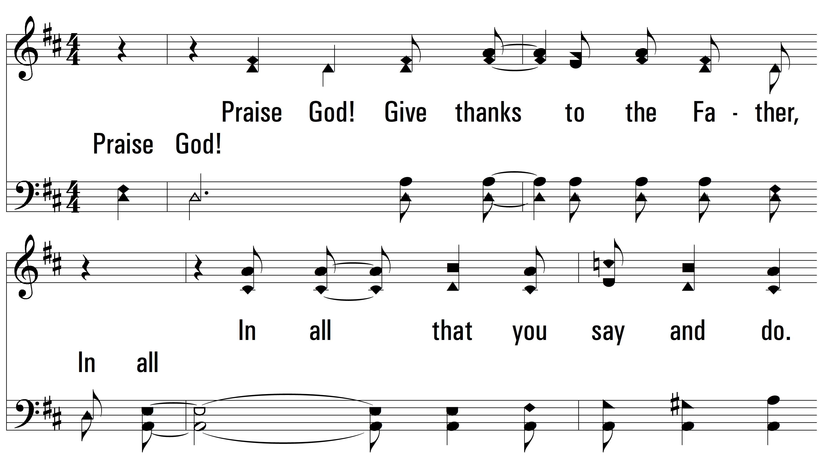
vs. 1 ~ Praise God

Slide 3
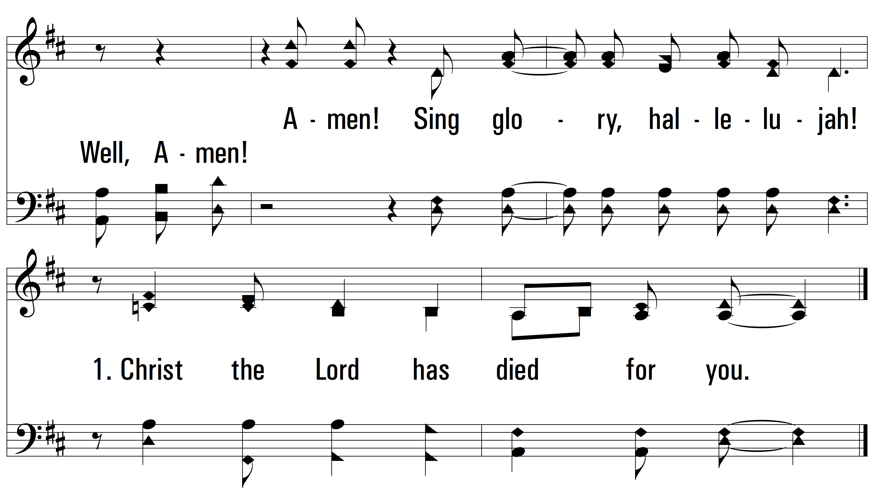
vs. 1

Slide 4
vs. 2 ~ Praise God

Slide 5
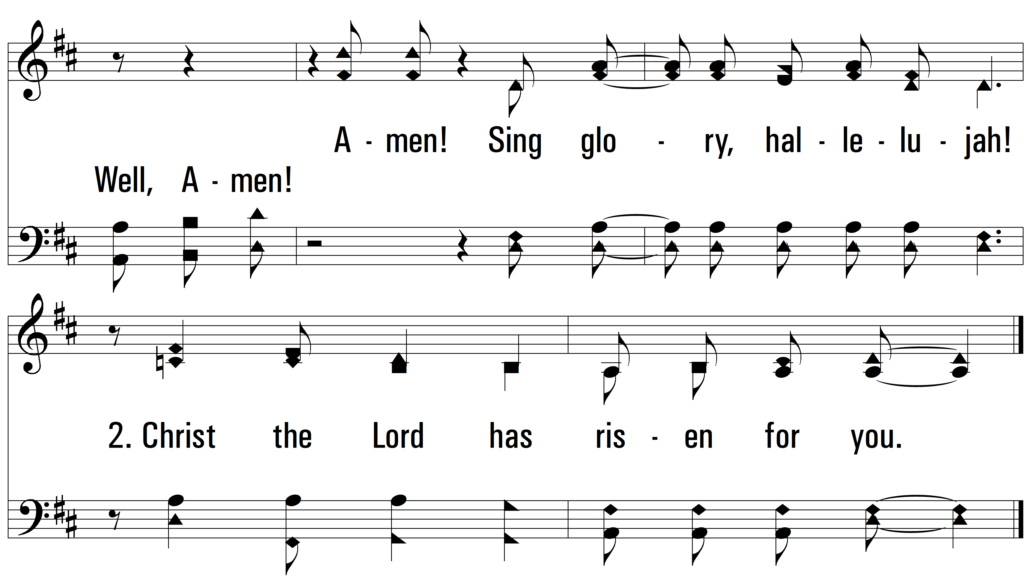
vs. 2

Slide 6
vs. 3 ~ Praise God

Slide 7
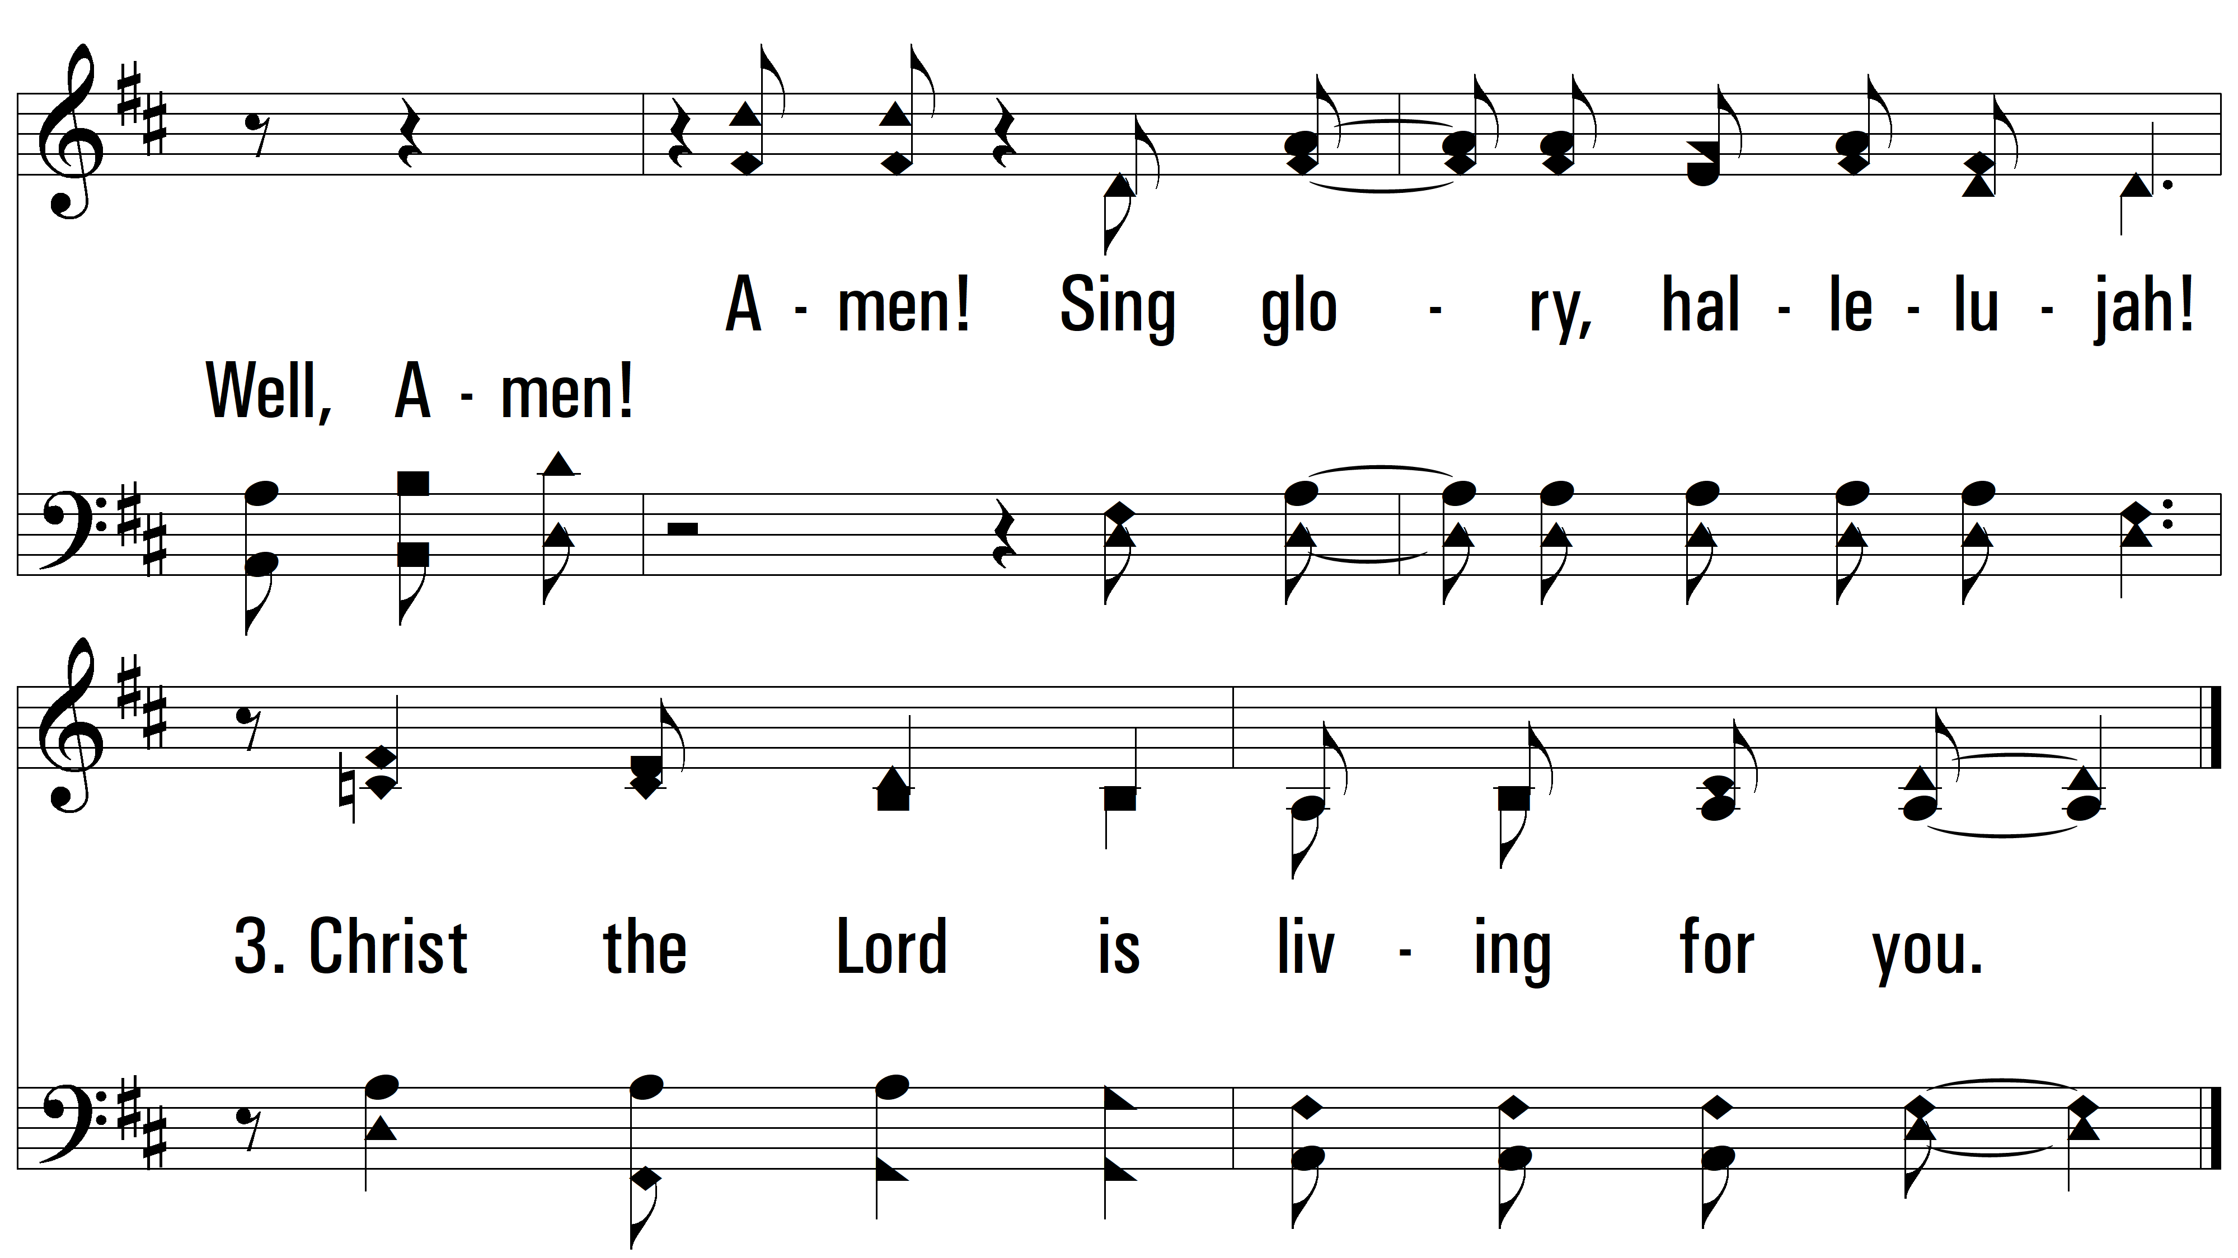
vs. 3

Slide 8
vs. 4 ~ Praise God

Slide 9

vs. 4
PDHymns.com
END

