Slide 1
Peace, Perfect Peace
PAX TECUM
10.10
Words: | Edward H. Bickersteth (1875)
Music: | George T. Caldbeck (1877)
4/4
C/G - SOL
Verses: 3
Lead - | SOL
Alto - | MI
Tenor - | DO
Bass - | DO
PDHymns.com

Slide 2
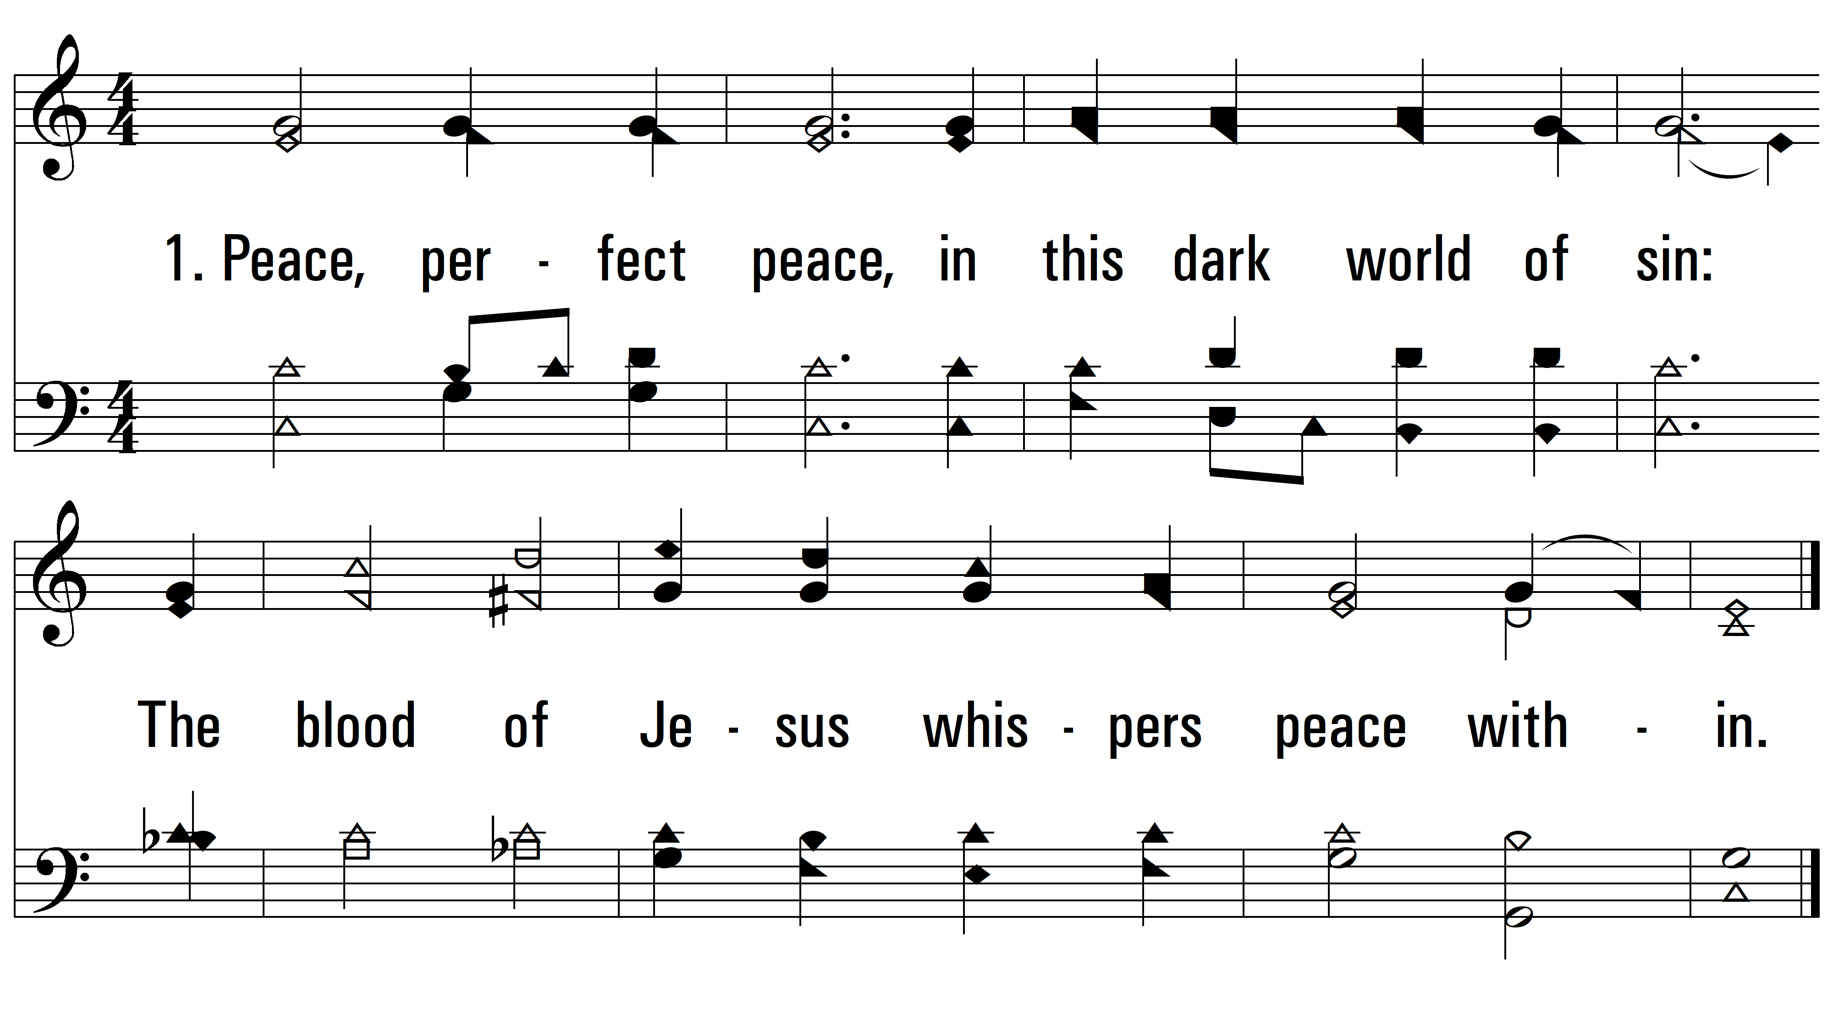
vs. 1 ~ Peace, Perfect Peace

Slide 3
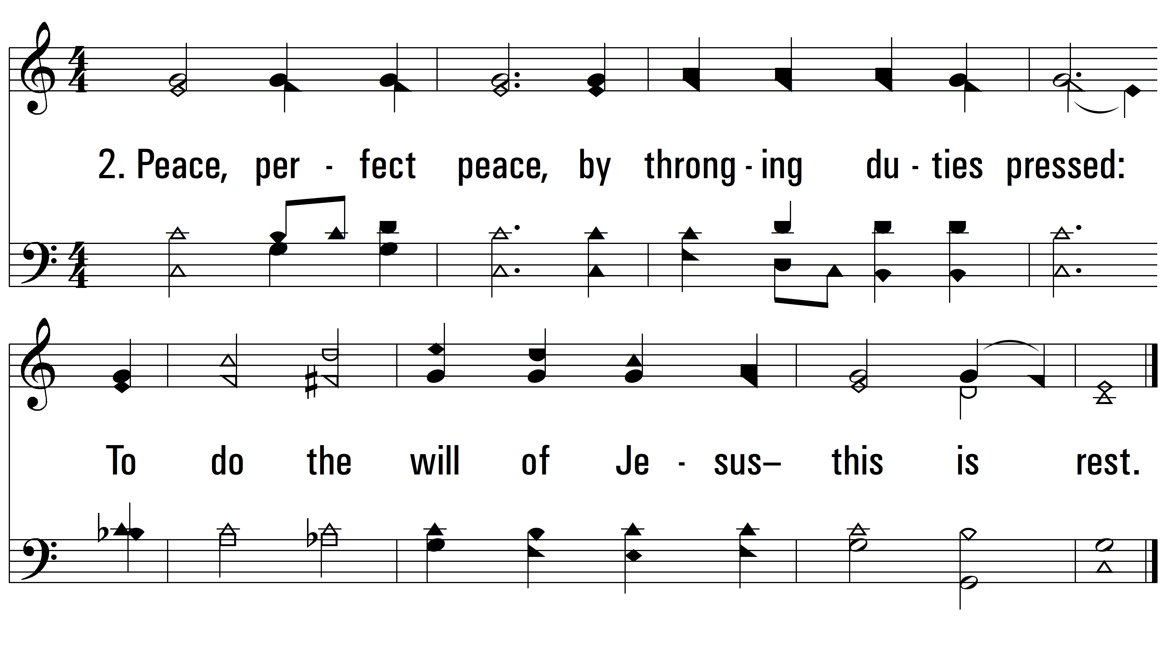
vs. 2 ~ Peace, Perfect Peace

Slide 4
vs. 4 ~ Peace, Perfect Peace
PDHymns.com
END

