Slide 1
Pass Me Not
Words: | Fanny J. Crosby (1868)
Music: | W. H. Doane (1868)
4/4
A^{b}/C - MI
Verses: 4/Chorus
Lead - | MI
Alto - | SOL
Tenor - | DO
Bass - | DO
PDHymns.com

Slide 2
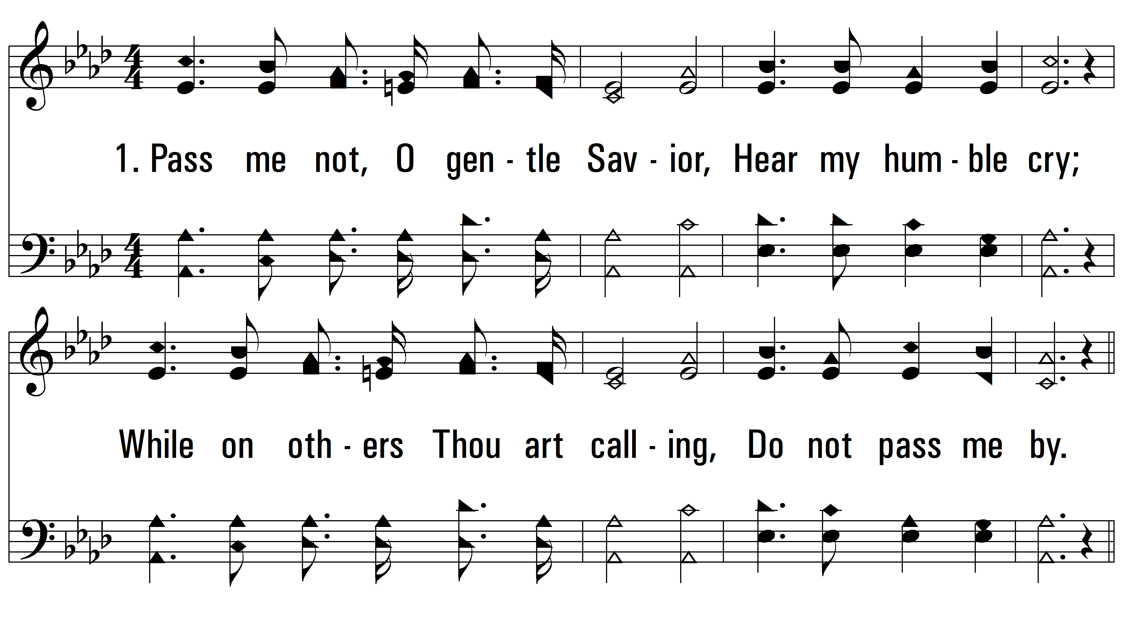
vs. 1 ~ Pass Me Not

Slide 3
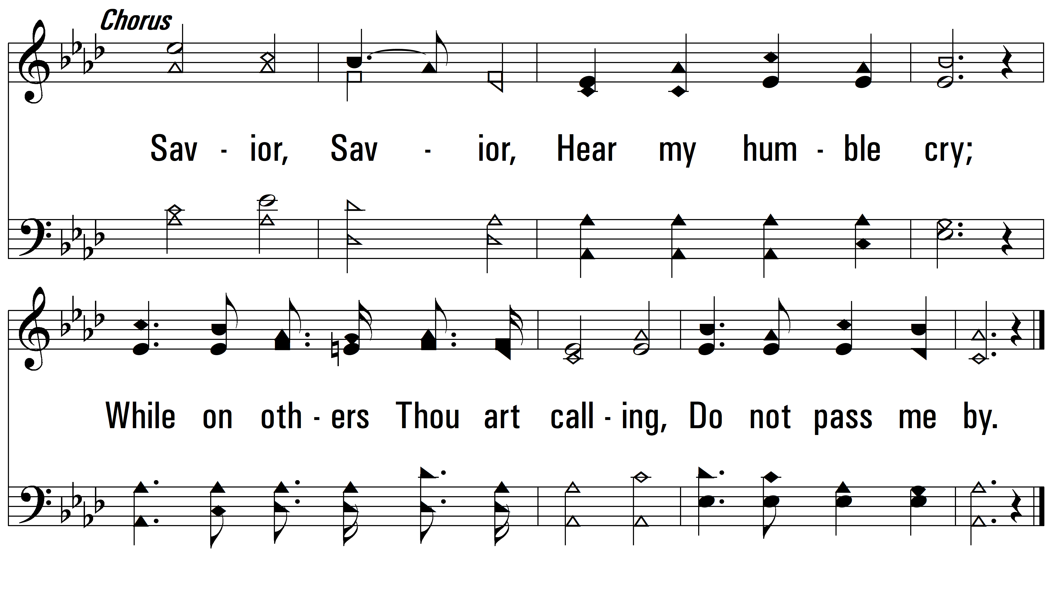
vs. 1

Slide 4
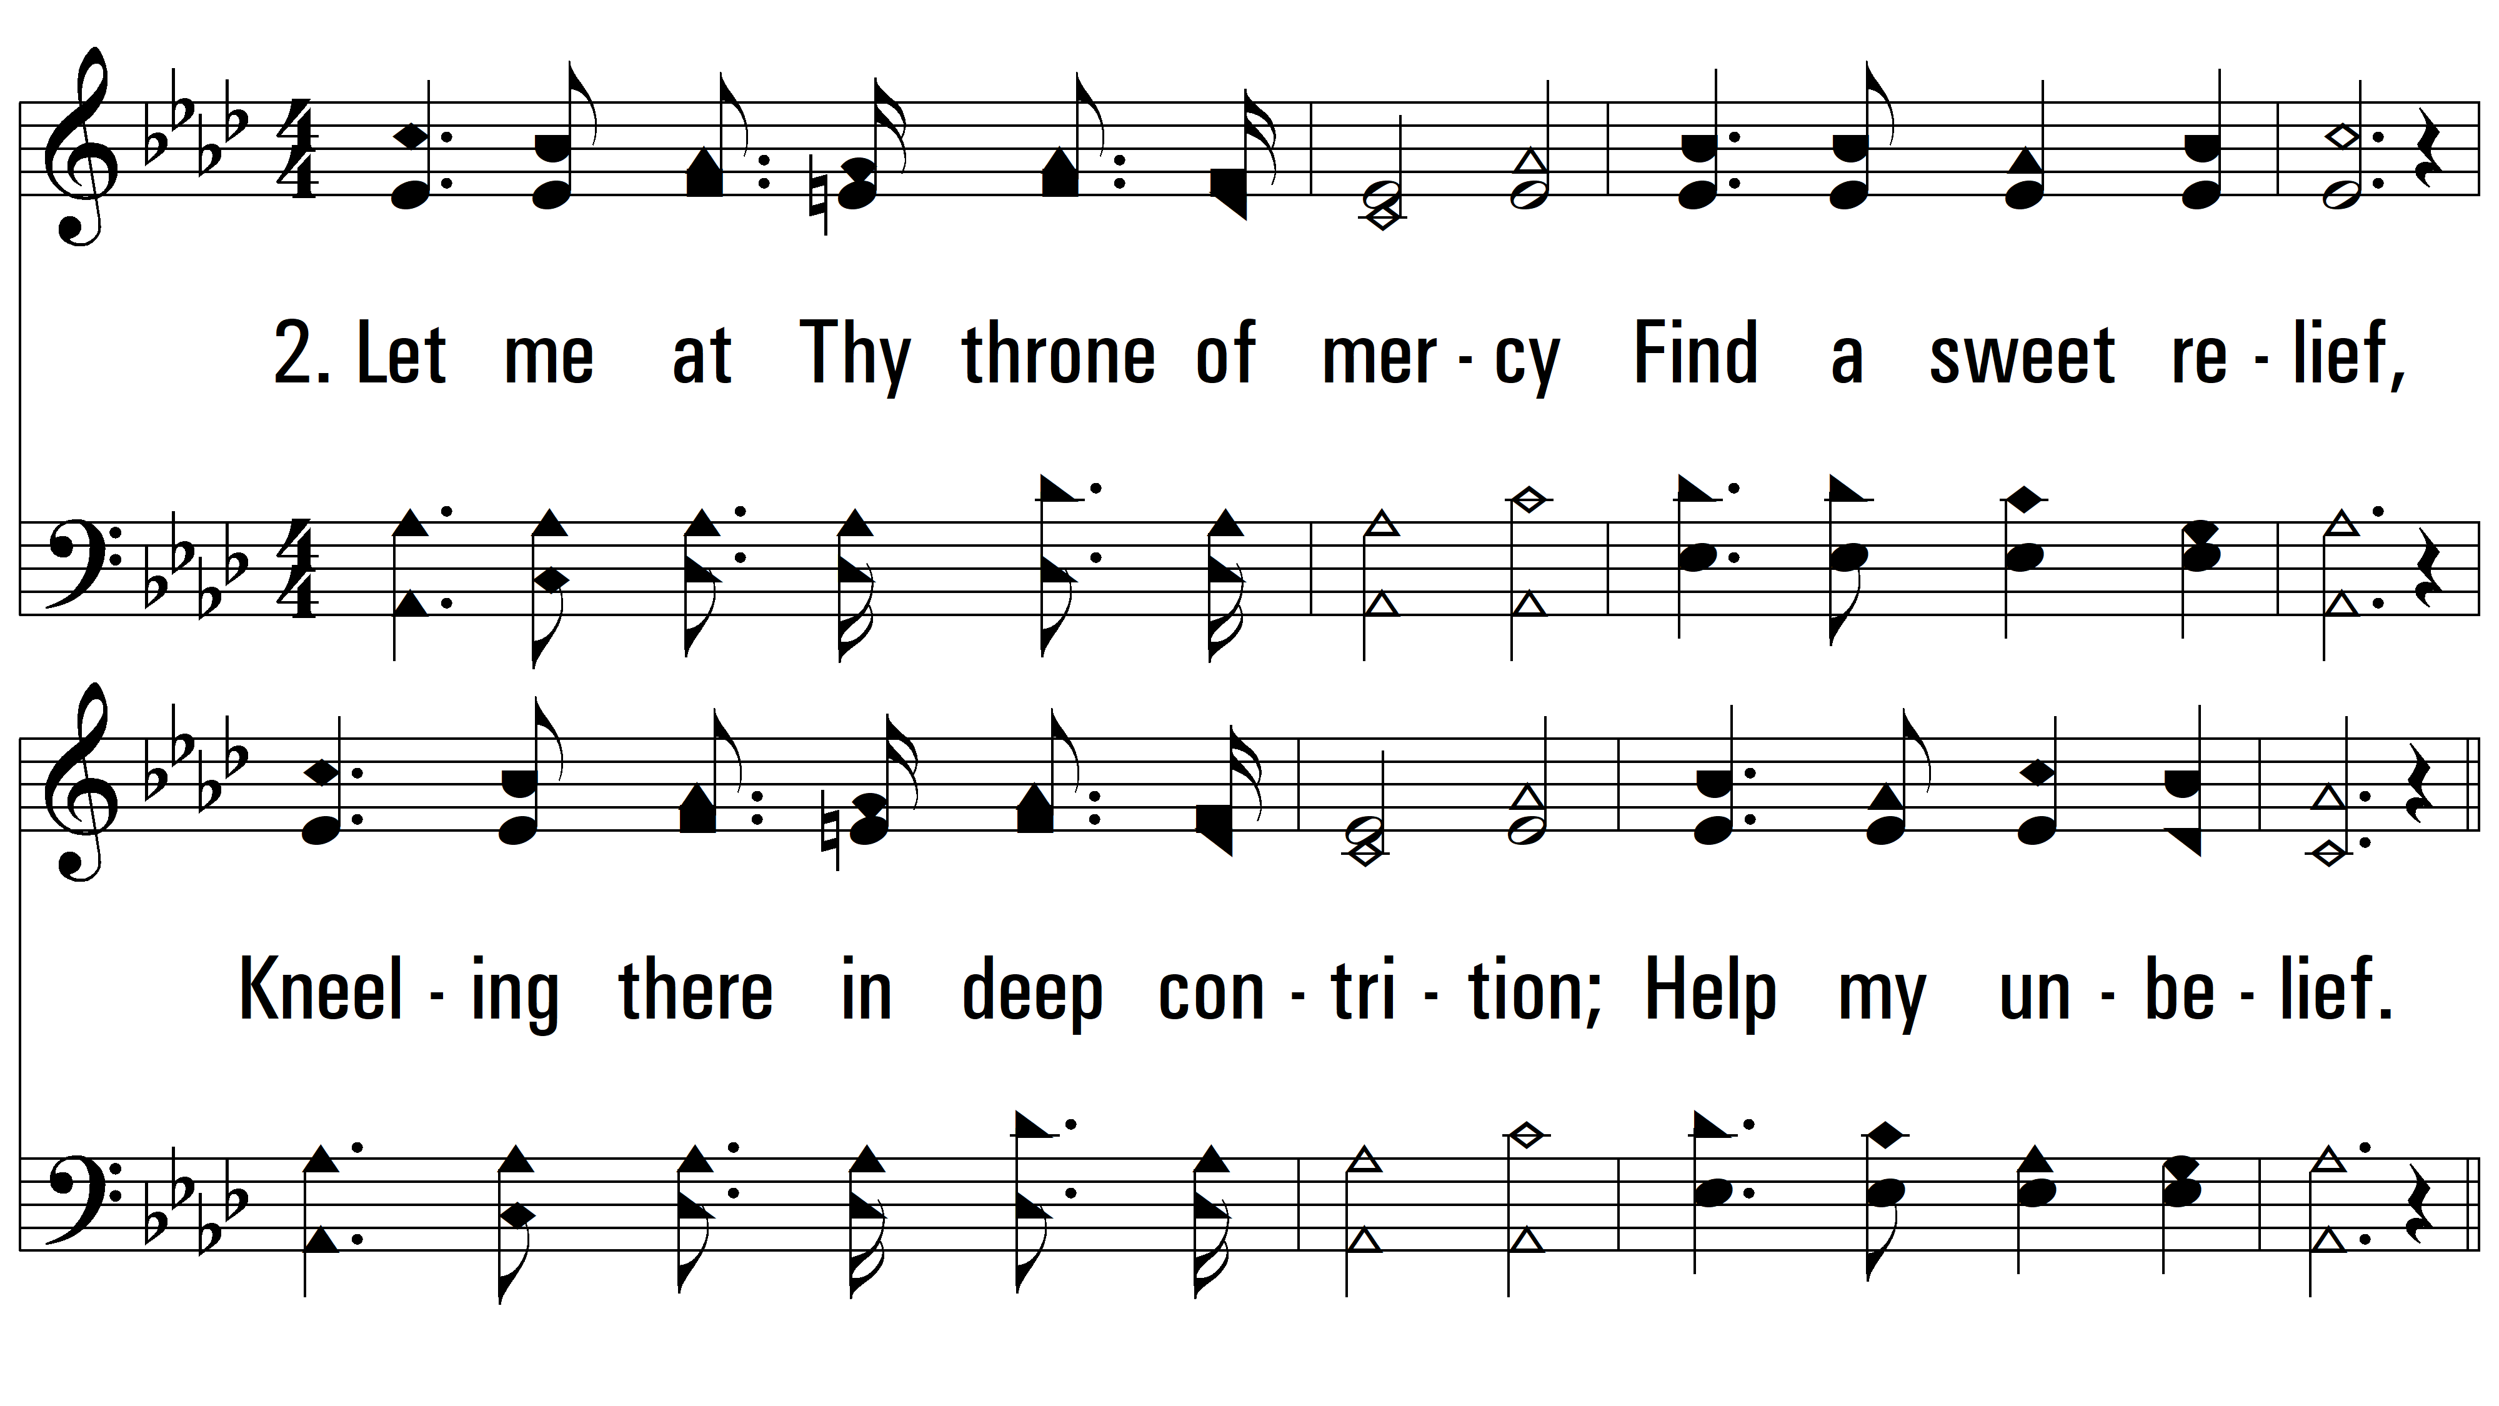
vs. 2 ~ Pass Me Not

Slide 5
vs. 2

Slide 6
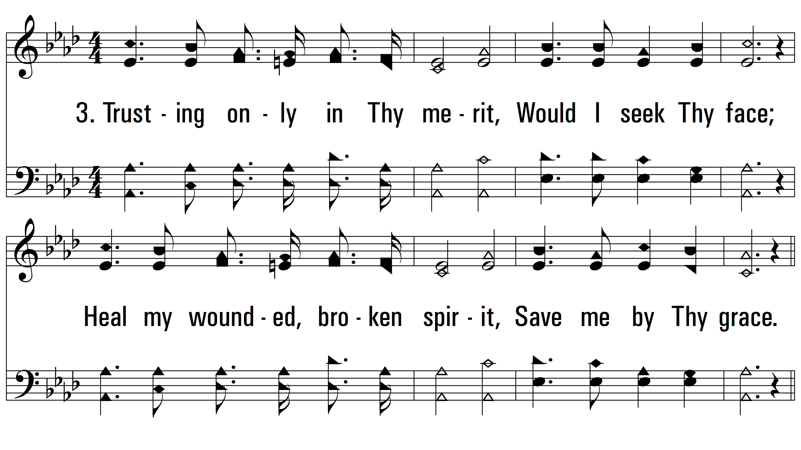
vs. 3 ~ Pass Me Not

Slide 7
vs. 3

Slide 8
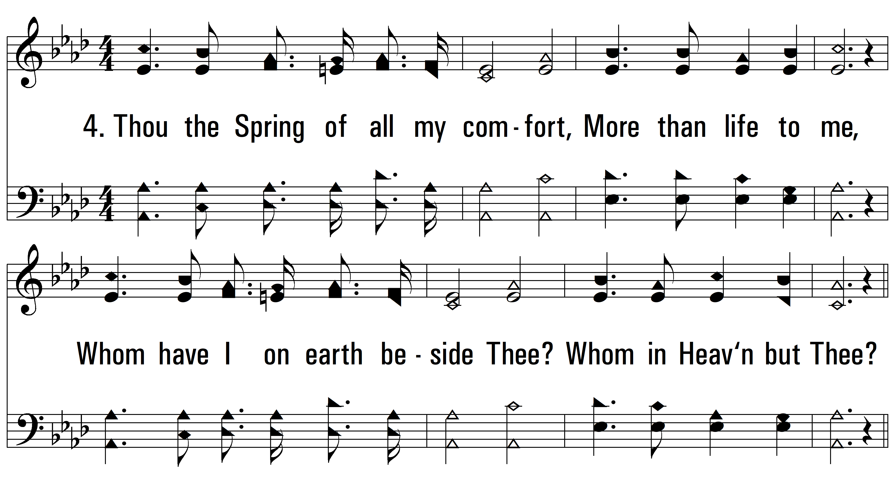
vs. 4 ~ Pass Me Not

Slide 9
vs. 4
PDHymns.com
END

