Slide 1
Out Of Self And Into Thee
Words: | Jessie H. Brown
Music: | J. H. Filmore, Arr. L. O. Sanderson
3/4
A^{b}/C - MI
Verses: 3
Lead - | MI
Alto - | SOL
Tenor - | DO
Bass - | DO
PDHymns.com

Slide 2
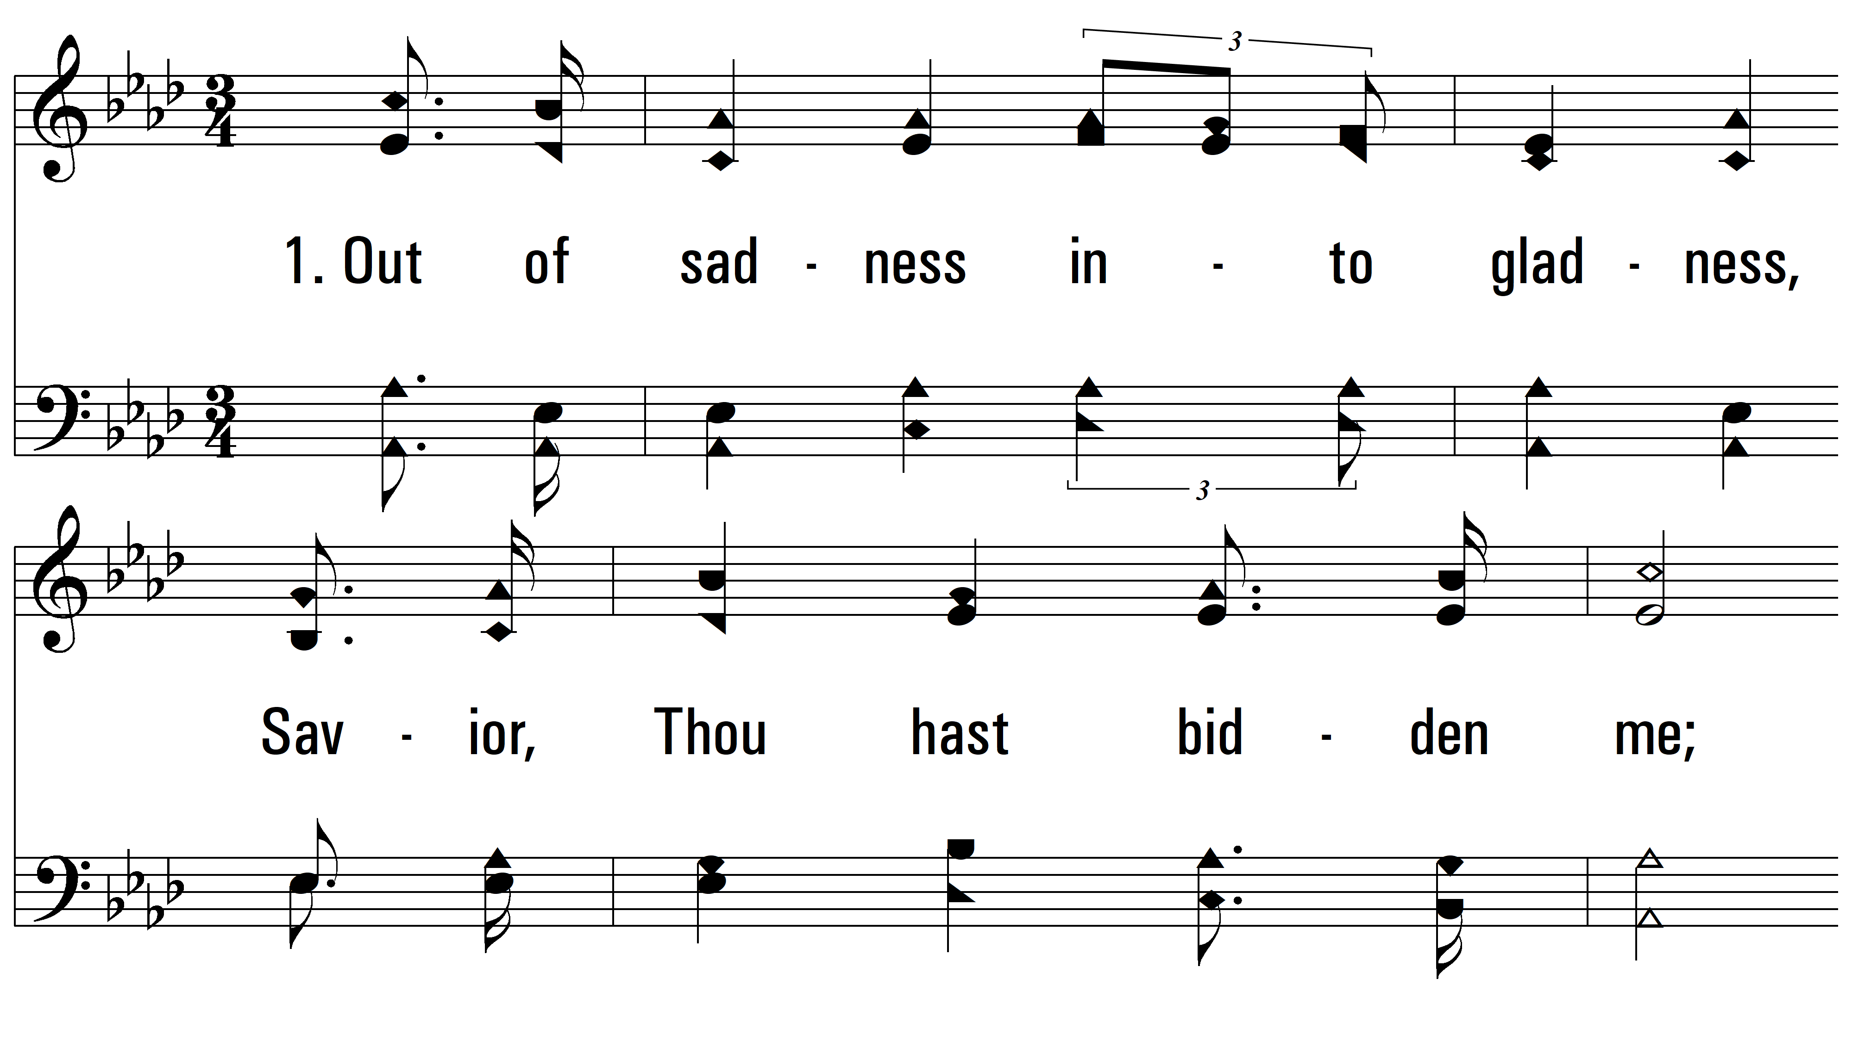
vs. 1 ~ Out Of Self And Into Thee

Slide 3
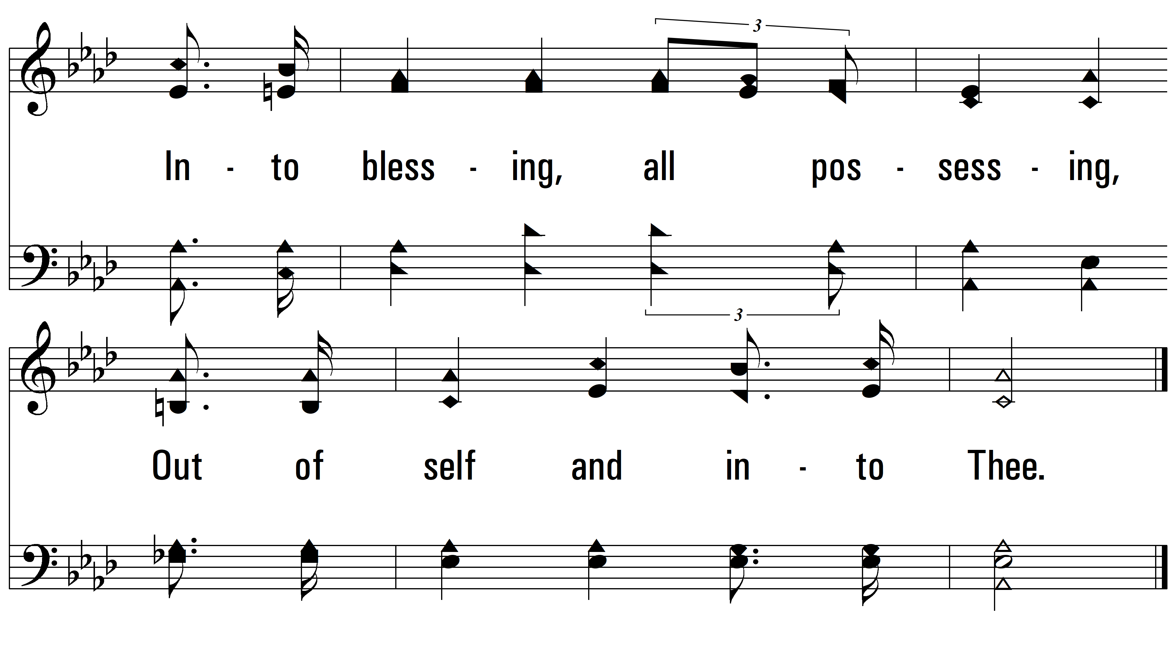
vs. 1

Slide 4
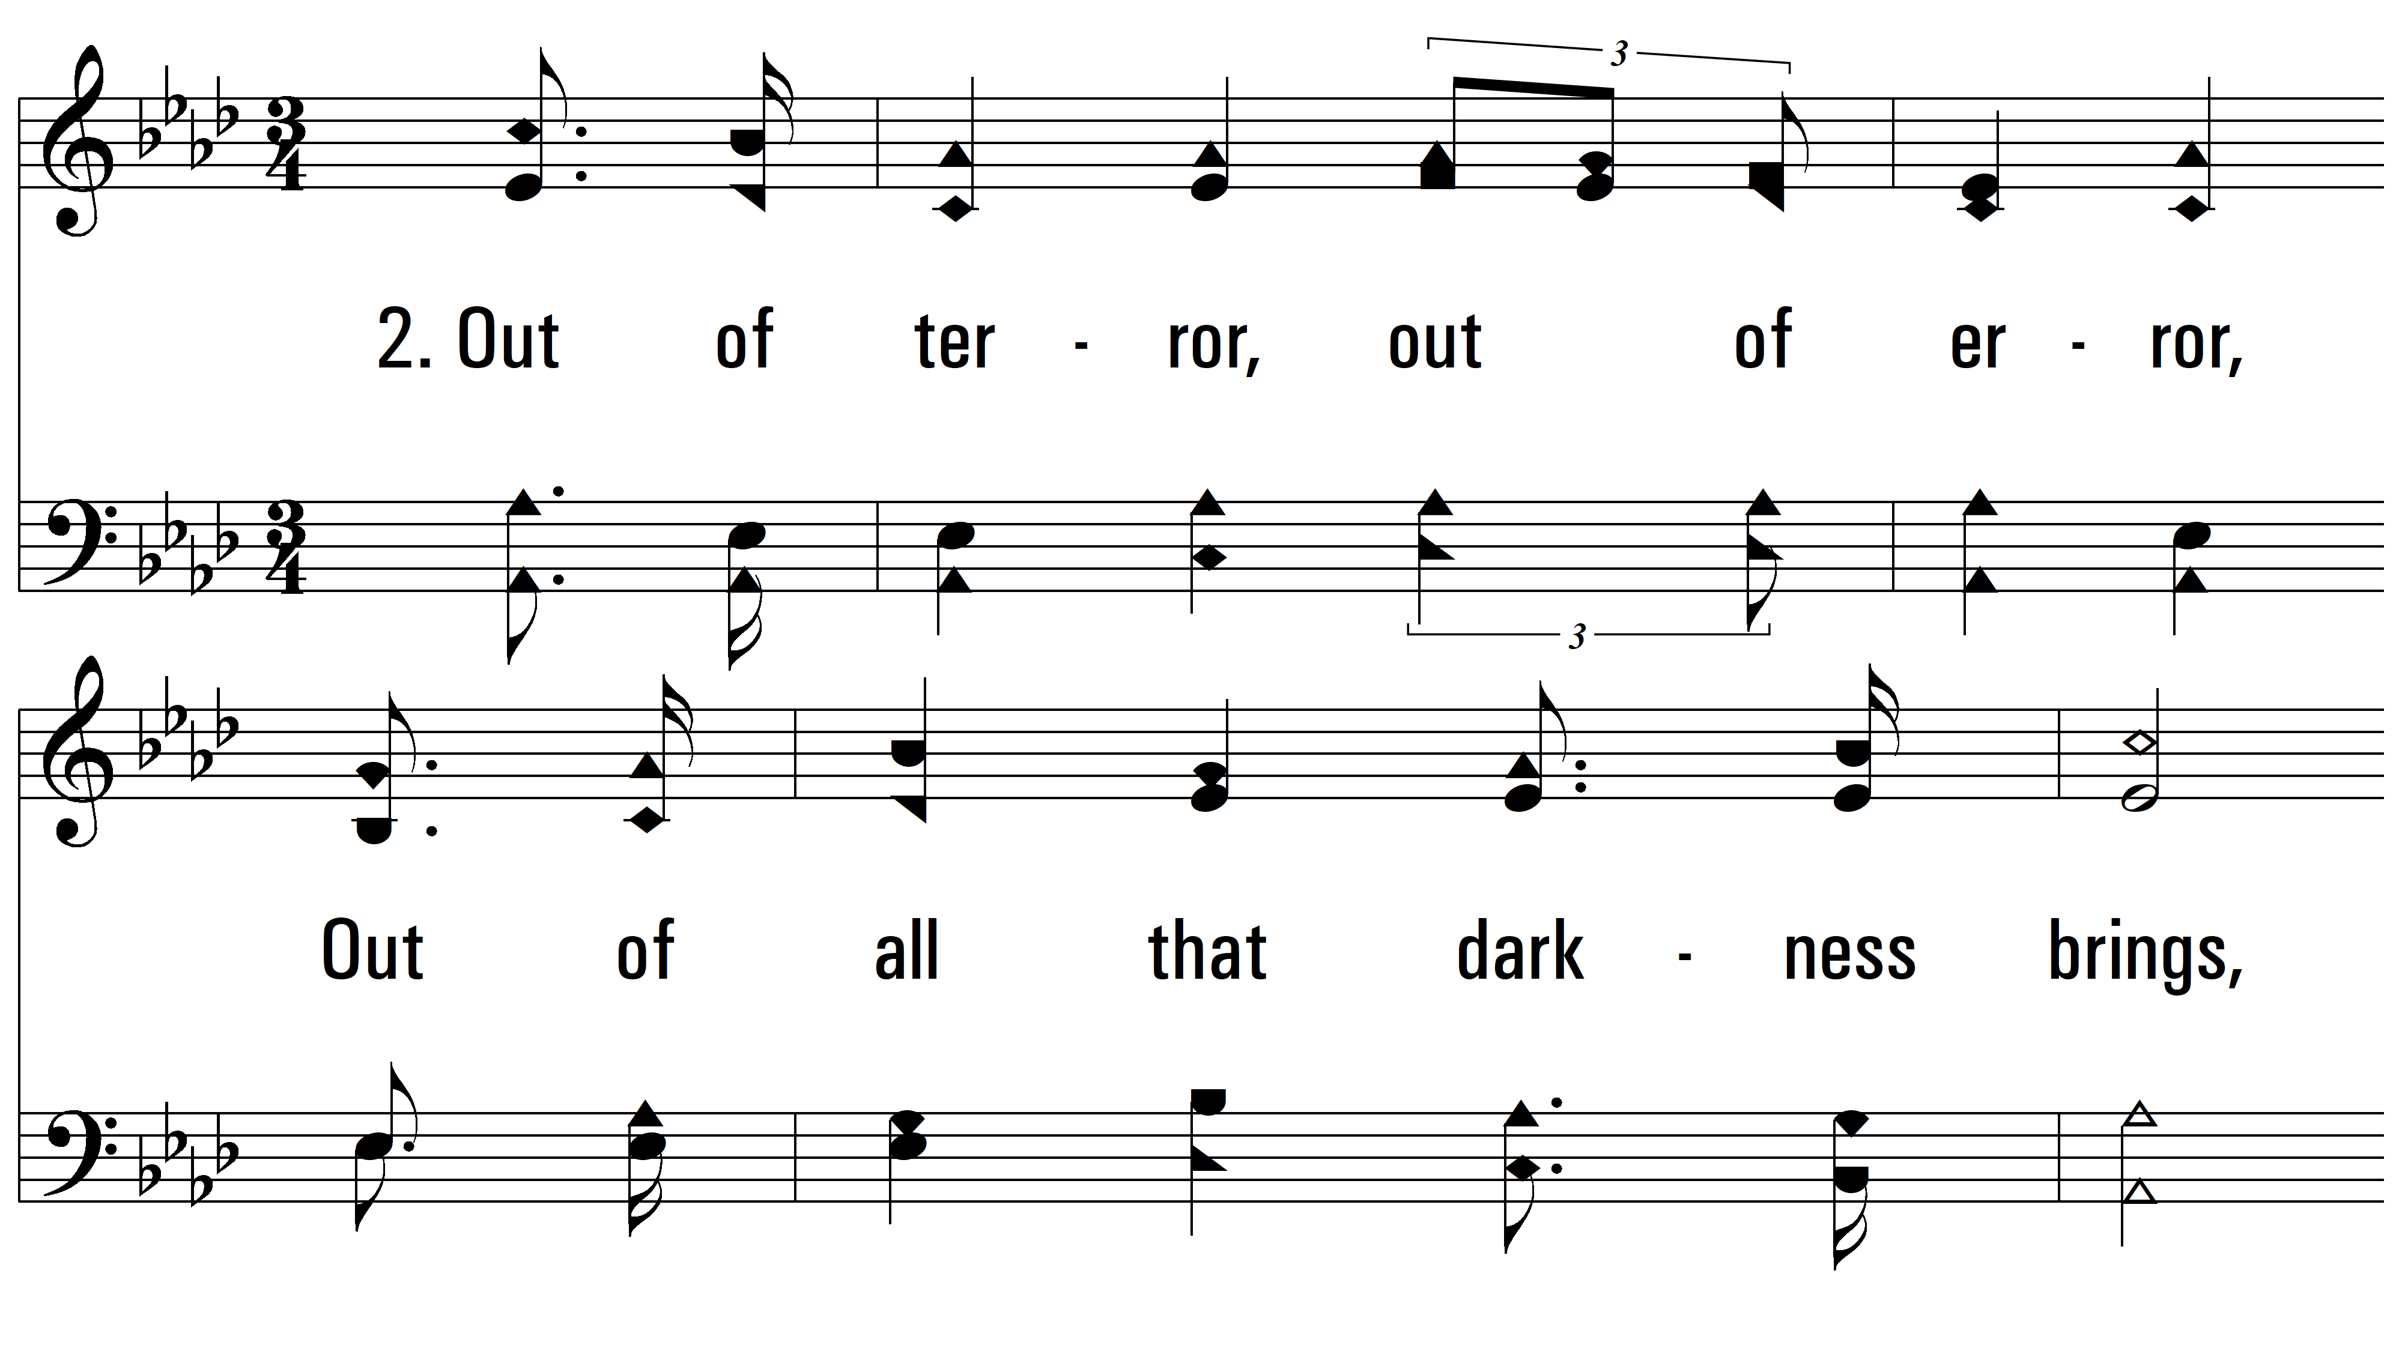
vs. 2 ~ Out Of Self And Into Thee

Slide 5
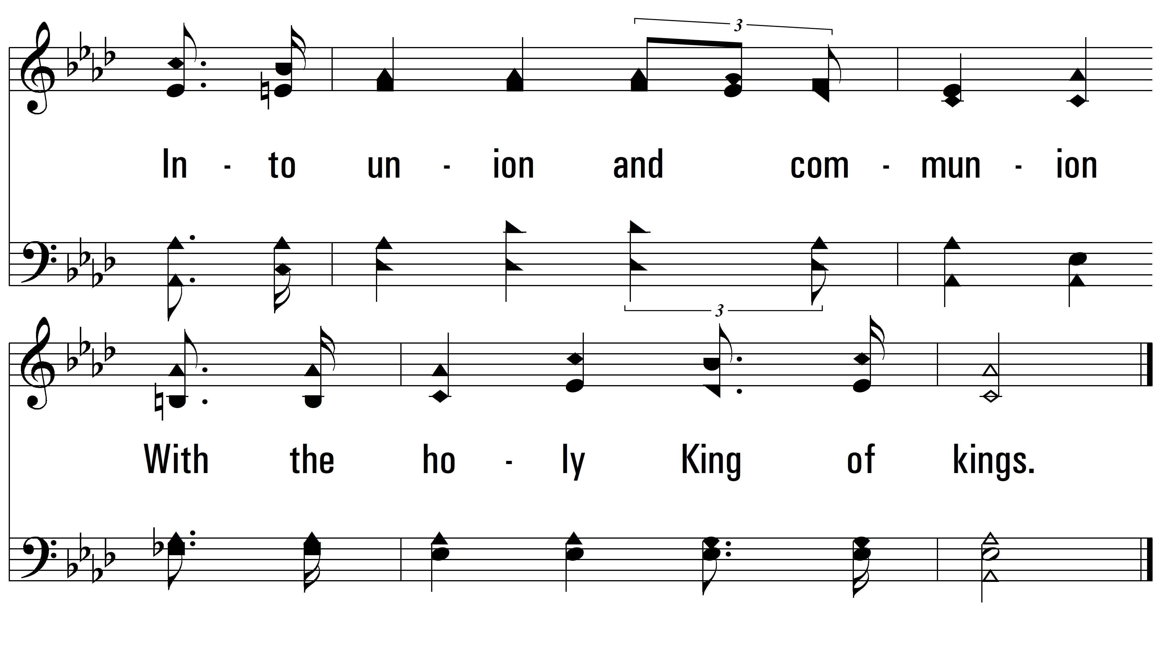
vs. 2

Slide 6
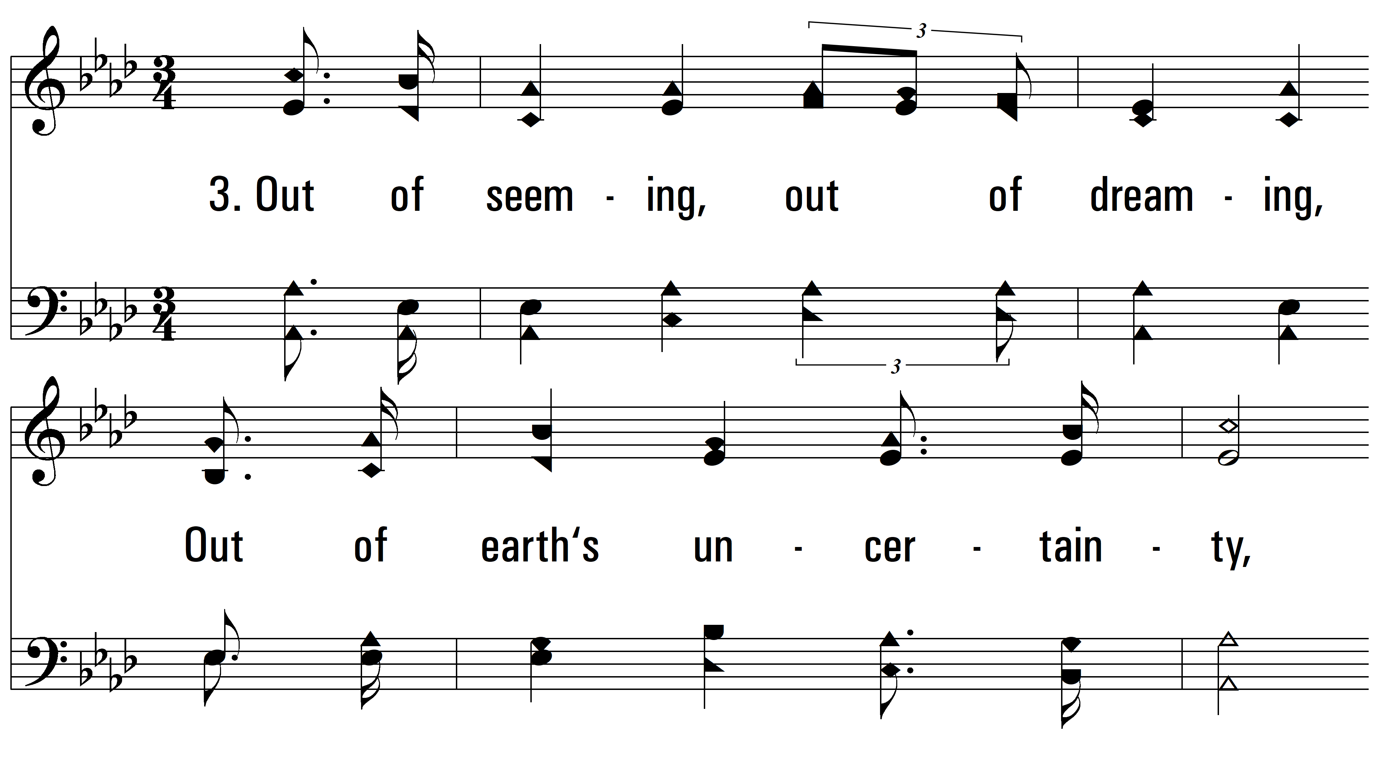
vs. 3 ~ Out Of Self And Into Thee

Slide 7
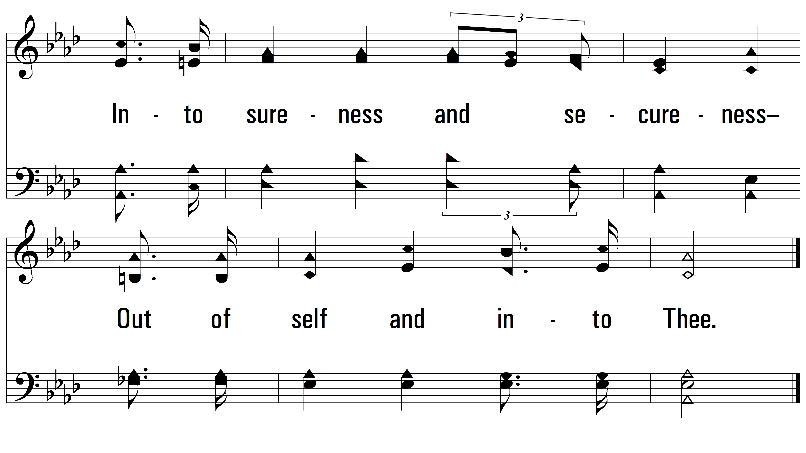
vs. 3
PDHymns.com
END

