Slide 1
Open My Eyes, That I May See
SCOTT
8.8.9.8.8.8.8.4
Words: | Charles H. Scott (1895)
Music: | Charles H. Scott (1895)
6/8
A^{b}/A^{b} - DO
Verses: 5/Chorus
Lead - | DO
Alto - | SOL
Tenor - | MI
Bass - | DO
PDHymns.com

Slide 2
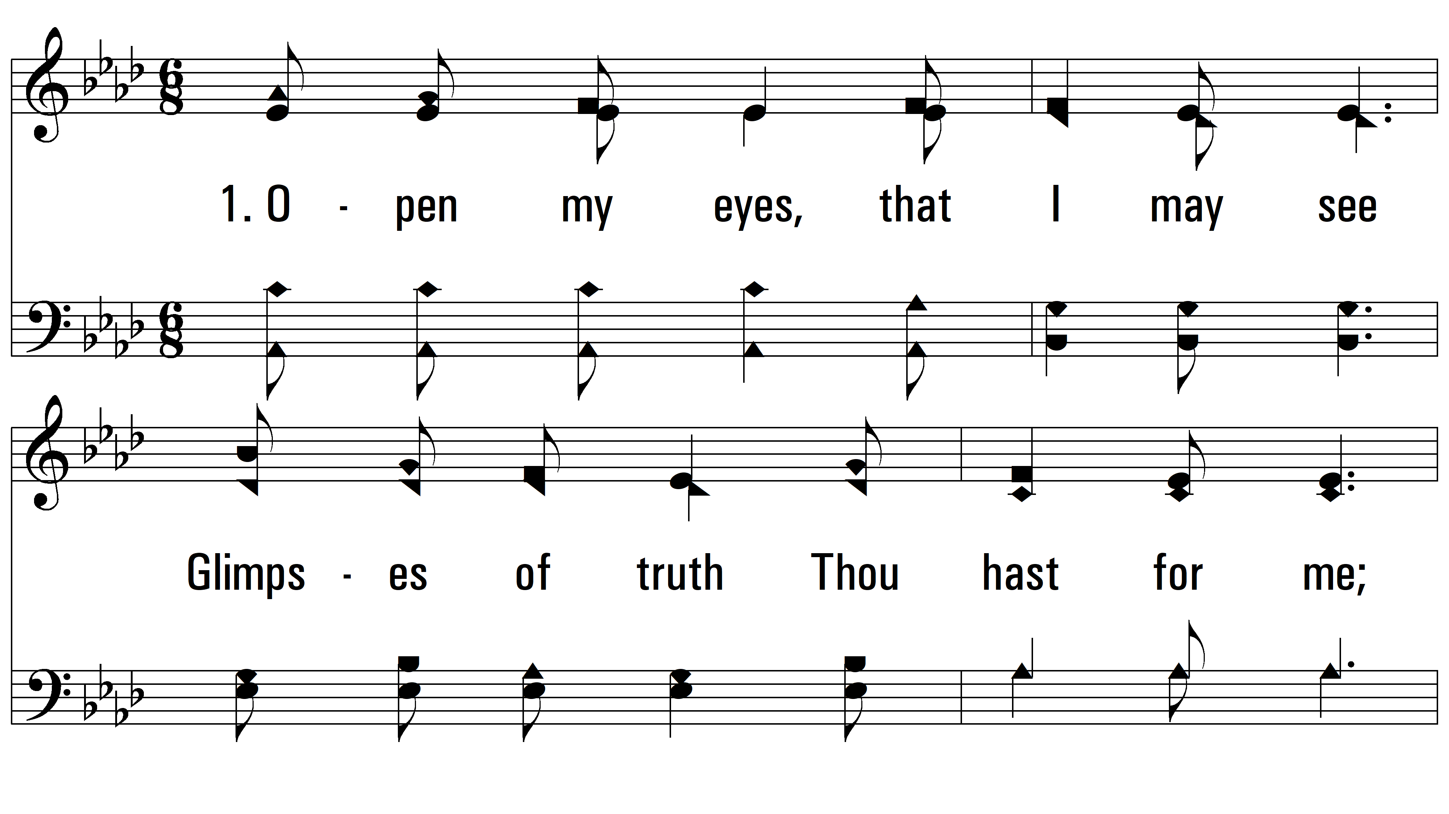
vs. 1 ~ Open My Eyes, That I May See

Slide 3
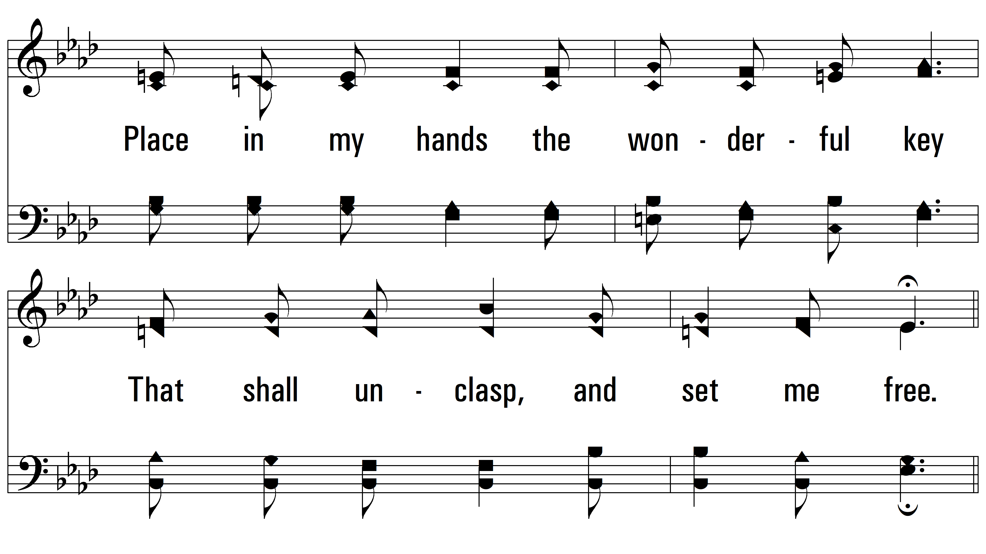
vs. 1

Slide 4
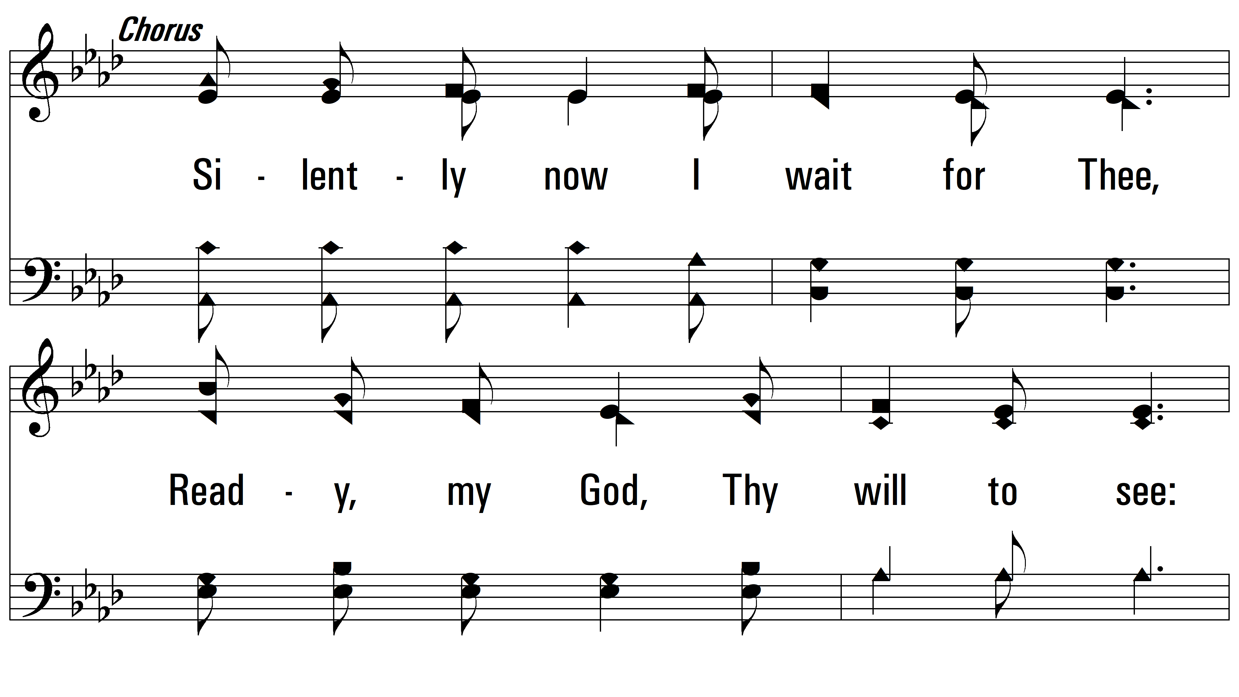
vs. 1

Slide 5
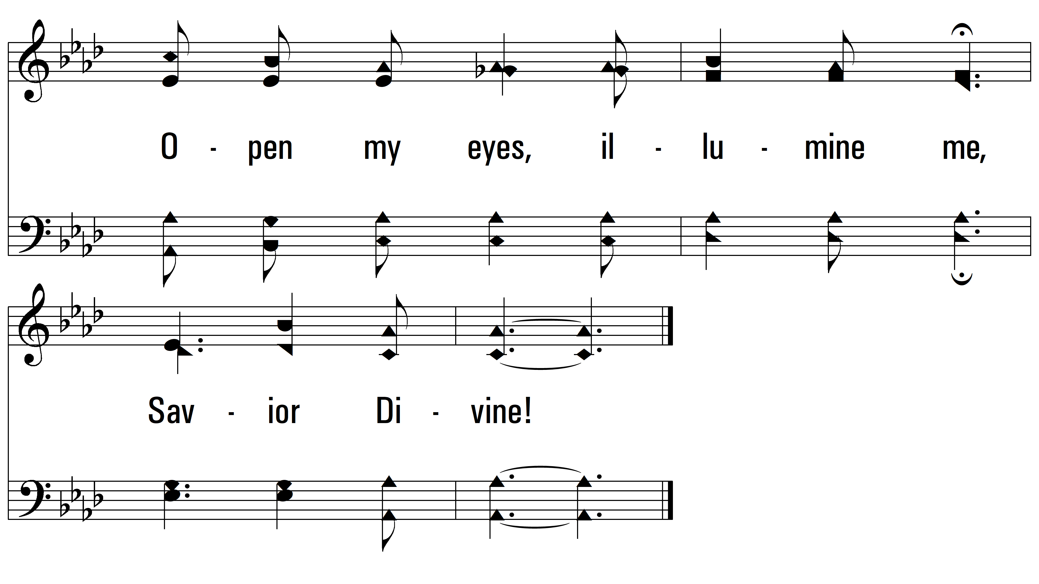
vs. 1

Slide 6
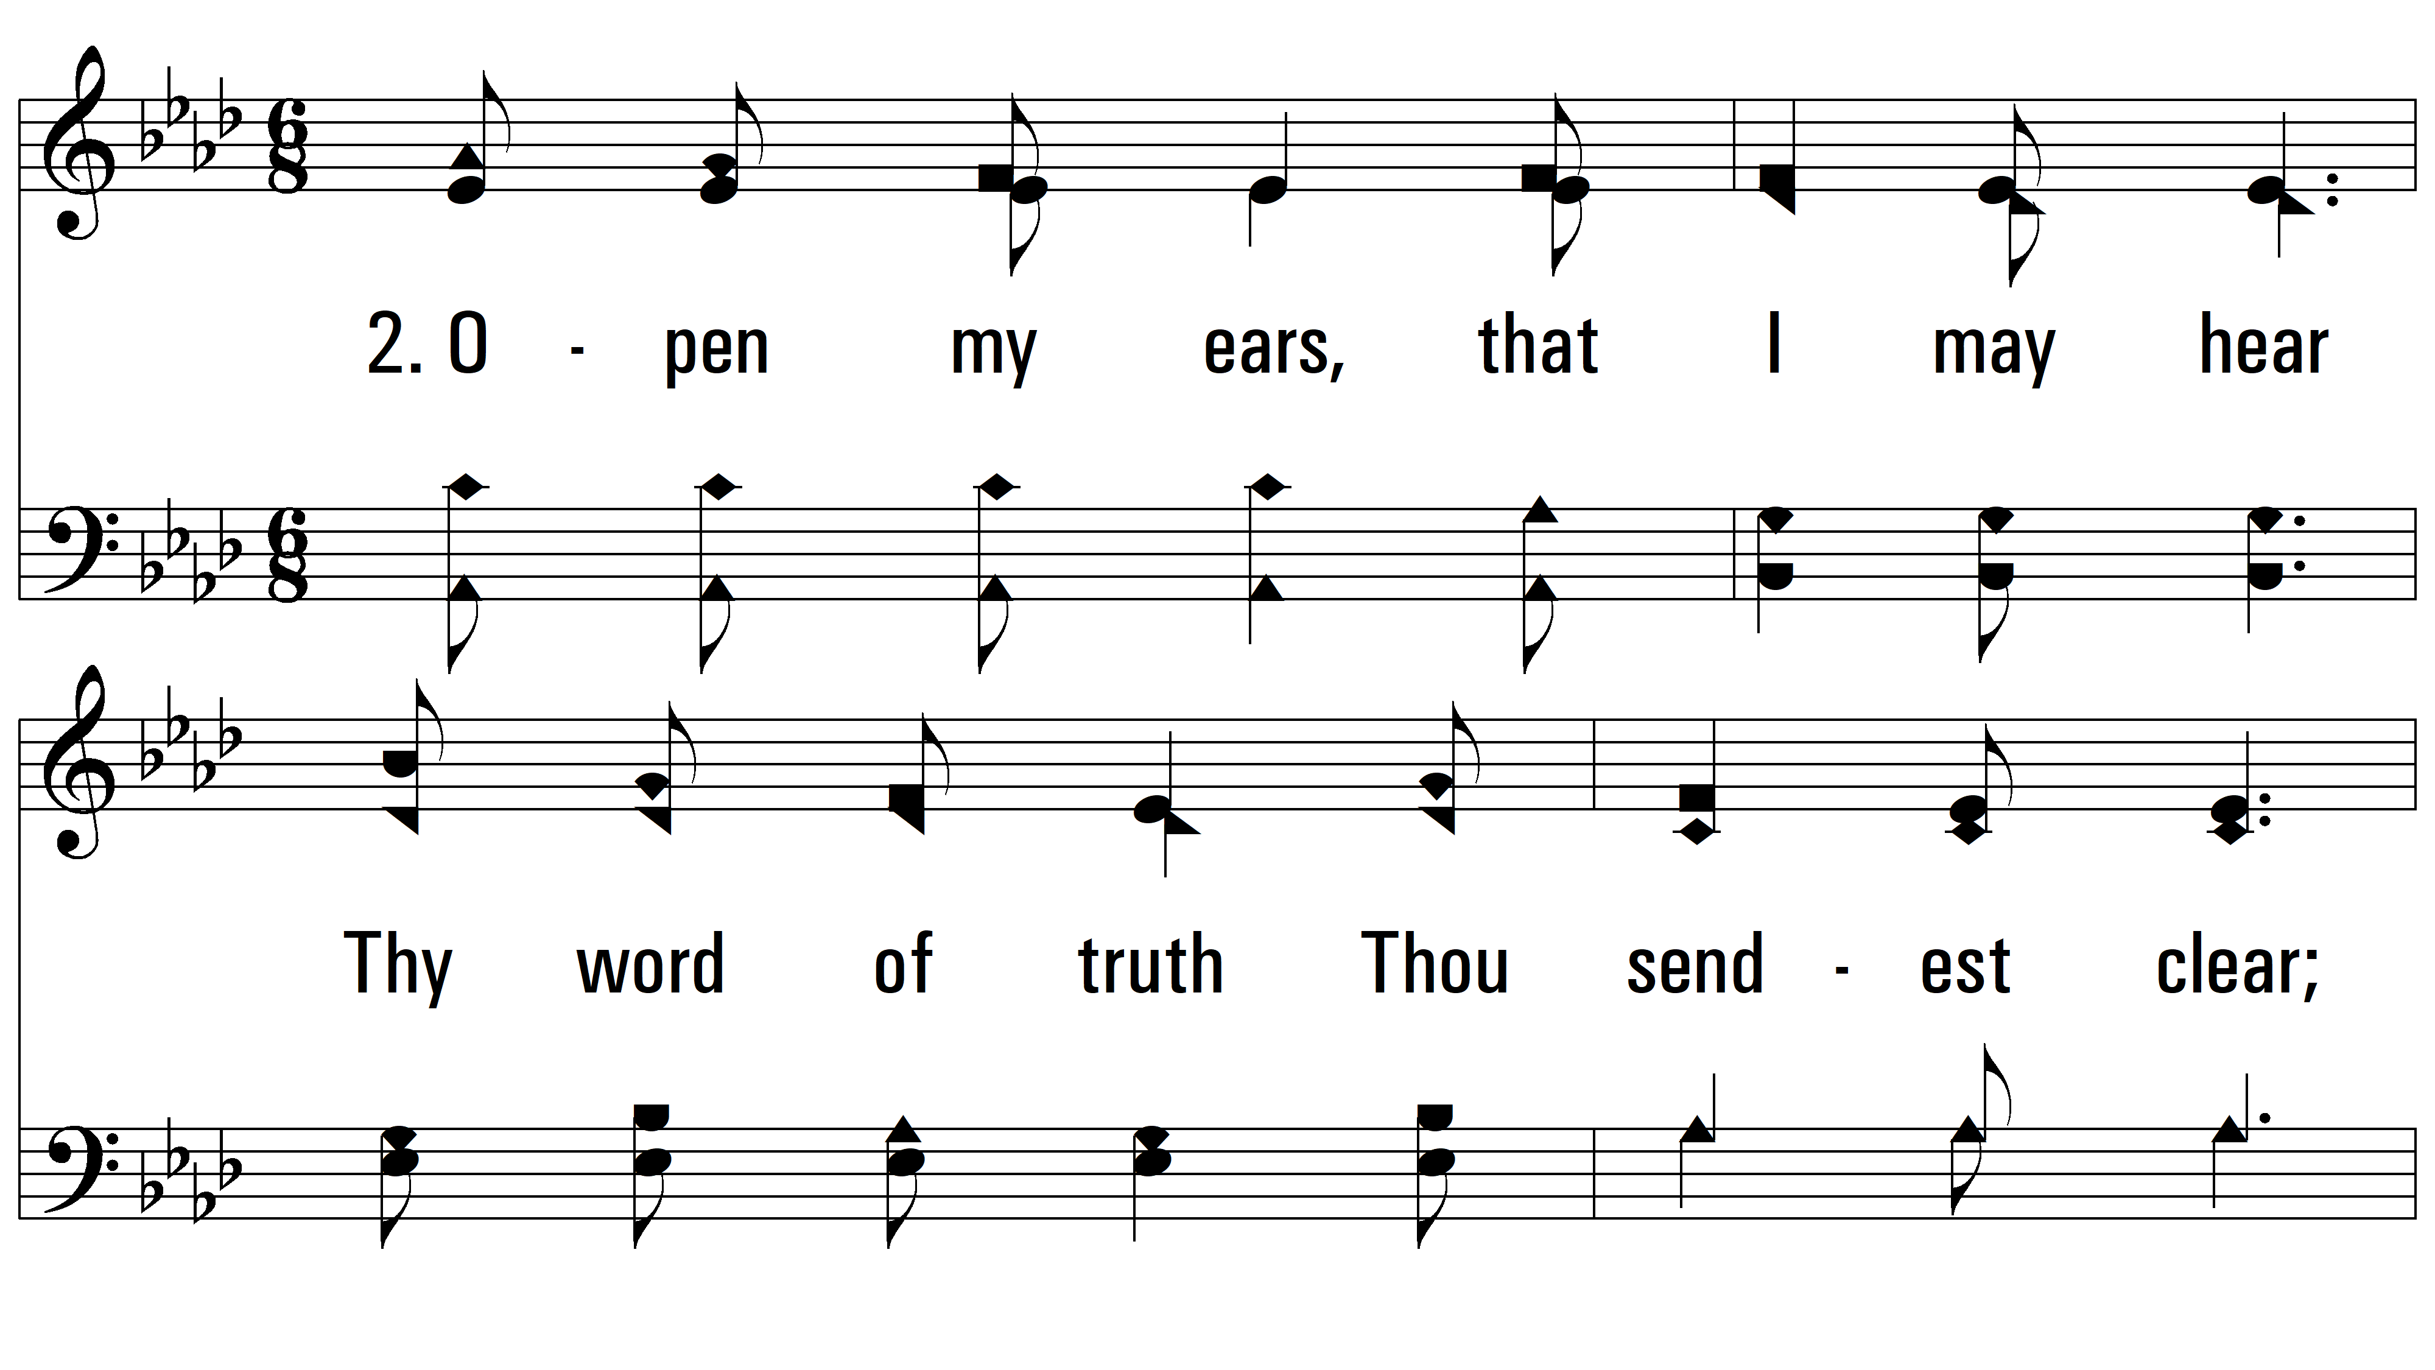
vs. 2 ~ Open My Eyes, That I May See

Slide 7
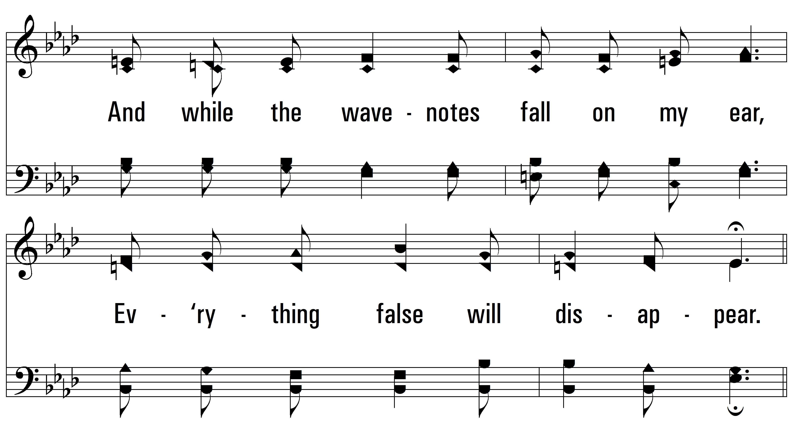
vs. 2

Slide 8
vs. 2

Slide 9
vs. 2

Slide 10
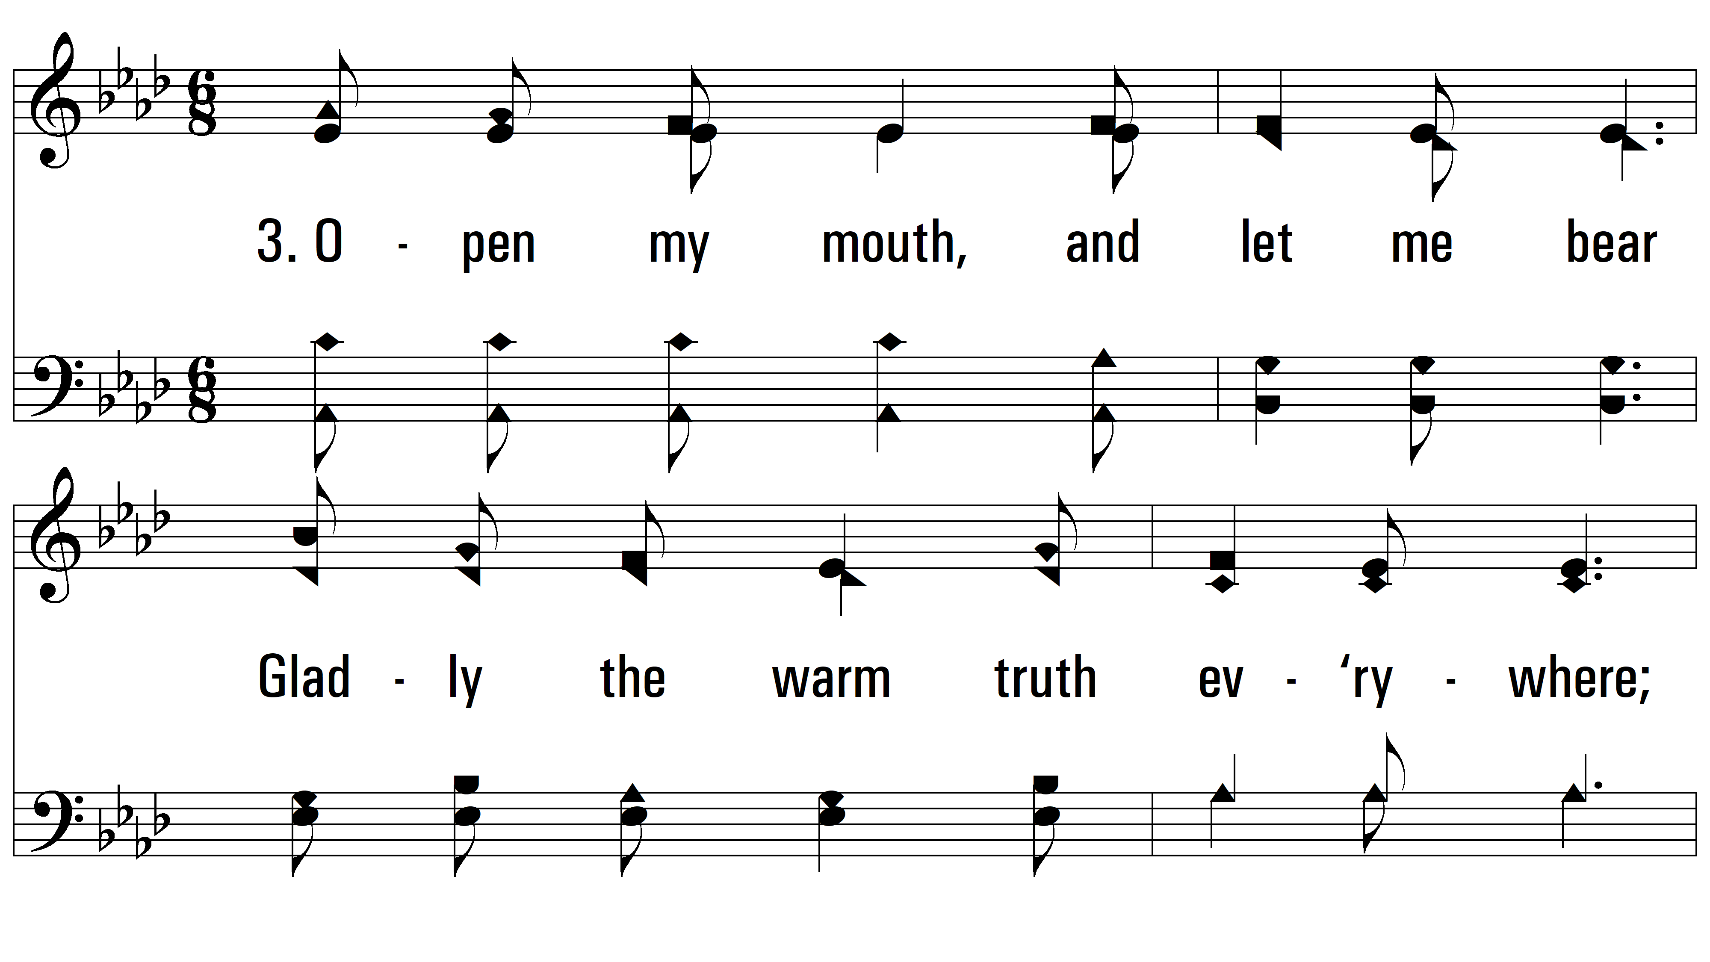
vs. 3 ~ Open My Eyes, That I May See

Slide 11
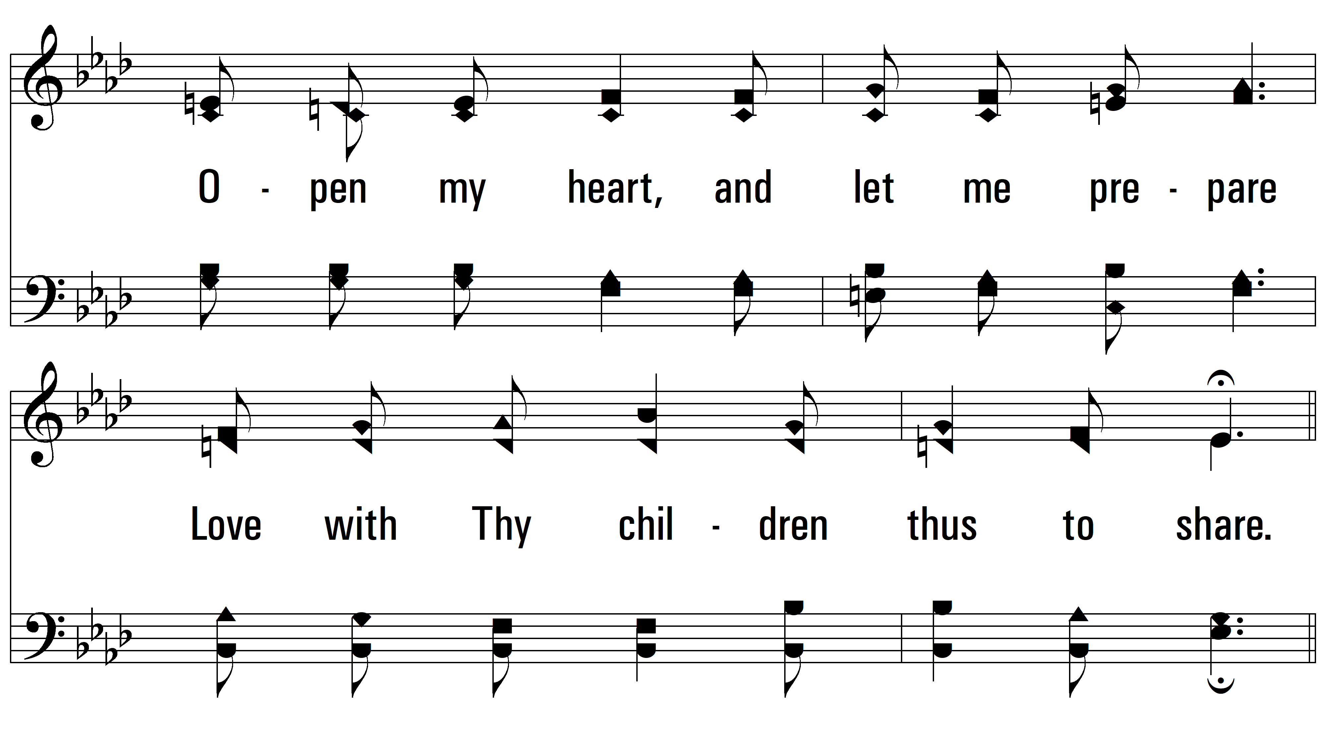
vs. 3

Slide 12
vs. 3

Slide 13
vs. 3

Slide 14
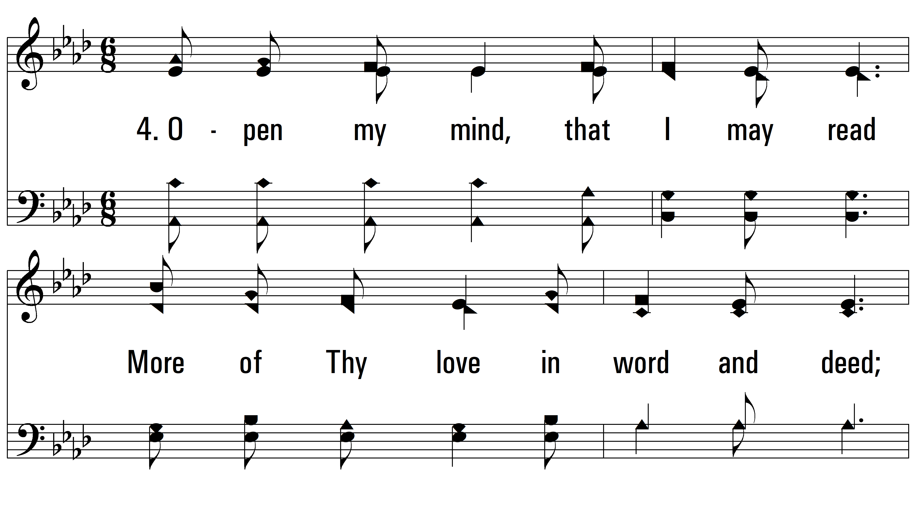
vs. 4 ~ Open My Eyes, That I May See

Slide 15
vs. 4

Slide 16
vs. 4

Slide 17
vs. 4

Slide 18
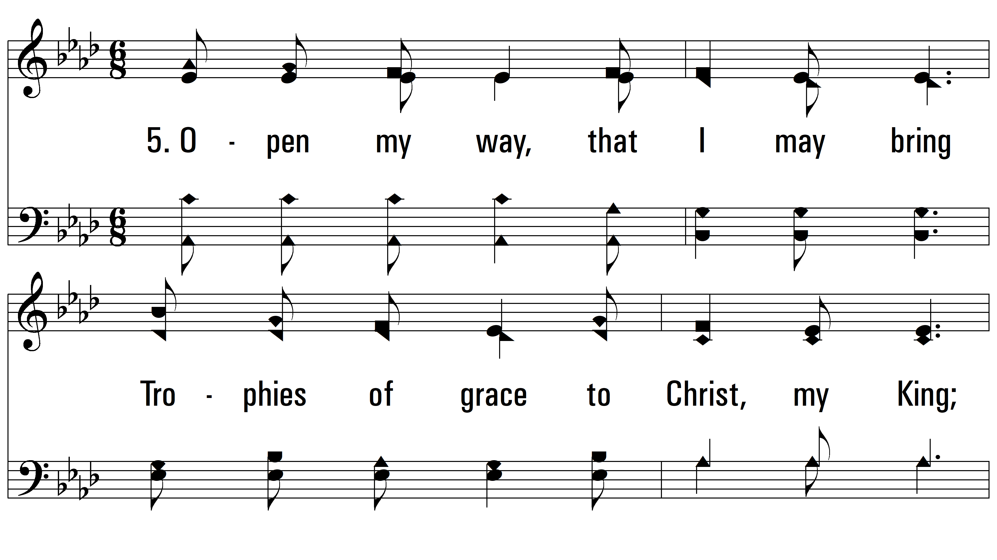
vs. 5 ~ Open My Eyes, That I May See

Slide 19
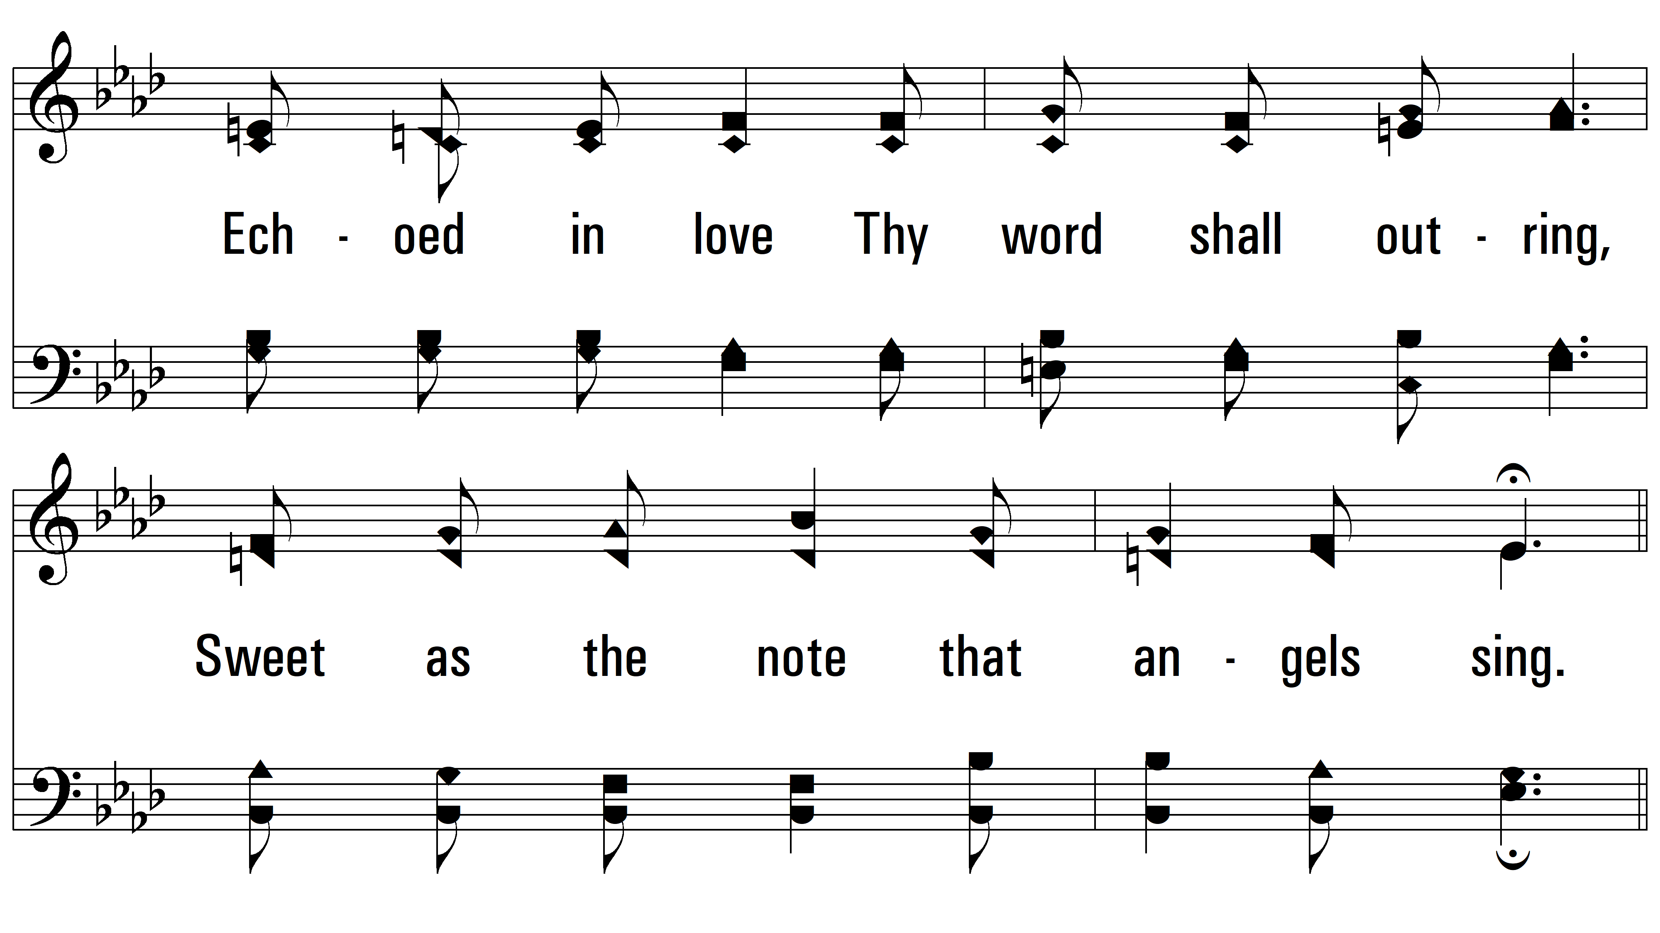
vs. 5

Slide 20
vs. 5

Slide 21
vs. 5
PDHymns.com
END

