Slide 1
Onward, Christian Soldiers
Words: | Sabine Baring-Gould (1864)
Music: | Arthur Sullivan (1871)
4/4
E/B - SOL
Verses: 3/Chorus
Lead - | SOL
Alto - | MI
Tenor - | DO
Bass - | DO
PDHymns.com

Slide 2
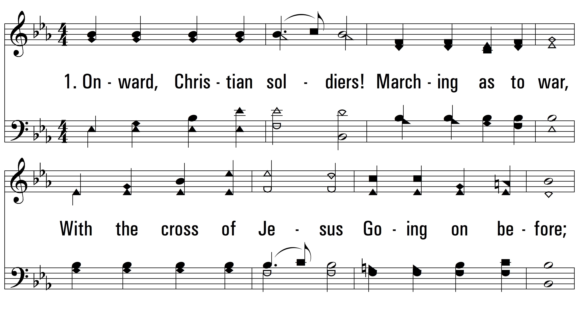
vs. 1 ~ Onward, Christian Soldiers

Slide 3
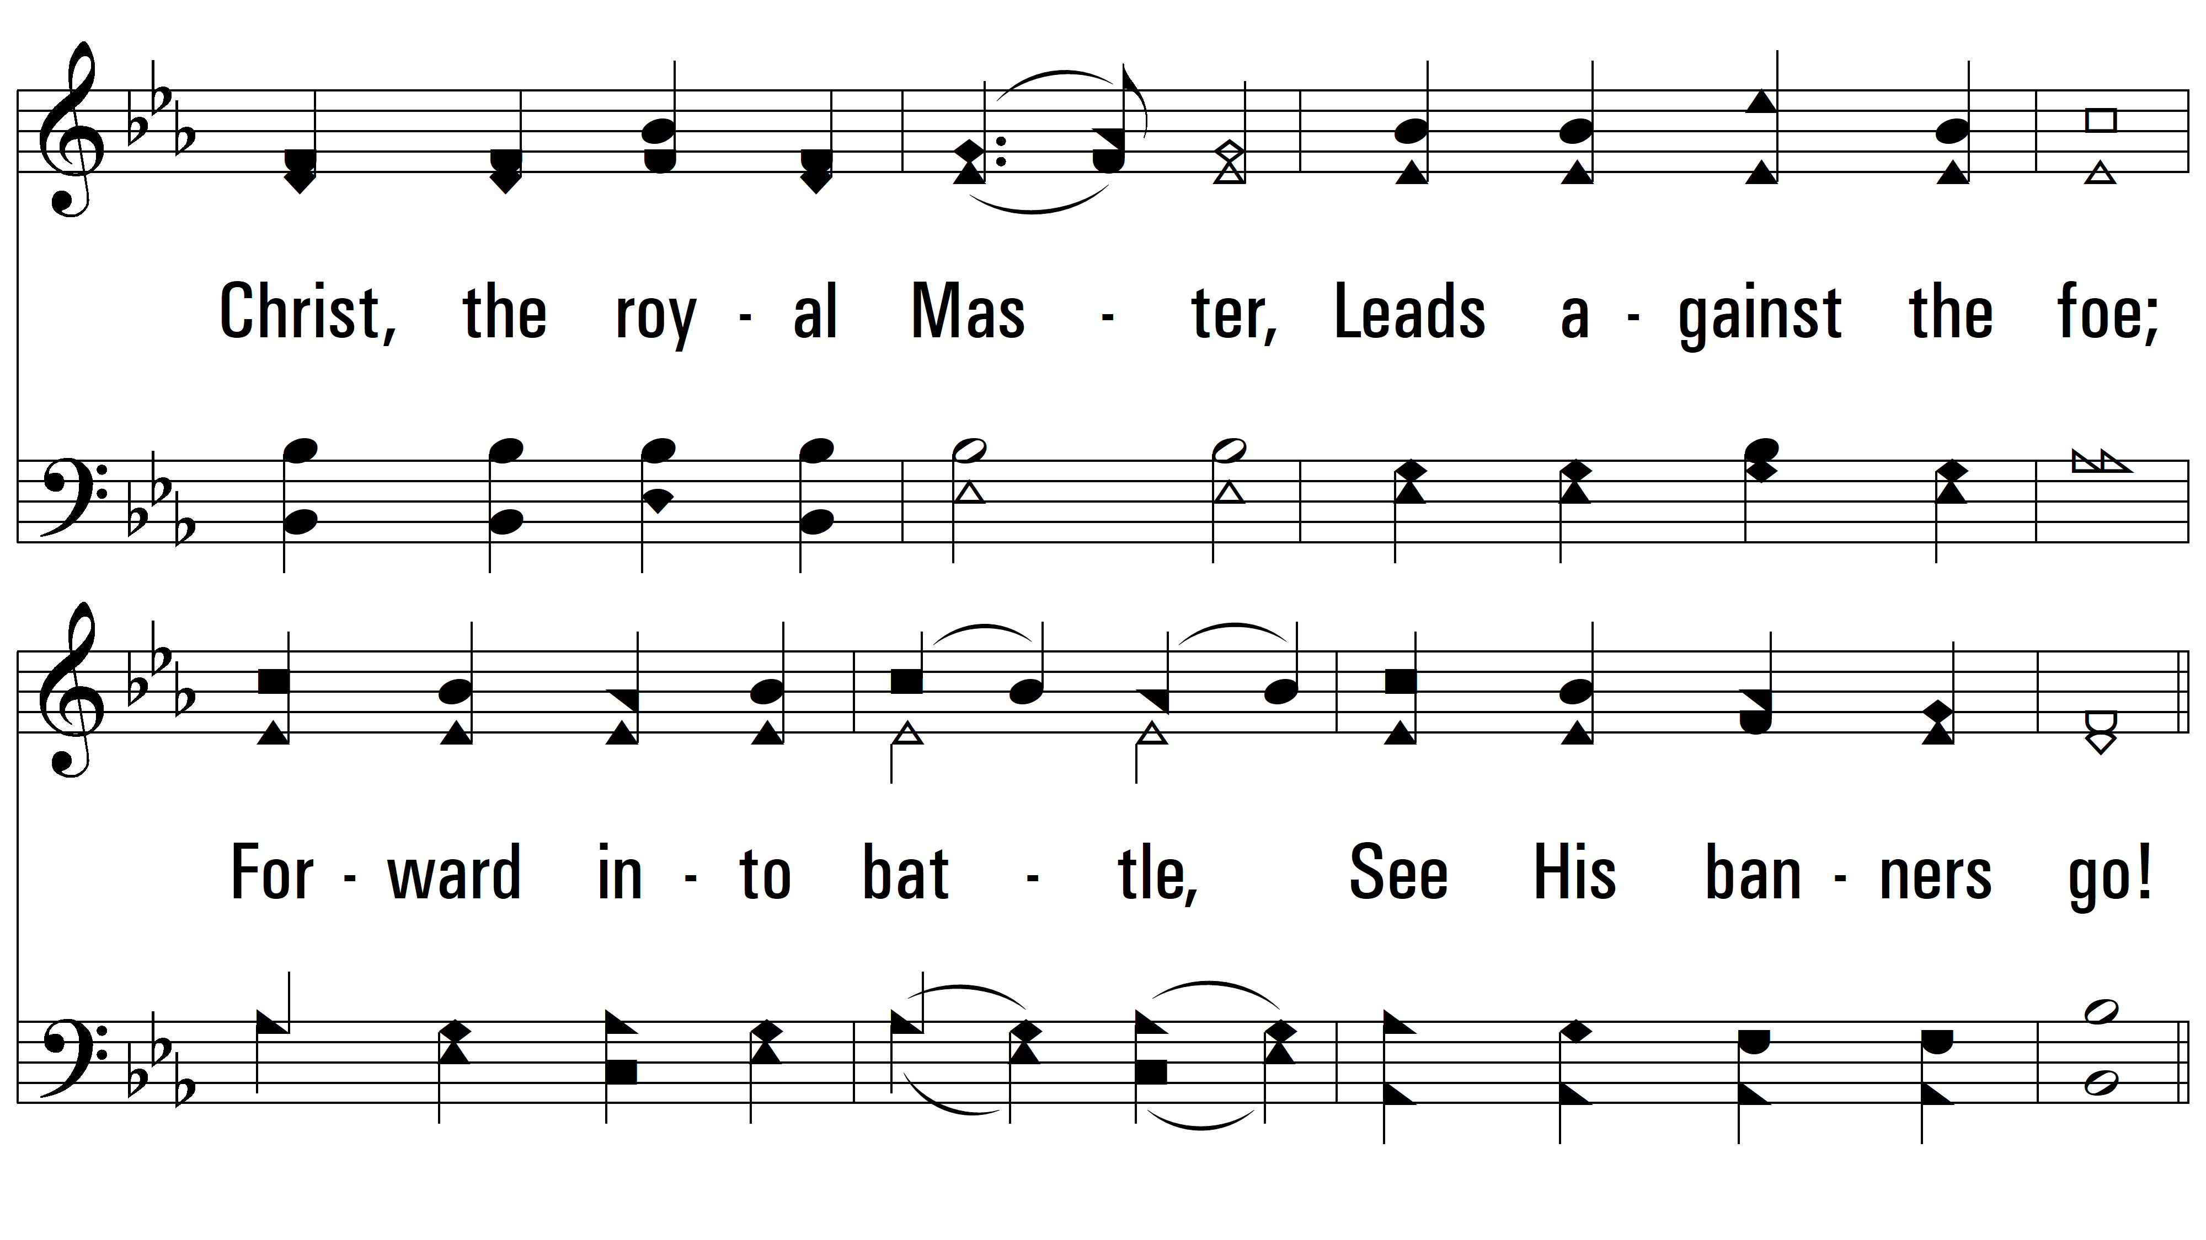
vs. 1

Slide 4
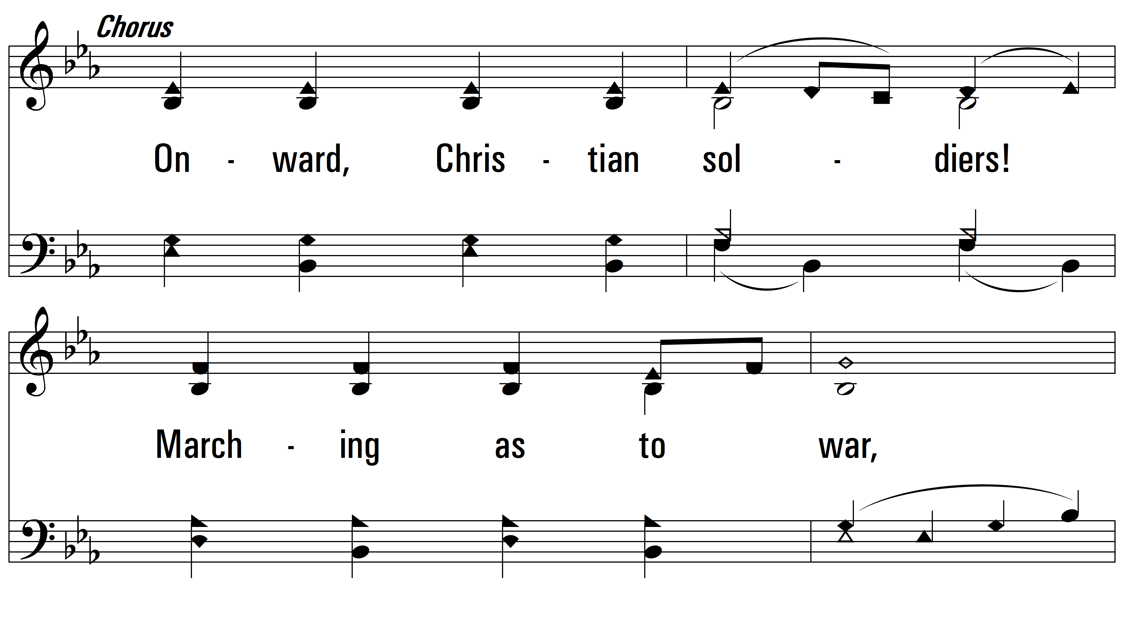
vs. 1

Slide 5
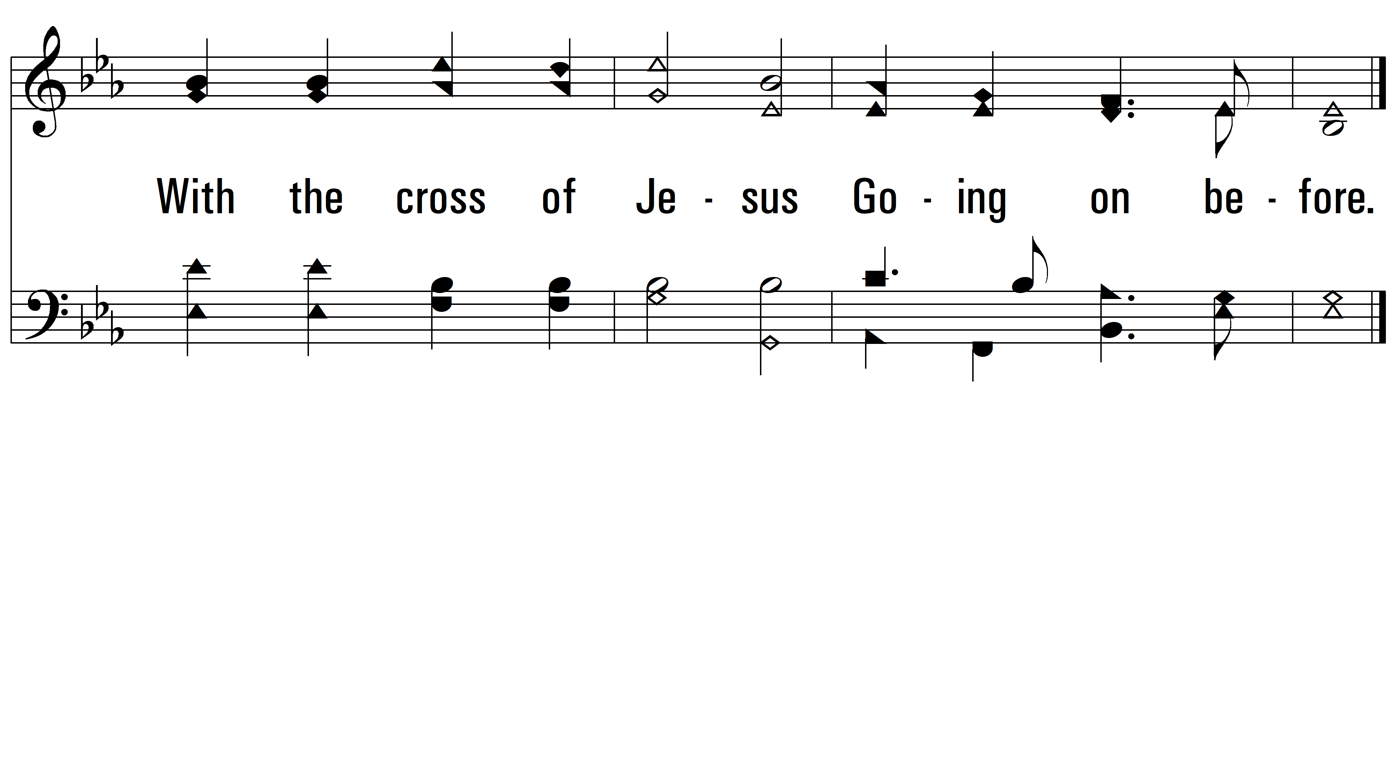
vs. 1

Slide 6
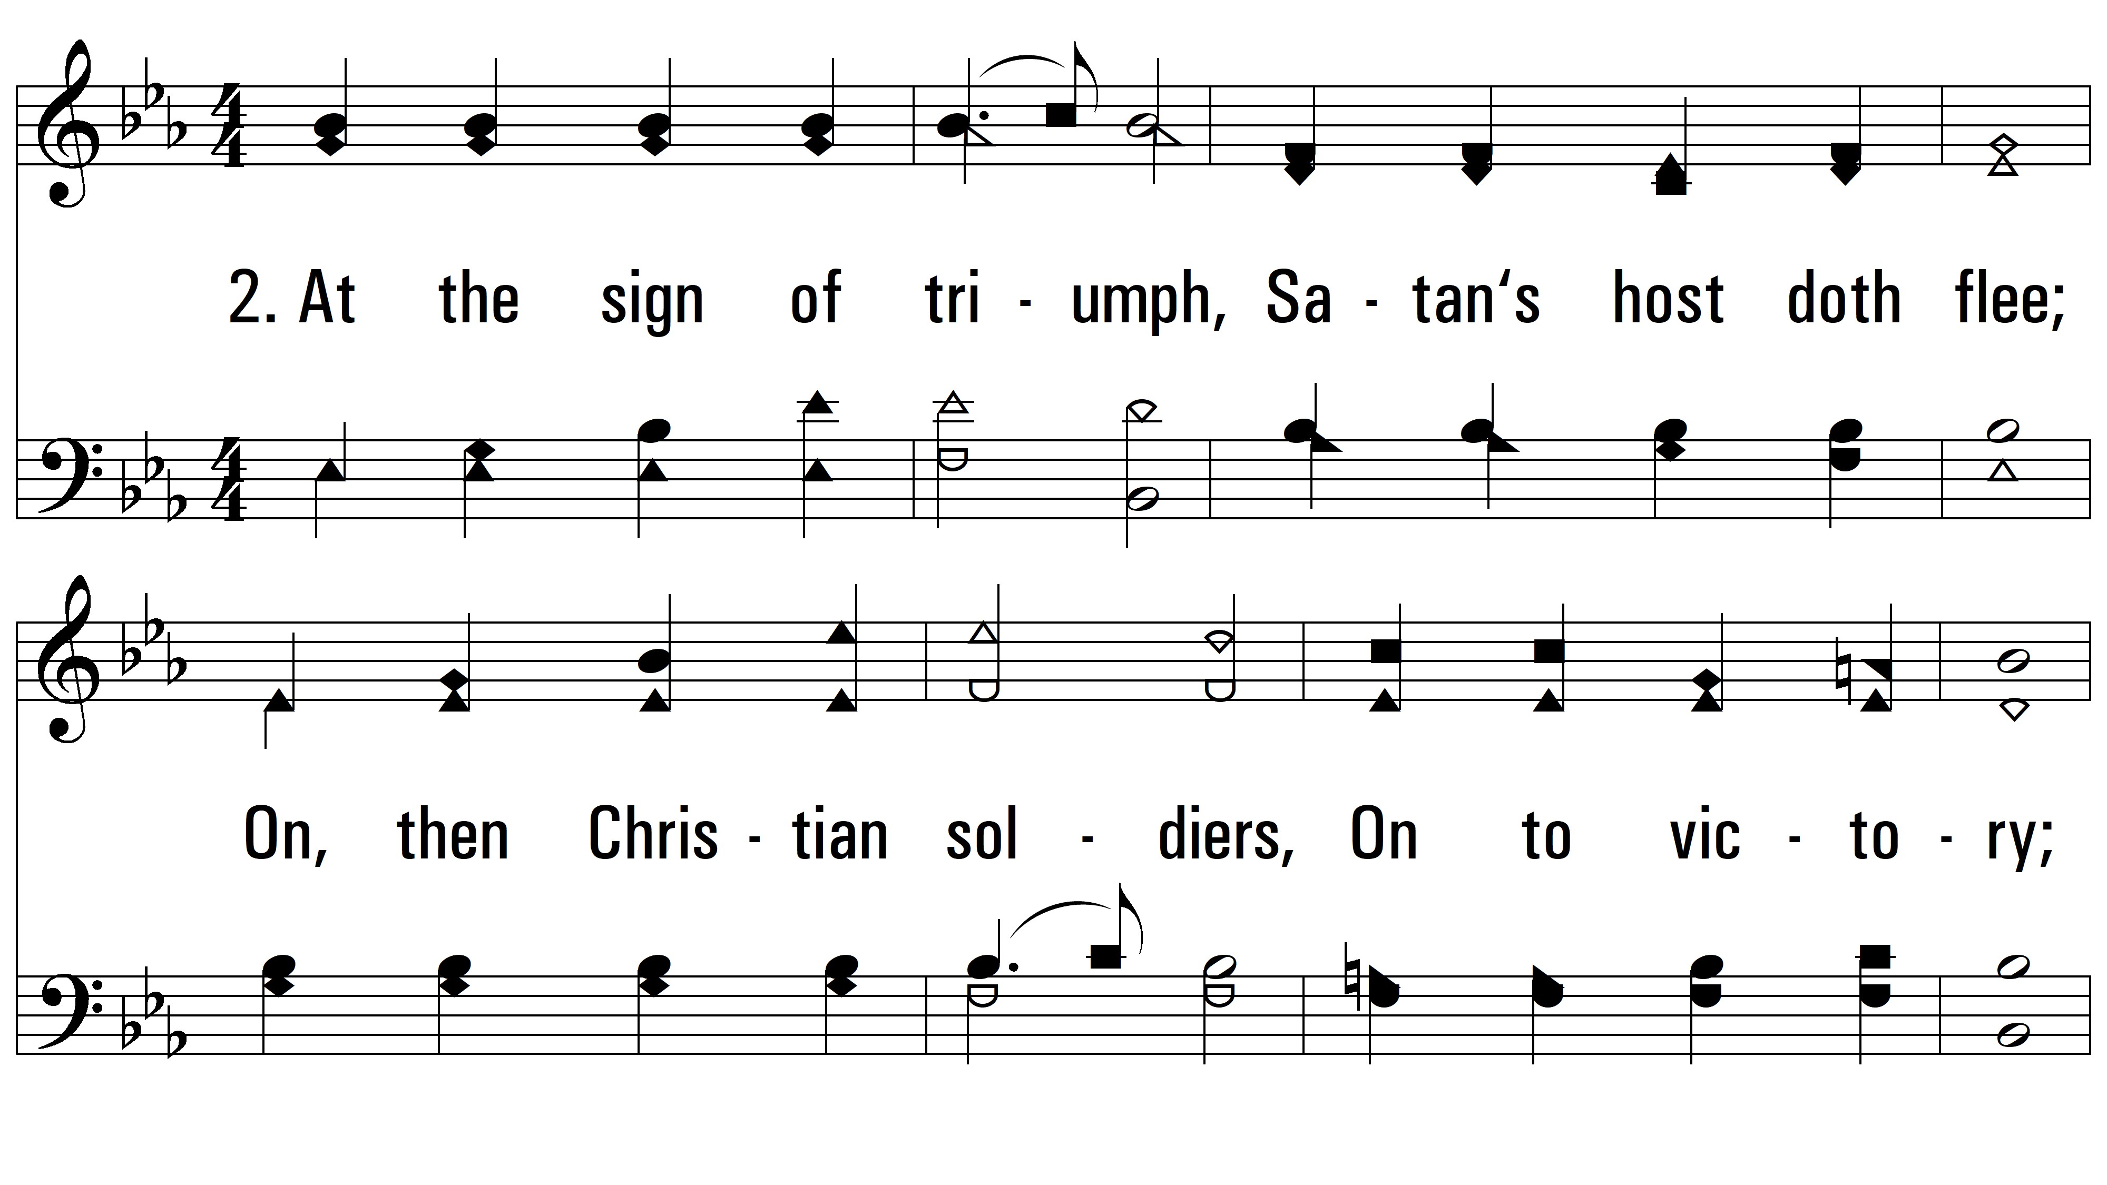
vs. 2 ~ Onward, Christian Soldiers

Slide 7
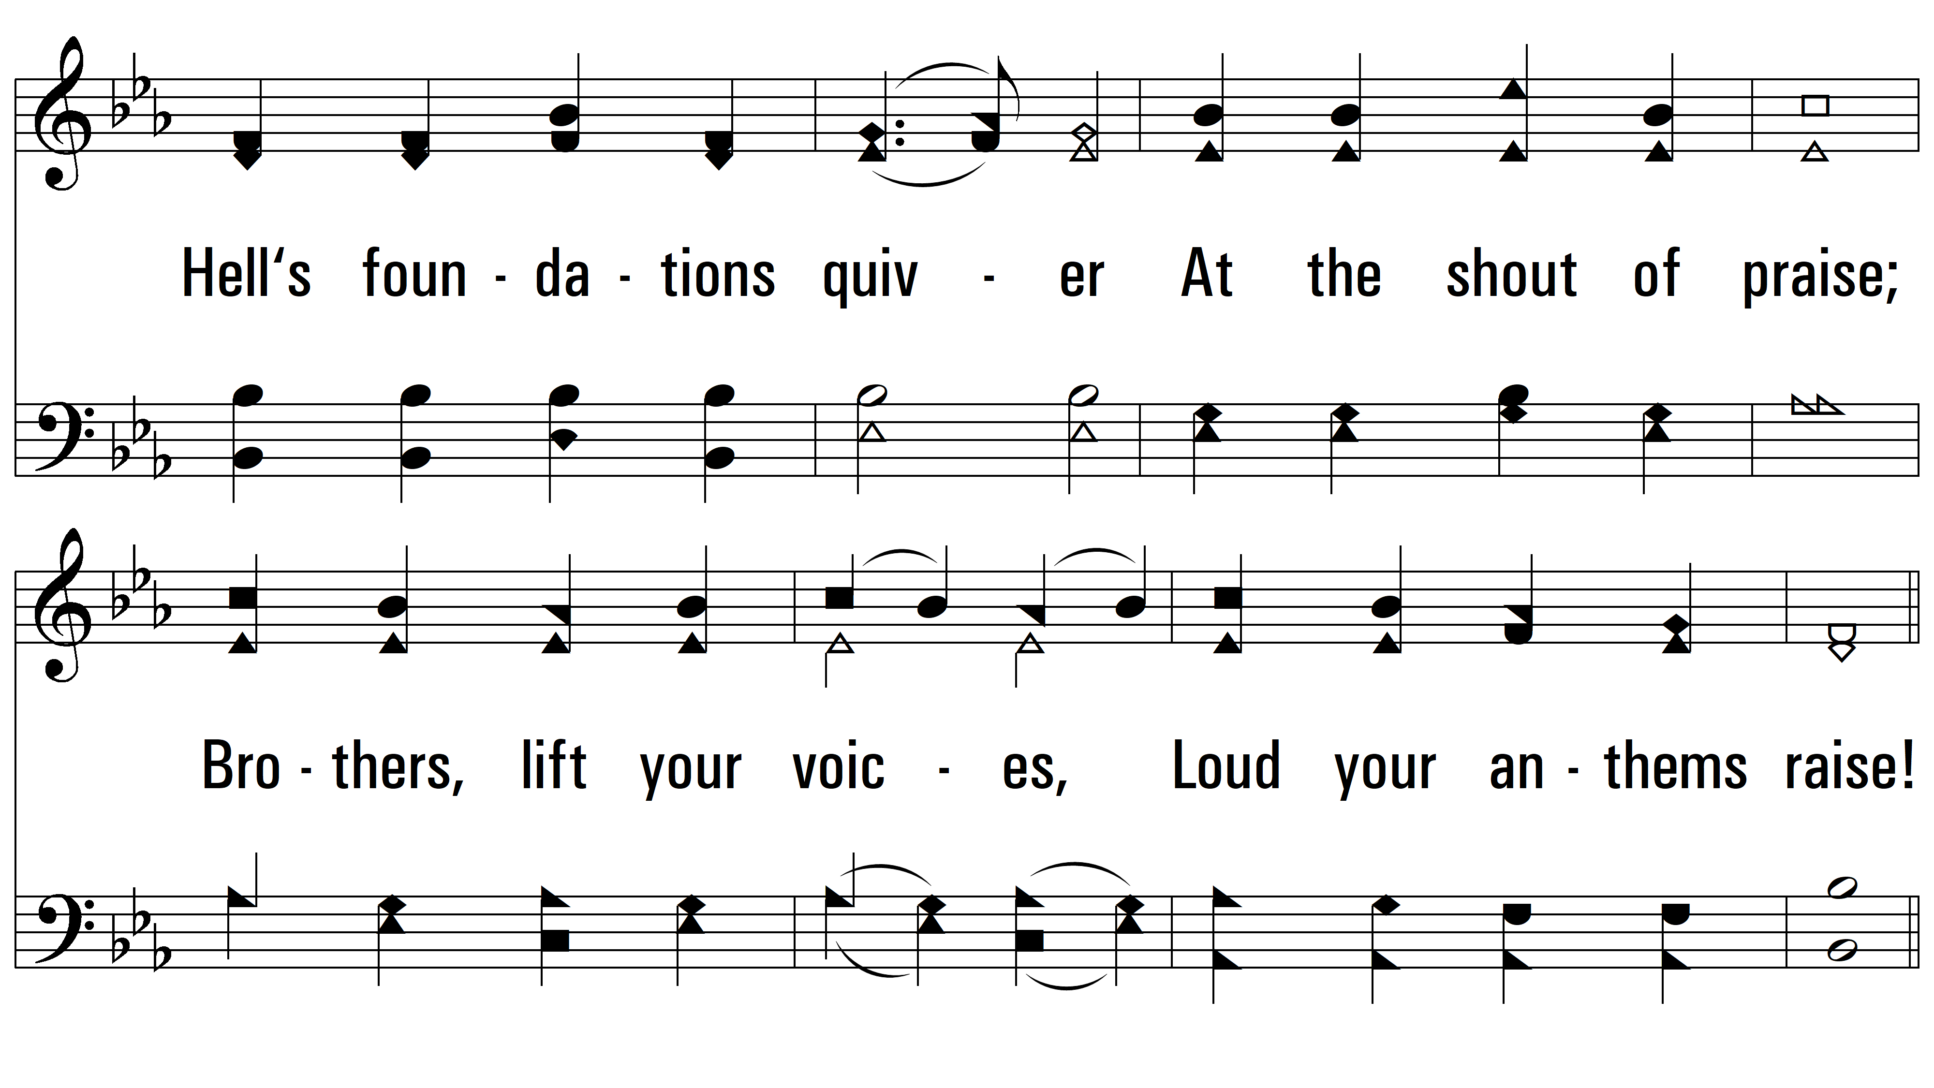
vs. 2

Slide 8
vs. 2

Slide 9
vs. 2

Slide 10
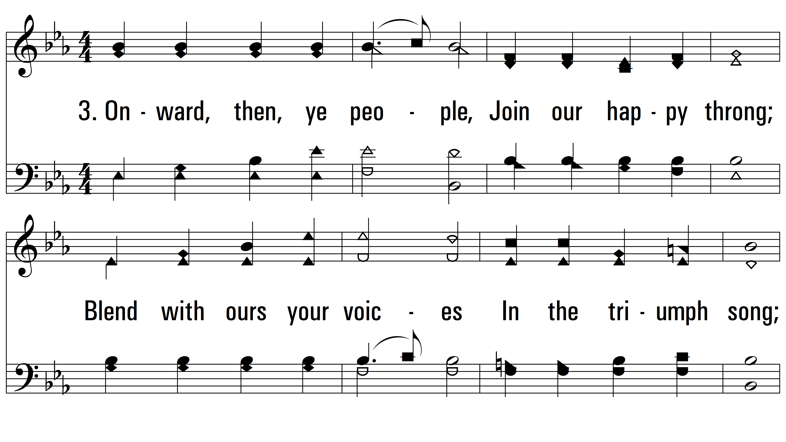
vs. 3~ Onward, Christian Soldiers

Slide 11
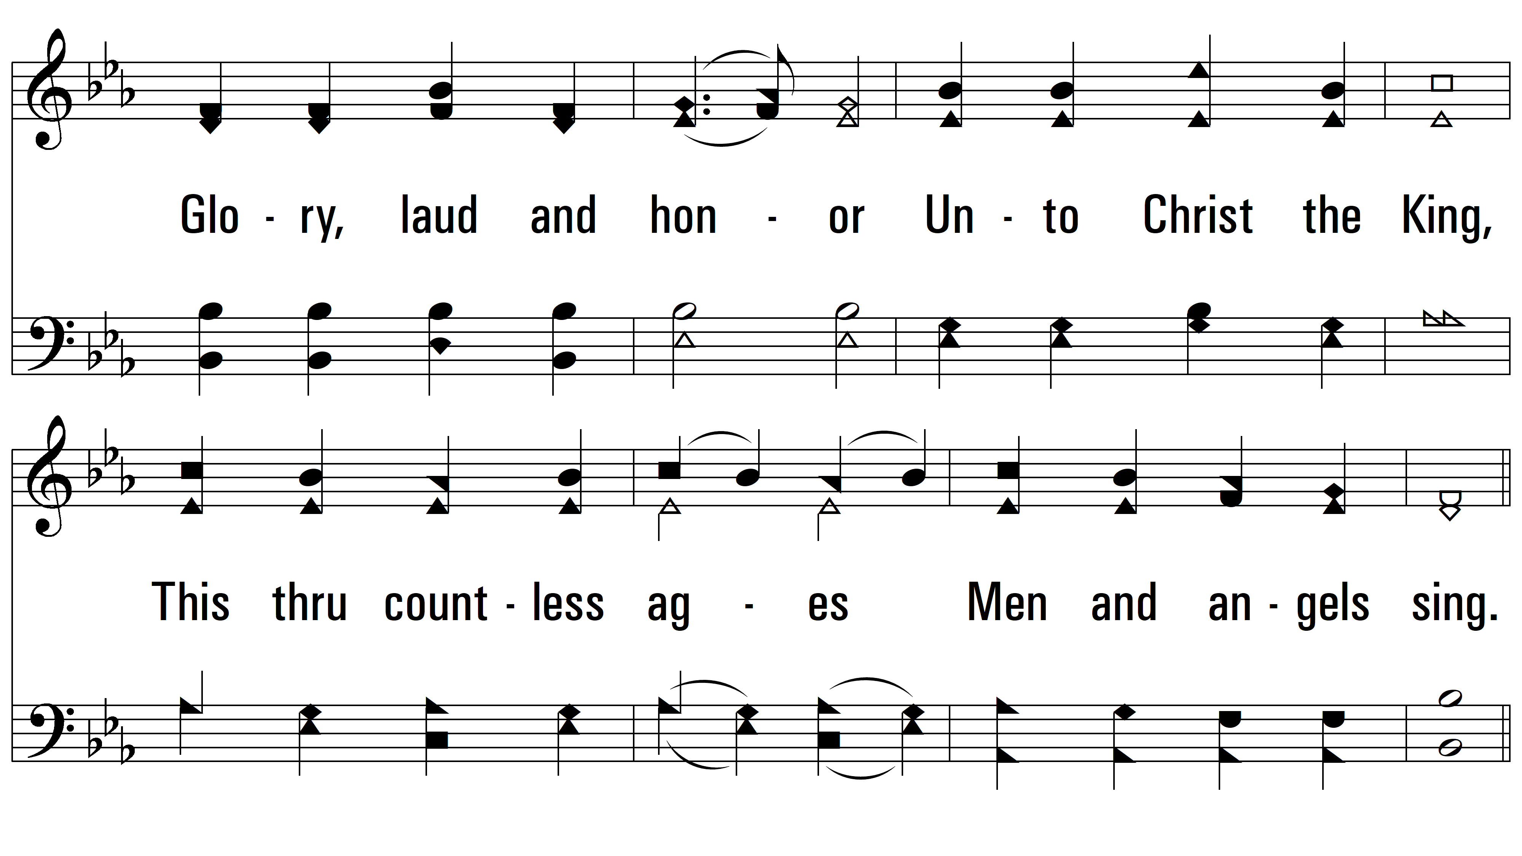
vs. 3

Slide 12
vs. 3

Slide 13
vs. 3
PDHymns.com
END

