Slide 1
Only One Way
Words: | Birdie Bell (1923)
Music: | Leonard Daugherty (1923)
6/4
E^{b}/G - MI
Verses: 4/Chorus
Lead - | MI
Alto - | DO
Tenor - | SOL
Bass - | DO
PDHymns.com

Slide 2
vs. 1 ~ Only One Way

Slide 3
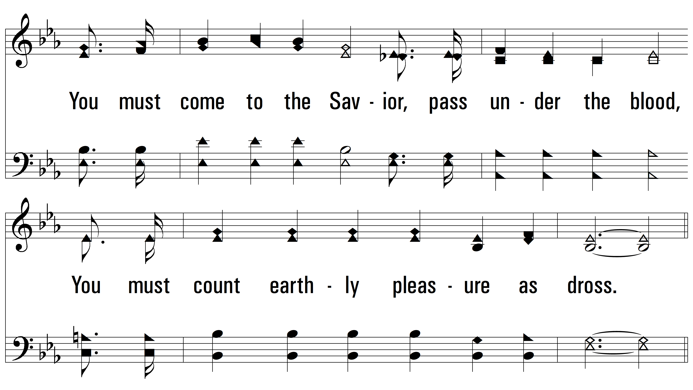
vs. 1

Slide 4
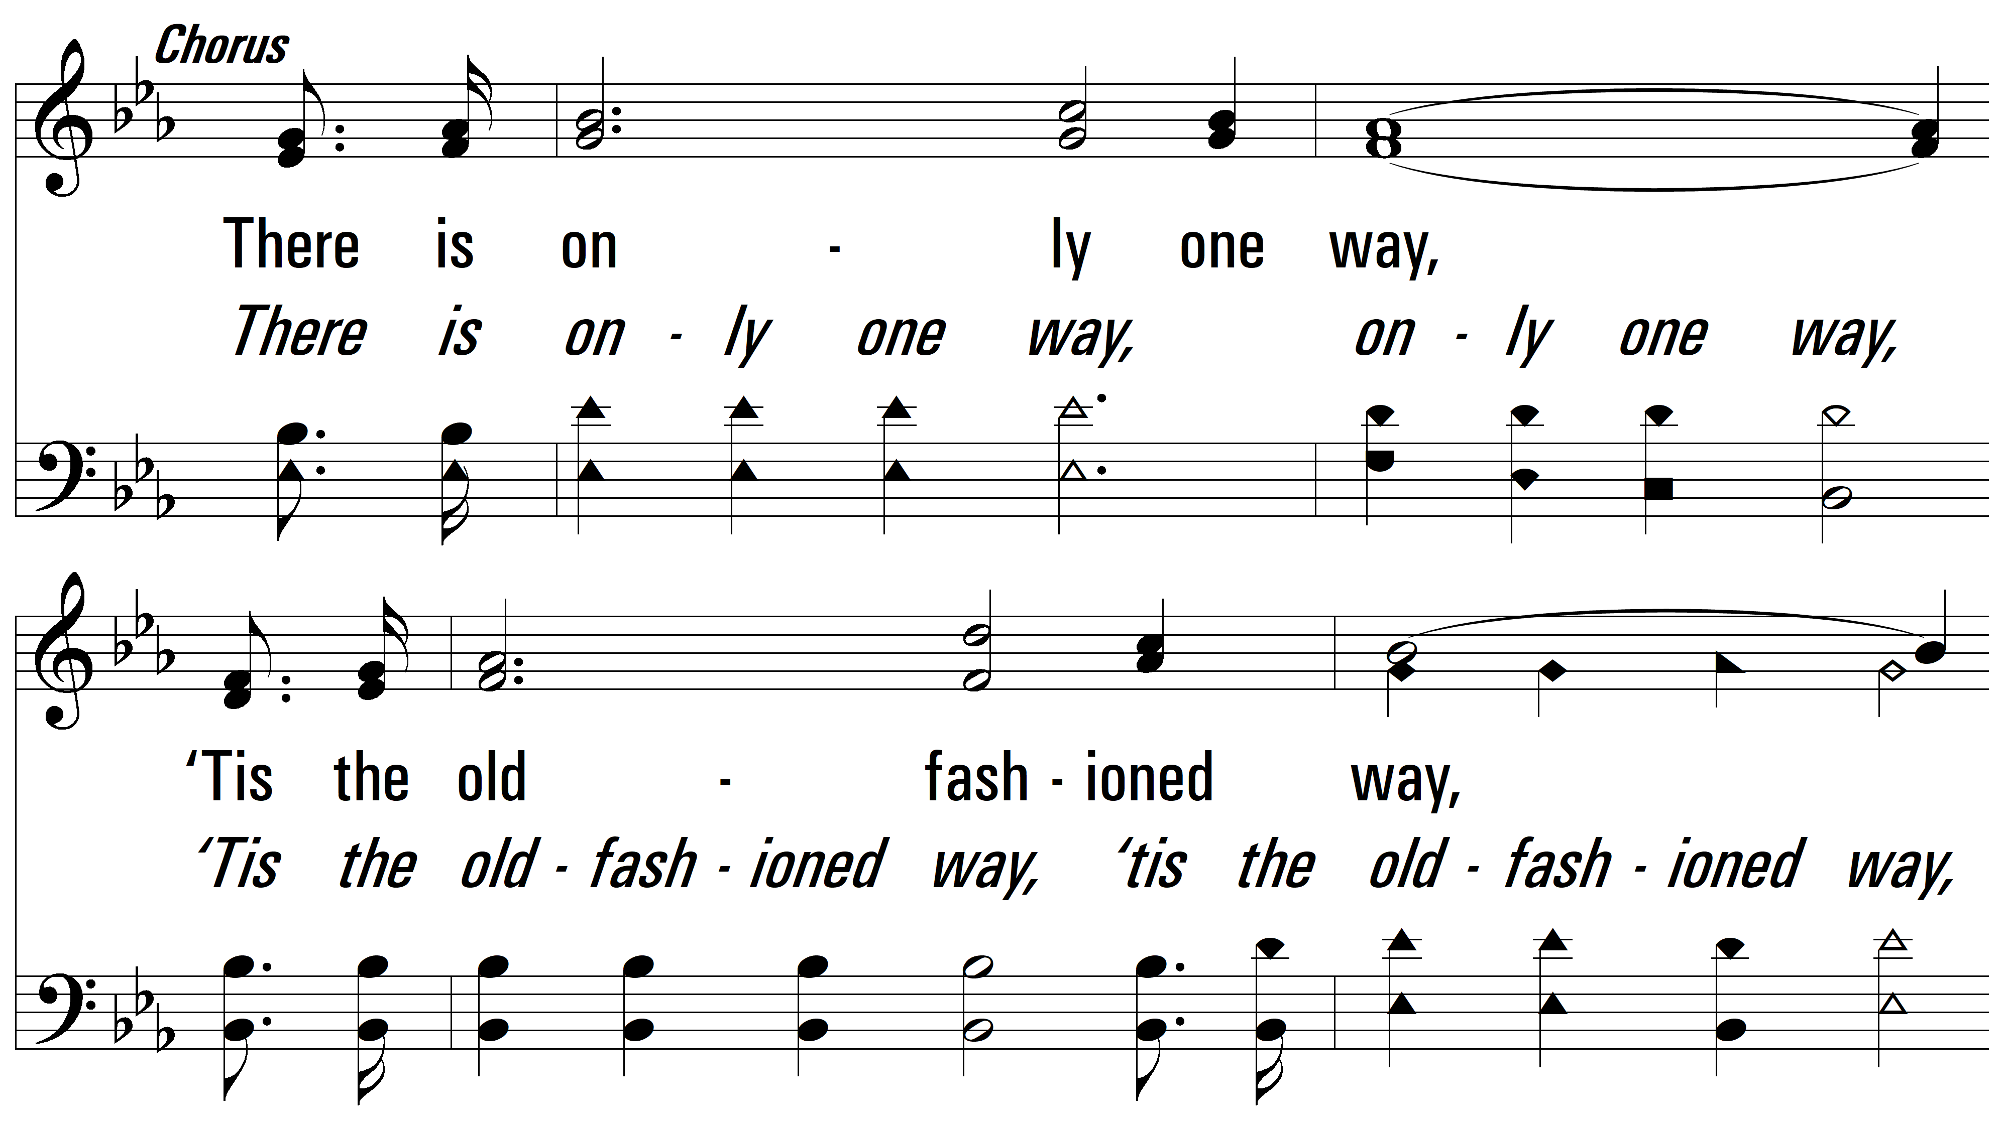
vs. 1

Slide 5
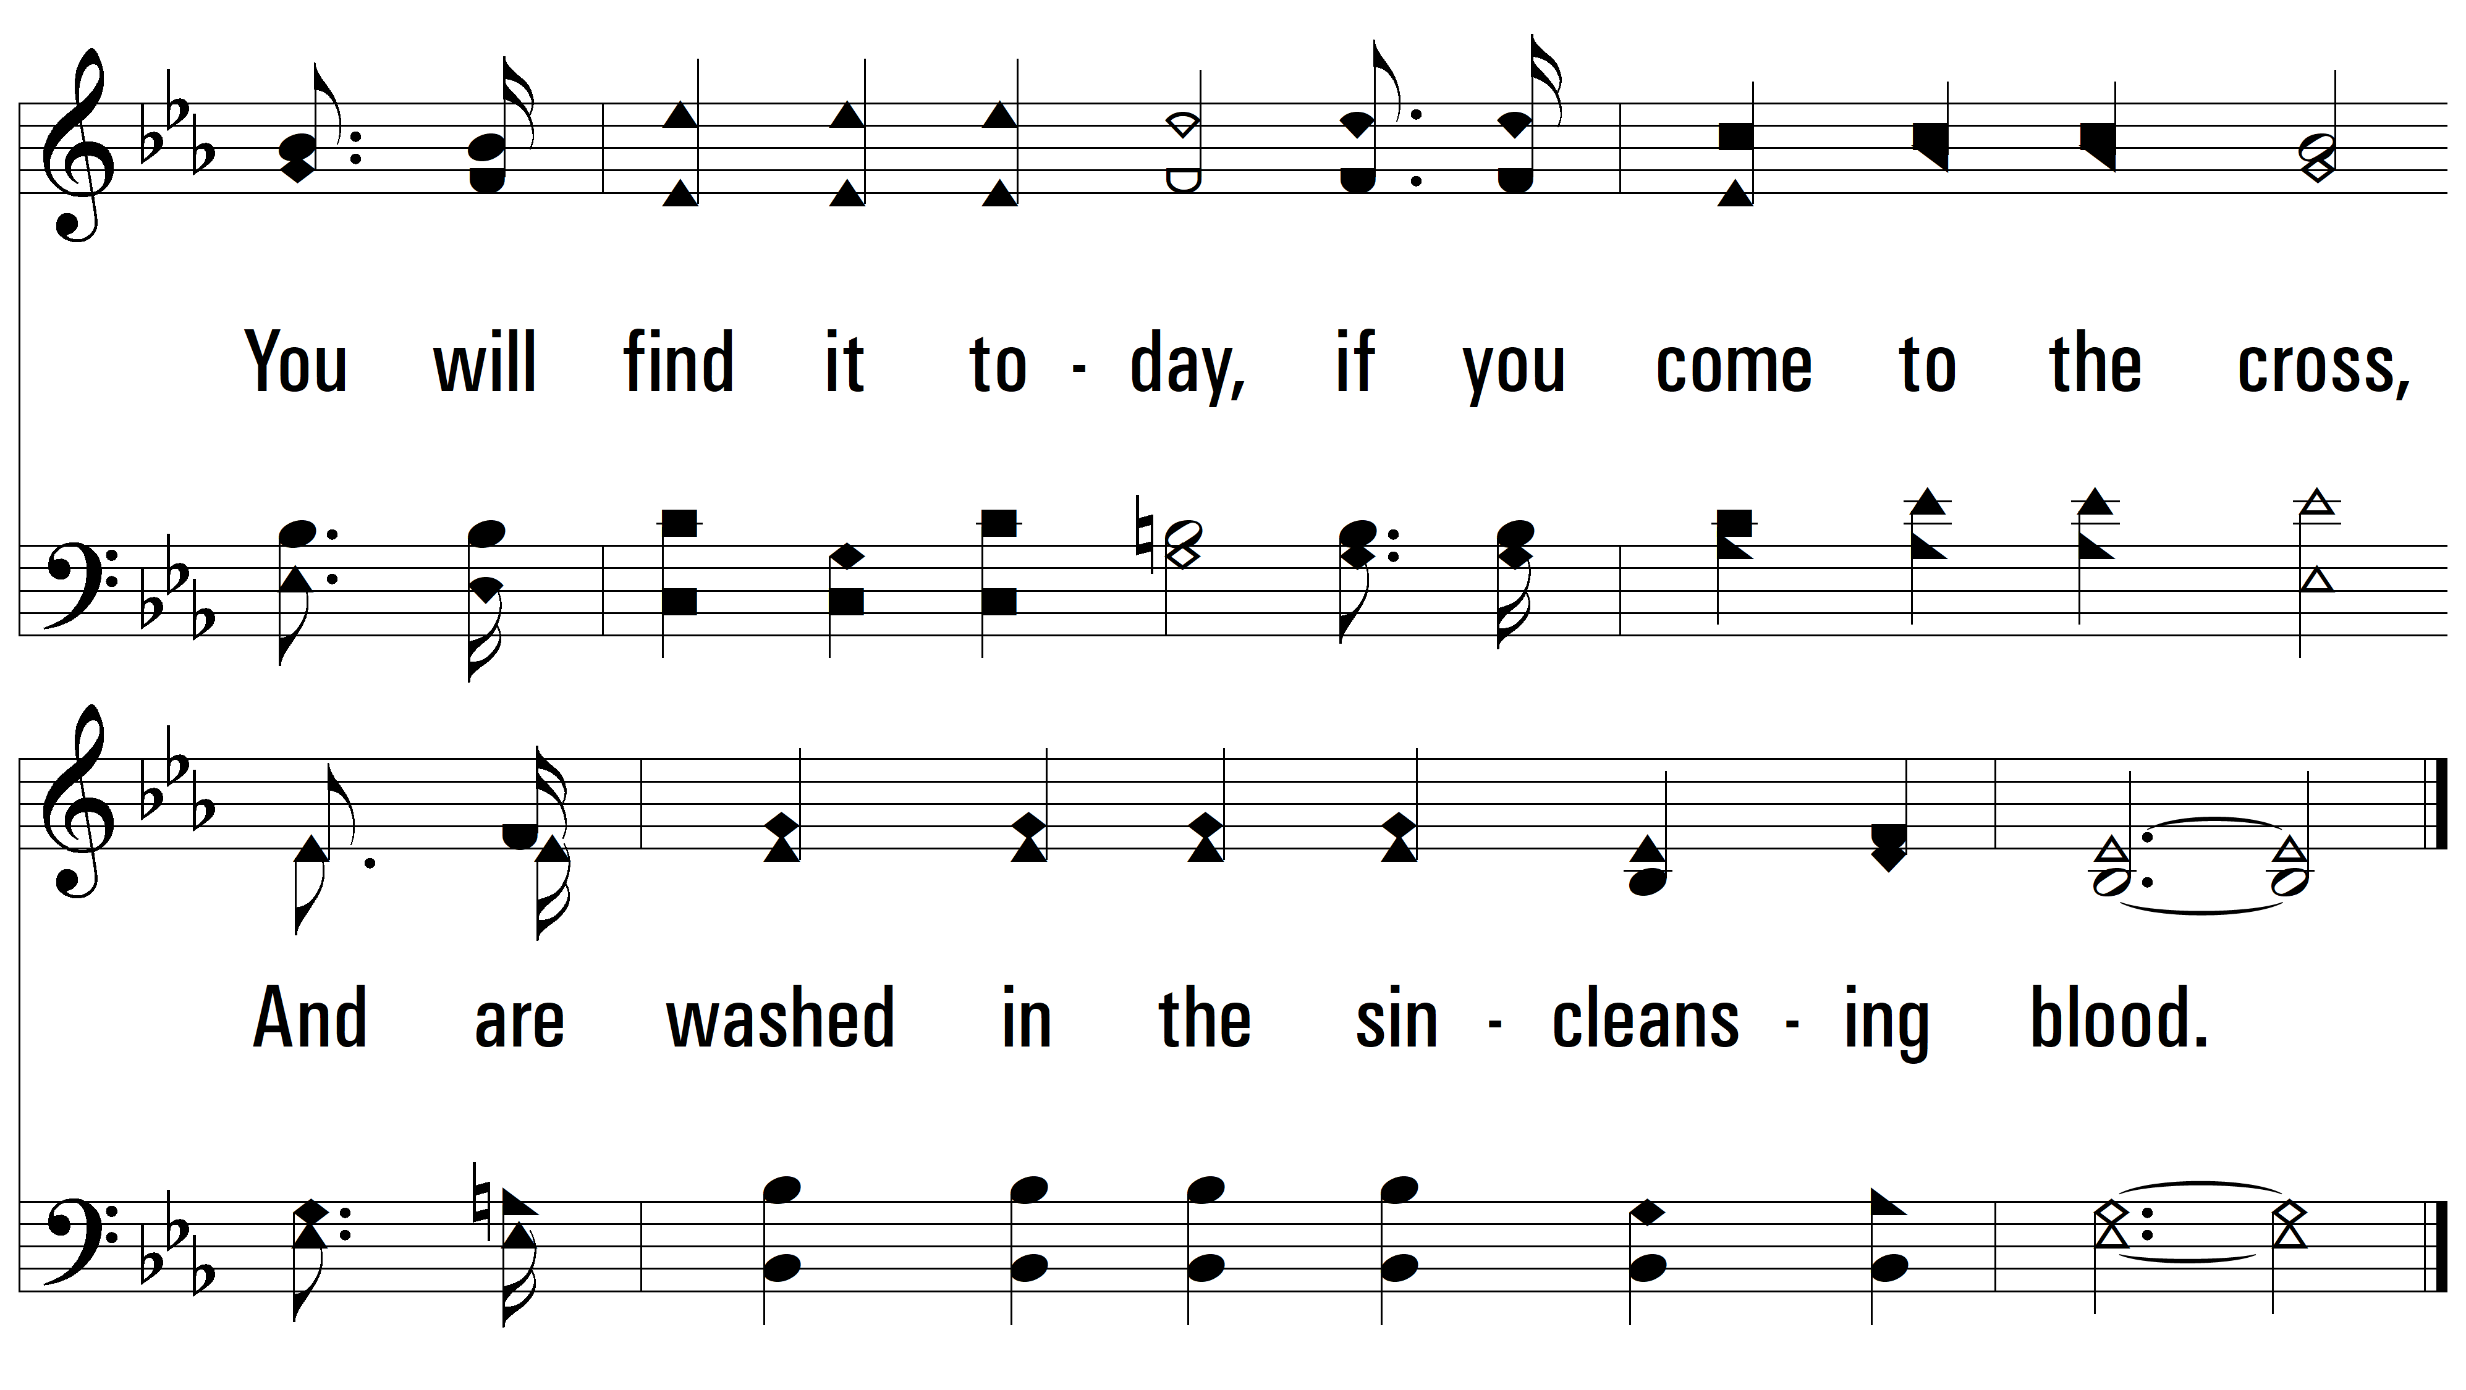
vs. 1

Slide 6
vs. 2 ~ Only One Way

Slide 7
vs. 2

Slide 8
vs. 2

Slide 9
vs. 2

Slide 10
vs. 3 ~ Only One Way

Slide 11
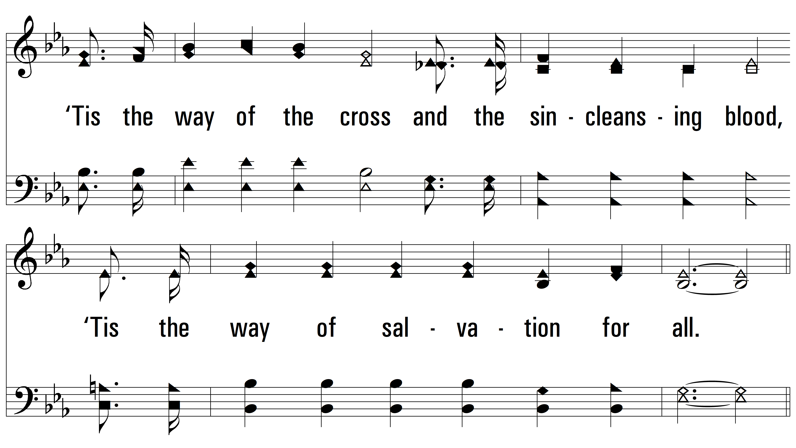
vs. 3

Slide 12
vs. 3

Slide 13
vs. 3

Slide 14
vs. 4 ~ Only One Way

Slide 15
vs. 4

Slide 16
vs. 4

Slide 17
vs. 4
PDHymns.com
END

