Slide 1
Only In Thee
MONOS
8.8.8.6.9.9.9.6
Words: | Thomas O. Chisholm (1905)
Music: | Charles H. Gabriel (1905)
9/8
B^{b}/D - MI
Verses: 4
Lead - | MI
Alto - | DO
Tenor - | SOL
Bass - | DO
PDHymns.com

Slide 2
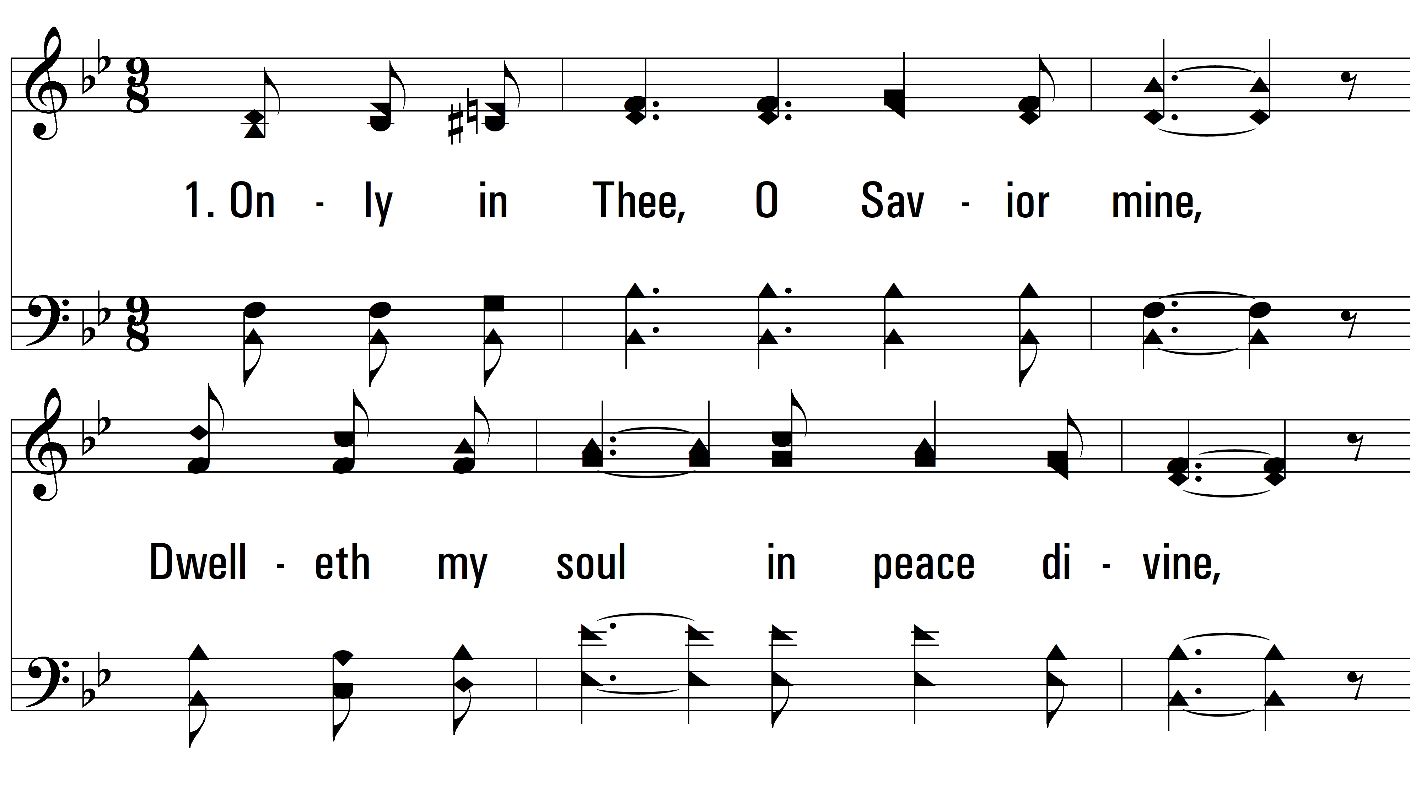
vs. 1 ~ Only In Thee

Slide 3
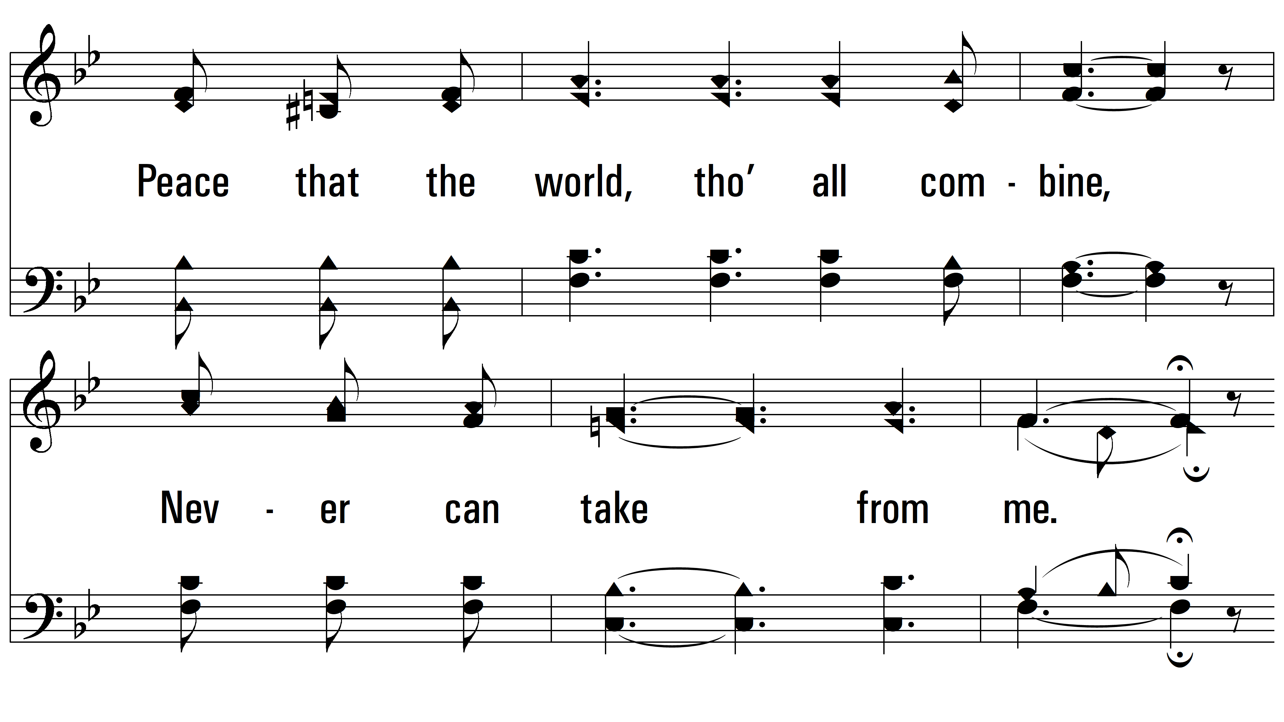
vs. 1

Slide 4
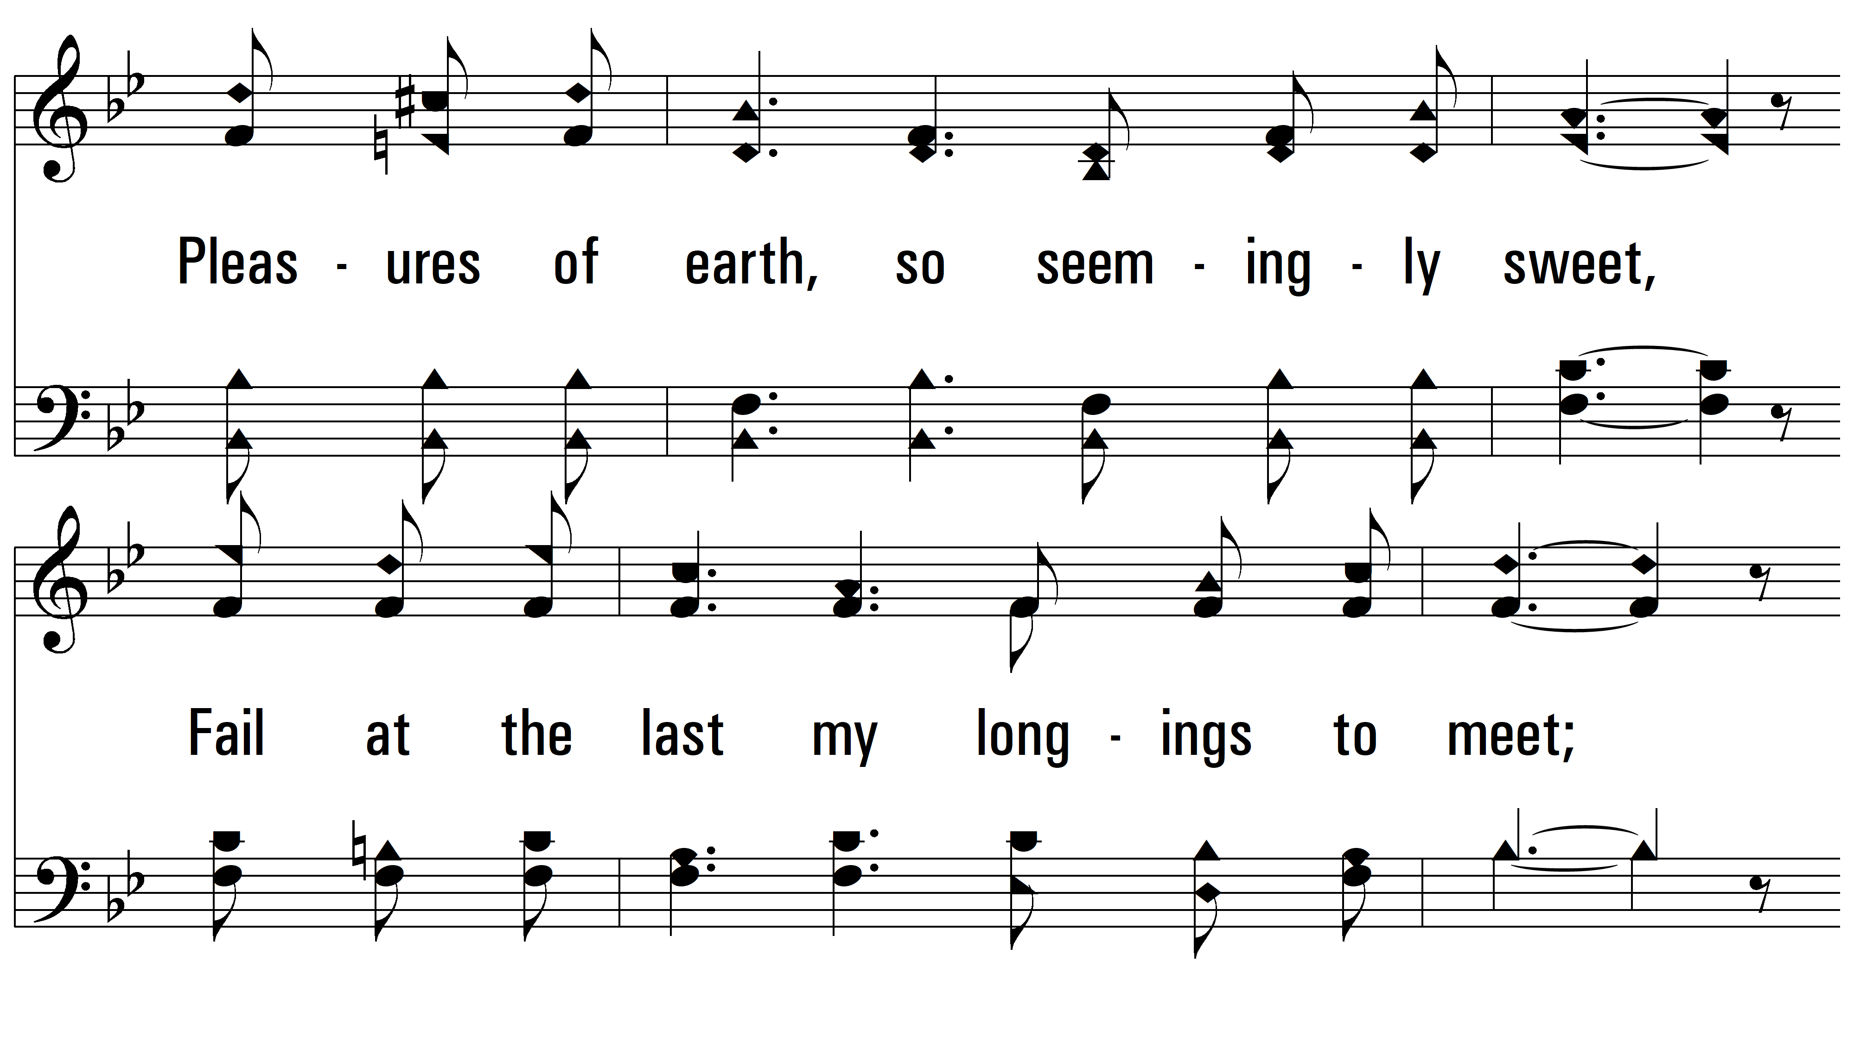
vs. 1

Slide 5
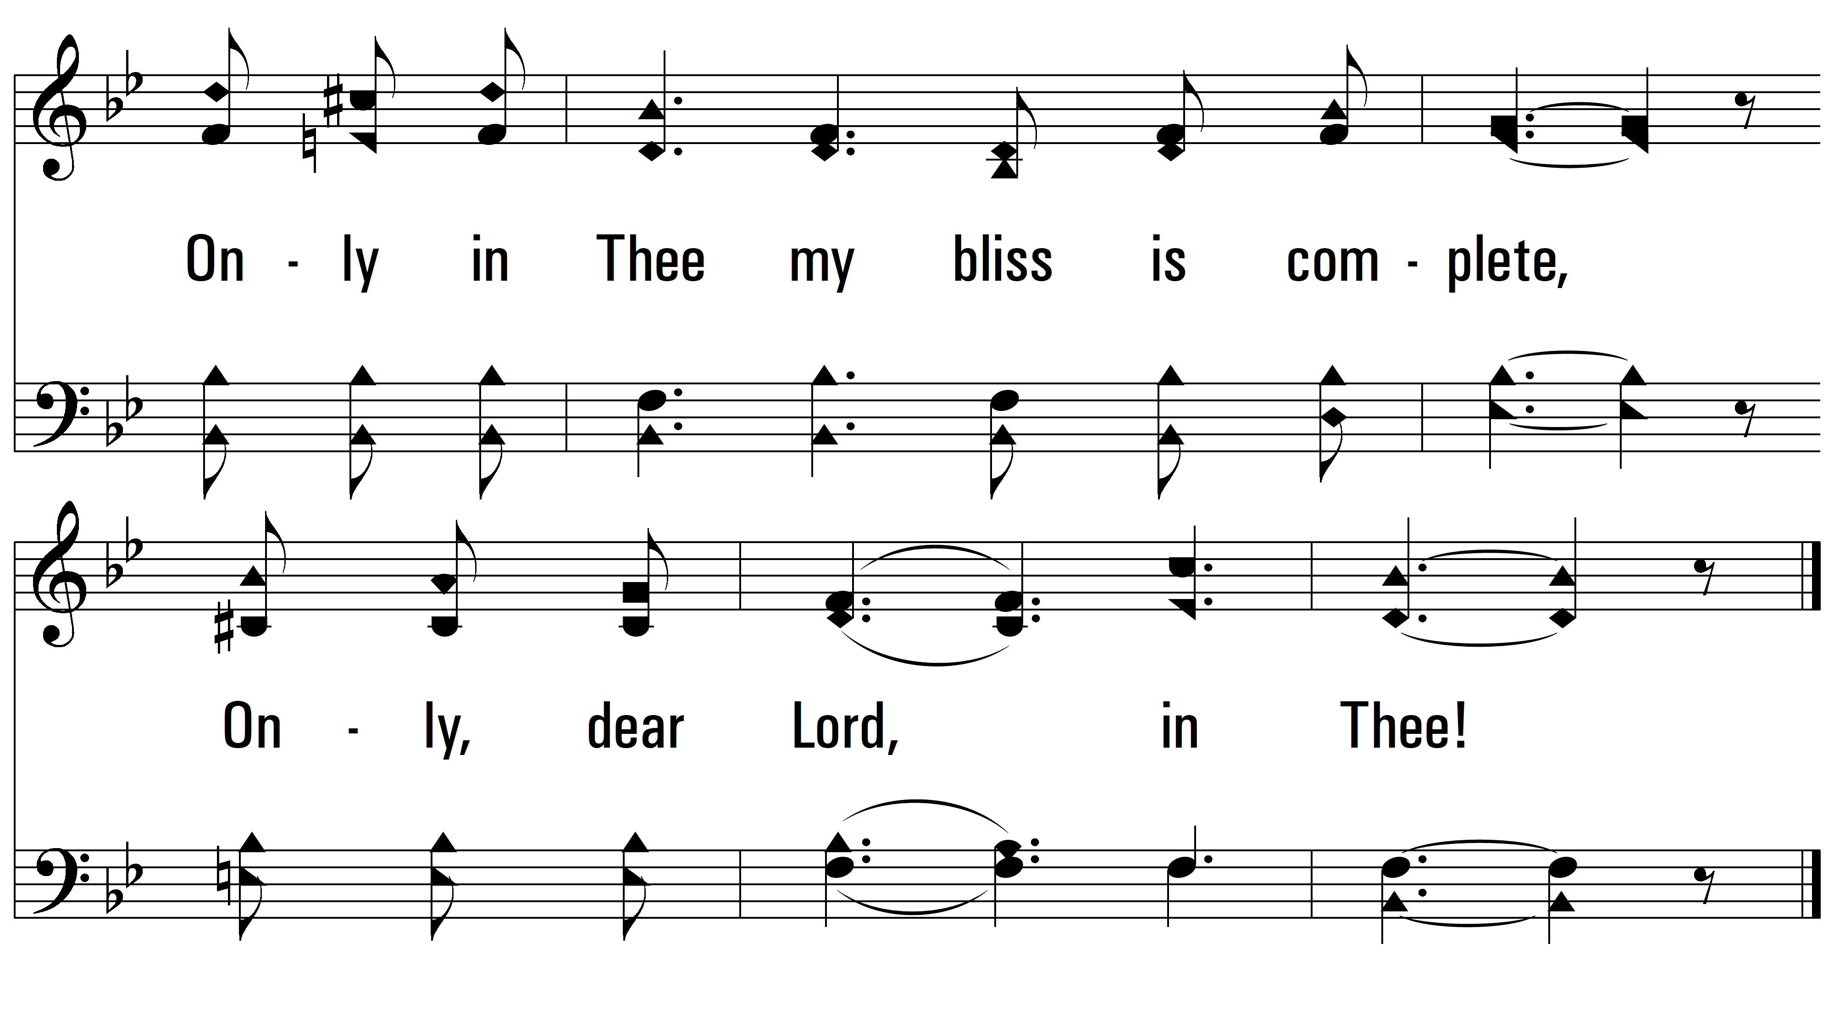
vs. 1

Slide 6
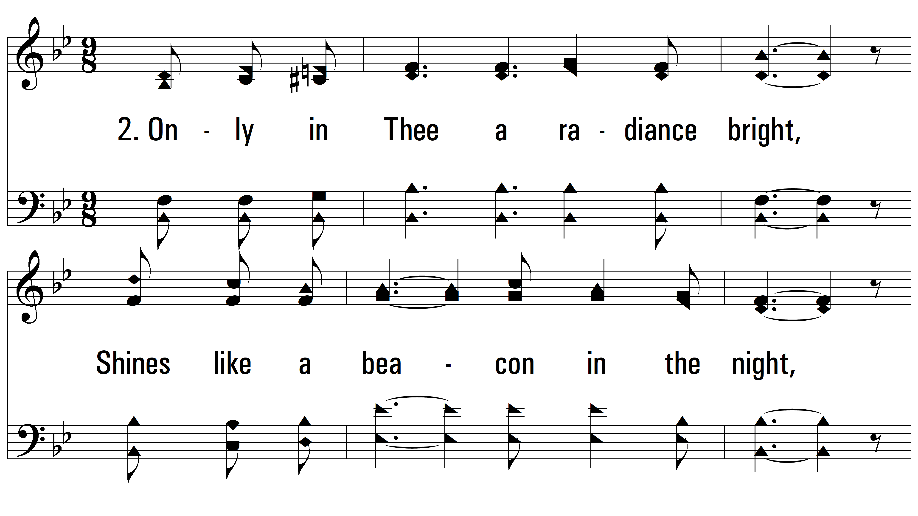
vs. 2 ~ Only In Thee

Slide 7
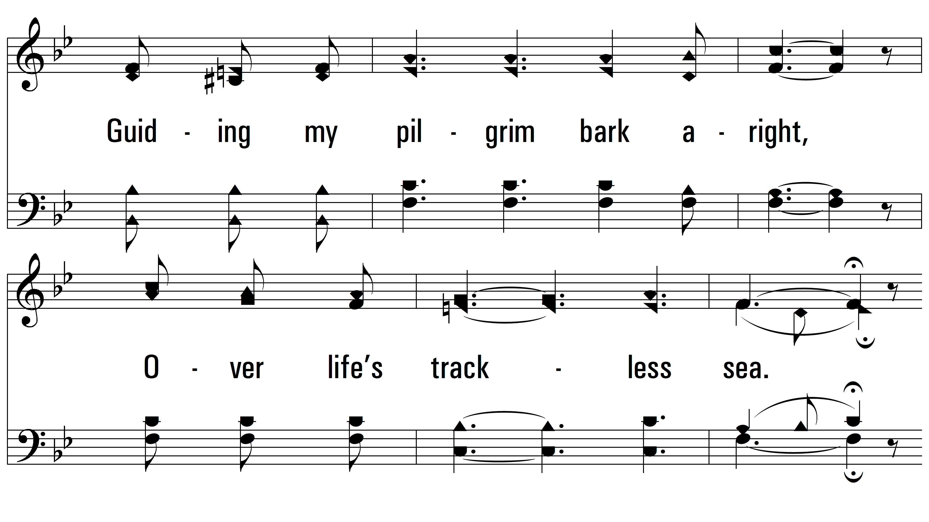
vs. 2

Slide 8
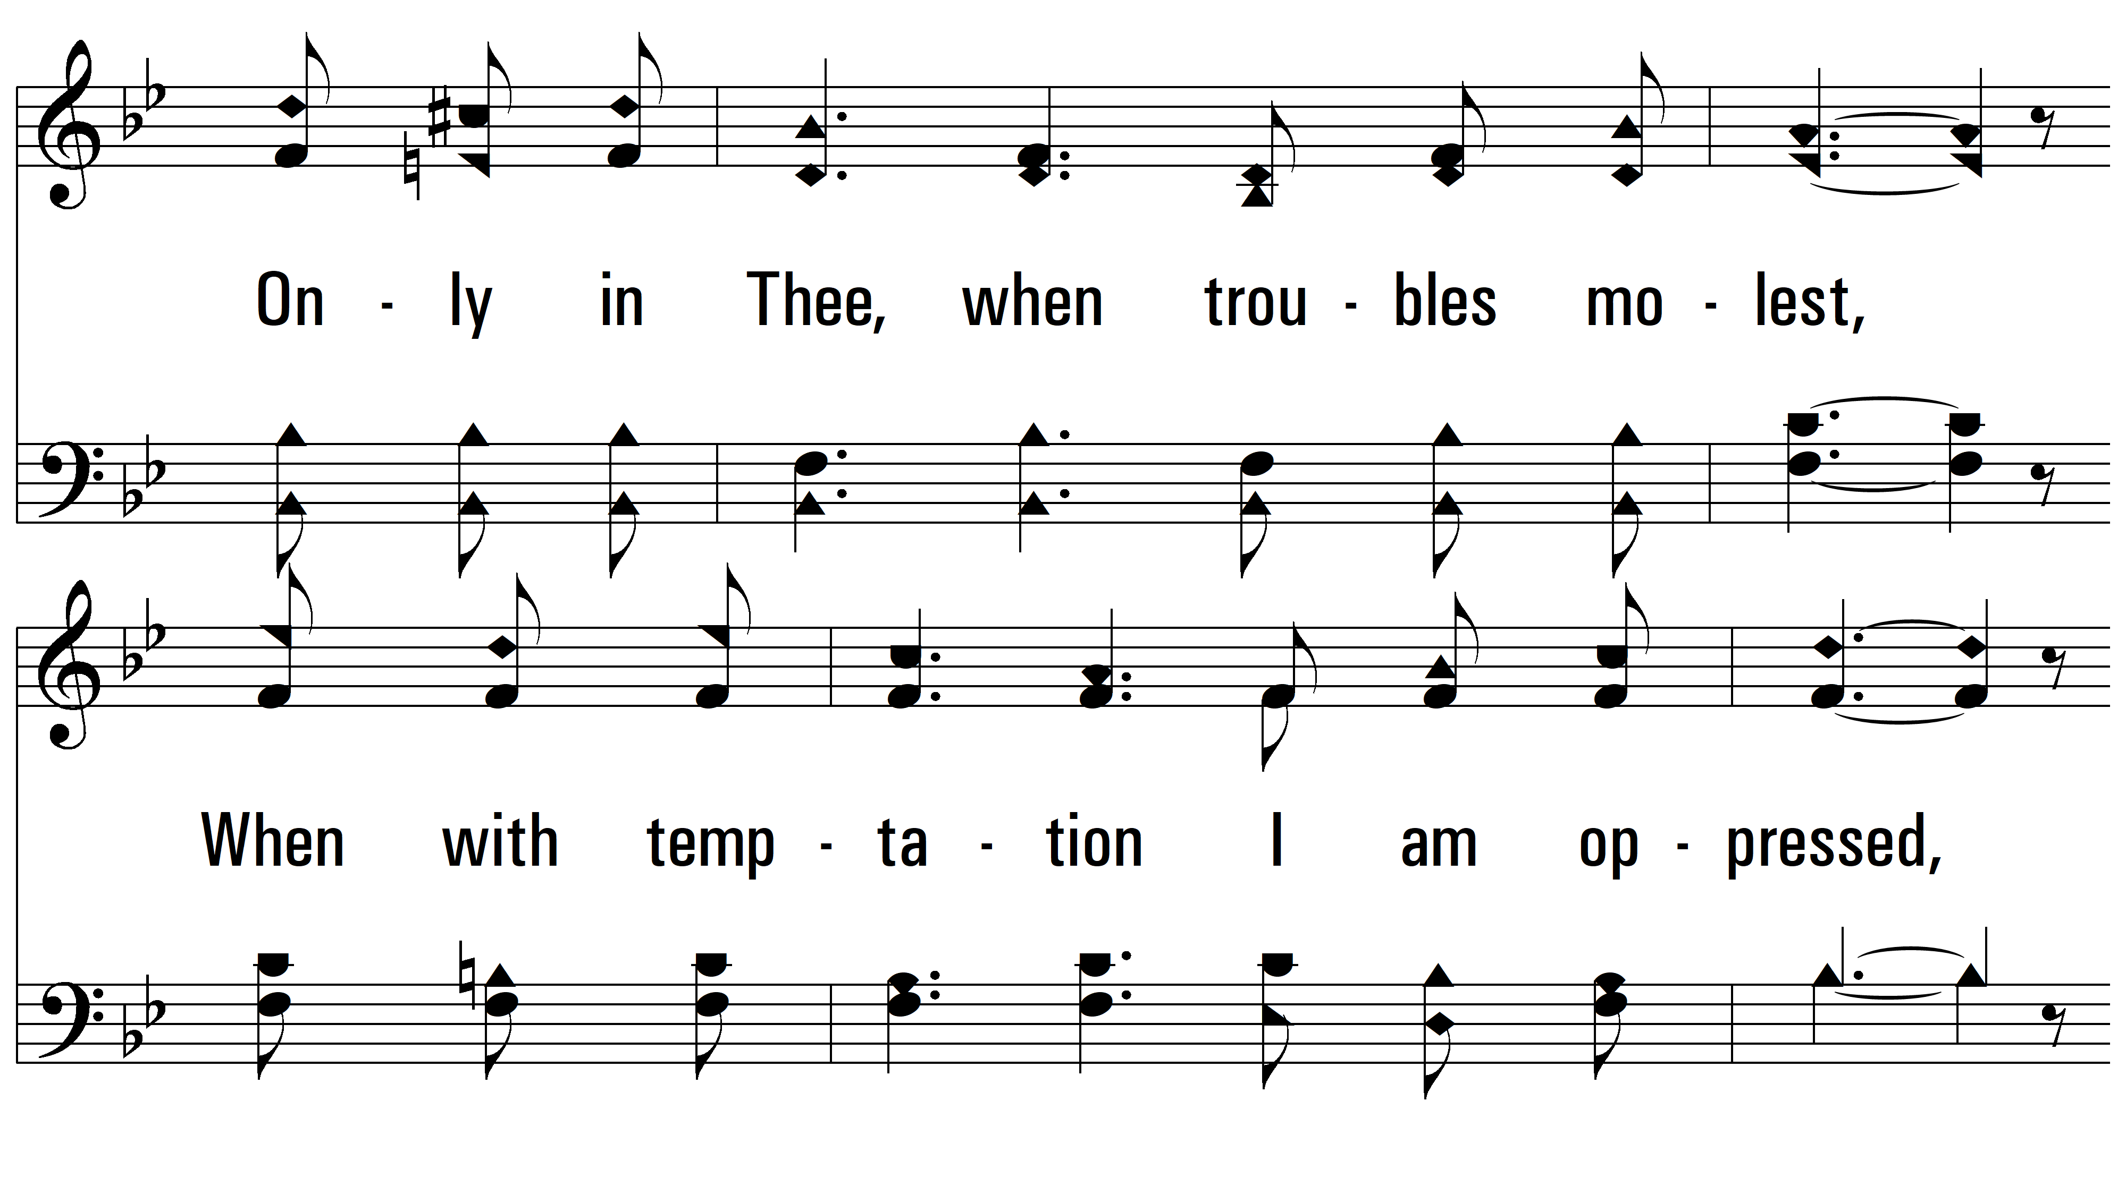
vs. 2

Slide 9
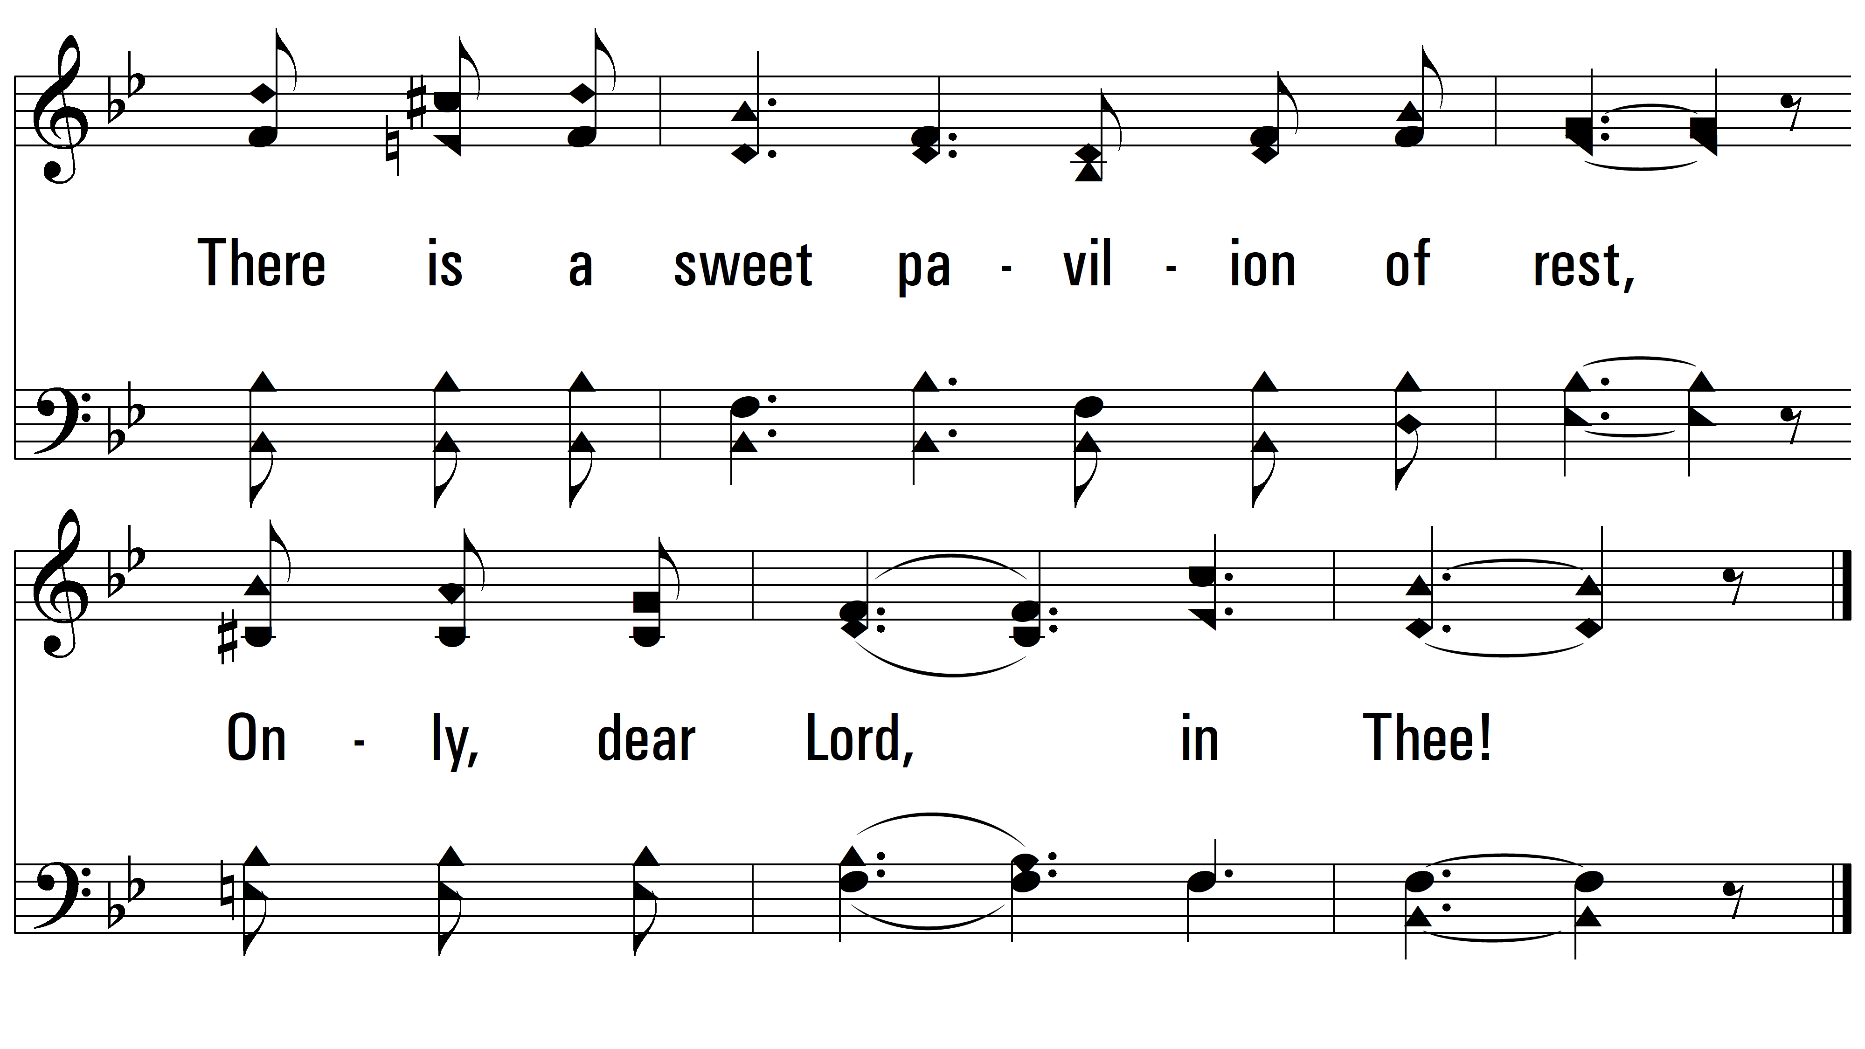
vs. 2

Slide 10
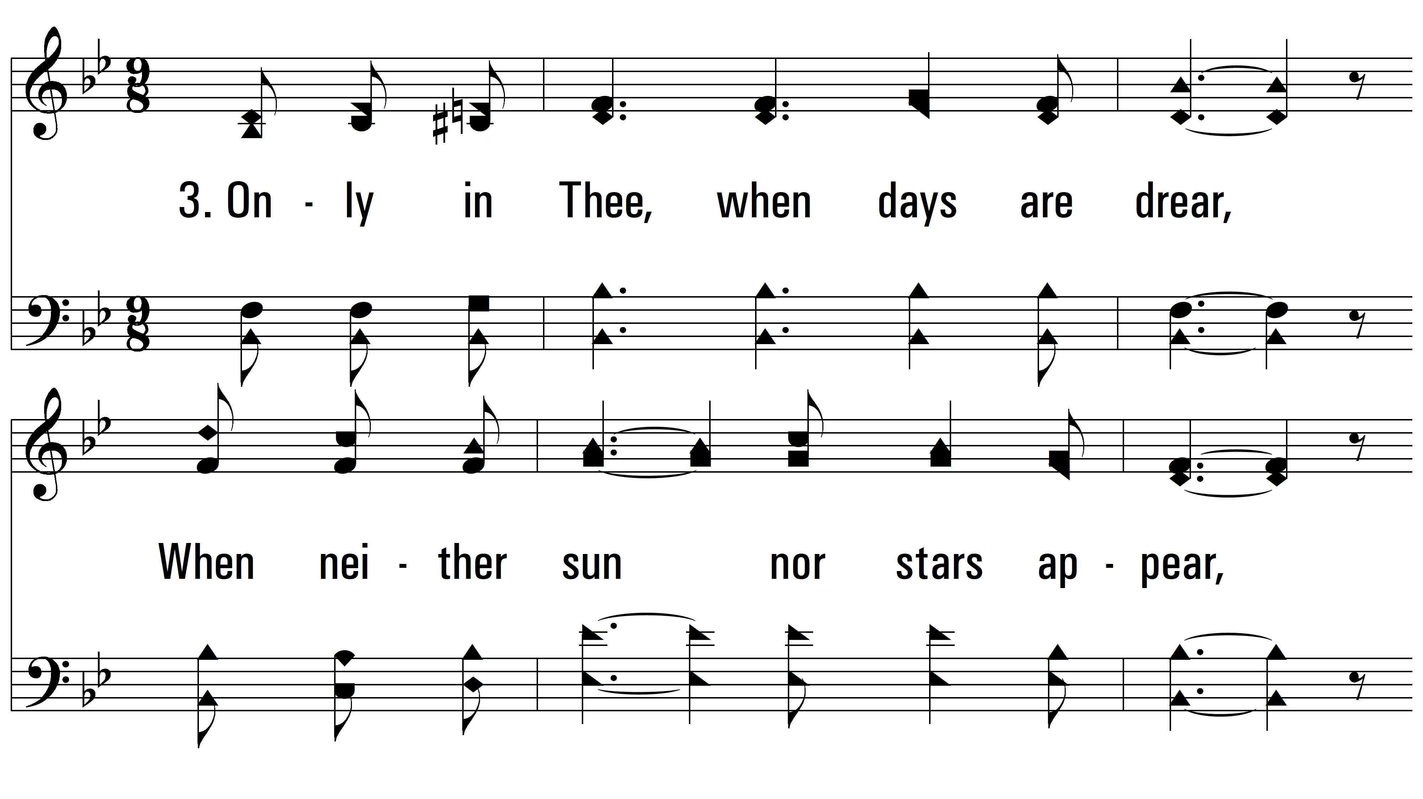
vs. 3 ~ Only In Thee

Slide 11
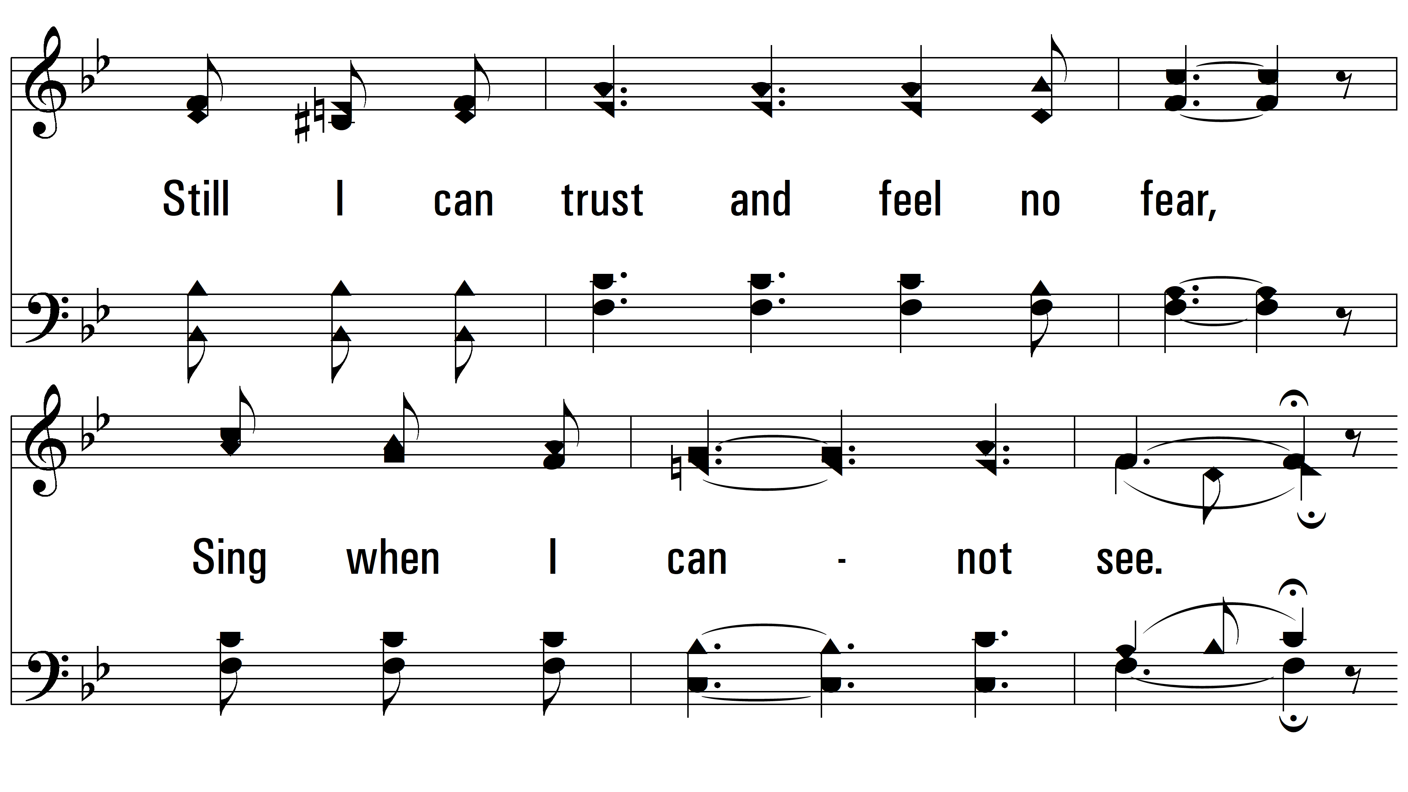
vs. 3

Slide 12
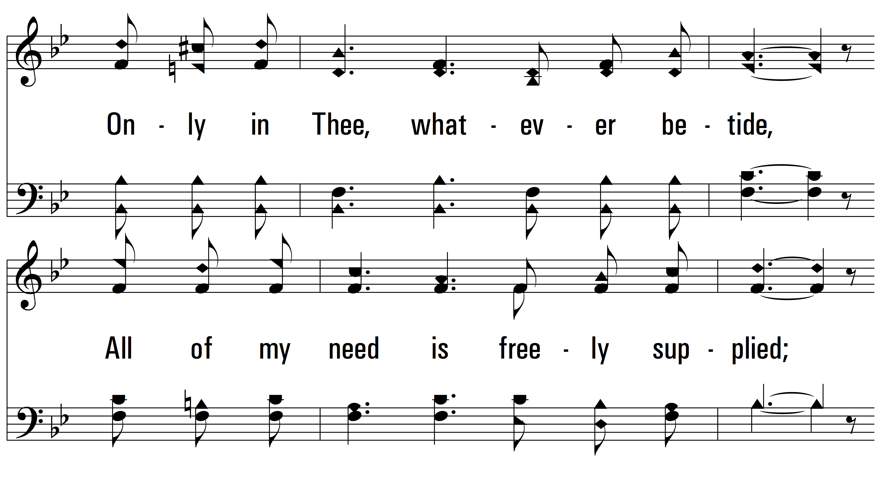
vs. 3

Slide 13
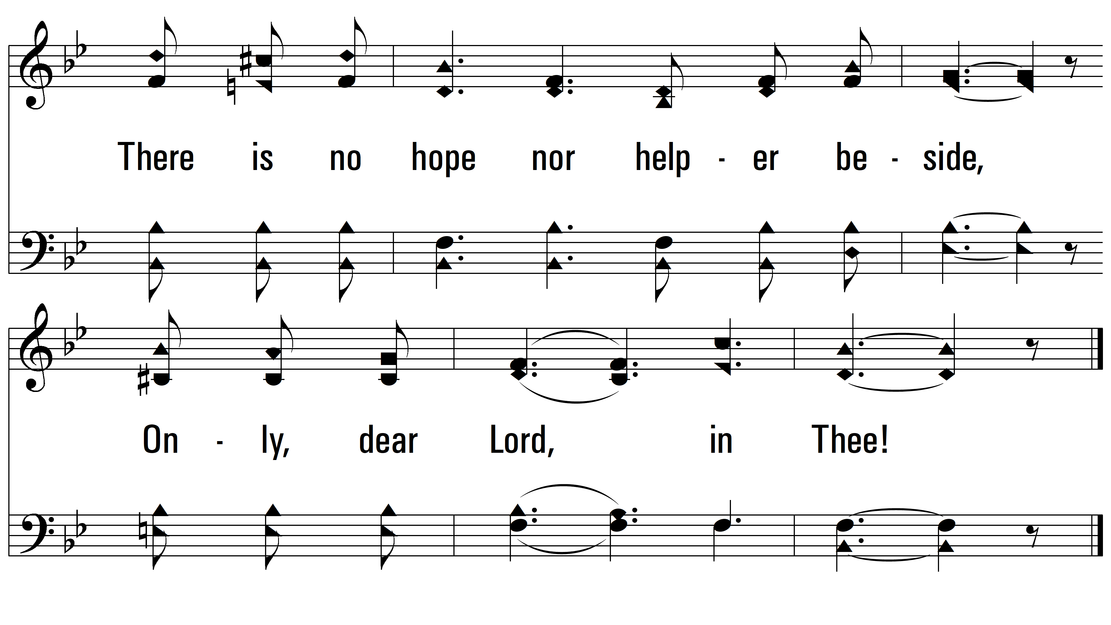
vs. 3

Slide 14
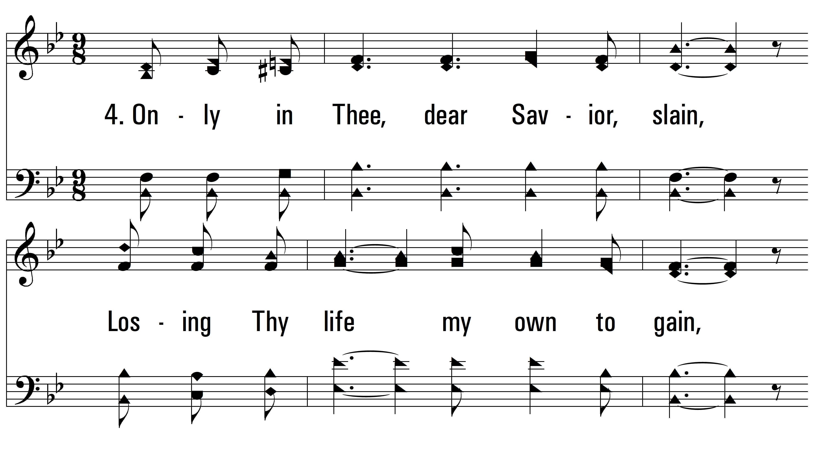
vs. 4 ~ Only In Thee

Slide 15
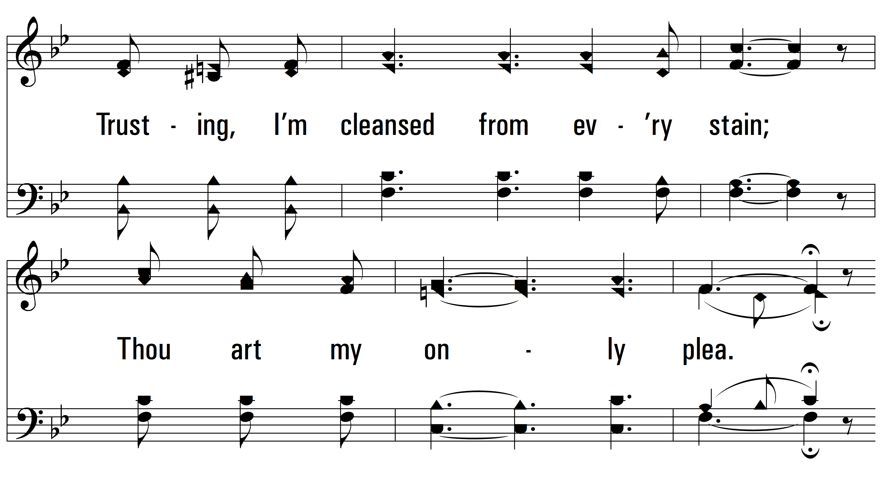
vs. 4

Slide 16
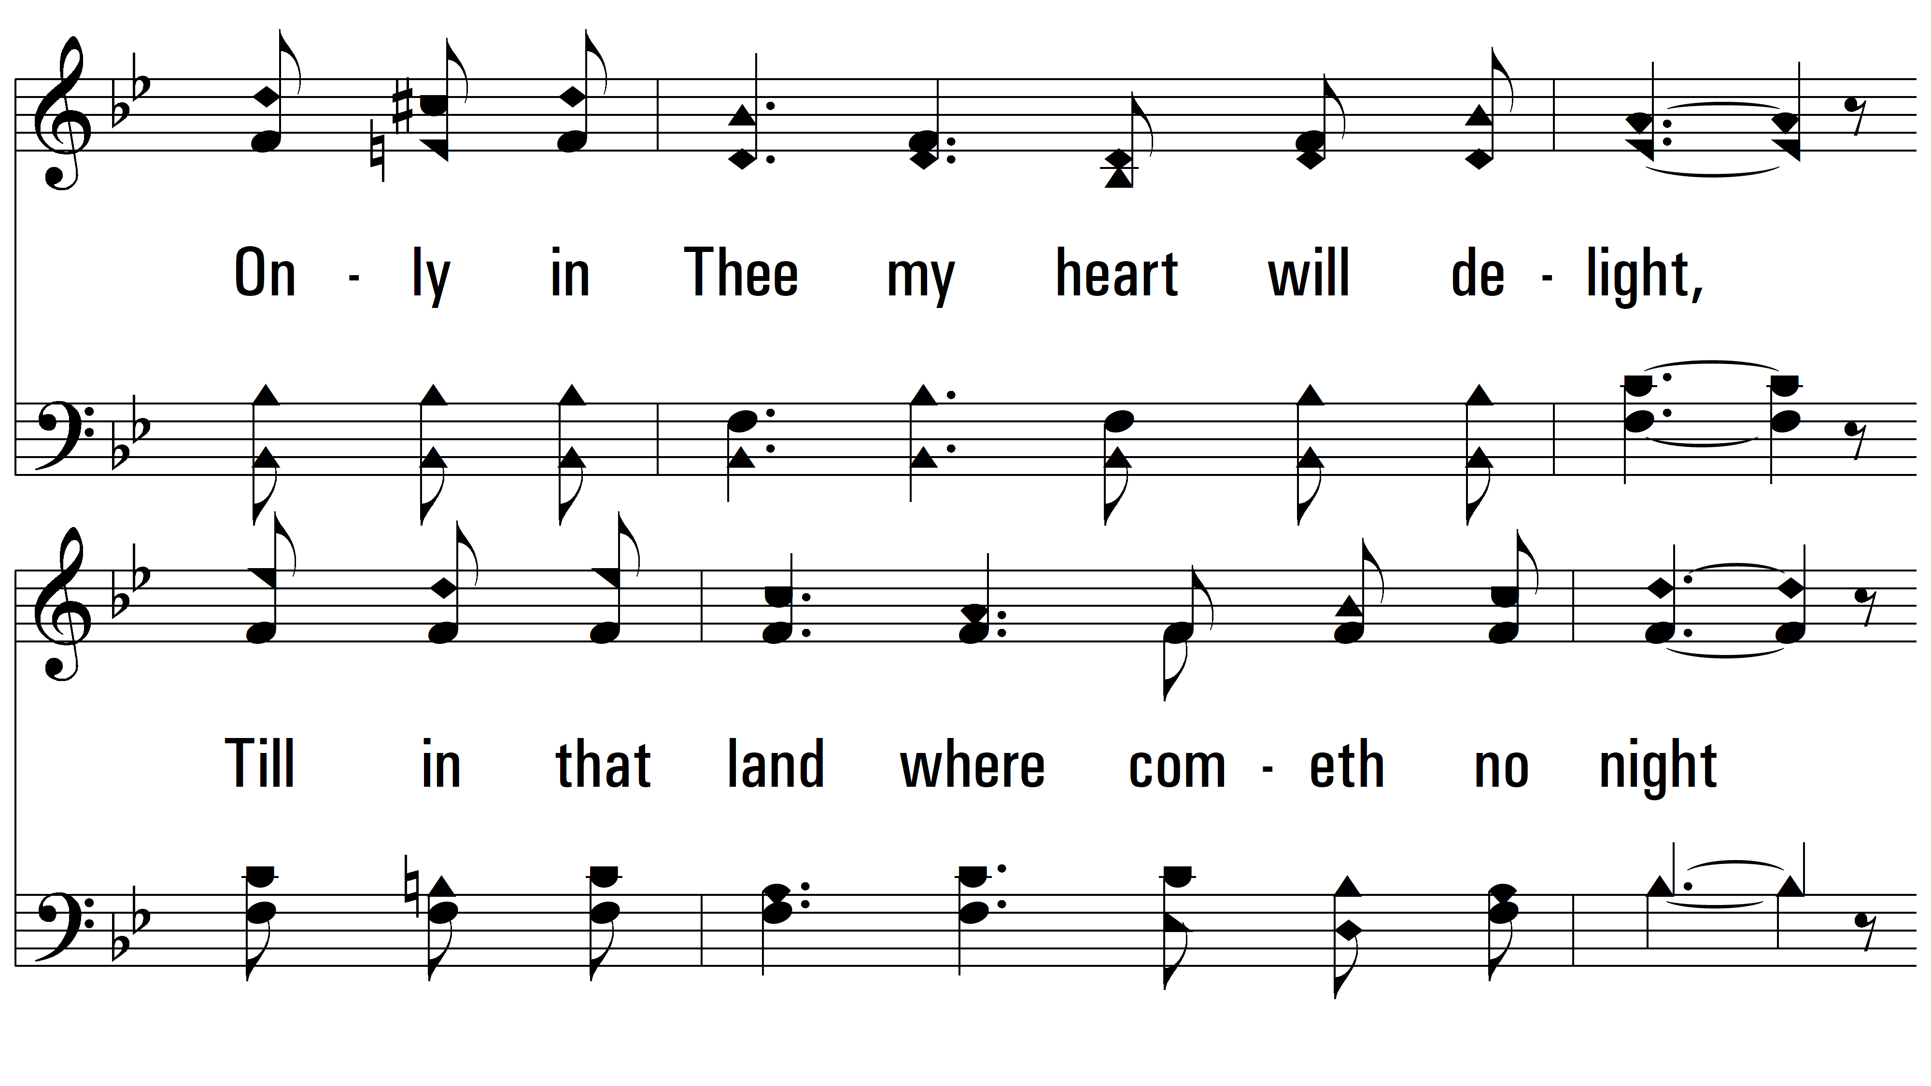
vs. 4

Slide 17
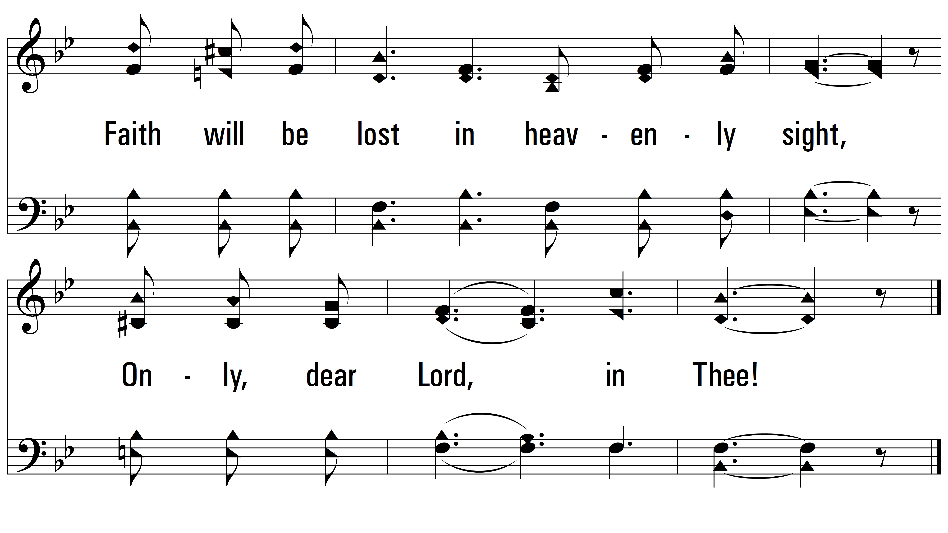
vs. 4
PDHymns.com
END

