Slide 1
One Day!
Words: | J. Wilbur Chapman (1909)
Music: | Charles H. March (1909)
9/4
D^{b}/A^{b} - SOL
Verses: 5/Chorus
Lead - | SOL
Alto - | MI
Tenor - | SOL
Bass - | DO
PDHymns.com

Slide 2
vs. 1 ~ One Day!

Slide 3
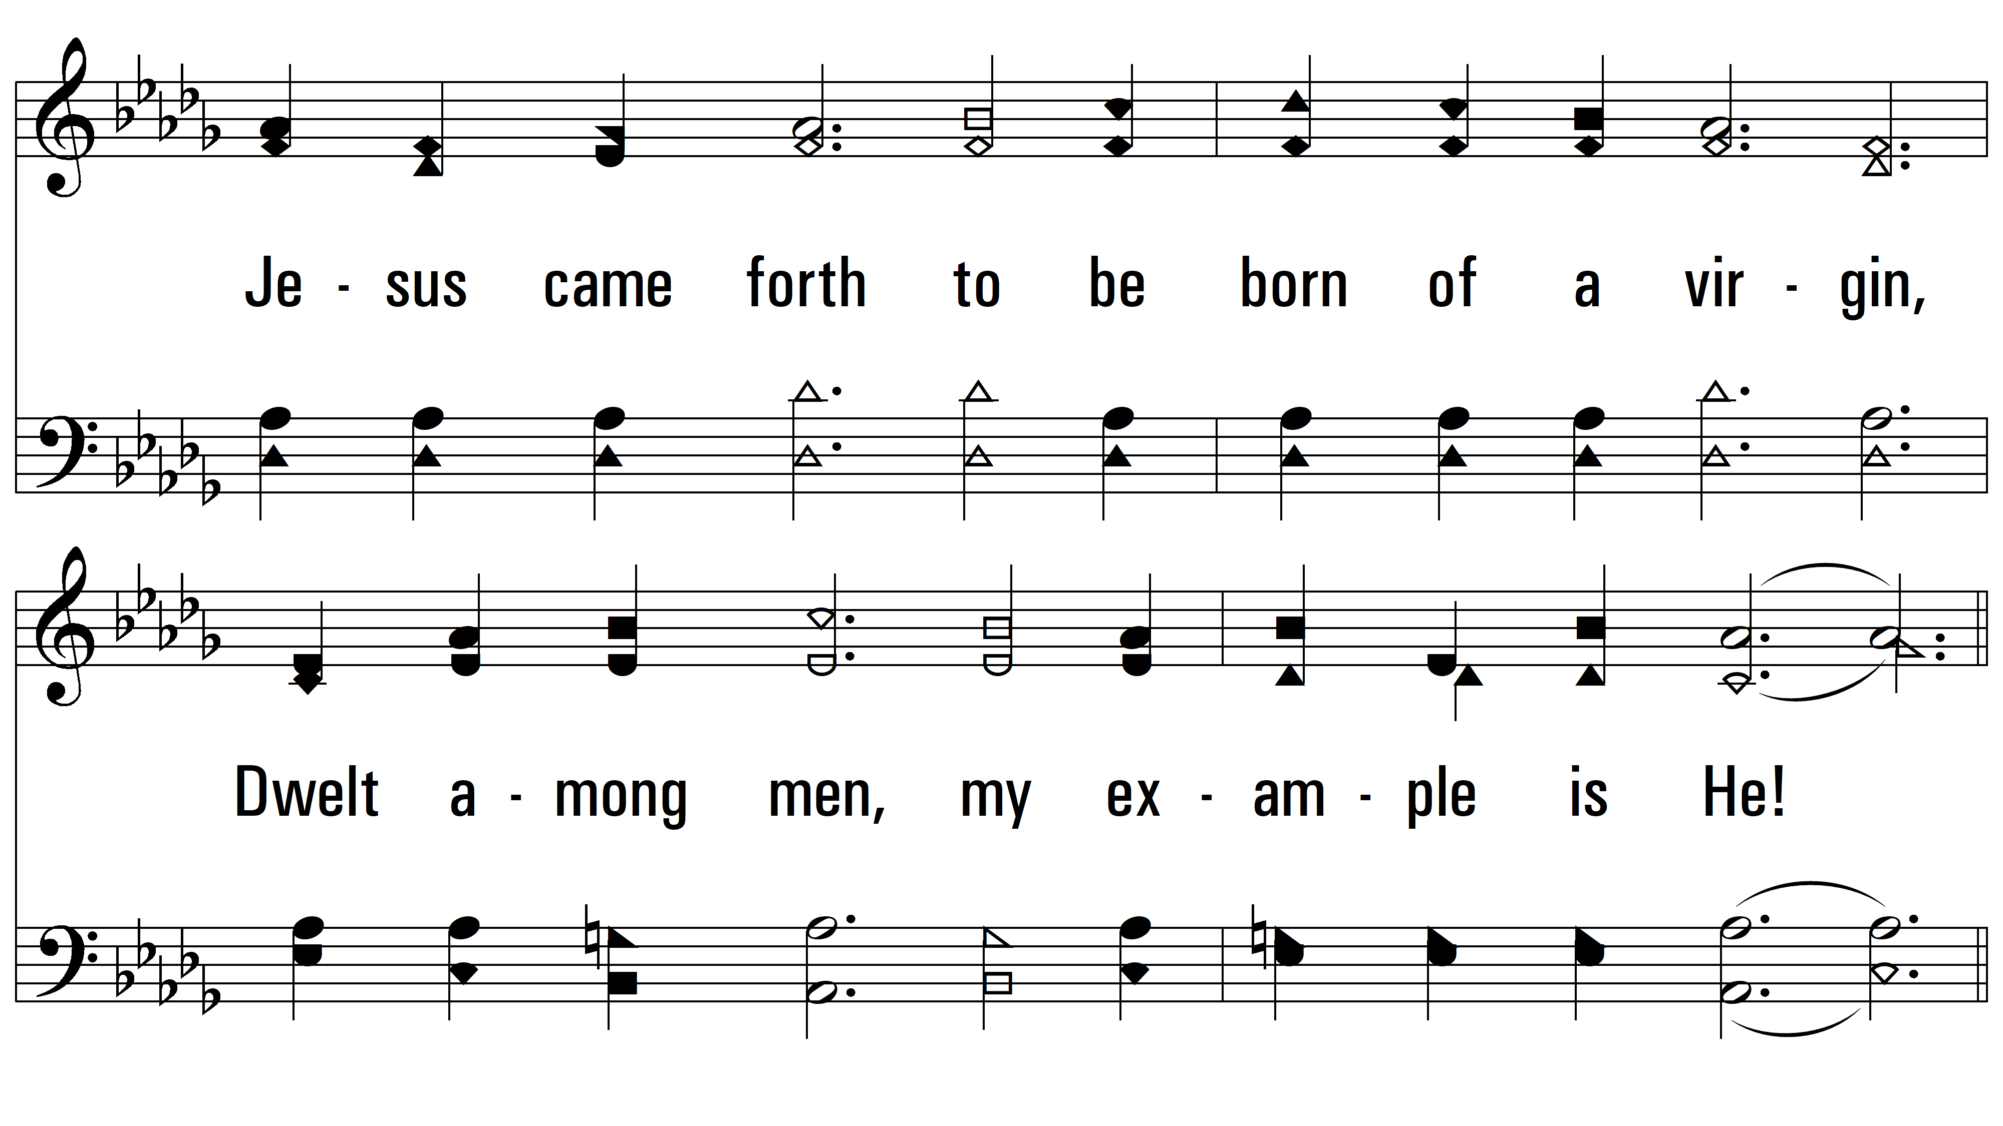
vs. 1

Slide 4
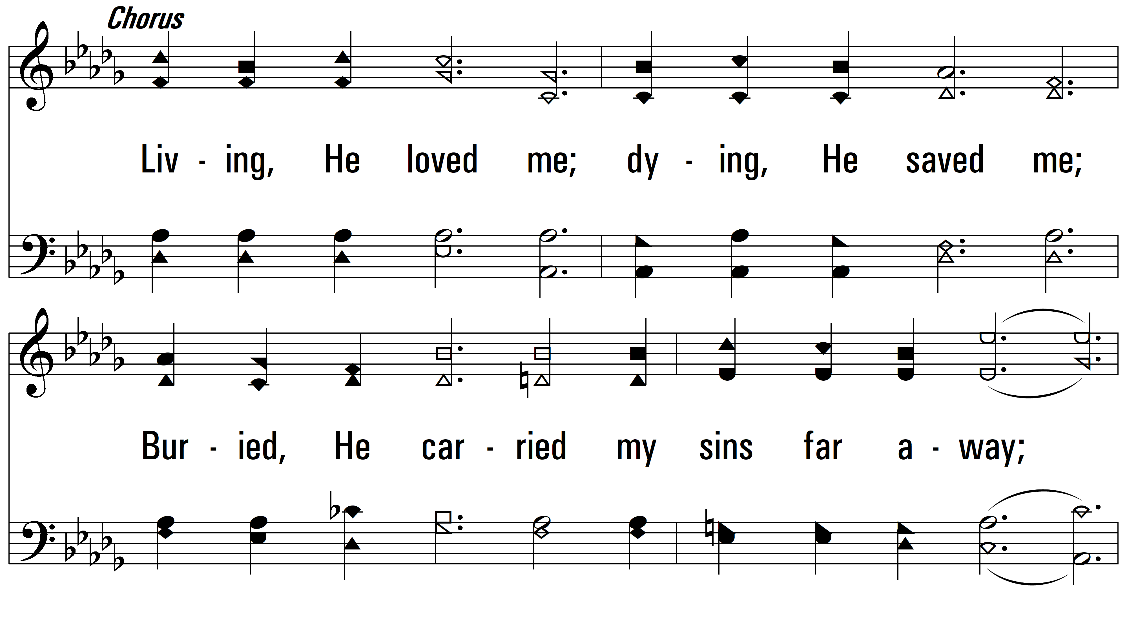
vs. 1

Slide 5
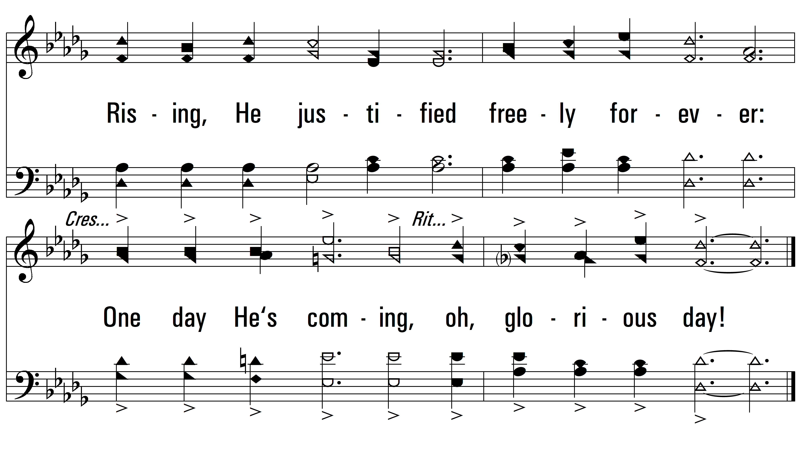
vs. 1

Slide 6
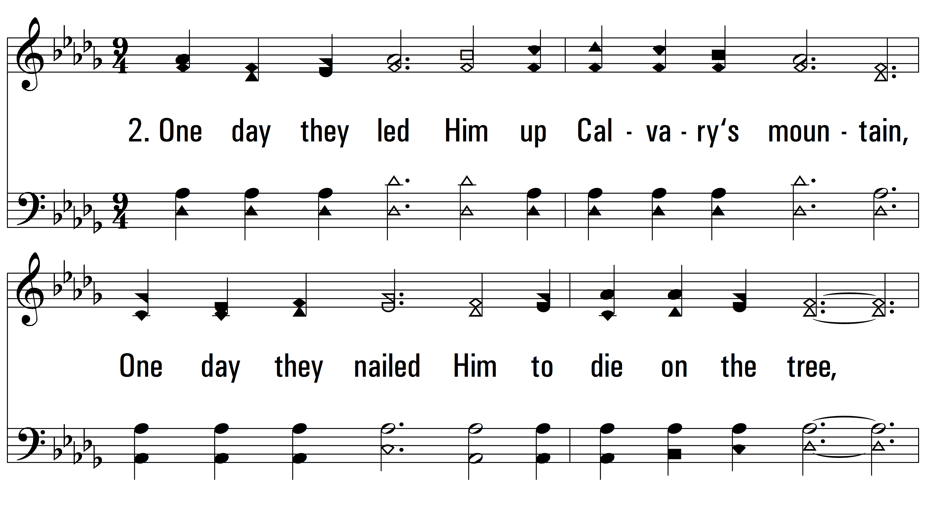
vs. 2 ~ One Day!

Slide 7
vs. 2

Slide 8
vs. 2

Slide 9
vs. 2

Slide 10
vs. 3 ~ One Day!

Slide 11
vs. 3

Slide 12
vs. 3

Slide 13
vs. 3

Slide 14
vs. 4 ~ One Day!

Slide 15
vs. 4

Slide 16
vs. 4

Slide 17
vs. 4

Slide 18
vs. 5 ~ One Day!

Slide 19
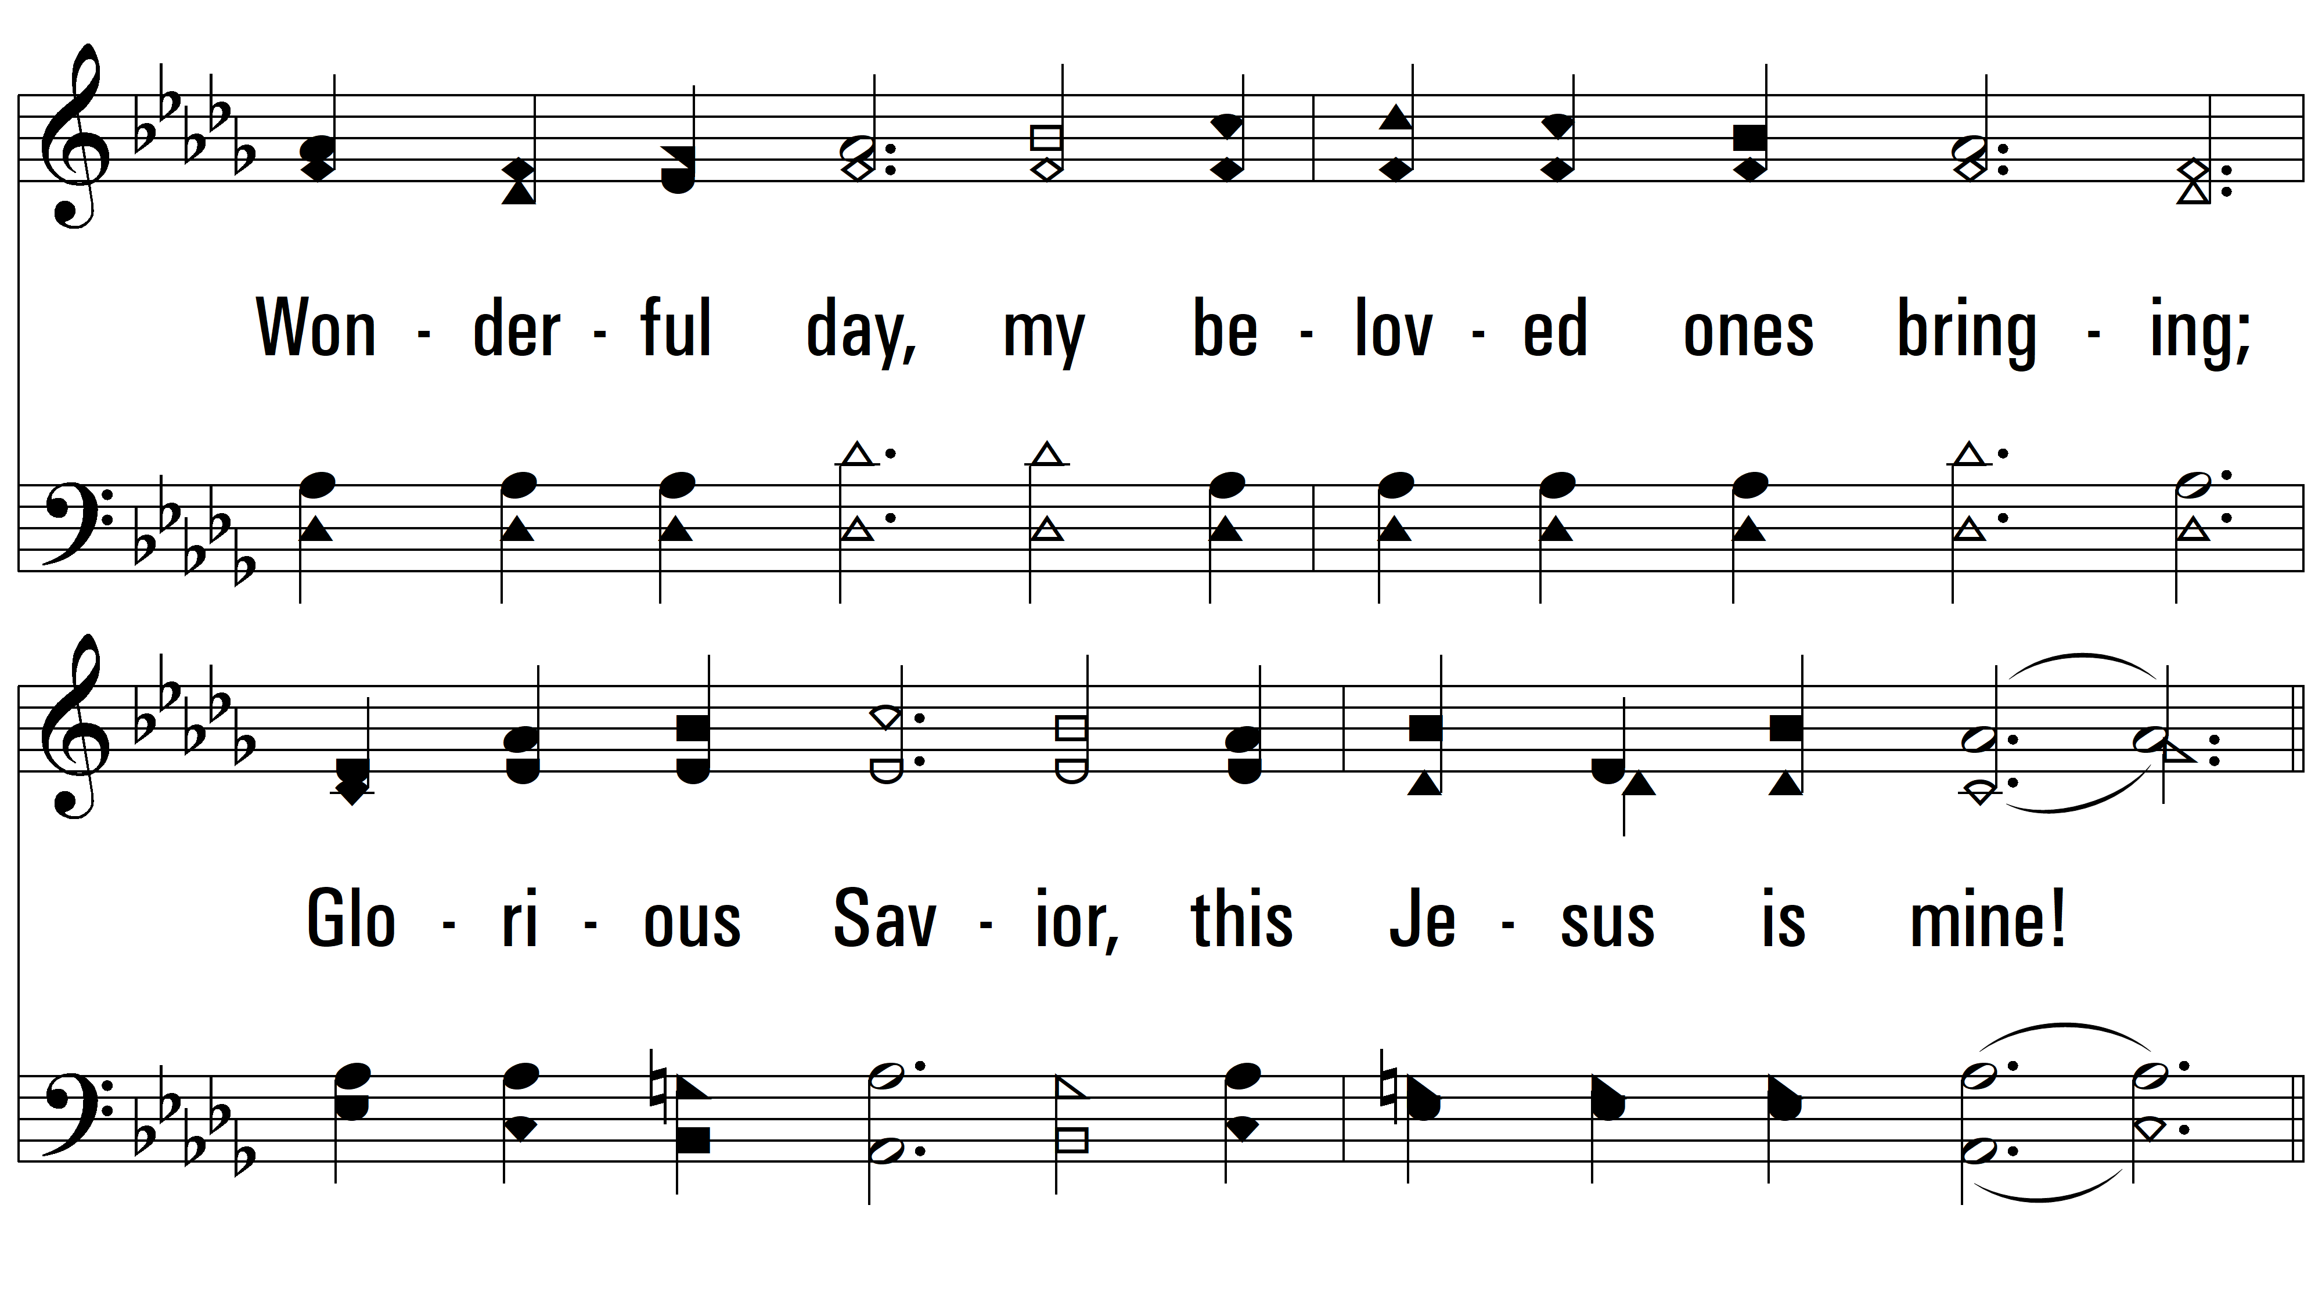
vs. 5

Slide 20
vs. 5

Slide 21
vs. 5
PDHymns.com
END

