Slide 1
On The Cross Of Calvary
Words: | Gill’s & McLaughlin’s Good News in Song (1886), Attr. Lizzie DeArmond
Music: | Gill’s & McLaughlin’s Good News in Song (1886), Arr. William J. Kirkpatrick (1906)
3/4 + 4/4
B^{b}/D - MI
Verses: 4/Chorus
Lead - | MI
Alto - | DO
Tenor - | SOL
Bass - | DO
PDHymns.com

Slide 2
vs. 1 ~ On The Cross Of Calvary

Slide 3
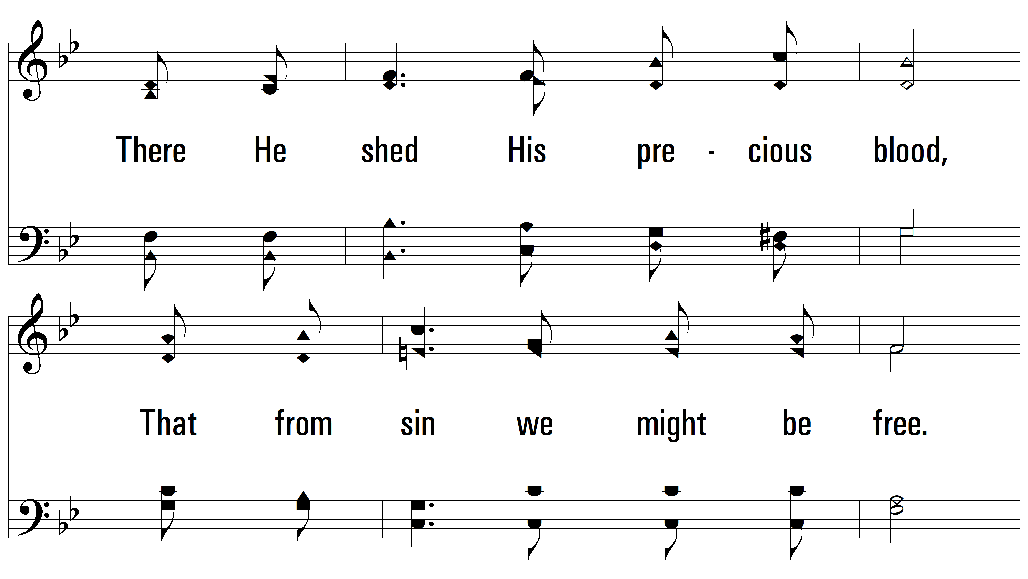
vs. 1

Slide 4
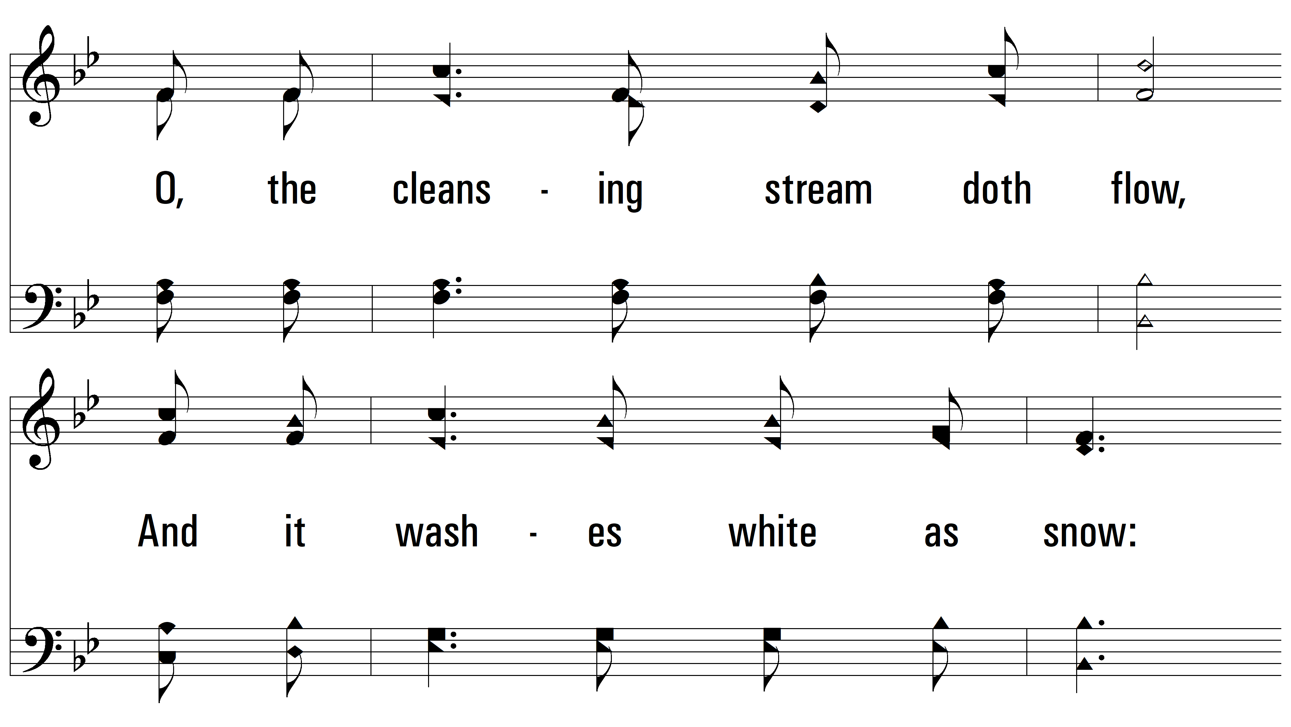
vs. 1

Slide 5
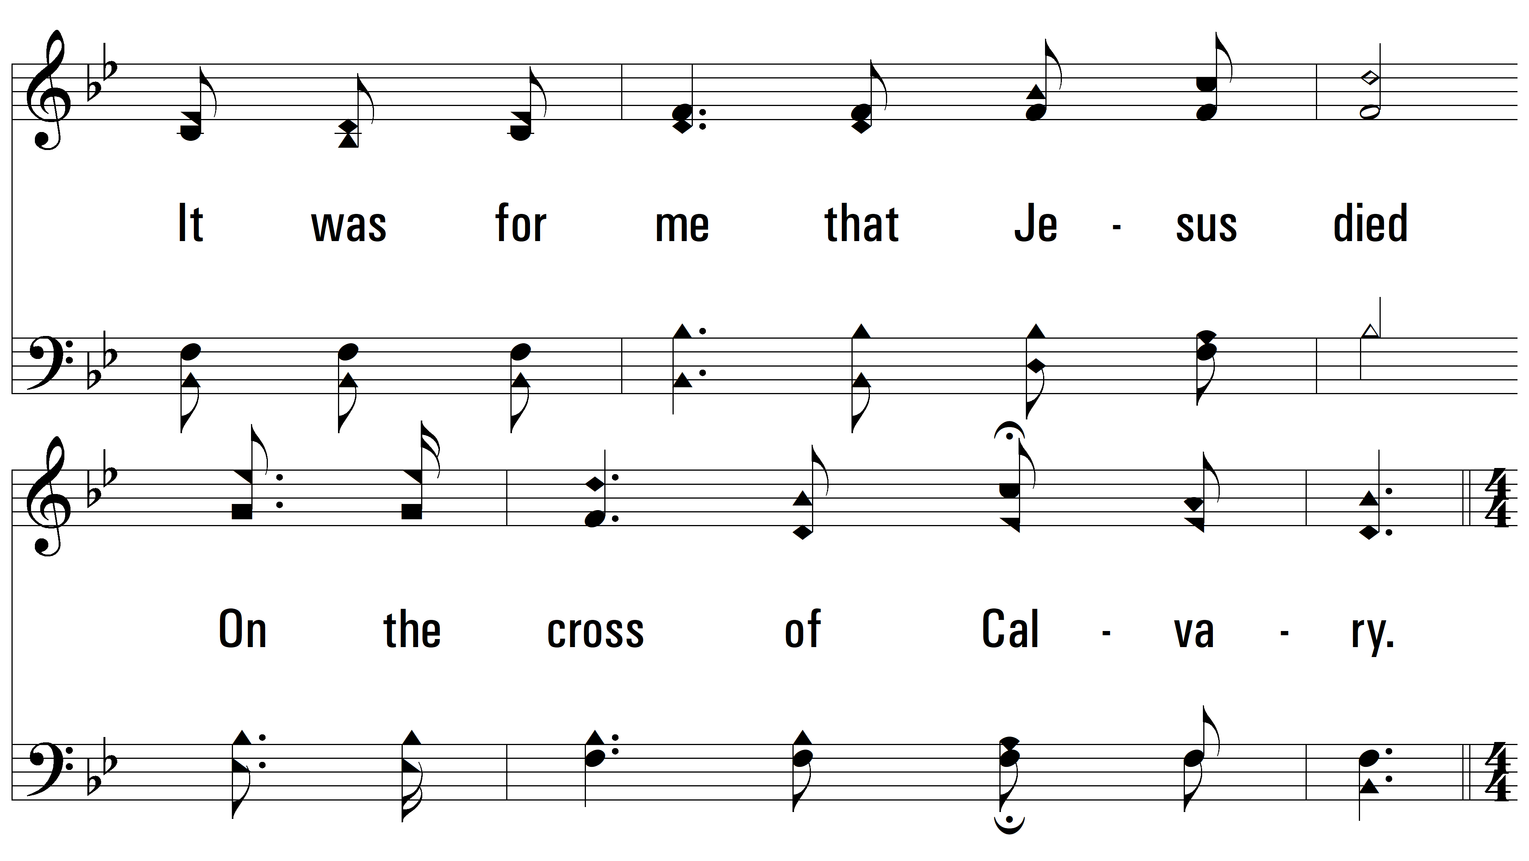
vs. 1

Slide 6
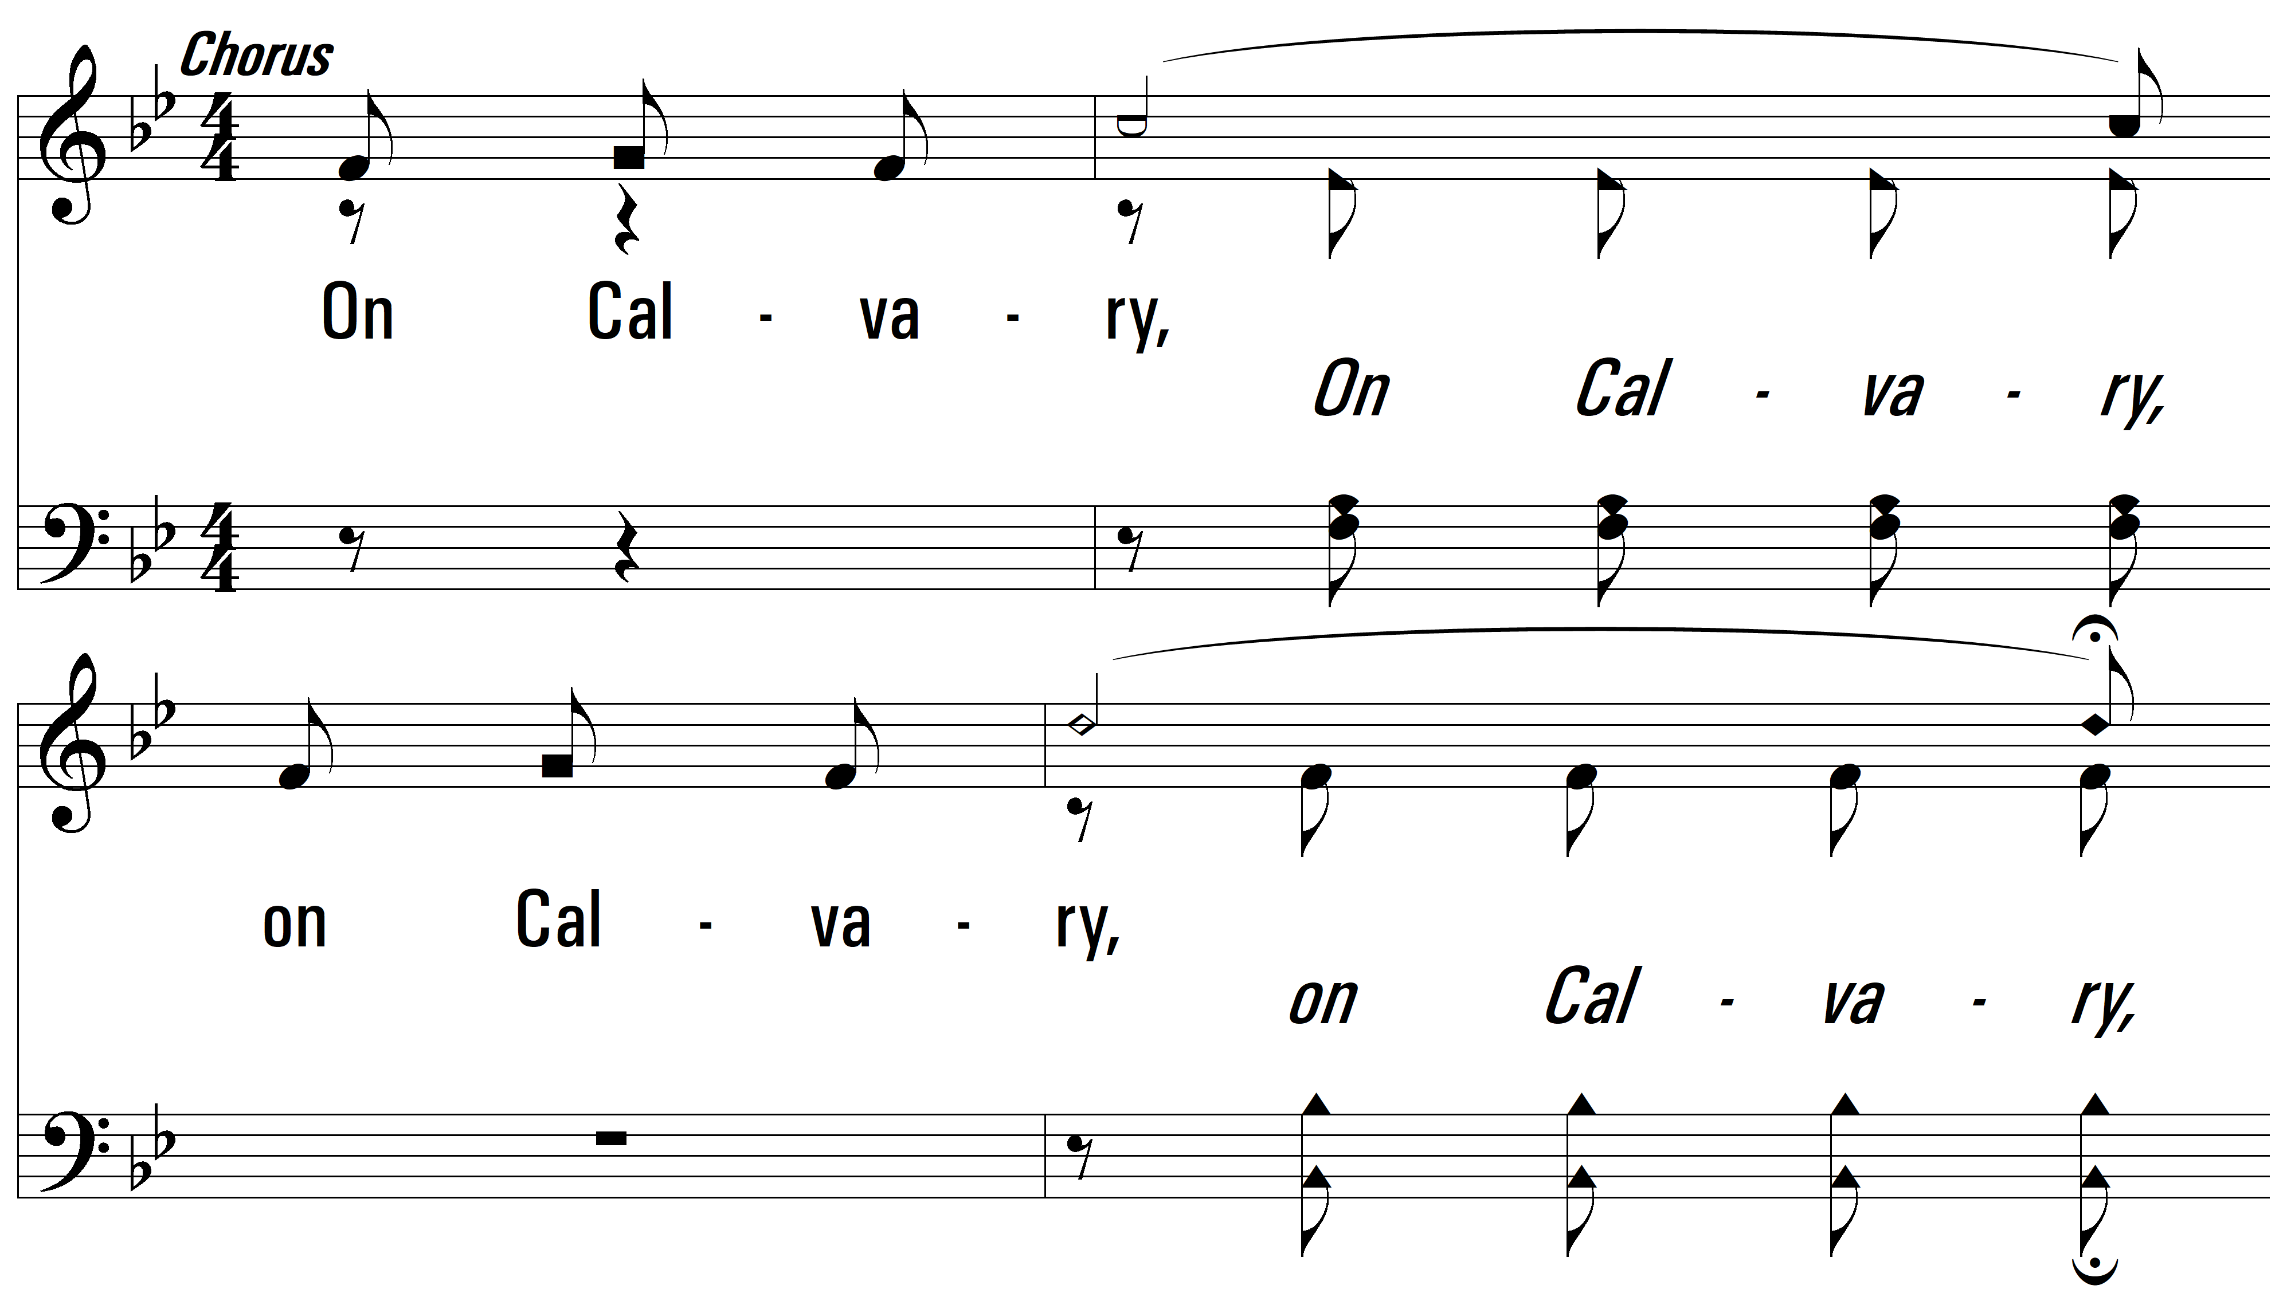
vs. 1

Slide 7
vs. 1

Slide 8
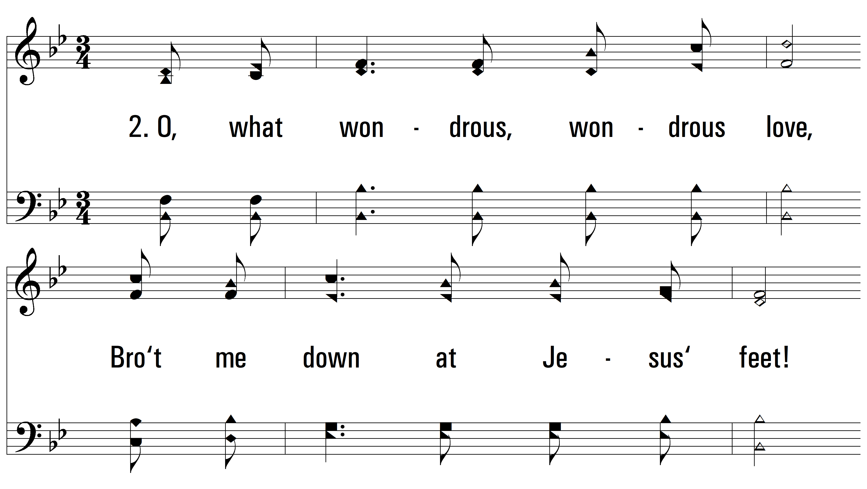
vs. 2 ~ On The Cross Of Calvary

Slide 9
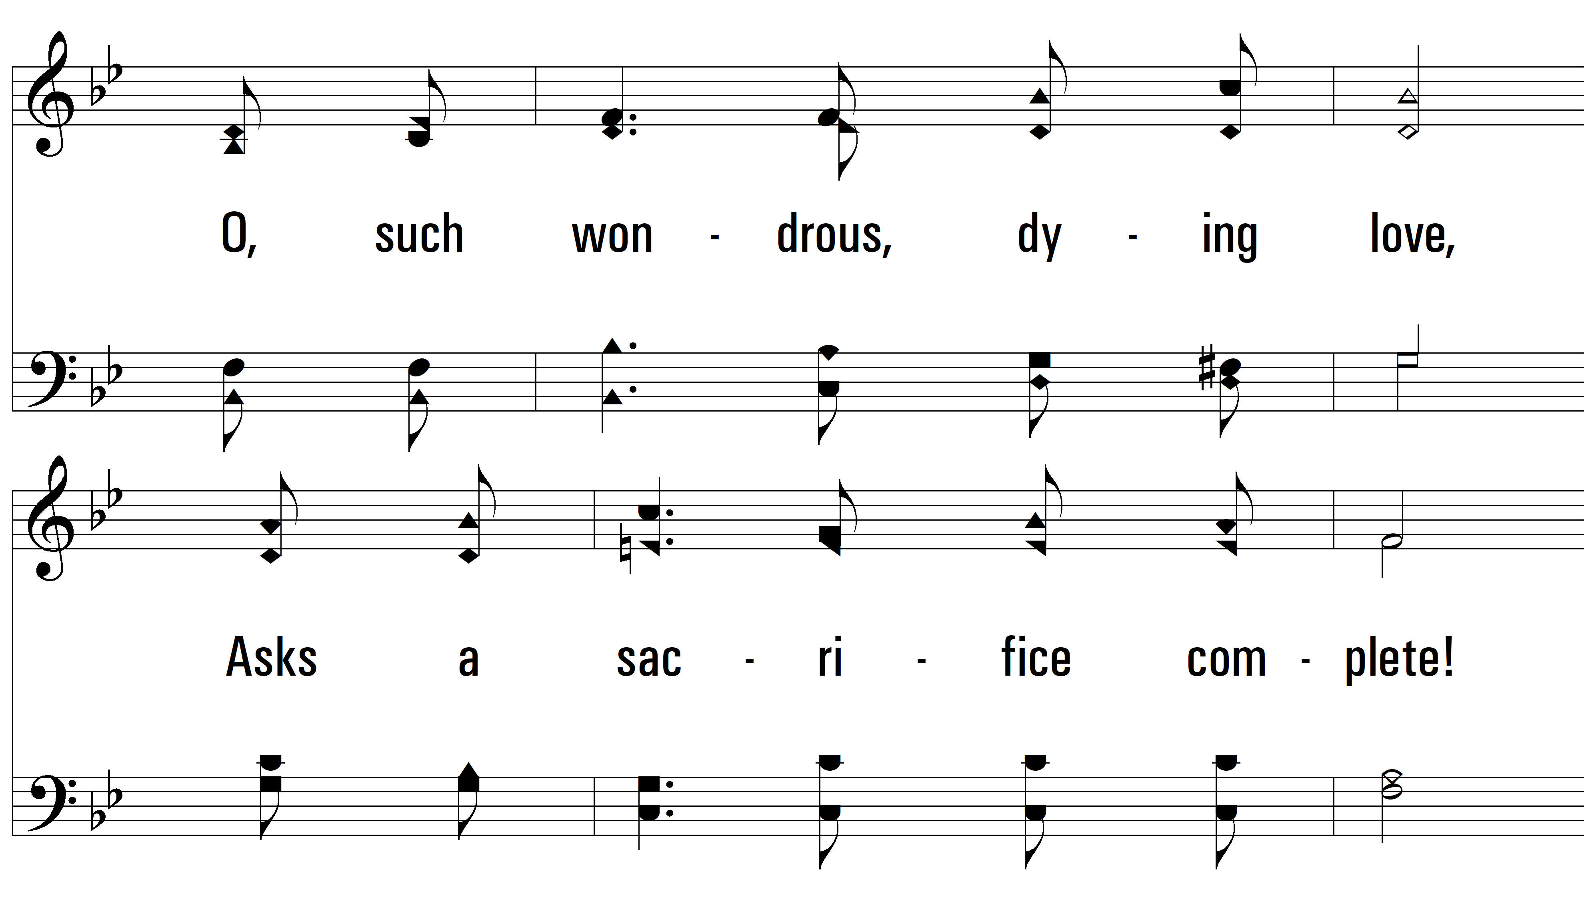
vs. 2

Slide 10
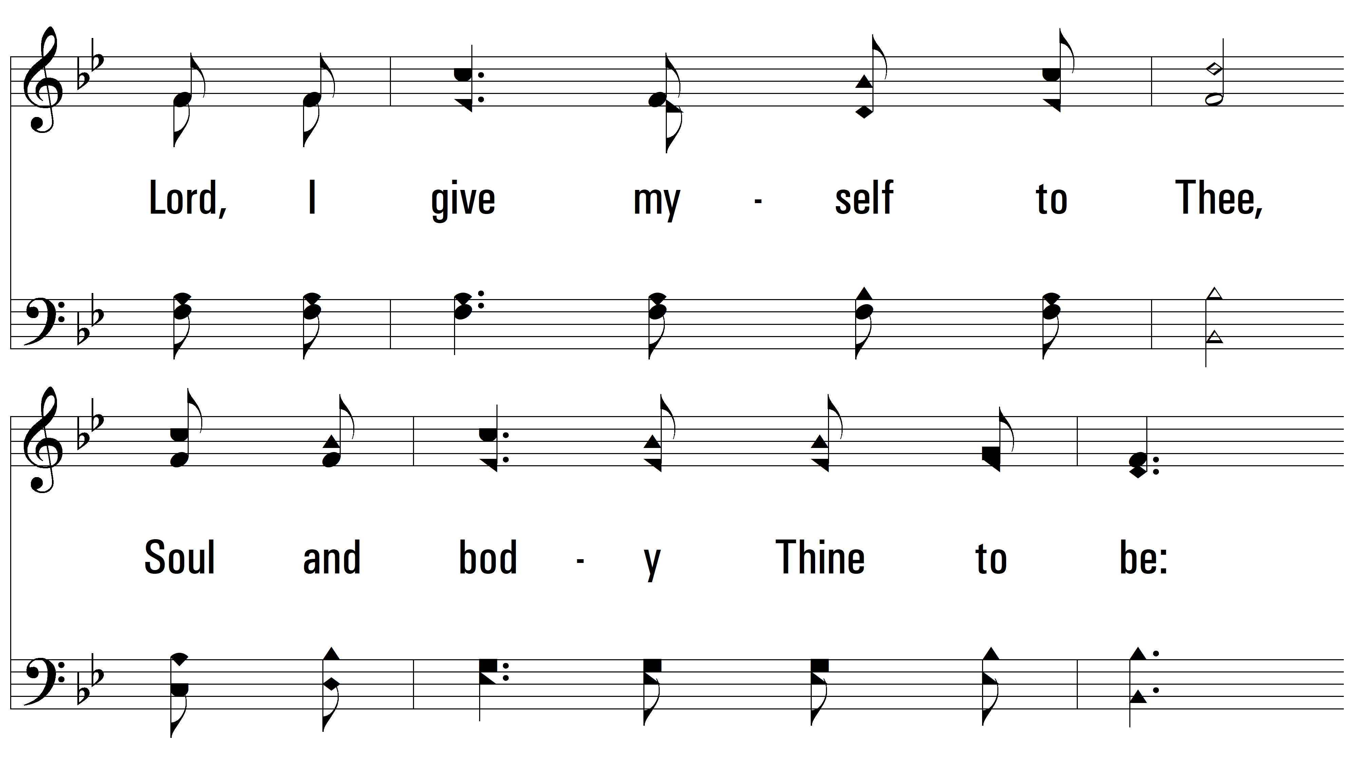
vs. 2

Slide 11
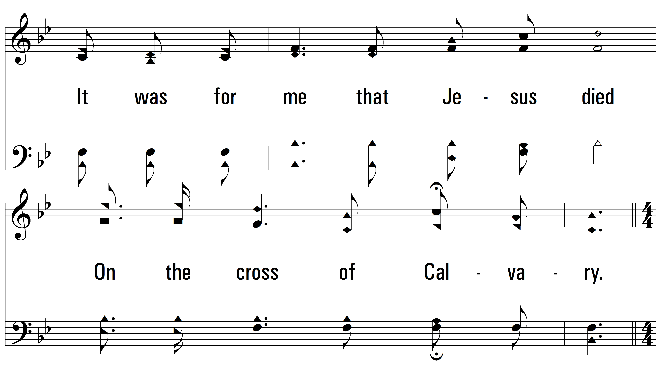
vs. 2

Slide 12
vs. 2

Slide 13
vs. 2

Slide 14
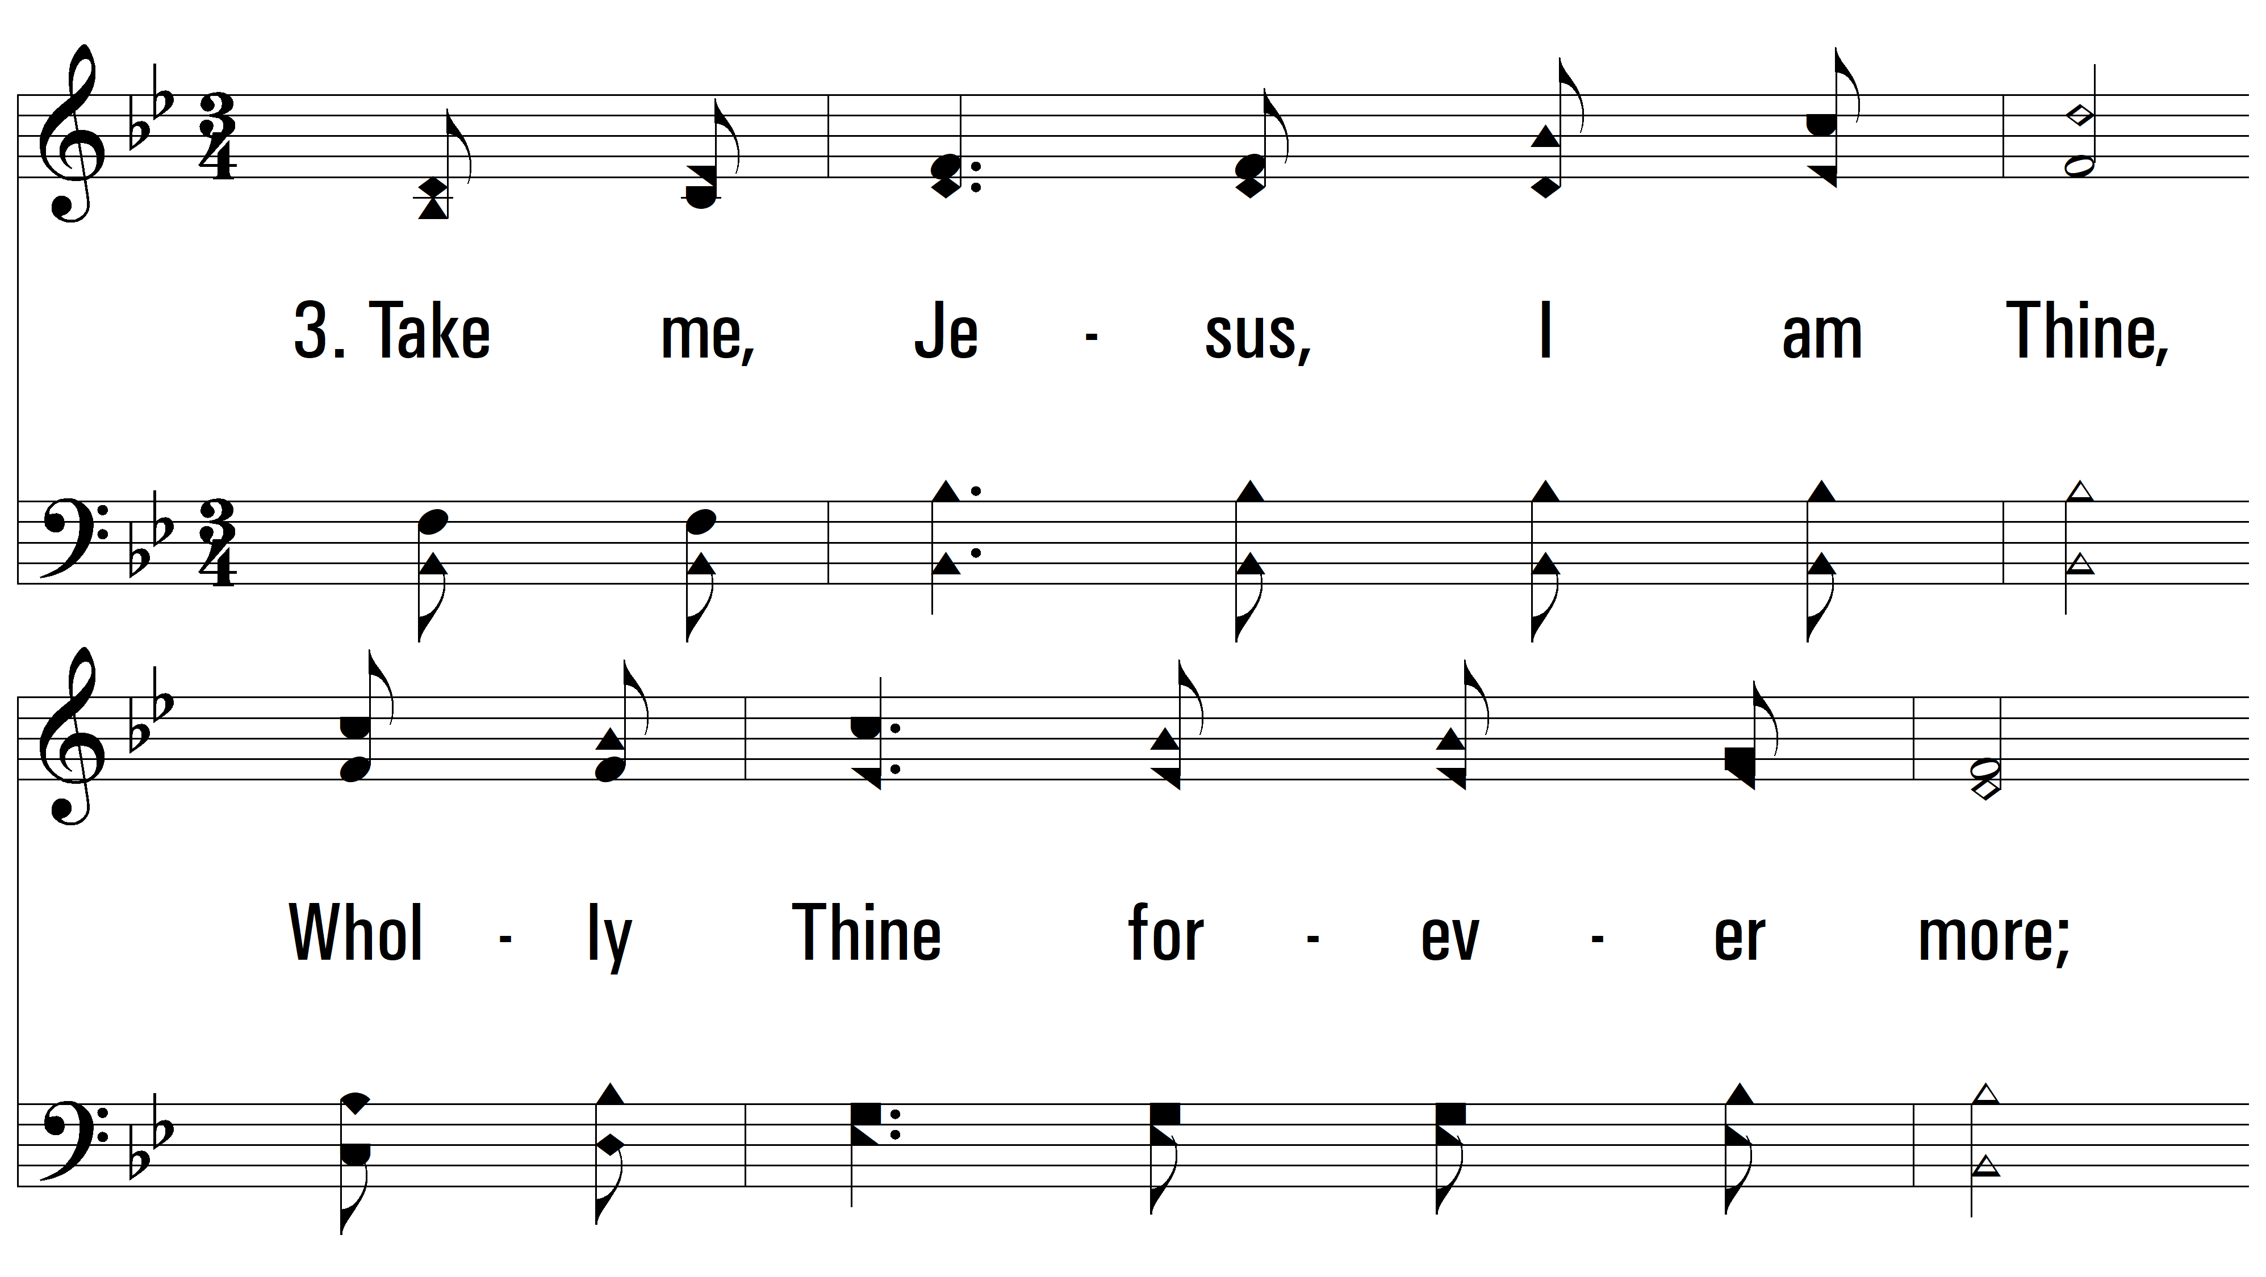
vs. 3 ~ On The Cross Of Calvary

Slide 15
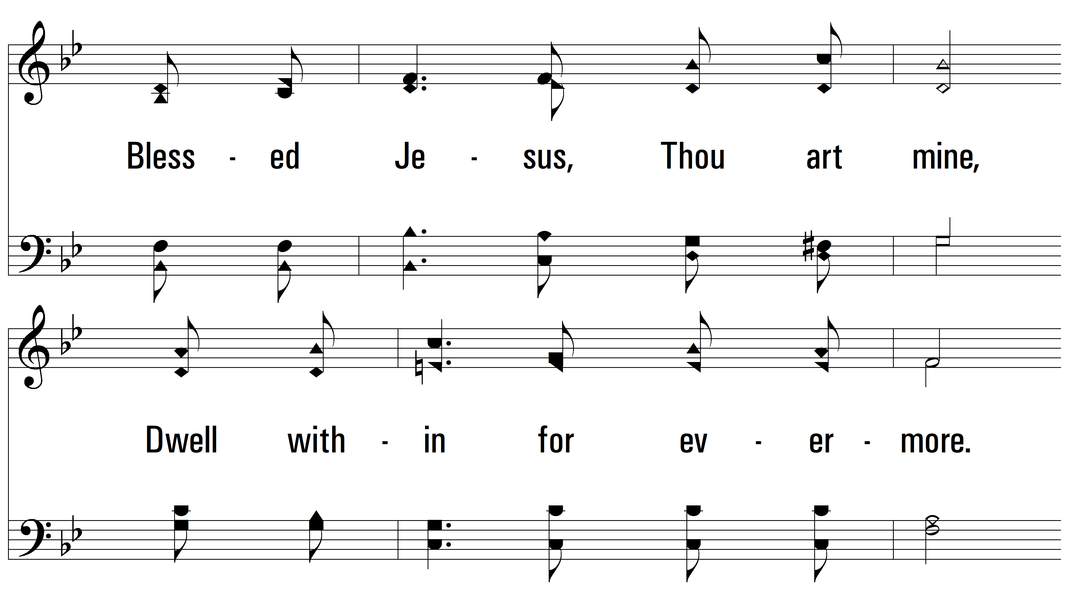
vs. 3

Slide 16
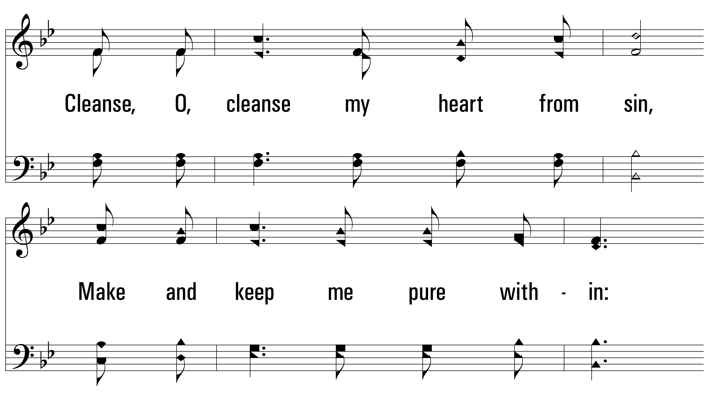
vs. 3

Slide 17
vs. 3

Slide 18
vs. 3

Slide 19
vs. 3

Slide 20
vs. 4 ~ On The Cross Of Calvary

Slide 21
vs. 4

Slide 22
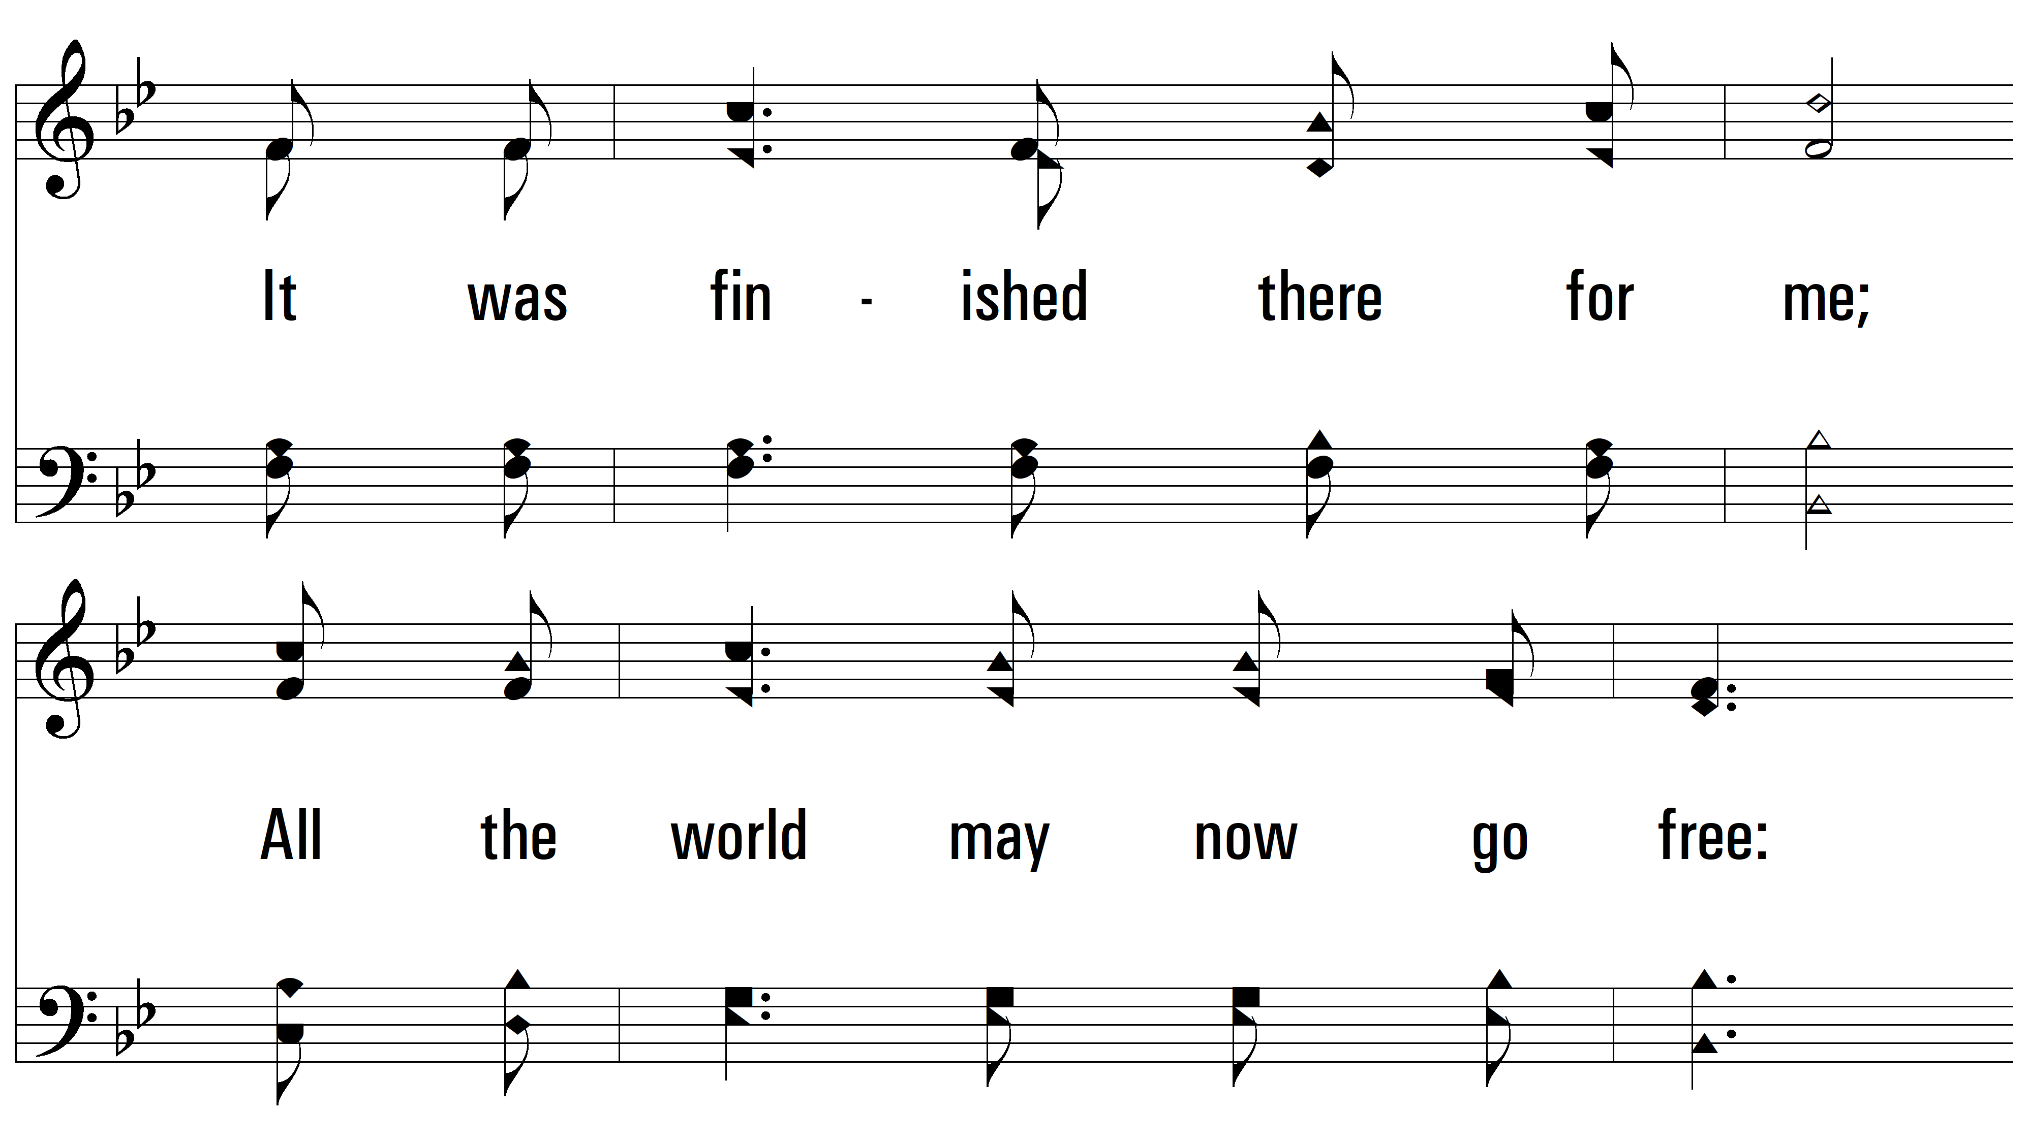
vs. 4

Slide 23
vs. 4

Slide 24
vs. 4

Slide 25
vs. 4
PDHymns.com
END

