Slide 1
Oh, To Be Like Thee
Words: | T. O. Chisholm (1897)
Music: | William J. Kirkpatrick (1897)
9/8
D/D - DO
Verses: 3/Chorus
Lead - | DO
Alto - | DO
Tenor - | MI
Bass - | DO
PDHymns.com

Slide 2
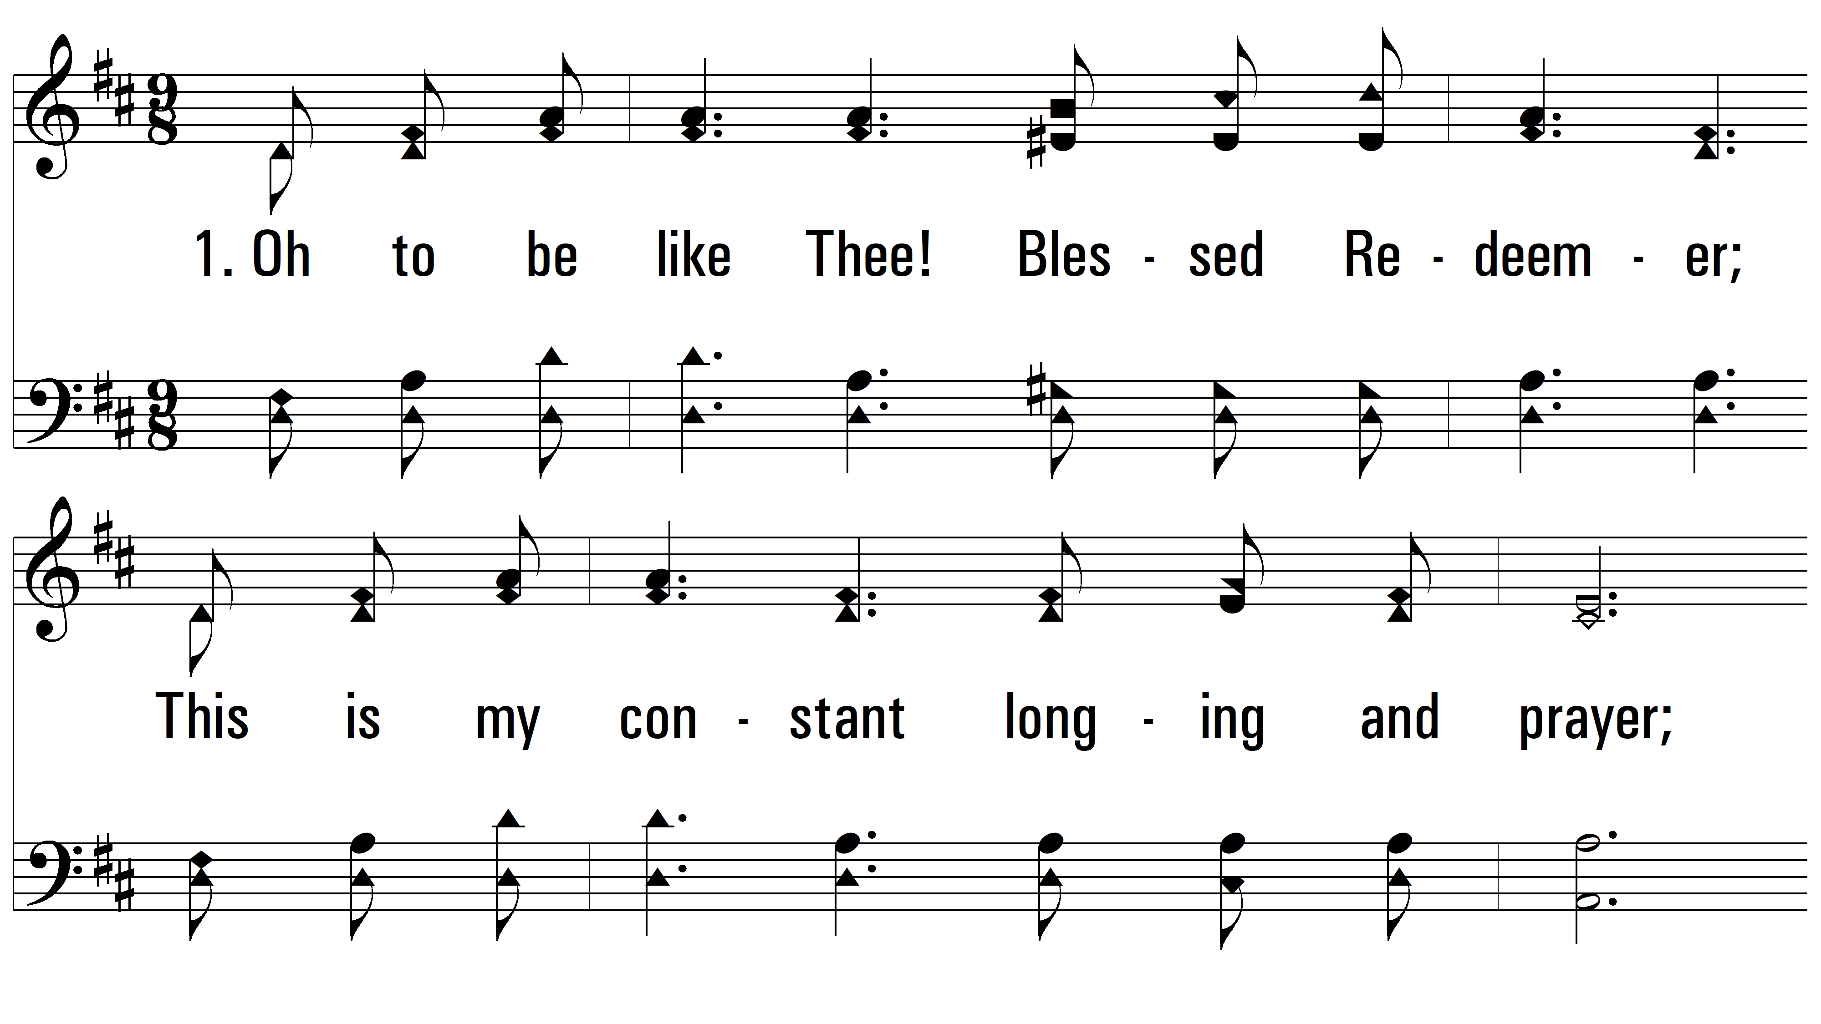
vs. 1 ~ Oh, To Be Like Thee

Slide 3
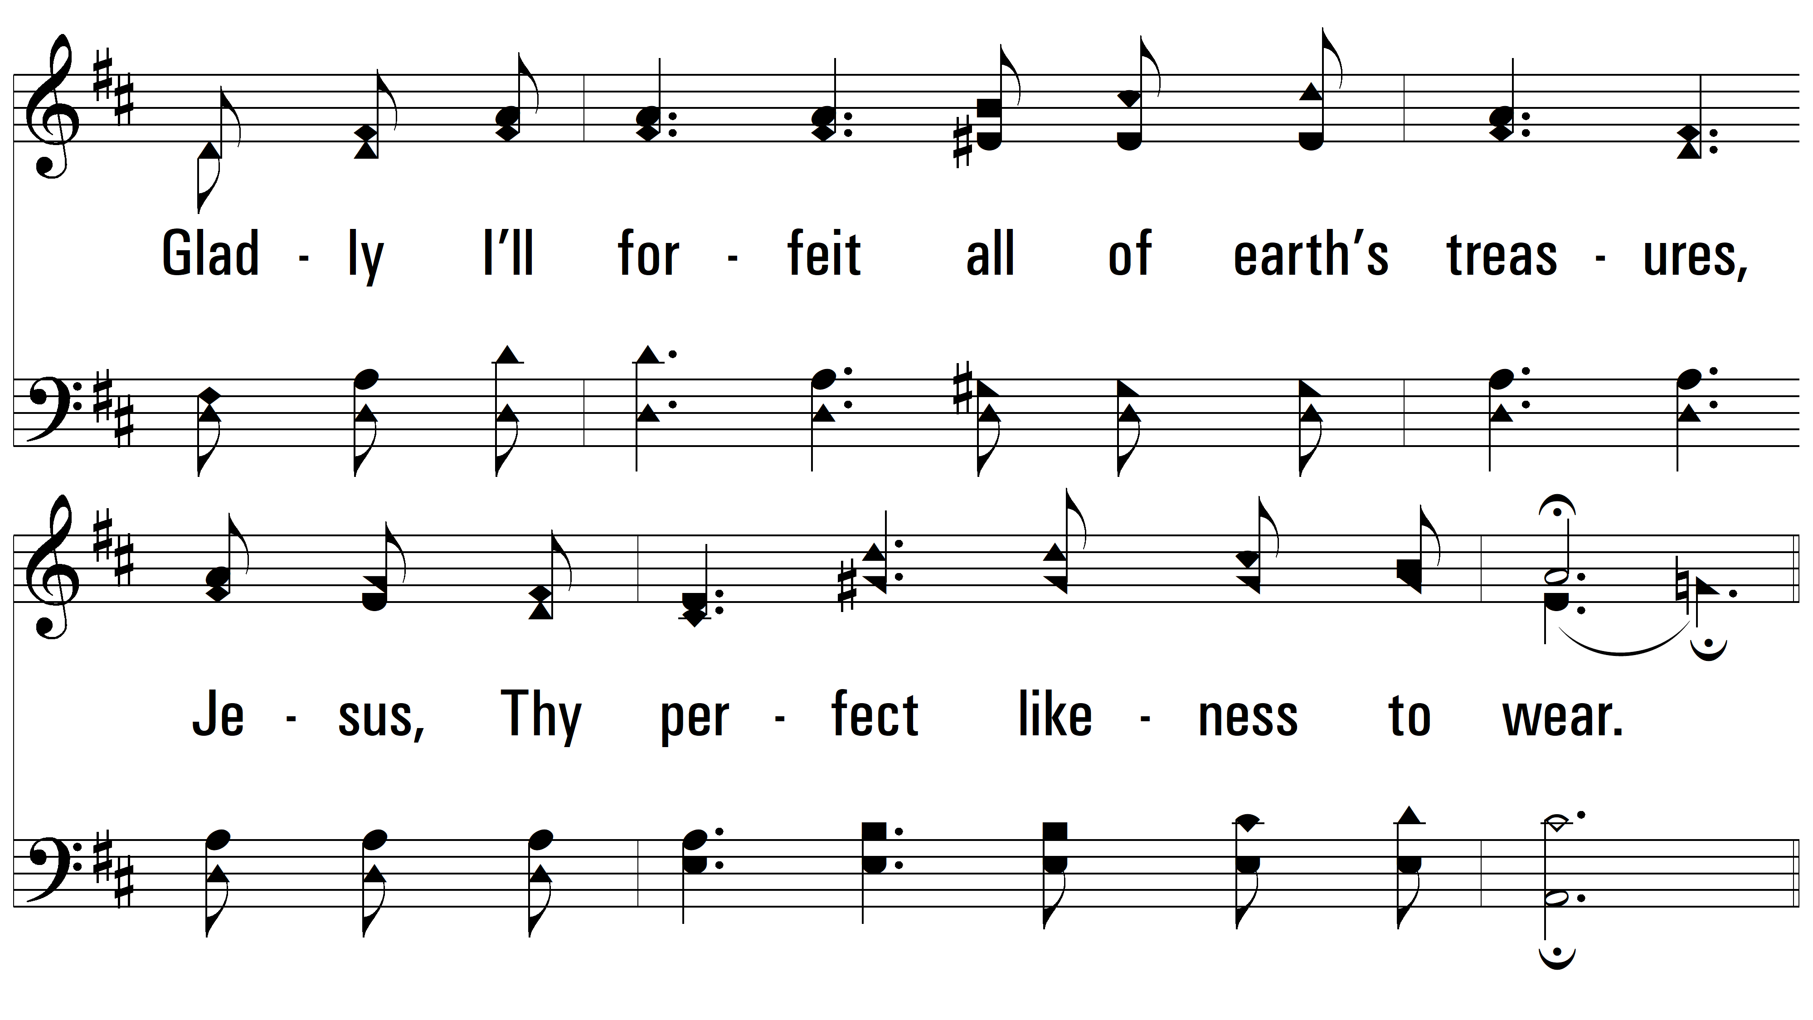
vs. 1

Slide 4
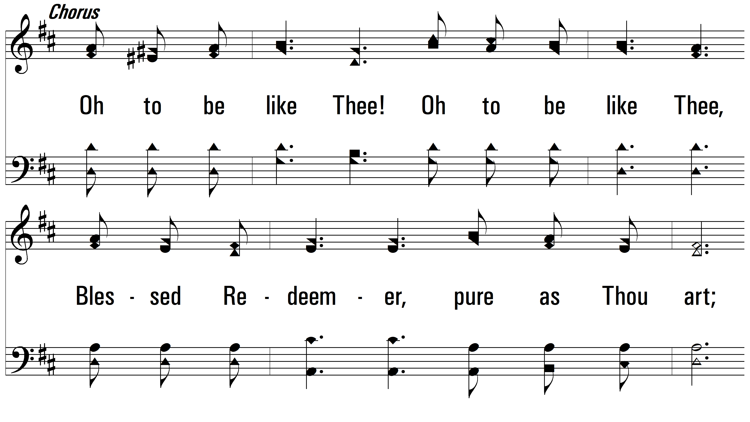
vs. 1

Slide 5
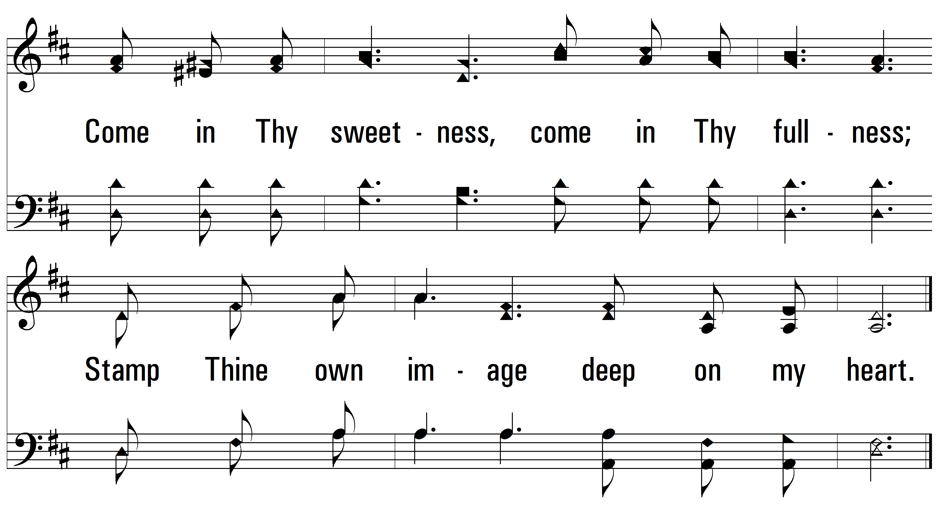
vs. 1

Slide 6
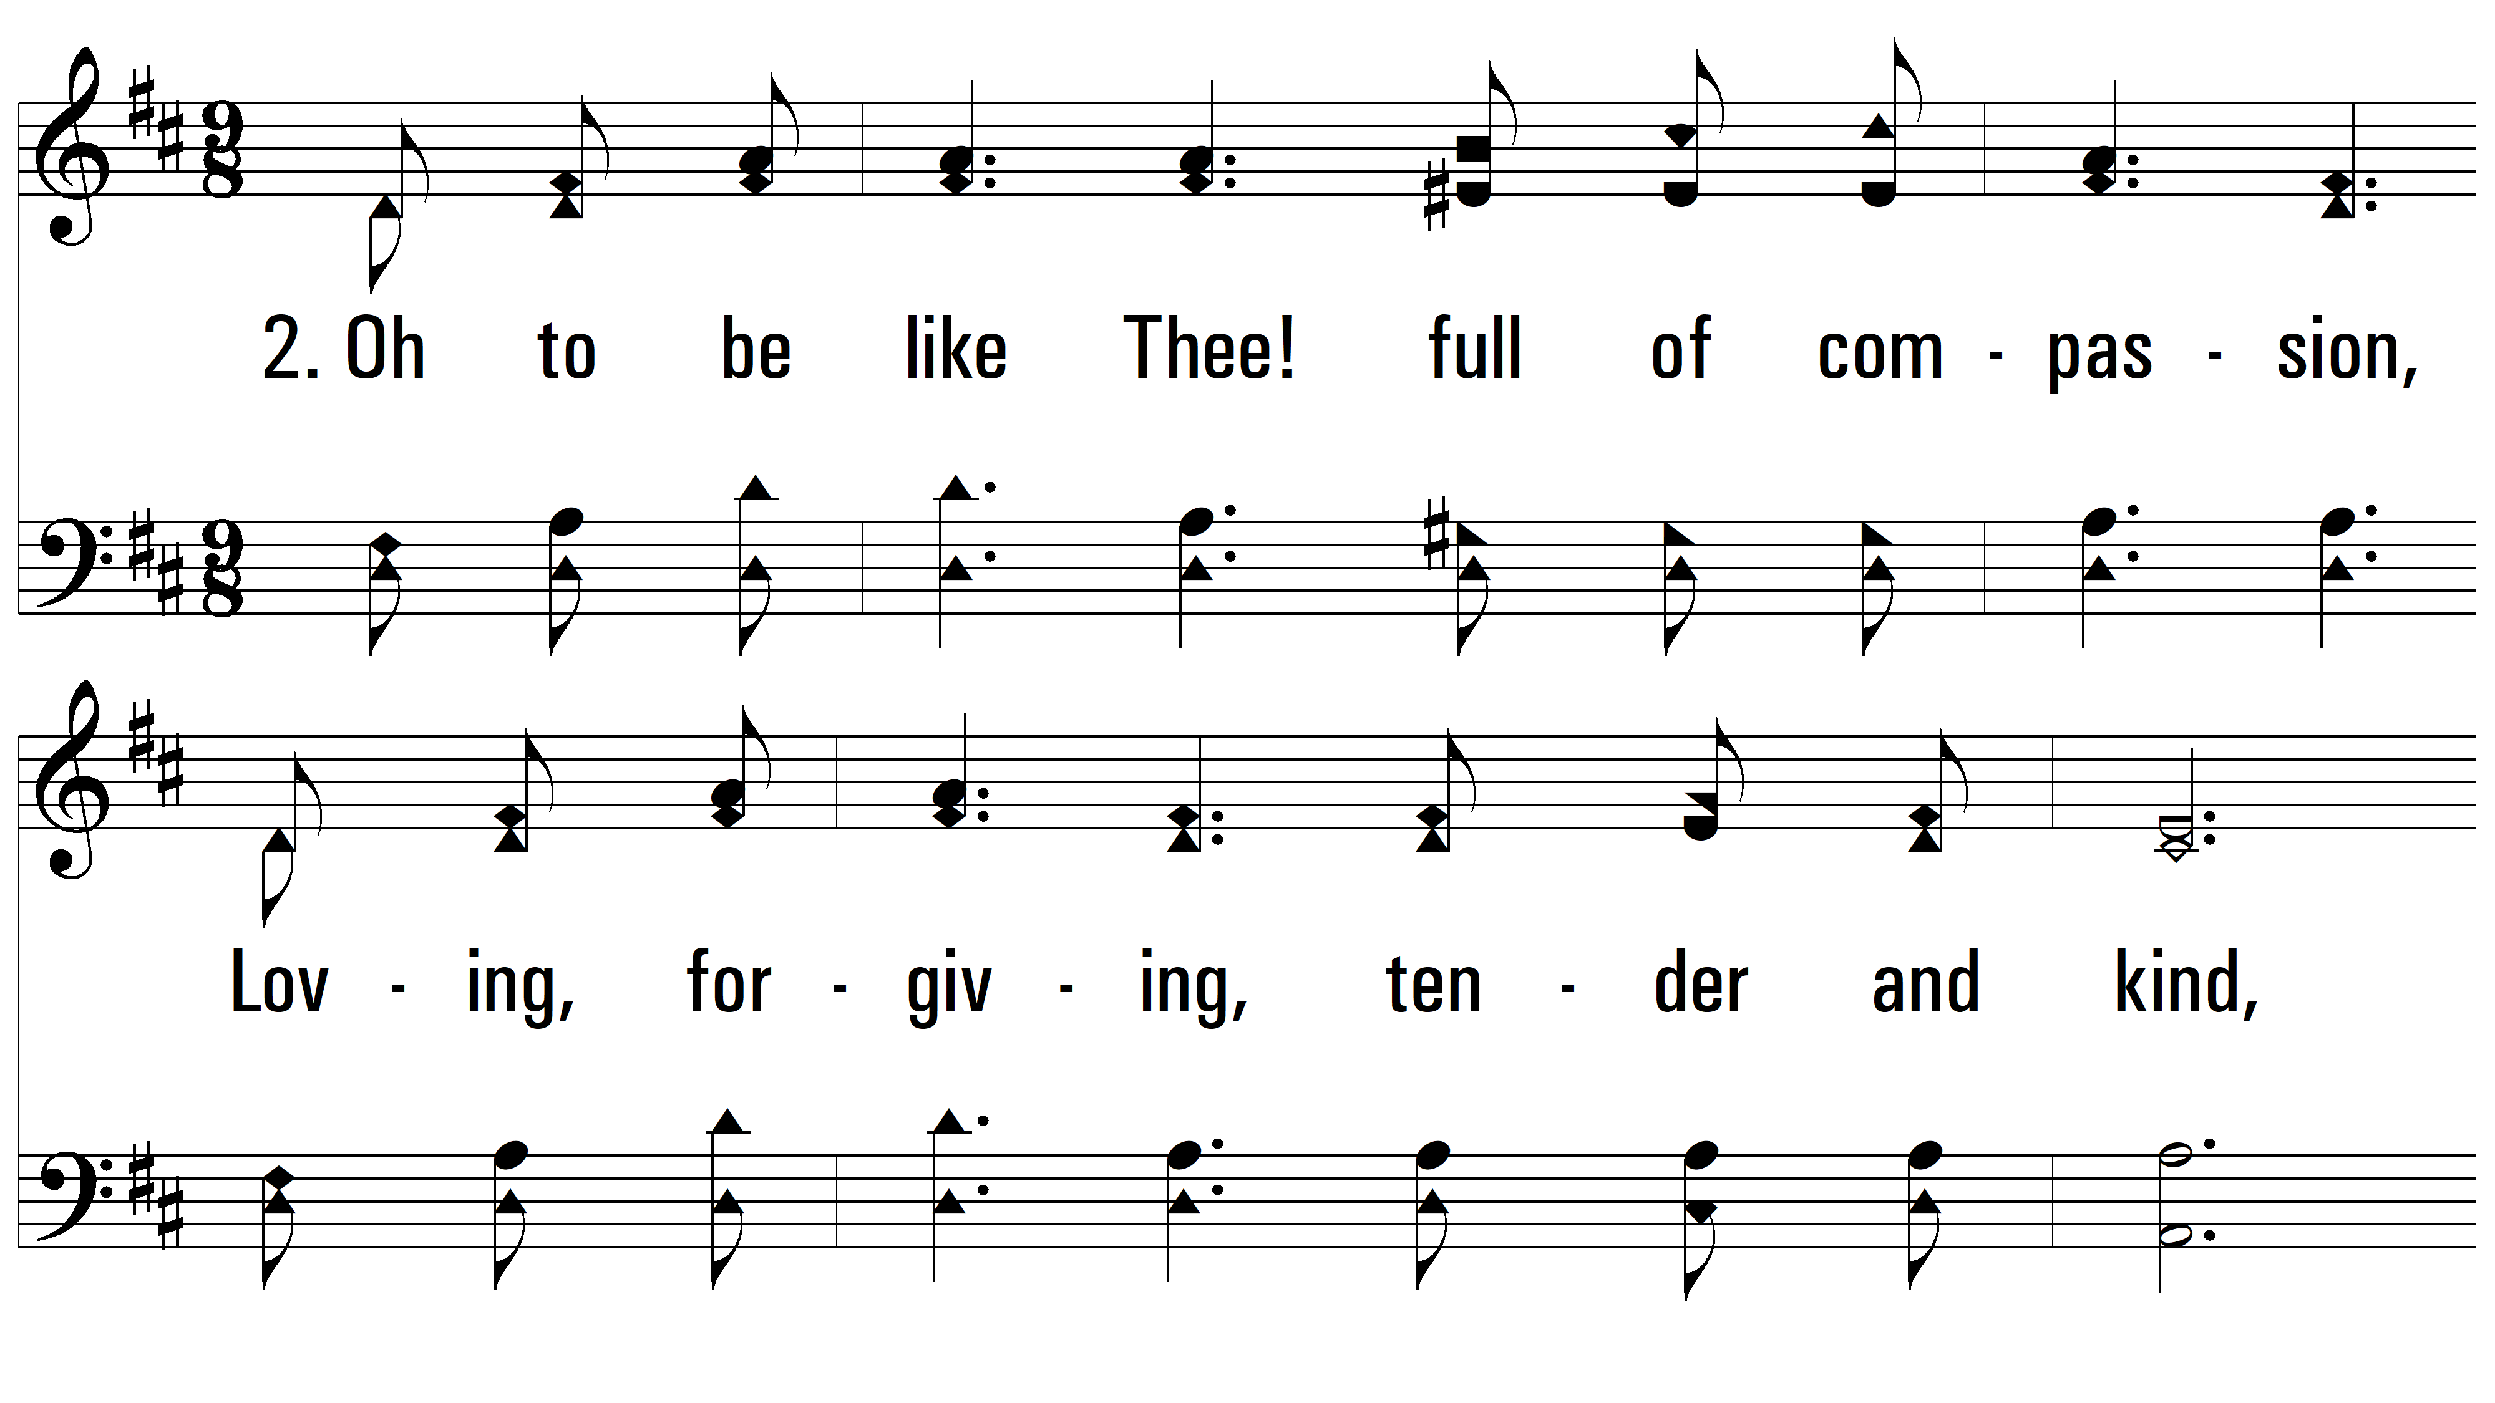
vs. 2 ~ Oh, To Be Like Thee

Slide 7
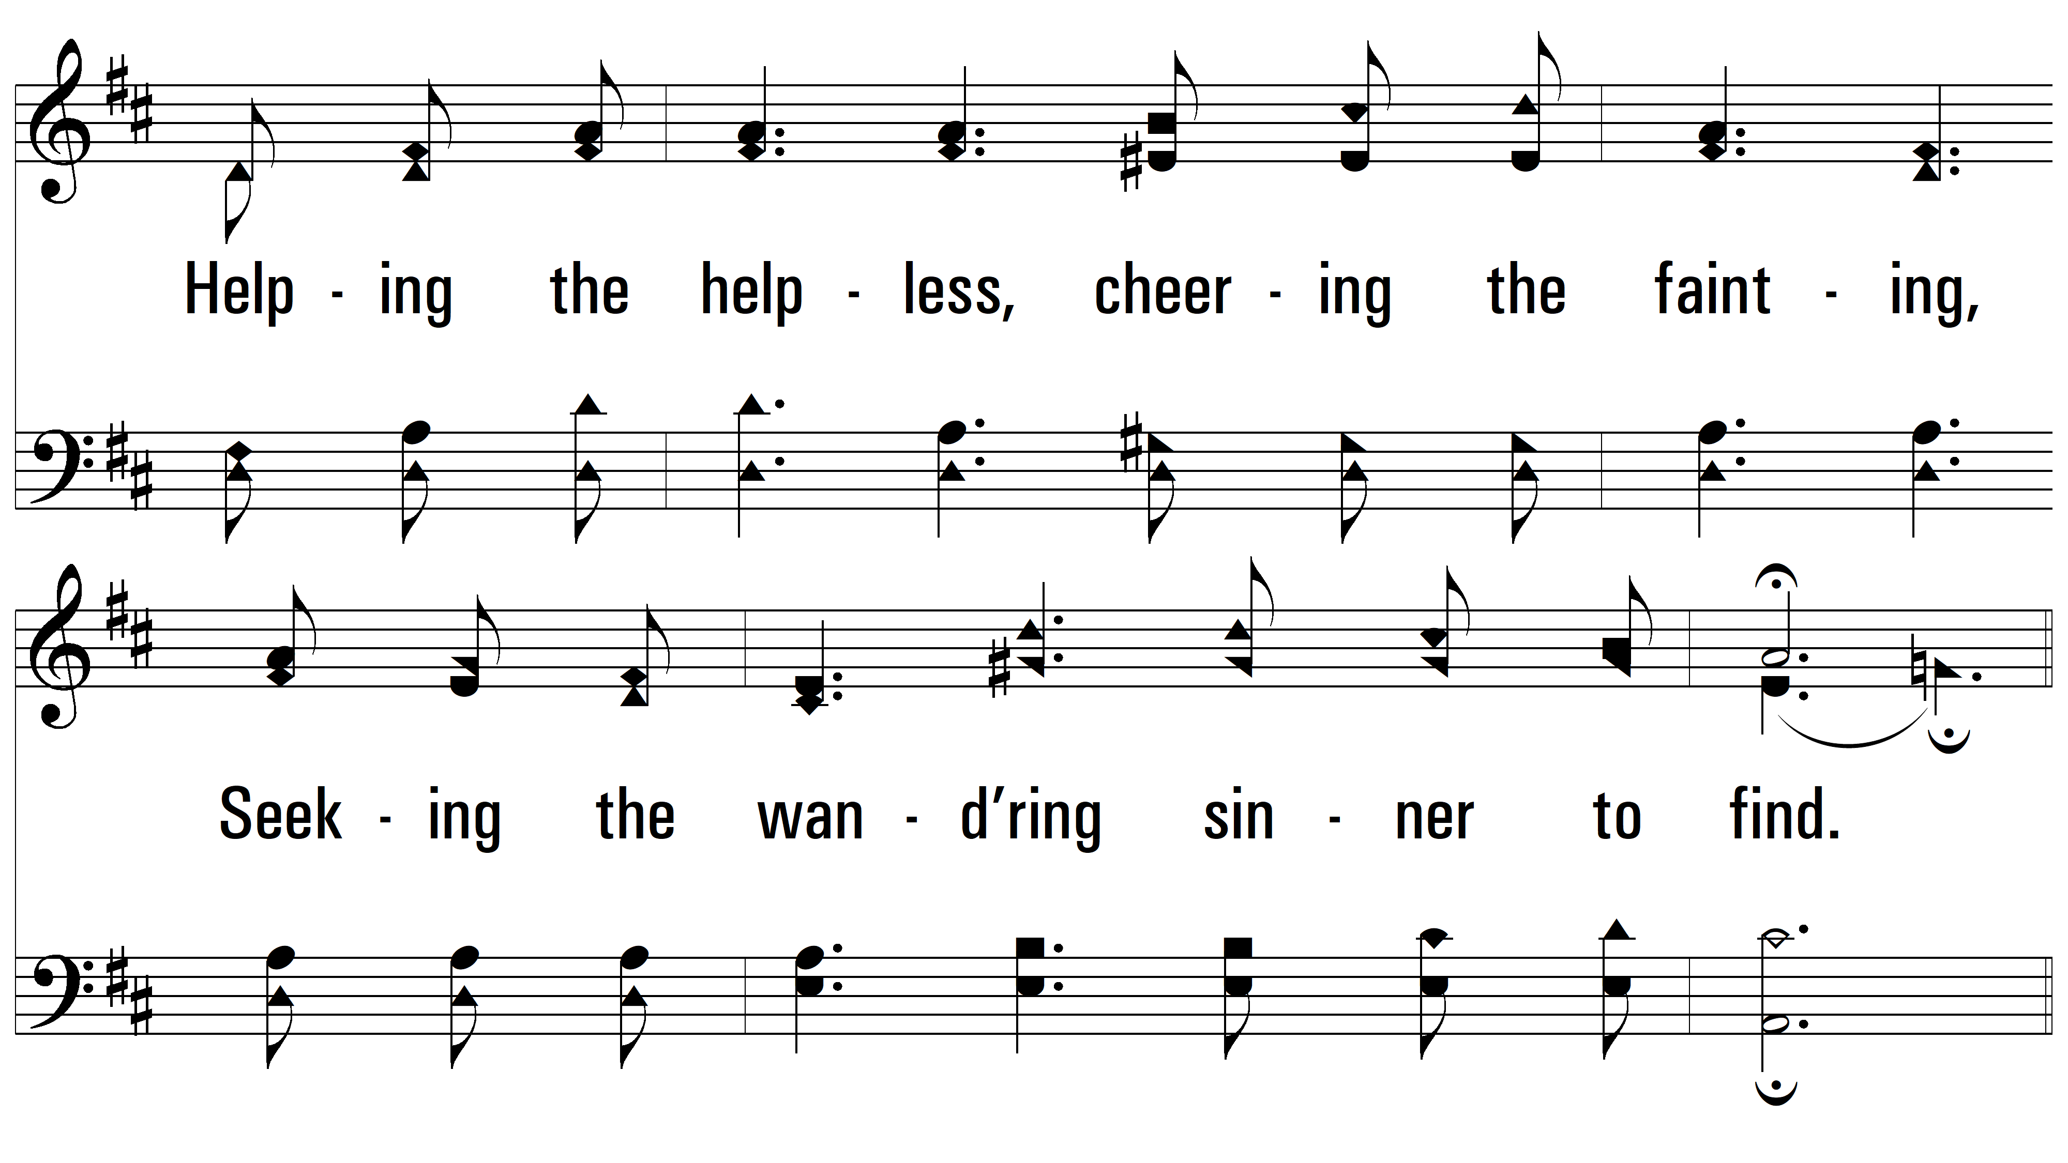
vs. 2

Slide 8
vs. 2

Slide 9
vs. 2

Slide 10
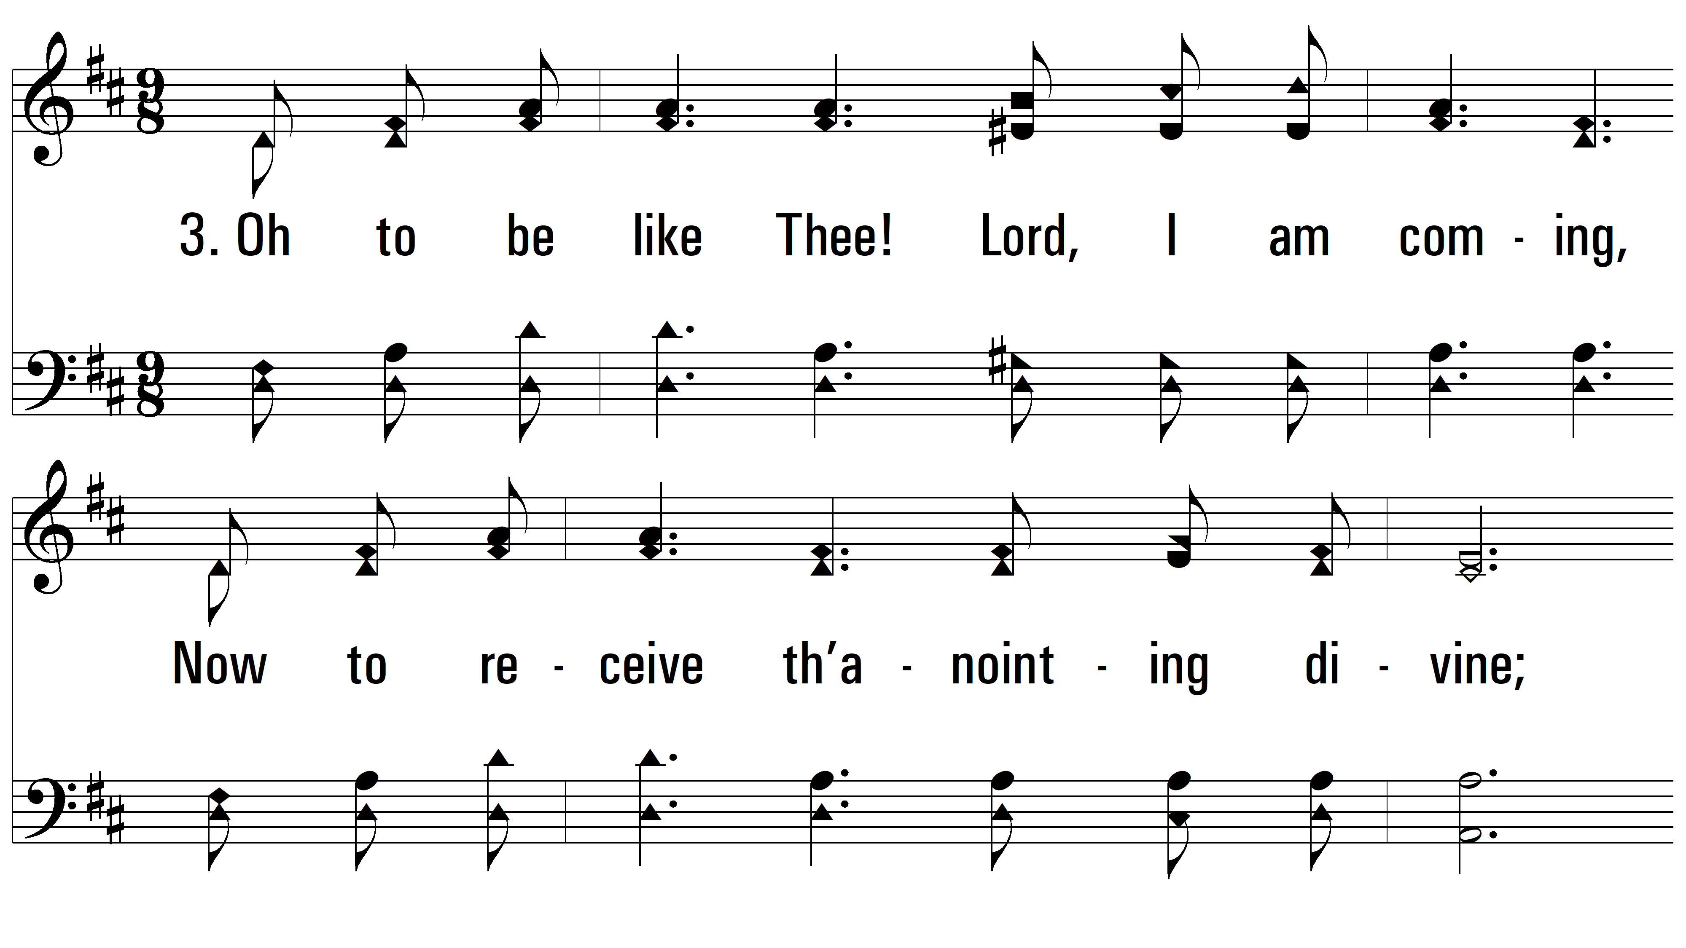
vs. 3 ~ Oh, To Be Like Thee

Slide 11
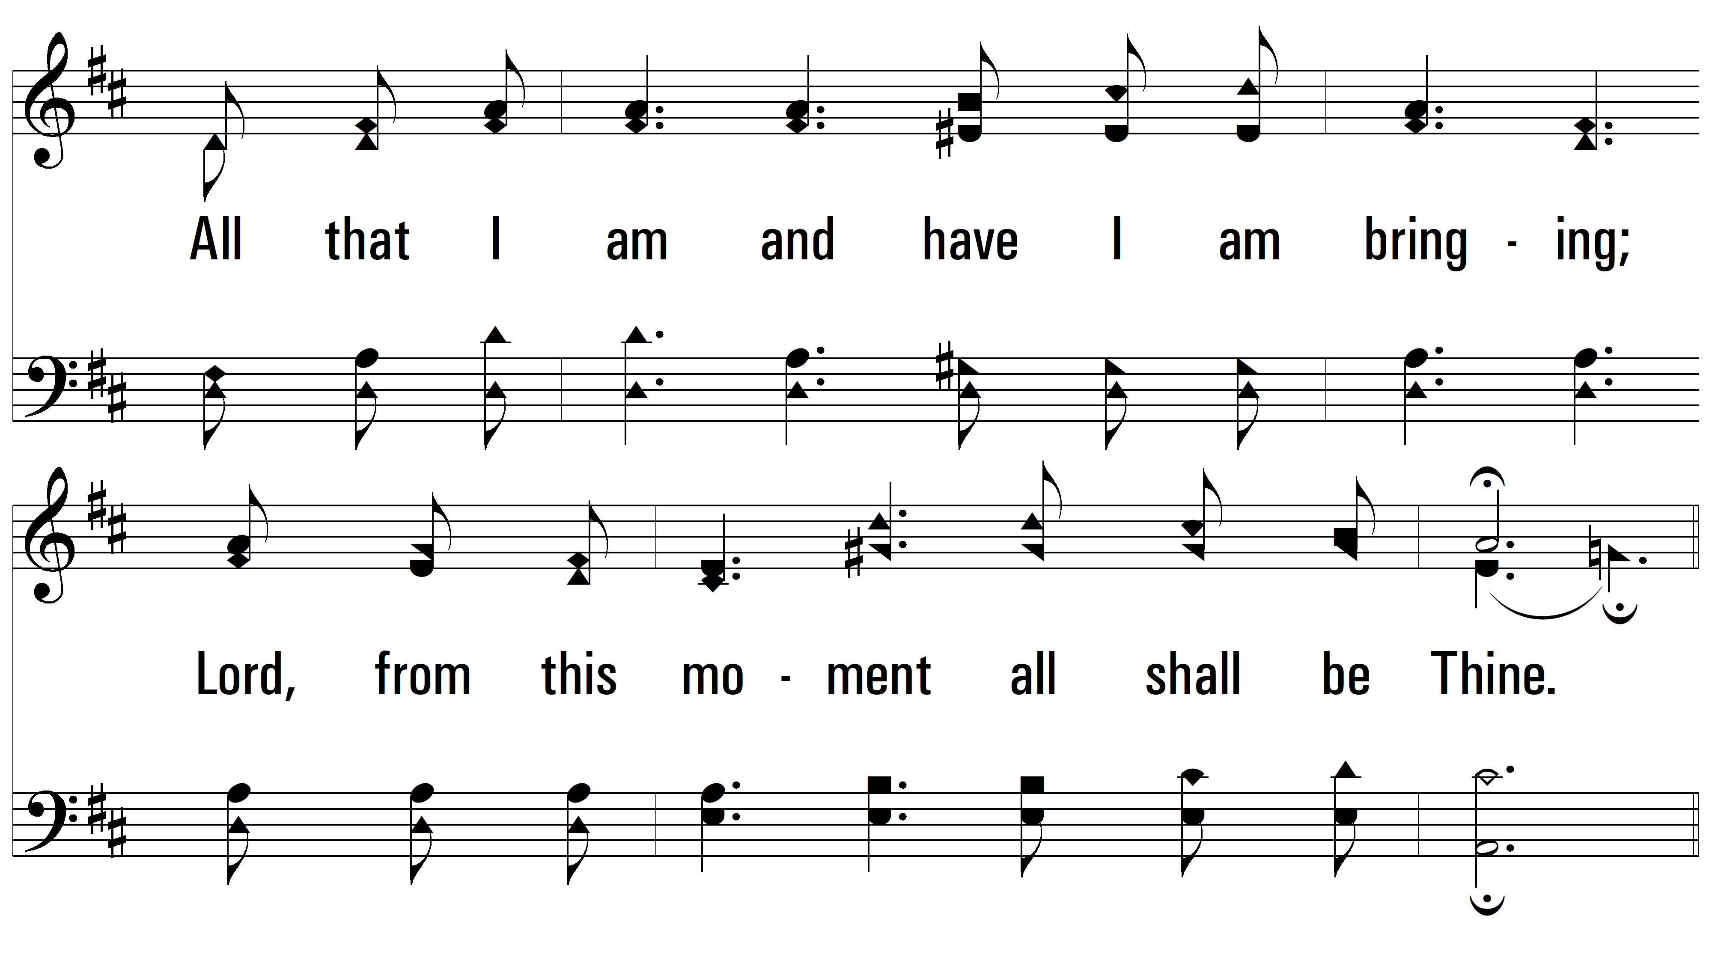
vs. 3

Slide 12
vs. 3

Slide 13
vs. 3
PDHymns.com
END

