Slide 1
Oh, That Will Be Glory
(Glory For Me)
Words: | Charles H. Gabriel (1900)
Music: | Charles H. Gabriel (1900)
6/4
A^{b}/E^{b} - SOL
Verses: 3/Chorus
Lead - | SOL
Alto - | MI
Tenor - | DO
Bass - | DO
PDHymns.com

Slide 2
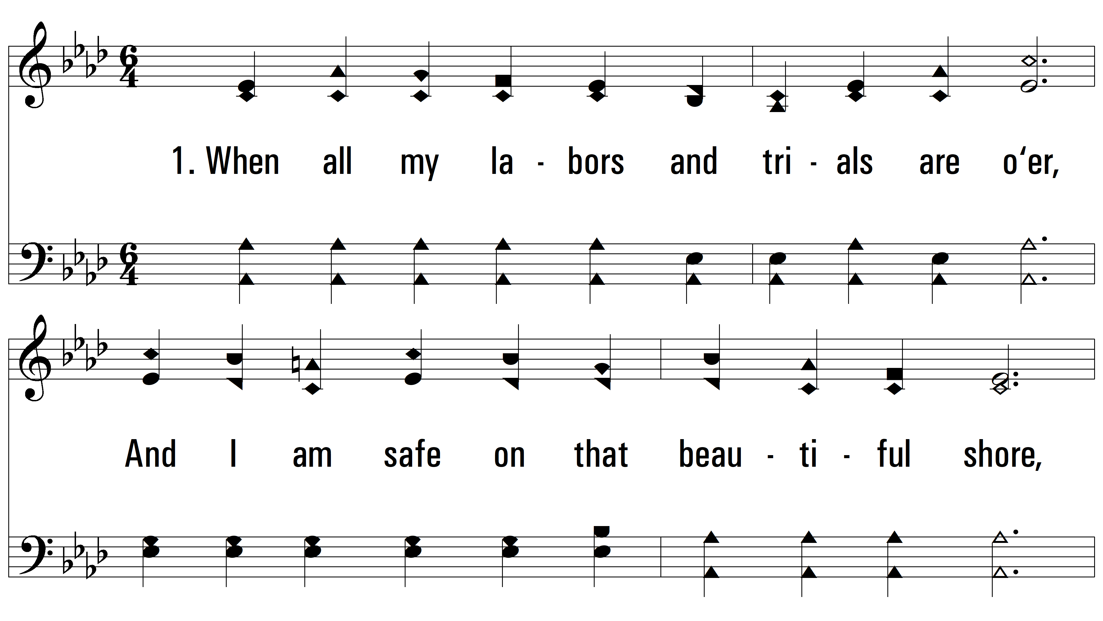
vs. 1 ~ Oh, That Will Be Glory

Slide 3
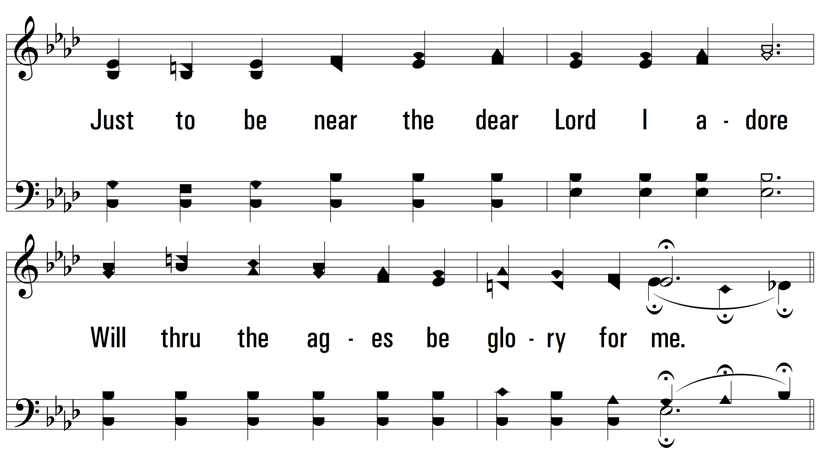
vs. 1

Slide 4
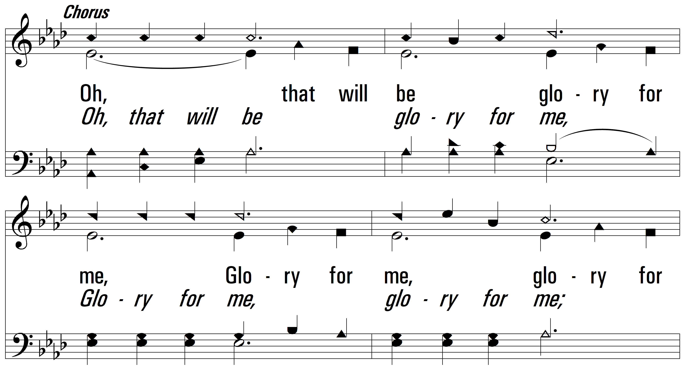
vs. 1

Slide 5
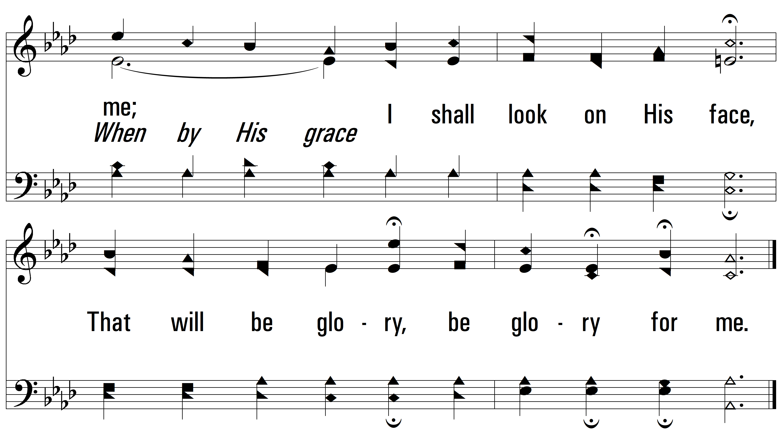
vs. 1

Slide 6
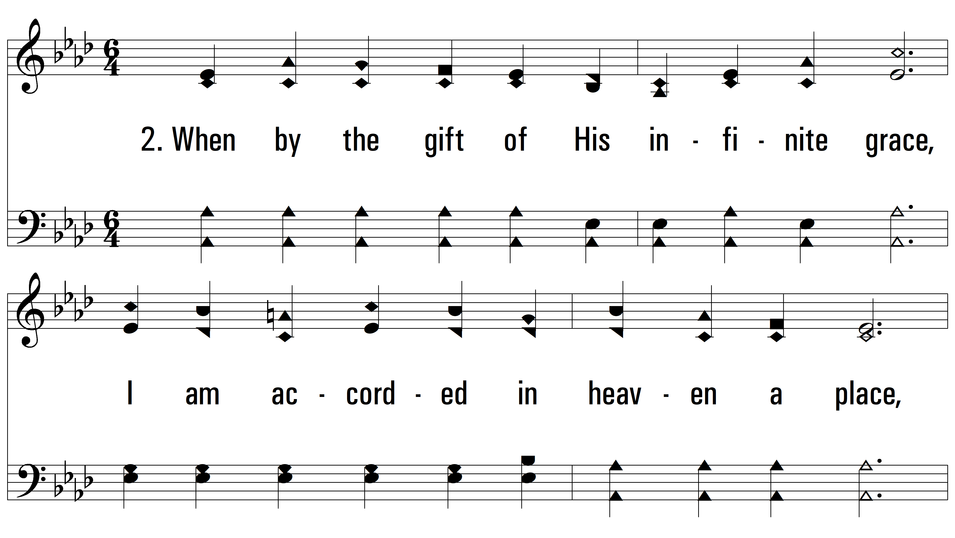
vs. 2 ~ Oh, That Will Be Glory

Slide 7
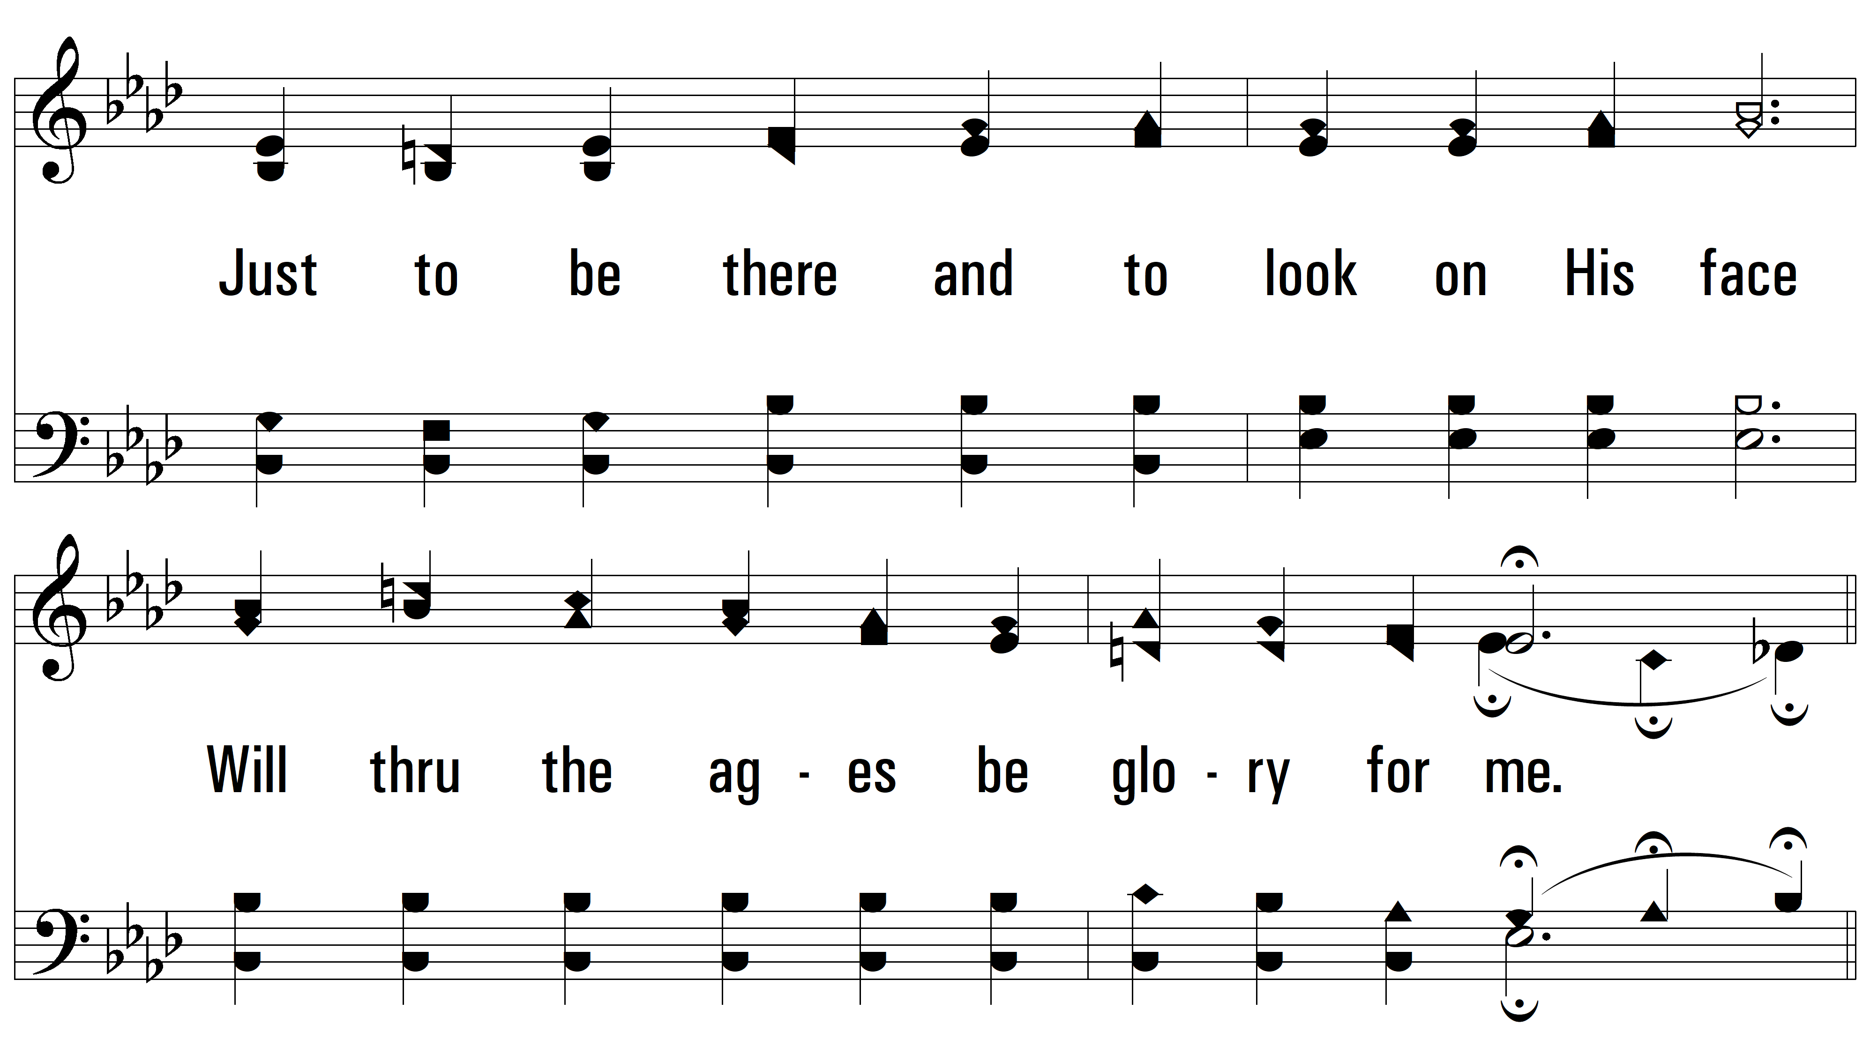
vs. 2

Slide 8
vs. 2

Slide 9
vs. 2

Slide 10
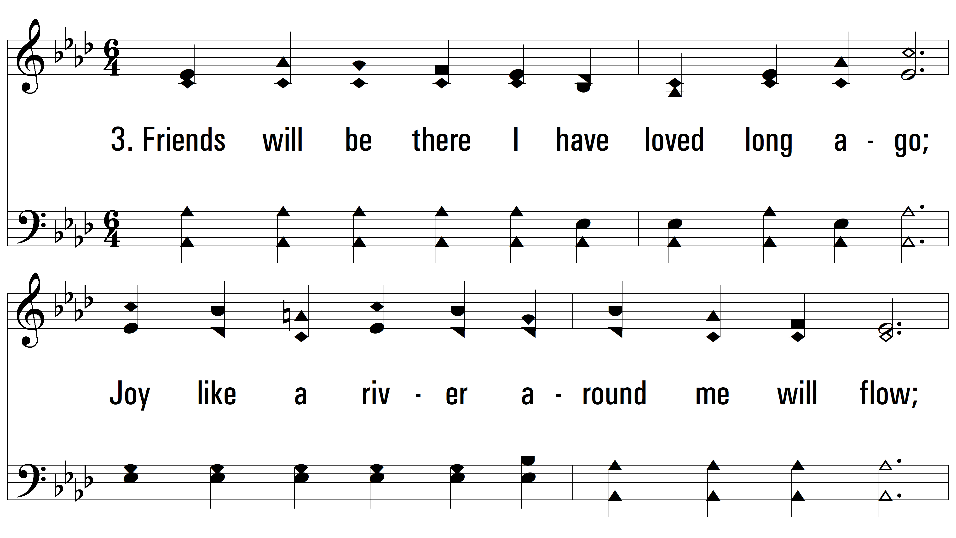
vs. 3 ~ Oh, That Will Be Glory

Slide 11
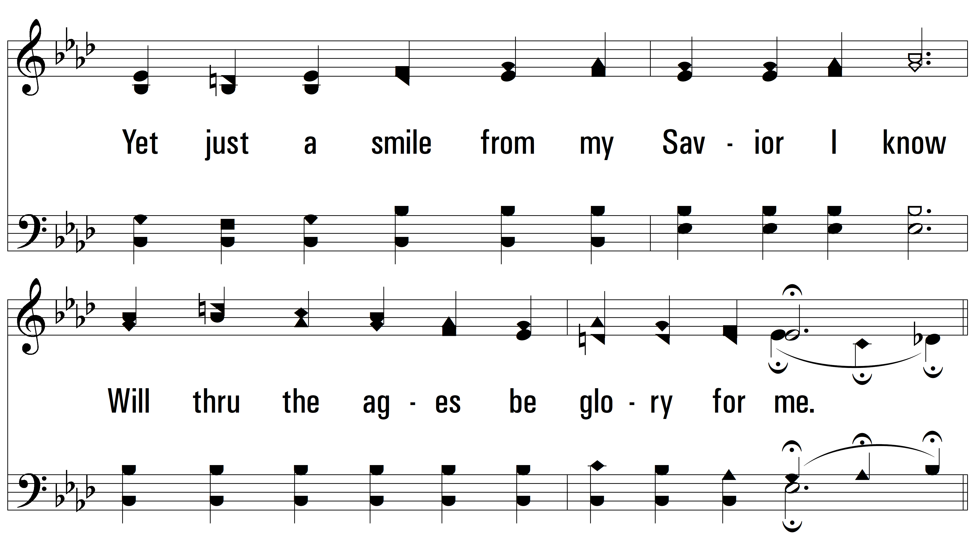
vs. 3

Slide 12
vs. 3

Slide 13
vs. 3
PDHymns.com
END

