Slide 1
Oh, How I Love Jesus
Words: | Frederick Whitfield (1855), Cho. Bradbury’s Devotional Hymn & Tune Book (1864)
Music: | Bradbury’s Devotional Hymn & Tune Book (1864)
6/8
A^{b}/A^{b} - DO
Verses: 3/Chorus
Lead - | DO
Alto - | MI
Tenor - | SOL
Bass - | DO
PDHymns.com

Slide 2
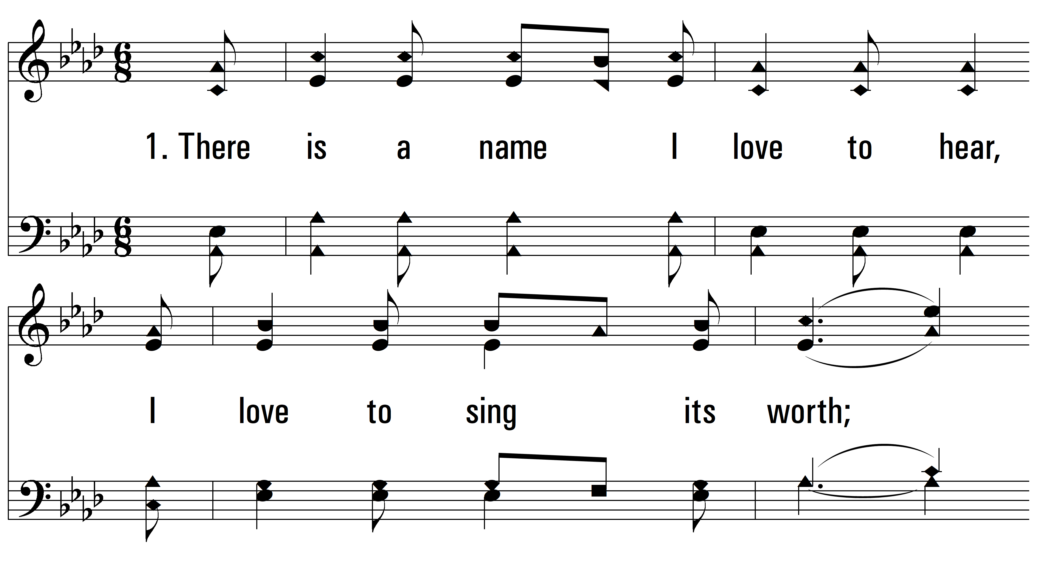
vs. 1 ~ Oh, How I Love Jesus

Slide 3
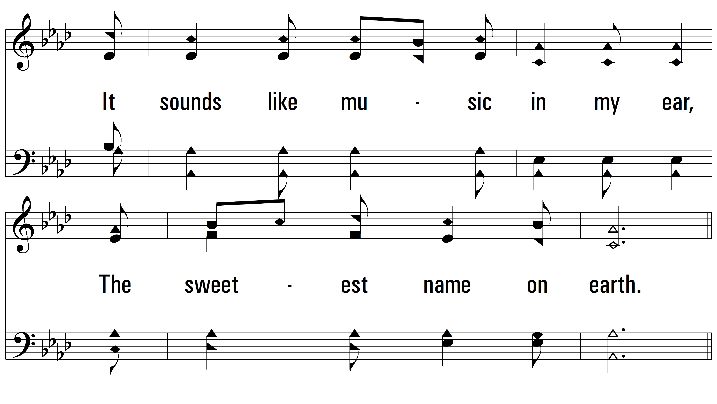
vs. 1

Slide 4
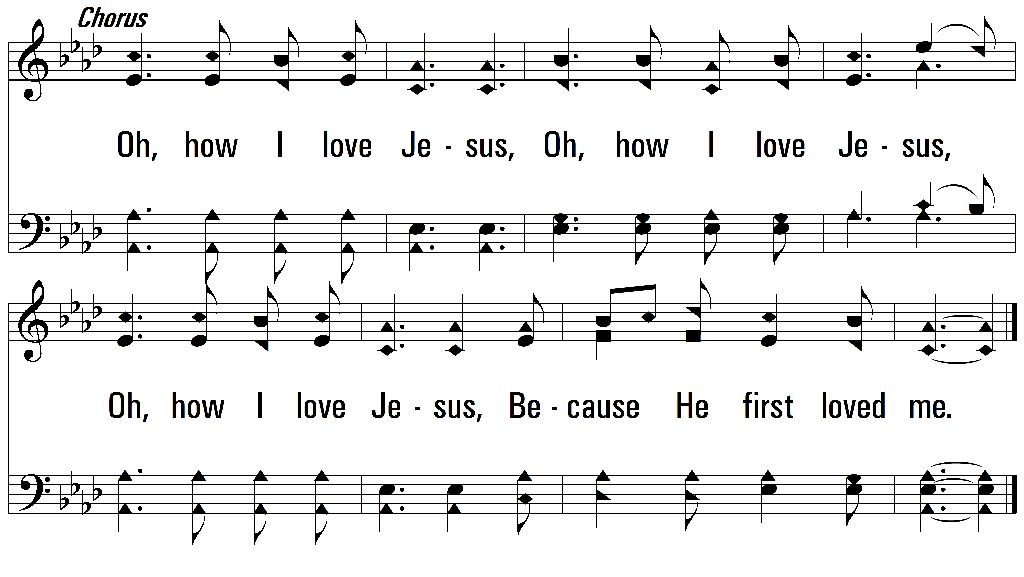
vs. 1

Slide 5
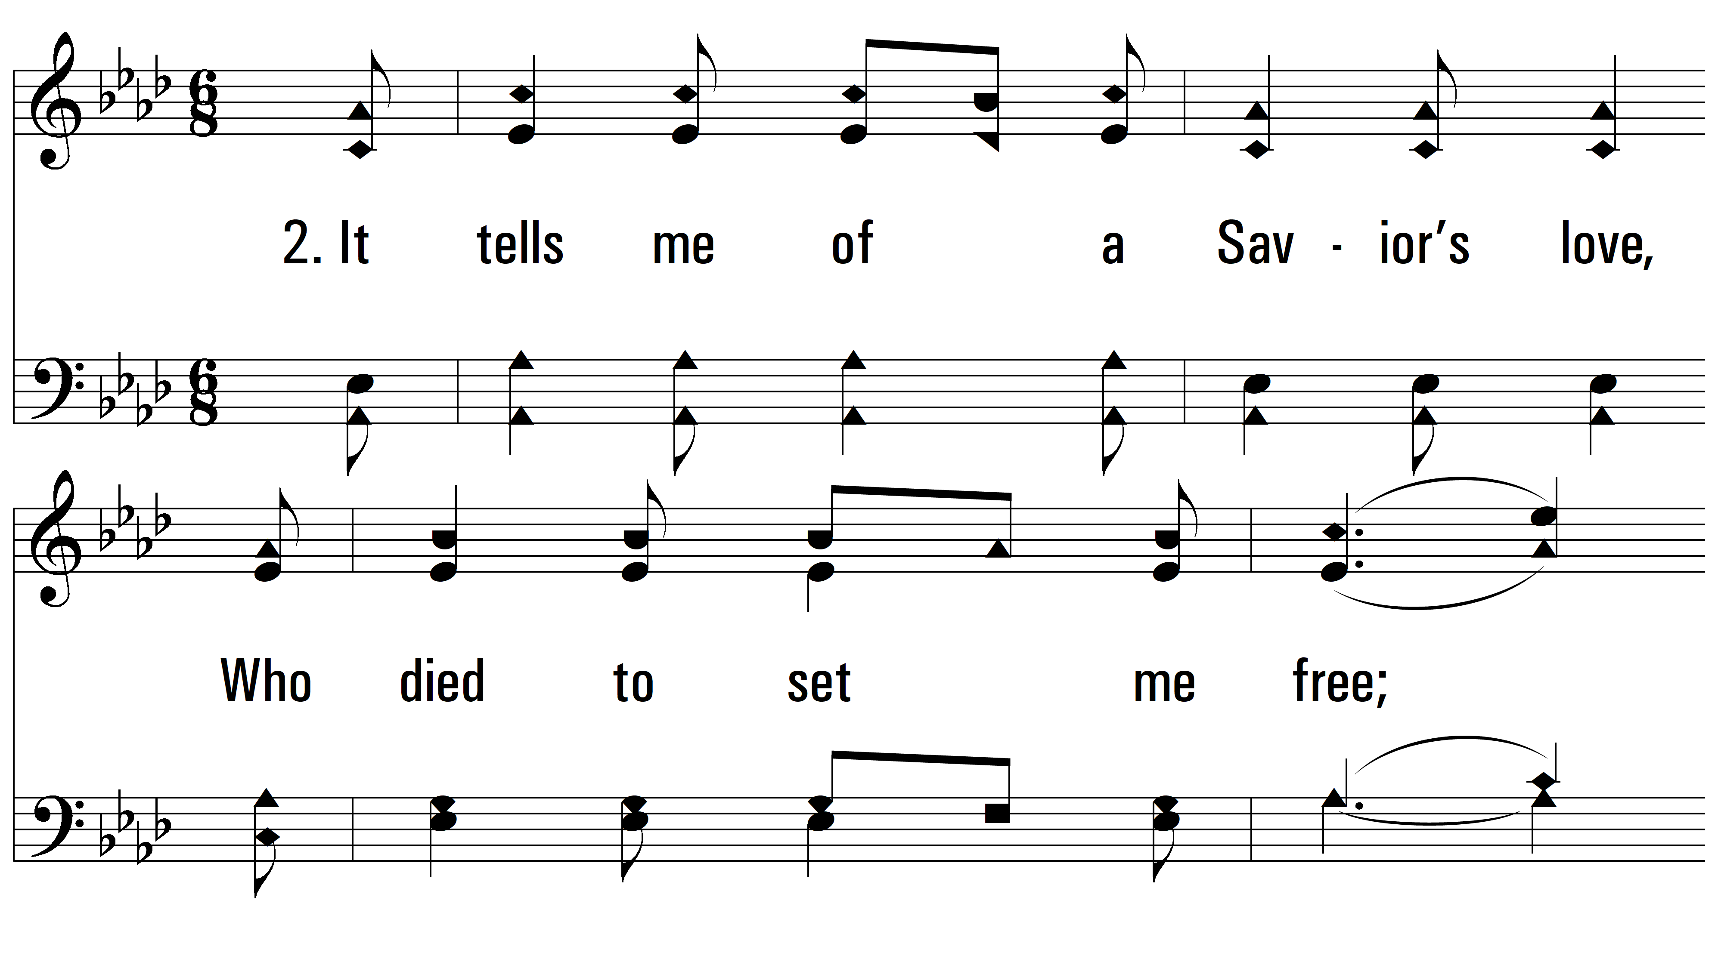
vs. 2 ~ Oh, How I Love Jesus

Slide 6
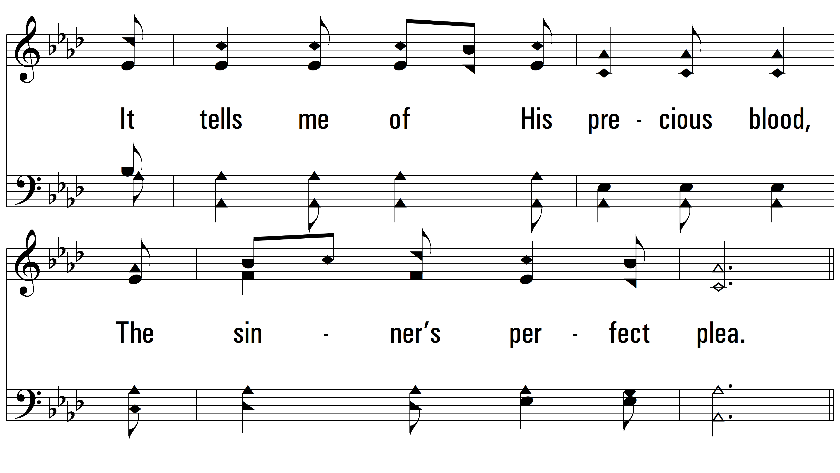
vs. 2

Slide 7
vs. 2

Slide 8
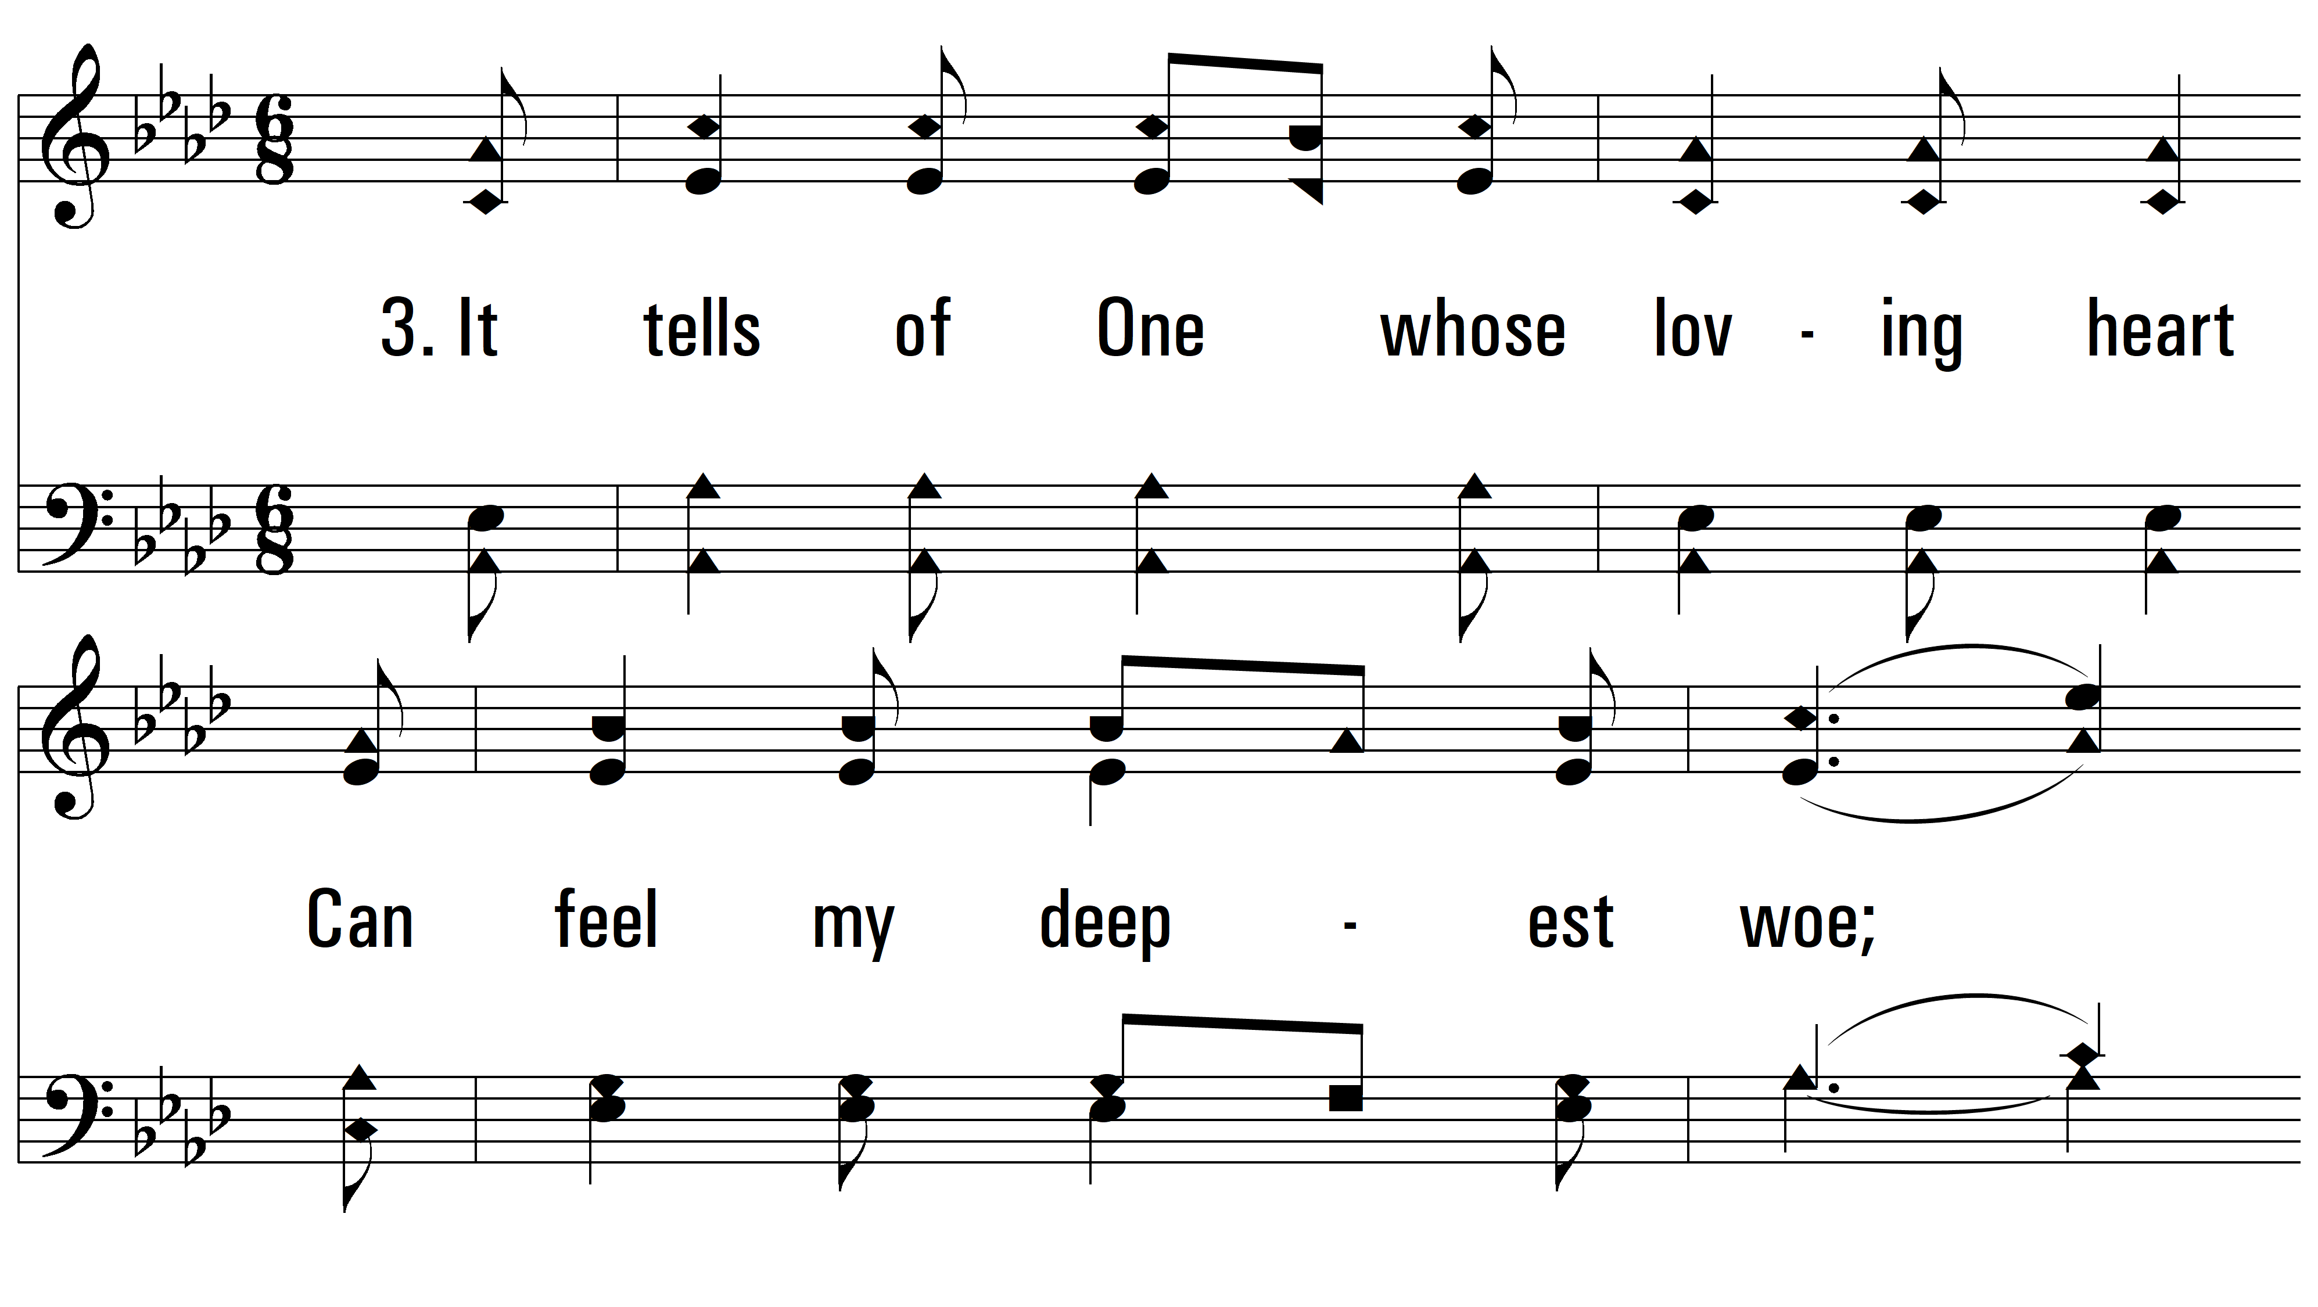
vs. 3 ~ Oh, How I Love Jesus

Slide 9
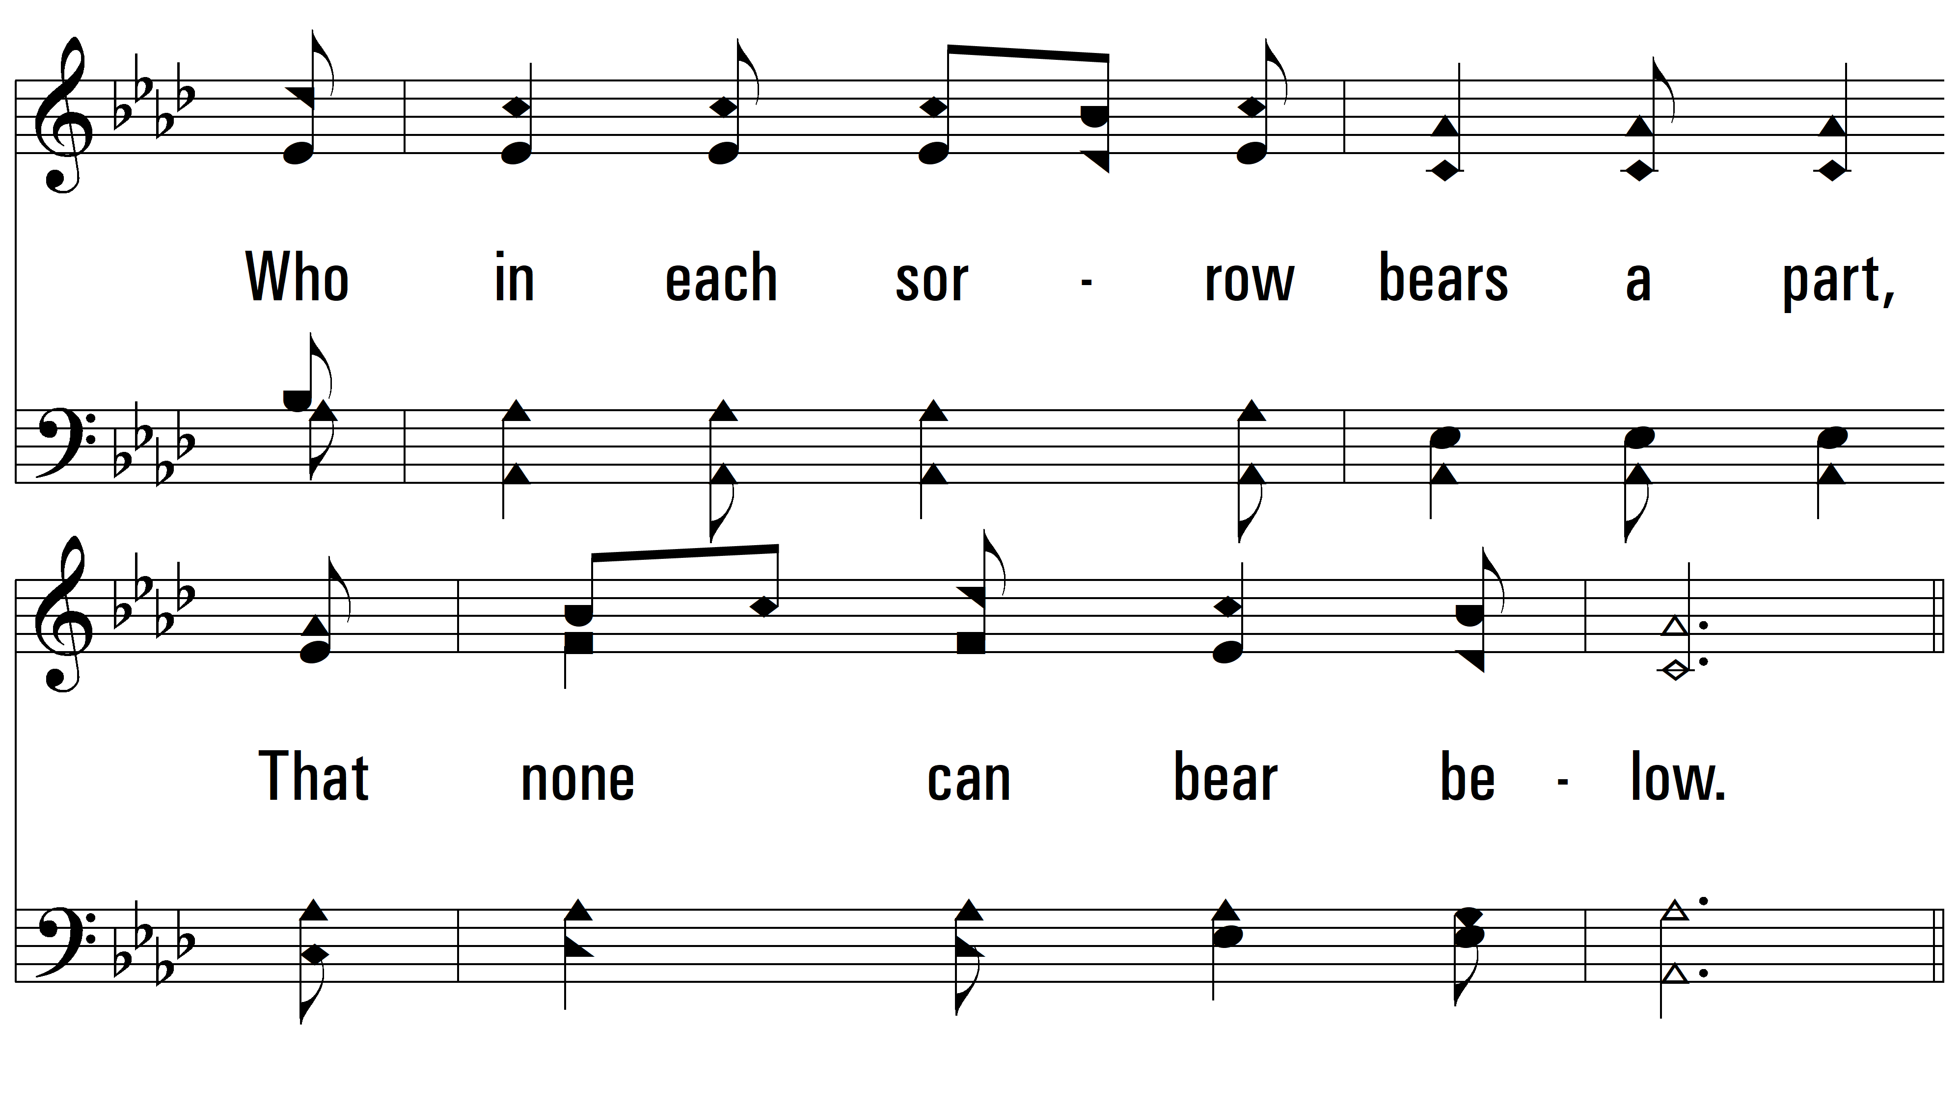
vs. 3

Slide 10
vs. 3
PDHymns.com
END

