Slide 1
O Think Of The Home Over There
Words: | D. W. C. Huntington (1868)
Music: | T. C. O’Kane (1868)
4/4
A/E - SOL
Verses: 4/Chorus
Lead - | SOL
Alto - | MI
Tenor - | DO
Bass - | DO
PDHymns.com

Slide 2
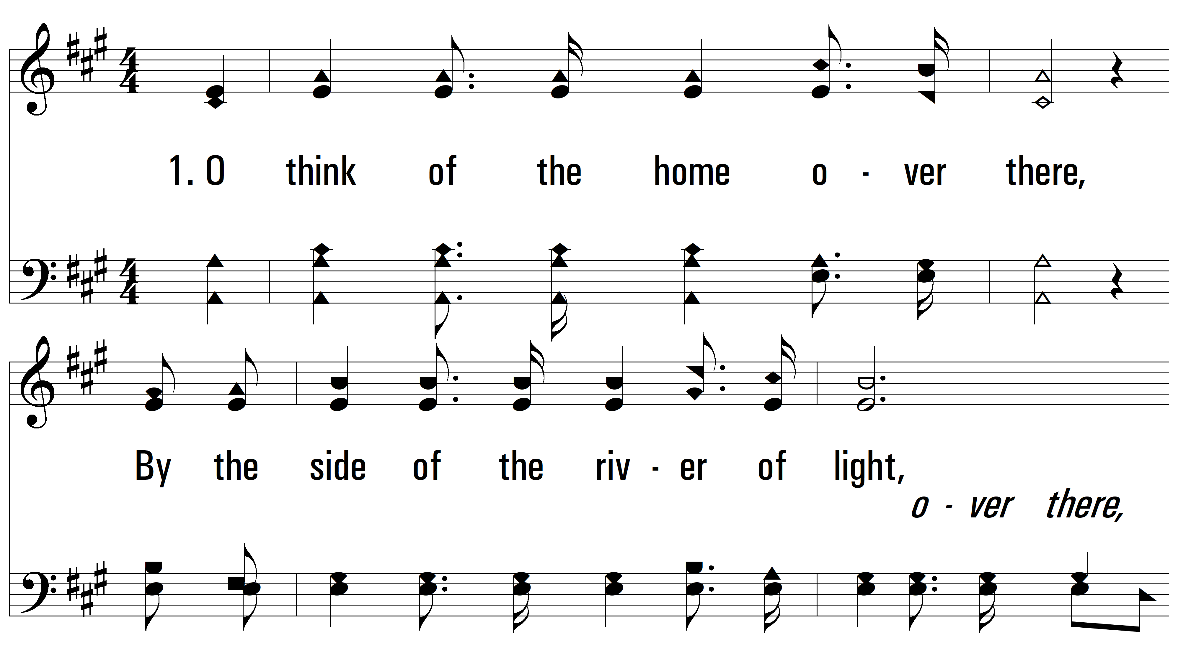
vs. 1 ~ O Think Of The Home Over There

Slide 3
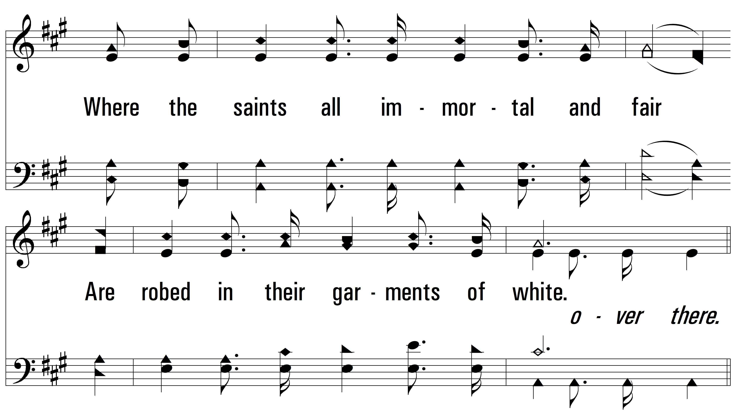
vs. 1

Slide 4
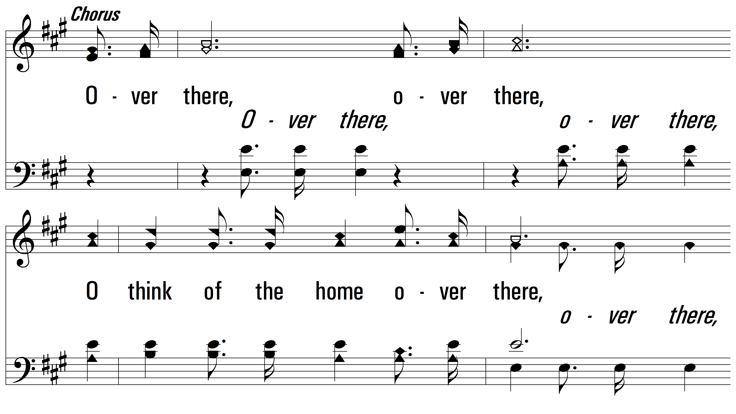
vs. 1

Slide 5
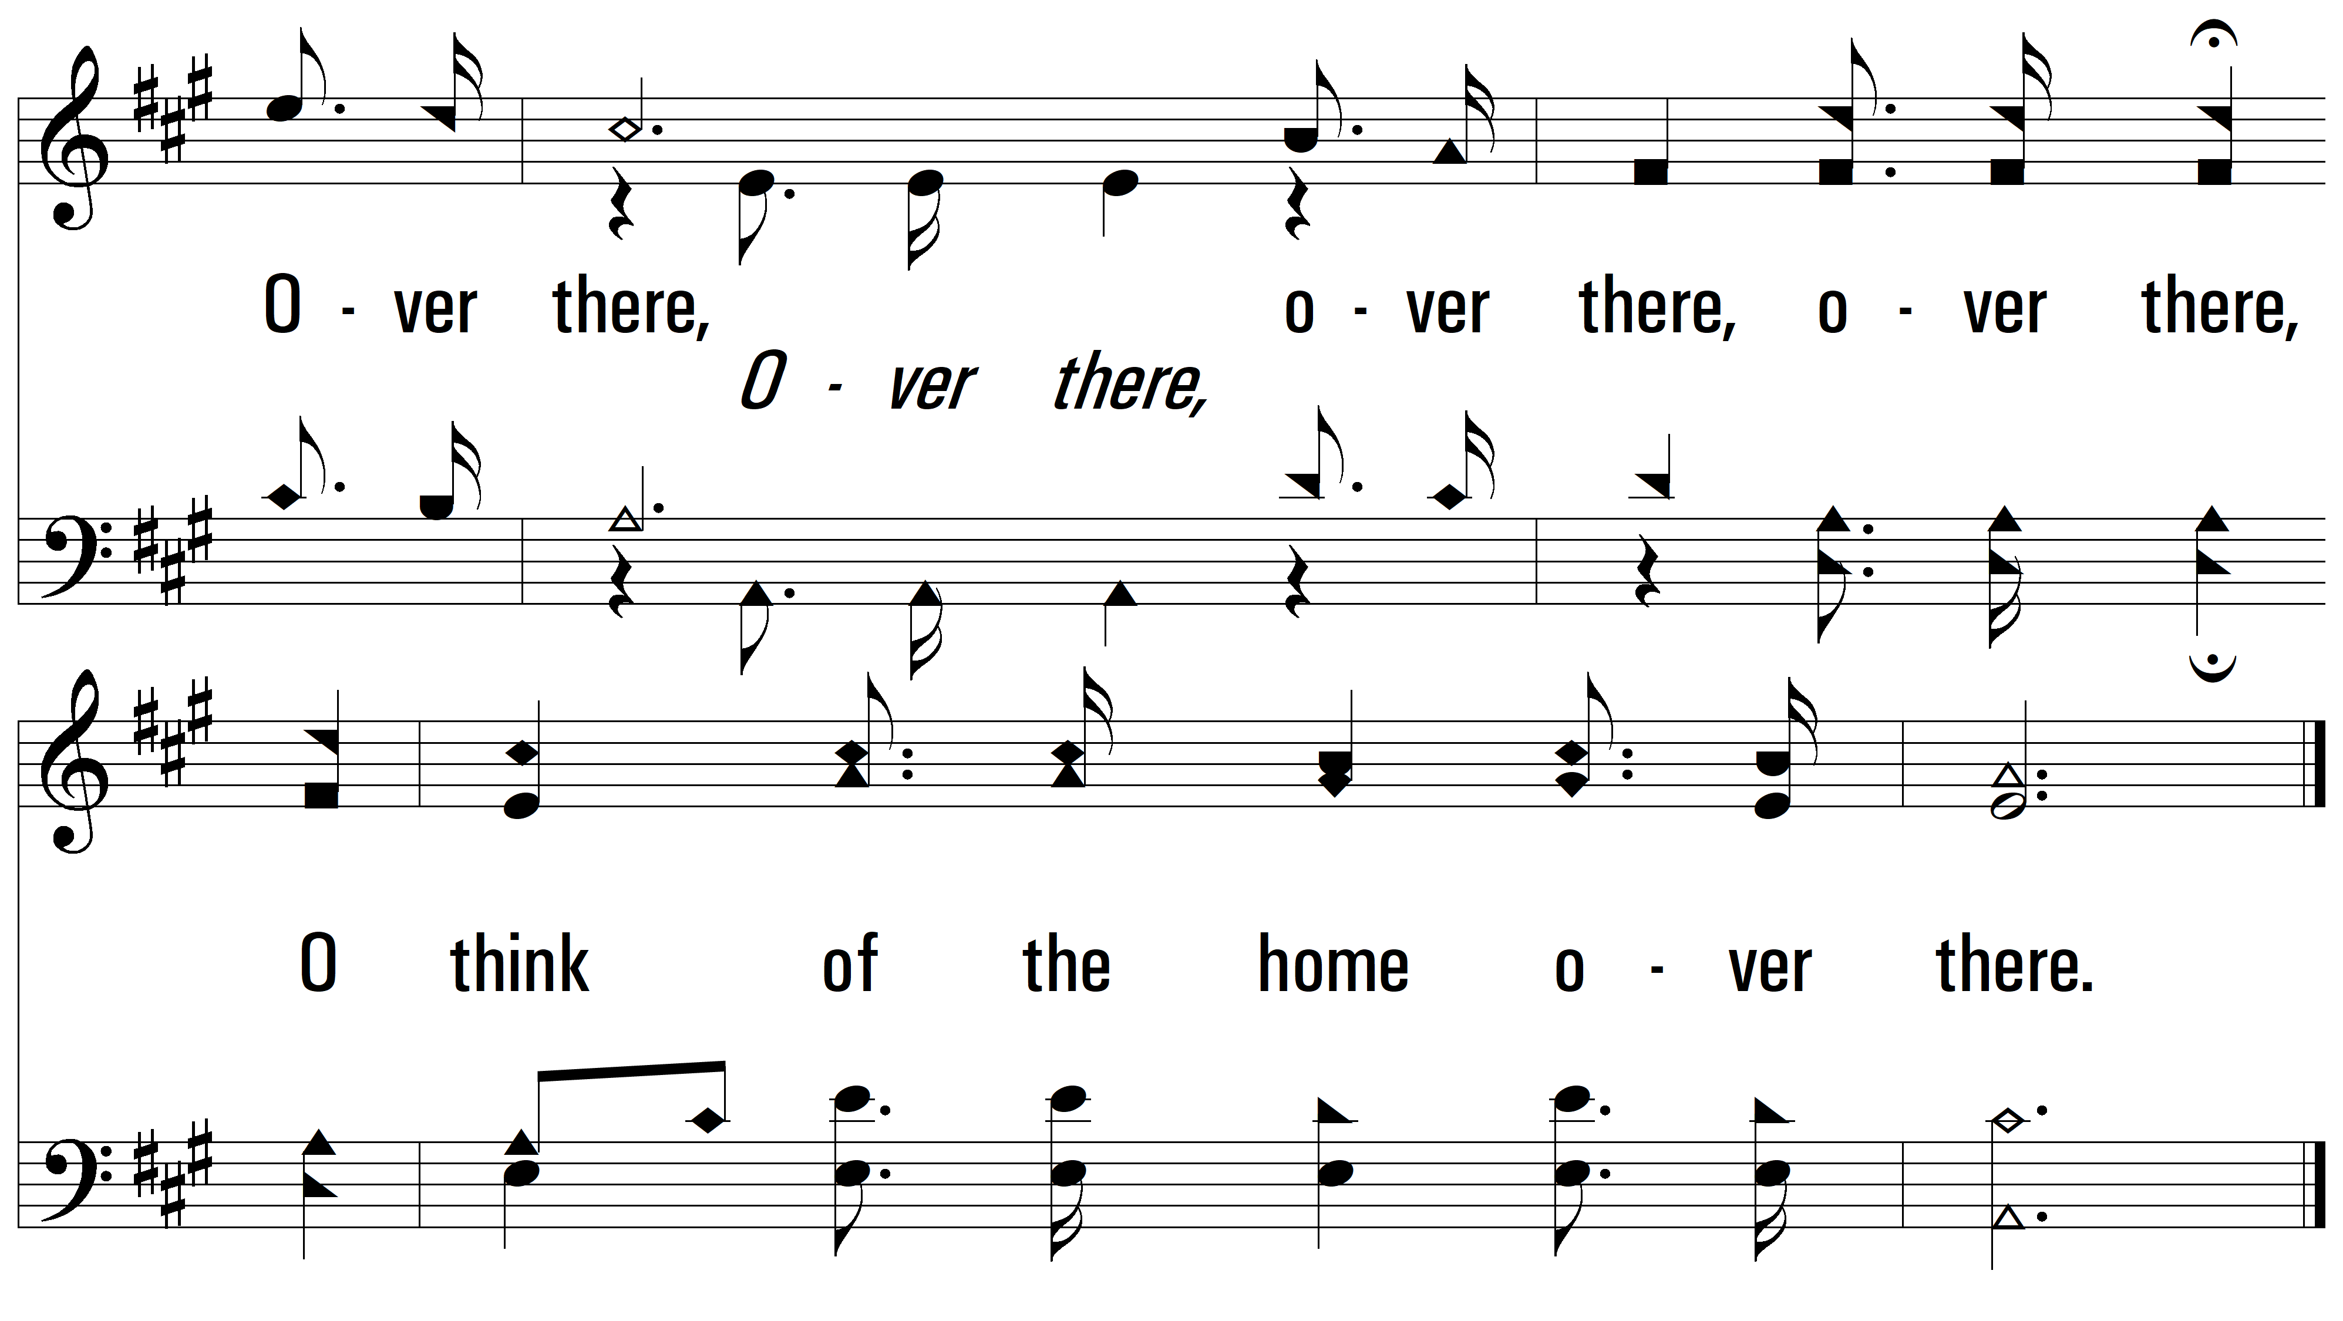
vs. 1

Slide 6
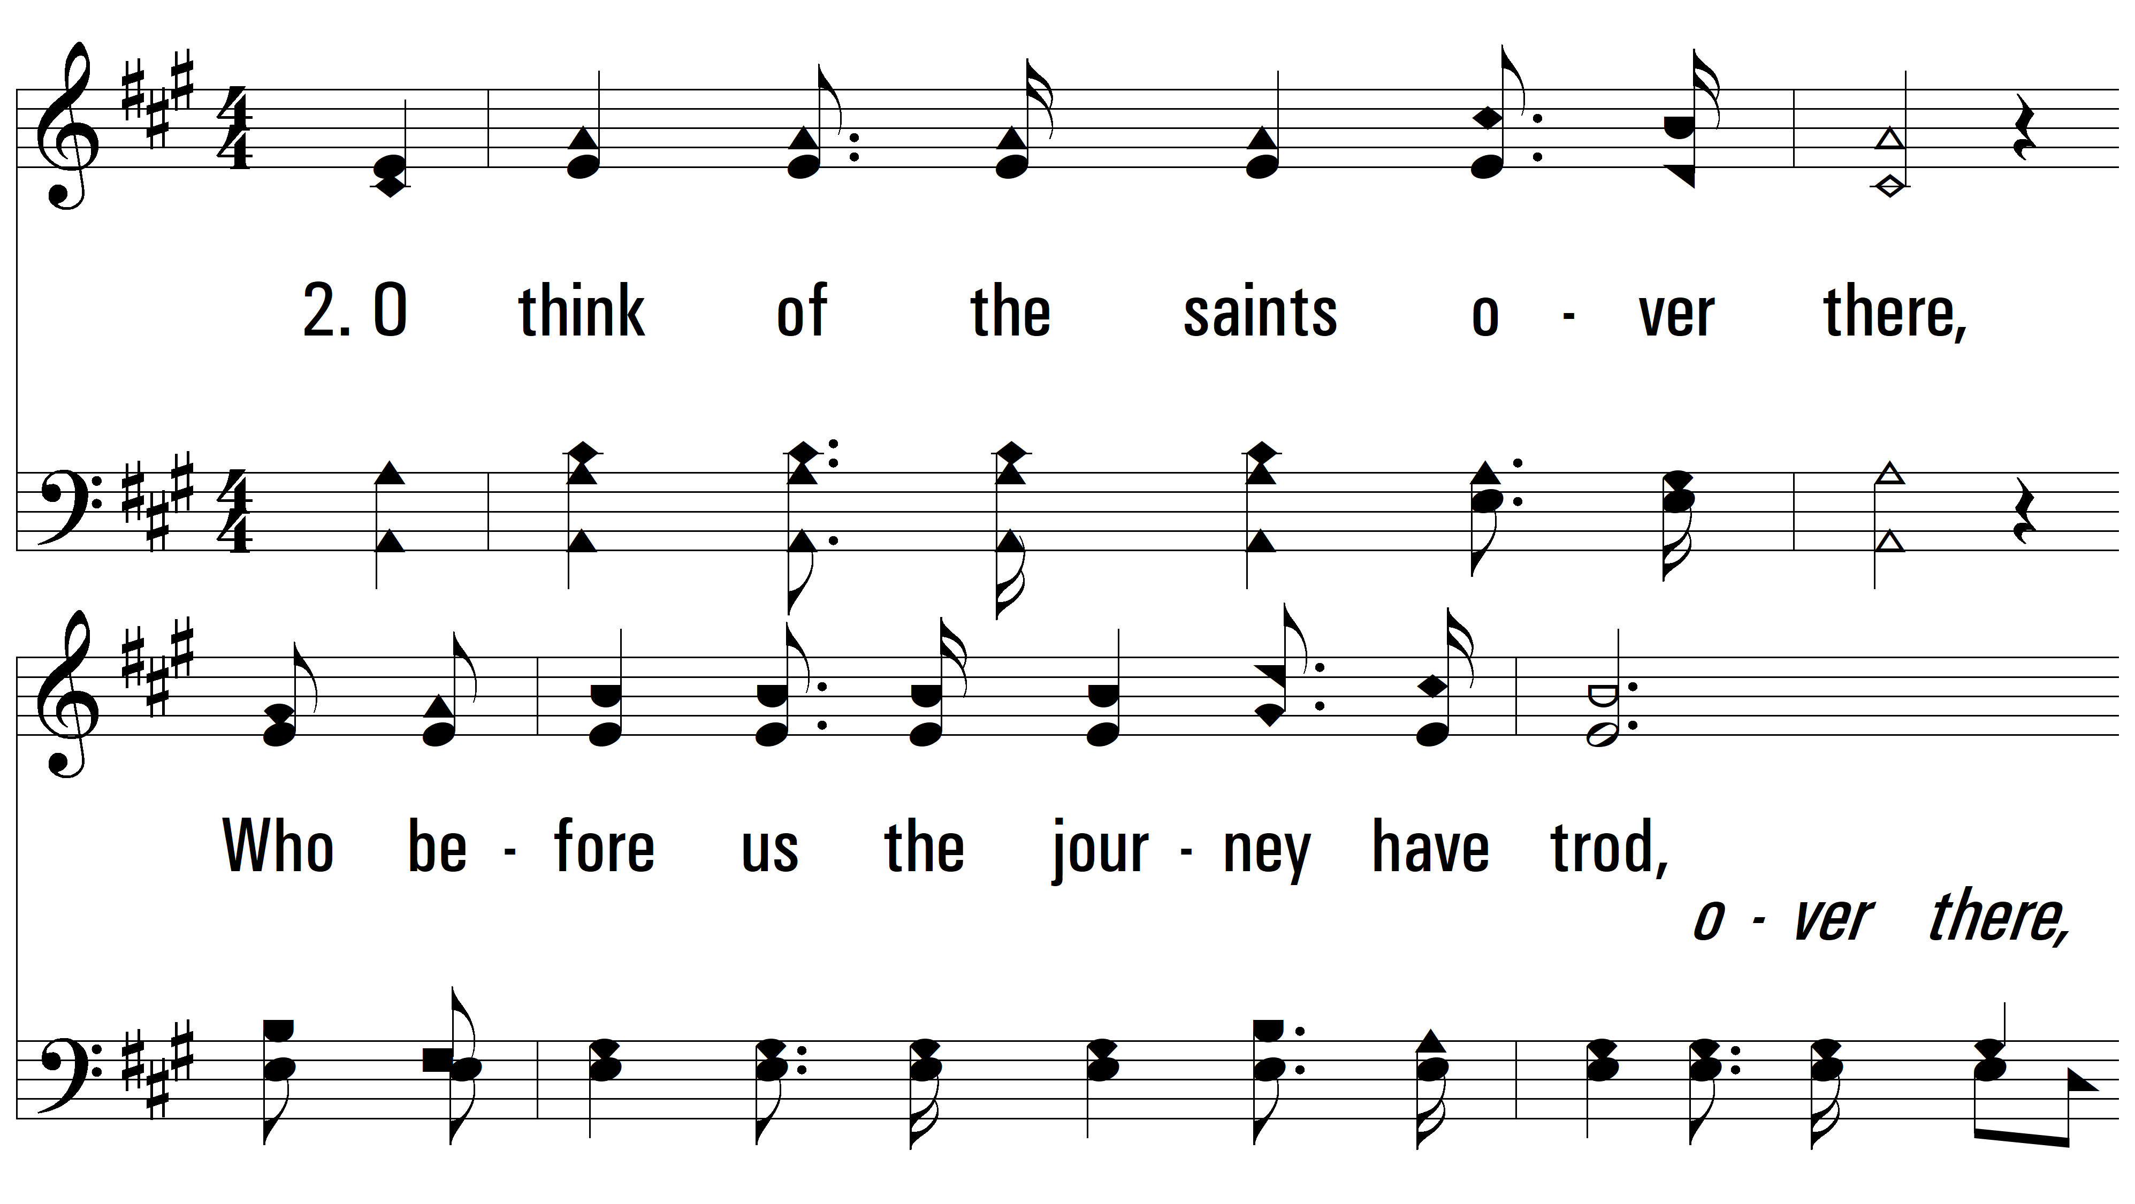
vs. 2 ~ O Think Of The Home Over There

Slide 7
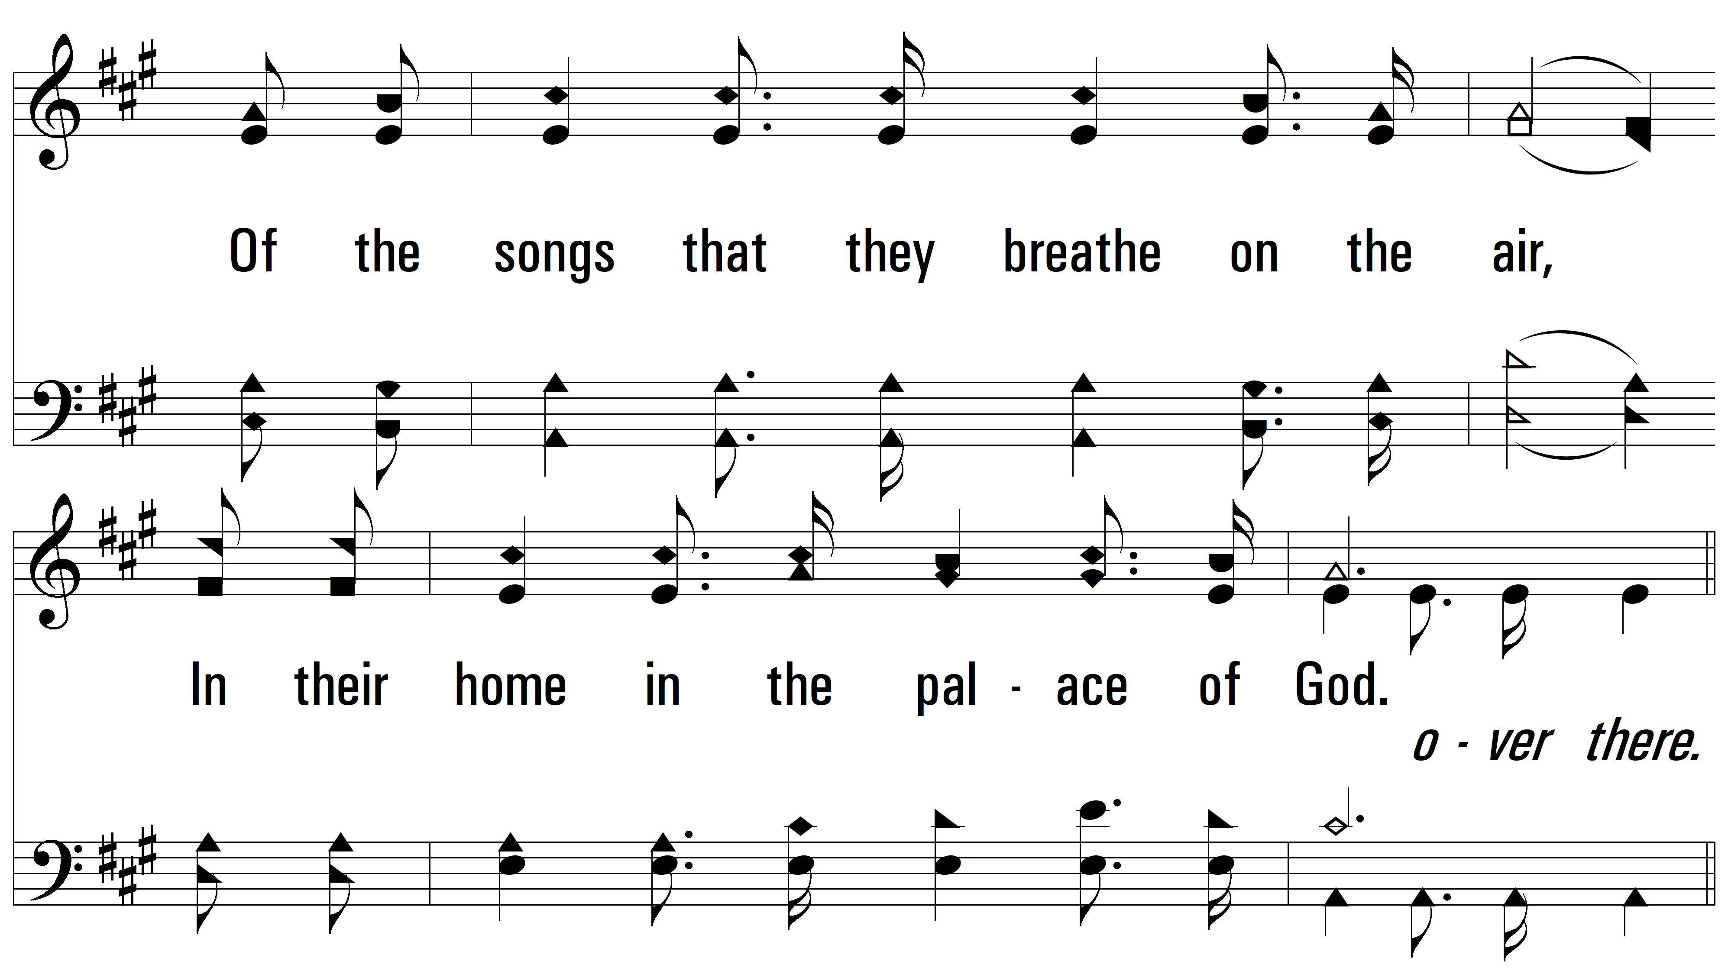
vs. 2

Slide 8
vs. 2

Slide 9
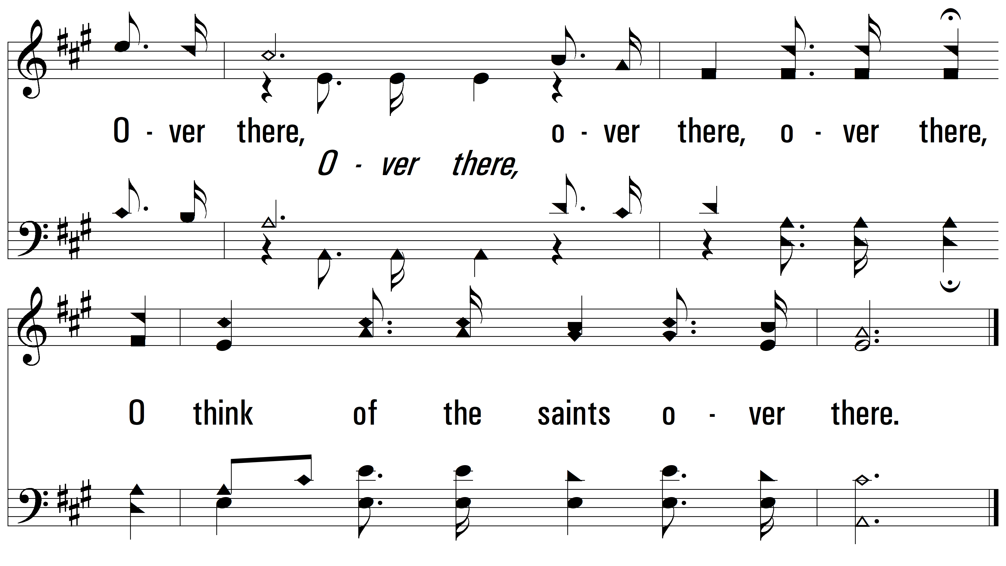
vs. 2

Slide 10
vs. 3 ~ O Think Of The Home Over There

Slide 11
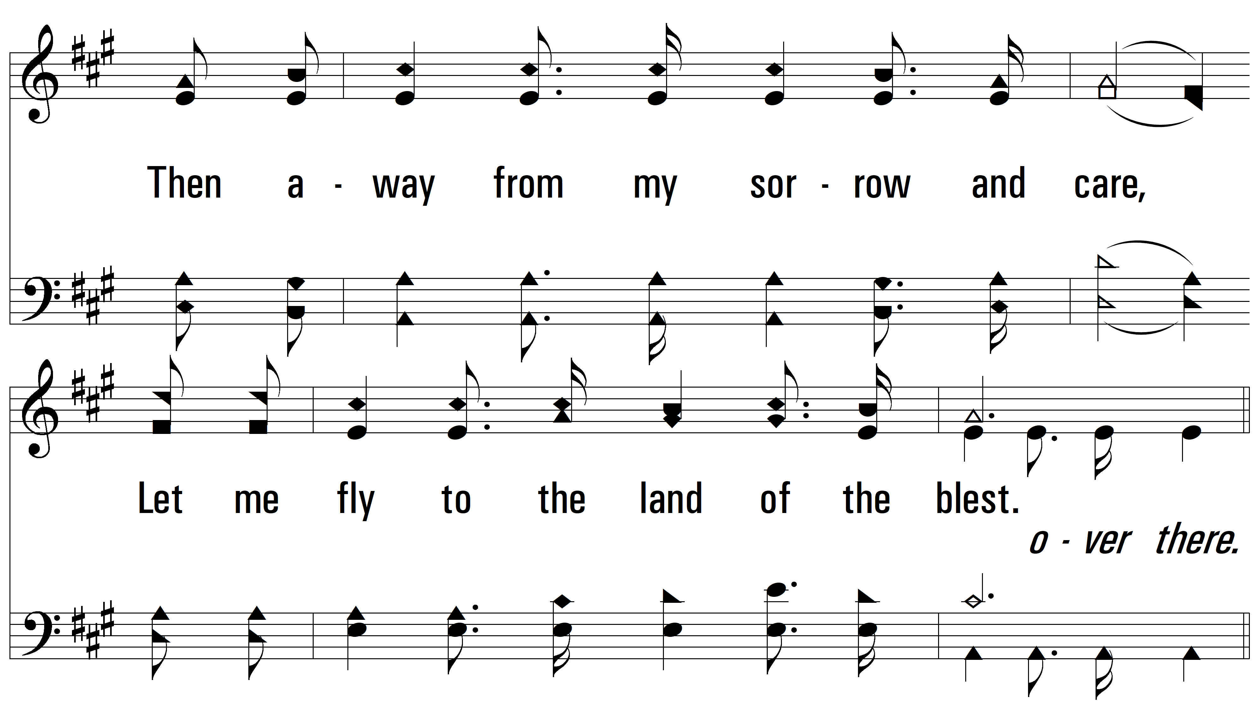
vs. 3

Slide 12
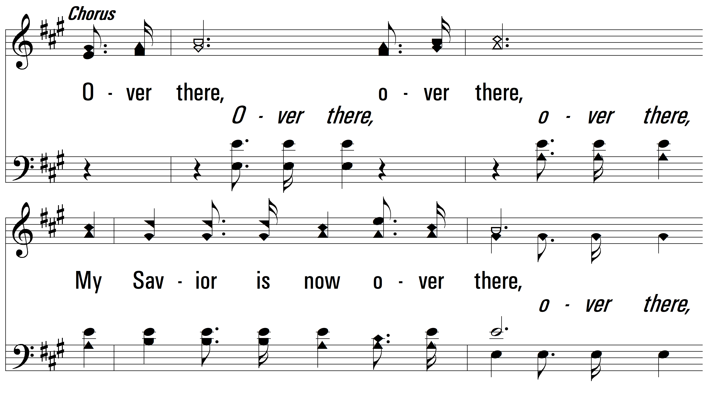
vs. 3

Slide 13
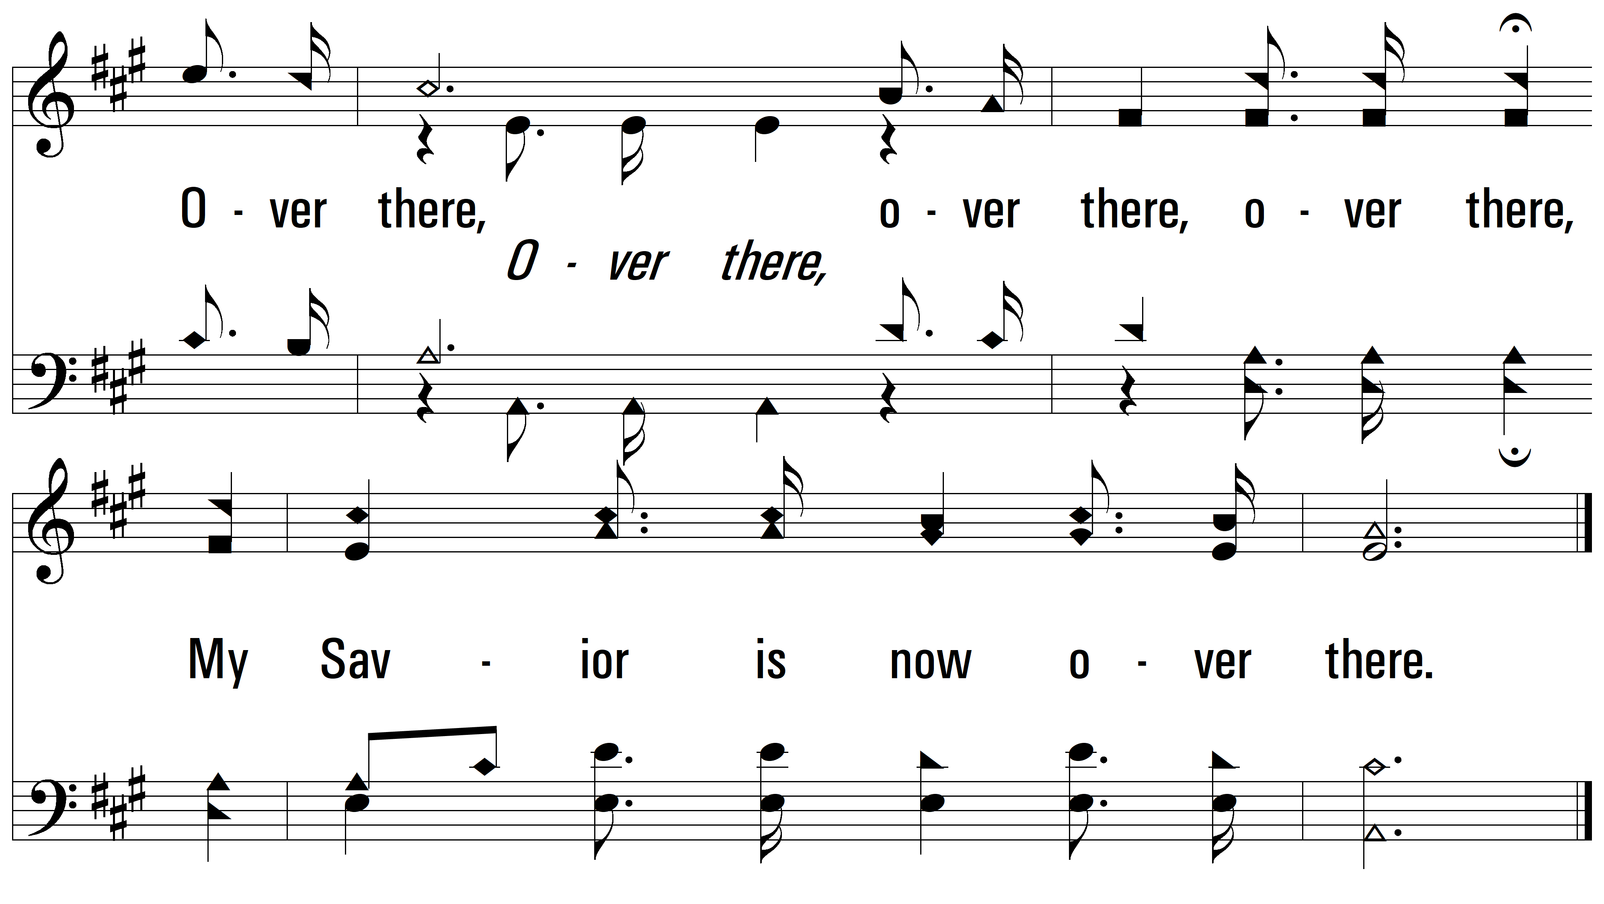
vs. 3

Slide 14
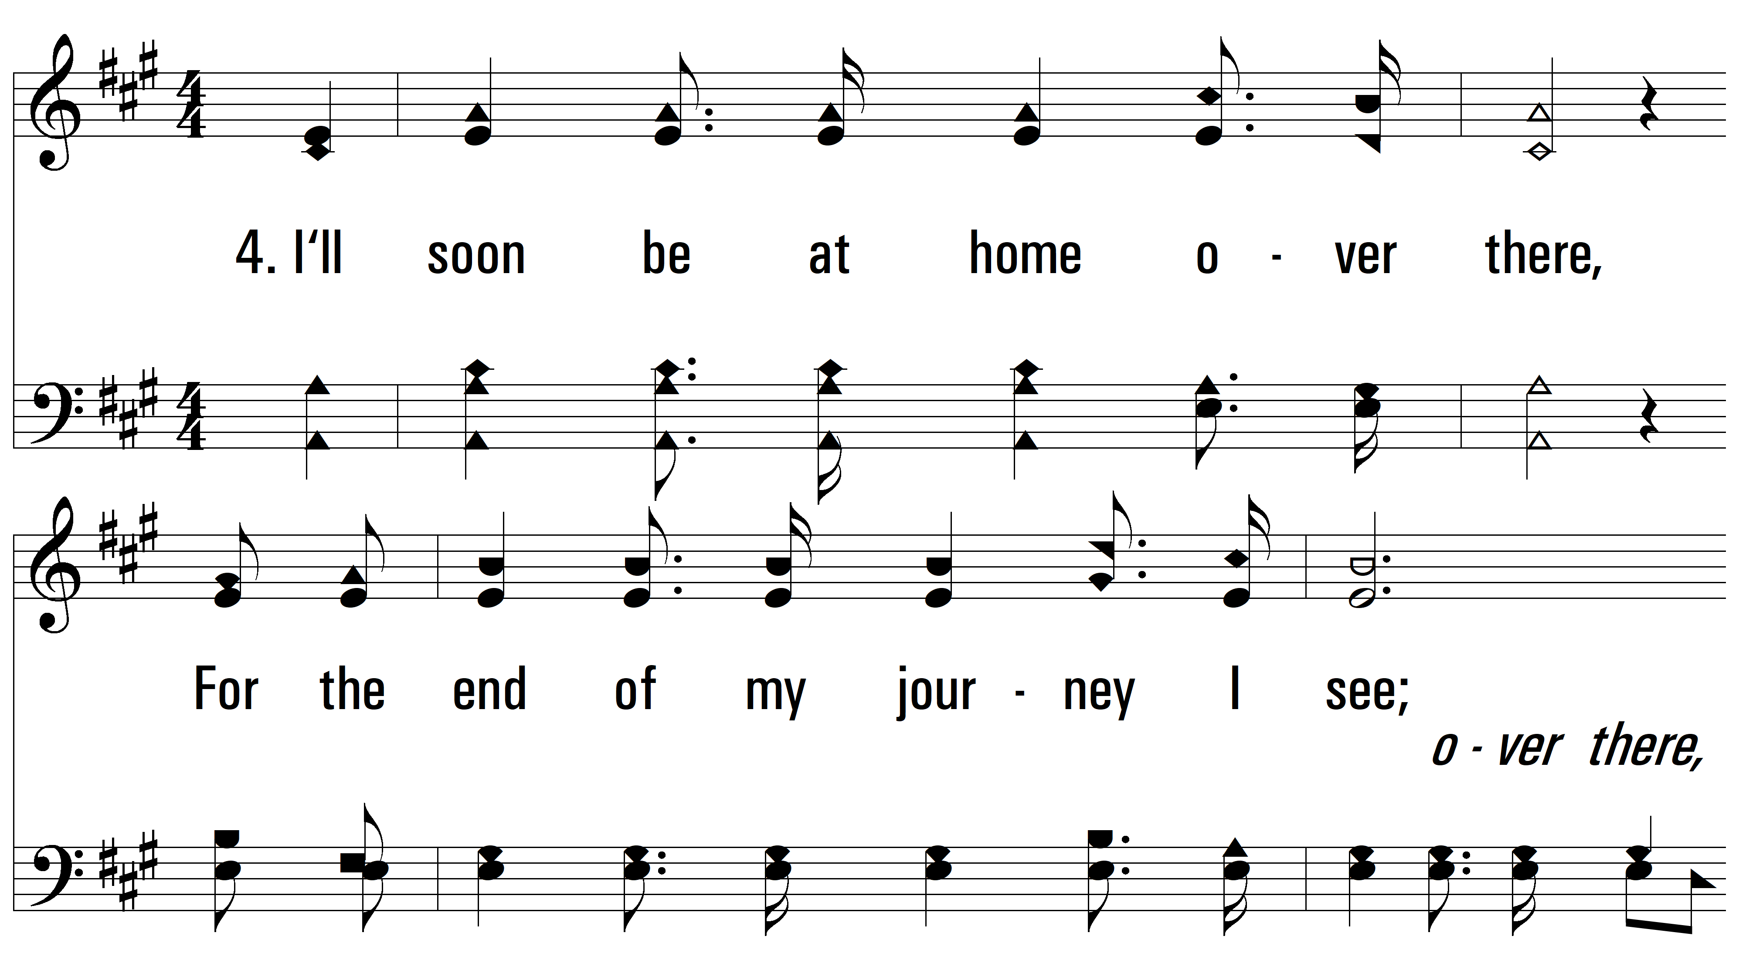
vs. 4 ~ O Think Of The Home Over There

Slide 15
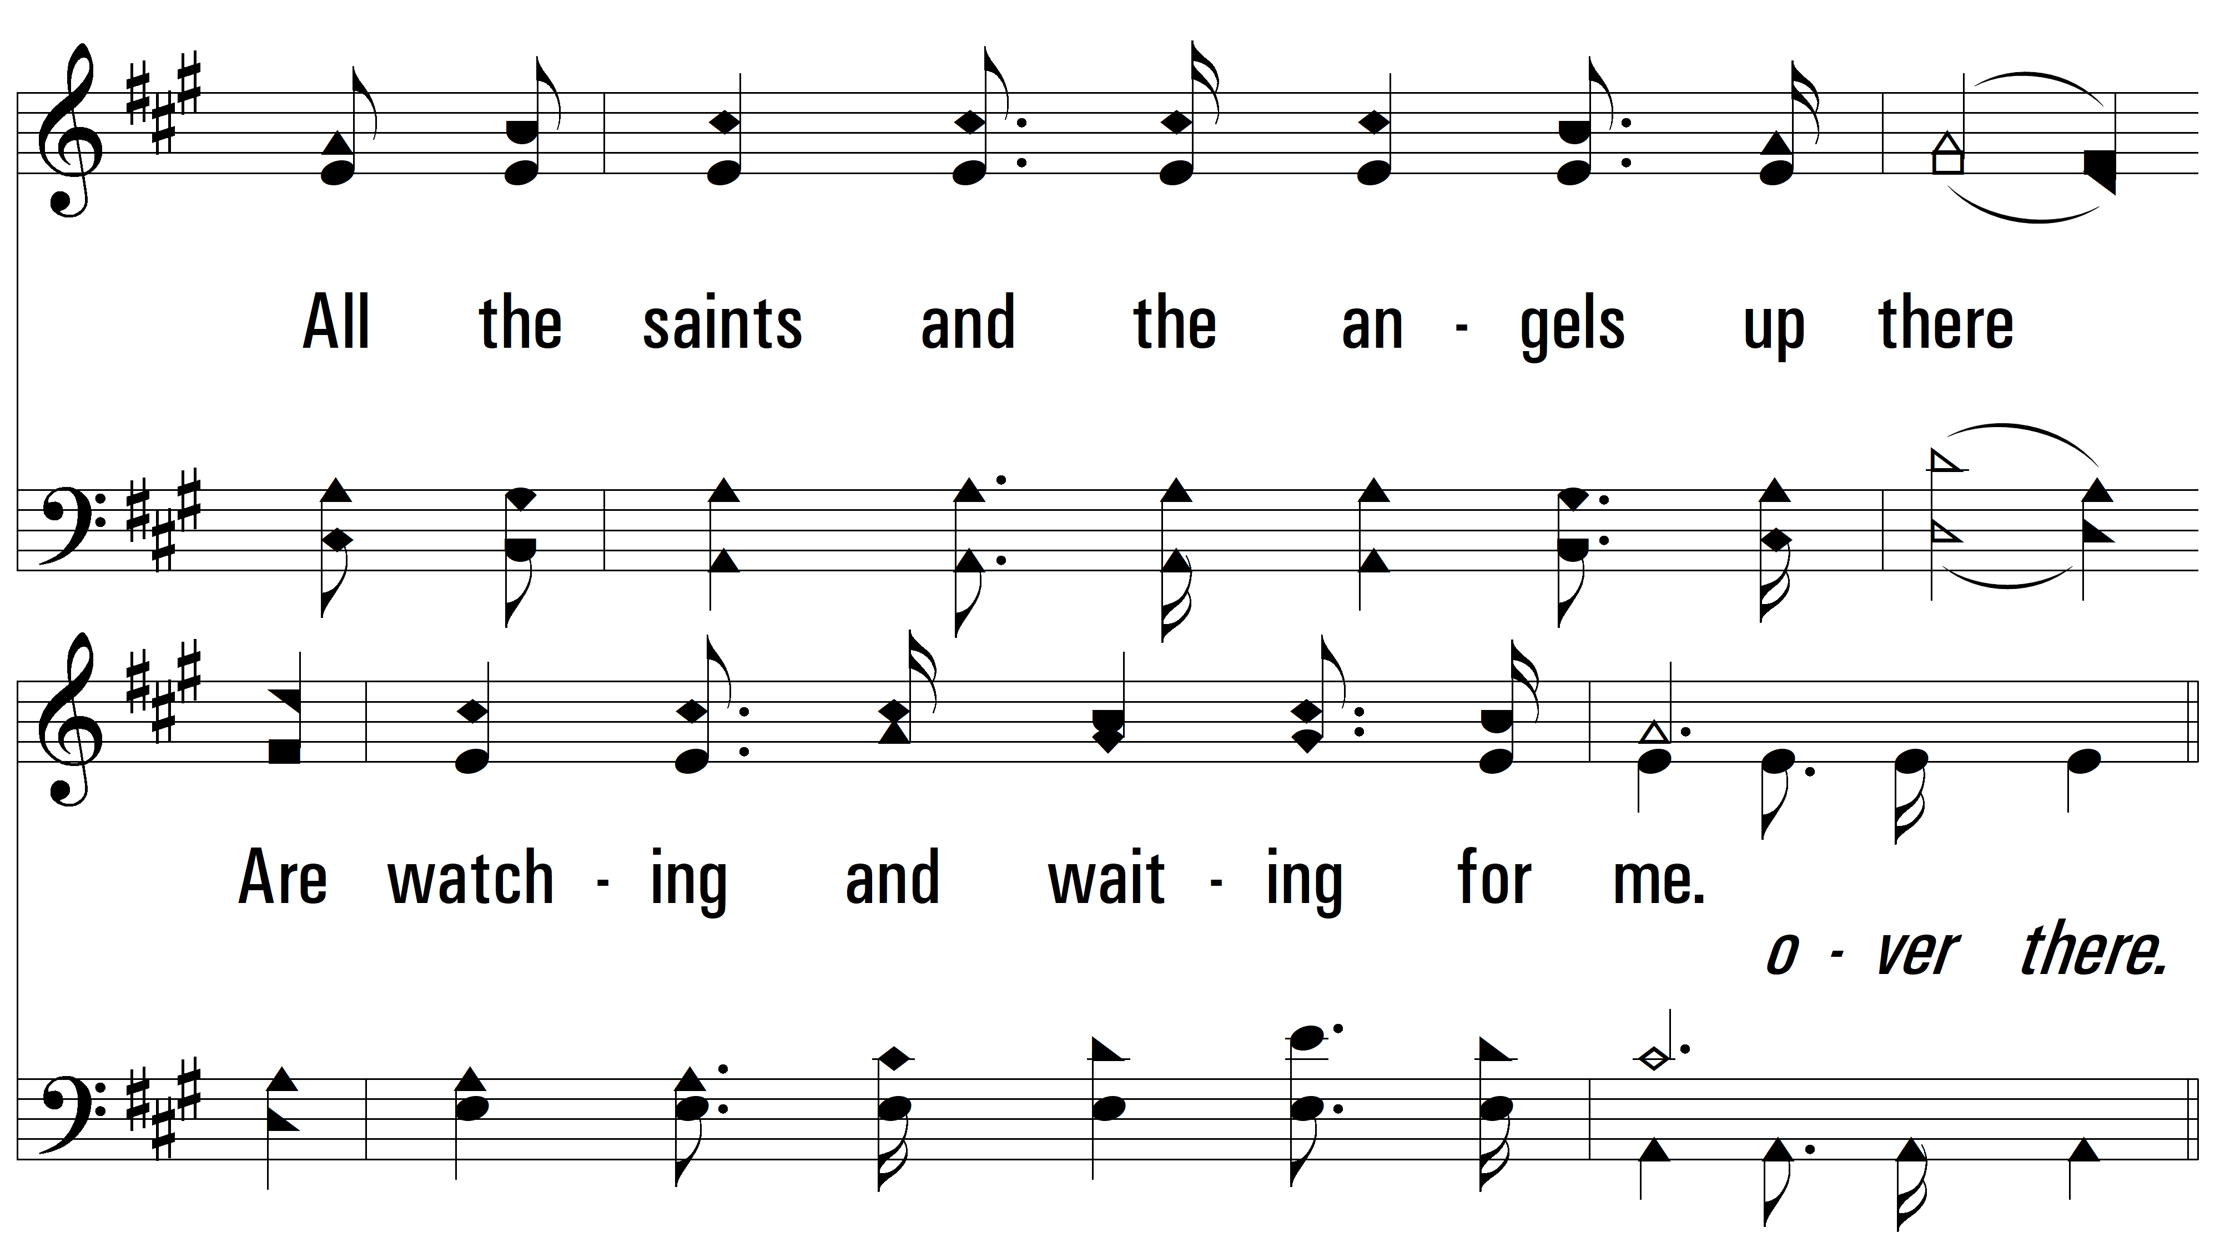
vs. 4

Slide 16
vs. 4

Slide 17
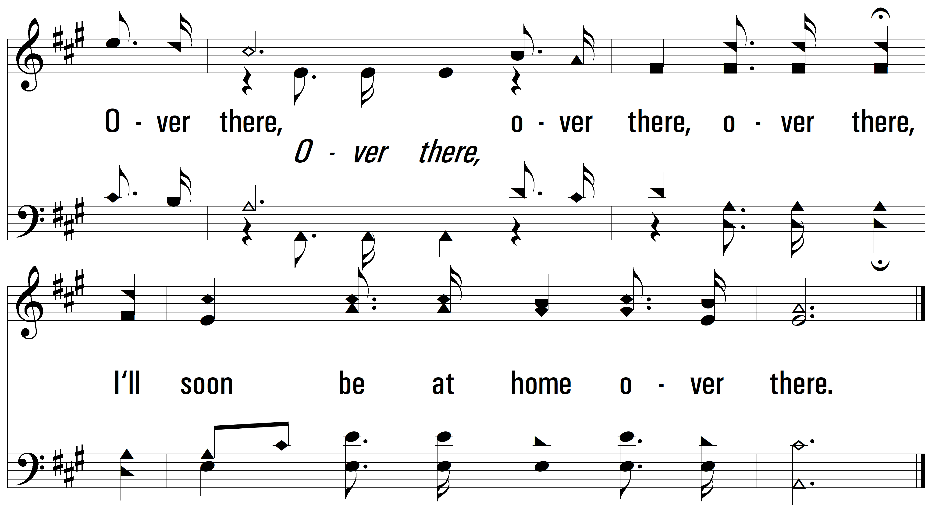
vs. 4
PDHymns.com
END

