Slide 1
O Spread The Tidings 'Round
(The Comforter Has Come)
Words: | Francis Bottoms (1890)
Music: | William J. Kirkpatrick (1890)
3/4
C/G - SOL
Verses: 3/Chorus
Lead - | SOL
Alto - | MI
Tenor - | DO
Bass - | DO
PDHymns.com

Slide 2
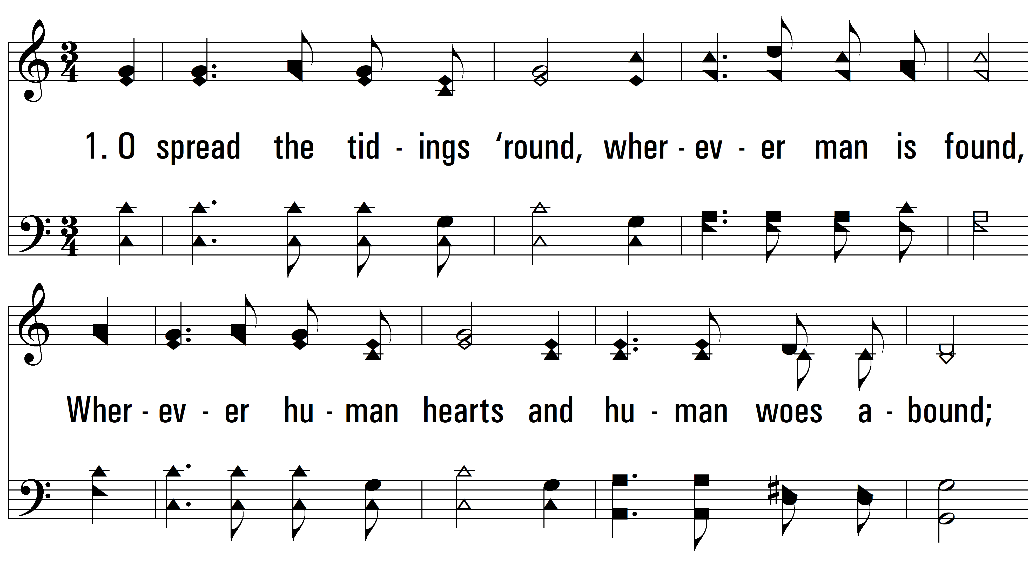
vs. 1 ~ O Spread The Tidings 'Round

Slide 3
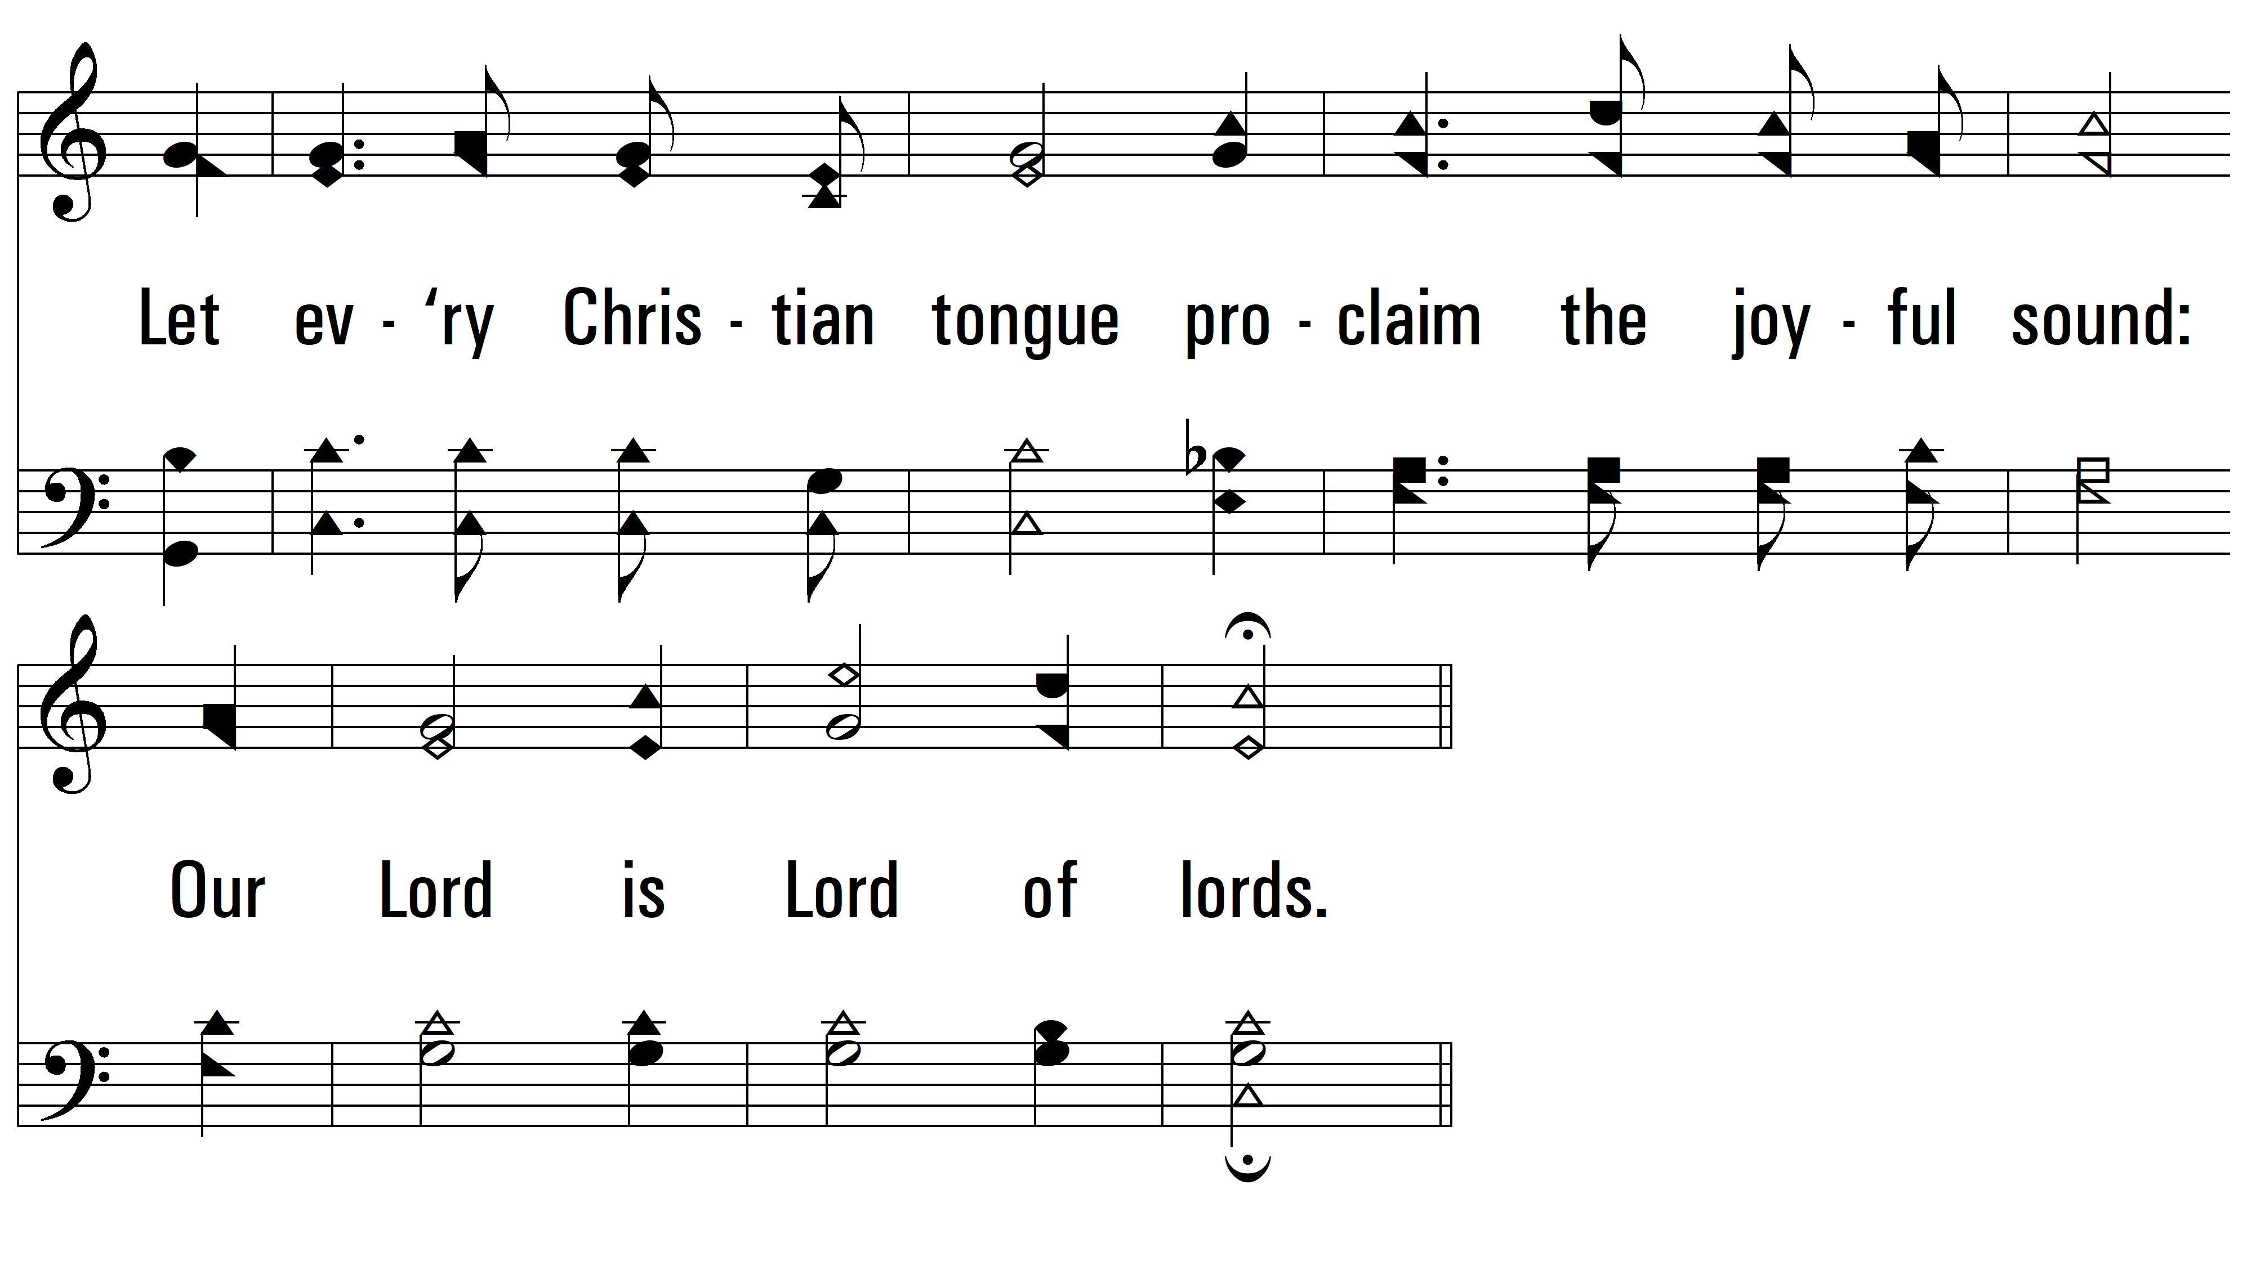
vs. 1

Slide 4
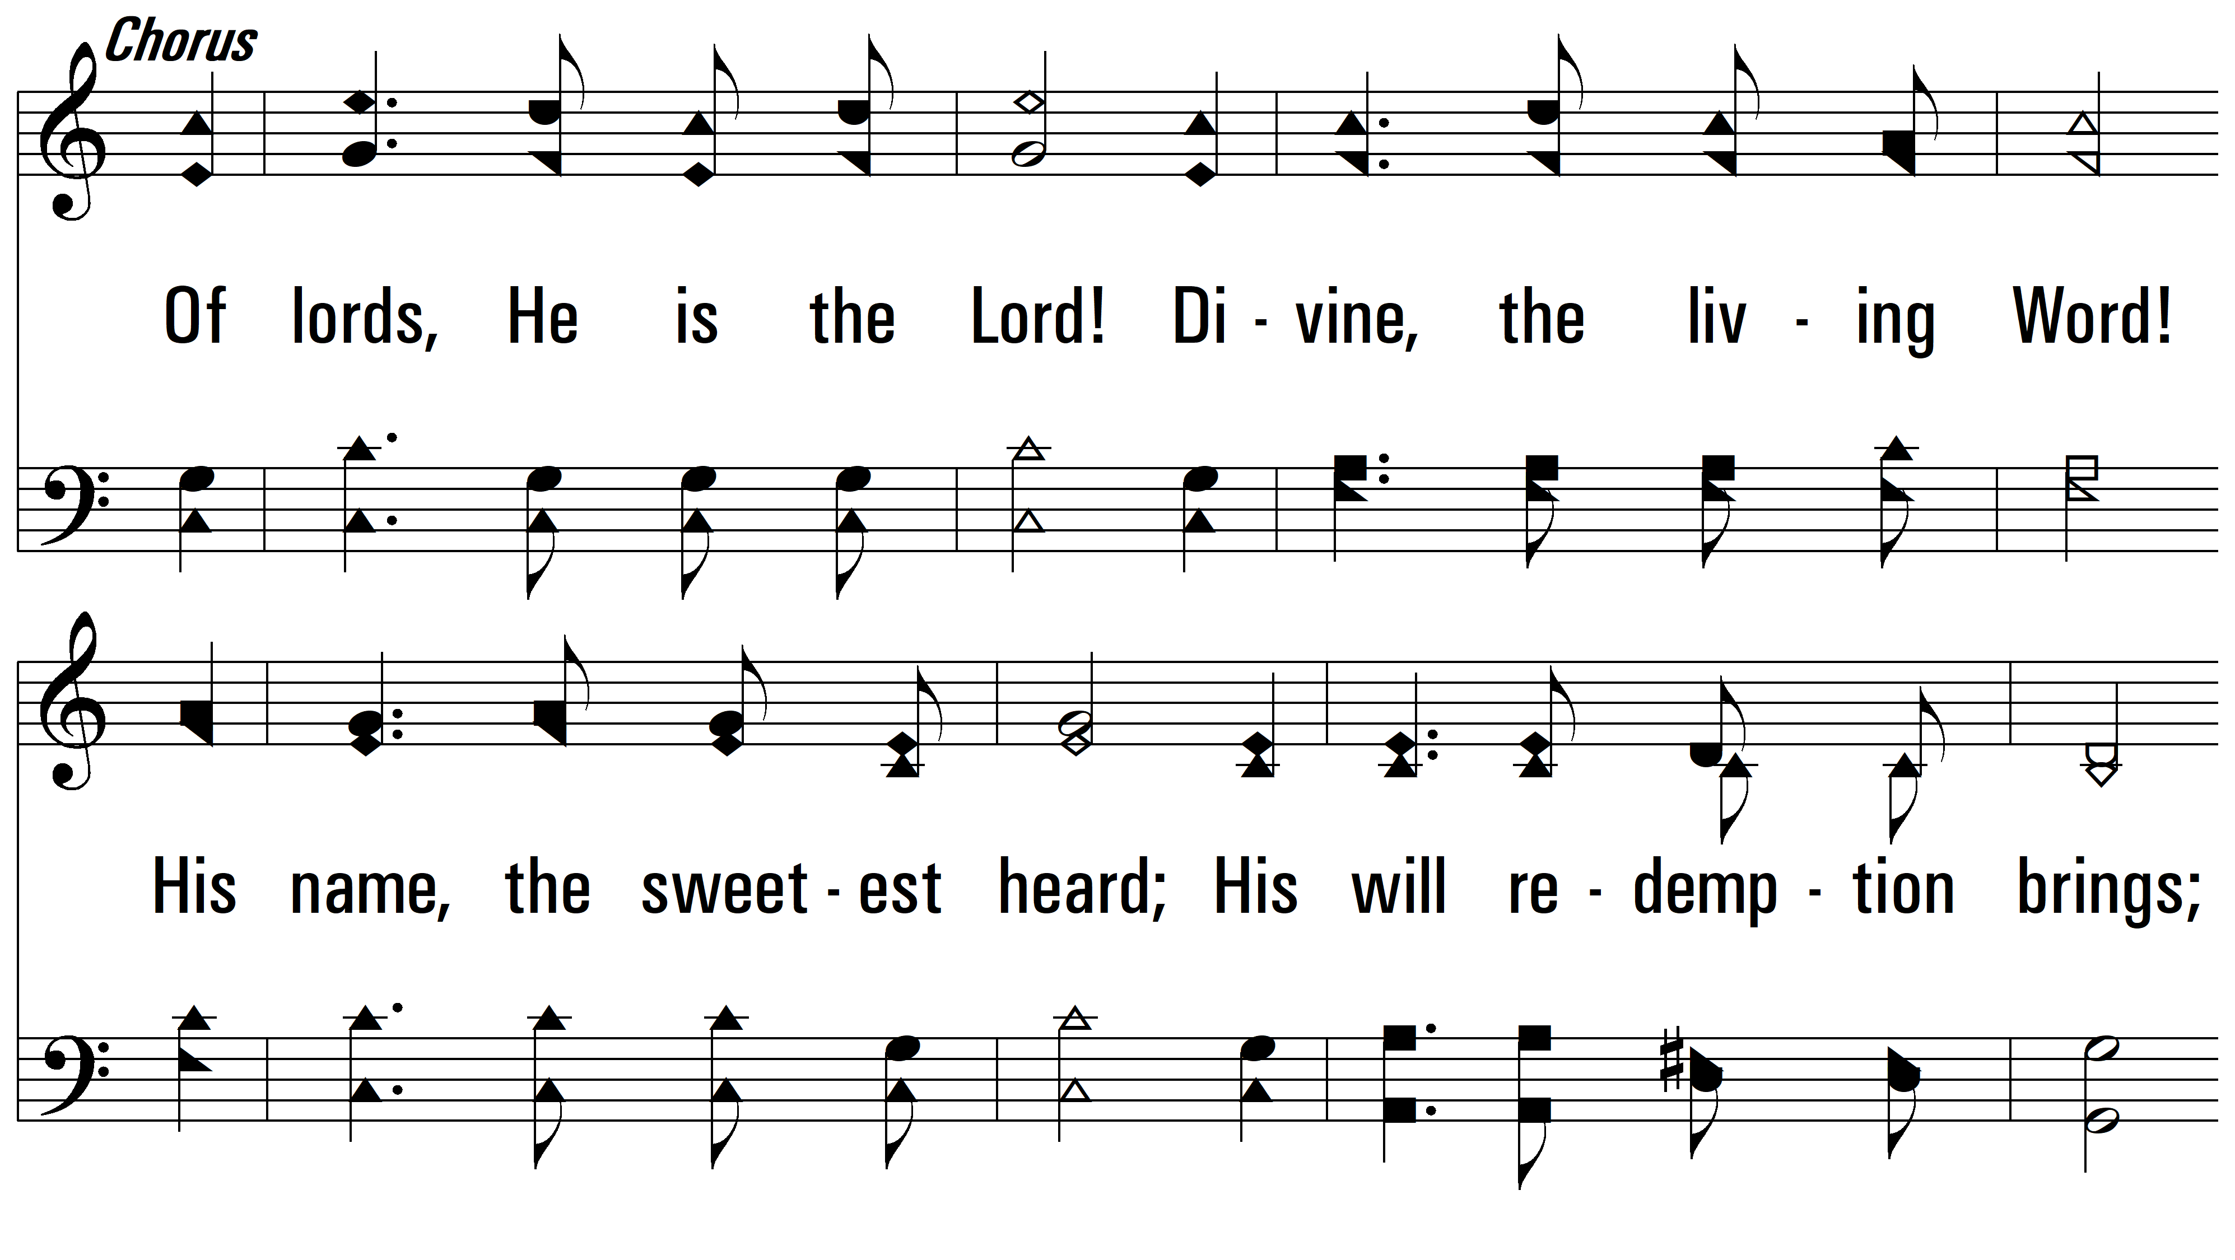
vs. 1

Slide 5
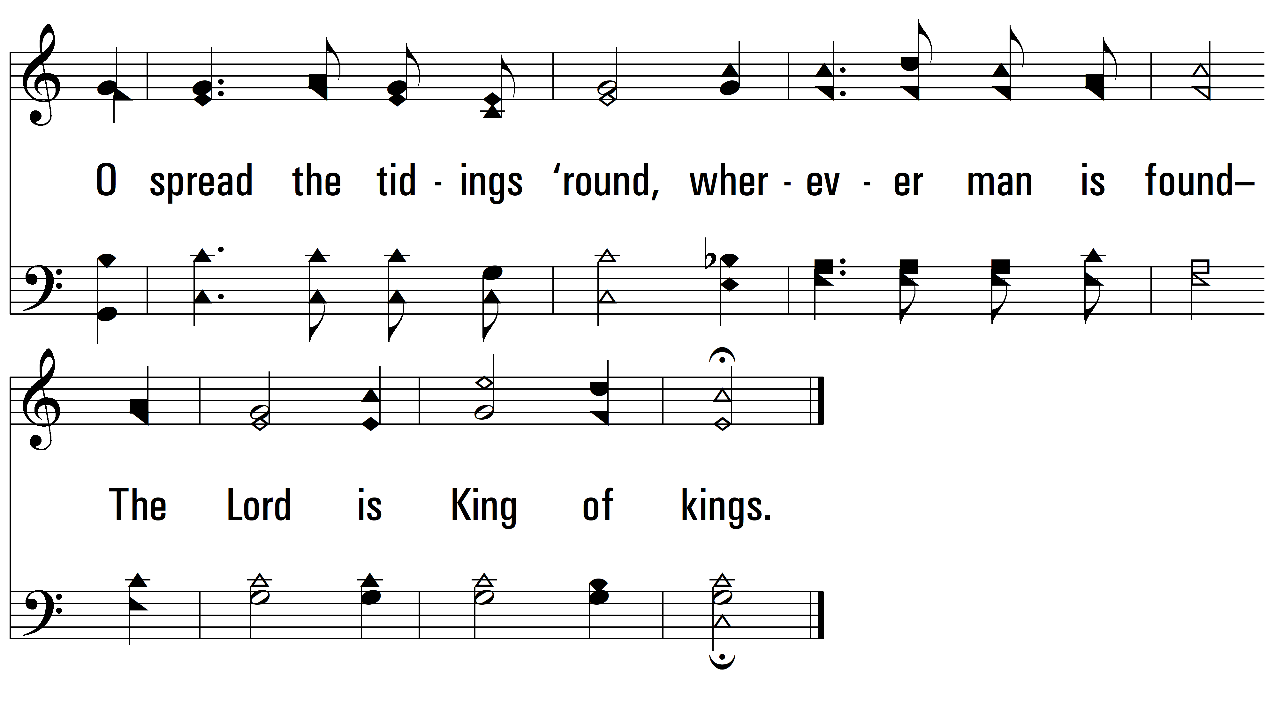
vs. 1

Slide 6
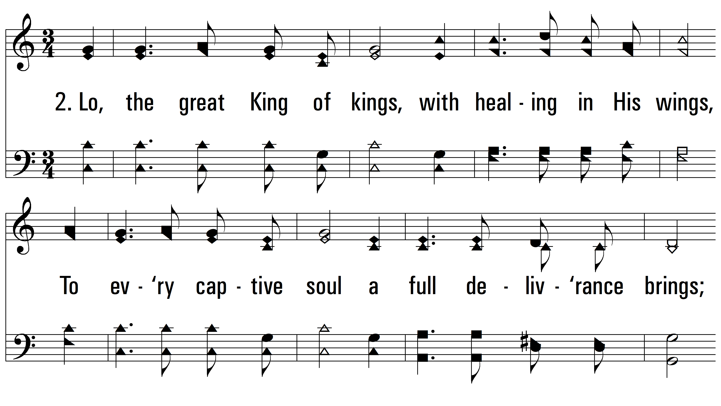
vs. 2 ~ O Spread The Tidings 'Round

Slide 7
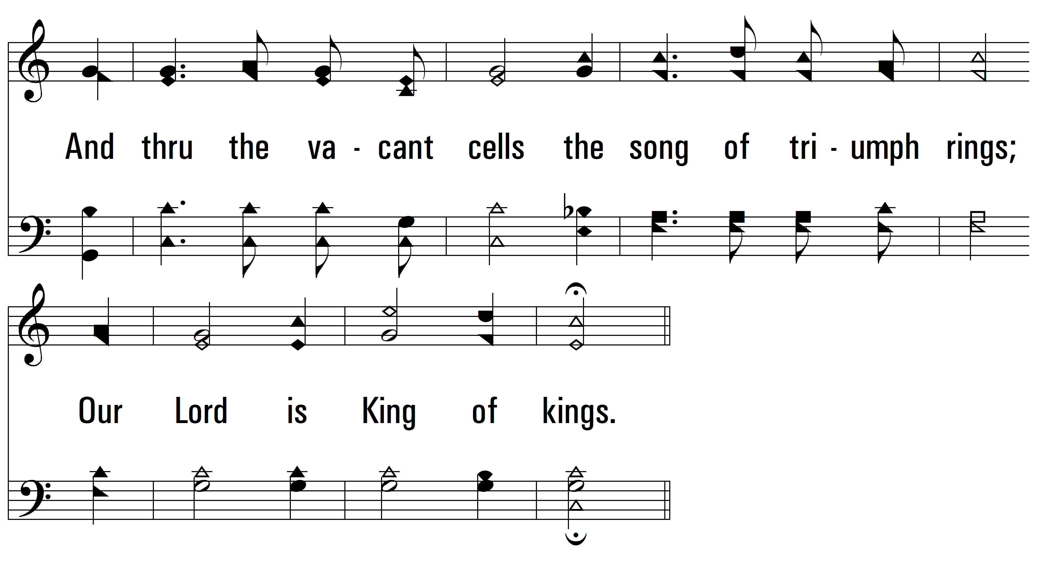
vs. 2

Slide 8
vs. 2

Slide 9
vs. 2

Slide 10
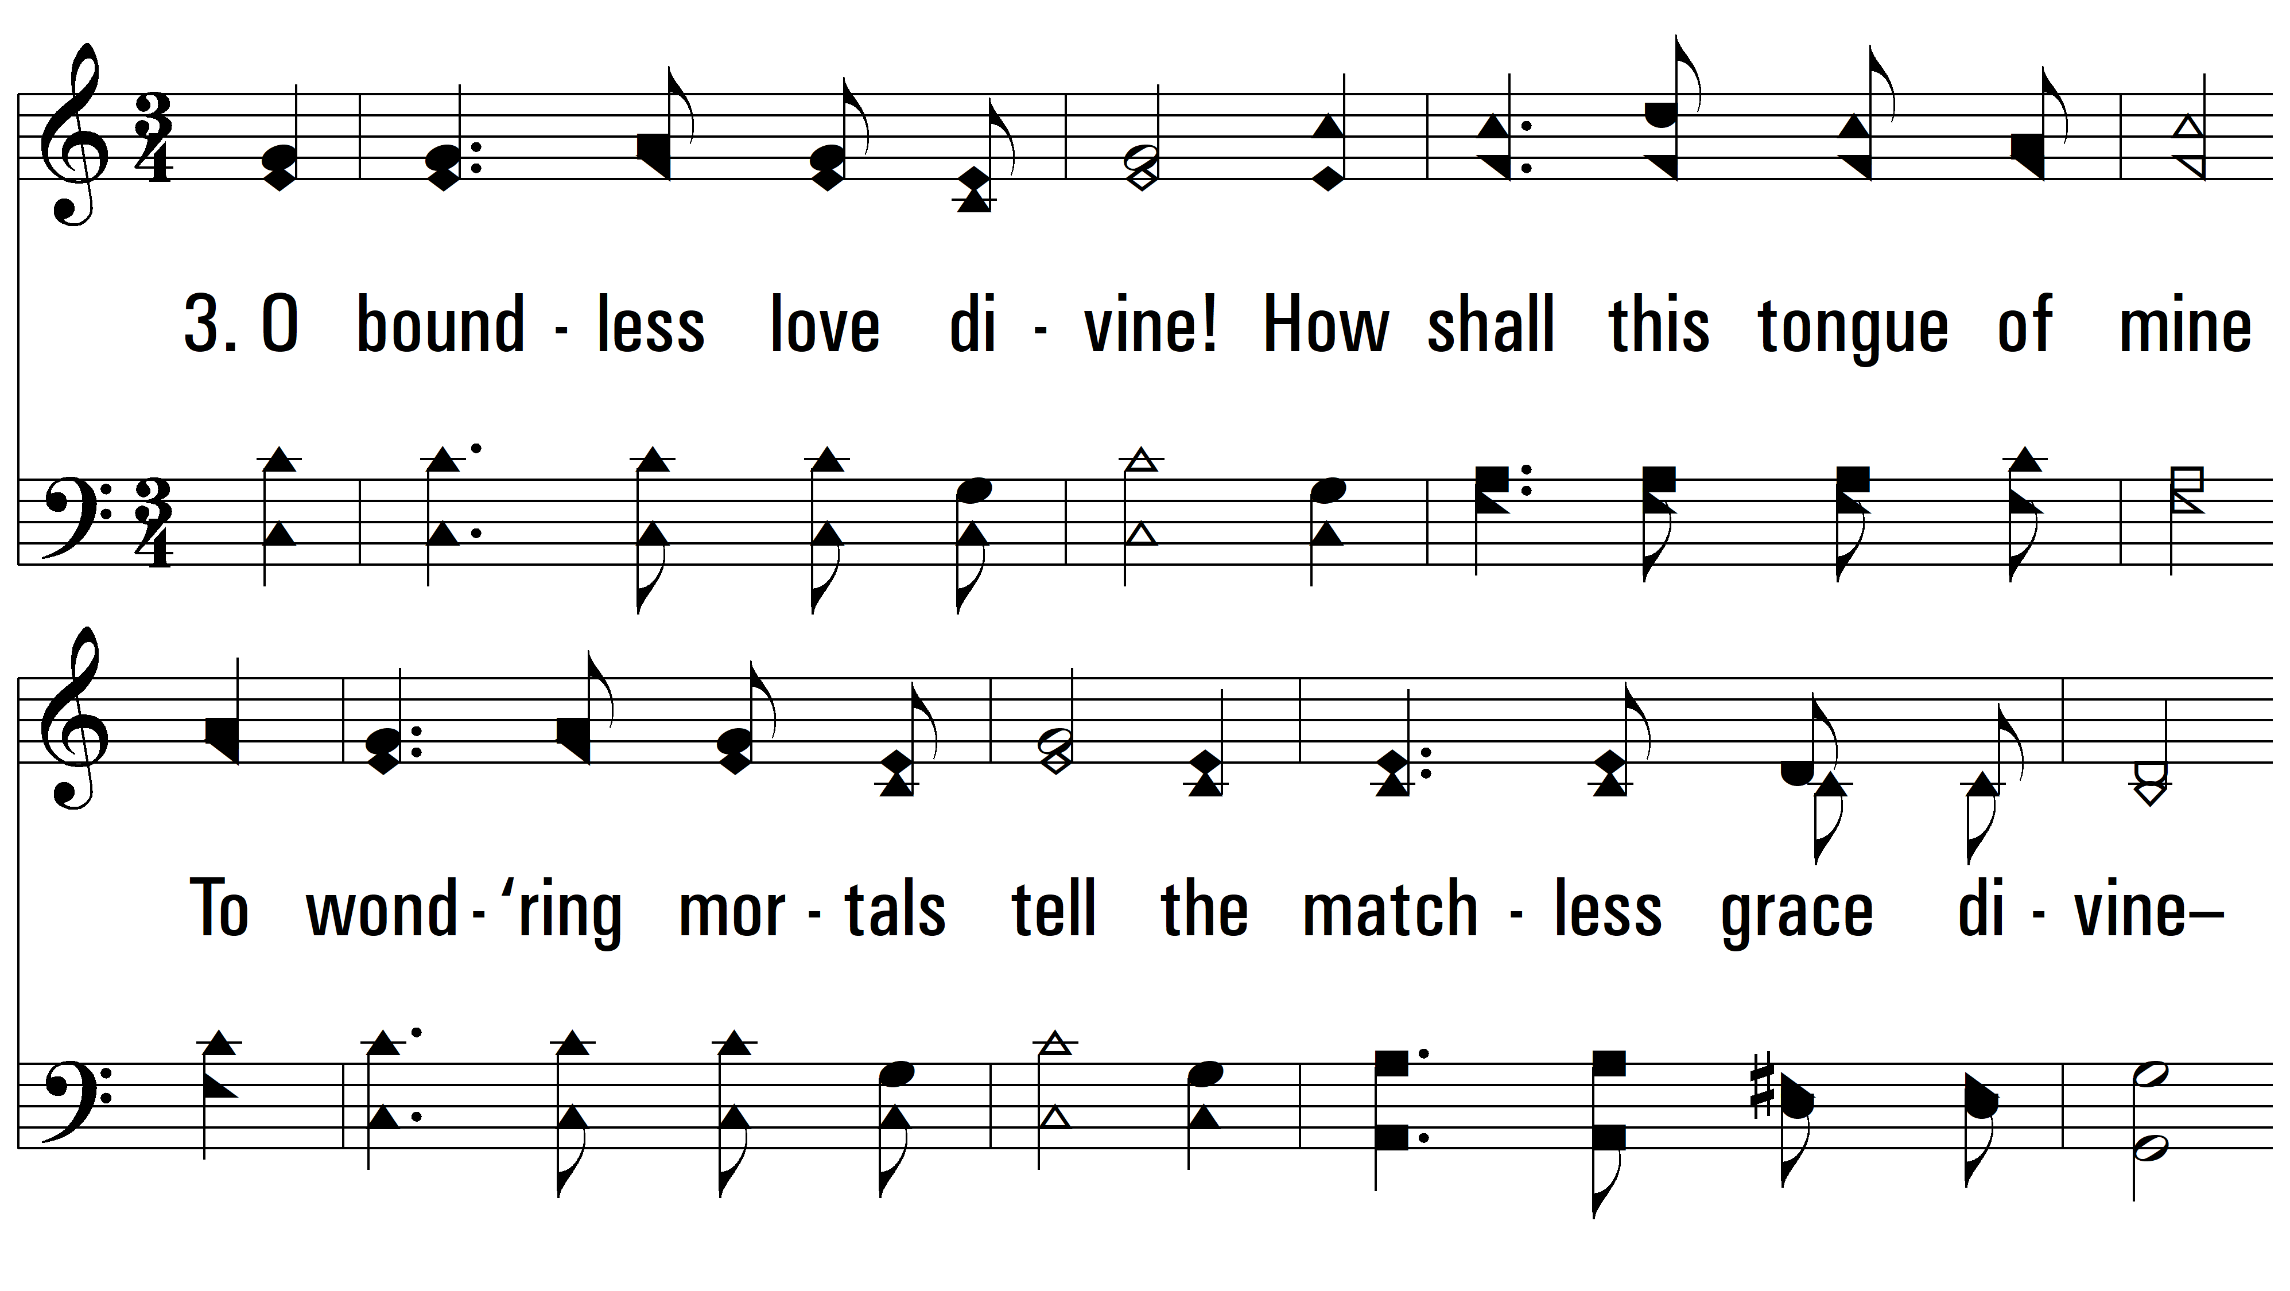
vs. 3 ~ O Spread The Tidings 'Round

Slide 11
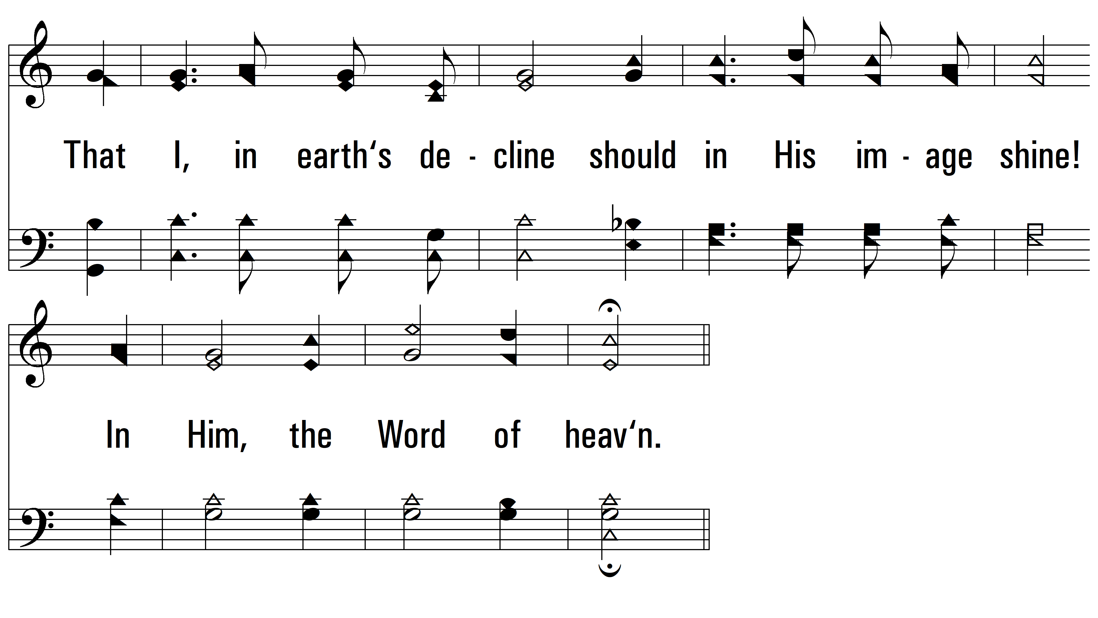
vs. 3

Slide 12
vs. 3

Slide 13
vs. 3
PDHymns.com
END

